Slide 2
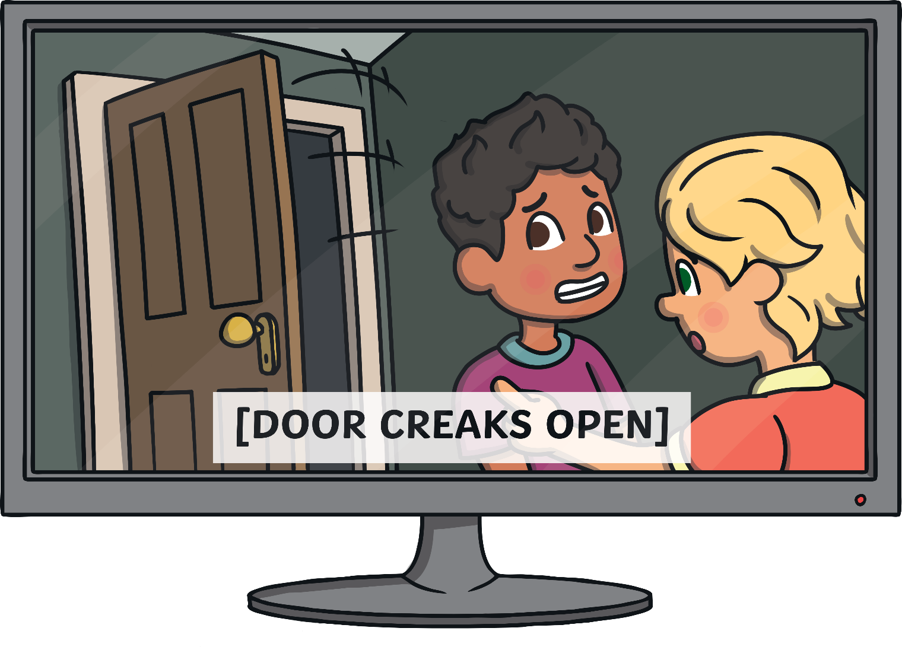
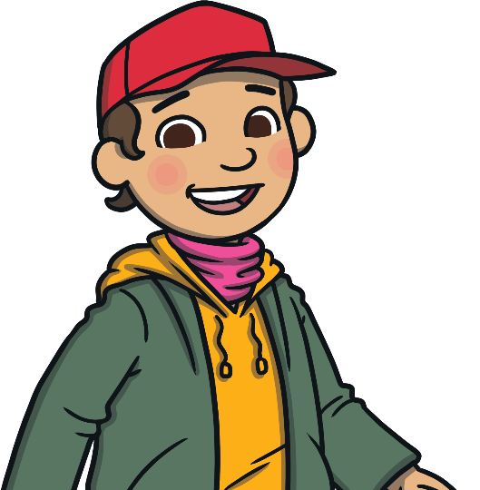
Watch the Winter - Live Lesson from BBC Teach with your class.

Slide 3
When is Winter?
Winter is one of the four seasons of the year. In the UK, winter lasts from December to March.
Can you remember all four seasons, in order?
Autumn
Spring
Winter
Summer

Slide 4
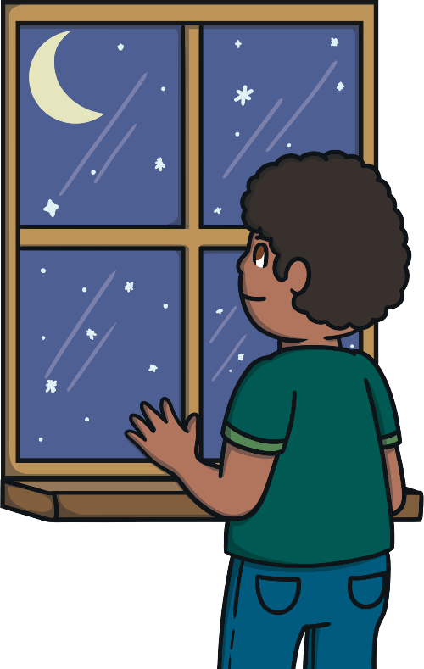
What Happens to the Days?
You may have noticed that the days seem shorter in winter.
This is because it gets darker earlier in the day.
The winter solstice is often called ‘the shortest day’ because it is the day when the sun sets the earliest. The winter solstice marks the start of winter.
In the UK, the winter solstice is on 21st or 22nd December every year.
In 2021, the winter solstice will be on 21st December.

Slide 5
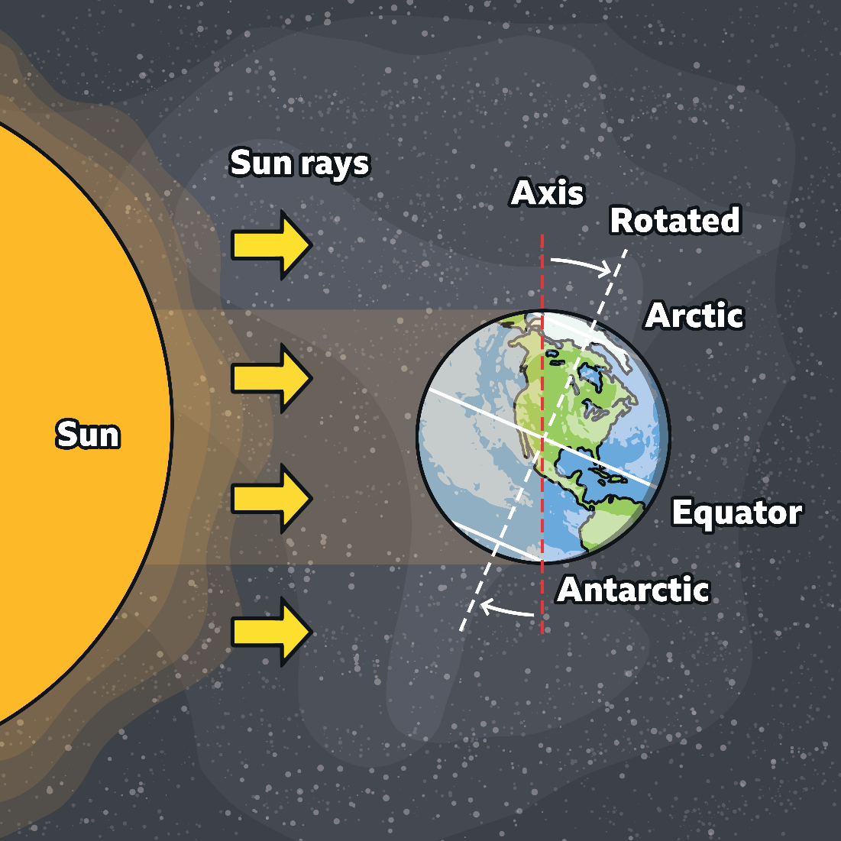
What is the Winter Solstice?
On the winter solstice, the North Pole is tilted the furthest away from the sun.
This means that it gets the least sunlight of the year.
People often call the winter solstice the ‘shortest day’ but it is actually the darkest day. The sun rises late and sets early so we get less daylight than on any other day of the year.

Slide 6
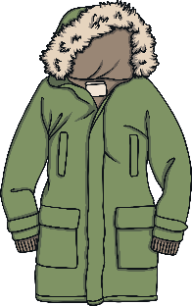
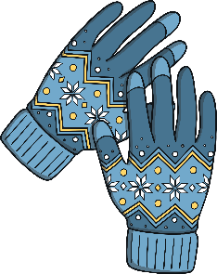
What is the Weather Like in Winter?
You may also notice that it is colder in winter than at other times of the year.
In winter, you will often need to wear winter clothing outside to keep you warm in the cold weather.
*It is also a good idea to wear a reflective coat so that others can spot you easier in the dark.
You might need to wear…
a pair of gloves
a scarf
a warm coat
a hat

Slide 7
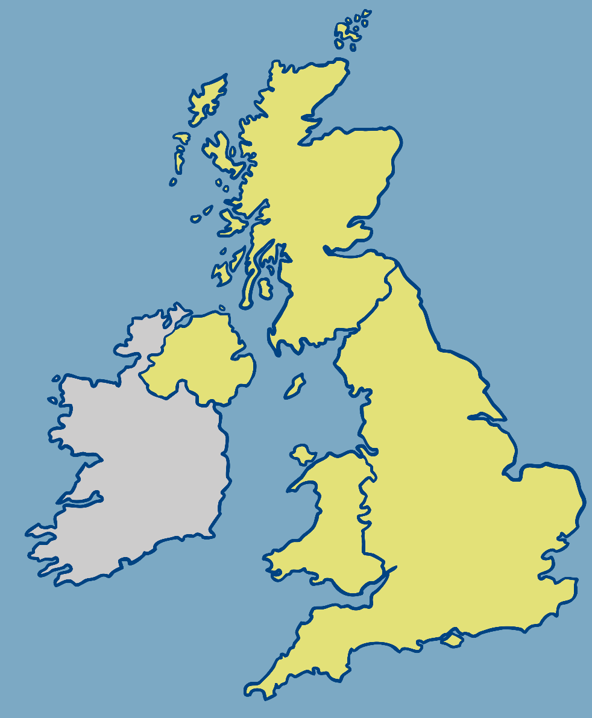
What is the Weather Like in Winter?
If you have ever seen a weather forecast on TV, you will notice that they use lots of little pictures (called symbols) to show each type of weather.
wind (strength and direction)
frost
thunder
and
lightning
snow
snow
Can you guess what each of these symbols mean?
Click on each one to find out.
fog
ice warning
fog
ice warning
It is possible to see all of these types of weather in winter. However, which of these symbols do you think that we might see a lot more at this time of year?
temperature shown in degrees
4°C
cloud
rain
sunshine

Slide 8
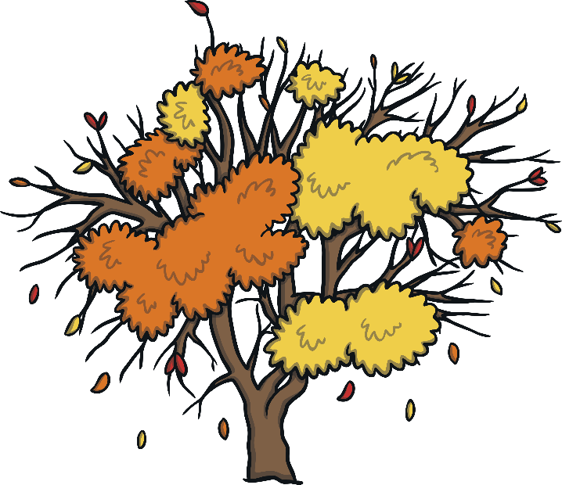
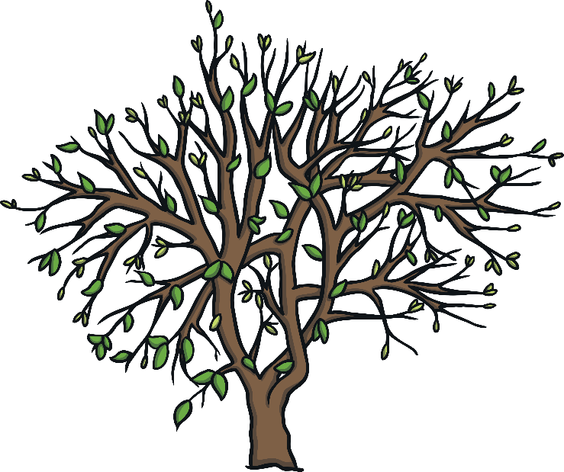
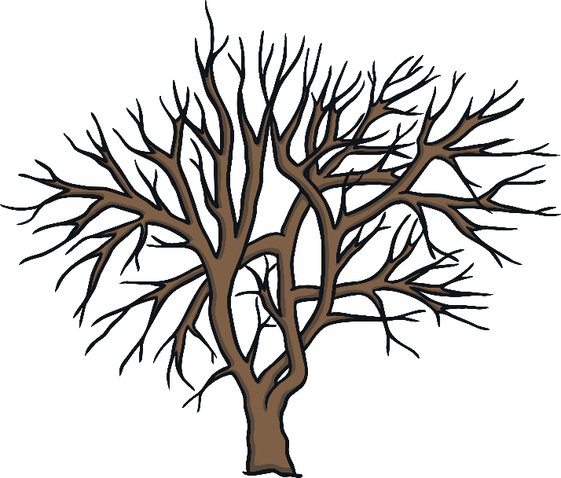
What Happens to Trees in Winter?
In autumn, you may notice many leaves changing colour before falling from the trees. Most trees have bare branches by wintertime.
If you look closely then you might notice small buds forming. These will become new shoots and leaves in spring.
There are some trees that stay green all year round. These trees are called evergreens.

Slide 9
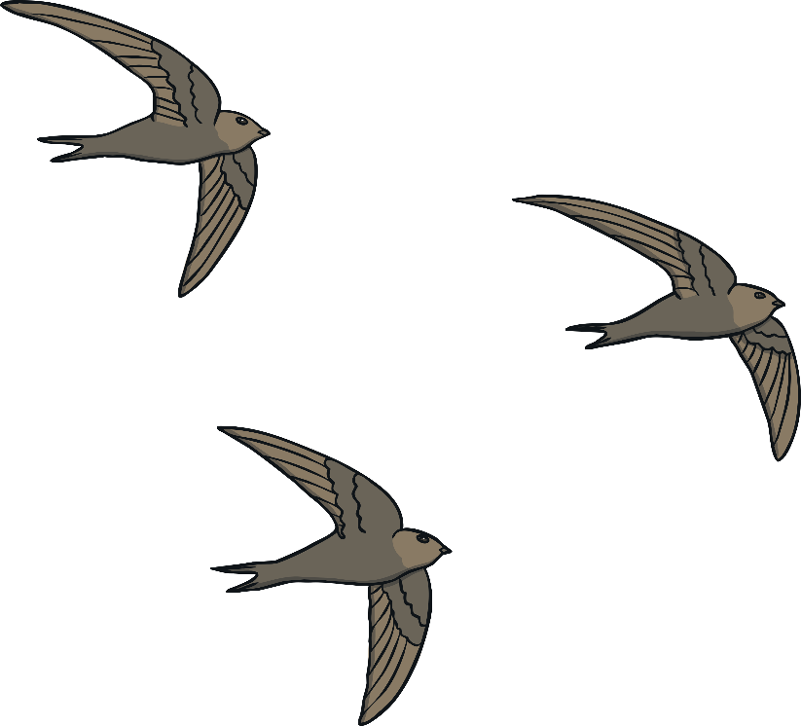
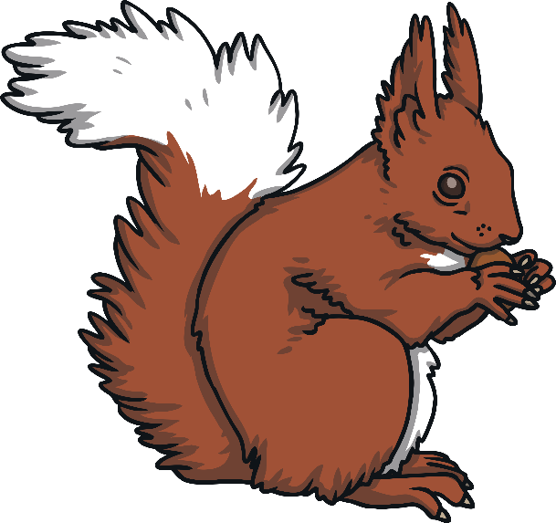
What Happens to Animals in Winter?
The winter changes mean that animals have to get ready for winter.
Other animals remain active in winter.
Some animals prepare to hibernate.
Some animals migrate.
However, they may grow extra fur to keep them warm. Some creatures also collect and hide food for the winter so that they have enough to eat when food is in short supply.
This means that they go into a deep sleep during the colder months. Animals that hibernate include hedgehogs, dormice and bats.
This means that they fly south to warmer countries to escape the cold weather. Animals that migrate include birds, some butterflies and basking sharks.

Slide 10
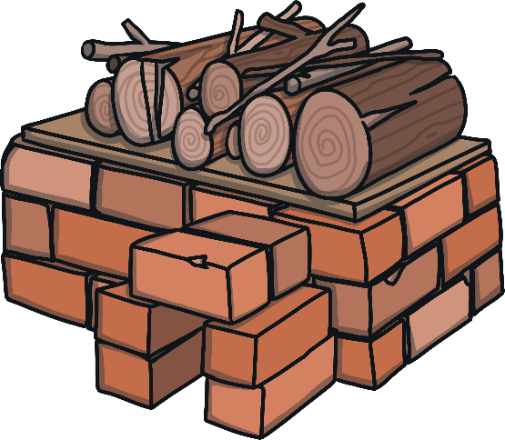
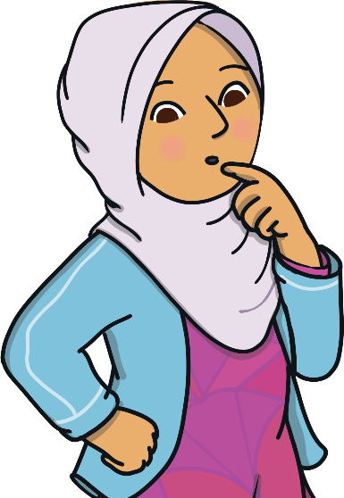
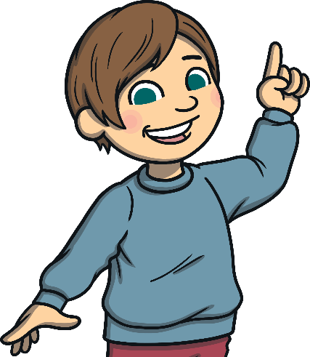
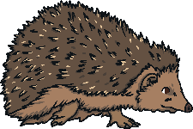
What Happens to Animals in Winter?
There a few ways that we can help wildlife during winter so that they can stay happy and healthy during the colder months.
Check for hibernating animals
Leave out food for birds
Melt any frozen water
Help hedgehogs
Keep bird feeders full of food to help
our feathered friends who may find it
tricky to find food.
The water inside frozen ponds can become poisonous for fish.
Birds and other wildlife also need to find water to drink.
Ask an adult to put something warm over frozen ponds or bird baths to melt the ice.
These spiky creatures need somewhere to hibernate so try to leave piles of leaves
and logs as they are. You could also think about making hidey holes
or even putting a hedgehog house in your garden.
Remind grown ups to check under any bonfires before they light them in case
there are animals hibernating there. Always leave hibernating animals alone
and try not to disturb them.

