Slide 1
Disclaimers
We hope you find the information on our website and resources useful.
Animations
This resource has been designed with animations to make it as fun and engaging as possible. To view the content in the correct formatting, please view the PowerPoint in ‘slide show mode’. This takes you from desktop to presentation mode. If you view the slides out of ‘slide show mode’, you may find that some of the text and images overlap each other and/or are difficult to read.
To enter slide show mode, go to the slide show menu tab and select either from beginning or from current slide.
Links to External Video Websites
This resource contains links to external video websites. These websites often have autoplay features meaning that other videos will play after the video you are watching finishes. You should disable this feature before using the video in any classroom or similar setting. Twinkl assumes no responsibility for the contents of linked websites. The inclusion of any link in this resource should not be taken as an endorsement of any kind by Twinkl of the linked website or any association with its operators. We have no control over the availability of the linked pages. If the link is not working, please let us know by contacting TwinklCares and we will try to fix it, although we can assume no responsibility if this is
the case.
You may wish to delete this slide before beginning the presentation.

Slide 3
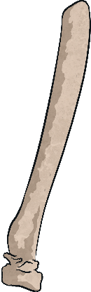
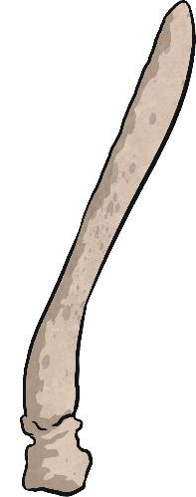
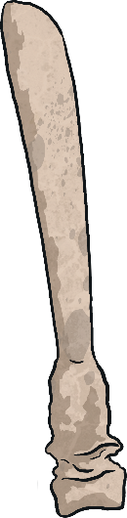
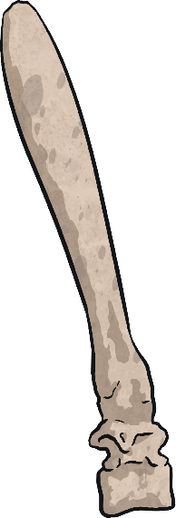

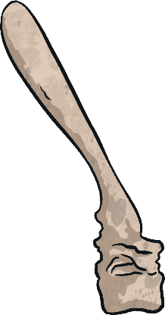
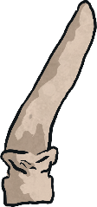
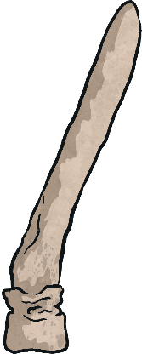
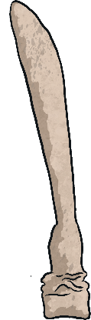
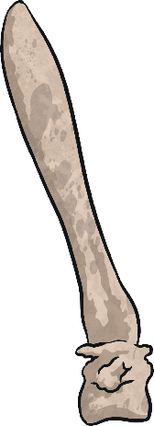
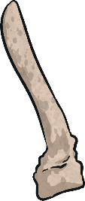
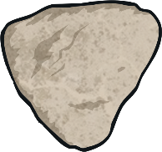
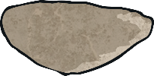
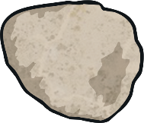
Watch the Deadly 60: Museum Escape Live Lesson with your class.

Slide 4

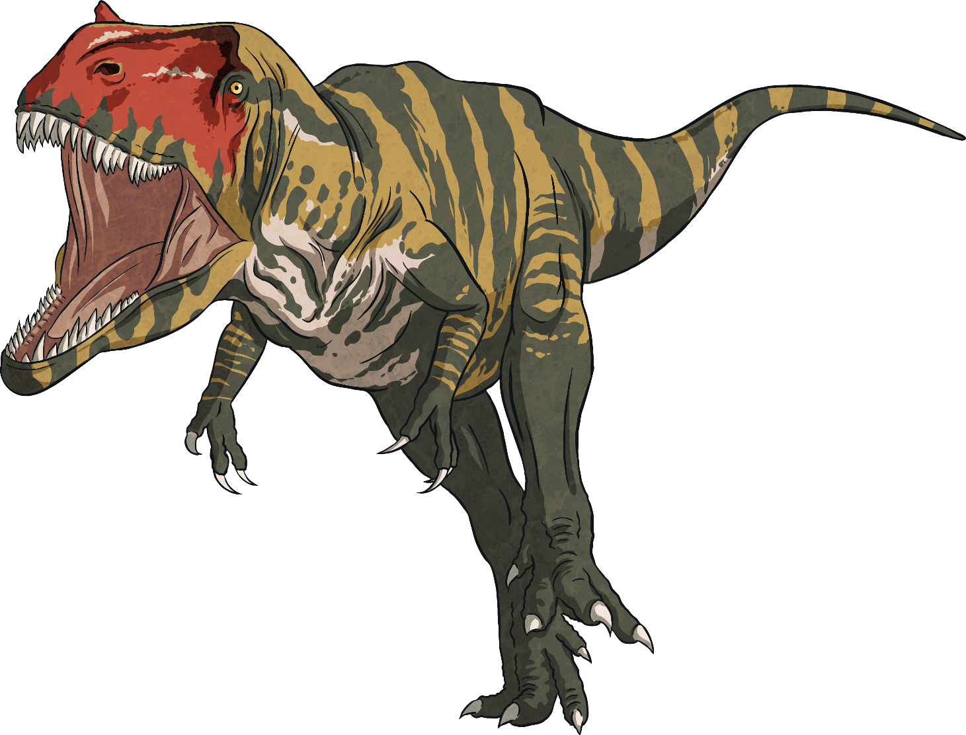
Natural History
Natural history is the study of everything that has happened in the natural world. Scientists observe plants and animals to find out more about the history of life on Earth.
This could include observations of plants and animals still living, remains of animals that still exist on Earth today or those that have become extinct.

Slide 5
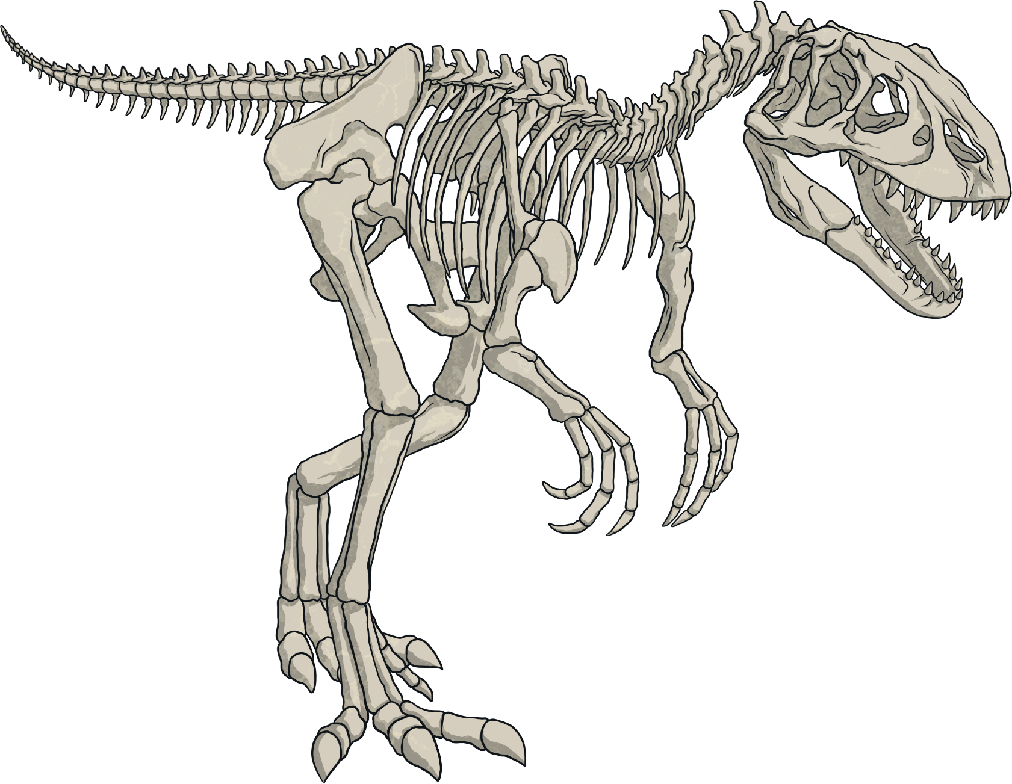

Natural History
The Natural History Museum
in London has collections of
objects from all over the world
that have helped scientists to
discover some of the most important and fascinating facts about living things.
One collection that can be found at the Natural History Museum includes fossils, which give us evidence about life on prehistoric Earth before any record of humans had even been made.

Slide 6

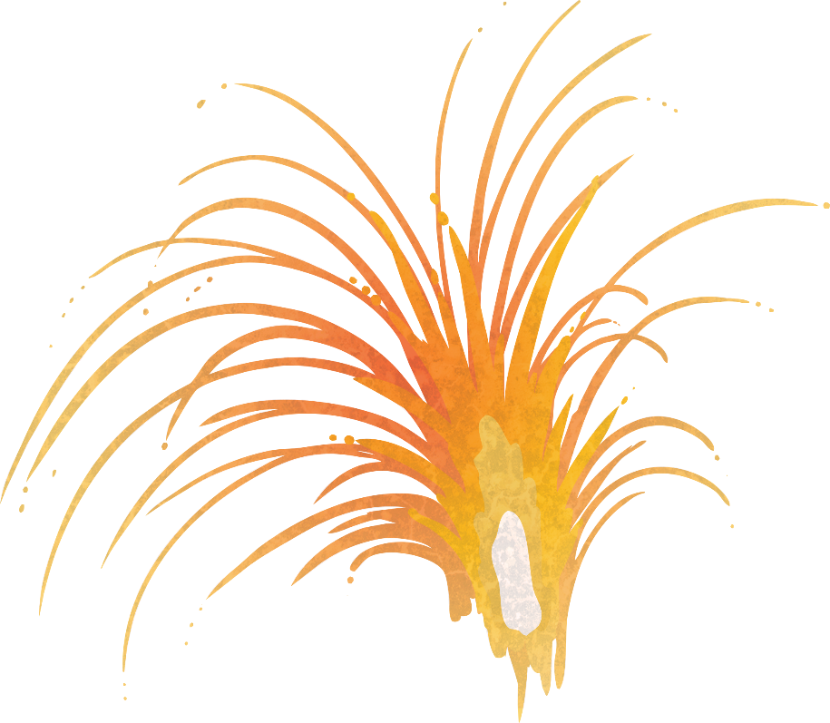
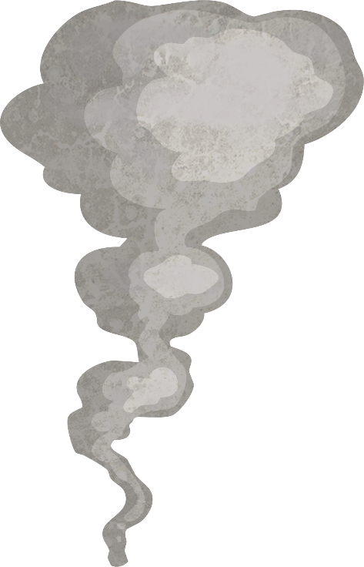
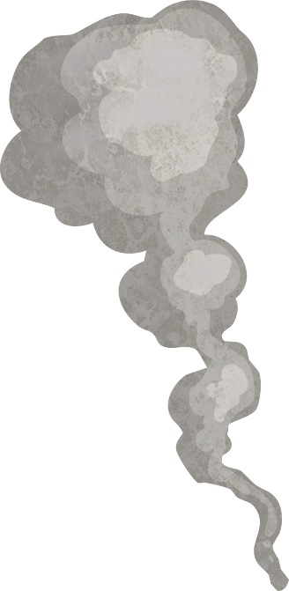
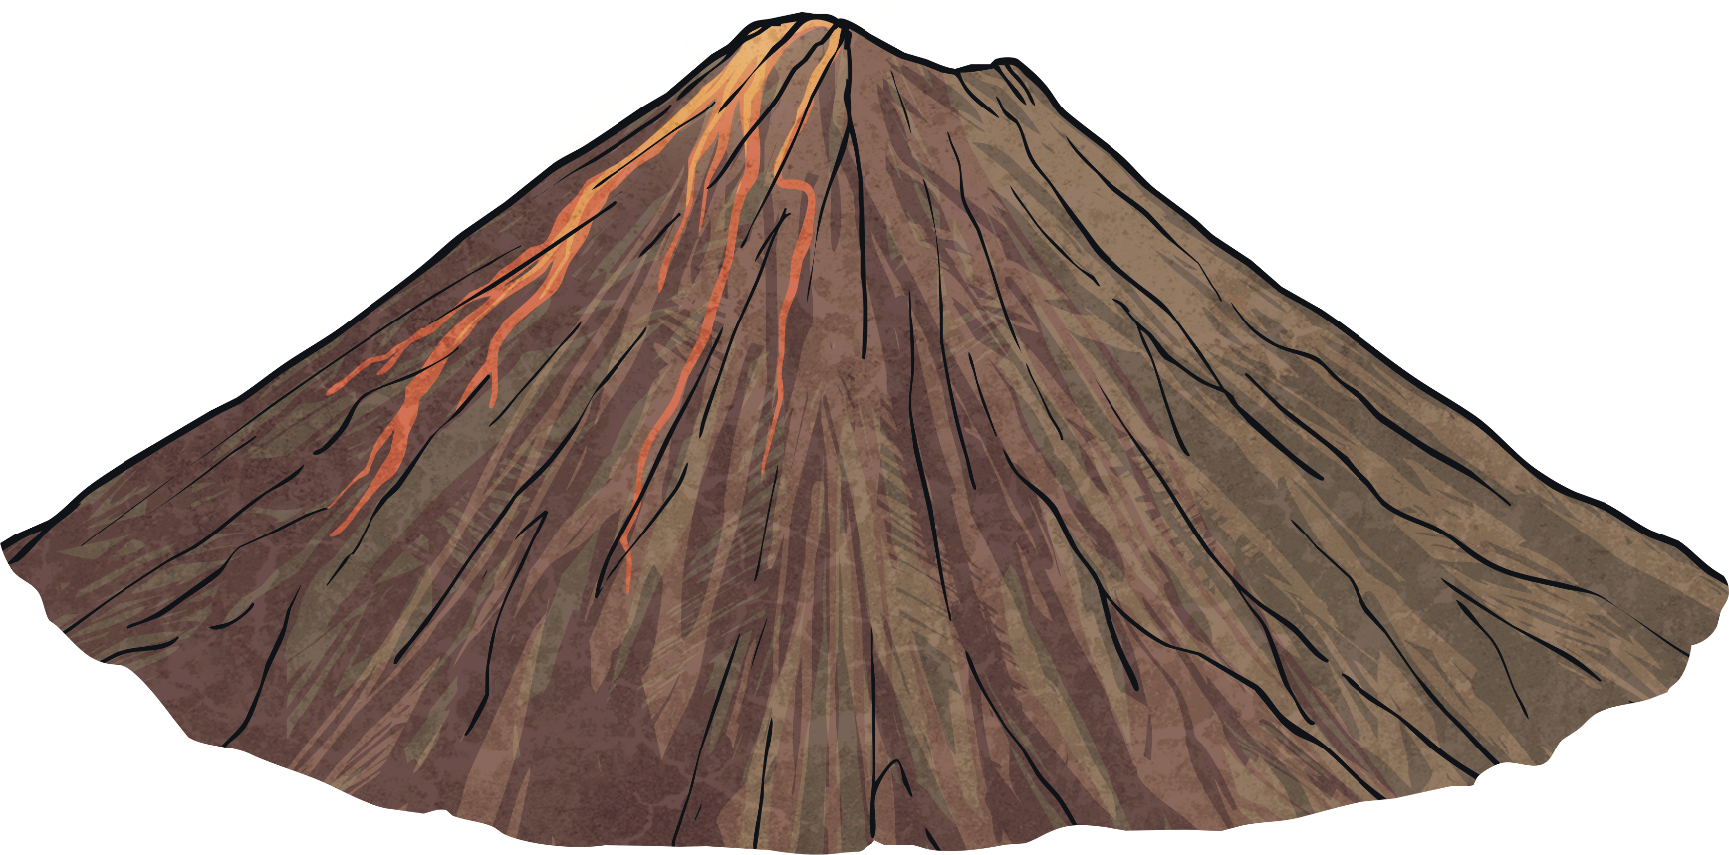
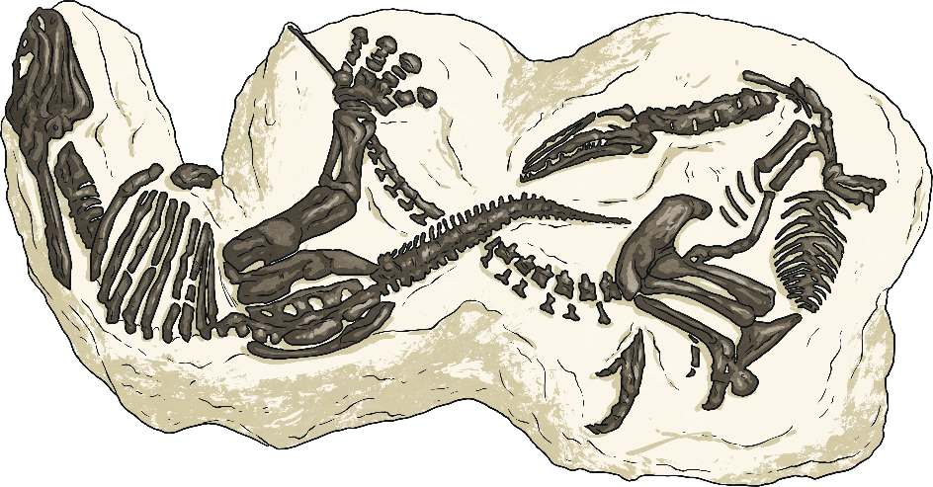

What Are Fossils and
How Are They Formed?
The fossils that we study now formed many millions and even billions of years ago in the prehistoric era, which was long before there is any written record of humans.
Fossils can form in different ways but most have formed when living things were buried very quickly after they have died in sand, volcanic ash or mud.

Slide 7
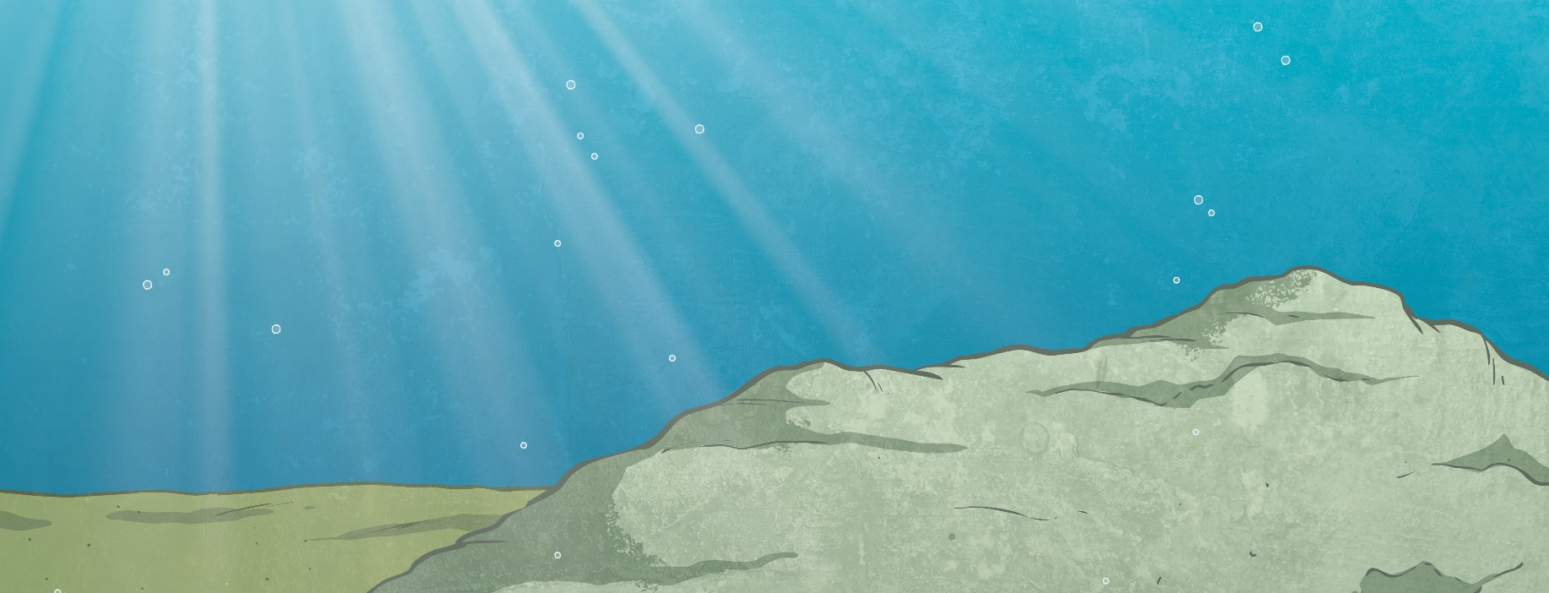

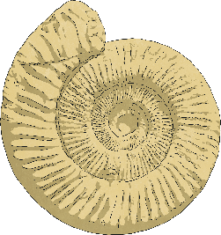
What Are Fossils and
How Are They Formed?
Often, this would happen close to or in water, where sediment on the bottom of a river, lake or ocean would move easily to cover them.

Slide 8
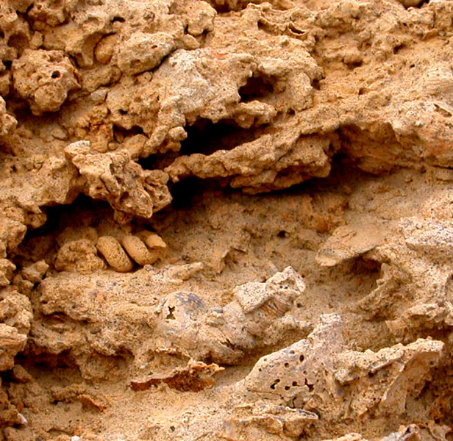
What Are Fossils and
How Are They Formed?
When the soft parts of an animal rotted away, the hard parts, such as bones, teeth and shells, would be left and then covered with more sediment over time.
This sediment would be pushed closely together under the pressure of more sediment above it, forming sedimentary rocks.
Therefore, fossils are mostly only found in this type of rock and they usually take millions of years to reappear after the rock has been worn away by the weather.
Sedimentary rock erosion
showing fossils.

Slide 9

What Are Fossils and
How Are They Formed?
Over many years, water will have seeped through the rock and dissolved the animals’ bones, leaving an empty space.
However, special minerals in the water turn to hard crystals, which will have left a hard case around the shape of the animal that once lived. This is the fossil.
A fossil of two dinosaurs in sedimentary rock.
Check out how this all happens here.

Slide 10
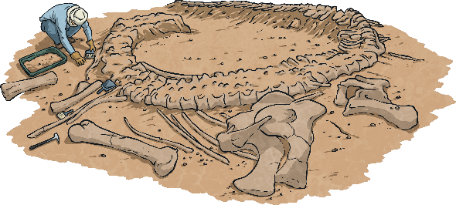
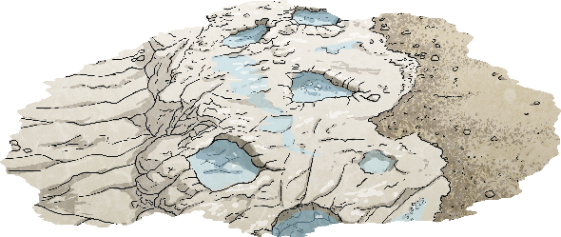
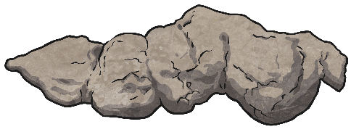
Different Types of Fossils
Fossils can be grouped into three types:
Body fossil, which is a part of an animal or plant.
Body fossils could be of a complete body, though
this is very rare, and more often fossils may only
be part of an animal or plant.
Trace fossils, such as a footprint or an egg.
These fossils are not part of an animal but
exist because of the animal being in the place
where these fossils are found.
Coprolite fossils, which are poo!
Animal poo that has been buried in sediment and
has turned into a fossil in the same way as
animals is called a coprolite.

Slide 11
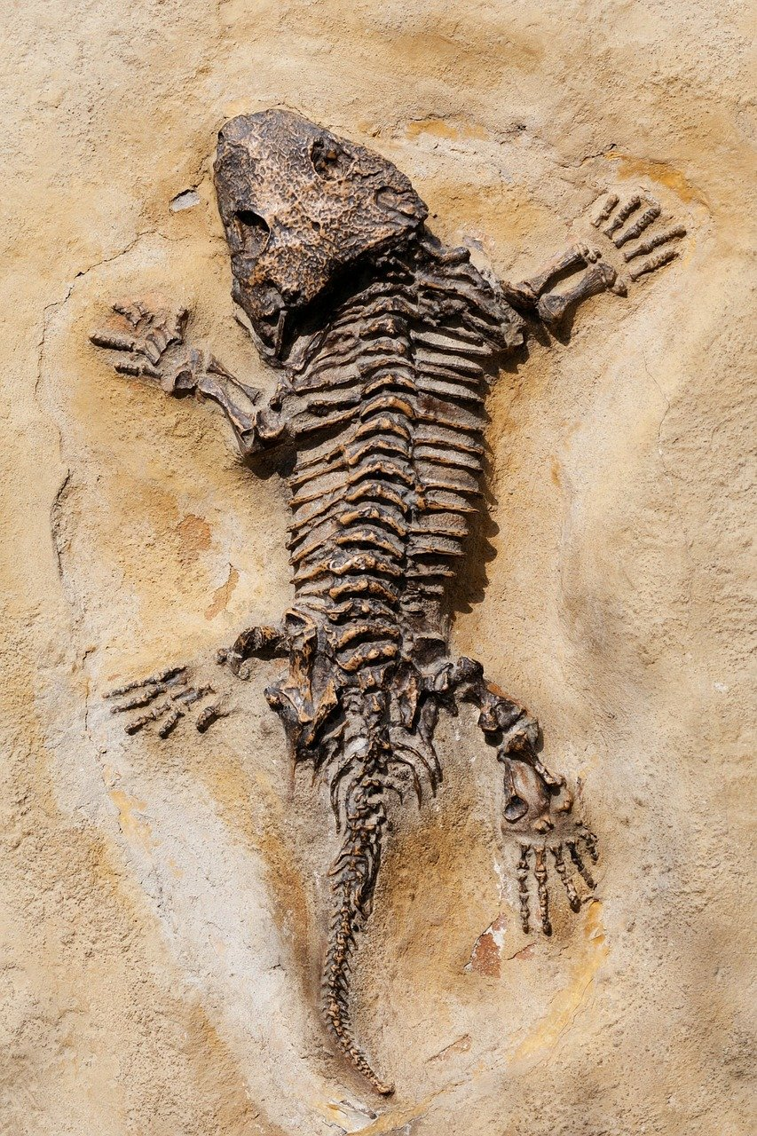
What Can Fossils Tell Us?
Fossils have been found in rocks that were first formed billions of years ago. Many of the species found are now extinct so fossils help scientists understand what these species looked like, how they lived, how different animals were related to each other and where on Earth they lived.
They also help scientists to understand what the Earth was like long ago and how it has changed over time.
An ancient dinosaur lizard fossil in rock.

Slide 12
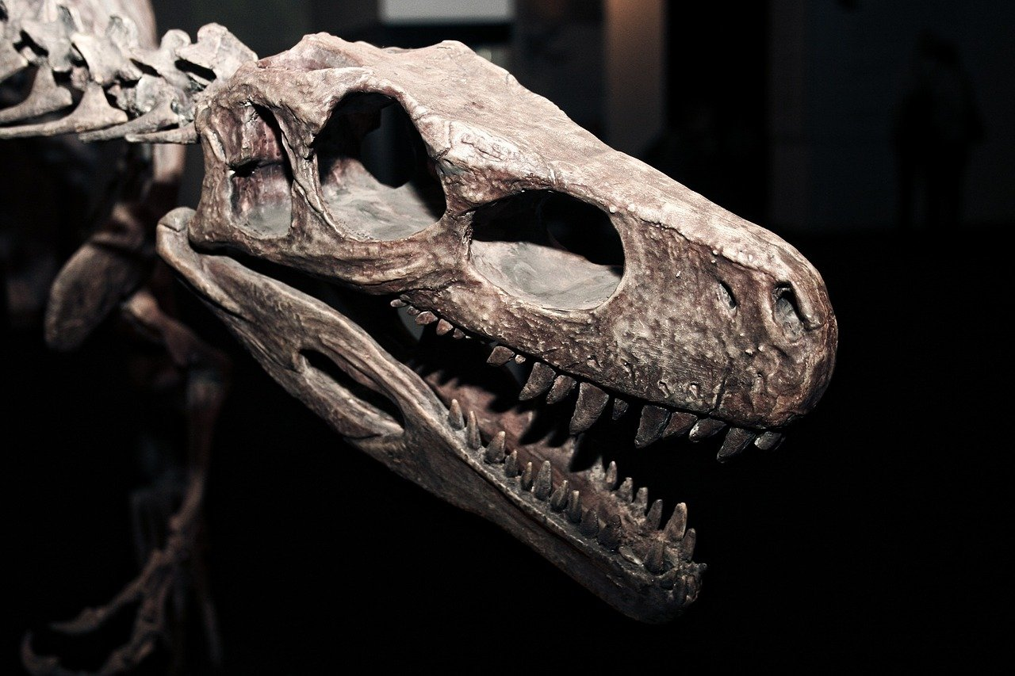
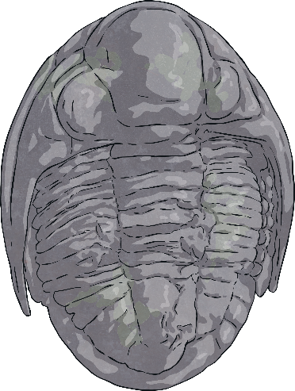
What Can Fossils Tell Us?
Body fossils show what prehistoric animals looked like.
In many cases, these fossils are the only evidence that certain animals, such as dinosaurs, ever lived because they have long been extinct.
Body fossils can give experts information about the size of a creature and how it looked.
A dinosaur head fossil showing its physical features.

Slide 13
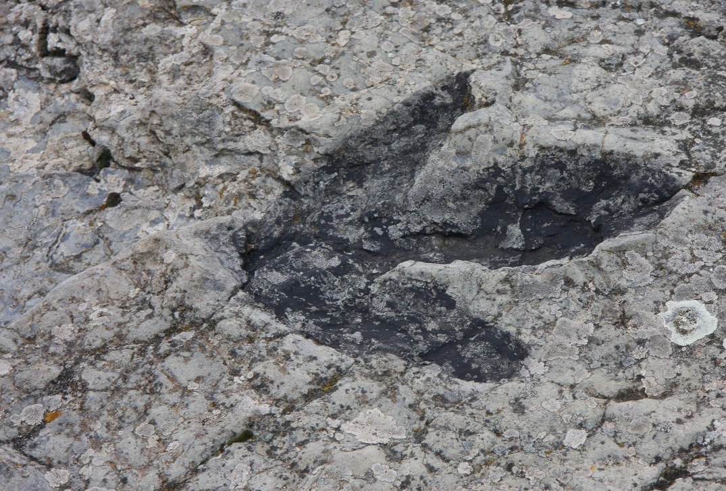
What Can Fossils Tell Us?
Trace fossils are not part of an animal but instead evidence of the movements and activities of an animal in the past.
Trace fossils can include footprints, burrows and eggs.
These might be helpful to work out the size of an animal, such as a dinosaur, but tracks are more helpful to tell experts where animals lived, how they searched for food and what their habitats were like when they roamed the Earth.
A dinosaur footprint fossil found
in Spain.

Slide 14
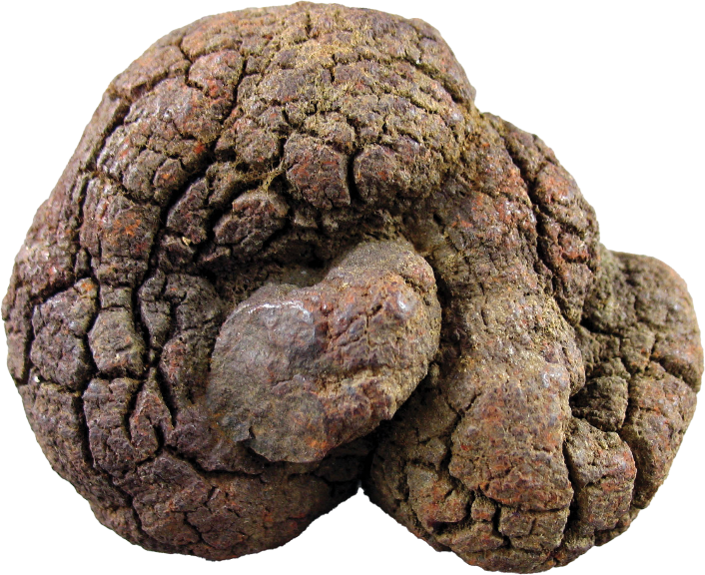
What Can Fossils Tell Us?
Coprolites (animal poo fossils) come in many shapes and sizes, which helps scientists to understand what kind of animal the poo belonged to. They also tell us what the animal’s diet was like, for example whether they were carnivores, herbivores or omnivores.
Experts are able to look deeper into coprolites to find out what is inside them.
If experts find tiny pieces of bone, the animal would have been a meat-eater.
The coprolite of a plant-eater might contain seeds, bark or leaf fragments for example.
A coprolite fossil.

Slide 15
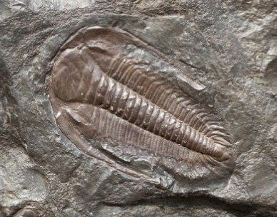
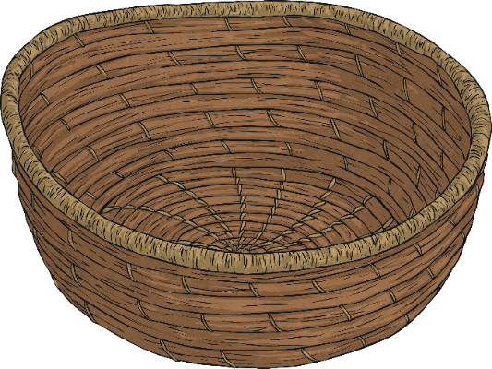
Quick Quiz
Sort these fossils into the correct group.
Click on each image to move the fossil into the basket they belong to.
Coprolite
Trace
Body

Slide 16
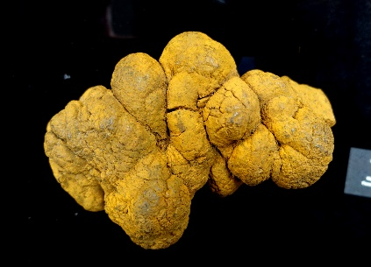
Quick Quiz
Sort these fossils into the correct group.
Click on each image to move the fossil into the basket they belong to.
Coprolite
Trace
Body

Slide 17
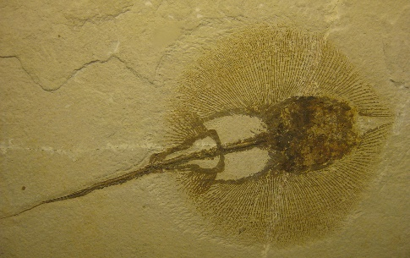
Quick Quiz
Sort these fossils into the correct group.
Click on each image to move the fossil into the basket they belong to.
Coprolite
Trace
Body

Slide 18
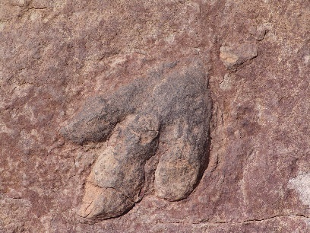
Quick Quiz
Sort these fossils into the correct group.
Click on each image to move the fossil into the basket they belong to.
Coprolite
Trace
Body

Slide 19
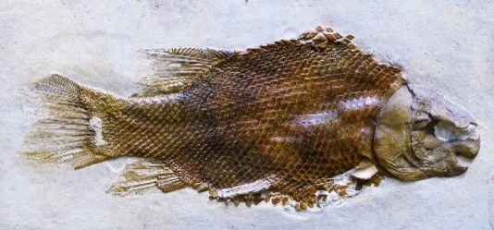
Quick Quiz
Sort these fossils into the correct group.
Click on each image to move the fossil into the basket they belong to.
Coprolite
Trace
Body

Slide 20
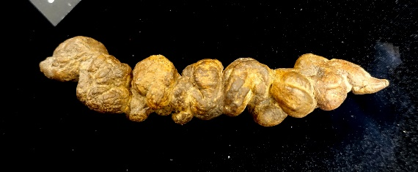
Quick Quiz
Sort these fossils into the correct group.
Click on each image to move the fossil into the basket they belong to.
Coprolite
Trace
Body

Slide 21

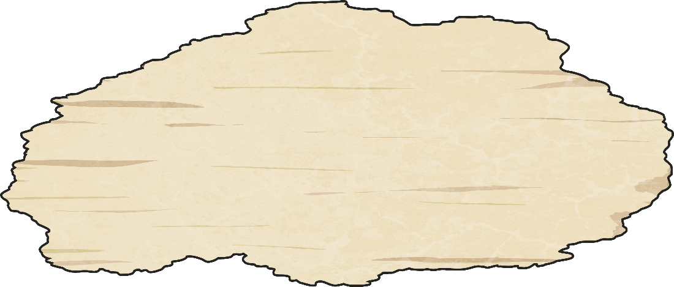
Fossil Hunting
For many people, finding a fossil is something that happens by chance when out and about near the coast. Many amateur fossil hunters search for and study fossils as a fun pastime.
However, for some, fossil
hunting is a full-time career, for which they have trained to become palaeontologists.

Slide 22
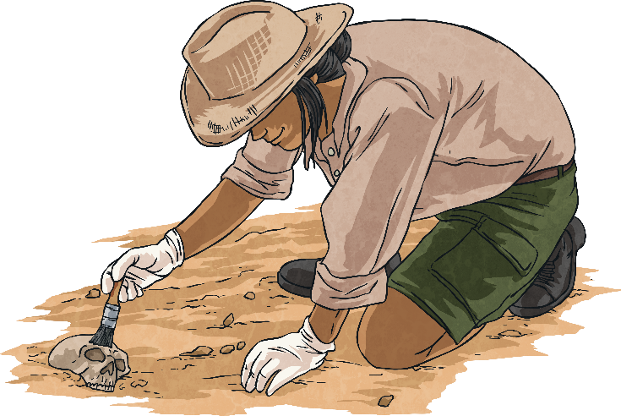
How Do Fossil
Hunters Find Fossils?
Palaeontologists must consider a number of things when searching for fossils:
Place
sites with sedimentary rock formed over 65 million years ago.
Signs
signs of fossils before digging deeper.
choosing the right tools at the right time:
machines to dig through deep chunks of rock
small tools to dig through shallow rock
small brushes to remove rock dust when fossils can be seen
Tools

Slide 23
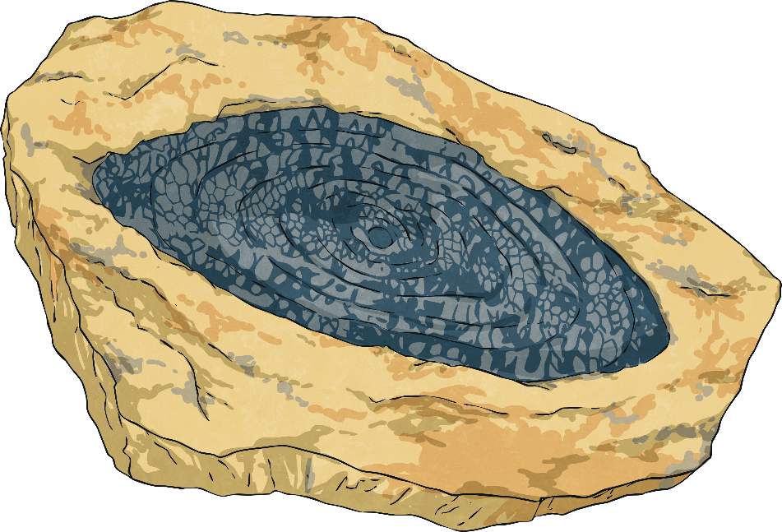
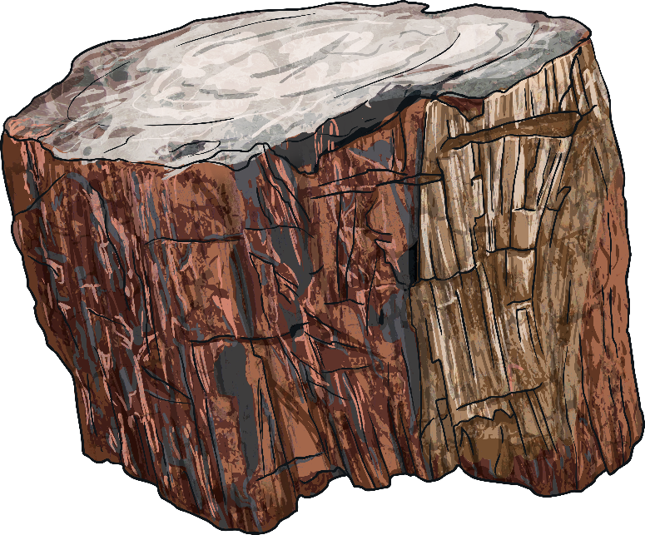
How Do Fossil
Hunters Find Fossils?
Place
sites with sedimentary rock formed over 65 million years ago.
Movement
fossils can be very fragile so experts wrap them in special jackets made of plaster and fabric to move them.

Slide 24
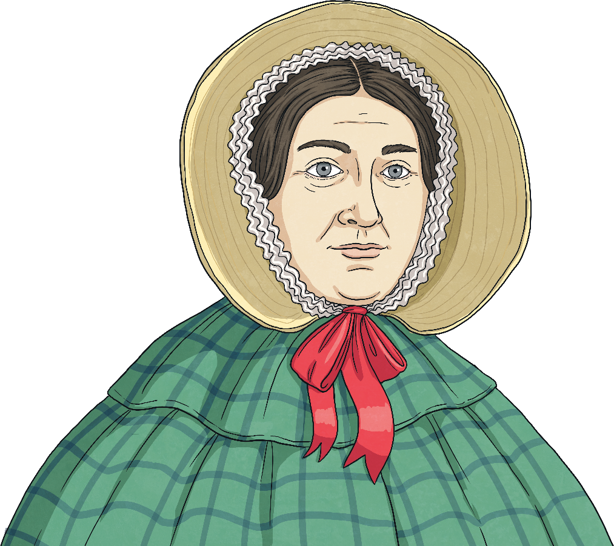
Famous Fossil Hunters
Well-known palaeontologists have come from all over the world.
However, one of the most famous fossil hunters, and one of the few well-known, female names, is Mary Anning.
Mary Anning, a famous
British palaeontologist.

Slide 25
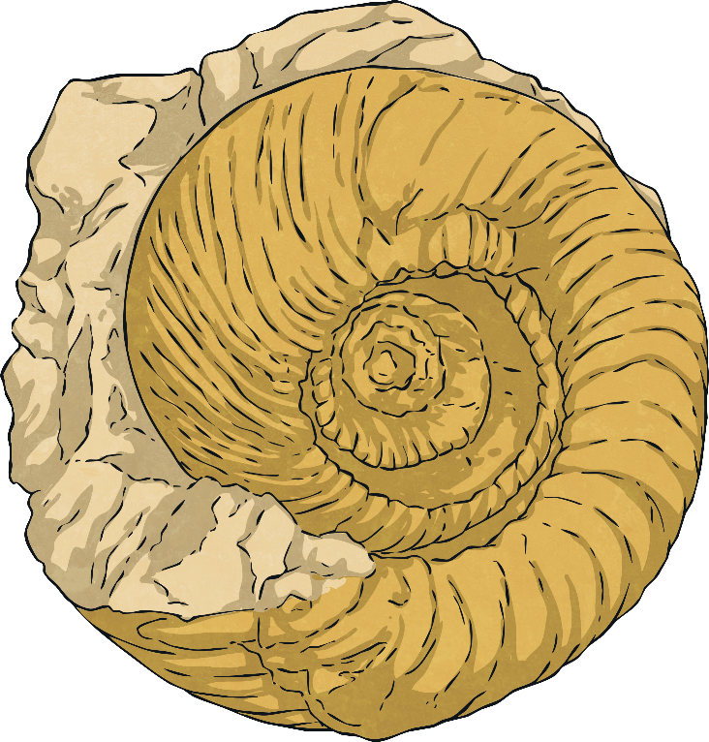
Who Was Mary Anning?
Mary Anning was born in the town of Lyme Regis on the Dorset coast in 1799. Her family had little money so Mary and her brother spent a lot of their spare time looking for things they could sell along the beaches.
Mary collected these findings called curiosities and, at first, she wasn’t sure what they were. Over time, once she had a large collection and a better understanding of her finds, she realised they were fossils.
Mary would find ammonites and collect them as curiosities.

Slide 26
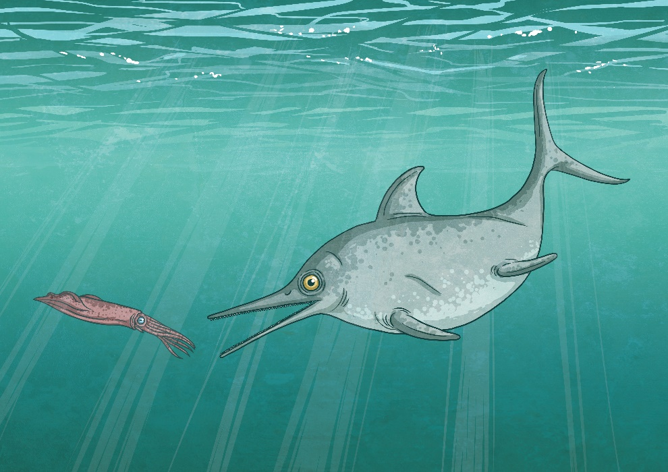
Who Was Mary Anning?
Mary continued her searches with her dog Tray at her side.
At the age of 12, Mary and her brother discovered the skull of an ancient reptile called an ichthyosaur, meaning ‘fish lizard’.
This discovery was a big development in fossils and Mary would go on to find more, including a marine reptile called a plesiosaur and a flying reptile known as a dimorphodon.
ichthyosaur

Slide 27
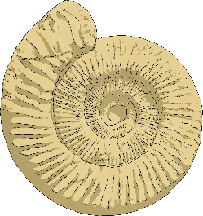
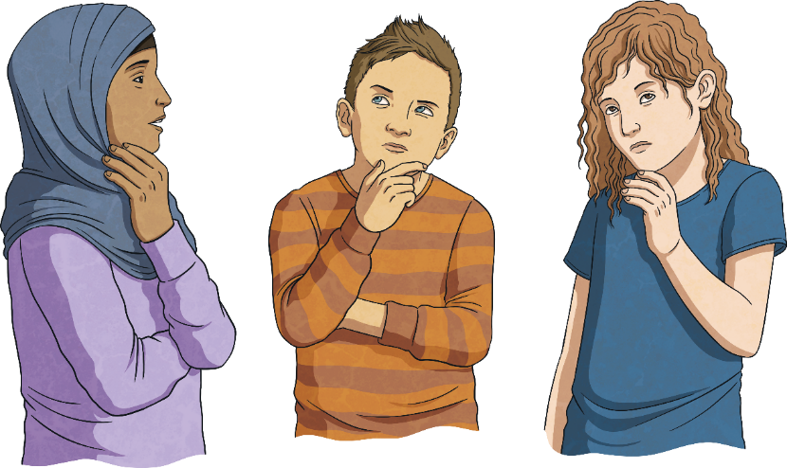
Quick Quiz
What type of rock is best for finding fossils?
1
igneous
sedimentary
sedimentary
metamorphic
hard

Slide 28

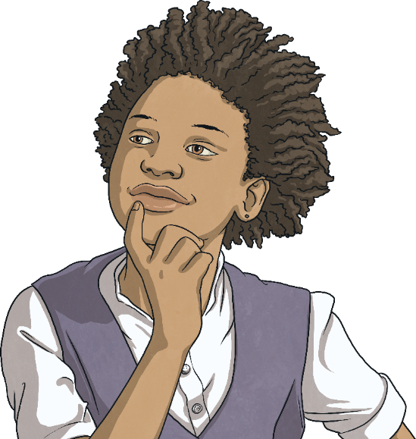
Quick Quiz
Which tool is best to remove dust once fossils can be seen?
2
heavy machinery digger
pickaxe
trowel
soft brush
soft brush

Slide 29

Quick Quiz
In what year was Mary Anning born?
3
1979
1797
1799
1799
1977

Slide 30
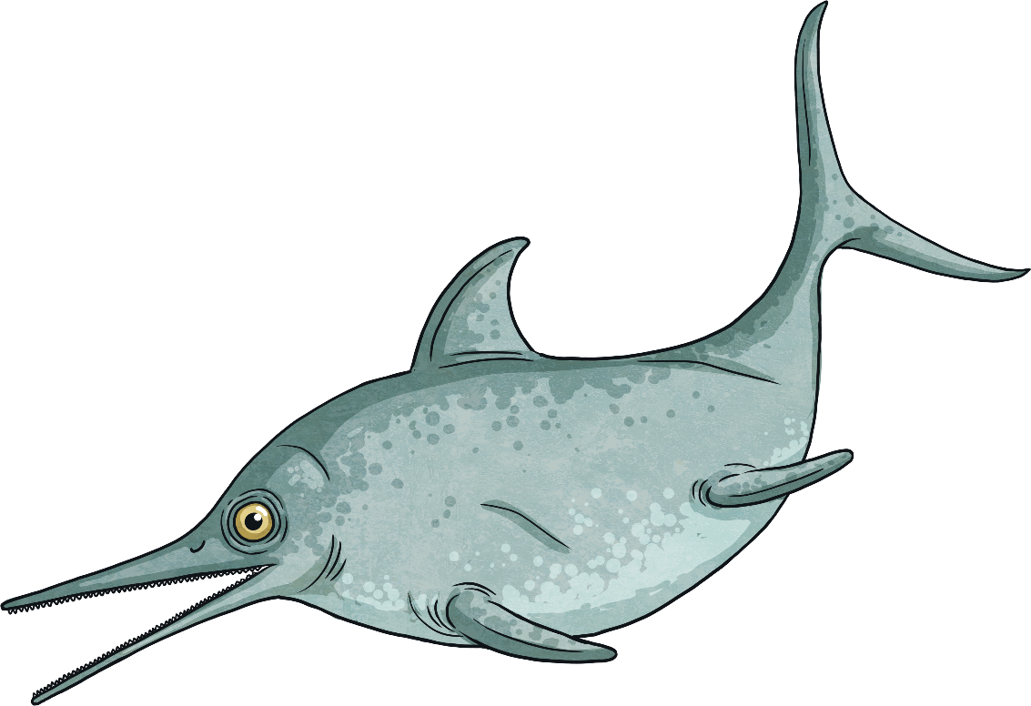
Quick Quiz
What age was Mary Anning when she found the ichthyosaur?
4
12
12
7
16
32

Slide 31
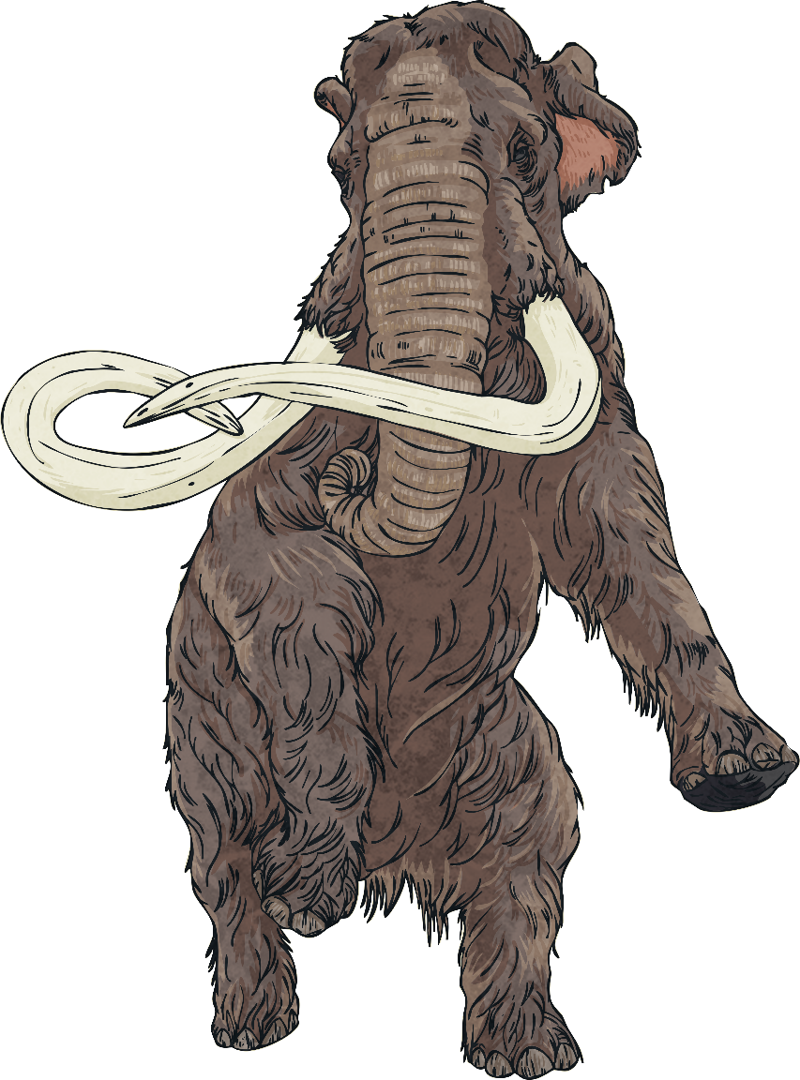

What Do Fossils
Tell Us about Evolution?
Evolution describes the way living things change over time.
All animals in a species are slightly different to each other and
have to compete against each other to do well and survive.
This is called natural selection.
The animals that are better suited to their environment by being stronger, faster or more intelligent are more likely to survive and reproduce so the traits that have helped them to survive are passed down to their offspring.
Over time, these traits become more common and the entire species gradually changes. This is evolution.
Check out how this all happens here.

Slide 32


What Do Fossils
Tell Us about Evolution?
Fossils show what animals were like long ago so palaeontologists can compare these to the same species over time. This helps them to understand evolution.
Horses are a perfect example of this.
Horses have a single toe on the end of each leg - the hoof - which is different to any other animal on the planet.
However, this has not always been
the case.
Current horses species have only one toe - a hoof.

Slide 33


What Do Fossils
Tell Us about Evolution?
Fossils of horses’ hooves from over 33 million years ago show horses started out with at least three toes.
At this time, they lived in forests, where the ground was soft and having toes
was useful.
As horses moved to live on open grassland where they could run freely, they slowly evolved from having toes to having smaller toes to having only one hoof, which allowed them to run quickly.
Three-toed horse fossils show how horses’ feet have changed over millions of years.

Slide 34





What Have We Learnt?
Share at least three different facts you have learnt about the following topics:
Mary Anning
what fossils
can tell us
how fossils are made
different types of fossils
evolution - how species change over time

Slide 35

Glossary
Please click on the word to take you back to the slide it is on.
ammonites
sites with sedimentary rock formed over 65 million years ago.
dissolved
When a solid has mixed fully with a liquid to form a solution.
extinct
Relating to a species being no longer living anywhere on Earth.
fossils
The remains of a prehistoric plant or animal preserved in rock.
minerals
Natural, solid substances.
offspring
The young of an animal.

Slide 36
Glossary
Please click on the word to take you back to the slide it is on.
palaeontologist
An expert who studies fossils.
prehistoric
A time on Earth before anything was written.
reproduce
Produce young animals.
sediment
Fine fragments of rock, sand, mud or volcanic ash that settles, usually at the bottom of a body of water.
sedimentary
Relating to sediment, e.g. rock composed of sediment.
species
A type of living thing sharing characteristics.

