Slide 1

Disclaimers
We hope you find the information on our website and resources useful.
Animations
This resource has been designed with animations to make it as fun and engaging as possible. To view the content in the correct formatting, please view the PowerPoint in ‘slide show mode’. This takes you from desktop to presentation mode. If you view the slides out of ‘slide show mode’, you may find that some of the text and images overlap each other and/or are difficult to read.
To enter slide show mode, go to the slide show menu tab and select either from beginning or from current slide.
Links to External Video Websites
This resource contains links to external video websites. These websites often have autoplay features meaning that other videos will play after the video you are watching finishes. You should disable this feature before using the video in any classroom or similar setting. Twinkl assumes no responsibility for the contents of linked websites. The inclusion of any link in this resource should not be taken as an endorsement of any kind by Twinkl of the linked website or any association with its operators. We have no control over the availability of the linked pages. If the link is not working, please let us know by contacting TwinklCares and we will try to fix it, although we can assume no responsibility if this is the case.

Slide 3

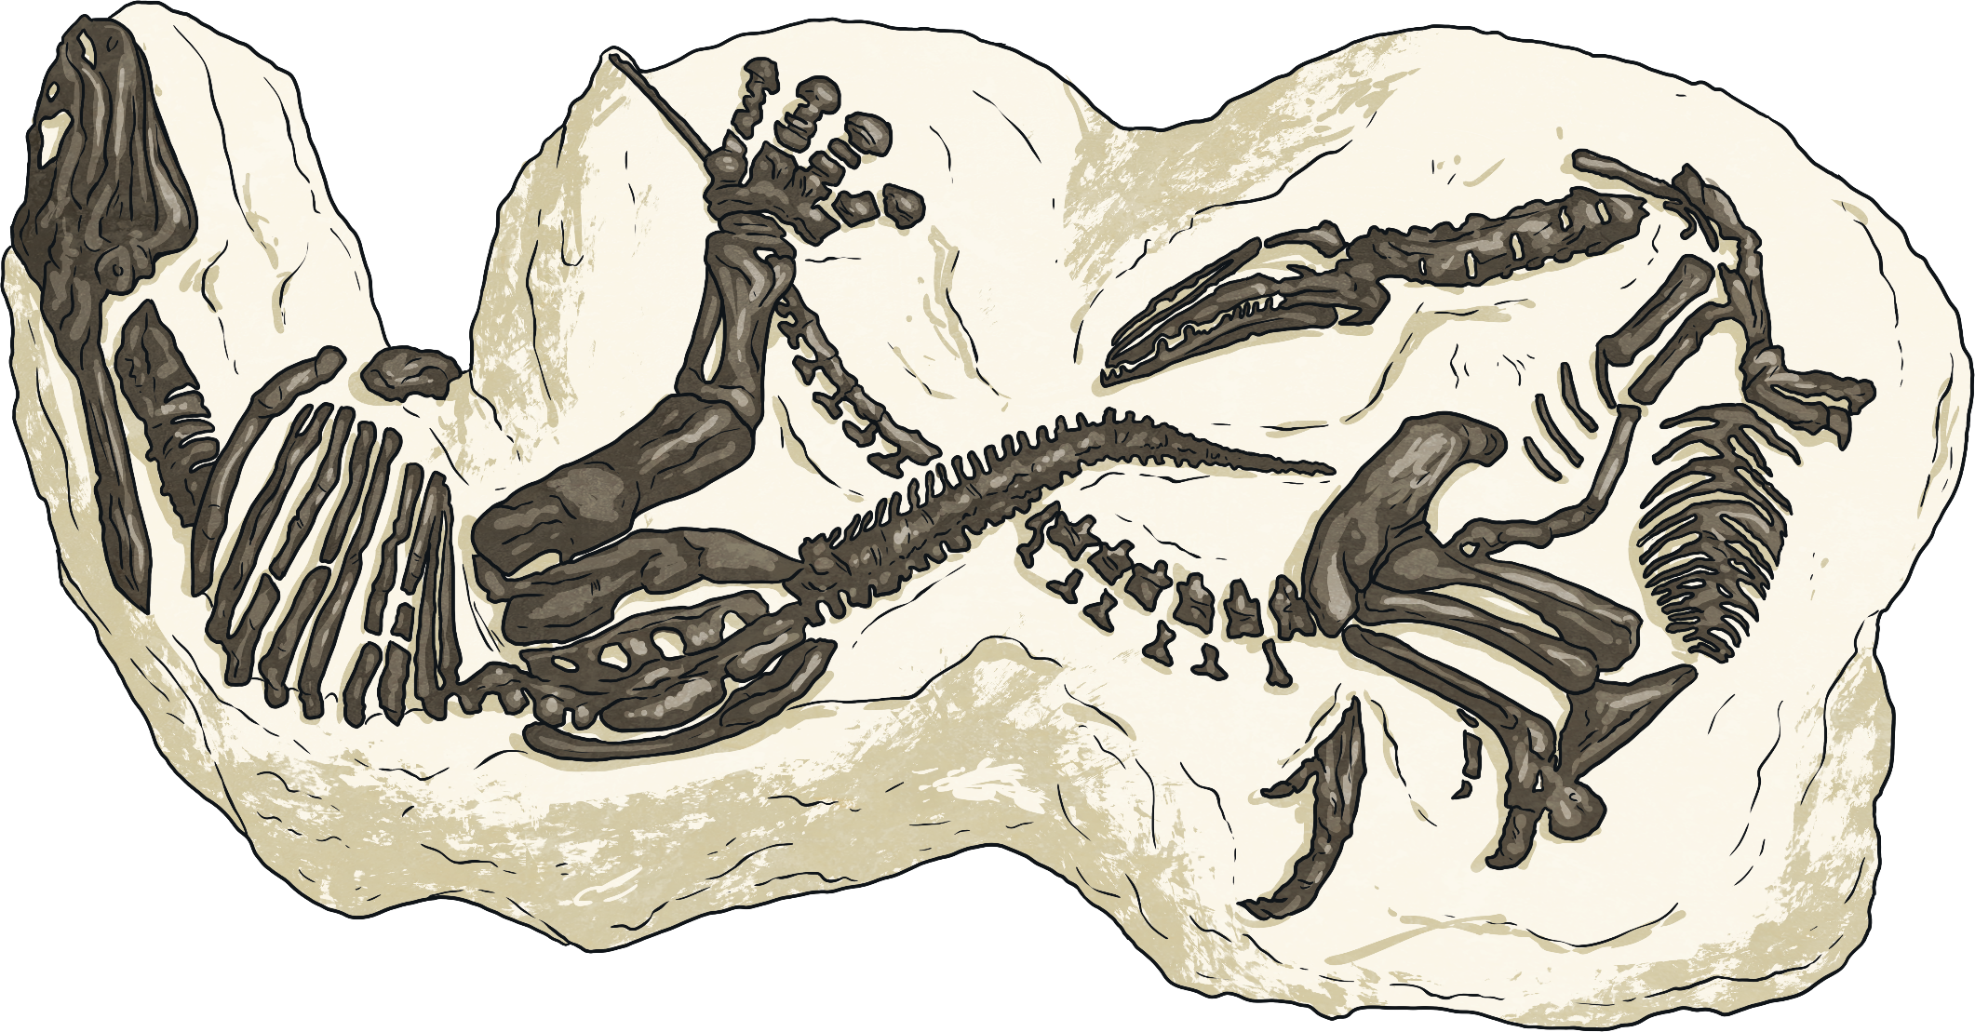
Watch the Deadly 60: Museum Escape - Live Lesson with your class.

Slide 4
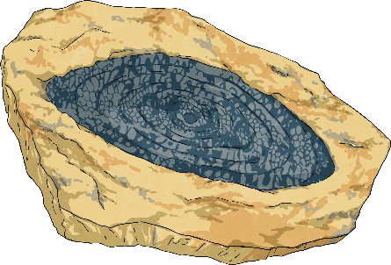
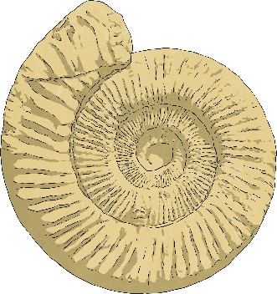
Natural History
Natural history involves the scientific study of the natural world. Scientists observe plants and animals to find out more about the history of life on Earth.
This could include observations of plants and animals still living, remains of animals that still exist on Earth today or those that have become extinct.
The Natural History Museum in London has collections of objects that have been sourced from all over the world and have helped scientists to discover some of the most important and fascinating facts about living things.
One captivating collection that can be found at the Natural History Museum includes fossils, which provide evidence about life on prehistoric Earth before any record of humans had even been made.

Slide 5

What Are Fossils and How Are They Formed?
The fossils that we study now were formed many millions, even billions, of years ago in the prehistoric era, which was long before there was any written record.
Fossils can form in different ways but most have formed when organisms that lived on Earth were buried very quickly after they died. They would often be covered in substances, such as sand, volcanic ash or mud, which would surround the plant or animal.
Often, this would happen if a living thing died close to or in water, where sediment on the bottom of a river, lake or ocean would drift easily to cover it.

Slide 6
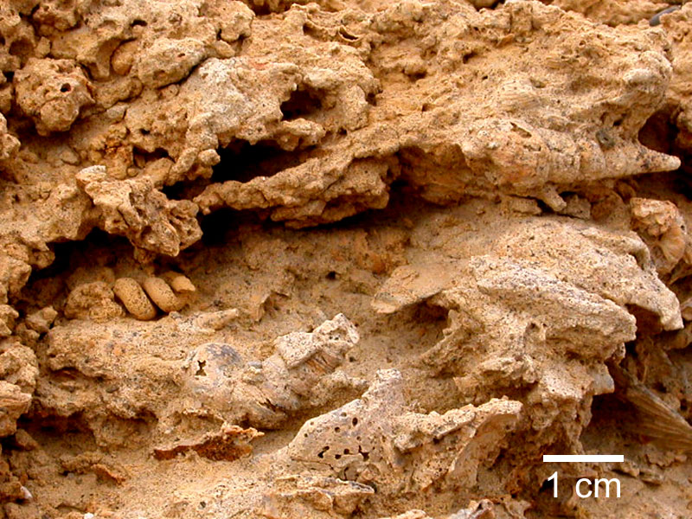
What Are Fossils and How Are They Formed?
When the soft tissue of an animal decomposed, the remaining skeleton and other hard parts, such as teeth, claws and shells, would remain and be covered with more sediment over time.
This sediment would be compacted under the pressure of more sediment above it, forming sedimentary rocks.
Therefore, fossils are mostly only found in this type of rock formation and they usually appear after millions of years once sedimentary rocks have moved or changed due to pressure and erosion (or when palaeontologists dig for them).
Sedimentary rock erosion revealing fossils.

Slide 7


What Are Fossils and How Are They Formed?
Over many years, water from above and below the Earth’s surface would seep through the rock and dissolve the animals’ bones, leaving an empty space.
However, minerals within the water would be left in the empty space. These minerals crystallise and leave a hard case around the shape of the animal that once lived.
Check out how this all happens here.
A fossil of two duelling dinosaurs, encased in sedimentary rock.

Slide 8
Different Types of Fossils
Fossils can be grouped into three types:
Body fossils, which are parts of an animal or plant. Body fossils could be of a complete body, though this is extremely rare and more often, a fossil may only be part of an animal or plant.
Trace fossils, such as a footprint or an egg. These fossils are not a physical remain of an animal but something that has come as a result of an animal’s presence.
Coprolite fossils - otherwise known as poo! Animal poo that has been buried in sediment and has fossilised in the same way as animals becomes a coprolite.

Slide 9
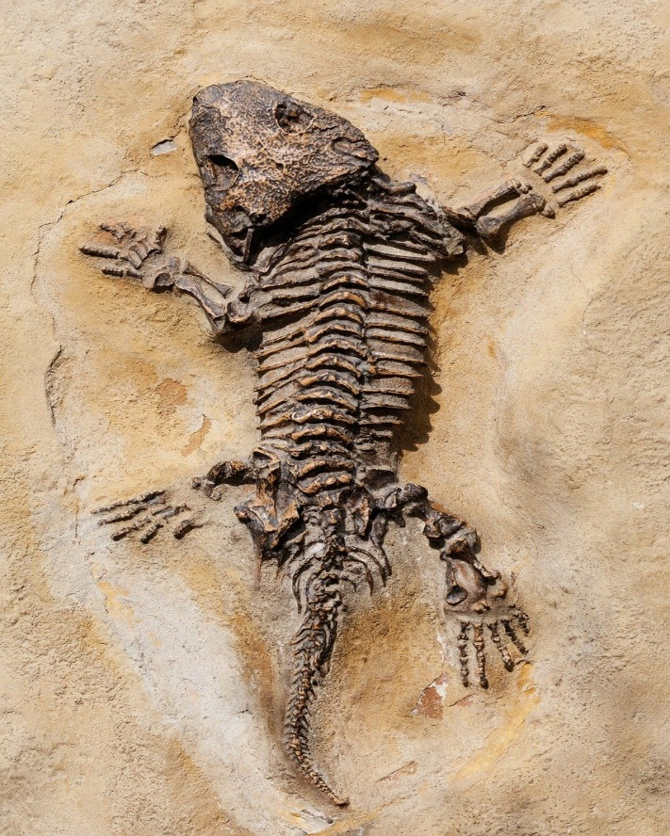
What Can Fossils Tell Us?
Fossils have been discovered in rocks that first developed billions of years ago. Many of the species found are now extinct so fossils help scientists to understand what these species looked like, how they lived, how different plants and animals were related to each other and, of course, where on Earth they lived.
They also help scientists to understand what the Earth was like long ago and how it has evolved over time.
Coprolite fossils - otherwise known a
s poo! Animal poo that has been buried in sediment and has fossilised in the same way as animals becomes a coprolite.
An ancient dinosaur lizard fossil preserved in stone.

Slide 10
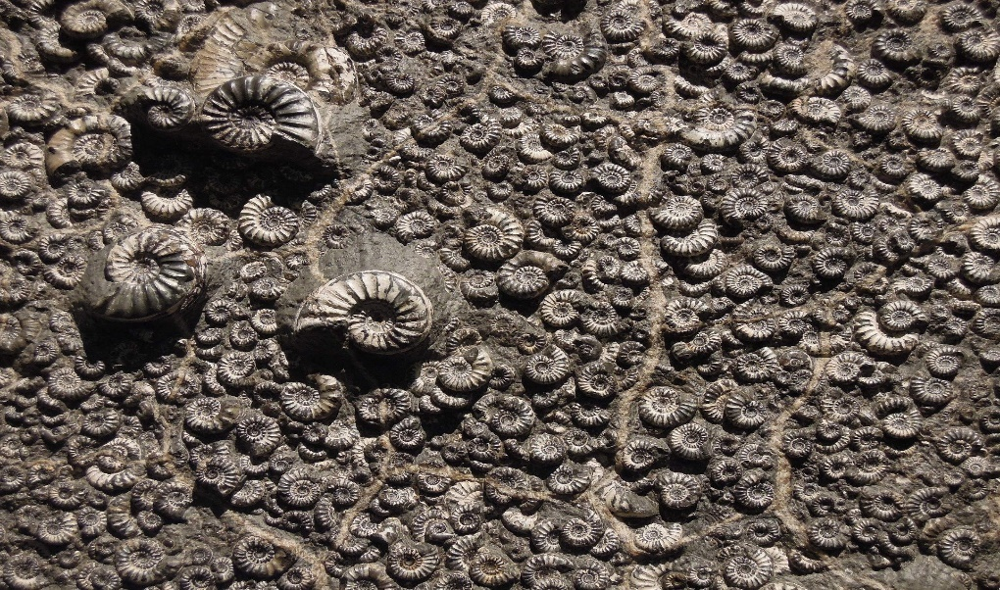
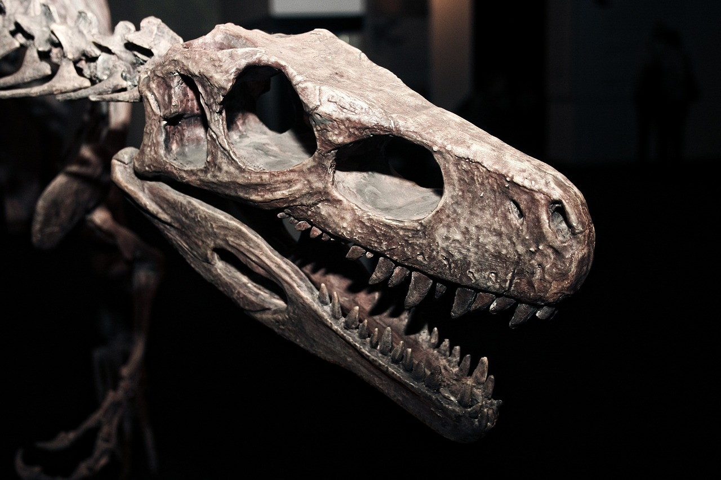
What Can Fossils Tell Us?
Body fossils are the remains of a living organism, whether as the whole body or only in part, and they can be the most revealing fossils about the appearance of prehistoric life forms.
In many cases, these fossils are the only evidence of the existence of certain animals, such as dinosaurs and ammonites, because they have long been extinct.
Ammonite fossils from the seabed.
Body fossils can give experts information about the size of the creature and its physical features, such as teeth, shells and bones.
A fossilised dinosaur head showing its physical features

Slide 11
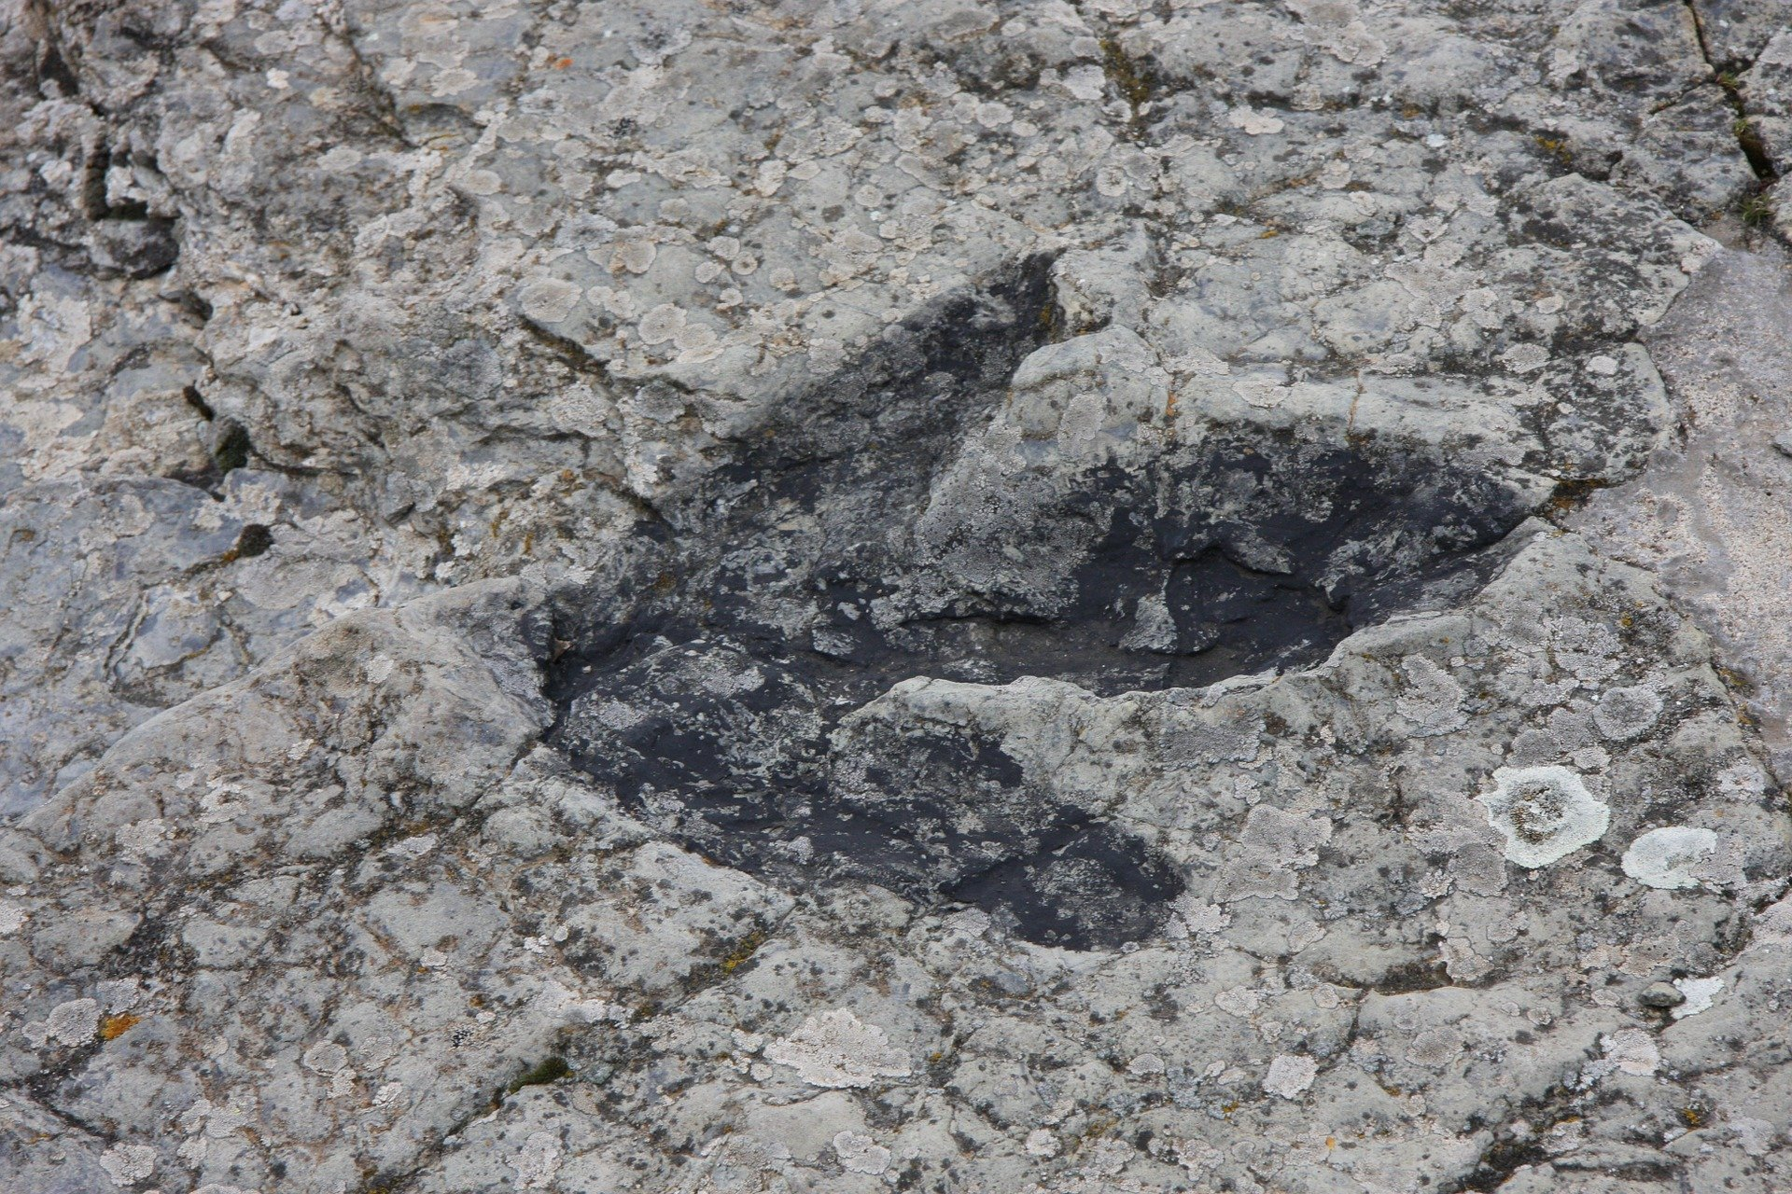
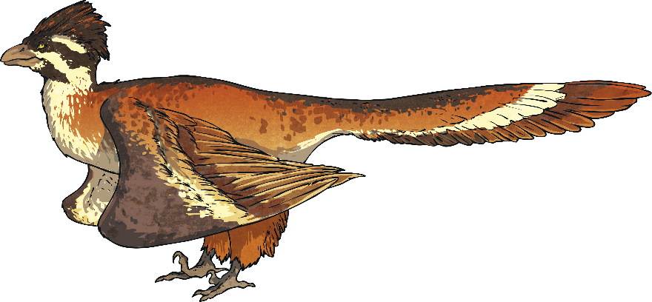
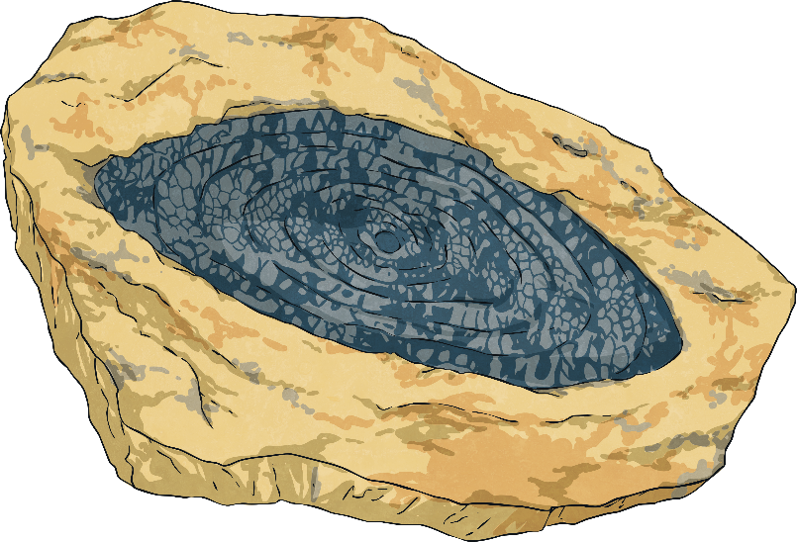
What Can Fossils Tell Us?
Though not physical remains of an animal, trace fossils are visible as a result of an animal’s presence and can therefore be used to help scientists understand more about the movements and activities of animals in the past.
Trace fossils can include footprints, burrows and eggs.
A dinosaur footprint fossil found in Spain.
These might be helpful to determine the size of an animal, such as a dinosaur; however, tracks are more helpful to tell experts where animals lived, how they searched for food and what the conditions of their habitats were like when they roamed the Earth.

Slide 12
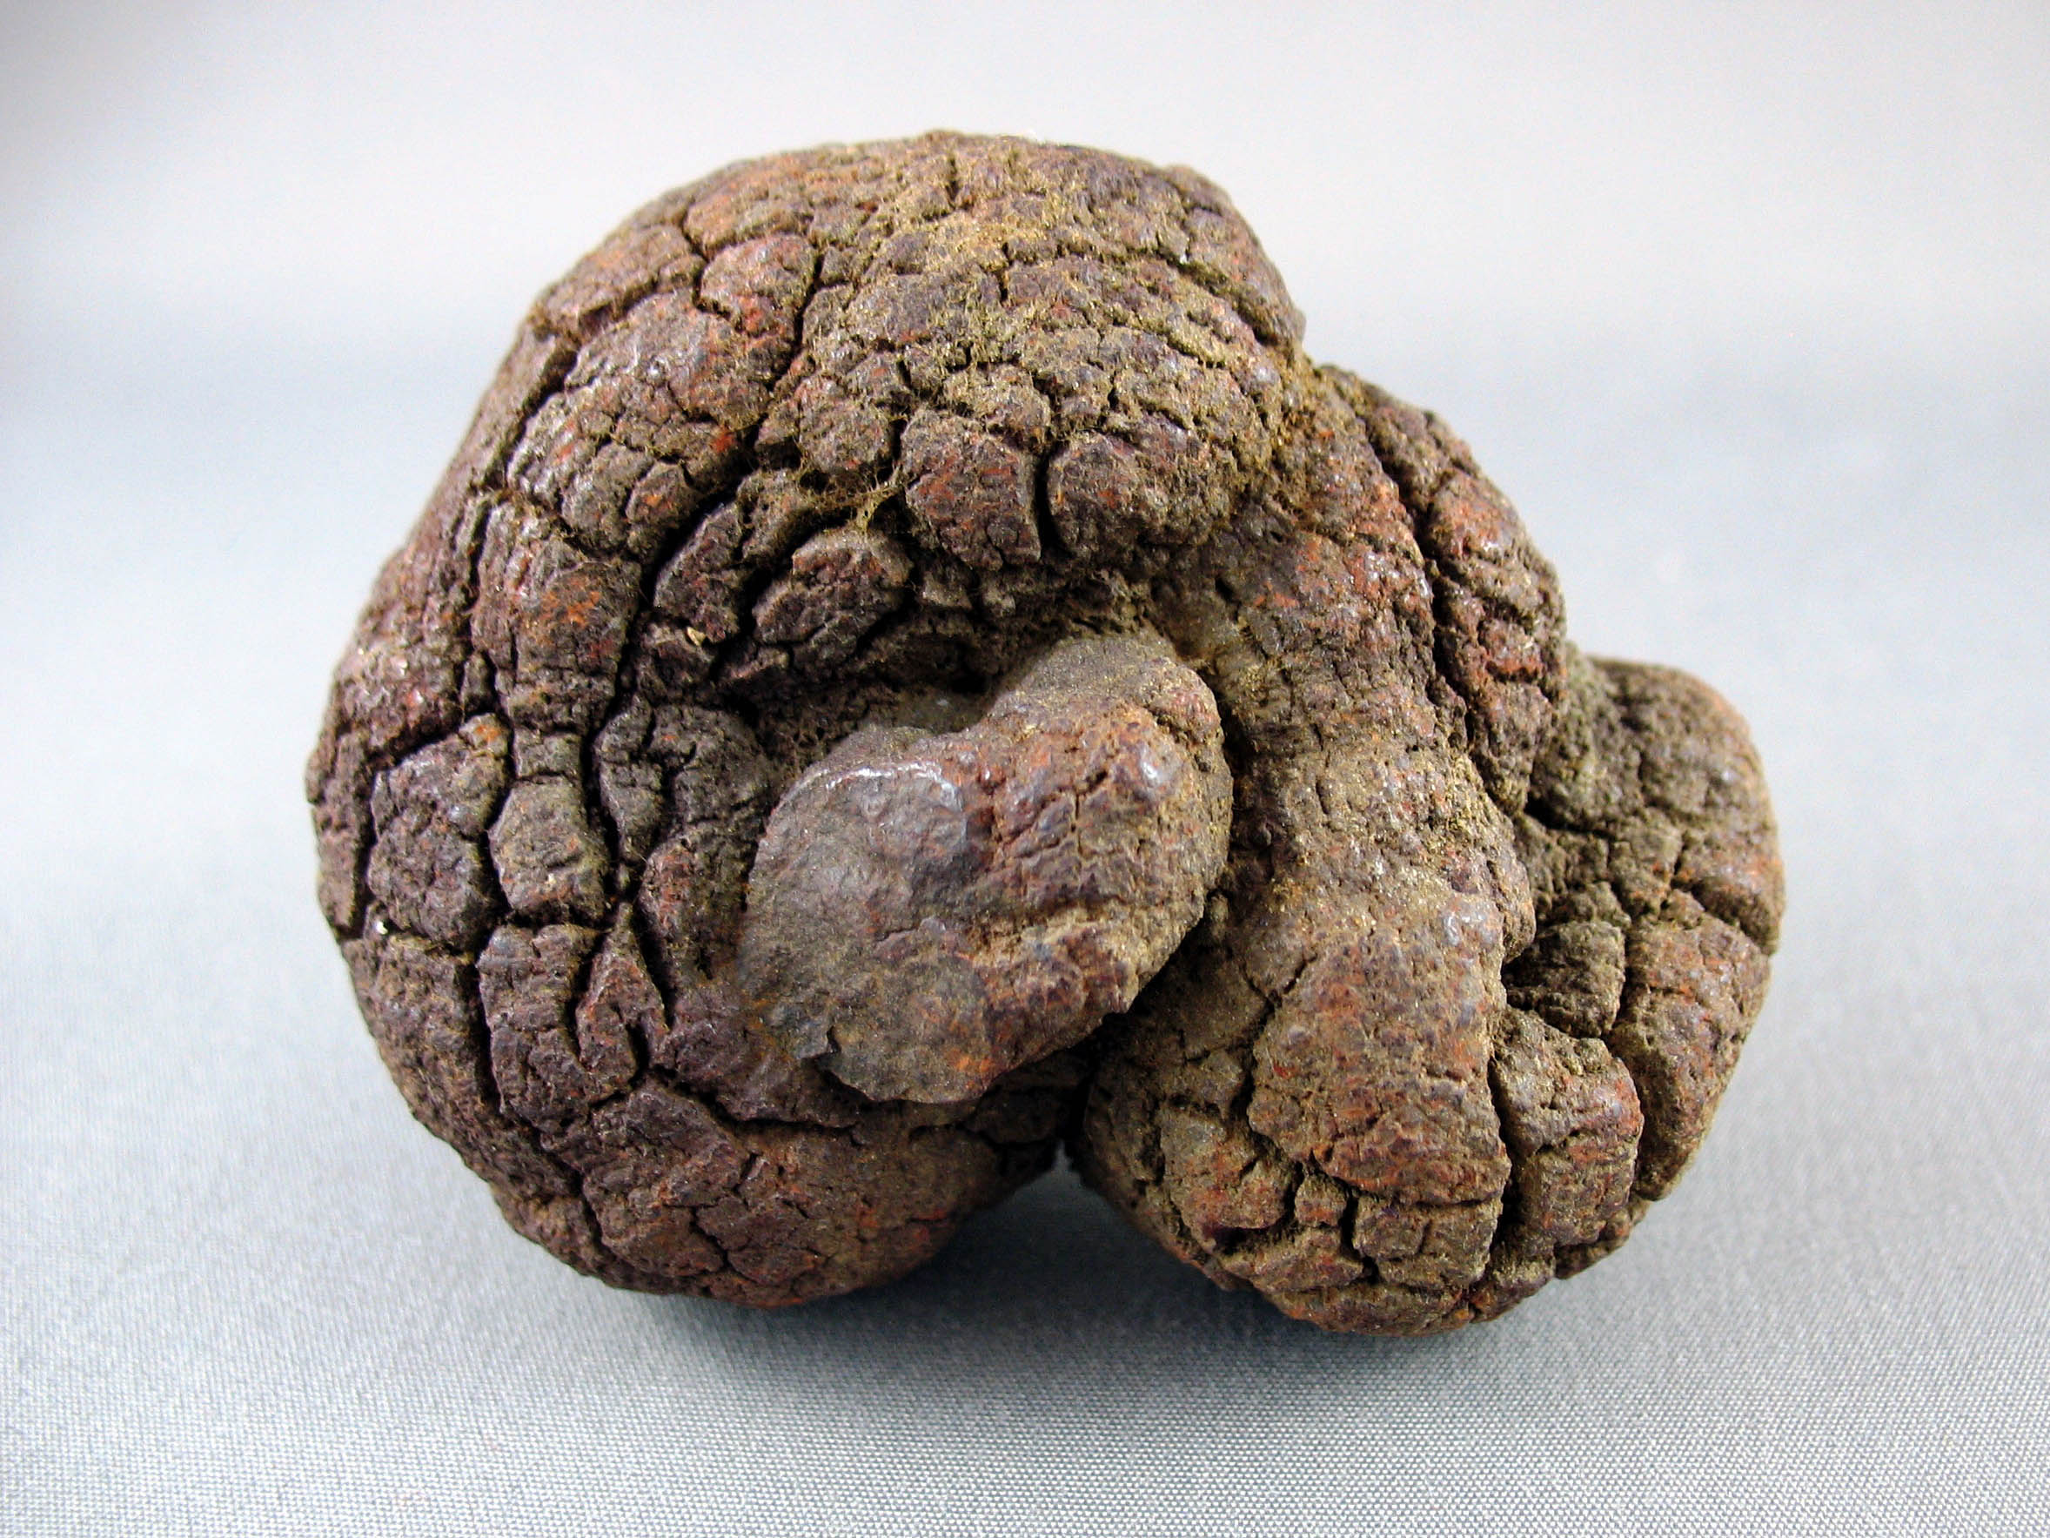
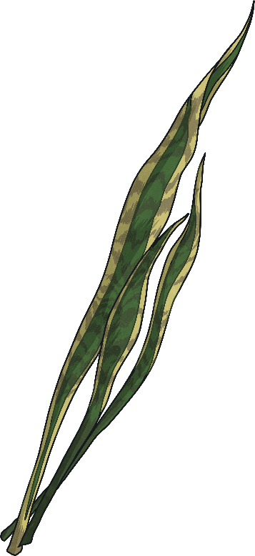
What Can Fossils Tell Us?
Coprolites come in many shapes and sizes and this helps scientists to understand what kind of animal the poo belonged to. They also help them understand what the animal’s diet was like, for example whether they were carnivores, herbivores or omnivores.
Experts are able to inspect coprolites to find out what is inside them.
Delving deeper might expose tiny bone fragments, demonstrating a meat-eater, and scientists might even be able to tell how the prey was eaten by examining teeth indentations on the fragments.
A coprolite fossil.
The coprolite of a vegetarian, however, might contain plant-based signs, such as seeds, bark or leaf fragments.

Slide 13
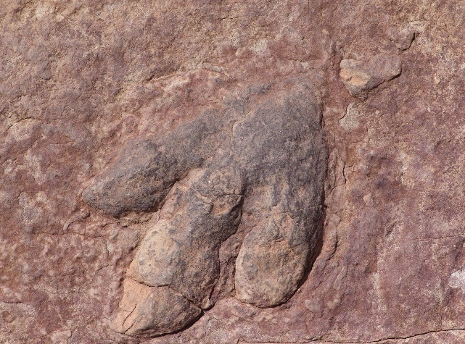
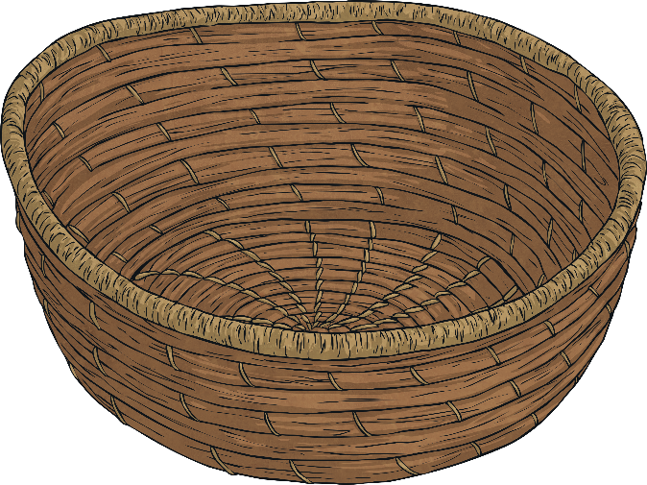
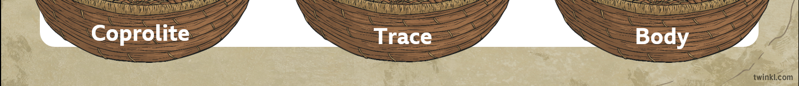
Quick Quiz
Sort these fossils into the correct group.
Click on each image to move the fossil into the basket they belong to.
Coprolite
Trace
Body

Slide 14
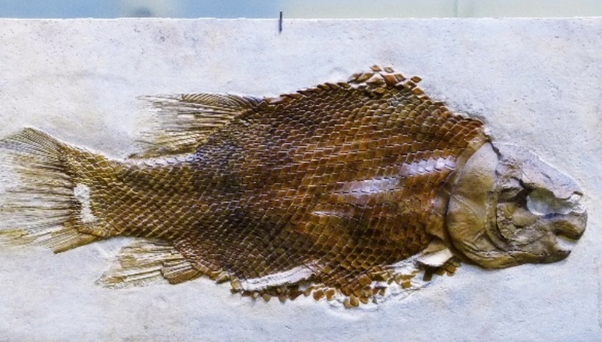
Quick Quiz
Sort these fossils into the correct group.
Click on each image to move the fossil into the basket they belong to.
Coprolite
Trace
Body

Slide 15
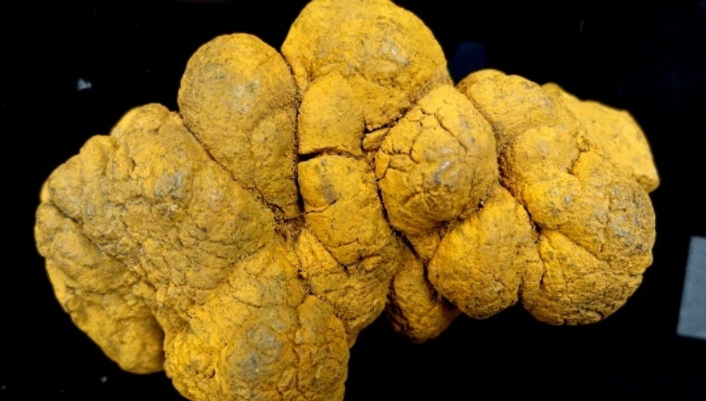
Quick Quiz
Sort these fossils into the correct group.
Click on each image to move the fossil into the basket they belong to.
Coprolite
Trace
Body

Slide 16
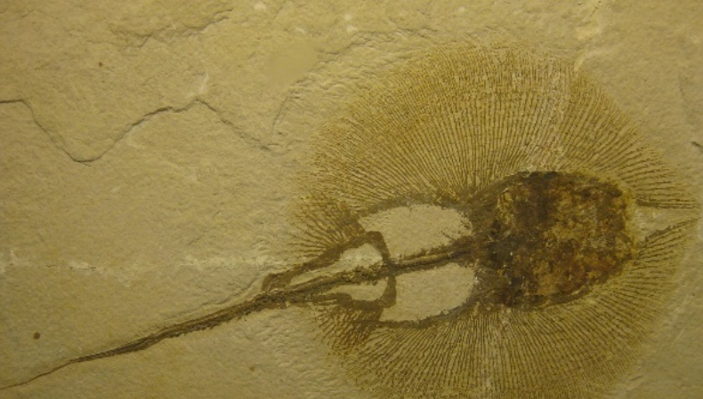
Quick Quiz
Sort these fossils into the correct group.
Click on each image to move the fossil into the basket they belong to.
Coprolite
Trace
Body

Slide 17
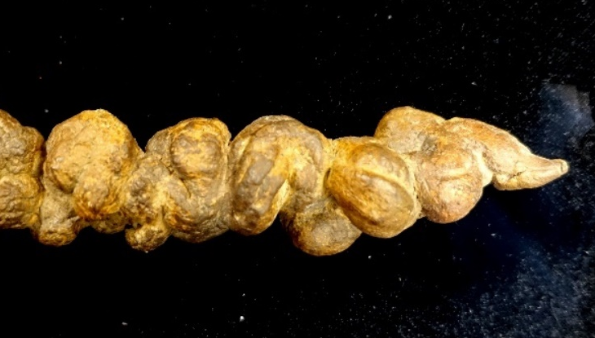
Quick Quiz
Sort these fossils into the correct group.
Click on each image to move the fossil into the basket they belong to.
Coprolite
Trace
Body

Slide 18
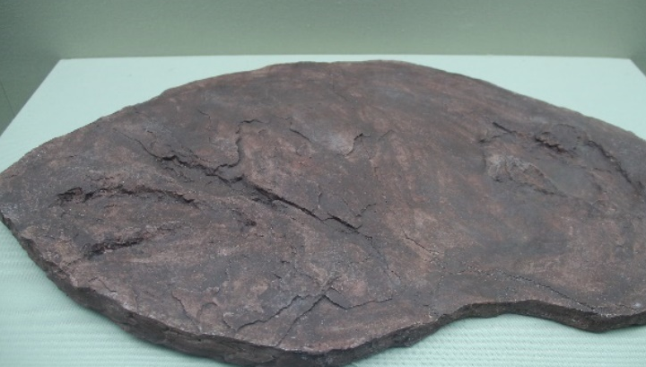
Quick Quiz
Sort these fossils into the correct group.
Click on each image to move the fossil into the basket they belong to.
Coprolite
Trace
Body

Slide 19
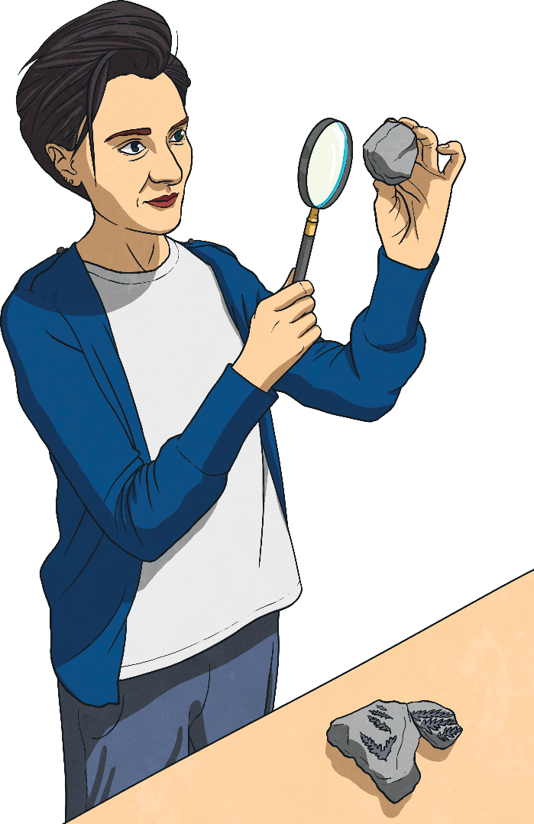
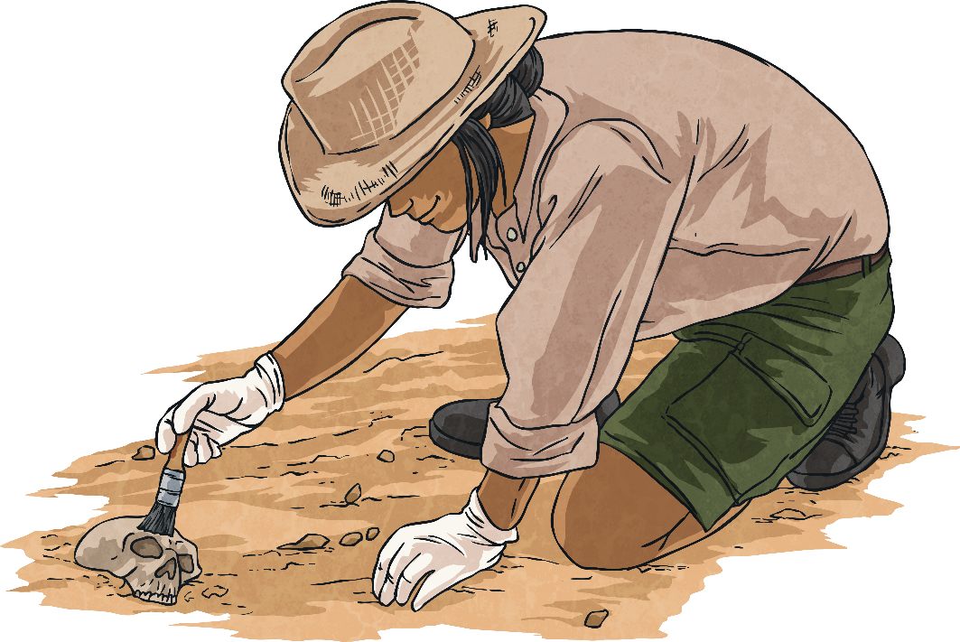
Fossil Hunting
For many people, finding a fossil is something that happens by chance when out and about near the coast. Many amateur fossil hunters search for and study fossils as a fascinating pastime, without needing any training or experience.
However, for some, fossil hunting is a full-time profession for which they have trained to become palaeontologists.

Slide 20
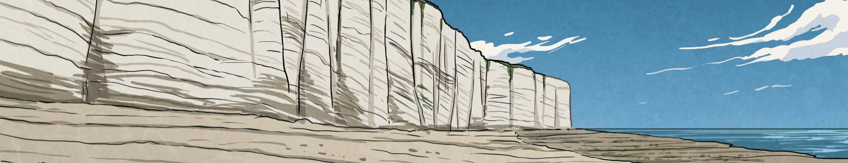
How Do Fossil Hunters Find Fossils?
Palaeontologists must consider a number of factors when searching for fossils:
Location Since fossils are most commonly found within sedimentary rock formations, suitable search sites with exposed rocks of the right age and type (rocks from the Triassic, Jurassic or Cretaceous periods) must be identified using geology maps.
Signs Assessing rocks once on site to identify signs of fossils prior to digging.

Slide 21
How Do Fossil Hunters Find Fossils?
Tools Identifying the most suitable tools to use: heavy machinery if fossils are likely to still be deeply buried, smaller tools to dig through shallow samples of rock and small brushes to remove rock dust away once fossils have been exposed.
Time Locating and retrieving fossils from the ground with minimal damage can take days, weeks or even months.
Transportation Fossils can be incredibly fragile and moving them to a new site, such as a laboratory, takes care and patience. Often, fossils go through a process called jacketing in order for palaeontologists to transport them.

Slide 22
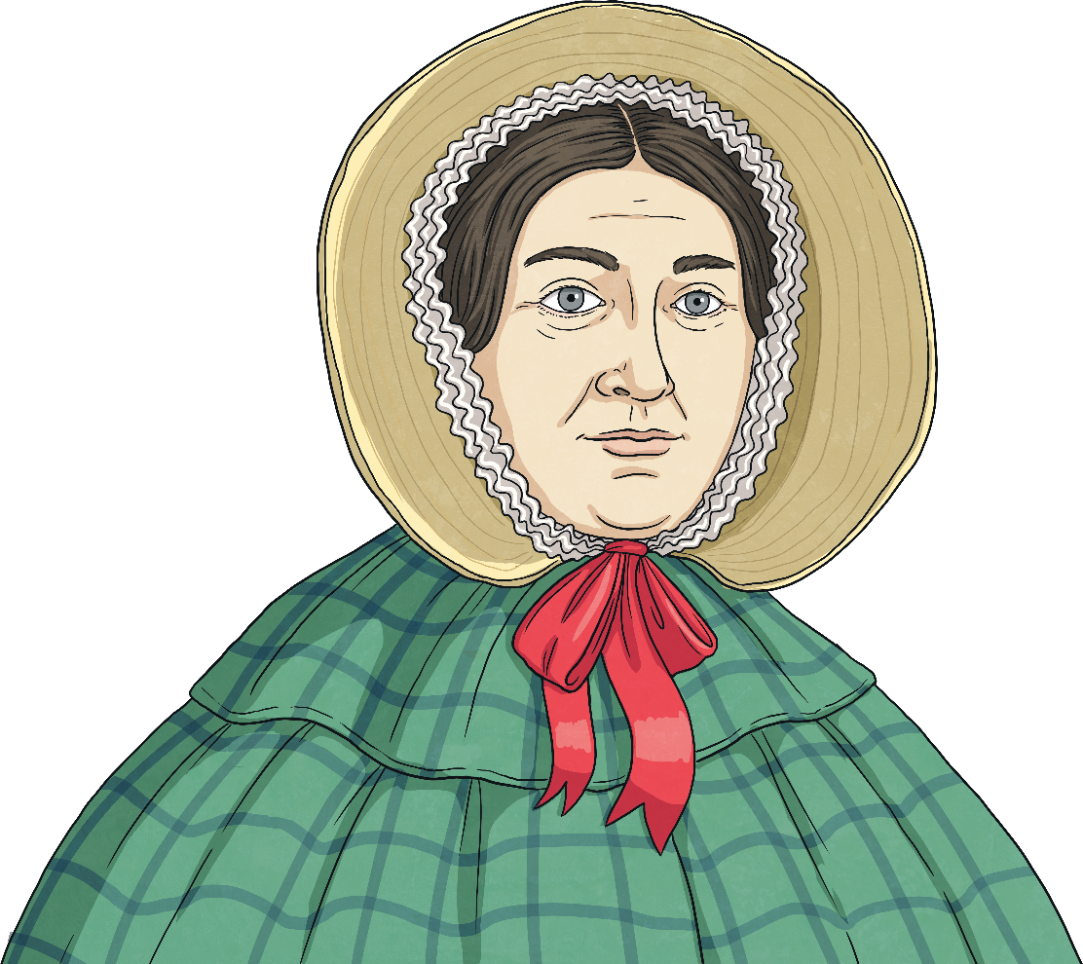
Famous Fossil Hunters
Well-known names in the field of palaeontology come from all over the world, including Americans Edwin H. Colbert and Stephen Jay Gould; Richard Owen, a British citizen, and Dong Zhiming from China.
However, one of the most famous names in the field of palaeontology, and one of the few females in the earliest studies of fossils, is Mary Anning.

Slide 23

Who Was Mary Anning?
Mary Anning is recognised as one of the most important palaeontologists of all time.
She was born in the town of Lyme Regis, on the Dorset coast, in 1799. Her family had little money so Mary and her brother spent much of their spare time scouring the coast for items they could sell.
Many of Mary’s findings she added to her collection of ‘curiosities’. Over time, once she had collected a number of curiosities and had developed a better understanding of her finds, she realised many were, in fact, fossils.
Mary would find ammonites and collect them as curiosities.

Slide 24
Who Was Mary Anning?
Mary continued her searches with her dog Tray at her side.
At the age of 12, Mary and her brother discovered the skull of an ancient reptile called an ichthyosaur, meaning ‘fish lizard’.
This discovery was huge in terms of palaeontology and Mary would go on to find more amazing fossils, including a marine reptile called a plesiosaur and a flying reptile known as a dimorphodon.

Slide 25
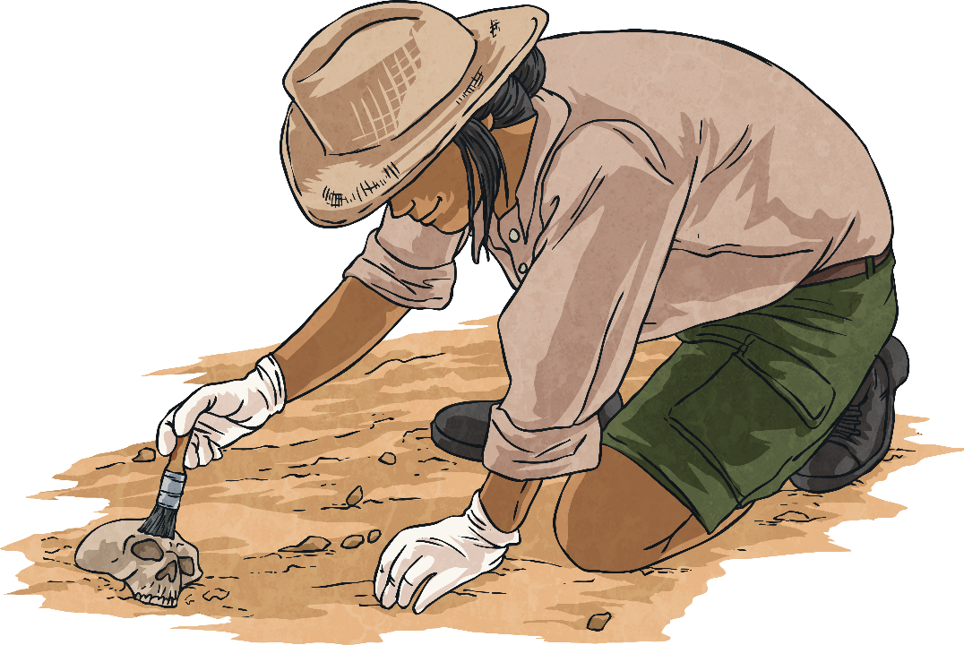
Quick Quiz
1
What type of rock is best for finding fossils?
igneous
a
sedimentary
b
metamorphic
c
d
hard
Try again!
Try again!
Try again!
Correct!

Slide 26
Quick Quiz
1
Which tool is best once fossils are exposed to remove dust?
heavy machinery digger
a
b
pickaxe
trowel
c
soft brush
d
Try again!
Try again!
Try again!
Correct!

Slide 27
Quick Quiz
1
In what year was Mary Anning born?
1979
a
b
1797
1799
c
1977
d
Try again!
Try again!
Try again!
Correct!

Slide 28
Quick Quiz
1
What age was Mary Anning when she found the ichthyosaur?
12
a
b
7
16
c
32
d
Try again!
Try again!
Try again!
Correct!

Slide 29
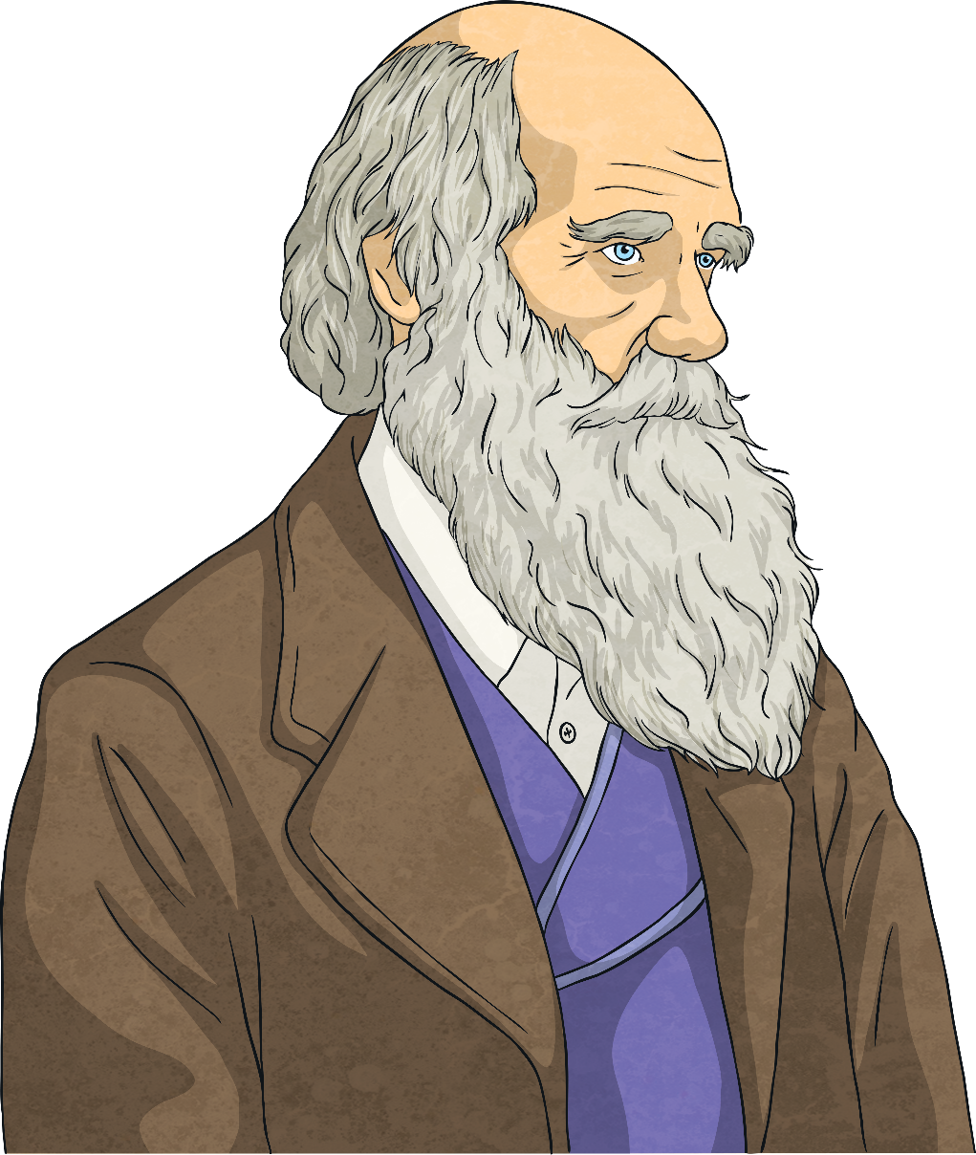
What Do Fossils Tell Us about Evolution?
Evolution describes the way living things change over time.
Charles Darwin, a British botanist, first presented his theory of natural selection, in which he explained that individuals in a species all varied slightly in their characteristics. He stated that these individuals tended to be in competition with each other and this meant that those better suited to their environment were likely to fare better than those less adapted.
This is natural selection.
Charles Darwin, who presented his theory of natural selection.

Slide 30
What Do Fossils Tell Us about Evolution?
Darwin stated that characteristics, such as strength, speed, intelligence and physical appeal, make species more likely to survive and reproduce, passing on those same traits to their offspring.
Over time, these characteristics become more common and the entire species gradually changes.
This is evolution.
Check out how this all happens here.

Slide 31
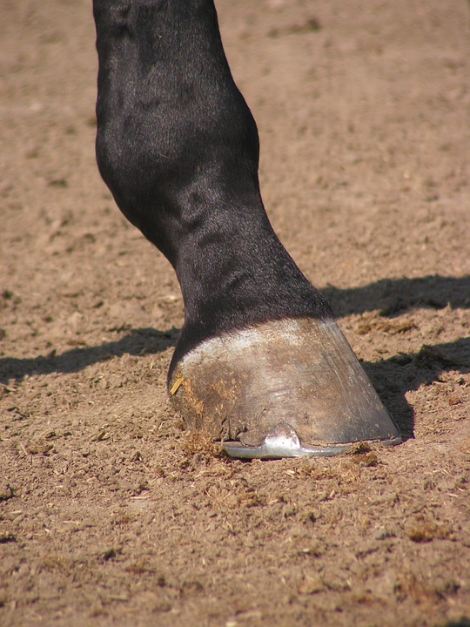
What Do Fossils Tell Us about Evolution?
Fossils have been an essential part of the puzzle when understanding evolution of different species.
Fossils that have been preserved showing parts of prehistoric animals can be used to show what species were like long ago. Palaeontologists can compare these to the same species over time to see the effects of evolution.
Current horses species have only one toe - a hoof.
Horses are a perfect example of this. The horse has a single toe on the end of each leg - the hoof - which makes it unique in the kingdom of animals. However, this has not always been the case.

Slide 32
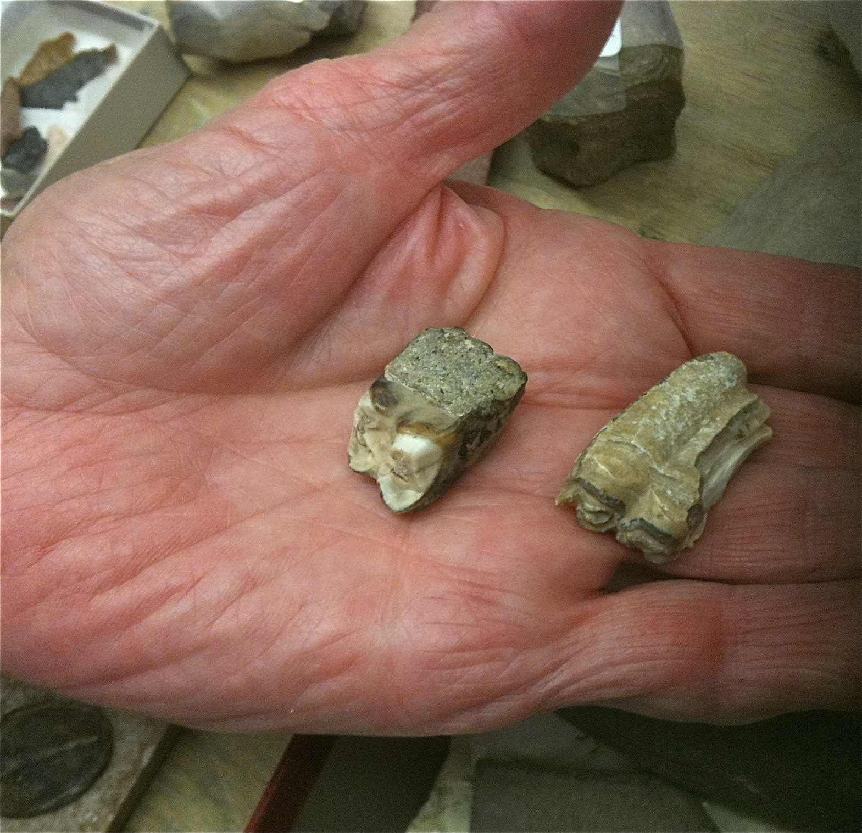
What Do Fossils Tell Us about Evolution?
Fossils of early horses’ hooves from over 33 million years ago reveal that horses started out with up to four toes (four on the fore feet and three on the hind feet) but this had changed 10 million years later to all feet having only three toes.
As the habitat of horses changed from the soft-floored forest to the firm ground of the open grassland, horses slowly evolved from having toes to having smaller toes to having only one hoof, which allowed them to run quickly over their new-found habitat.
Three-toed horse fossils show how horses’ feet have changed over millions of years.

Slide 33
What Have We Learnt?
Share at least three different facts you have learnt about the following topics:
how fossils are made
different types of fossils
what fossils can tell us
Mary Anning
evolution

Slide 34
Glossary
Click on a word to go back to the slide it is featured on.
ammonite - An extinct type of an animal called a mollusc.
botanist - A scientist who studies plants.
Cretaceous - The period of time ranging from 145 million to 66 million years ago.
crystallise - To form into crystals.
decomposed - To break down and decay.
dissolve - When a solid mixes fully with a liquid to form a solution.
evolved - Developed gradually.
extinct - Relating to a species being no longer living anywhere on Earth.

Slide 35
Glossary
Click on a word to go back to the slide it is featured on.
fossilised - Preserved as a fossil.
fossils - The remains of a prehistoric plant or animal preserved in rock.
indentations - Shaped grooves on the surface of something.
Jurassic - The period of time ranging from 201 million to 145 million years ago.
minerals - Natural, solid substances.
organisms - A plant, animal or other life form.
palaeontologist - An expert who studies fossils.

Slide 36
Glossary
Click on a word to go back to the slide it is featured on.
prehistoric - A time on Earth before anything was written.
sediment - Fine fragments of rock, sand, mud or volcanic ash that settles, usually at the bottom of a body of water.
sedimentary - Relating to sediment, e.g. rock composed of sediment.
soft tissue - The softer parts of a body, excluding bones.
species - A type of living thing sharing characteristics.
substance - Particular type of solid or liquid.
Triassic - The period of time ranging from 252 million to 201 million years ago.

