Slide 1
Animations
This resource has been designed with animations to make it as fun and engaging as possible. To view the content in the correct formatting, please view the PowerPoint in ‘slide show mode’. This takes you from desktop to presentation mode. If you view the slides out of ‘slide show mode’, you may find that some of the text and images overlap each other and/or are difficult to read.
To enter slide show mode, go to the slide show menu tab and select either from beginning or from current slide.
Links to External Video Websites
This resource contains links to external video websites. These websites often have autoplay features meaning that other videos will play after the video you are watching finishes. You should disable this feature before using the video in any classroom or similar setting. Twinkl assumes no responsibility for the contents of linked websites. The inclusion of any link in this resource should not be taken as an endorsement of any kind by Twinkl of the linked website or any association with its operators. We have no control over the availability of the linked pages. If the link is not working, please let us know by contacting TwinklCares and we will try to fix it, although we can assume no responsibility if this is the case.
You may wish to delete this slide before beginning the presentation.

Slide 3
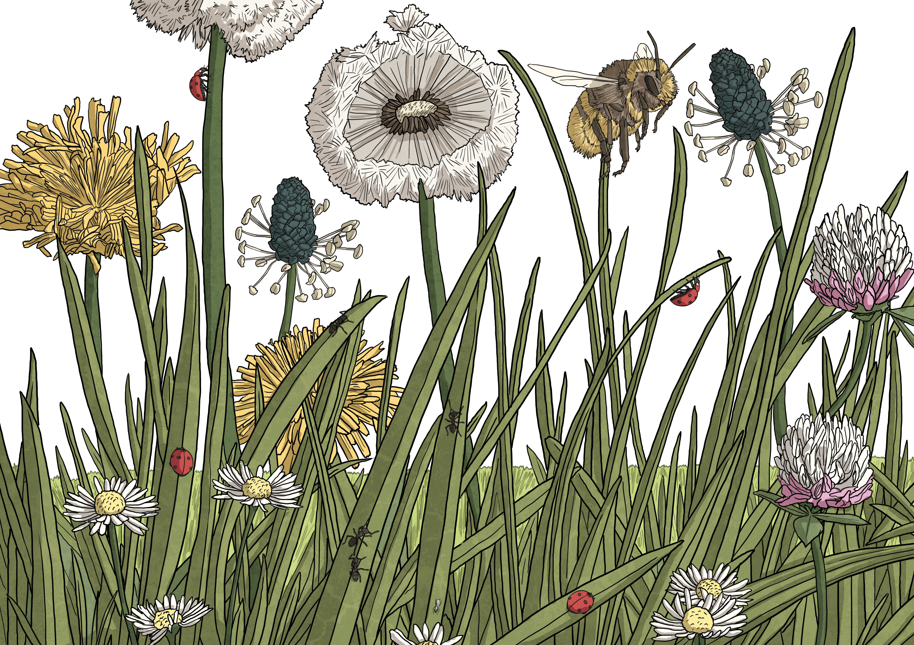
Watch the Bitesize: The Regenerators - The Green Planet Live Lesson with your class.

Slide 4
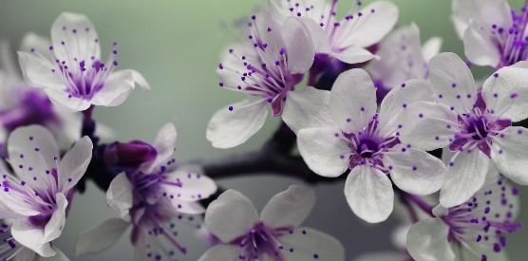
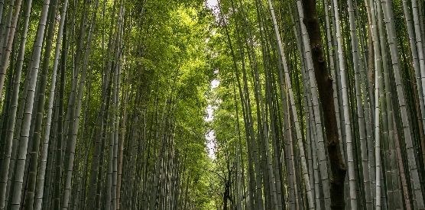
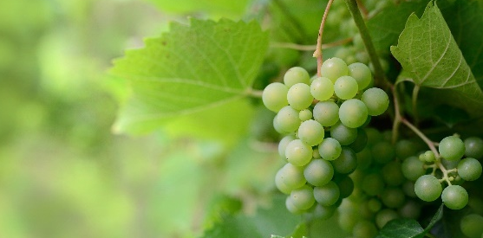
The World of Plants
The natural world offers a diverse variety of plants and scientists estimate that over 390,000 species exist across the Earth with many more still waiting to be discovered.
That’s a lot of plants!
Many produce flowers, some grow incredibly tall and a large number provide essential food for people and other animals all over the world. When we explore our green planet more closely, we can find out just how amazing plants can be.

Slide 5
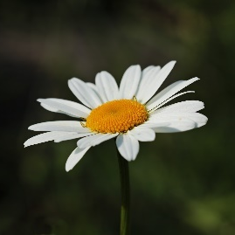
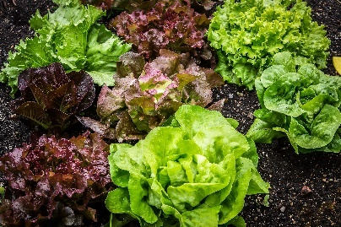
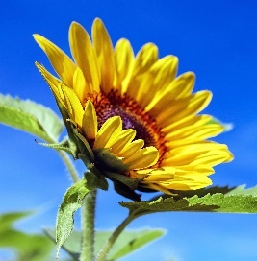
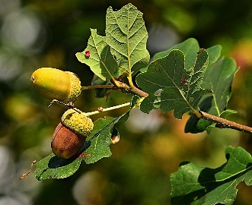
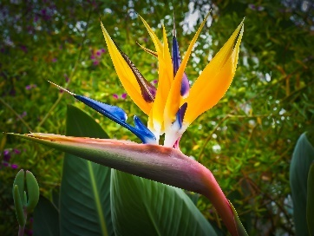
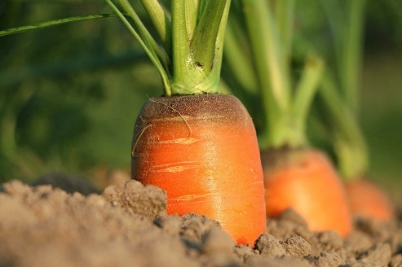
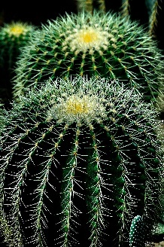
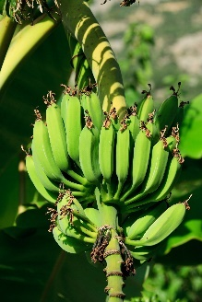
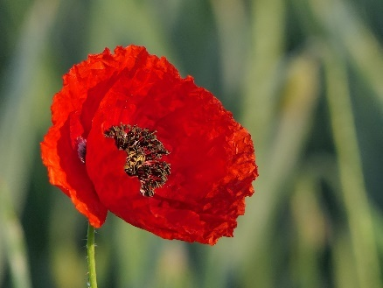
The World of Plants
Can you name any of these plants?

Slide 6
The World of Plants
daisy
lettuce
sunflower
oak
bird of Paradise
carrot
cactus
banana
poppy
grass

Slide 7
Parts of a Plant
As you saw in the BBC Live Lesson, each part of a plant has a scientific name. However, the labels on this plant have been mixed up.
Can you make this diagram correct?
stem
Click the ‘next’ button to see the labels in their correct places.
roots
flower
leaf
next

Slide 8
Parts of a Plant
flower
Some plants produce flowers. These are usually brightly coloured and contain nectar to attract pollinators (animals that carry pollen between flowers) for pollination to happen; this is the process necessary for a plant to reproduce, which results in it forming seeds. These seeds are then dispersed in different ways to grow new plants of the same species.
leaf
The leaves are attached to the stem in such a way that the plant’s system for transporting nutrients and water extends to them. Leaves make use of this water, along with light absorbed from the Sun and carbon dioxide taken in from the air around the plant to make food for the plant. This process is called photosynthesis.

Slide 9
Parts of a Plant
stem
The stem allows water and nutrients to travel between the roots and other parts of the plant while also supporting the leaves and helping the plant to stand upright. Some stems store water and nutrients that have been taken in by the roots.
roots
All plants have roots, which are usually below the surface of the soil and have the primary aim of taking up water and nutrients from the soil. Additionally, roots help to anchor the plant, keeping it stable and upright.

Slide 10
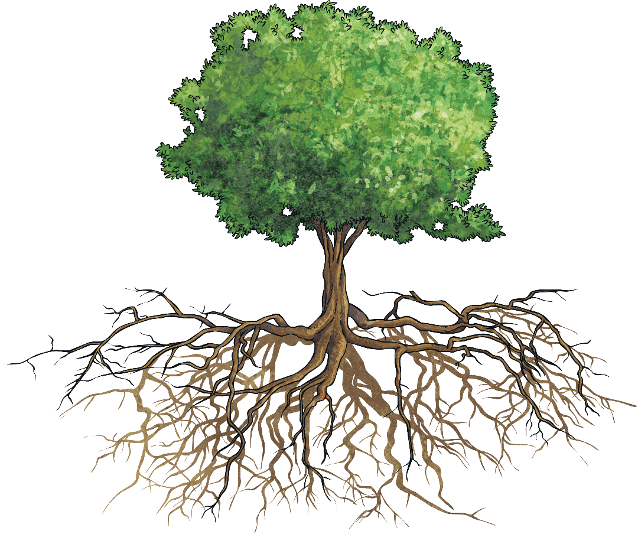
Trees Are Also Plants
Trees are also plants although some of their features can look quite different to those of other plants.
Where would you place the following labels?
roots
trunk
branches
bark
leaves

Slide 11
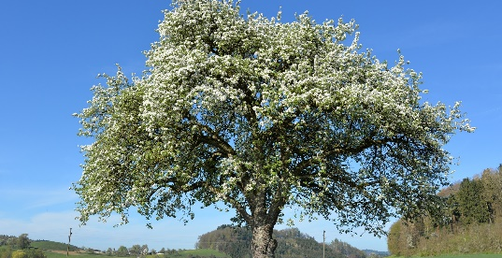
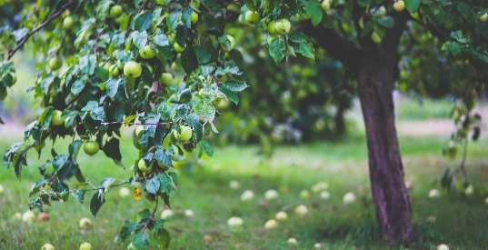
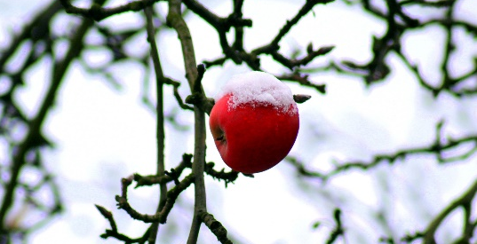
Variation In Plants
Even though many plants share similar characteristics, their appearance can vary hugely. Lots of plants exhibit different colours, shapes and sizes at different times of the year and in different parts of the world.
Some of the tallest plants in the world include the Redwood trees native to North America while certain species of duckweed are among the smallest plants on Earth.
Many trees can change season by season like this apple tree: it blossoms in spring and early summer, produces fruit in late summer and autumn and presents its branches bare in winter.

Slide 12
What Do Plants Need?
The BBC Live Lesson programme explained that, despite their differences, most plants need the same things in order to survive and thrive.
Can you name the five key things that most plants need to grow?
LAWNS
Light - most plants absorb sunlight in order to make their own food.
Air - plants absorb carbon dioxide from the air and use this in photosynthesis.
Water - roots absorb water from the soil, which generally comes from rainwater or when humans water plants.
Nutrients - these also come from the soil and are essential for the plant to function and grow. They are mostly elements that come from the soil, including carbon, nitrogen, oxygen, phosphorus and potassium.
Space - plants need room to grow (often up and also out)!

Slide 13
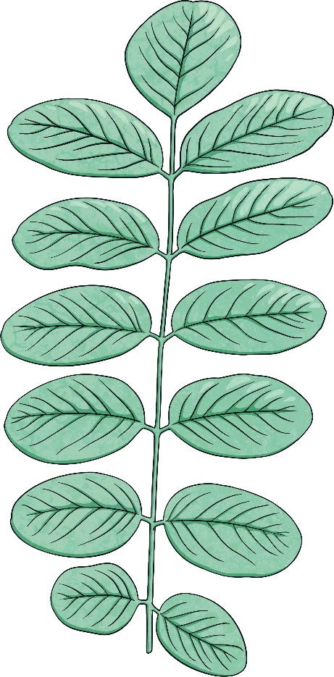
Adaptation of Plants
The amount of each requirement can vary from one plant to another. Some plants, in some areas of the world, don’t always have access to all of these things.
Over many millions of years, plants like these have changed, or adapted, to be able to survive in their habitats. This is called adaptation.
Plants exist, survive and grow all over the Earth, including in some of its most challenging environments:
extreme heat of deserts
extreme cold of the Arctic tundra and Antarctic continent
high levels of moisture and humidity found in tropical rainforests
Plants that have adapted to one environment may not be able to survive in another.
Can you think of a plant that is well adapted to its environment?

Slide 14
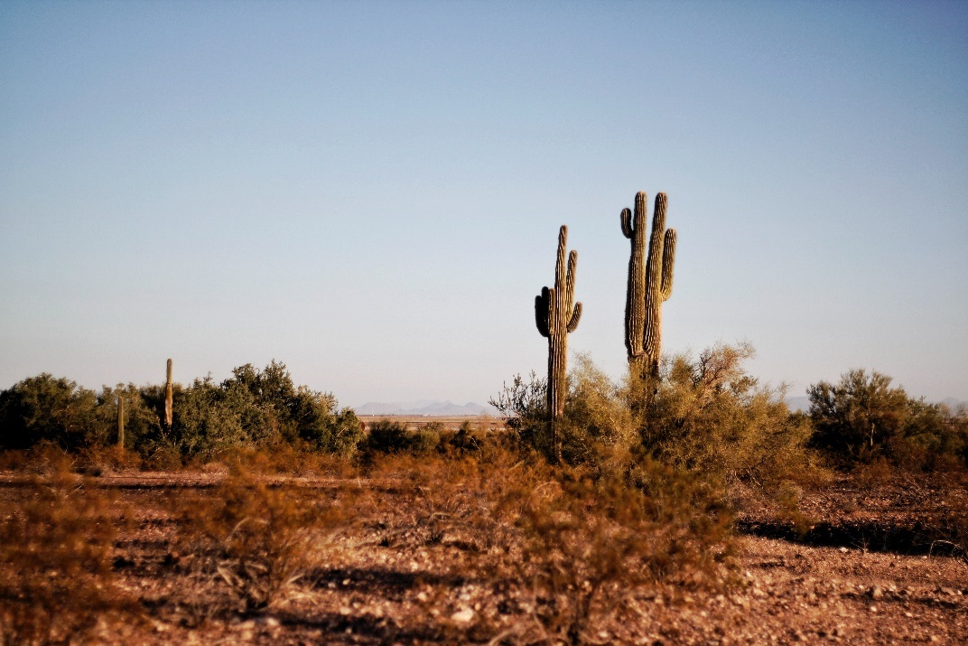
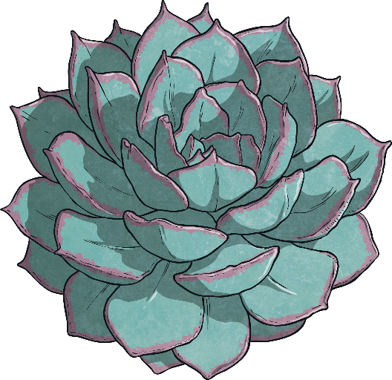
Adaptation of Plants
Many cacti have adapted to suit the extreme heat and lack of water in their desert habitat.
They can have very deep or widespread roots, which collect water from deep underground. Their stems can often store water and their spines are actually a type of leaf that are so thin that they lose less water than the larger, broader leaves of many plants.

Slide 15
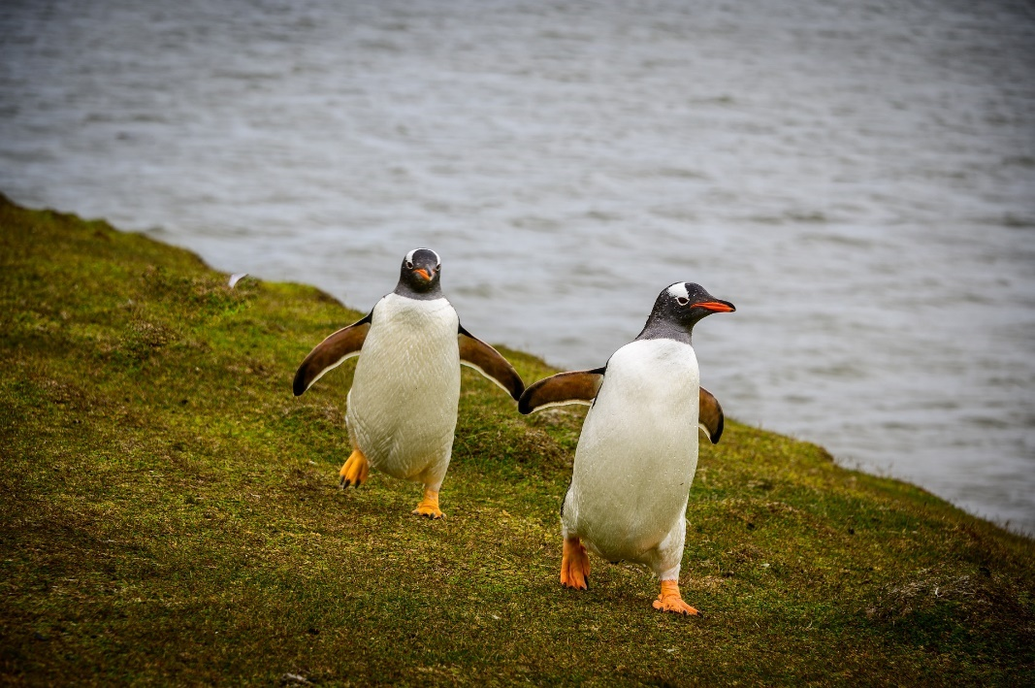
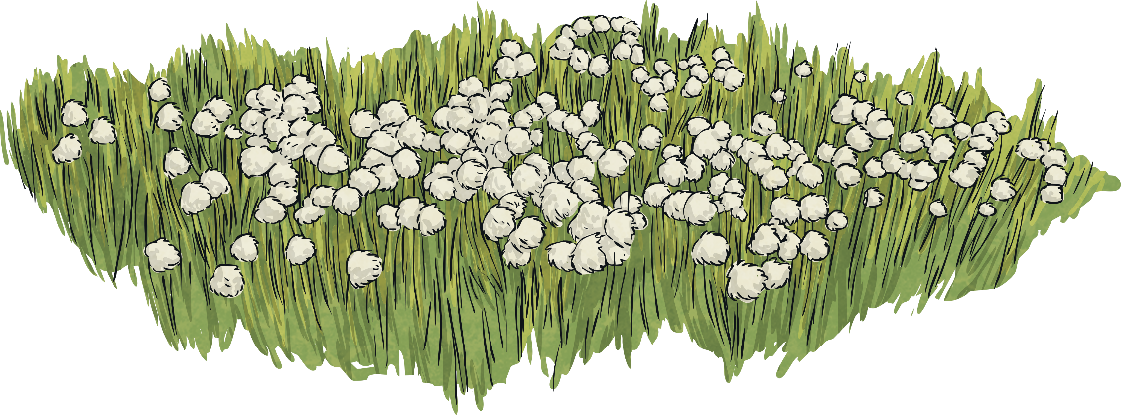
Adaptation of Plants
Antarctic hair grass and Antarctic pearlwort are the only species of plants that grow flowers on the continent of Antarctica.
Other plants have adapted to survive in the extreme cold of this environment by staying small and close to the ground. Some plants can perform photosynthesis when the temperature around them is extremely cold.

Slide 16
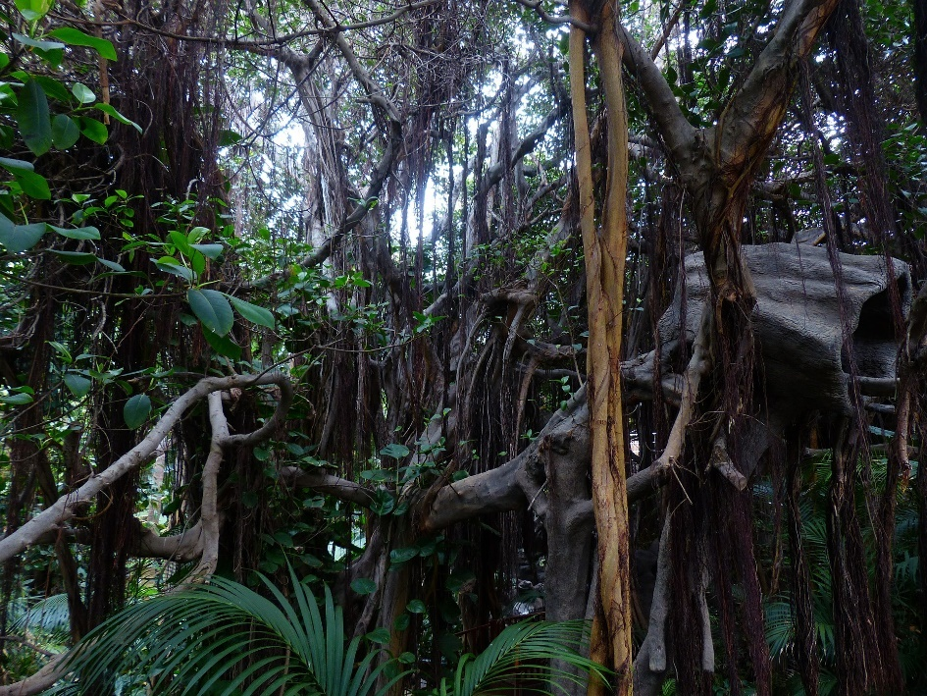
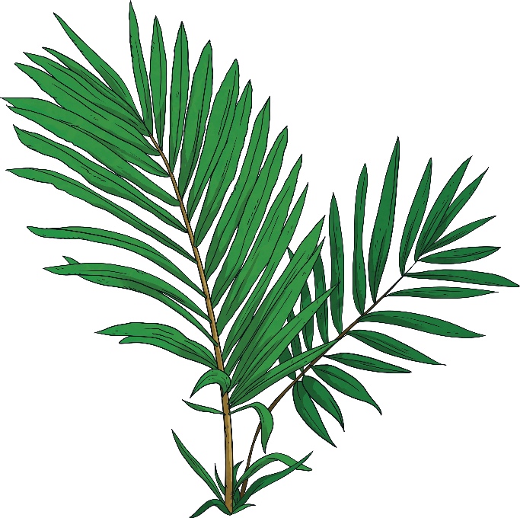
Adaptation of Plants
Many rainforest plants struggle to absorb sunlight because of the wide canopy of trees that block this light out from the forest floor below.
Some rainforest plants have adapted to overcome this: lianas have their roots in the ground but stems that make their way up along tree trunks to reach the lofty heights of the canopy, where their leaves and flowers grow above the treetops.

Slide 17
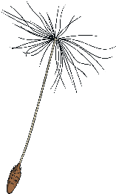
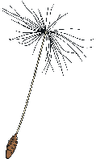
Pollination of Plants
As well as some plants adapting to thrive in their environment, many have developed features that attract pollinators to allow them to reproduce (produce seeds that will grow more of the same species of plant).
The brightly coloured and sweetly scented flowers of many plants attract a range of pollinators.
As pollinators land and suck up the sweet nectar, pollen becomes attached to their bodies. Moving from flower to flower, they carry and distribute the pollen as they go. Once the pollen has rubbed off onto egg cells in other flowers, the eggs become fertilised and can make seeds.
Seeds are then dispersed in lots of ways and settle in soil to grow into new plants.

Slide 18
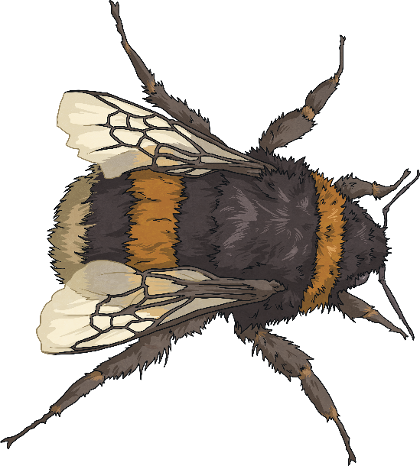
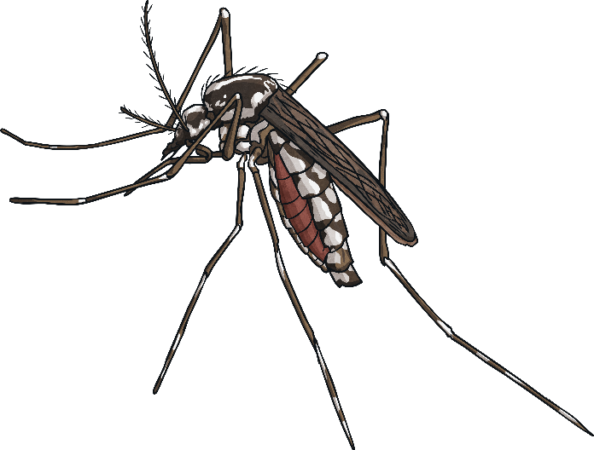
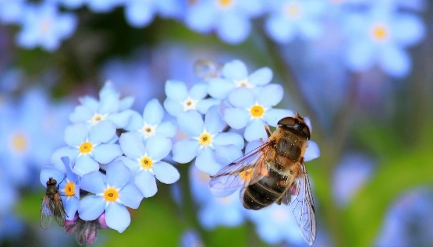
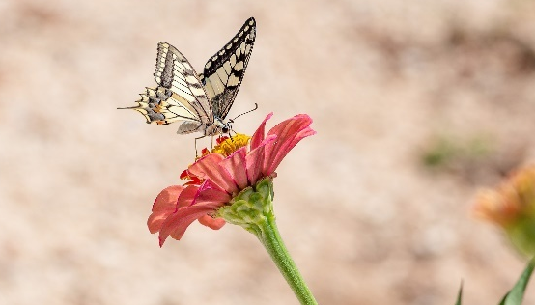
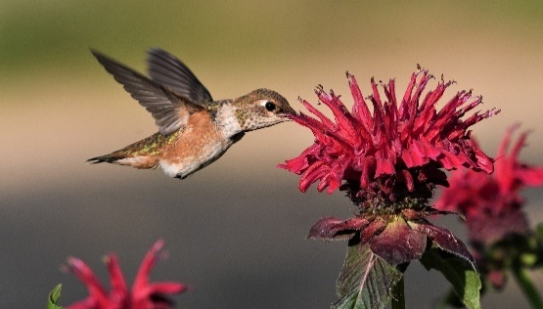
Pollination of Plants
Pollinators include the kind of insects often seen in gardens landing on flowers, such as bees, butterflies and beetles as well as lots of less commonly considered insects, including mosquitoes and flies. In some areas of the planet, even bats, birds and other animals pollinate flowers.

Slide 19
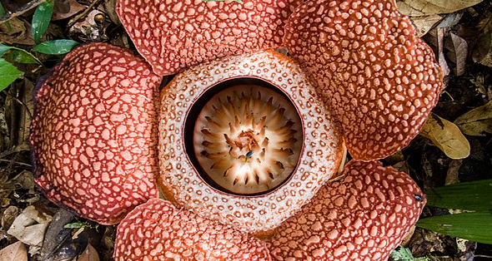
Pollination of Plants
We learnt in the BBC Live Lesson that some plants even mimic the pollinators they need to attract in order to achieve pollination.
This bee orchid looks a little like a bee. This helps to attract bees to it.
This rafflesia smells of rotting meat to attract pollinators that like to feed on flesh and poo.
“Rafflesia keithii (13890819315).jpg” by Mike Prince is licensed under CC BY 2.0

Slide 20
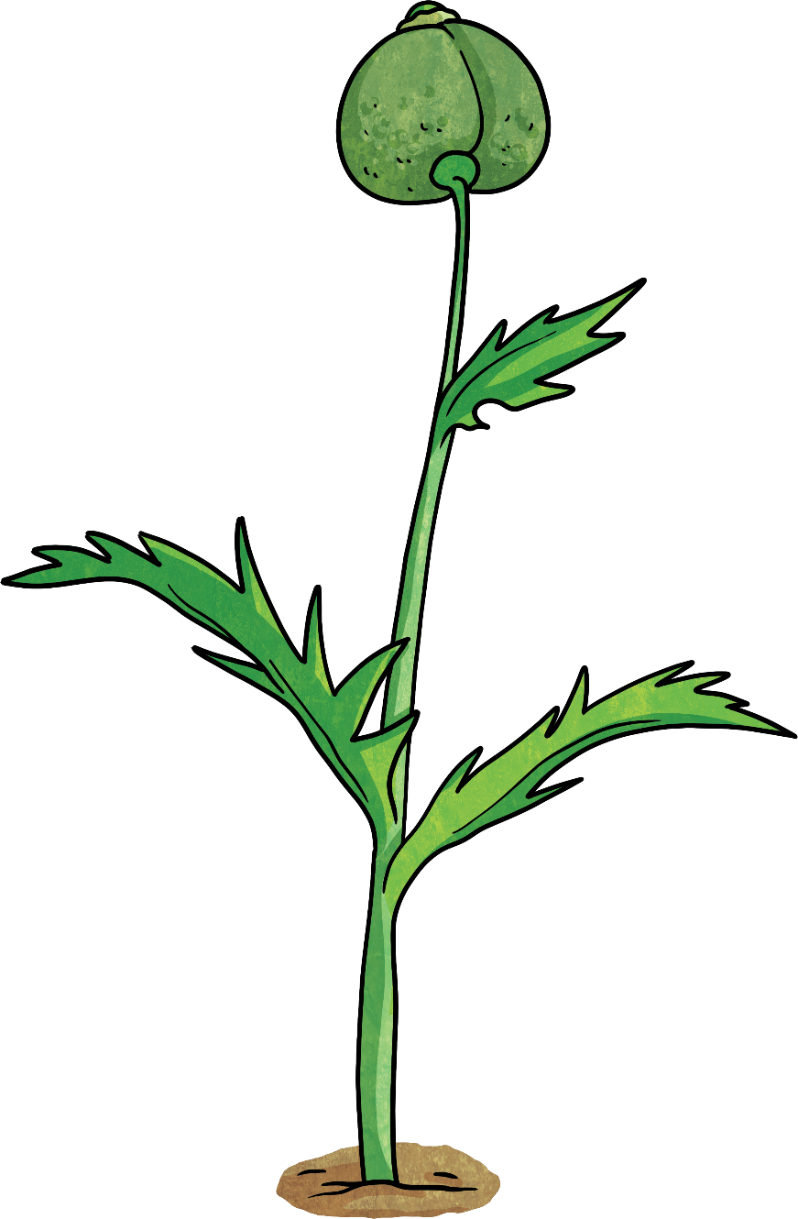
Quick Quiz
What is one purpose of the stem of a plant?
a)
to absorb water from the soil
b)
to attract pollinators to the plant
c)
to transport water between the roots and other parts of the plant
d)
to make food for the plant

Slide 21
Quick Quiz
Which two of these things do plants need to grow?
a)
worms
b)
nutrients
c)
darkness
d)
water

Slide 22
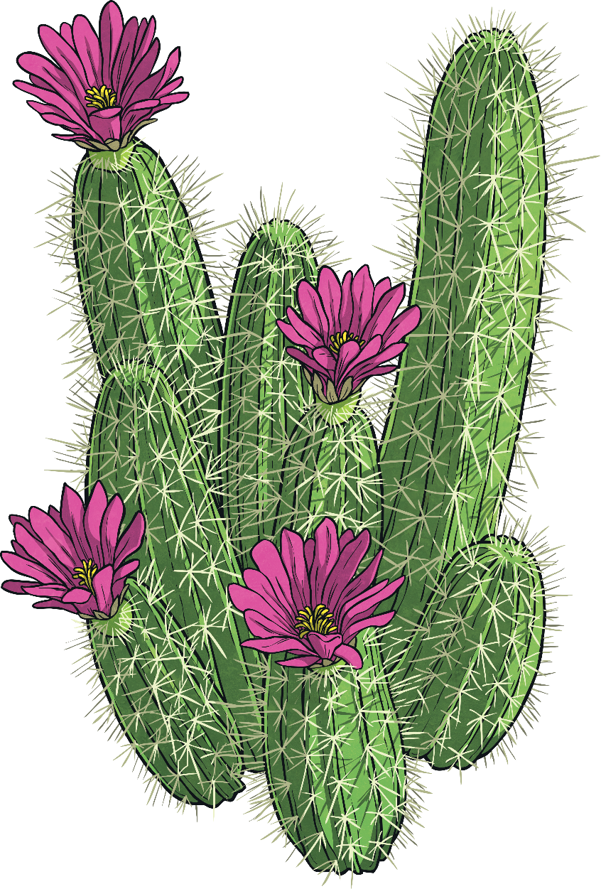
Quick Quiz
Choose one adapted feature of cacti that allow them to thrive in their desert habitat.
a)
deep roots
b)
large, broad leaves
c)
tall, thin stems
d)
bright, coloured flowers

Slide 23
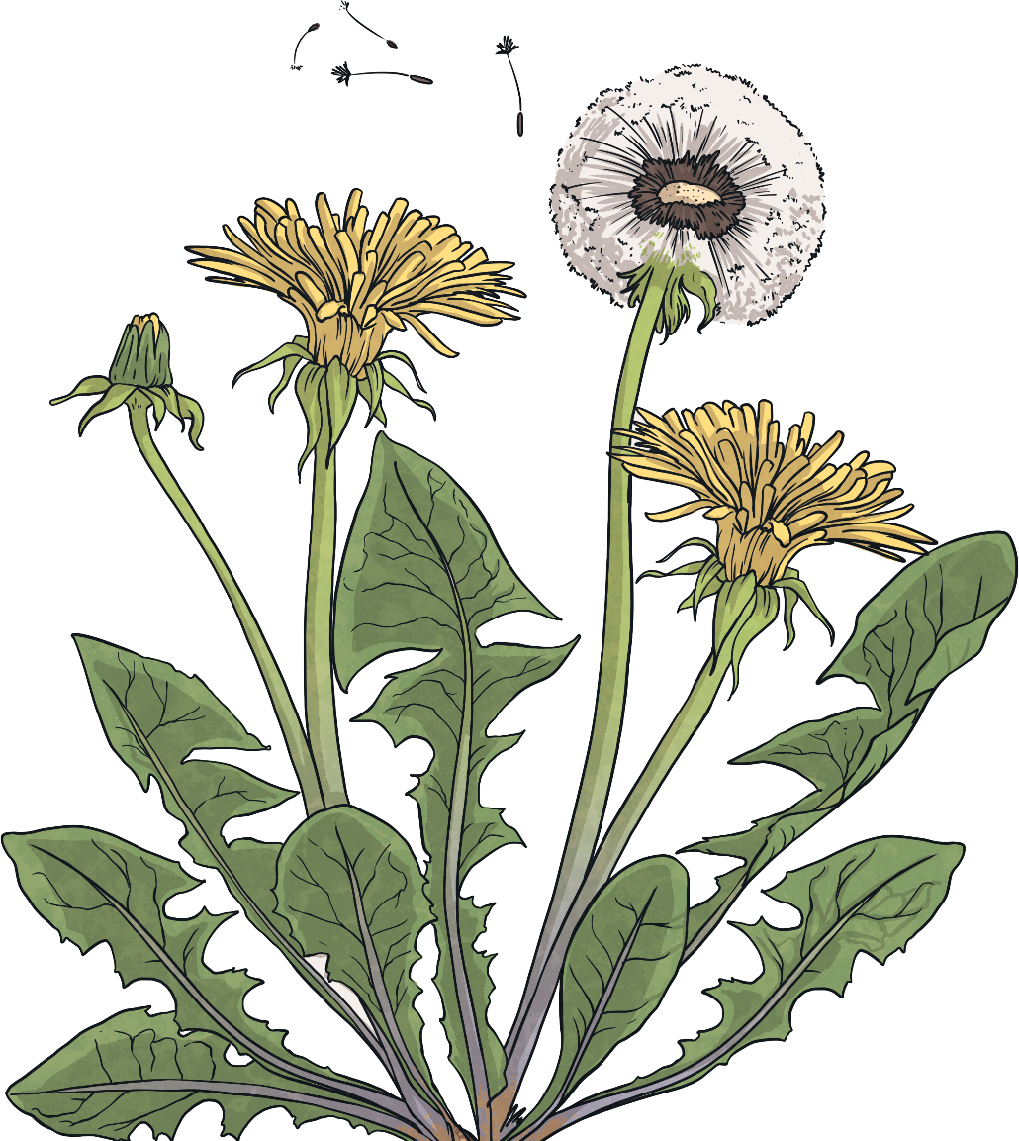
Quick Quiz
Which of these might be pollinators?
a)
butterflies
b)
flies
c)
mosquitoes
d)
all of them

