Slide 1
Animations
This resource has been designed with animations to make it as fun and engaging as possible. To view the content in the correct formatting, please view the PowerPoint in ‘slide show mode’. This takes you from desktop to presentation mode. If you view the slides out of ‘slide show mode’, you may find that some of the text and images overlap each other and/or are difficult to read.
To enter slide show mode, go to the slide show menu tab and select either from beginning or from current slide.
Links to External Video Websites
This resource contains links to external video websites. These websites often have autoplay features meaning that other videos will play after the video you are watching finishes. You should disable this feature before using the video in any classroom or similar setting. Twinkl assumes no responsibility for the contents of linked websites. The inclusion of any link in this resource should not be taken as an endorsement of any kind by Twinkl of the linked website or any association with its operators. We have no control over the availability of the linked pages. If the link is not working, please let us know by contacting TwinklCares and we will try to fix it, although we can assume no responsibility if this is the case.
You may wish to delete this slide before beginning the presentation.

Slide 3
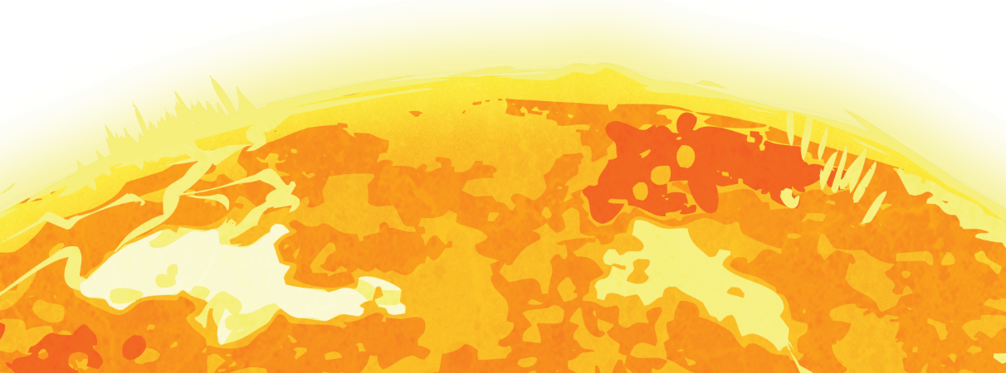
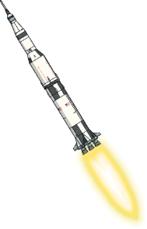
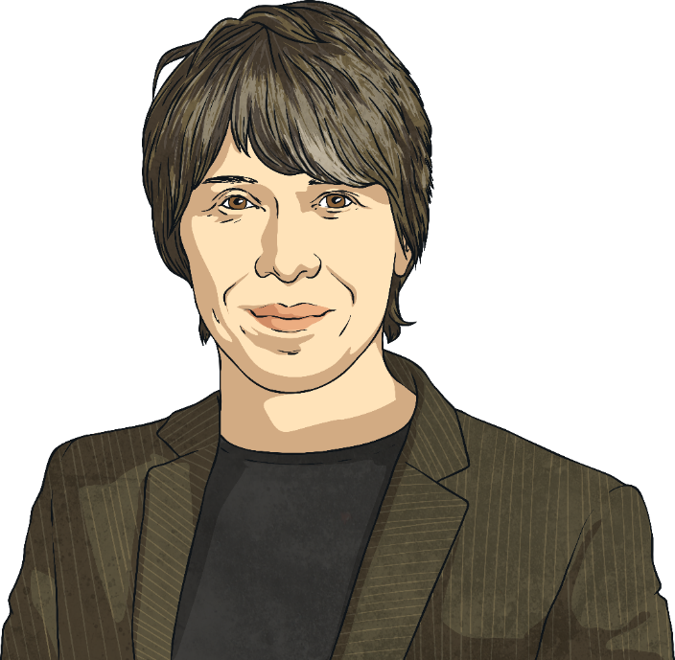
BBC World Space Week Live Lesson
Watch the BBC World Space Week Live Lesson with your class.

Slide 4
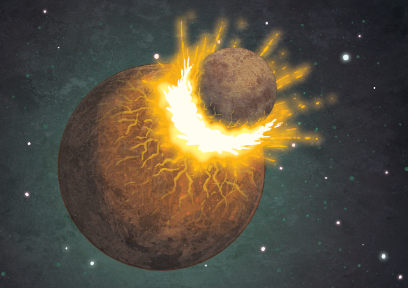
Introducing the Solar System
The Solar System consists of the Sun at its centre and everything else that revolves around it, including the eight planets, their moons, comets, asteroids, rocks and ice, as well as five dwarf planets.
The Earth is the third planet from the Sun and is the only planet to have its own single moon.
Many scientists believe that at some time in the past, over four billion years ago, a large chunk of rock around half the size of the Earth (possibly even another planet) collided with it.
The resulting rocky debris clumped together to form the Moon.

Slide 5
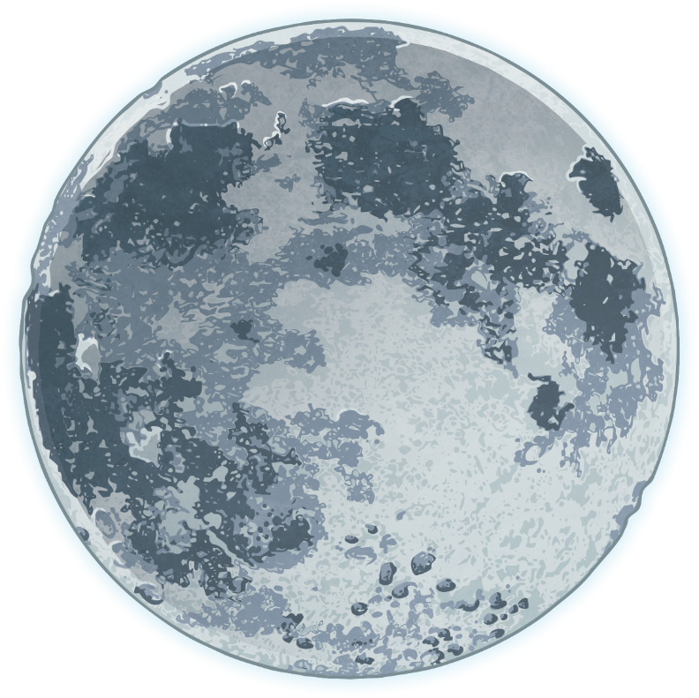
The Moon
The Moon is the brightest object you will see in the night sky.
It is the fifth largest moon in the Solar System; however, it is unique because it is much larger in relation to the planet it orbits than any of the other planets’ moons.
Top Lunar Facts
The word lunar derives from the Latin word for moon, ‘luna’ and means anything resembling or affected by the Moon.
The radius of the Moon is about 1740km, which is 27% of the radius of the Earth.
The Moon and the Earth are about 384 400km apart.

Slide 6
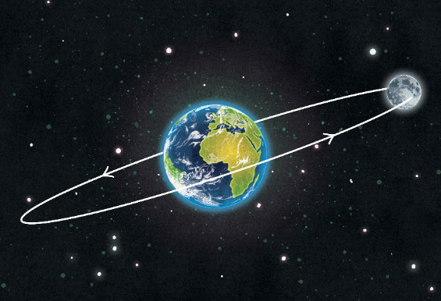
Orbits and Rotations
Just as the Earth orbits the Sun, the Moon orbits the Earth. One complete orbit takes around 27 Earth days. The Moon also rotates on its axis, just like the Earth, and this rotation occurs at the same rate as its orbit.
This means, here on Earth, we only ever see the same side of the Moon, the nearside.
Did you know… ?
Humans first set foot on the Moon on 20th July 1969 when the American crew from the Apollo 11 spaceflight successfully reached and made contact with the Moon. It was the nearside that they landed on.

Slide 7
Does the Moon Shine?
Although the Moon is the brightest object in the night sky, it doesn’t actually make its own light. The Moon appears to shine because it reflects light from the Sun.
The side of the Moon facing the Sun always appears bright because of the Sun’s rays shining on it. There will always be half of the Moon illuminated by the Sun and the other half will always be in the dark because no light can reach it.
Sun’s rays

Slide 8
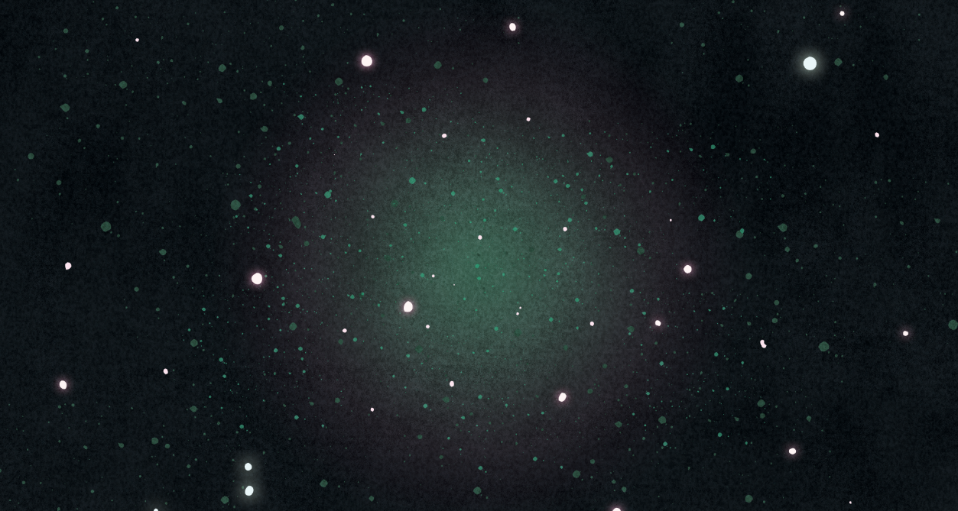
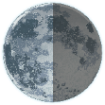
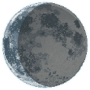
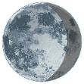
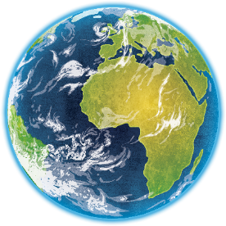
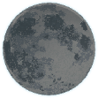
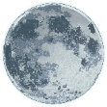
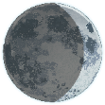
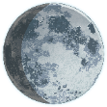
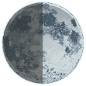
Phases of the Moon
Third Quarter
Waning Crescent
Waning Gibbous
New Moon
Full Moon
As the Moon orbits the Earth over 28 days and the Earth moves through space, the view from Earth of the half-lit side of the Moon changes so it appears to look different. These are called the phases of the Moon and each phase has its own name.
Waning Crescent
Waxing Gibbous
First Quarter

Slide 9
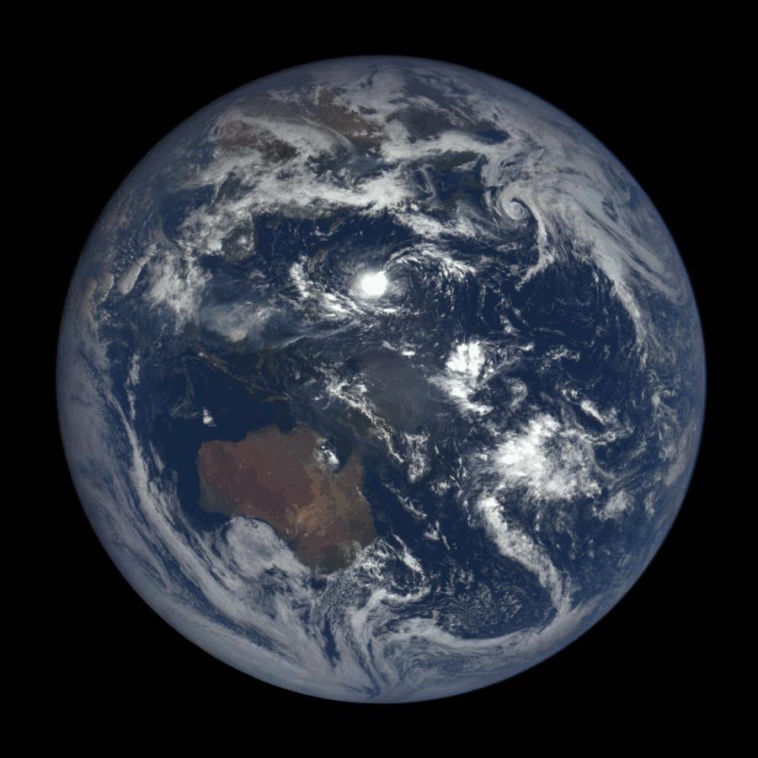
Effects of the Moon on the Earth
As both the Earth and the Moon rotate in space, the Moon has an effect on the Earth in different ways.
For a long time, some people believed that the Moon affected human behaviour; in fact, the word ‘lunatic’ comes from the Latin for ‘moonstruck’. However, this theory has never been scientifically proven!
Though much weaker than the gravity on Earth, the Moon’s gravity is strong enough to pull water on the nearest side of the Earth towards it, causing high and low tides.
The Earth spins at an angle on its axis. Without the Moon’s gravity, the Earth could wobble on its axis. The Moon acts to stabilise the Earth, which protects our climates and seasons.

Slide 10
Missions to the Moon
Scientists have been studying the Moon for many years and we already know a lot, but there is still so much more to be discovered.
There have only ever been 12 humans to set foot on the Moon and the rock samples they collected and brought back to Earth are still being studied by scientists now to help them understand more about the structure of the Moon and its conditions.
These are also useful in planning future missions to the Moon, which might allow people from diverse backgrounds to experience it first hand.
The first and most well-known mission that landed on the Moon in 1969 involved three American astronauts: Neil Armstrong, Buzz Aldrin and Michael Collins.

Slide 11
Planets in the Solar System
Remember that the Earth is one of eight planets in the Solar System.
How many other planets can you name in just 30 seconds?
Can you also guess, or remember, how many of these other planets have a moon?
You can complete this task on your activity sheet.
Start
3,
2,
1,
blast off!

Slide 12
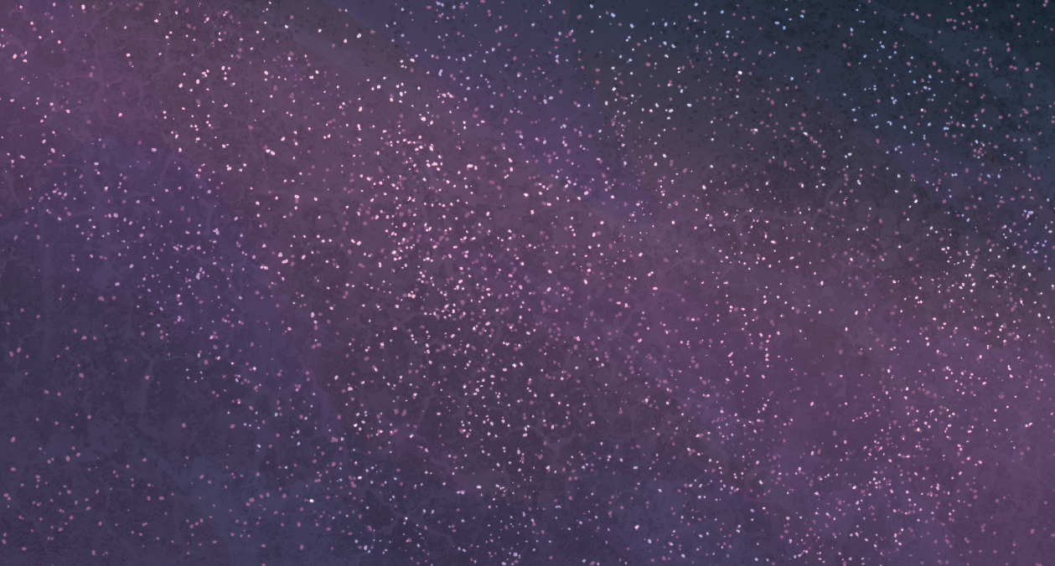
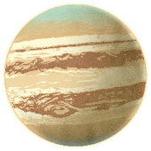
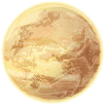
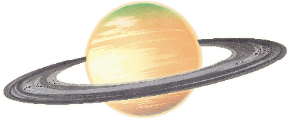
Planets in the Solar System
Sun
Jupiter
Earth
Mars
Uranus
Mercury
Neptune
Venus
Saturn

Slide 13
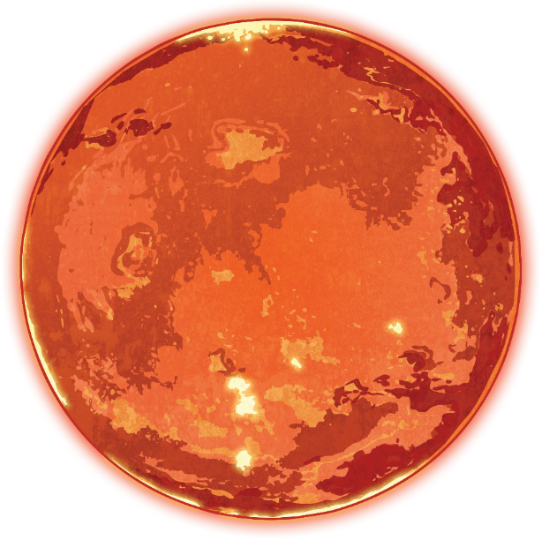
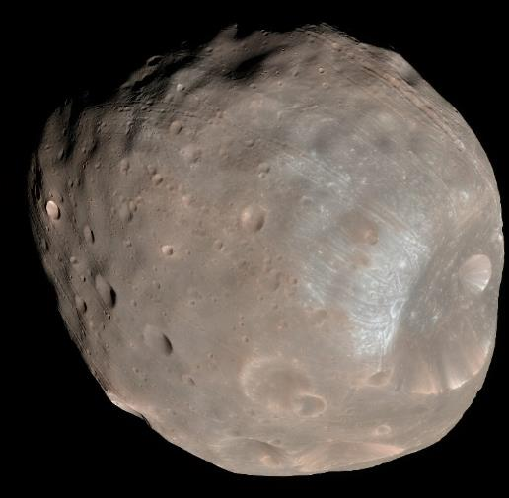
More Moons in the Solar System
As for moons, we know that Earth has one moon. What about the other planets?
Mars has two moons: Phobos and Deimos
Phobos: the larger of Mars’ two moons.

Slide 14
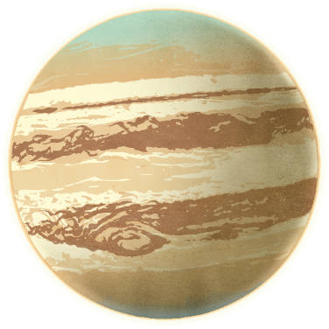
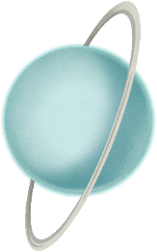
More Moons in the Solar System
Jupiter and Saturn each have over 50 named moons, though there are more awaiting official confirmation.
Jupiter
Uranus
Neptune
Saturn
Uranus has 27 moons, while Neptune has 14.

Slide 15
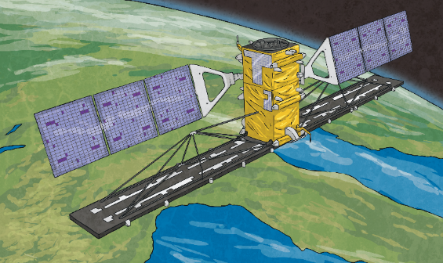
Satellites
Did You Know… ?
Moons might also be called satellites since a satellite is any object, such as a planet, moon or machine that orbits a planet or star. The Moon is the Earth’s only natural satellite; however, the Earth has humanly constructed satellites that help us in our daily lives by studying large parts of the Earth quickly.
Some satellites collect information from the Earth and send it back to a different locality on Earth very quickly, making TV signals and phone communications much faster. Others photograph the planet to help predict weather patterns, including extreme weather.

Slide 16
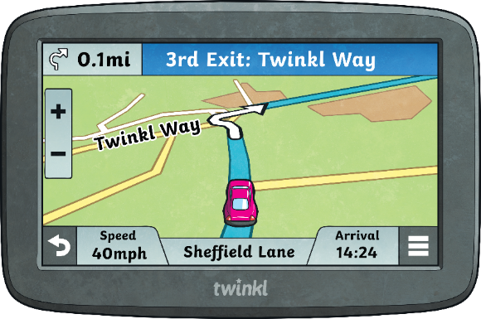
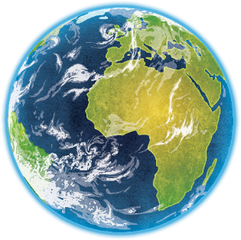
Satellites
A group of satellites work together to form the Global Positioning System (GPS), which can help to track routes and traffic on electronic devices.

Slide 17
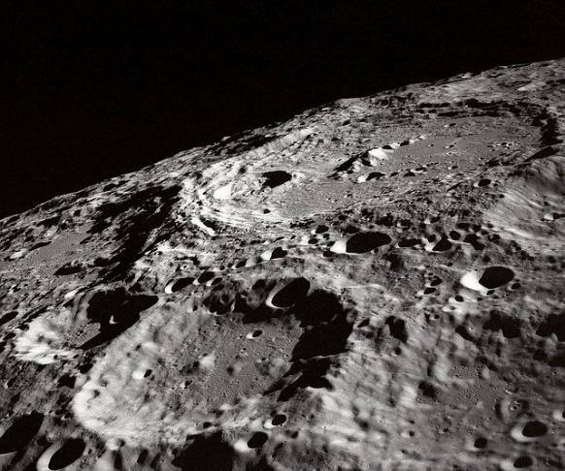
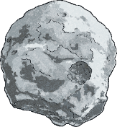
What Is It like on the Moon?
Remember that scientists’ most recent theory is that the Moon was made from the rocky debris of a collision? No surprise then that the Moon has a rocky surface covered in fine, grey dust.
What might come as a surprise are the huge number of craters on the surface of the Moon. These craters have been created when large space rocks such as asteroids and comets that orbit the Sun collide with the surface of the Moon and leave imprints.

Slide 18
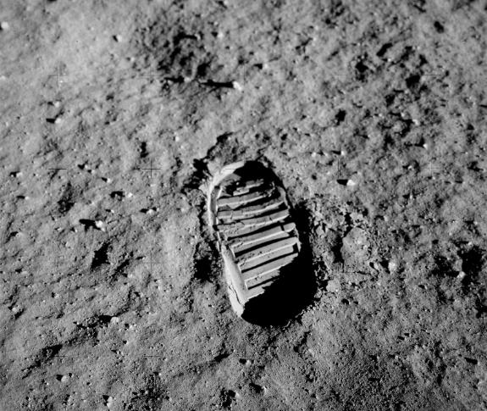
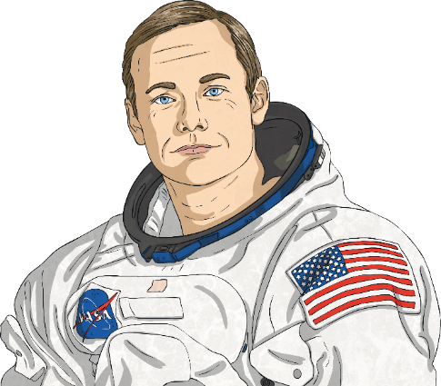
What Is It like on the Moon?
Unlike the Earth, the Moon has a very thin atmosphere, called an exosphere, with no air or weather to slow such missiles down so, if something bumps into it at speed, it leaves a mark on the surface.
A footprint left on the Moon by one of the first space explorers to have set foot there over 50 years ago!

Slide 19
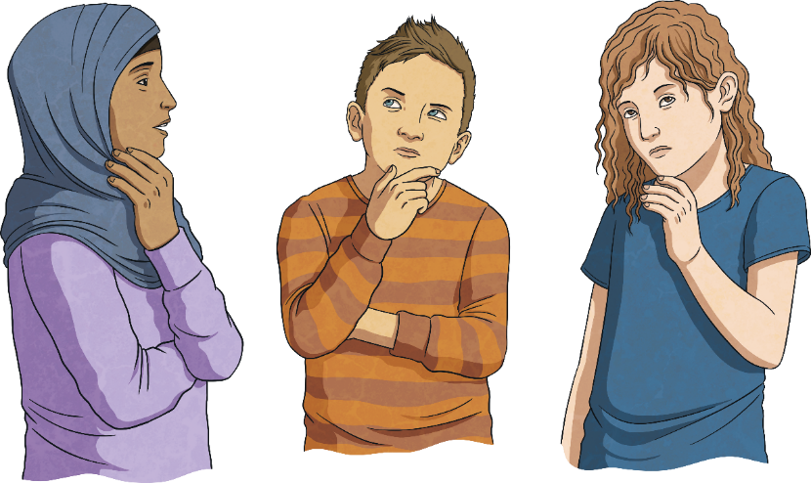
Quick Quiz
What is the Moon made of?
1
Rock
metal
rock
gas
cheese

Slide 20
Quick Quiz
How does the Moon affect the Earth?
2
It causes night and day.
It controls the ocean tides and helps to keep the Earth stable on its axis.
It controls the ocean tides and helps to keep the Earth stable on its axis.
It makes the Earth spin.
It turns the Earth into cheese.

Slide 21
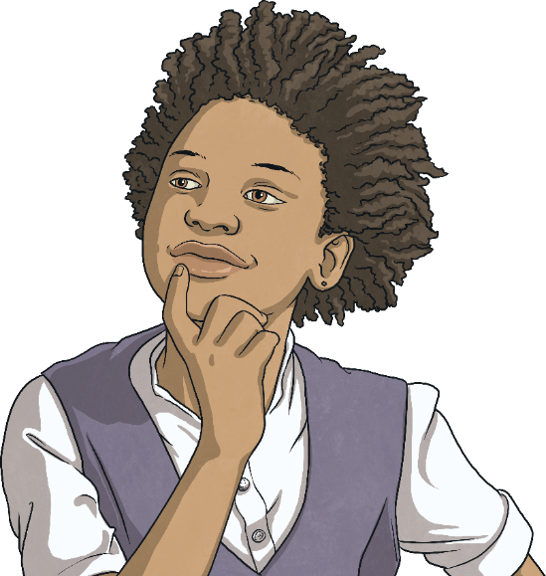
Quick Quiz
Why does the Moon shine so brightly?
3
It makes its own light.
It doesn’t shine - it is always completely dark.
Someone forgot to switch the lights off.
It reflects the sun’s light.
It reflects the Sun’s light.

Slide 22
Quick Quiz
Why does the Moon change shape and size?
4
It doesn’t! From Earth we only see the part that is lit up so our view changes as the Moon orbits the Earth but the shape and size of the Moon remains the same.
It doesn’t! From Earth, we only see the part that is lit up so our view changes as the Moon orbits the Earth but the shape and size of the Moon remains the same.
Sometimes it is further away from the Earth.
It gets smaller when it is night time.
Someone ate some of the cheese.

Slide 23
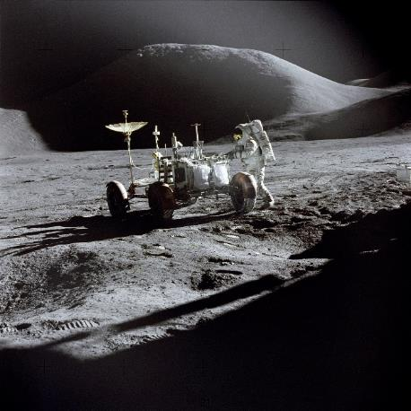
Further Exploration
The Moon continues to be of interest to space agencies across the world and many are still doing important work to take Moon exploration further, including plans for the first woman and first person of Black or Minority Ethnic background to set foot on the Moon.
There are still many opportunities for scientific discoveries to be made on the Moon, using special vehicles to collect samples of rock and to drive over the cratered surface.
The Moon could also be a stepping stone in the future for astronauts to make longer journeys, to Mars for example.

Slide 24
Glossary
an imaginary line around which an object, such as a moon or planet, rotates
asteroid
an object found in space made of ice, gas and dust
axis
a rocky object that orbits the Sun, varying hugely in size
comet

Slide 25
Glossary
a large bowl-shaped hole on the surface of an object, usually caused by a collision with another object
crater
an object in space that resembles a planet but without all of the features that allow it to be classified as such
debris
dwarf planet
the remains of something that has broken up, often left scattered

Slide 26
Glossary
an object orbiting another object in space, including the Earth, the Moon or another planet, either natural or humanly constructed
gravity
a straight line from the centre of a circle or spherical object to the side or outer edge
orbit
the movement of an object in space along a curved path around another object, such as a star, planet or moon
radius
the force that pulls everything towards the centre of a planet or moon and that keeps the planets and other bodies in their place, orbiting the Sun
satellite

