Slide 1
Disclaimer
We hope you find the information on our website and resources useful.
Links to External Websites
This PowerPoint Presentation contains links to external websites. Please check that the content of external links is appropriate for the intended audience. Twinkl Ltd is not responsible for the content of external links.
Animations
This resource has been designed with animations to make it as fun and engaging as possible. To view the content in the correct formatting, please view the PowerPoint in ‘slide show mode’. This takes you from desktop to presentation mode. If you view the slides out of ‘slide show mode’, you may find that some of the text and images overlap each other and/or are difficult to read.
To enter slide show mode, go to the slide show menu tab and select either from beginning or from current slide.
You may wish to delete this slide before beginning the presentation.

Slide 3
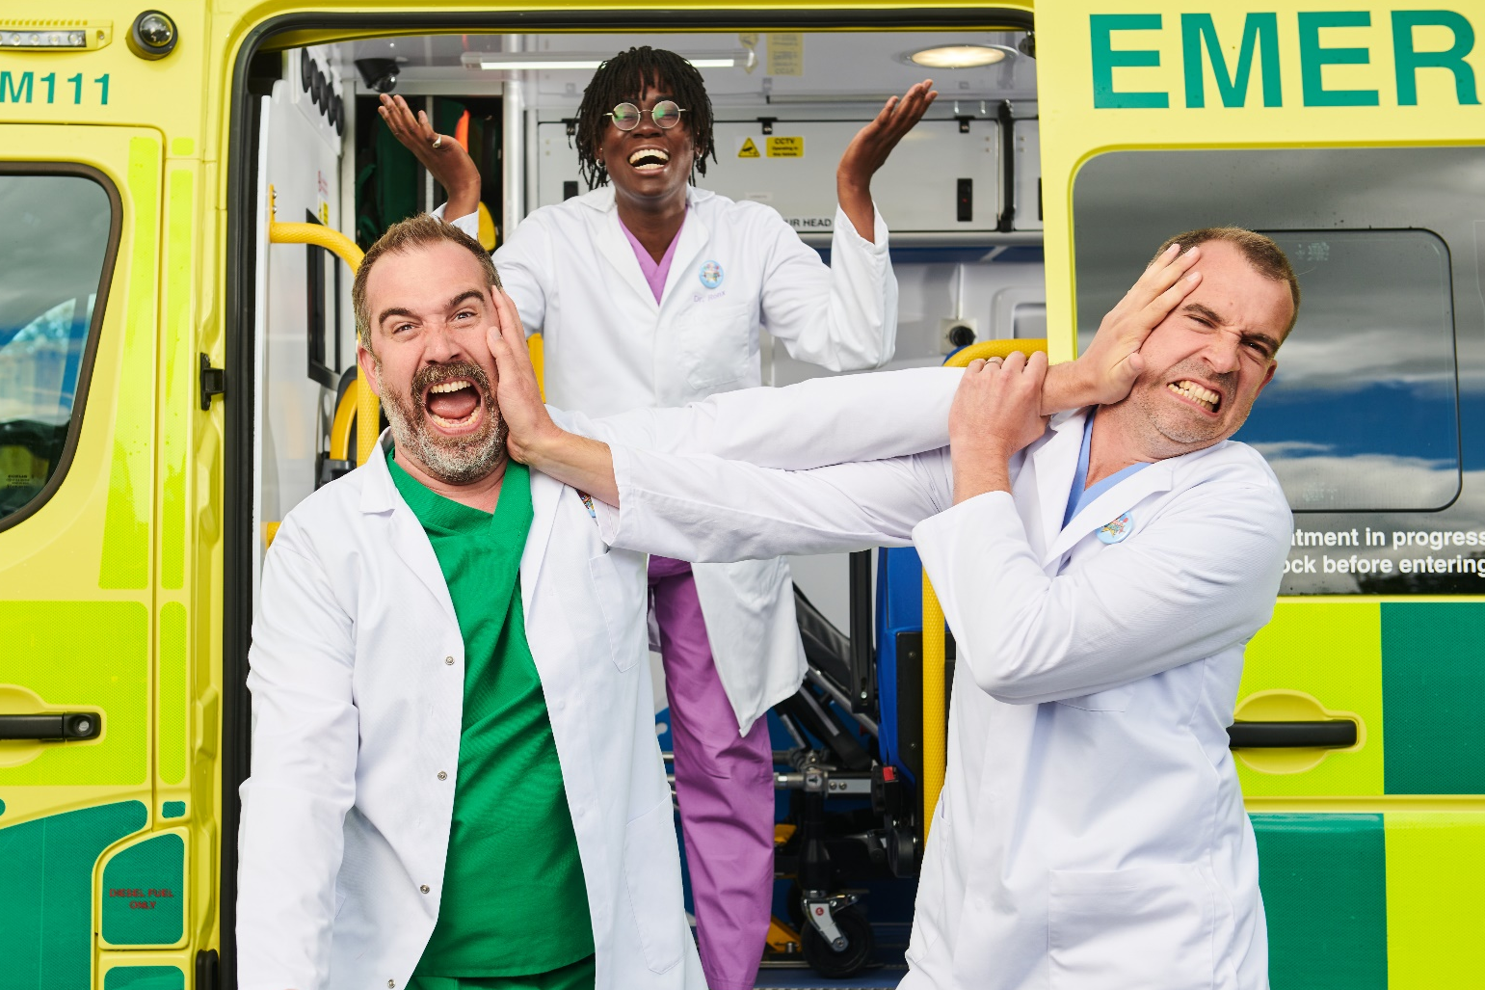
Watch the BBC Teach Operation Ouch! Science Live Lesson with your class.

Slide 4
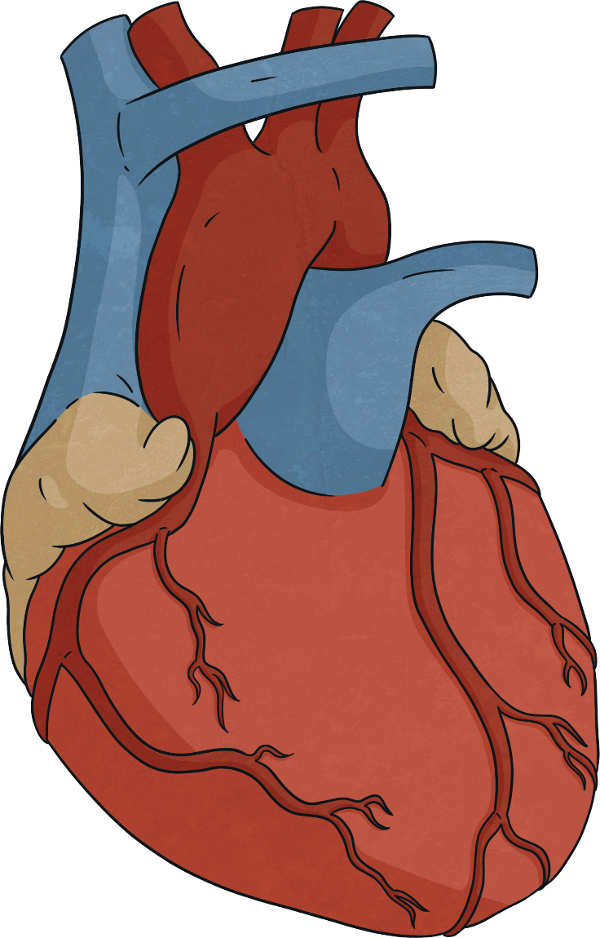

What is the Heart?
The heart is a muscle which pumps blood continuously through a huge network of blood vessels.
It is about the size of a human fist.
The heart delivers oxygen and nutrients to every part of the body.
Did You Know…?
The average adult heart beats around 100,000 times a day.

Slide 5
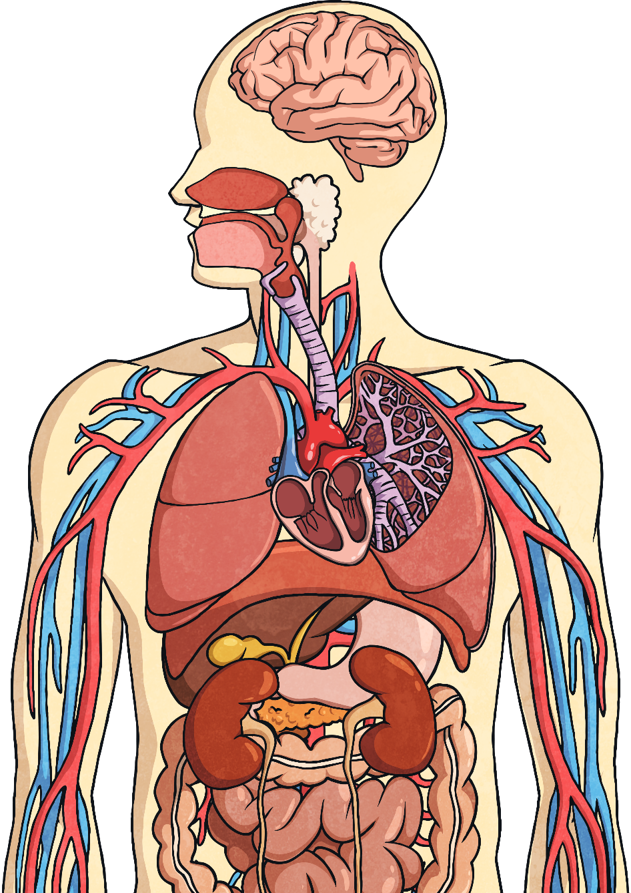


Where is the Heart Located?
In humans, the heart is located between the two lungs and behind the breastbone, slightly to the left of centre.
It rests on the diaphragm, which is the layer of muscle between the lungs and the stomach.
lungs
lungs
heart
diaphragm

Slide 6
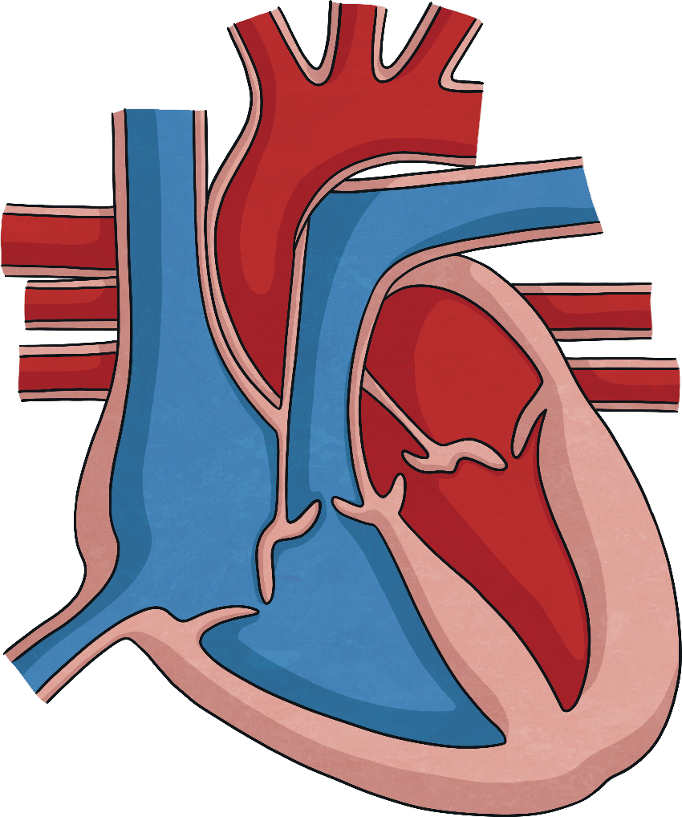


The Parts of the Heart
The heart has four sections, called chambers.
There are four valves inside the heart, which open and close to control the direction of blood flow.
left atrium
right atrium
left ventricle
right ventricle

Slide 7
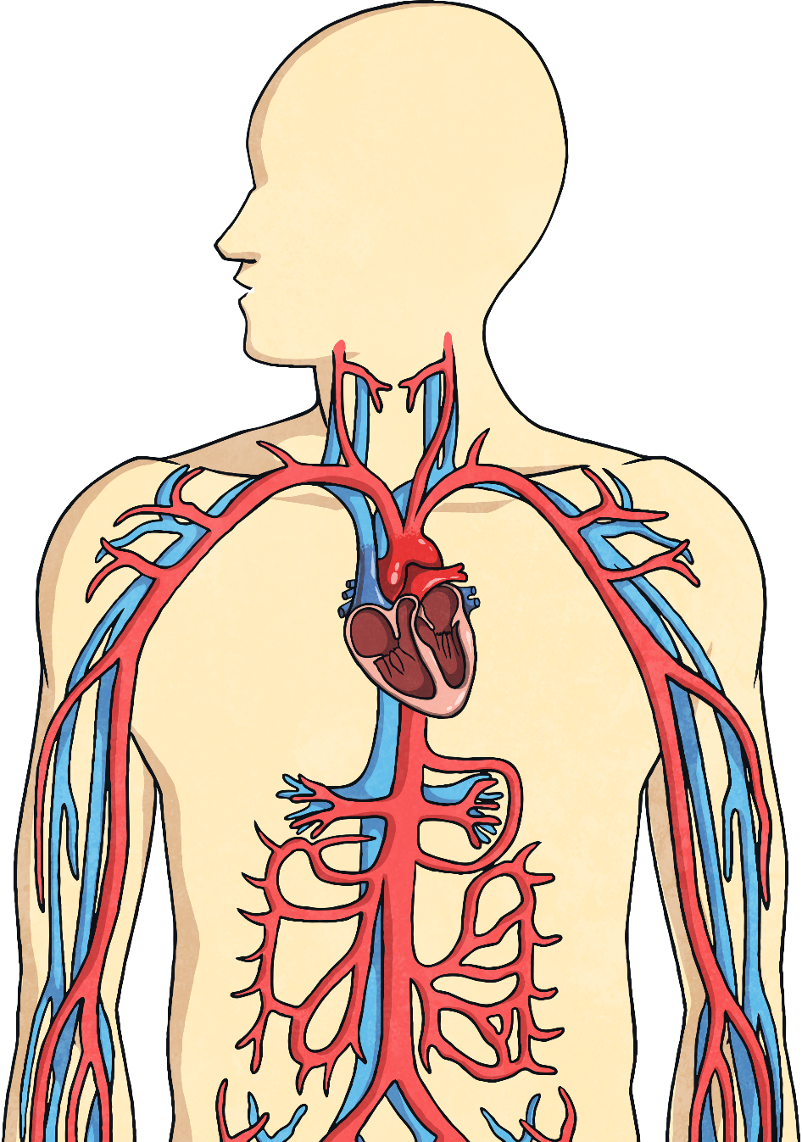
How Does Blood Flow around the Body?
Blood flows from the heart around the body in blood vessels called arteries, veins and capillaries. These form part of the circulatory system, along with the heart.
Arteries carry oxygenated blood (blood containing oxygen) away from the heart and to other organs of the body.
The main artery is called the aorta.
There are also tiny blood vessels known as capillaries, which deliver nutrients from the blood to every tissue in the body.
Veins carry deoxygenated blood (blood high in carbon dioxide and low in oxygen) from the organs back to the heart. These can appear blue under the skin’s surface.

Slide 8

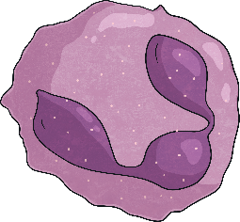
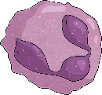
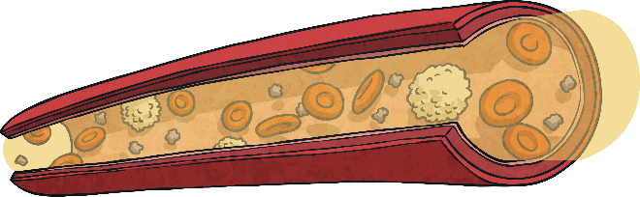
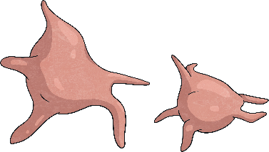
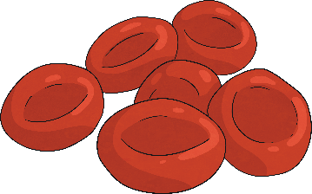
What is in Our Blood?
Blood is made up of different components, which all have a different function.
Plasma is the liquid part of the blood. It is made up of water and protein.
Platelets help to stop bleeding by forming scabs.
White blood cells help to fight infections and diseases.
Red blood cells carry oxygen around the body.
Did You Know…?
The average adult heart pumps approximately five litres
of blood around the body every minute!

Slide 9
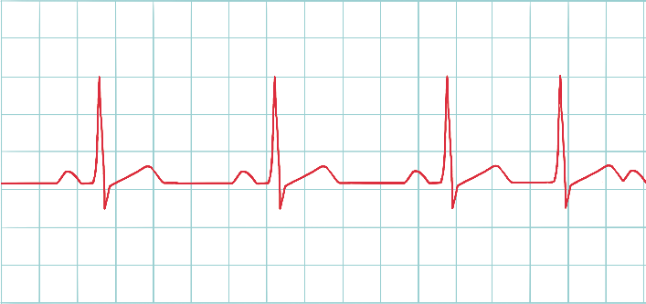
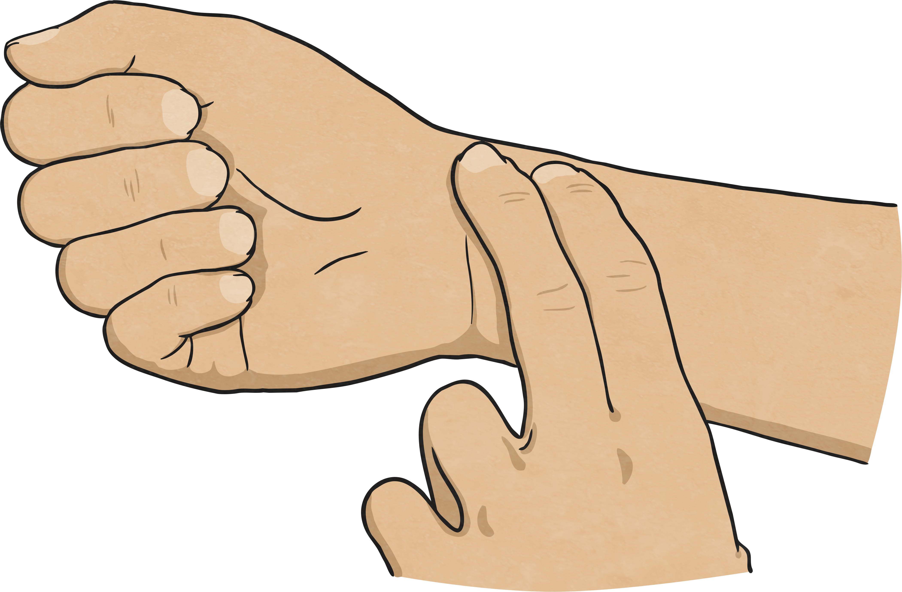
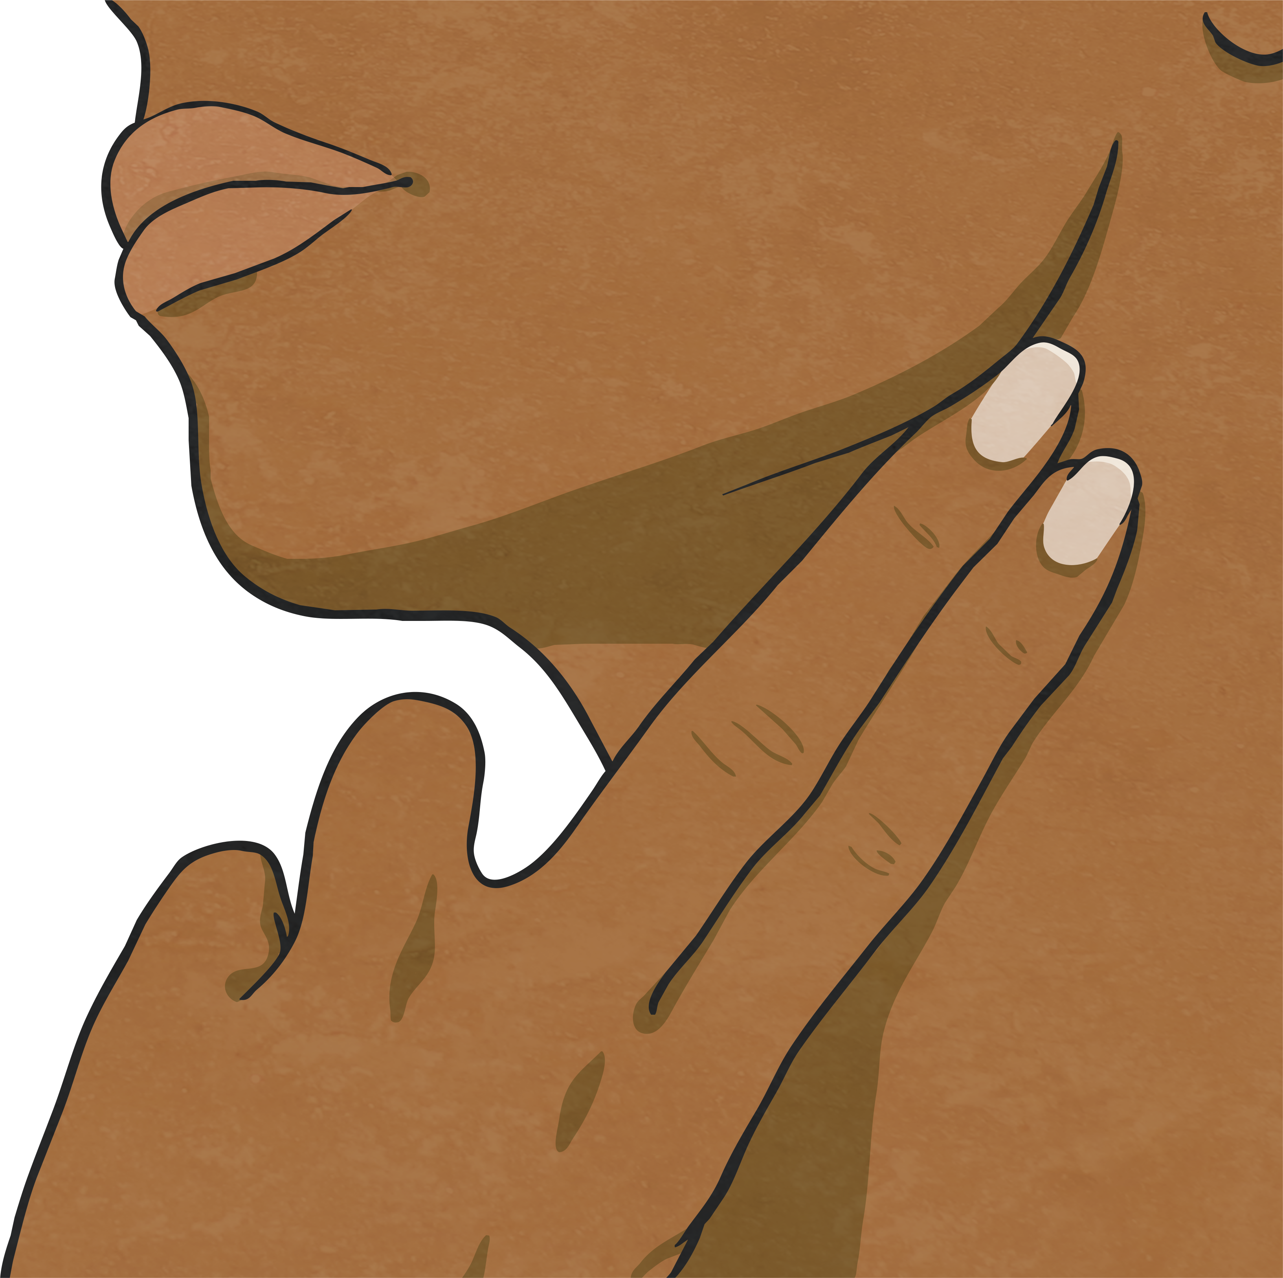
What is Heart Rate?
Heart rate is the measure of how many times a person’s heart beats in a minute.
Each person’s heart rate is different and can change with different factors.
You can measure your heart rate by finding your pulse on your wrist or neck and counting the number of beats per minute.
A normal adult’s resting heart rate is between 60 and 100 beats per minute (bpm).

Slide 10
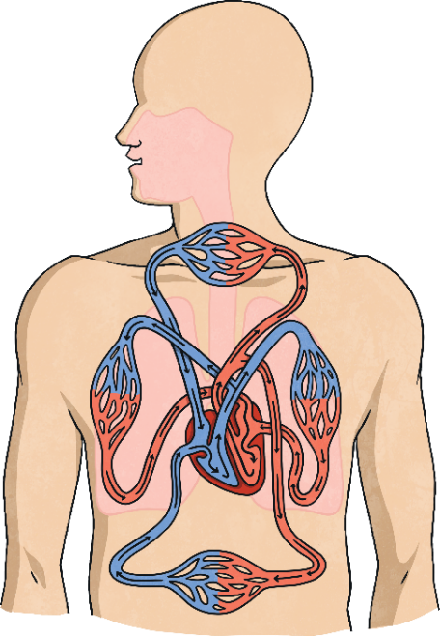
What Happens to the Heart During Exercise?
One of the main reasons that our heart rate can increase is physical activity. This is because, during exercise, the body’s muscles need more oxygen.
We breathe faster to take in more oxygen from the air into our lungs. The oxygen is then absorbed into the blood. Our heart then pumps faster (increasing our heart rate) so that the oxygenated blood can be delivered to the body’s muscles, where the oxygen is needed for the increased physical activity.
Did You Know…?
A person’s heart rate can also increase when they are scared. This is because, when a person is frightened or believes they are in danger, the brain triggers a release of adrenaline.
This adrenaline causes the heart to beat faster.

Slide 11
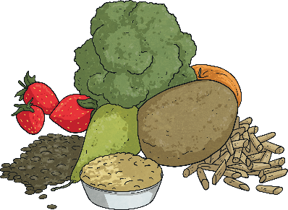
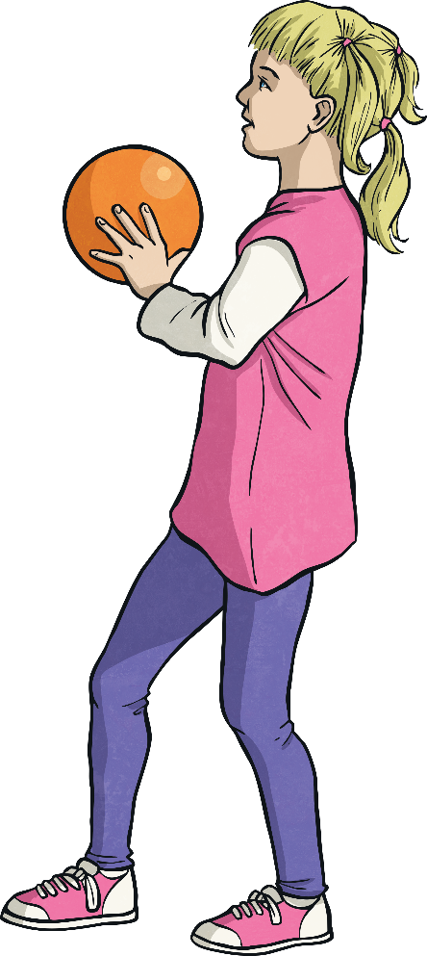
How Can We Keep Our Hearts Healthy?
The heart is a vital organ so it is important that we look after it to keep it healthy. Like most muscles in the body, your heart needs exercise in order to keep it healthy and strong.
Top tips for keeping your heart healthy include:
Eating a healthy, balanced diet
This should include lots of fruit and vegetables, whole grains with some lean protein and healthy fats. You should avoid eating too much salt, sugar or saturated fat.
Keeping active and getting lots of exercise
Even short bursts of activity can help keep your heart healthy. This might include walking, cycling, swimming, trampolining or playing active games.

