Slide 1
Animations
This resource has been designed with animations to make it as fun and engaging as possible. To view the content in the correct formatting, please view the PowerPoint in ‘slide show mode’. This takes you from desktop to presentation mode. If you view the slides out of ‘slide show mode’, you may find that some of the text and images overlap each other and/or are difficult to read.
To enter slide show mode, go to the slide show menu tab and select either from beginning or from current slide.
Links to External Video Websites
This PowerPoint Presentation contains links to external websites. Please check that the content of external links is appropriate for the intended audience. Twinkl Ltd is not responsible for the content of external links.
You may wish to delete this slide before beginning the presentation.

Slide 3

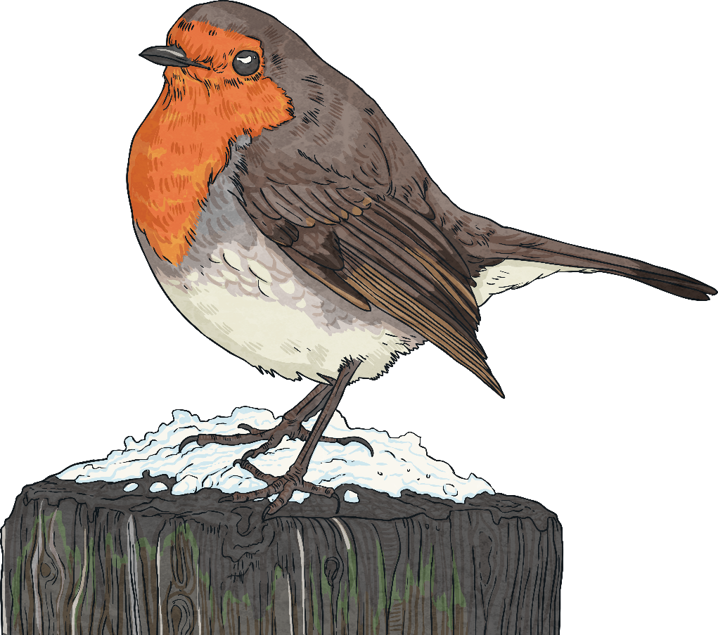
Watch the Big Schools’ Winterwatch 2023 – Live Lesson.
What have you
found out about Winterwatch?

Slide 4

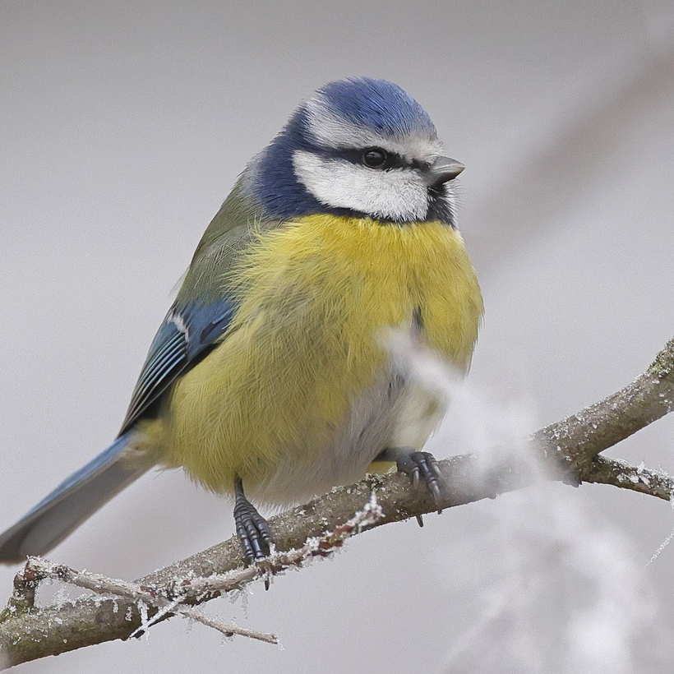
Wildlife in winter
Wildlife can be spotted in gardens and green spaces, coastlines and even some urban environments, such as towns and cities, throughout the year in the UK.
As both weather and sources of food can vary dramatically between different seasons, the abundance of wildlife on display
can be diverse too.
Winter can prove particularly challenging for wildlife. As temperatures plummet, certain species go into hibernation and a covering
of frost, ice or snow can all make sourcing
food difficult.

Slide 5
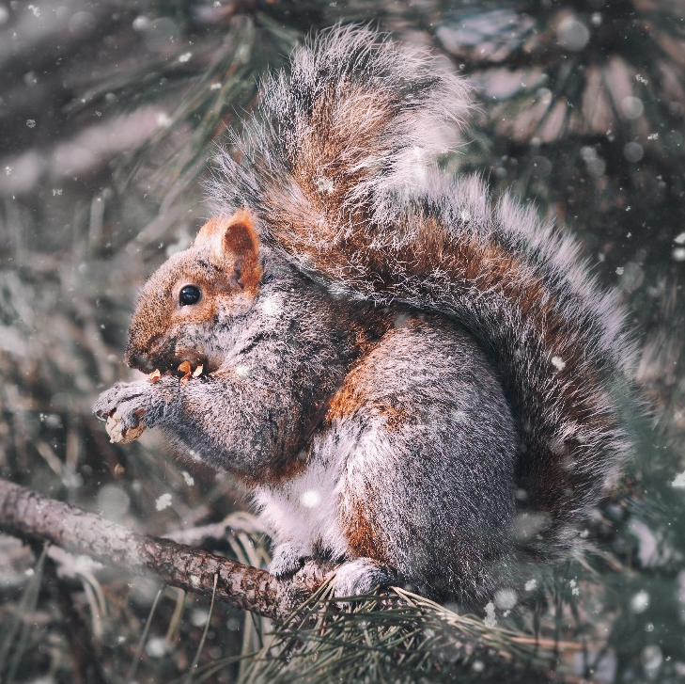
Animal nutrition
  Good nutrition involves animals taking in the range of nutrients that they need. Nutrients are substances that living things need in order to carry on living and
  to perform functions, such as growing, moving and respiring.
  All wild animals must
  find these nutrients in
  food that they source
  from the environment
  around them because,
  unlike plants, animals
  are not capable of
  making their own food.
      Many types of wildlife, including birds, rely on sourcing food from their natural habitat. Changes
      to these habitats can
      force animals to adapt their diets or habits to
      seek the nutrients that they need.

Slide 6
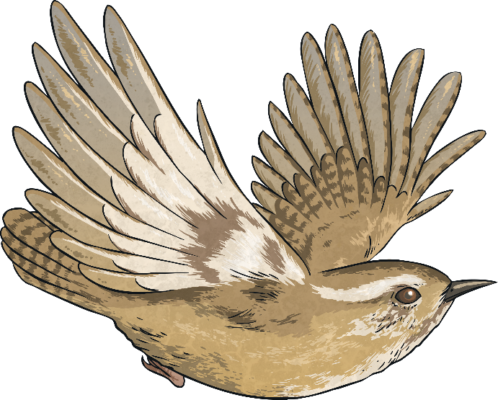
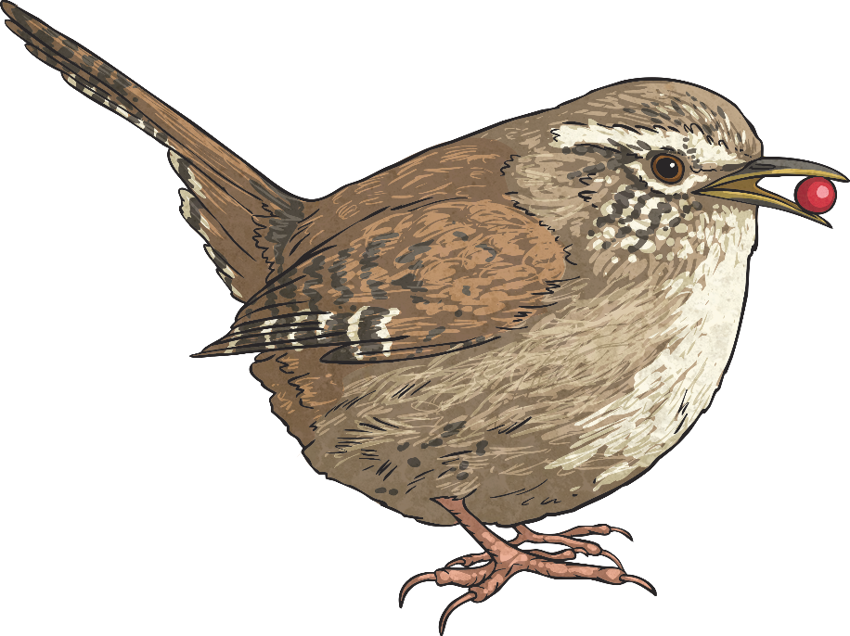
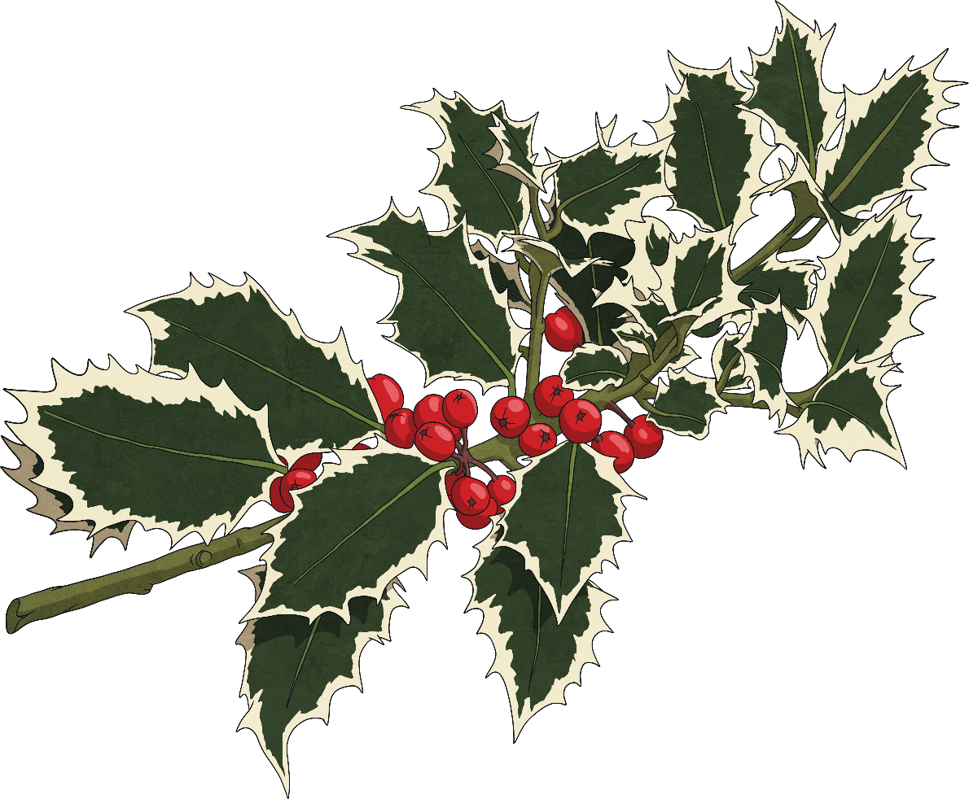
Bird nutrition
Like all animals, birds rely on food to give them
energy, which is essential for them to fly.
  Since birds come in different shapes and sizes, the
  amount and type of food consumed by different
  species can vary greatly.
Small birds generally eat a large amount of food
compared to their body weight, while all birds
must eat regularly in order to keep their
energy levels up for moving and
maintaining their body temperature.

Slide 7
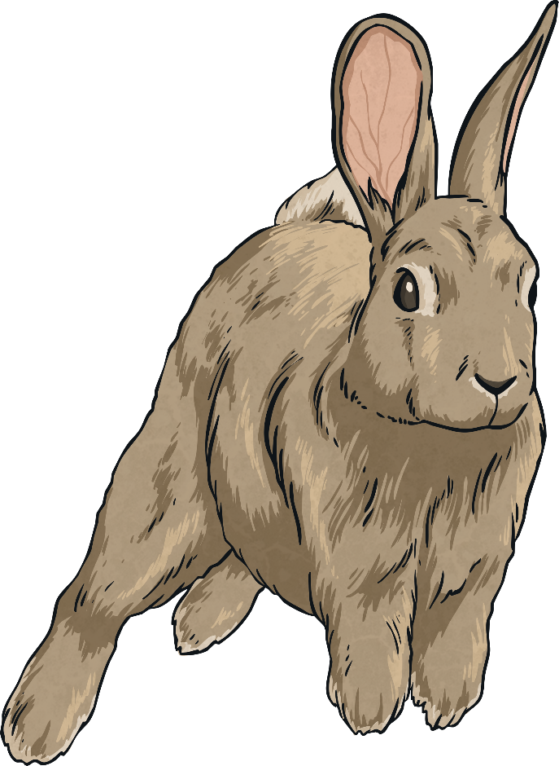
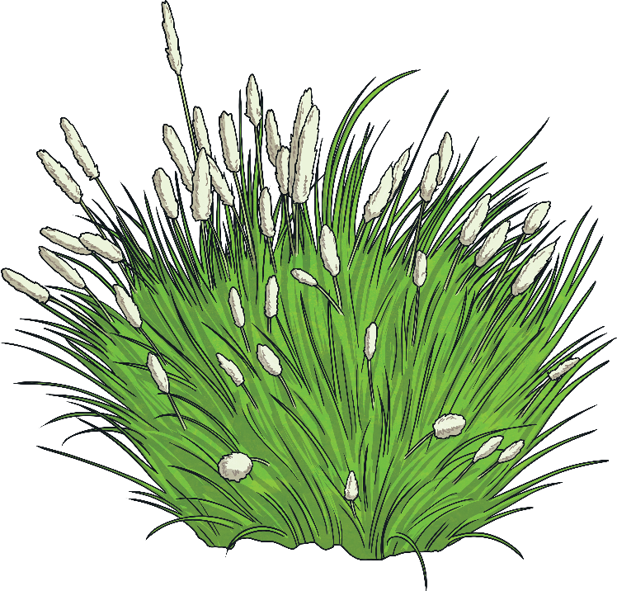
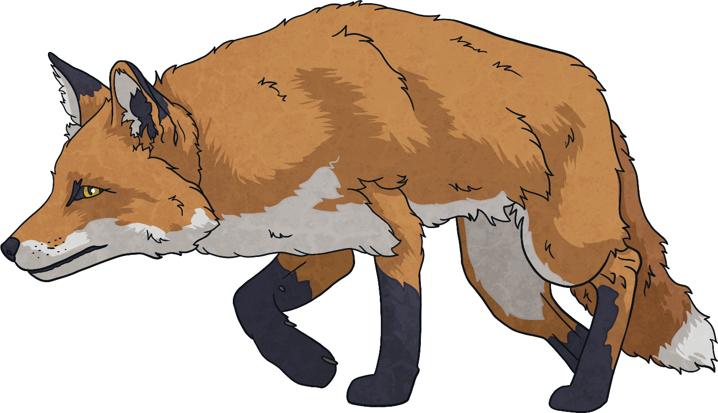
Food chains
A food chain shows the sequence of living things that depend on each other for their food and survival.
As one living thing in the food chain eats another, some energy transfers from one link in the chain to the next.

Slide 8




Food chains
Food chains start with a living thing that makes its own food, otherwise known as a producer.
Consumers are animals that eat food in the food chain; predators are animals that eat other animals, which are known as prey.
Arrows between living things show the order in which food is eaten.
is eaten by
is eaten by
energy transfers
energy transfers
producer
consumer
and prey
consumer
and predator

Slide 9
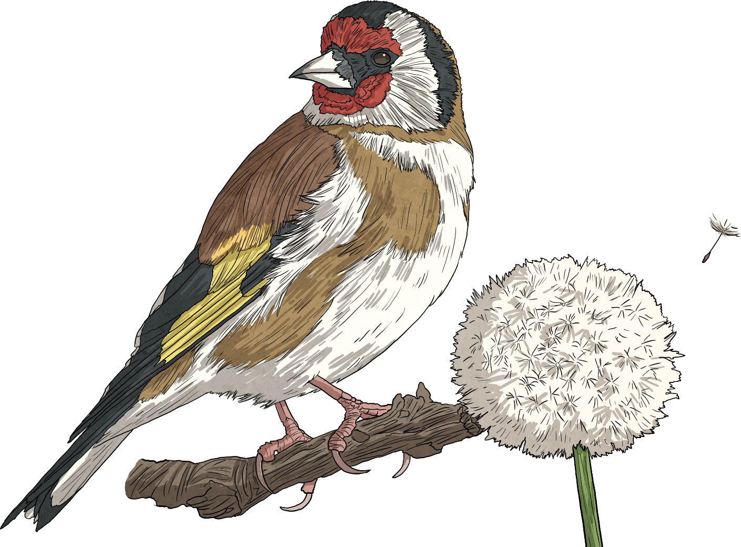
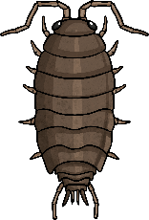
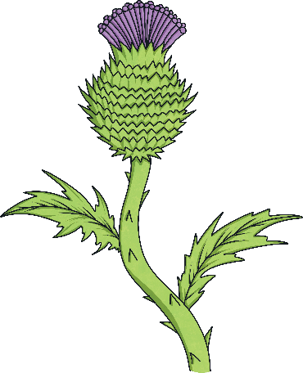
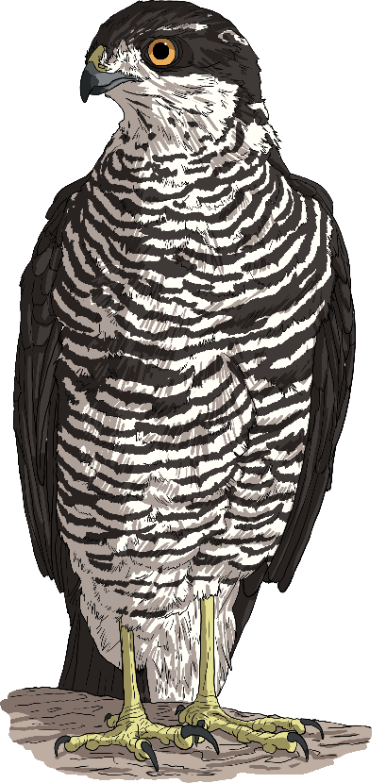
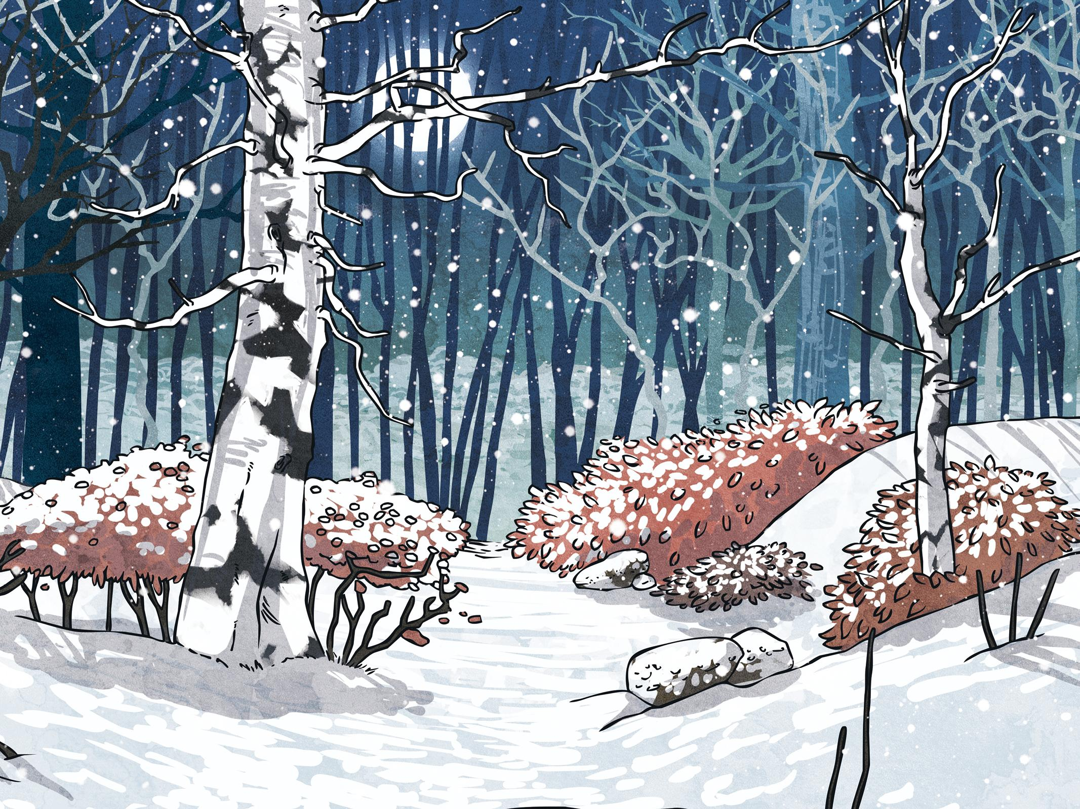

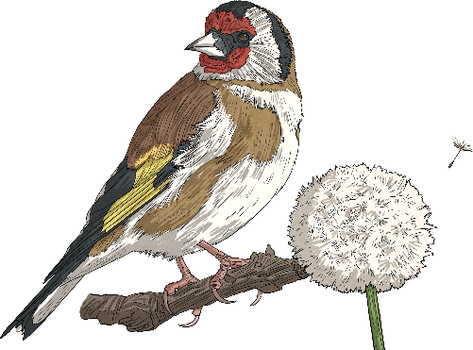
Where do birds feature in food chains?
Some birds, such as Goldfinches, are primary consumers. These are the first consumer in the food chain, eating the plant-based producer.
Goldfinches have specially adapted beaks for taking out seeds from thistles and similar plants.
Did You Know…?
is eaten by
is eaten by
Despite being herbivores as adults, Goldfinches feed insects and other minibeasts to their young.
energy transfers
energy transfers
producer
consumer
and prey
consumer
and predator

Slide 10
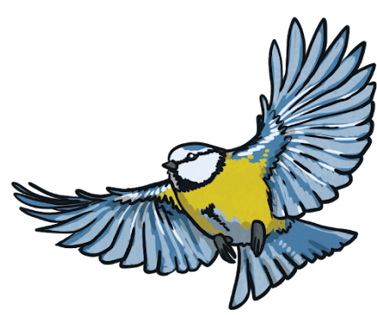
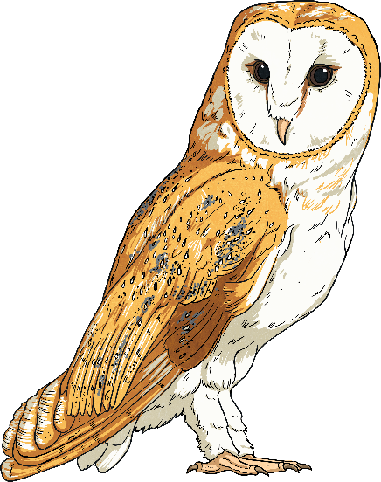


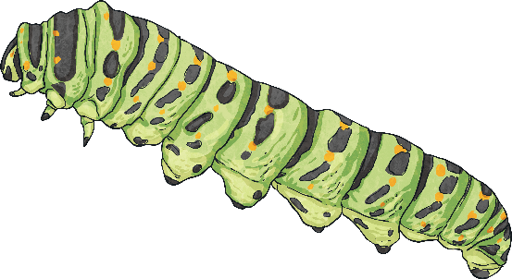
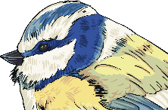

Where do birds feature in food chains?
The position of birds in a food chain can change based
on the food eaten at different times.
Some birds, such as Blue Tits, are primary consumers when they eat seeds; however, they also eat caterpillars and other invertebrates, which would make them a secondary consumer and predator.
Blue Tits can also be the prey of other animals, including Sparrowhawks and Barn Owls, which are predators.
producer
consumer, prey
and predator
consumer
and predator
consumer
and prey

Slide 11
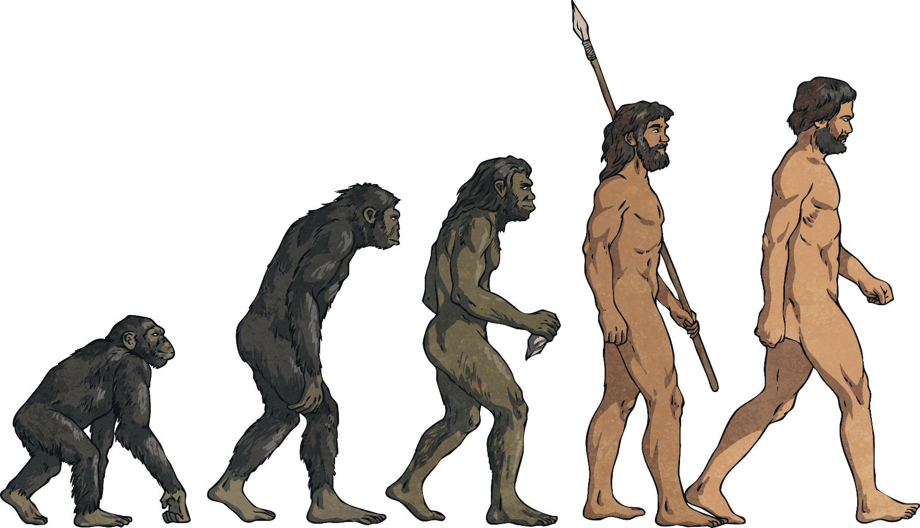
How have birds adapted to eat?
Adaptation is a process that sees characteristics of living things change gradually over time to become better equipped to survive in the environment around them.
This process applies to a whole species with changes passed on from generation to generation. This is known as evolution.

Slide 12
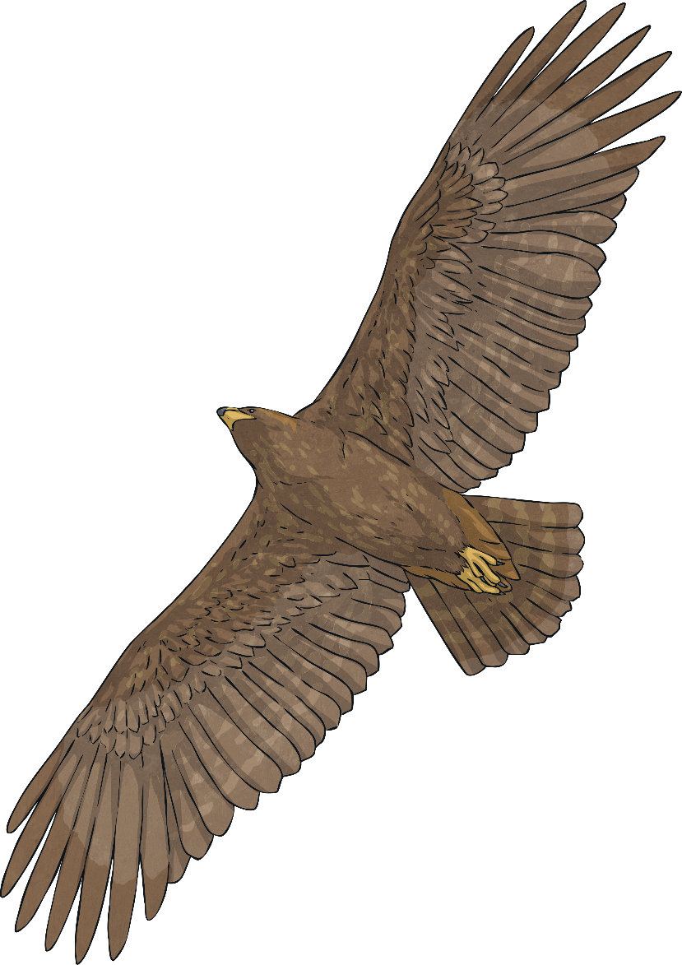
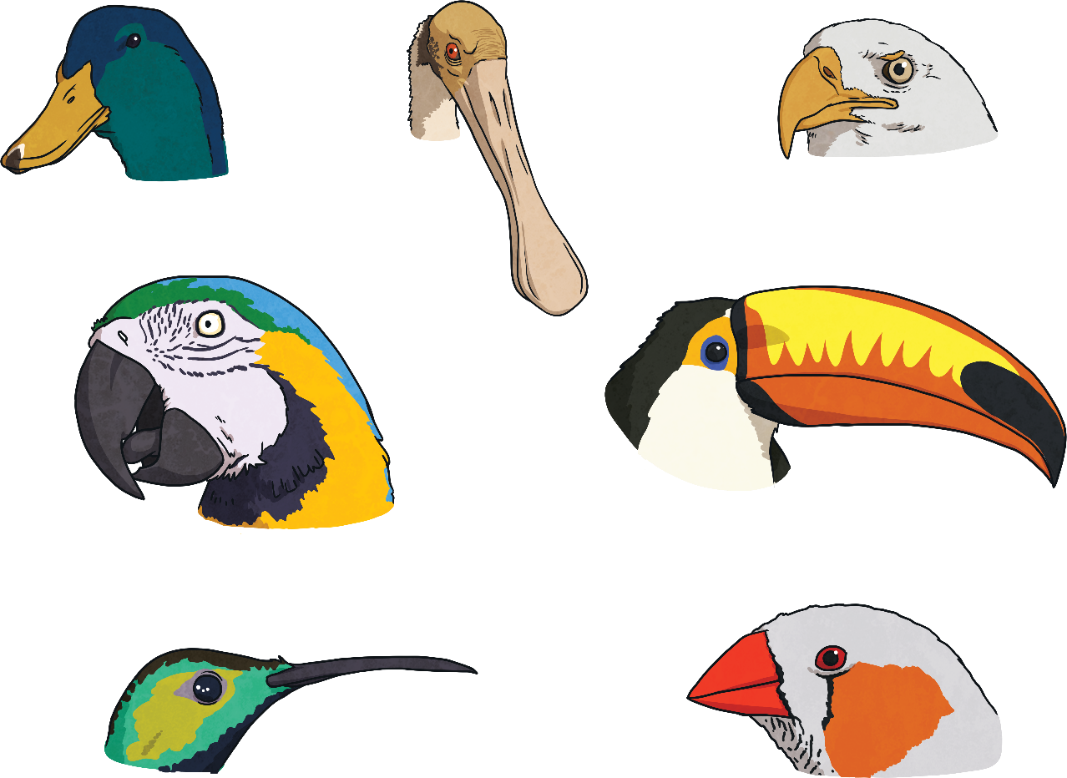

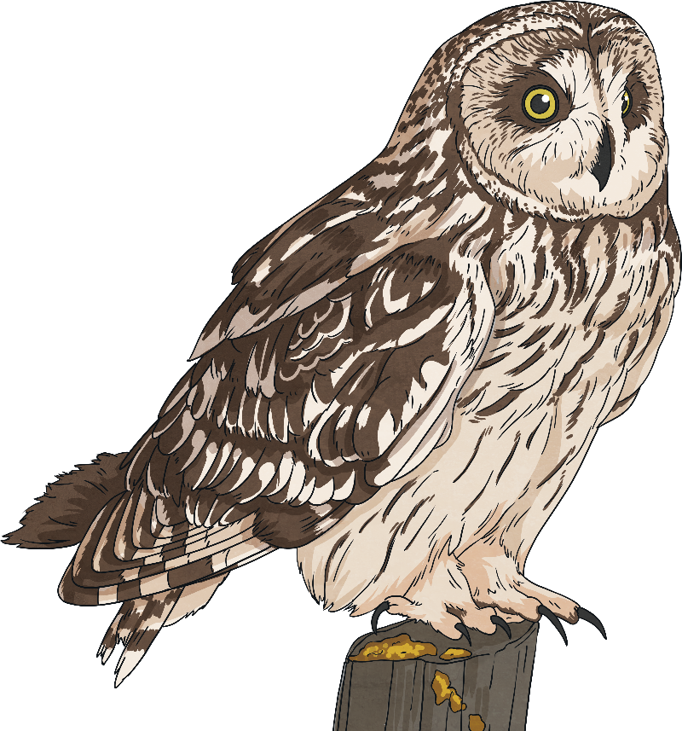


How have birds adapted to eat?
Like many animals, birds have adapted to eat in their natural environment:
The shape and size of birds’ beaks have evolved to suit the food available to them, for which they might need to dig, scoop, peck, tear or forage in different ways.
Birds have a digestive system that can quickly change nutrients in food into fat to give them
a good energy store, for example for a long flight or cold night.
Insect-eating birds use saliva to create clumps of food, while birds of prey store bits of food that they cannot digest and cough it up in a ball called a pellet.

Slide 13
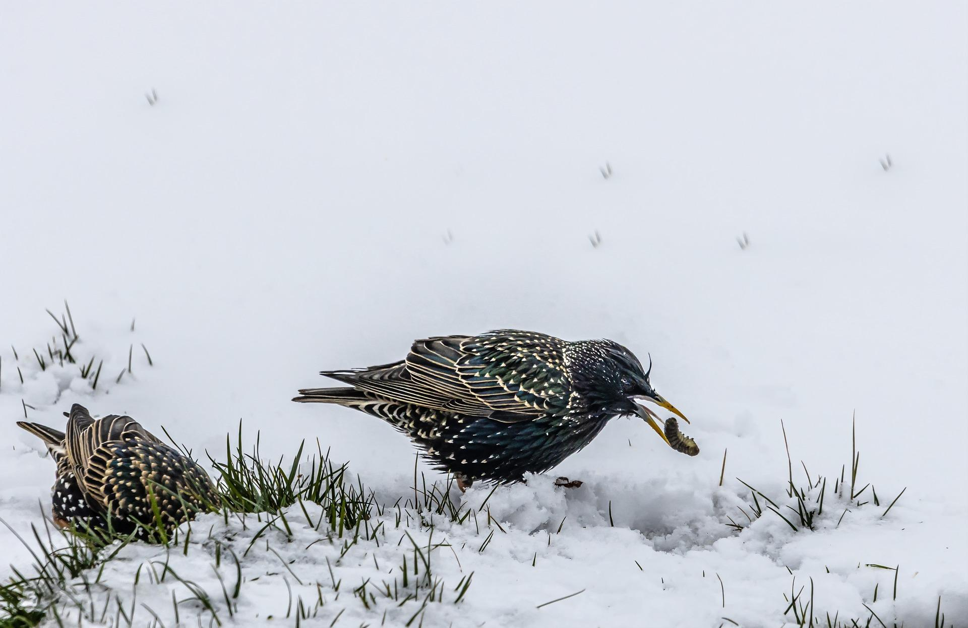

How does winter affect birds?
Different seasons can present a range of food options for birds.
However, winter can be a particularly difficult time.
Food supplies are much more scarce during the winter as other animals hibernate and the ground can be covered by snow, ice or frost.
Did You Know…?
Some small garden birds,
such as Blue Tits, breed at
the time of year when
caterpillars are hatching
to make sure they can find
plenty of food for their chicks.
With much longer, colder nights and shorter days, birds have less time to source food and they must eat enough in daylight hours to give them the energy to maintain their body temperature through the bleak, bitter nights.

Slide 14
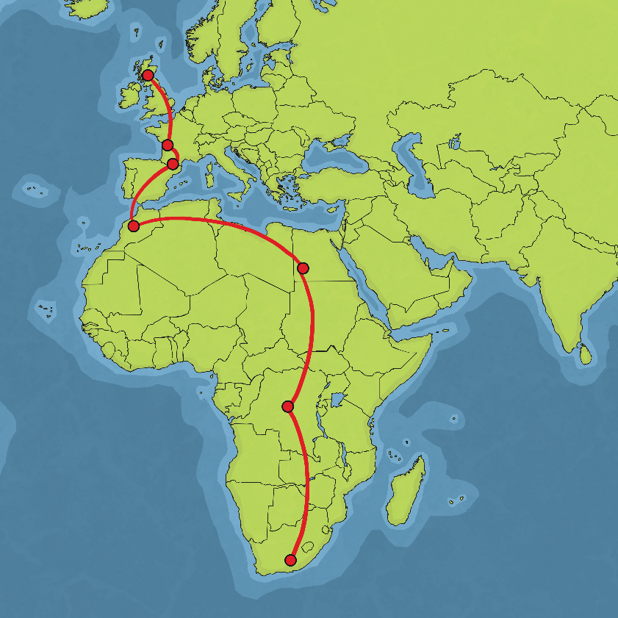
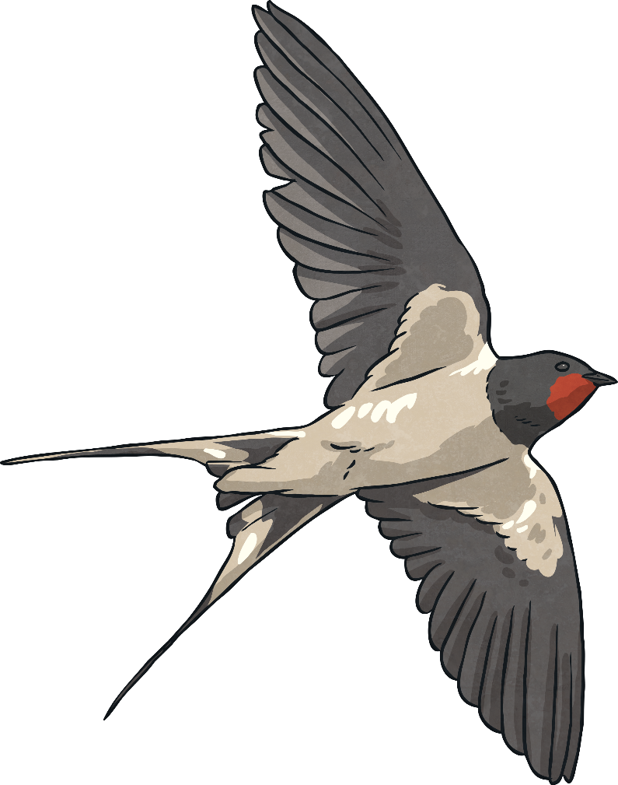
How have birds adapted to survive winter?
Different species of birds have learned to adapt their diets and habits during the winter months to enable them to survive.
Millions of birds migrate, which means
they travel to other parts of the Earth,
during winter months to ensure a good
food supply and a warmer environment. Swallows are known for migrating from
the UK to Africa in the winter.

Slide 15

How have birds adapted to survive winter?
Some birds have adapted beaks that allow them to source food in more than one way.
Robins have evolved to feature large eyes compared to many other garden birds; these allow them to spot food more easily when there is less light, such as dawn and dusk, so they can seek nourishment during the darker winter days.

Slide 16
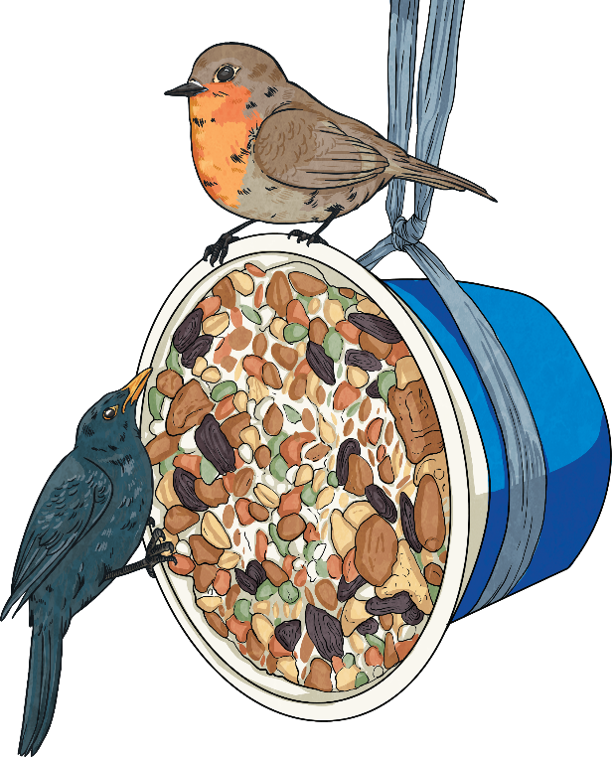
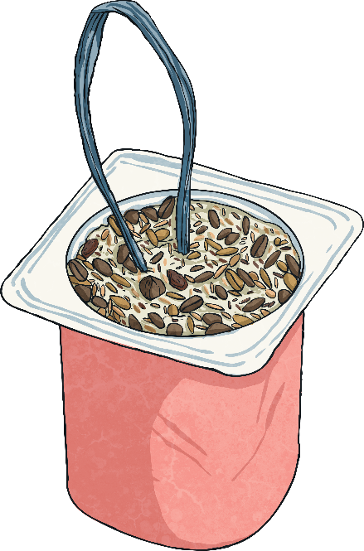
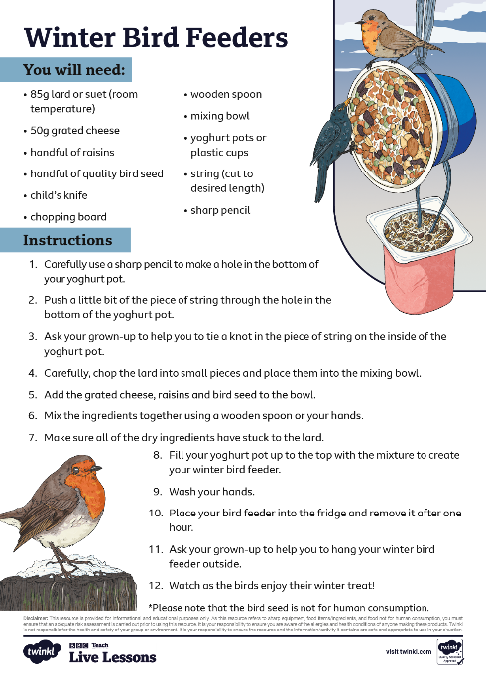
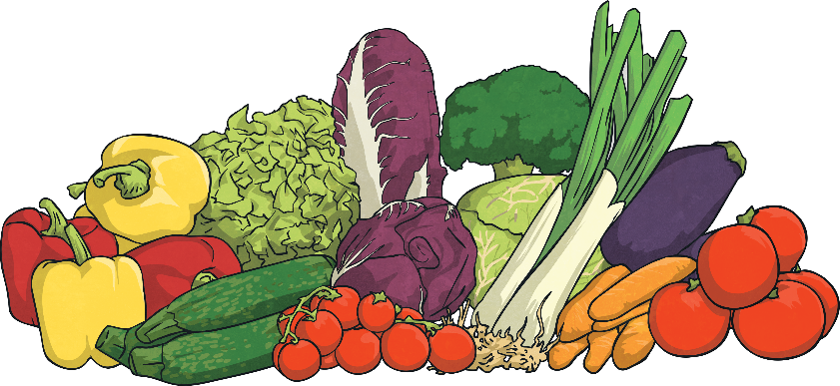
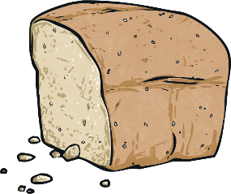
How can humans help birds in winter?
Hang out bird
feeders containing:
seeds
peanuts
oatmeal
Birds can be helped by humans year-round
but particularly in winter.
Why not try making your own bird feeder by following the instructions found here:
Stock bird tables with:
small chunks of fat
cold vegetables
small pieces of fresh and dried fruit
leftover pieces of stale cake or biscuits
Importantly, only offer unsalted food and enough of it for birds to consume in a day
(to deter other animals). Remember to wash hands after handling bird food and feeders.

