Slide 2
Hans Zimmer
Earth
Secondary / KS3 / 3rd & 4th Level Classroom Lesson Plan
Written by
Rachel Leach

Slide 3
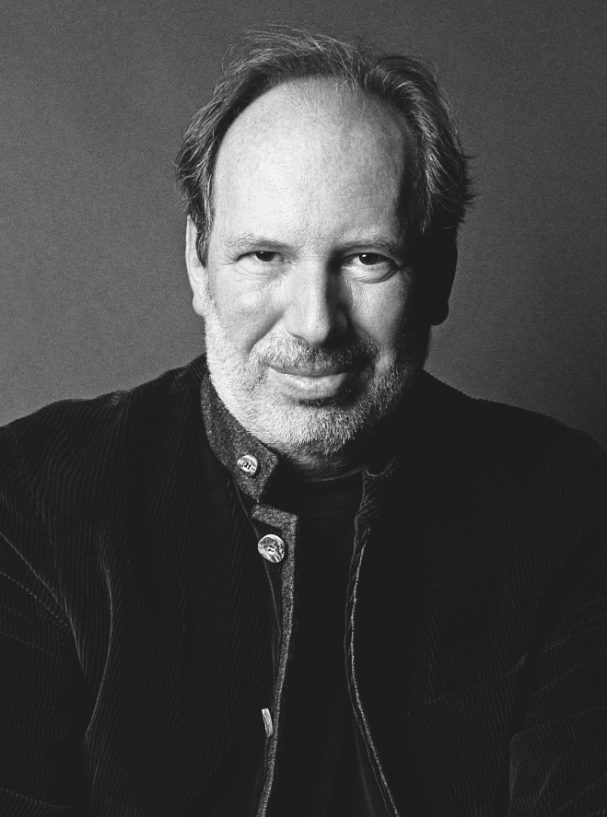
Trailblazer
Film composer Hans Zimmer uses all sorts of different techniques to create music. He has helped shape the sound of today’s film, tv and games music

Slide 4
Lesson outcomes
After this lesson, pupils will be able to:
listen and reflect on a piece of orchestral music
create their own piece of music using instruments and voice
perform as an ensemble
learn musical language appropriate to the task

Slide 5
Curriculum checklist
Learners will:
play and perform in ensemble contexts, using voices and playing musical instruments
improvise and compose music for a range of purposes using the interrelated dimensions of music
listen with attention to detail and recall sounds with increasing aural memory

Slide 6
Glossary of music terms
Term | Definition
Crescendo | gradually getting louder (opposite: decrescendo or diminuendo)
Duration | the length of a note. Different durations make rhythms
Dynamics | the term used for louds and softs/volume
Motif | A very short musical ‘idea’ – often just a sound or a rhythm
Pianissimo | Very softly
Pitched percussion | percussion instruments that can play different pitches – xylophones, glockenspiels, chime bars, etc.
Unpitched percussion | percussion instruments that can only make a limited number of sounds – drums, shakers, woodblocks, tambourines, etc.

Slide 7
Lesson 1
Watching and listening
Notes:
Prepare your class
Explain to your class that you are going to begin a six-week music project focusing on a fantastic piece of music by a film composer called Hans Zimmer. Tell your class that they probably already know Zimmer’s music; he wrote the scores for ‘Blue Planet II’, ‘Dunkirk’, ‘Planet Earth II’, ‘The Lion King’ and many, many other films and tv shows.
Watch the trailblazers film and full orchestral performance and have a discussion about what you have just seen.
Listening task
Watch and listen to the full performance again and ask your students to make a list of what they are hearing. Make sure there is a clock or stopwatch on the screen too so that they can note down the time at which events occur.
Encourage your class to fill this in fully thus creating a list of ‘events’ in the music and their corresponding time. You may have to listen several times.
Split your class into smaller working groups. Ask them to share their ideas and come up with one definitive list.
Using this list of events, ask each group to plot out the images they would see on screen if this music were a film score. They can do this by adding an extra column to the diagram.
They could even put drawings in the fifth column showing exactly what the images on screen would look like. This process is sometimes known as ‘storyboarding’.
FINALLY, when this is achieved, encourage each group to share their thoughts with the rest of the class and lead a short discussion. Keep their work safe, you will need it during the next lesson.

Slide 8
Background – the composer
Hans ZIMMER
(b. 1957)
Self-taught German film composer
Has composed more than 150 films scores and been nominated for ten Oscars
Loves using technology, synthesizers, samplers and computers as well as the orchestra

Slide 9
Background – the music
Earth
Written especially for BBC Ten Pieces
Draws upon the soundworld he used for Blue Planet II and Planet Earth II – two of his most popular scores
This isn’t a film score (it wasn’t written for a movie) but it does sound very ‘filmic’

Slide 10
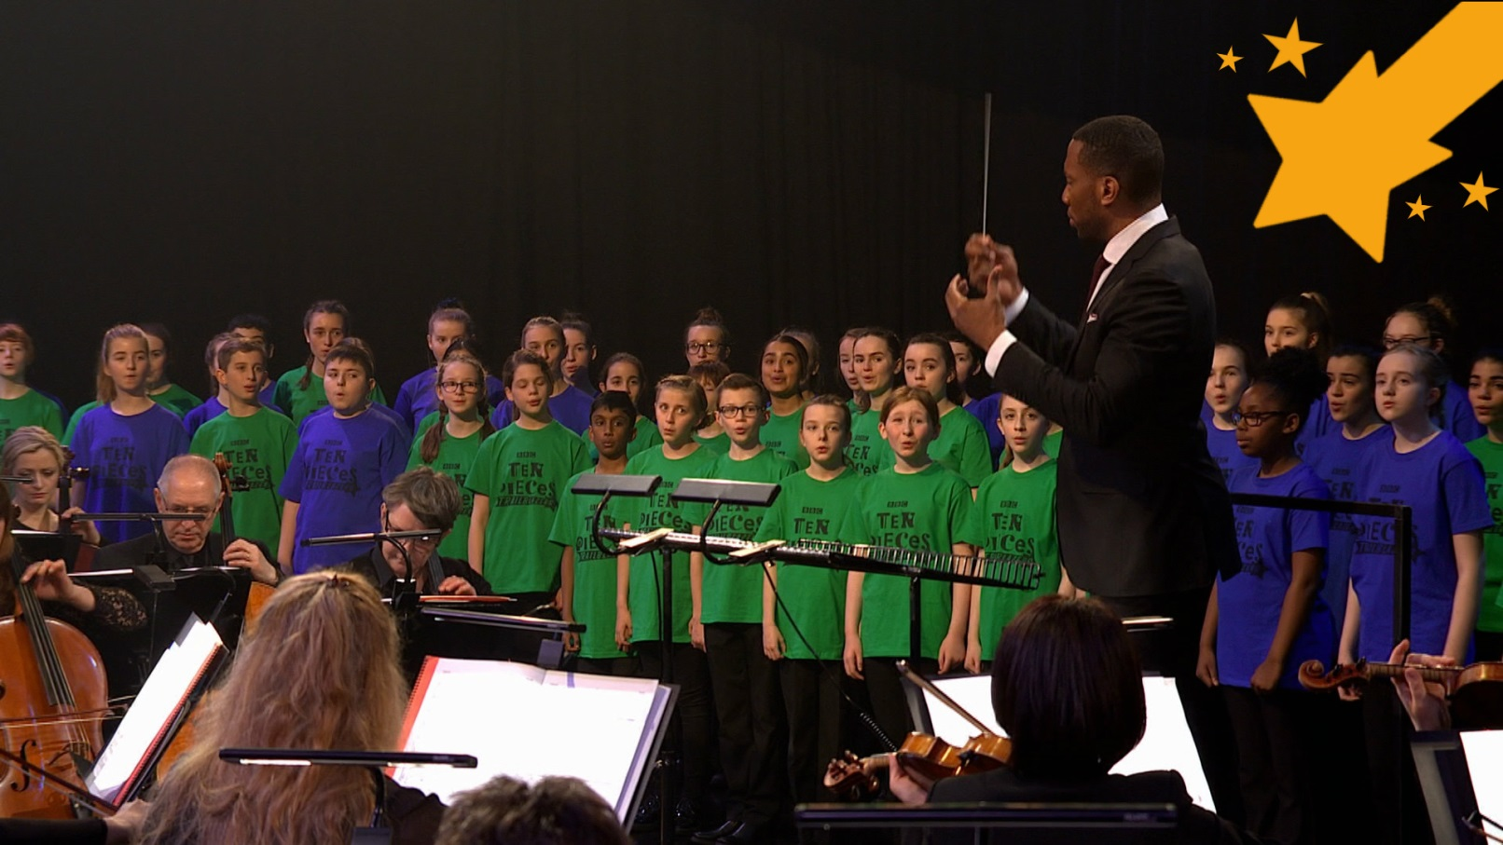
Watch the orchestral performance

Slide 11
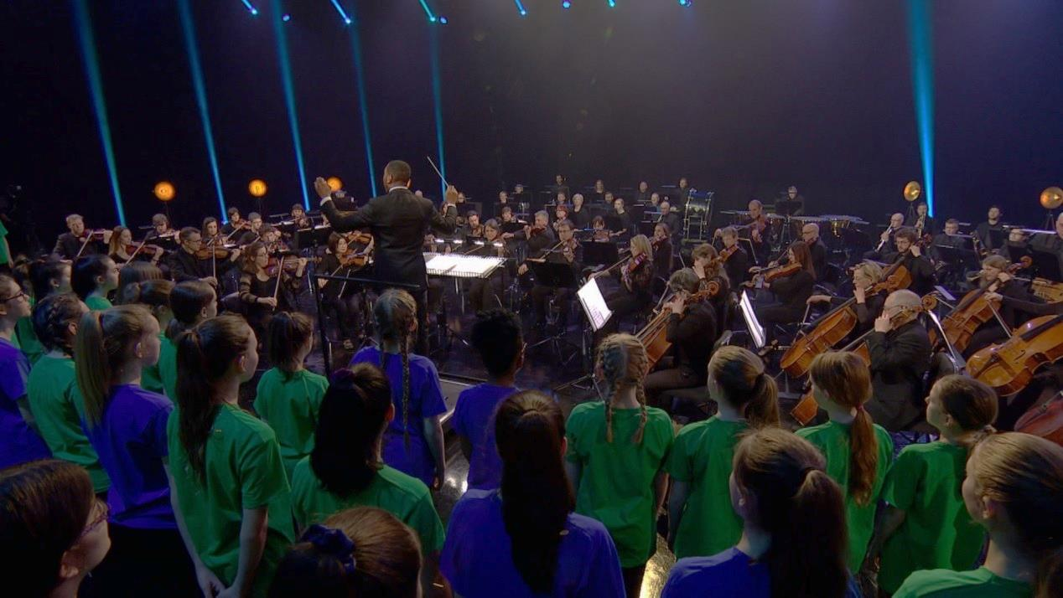
Listen carefully, and create a ‘list of events’ in the music

Slide 12
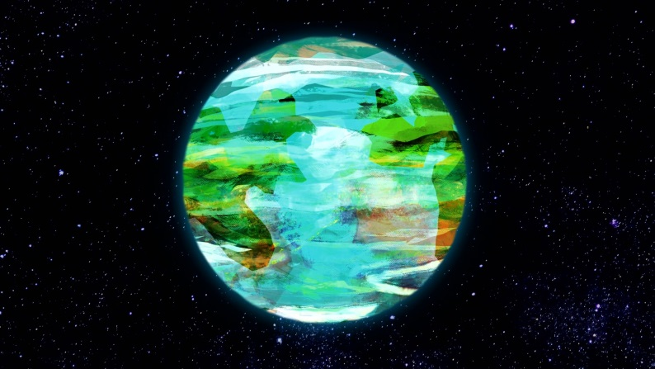
Create a storyboard!
What images would you like to see with each of these events?

Slide 13
Lesson 2
Make the film to fit the music
Notes:
This lesson is all about making images to go with Zimmer’s music. Your students should continue working in their small groups and referring to their ‘storyboard’ but there are two ways to proceed. Choose the option that best fits the resources you have available. If you don’t have such resources, simply skip this lesson or make live images to fit Zimmer’s music!
Option 1: shoot film
Each team needs film recording equipment. This could be a digital camera, video recorder or even a smart phone or tablet. Using places within the school and its grounds teams must find, stage and shoot the images listed on their storyboard.
Teams can then edit their images to Zimmer’s music using whatever software you have available.
Many operating systems come with their own editing software (for example iMovie) but free software is available to download (for example Wondershare Filmora). Video can also be edited on smart phones/tablets and then uploaded into music editing software such as Garageband, Logic, Sibelius.
Option 2: find film
Use the internet to source film clips (i.e. YouTube) and edit these to Zimmer’s music. The easiest way to do this is to simply find existing edited films and try them alongside Zimmer’s music. A good place to start would be clips from films to which Zimmer has already written the music (‘Blue Planet’, ‘Planet Earth’, etc.). Many such films are available on YouTube.
Your students could also edit existing film clips together to make a new film. To do this the clips must first be uploaded into your editing software. Again, free downloads are available (see above).

Slide 14
Let’s start filming!
If you have recording equipment, then great; if not, have a look at existing film clips on the internet and try editing these

Slide 15
Lesson 3
Recreating Zimmer - atmosphere
Notes:
Warm-up
Begin with your class sitting in a circle. Ask the students to close their eyes and listen. When you have absolute silence make a very soft shimmery sound by quickly tapping your fingers on your knees. Stop and ask everyone if they heard the shimmering sound. Perhaps students sat right across the circle from you won’t have heard it so repeat the activity and this time, ask students to join in with the sound when they hear the person next to them. Your shimmer will then gradually spread around the circle. Challenge your class to stop when the person next to them stops too (this is much harder!).
Explain that you have just made a ‘shimmer’ – similar to the sound at the beginning of Zimmer’s piece.
Look at your instrument collection. Ask the students to suggest some unpitched instruments to join in with the shimmer – these could be instruments capable of making a soft, continuous sound or capable of being played in such a way (i.e. a drum can be tapped lightly with the fingers instead of hit with a beater). Add some of these suggestions to your class shimmer.
Now try adding some pitched instruments.
Remind your class to keep their shimmer as quiet as possible. The technical term for this is ‘pianissimo’. Should they all shimmer at the same time or should they stagger the entries of the different types of shimmer?
Now it’s time to add some singing to your shimmer. Zimmer makes a series of short melodies by selecting just three or four pitches from this scale:
Feel free to adapt these notes to suit the instruments you have and the ability of your young musicians.
Teach these notes to your students – they can play them on instruments and/or sing them. Ask a volunteer to invent a short fragment of melody by choosing just three or four pitches and putting them in an order. Write this on the board and encourage half of your circle to sing and play it slowly. Everyone else can continue with the shimmer.
Split the class back into their groups and ask each team to invent at least two short melodies using the method above. Their resulting piece should have this structure:
Soft shimmer throughout
Short melodies alternate back and forth
Lots of space and stillness
FINALLY, bring the class back together and hear each group one by one. Give gentle feedback and encourage your students to carefully write down what they have done. They will return to this later.

Slide 16
Create a shimmery warm-up
Play pitches on your instruments, similar to Zimmer at the beginning of his piece.
Make sure they are really quiet, or pianissimo

Slide 17
Lesson 4
Recreating Zimmer – three-note patterns
Notes:
Warm-up
Repeat the warm-up from the last lesson and then talk and sing through your ‘shimmering introduction’. Get the instruments out and play through it making sure that everyone has the same instrument as last week.
Remind your class that Zimmer’s piece gets a bit ‘busier’ during the middle. Zimmer uses just three pitches during this section. Ask your class to choose three notes from the scale.
For example, your students may choose G, A, C – make sure that everyone with a pitched instrument can play the chosen pitches.
This is the same set of notes you used for the melodies in the last lesson.
Practise playing through your chosen notes encouraging everyone who has a pitched instrument to play each note.
Students with unpitched instruments can help with counting or provide a gentle pulse to keep everyone together.
This is a great way to introduce some technical terms or to begin teaching notation. These patterns are all different lengths, just like in Zimmer’s piece. This is so that every repeat creates a different collision of notes. The technical term for this is phasing.
Explain
Zimmer has all of these different note lengths (durations) layered up in his piece. Split the class into smaller groups and challenge each team to make a piece that layers up these different patterns. Unpitched players may add infrequent rumbles and surprises to the texture.
FINALLY, - bring the class back together and hear each group one by one giving some gentle feedback as you go through. Again, make sure the students write down what they have done and who played which element.

Slide 18
It gets much busier in the middle of Zimmer’s piece – what do you think is happening?
Choose three notes from these pitches
and play them at different speeds

Slide 19
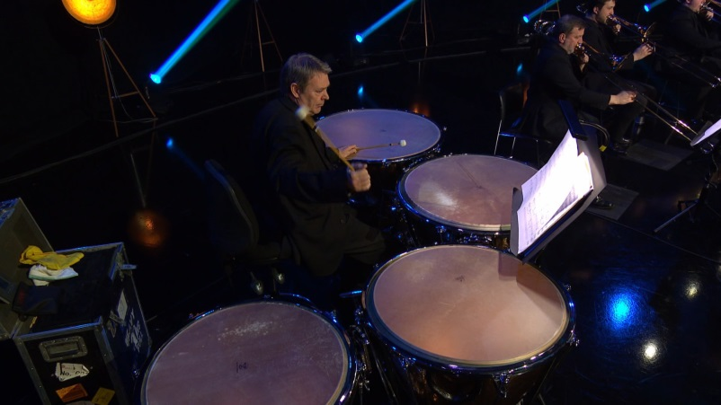
Which instruments should play which note lengths?
Try this out on the instruments that you have and see what sounds the best

Slide 20
Lesson 5
‘Life on Earth’ - leitmotifs
Notes:
Warm-up
Begin this lesson by leading a quick brainstorming activity. Ask your students to think of things associated with planet earth and make a huge list on the board. These can be descriptions of landscape life on the planet or even scientific facts.
Split the class back into their smaller working groups. Ask each group to choose three things from the list on the board making sure that, if possible, each group chooses something different from the others.
Ask each group to make a leitmotif to represent each of the things on their list. A musical motif that describes something (usually in a film or opera) is called a leitmotif. It can be a rhythm, a collection of notes or even a sound effect. Encourage your students to keep their motifs short and simple, and to use the same instruments they have been using so far on the project.
Challenge each group to make a short piece from their leitmotifs. They could use the following questions to guide them:
What goes first?
What goes last?
Do any of the leitmotifs fit together?
Do the leitmotifs overlap, transform or repeat?
FINALLY, hear each group one by one and again give some feedback. If you have time, allow the groups five minutes to recap the other two sections of music they have made (the shimmering intro and the three note patterns).

Slide 21
Have a brainstorm!
What can you think of that is associated with the earth – maybe landscape, life on the planet or scientific facts

Slide 22
Create a musical motif for the things on your list. Make a short piece using these motifs:
What goes first?
What goes last?
Do the motifs fit together?
Do the motifs overlap or repeat?

Slide 23
Lesson 6
‘Spot’ a film, perform to picture
Notes:
This lesson is about creating music for film. Ideally you will return to the films that were found or created in lesson 2. You can however do this task with any film clip, simply choose a clip with a lot of action and mute the sound. Again, a stopwatch on the screen will help.
Explain to your students that the next two lessons will be about creating new music for film. When composers are commissioned to write music for film they sit down with the director and watch it without music in a process called ‘spotting’. During this viewing they list the events, actions and emotions that require music alongside the time at which they occur. Then together, the composer and director agree on where the music will be placed and what style it will have.
There are five commonly used types of film music, as follows:
DIEGETIC – sounds/music that can be heard by the characters within the film as well as the audience
FOLEY – sound effects, non-musical sounds
MICKEY MOUSING – opportunities for music to perfectly mimic the action as in cartoons (musical footsteps, etc.)
ATMOSPHERE – created by music alone. Sometimes called ‘underscore’
LEITMOTIF – small motifs that represent a specific character/place/emotion/theme
Play your chosen film clip to the class without sound. Ask them to note down everything including characters, events, actions, emotions, scenery, and to note alongside these events the exact time at which they occur.
Working in your small groups again, ask each team to collate their ideas and come up with one list.
Challenge each group to use this list to help structure all of the musical ideas they have made so far (the shimmering intro, the three-note patterns and their ‘earth’ leitmotifs) into one piece that fits with the film. Allow them the rest of the lesson to do this and make sure that each group can see the film they are playing to as they work. Give them a deadline of ten minutes before the end of the lesson to have their music completed.
FINALLY, ask each group to perform their live film score to picture. You might like to invite an audience in to watch or you could simply record these performances and perhaps edit them back onto the films later.

Slide 24
Play your chosen or filmed clip to the group WITHOUT sound
Note down absolutely everything that is heard, including characters, events, actions, emotions and scenery

Slide 25
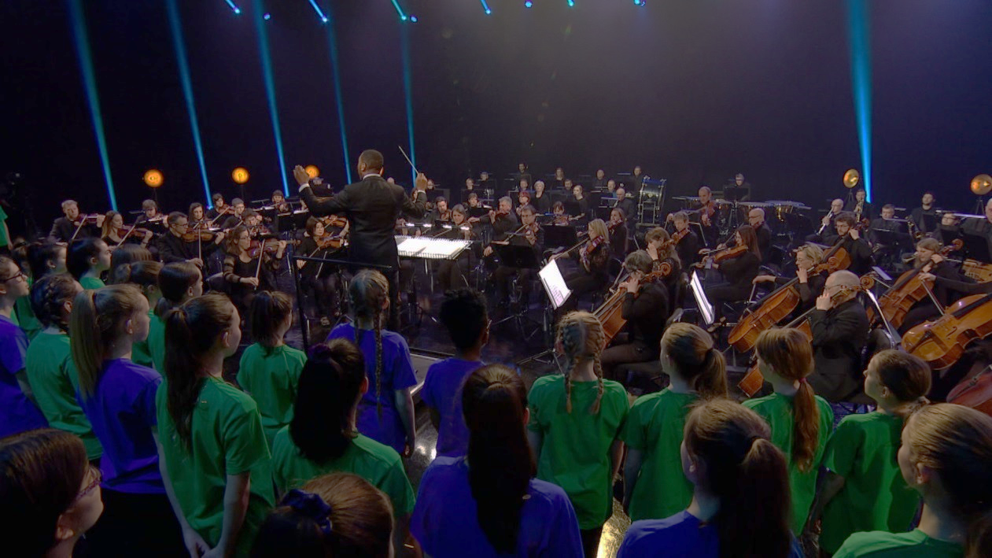
Structure all ideas, and use them to make a piece of music that fits with the film

Slide 26
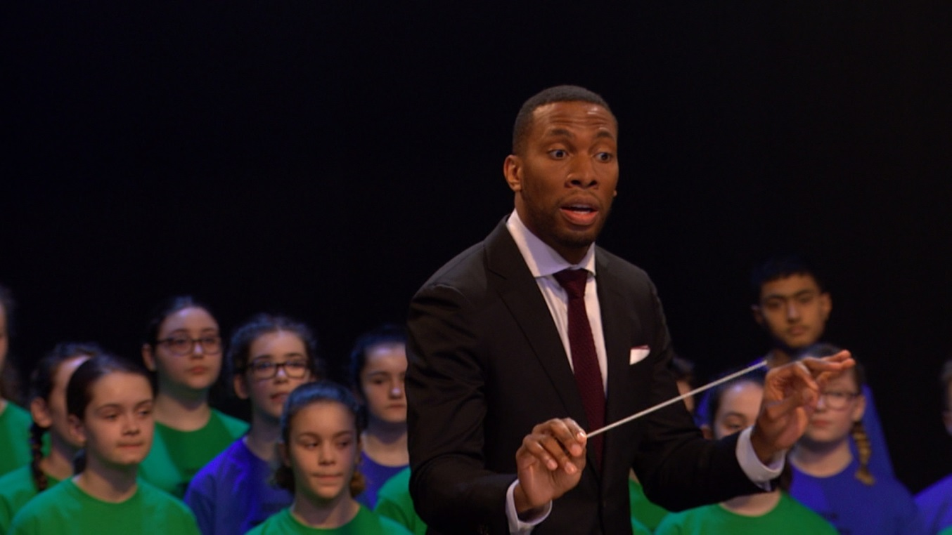
Perform your live score to picture!

Slide 27
Taking it further – cross-curricular activities
MUSIC: Explore the other planets with Holst’s Planet Suite. Mars features on BBC Ten Pieces.
MUSIC: Zimmer has a lot in common with another BBC Ten Pieces composer – Delia Derbyshire. She created the theme to ‘Doctor Who’. Zimmer has made many tv themes and like Delia, he is a huge fan of electronic music.
FILM: Watch some of Hans Zimmer’s greatest film music moments and have a go at creating your own film music by muting the sound and playing your new compositions on top. ‘Blue Planet’ and ‘Planet Earth’ are good places to start.
UPLOAD: Show us what you’ve created! Submit your creative responses using our Uploader for a chance to be featured on the Ten Pieces website .

