Slide 1
Ralph Vaughan Williams
The Lark Ascending
Primary classroom lesson plan
Written by
Rachel Leach
Notes:
For:
Key Stage 2 in England and Wales
Second Level, P5-P7 in Scotland
Key Stage 1/Key Stage 2 in Northern Ireland

Slide 2
Lesson outcomes
After this lesson, pupils will be able to:
• listen and reflect on a piece of orchestral music
• invent their own musical motifs and structure them into a piece
• perform as an ensemble
• learn musical language appropriate to the task
Notes:
Resources required
Paper and writing materials
Classroom percussion instruments and any other instruments that your children might be learning
Optional – full, unedited recording of Lark Ascending by Vaughan Williams
This scheme of work is plotted out over six lessons. Feel free to adapt it to suit your children and the resources you have available.
The six lessons at a glance
Lesson 1:
Activities: Listen and describe a piece of music
Watch the orchestral performance and discuss
Create a poem inspired by the music
Curriculum link: Listen with attention to detail and recall sounds with increasing aural memory
Appreciate and understand a wide range of high-quality live and recorded music drawn from different traditions and from great composers and musicians
Lesson 2:
Activities: Create a shimmer and tune using Vaughan Williams' notes
Curriculum link: Listen with attention to detail and recall sounds with increasing aural memory
Improvise and compose music for a range of purposes using the interrelated dimensions of music
Play and perform in solo and ensemble contexts, using voices and playing musical instruments with increasing accuracy, fluency, control and expression
Lesson 3:
Activities: Learn to sing and play a tune
Add lyrics to the tune
Use technical terminology where appropriate
Curriculum link: Listen with attention to detail and recall sounds with increasing aural memory
Improvise and compose music for a range of purposes using the interrelated dimensions of music
Play and perform in solo and ensemble contexts, using voices and playing musical instruments with
increasing accuracy, fluency, control and expression
Lesson 4:
Activities: Learn about birdsong
Create a short birdsong piece
Follow a conductor
Curriculum link: Improvise and compose music for a range of purposes using the interrelated dimensions of music
Play and perform in solo and ensemble contexts, using voices and playing musical instruments withincreasing accuracy, fluency, control and expression
Develop an understanding of the history of music
Lesson 5:
Activities: Structure musical ideas to tell a narrative
Use technical terminology
Curriculum link: Listen with attention to detail and recall sounds with increasing aural memory
Improvise and compose music for a range of purposes using the interrelated dimensions of music
Play and perform in solo and ensemble contexts, using their voices and playing musical instruments with increasing accuracy, fluency, control and expression
Lesson 6:
Activities: Create a coda
Perform in front of an audience
Curriculum link: Play and perform in solo and ensemble contexts, using their voices and playing musical instruments with increasing accuracy, fluency,
control and expression
Improvise and compose music for a range of purposes using the interrelated dimensions of music

Slide 3
Curriculum checklist
Learners will:
• play and perform in ensemble contexts, using voices and playing musical instruments
• improvise and compose music for a range of purposes using the interrelated dimensions of music
• listen with attention to detail and recall sounds with increasing aural memory
Notes:
Resources required
Paper and writing materials
Classroom percussion instruments and any other instruments that your children might be learning
Optional – full, unedited recording of Lark Ascending by Vaughan Williams
This scheme of work is plotted out over six lessons. Feel free to adapt it to suit your children and the resources you have available.
The six lessons at a glance
Lesson 1:
Activities: Listen and describe a piece of music
Watch the orchestral performance and discuss
Create a poem inspired by the music
Curriculum link: Listen with attention to detail and recall sounds with increasing aural memory
Appreciate and understand a wide range of high-quality live and recorded music drawn from different traditions and from great composers and musicians
Lesson 2:
Activities: Create a shimmer and tune using Vaughan Williams' notes
Curriculum link: Listen with attention to detail and recall sounds with increasing aural memory
Improvise and compose music for a range of purposes using the interrelated dimensions of music
Play and perform in solo and ensemble contexts, using voices and playing musical instruments with increasing accuracy, fluency, control and expression
Lesson 3:
Activities: Learn to sing and play a tune
Add lyrics to the tune
Use technical terminology where appropriate
Curriculum link: Listen with attention to detail and recall sounds with increasing aural memory
Improvise and compose music for a range of purposes using the interrelated dimensions of music
Play and perform in solo and ensemble contexts, using voices and playing musical instruments with
increasing accuracy, fluency, control and expression
Lesson 4:
Activities: Learn about birdsong
Create a short birdsong piece
Follow a conductor
Curriculum link: Improvise and compose music for a range of purposes using the interrelated dimensions of music
Play and perform in solo and ensemble contexts, using voices and playing musical instruments withincreasing accuracy, fluency, control and expression
Develop an understanding of the history of music
Lesson 5:
Activities: Structure musical ideas to tell a narrative
Use technical terminology
Curriculum link: Listen with attention to detail and recall sounds with increasing aural memory
Improvise and compose music for a range of purposes using the interrelated dimensions of music
Play and perform in solo and ensemble contexts, using their voices and playing musical instruments with increasing accuracy, fluency, control and expression
Lesson 6:
Activities: Create a coda
Perform in front of an audience
Curriculum link: Play and perform in solo and ensemble contexts, using their voices and playing musical instruments with increasing accuracy, fluency,
control and expression
Improvise and compose music for a range of purposes using the interrelated dimensions of music

Slide 4
Glossary of music terms
Term | Definition
Coda | another word for ending
Pitched percussion | percussion instruments that can play different pitches – xylophones, glockenspiels, chime bars etc.
Tune | another word for a melody. A linear line of notes that makes a satisfying musical shape
Unpitched percussion | percussion instruments that can only make a limited number of sounds – drums, shakers woodblocks, tambourine etc.

Slide 5
Lesson 1
Watching and listening
Copyright Rachel Leach & BBC
Notes:
Lesson 1:
Activities: Listen and describe a piece of music
Watch the orchestral performance and discuss
Create a poem inspired by the music
Curriculum link: Listen with attention to detail and recall sounds with increasing aural memory
Appreciate and understand a wide range of high-quality live and recorded music drawn from different traditions and from great composers and musicians

Slide 6
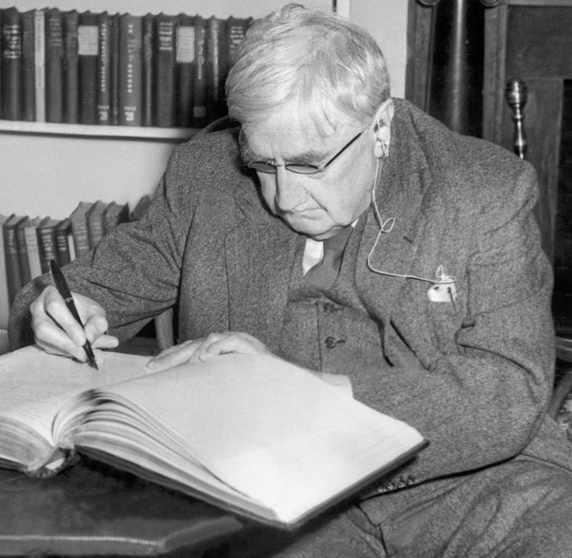
Background – the composer
Ralph Vaughan Williams (1872 - 1958)
English composer
Born into a wealthy, well-connected family and had the best education money could buy
Was a collector of folk songs

Slide 7
Background – the music
The Lark Ascending
Written in 1914, inspired by a poem of the same name
Describes a lark flying, gliding and soaring through the air, looking down at the fields below
Is often voted the nation’s favourite classical piece by radio audiences

Slide 8
Watch the orchestral performance
Notes:
Prepare your class
Explain to your class that you are going to begin a 6-week music project focusing on a fantastic piece of music by a composer called Ralph (pronounced Raif) Vaughan Williams. Watch the introductory film with Molly Rainford.
Watch the full orchestral performance. This is a gorgeous, gentle piece so you might like to dim the lights of your room or ask your children to close their eyes and relax as they listen. If you have space, ask them to lie on the floor!

Slide 9
Reflect
a) Did you like the music?
b) How did it make you feel?
c) If you could float off anywhere, where would you go?
d) What would you see down below?
Notes:
Discuss what you have just watched and perhaps ask the following questions –
Did you like the music?
How did it make you feel?
If you could float off anywhere, where would you go?
What would you see down below?

Slide 10
Make a list
• 1 colour (what colour does the music make you think of?)
• 1 emotion (how does the music make you feel?)
• 1 adjective (describe the music or the lark)
• 1 movement word (describe how the lark travels)
• 1 place (where is the lark flying over?)
• 1 thing/ noun (what can the lark see from the sky?)
Notes:
Listening task
Explain to your class that this piece is about a lark flying up into the air and looking down at the world below. Explain that you are going to create a poem written from the viewpoint of the lark. Make sure everyone has something to write on and with, and as you listen again ask your children to make a list of-
1 colour (what colour does the music make them think of?)
1 emotion (how does the music make them feel?)
1 adjective (describe the music or the lark)
1 movement word (to describe how the lark travels)
1 place (where is the lark flying over?)
1 thing/ noun (what can the lark see from the sky?)
Feel free to adapt this list to compliment what you are studying in literacy or other subject areas
Listen for a third time and ask your class to join together their words using conjunctions (or connectives) to make a poem. They may also add ‘the lark’ or imagine they are the lark. Explain further that their poem doesn’t have to rhyme or even make sense but it must be finished by the time the music has finished.
Finally, read out some of the poems to the class (or encourage the poets to read their own work). You could do this with the music playing softly in the background
If you have more time, encourage your children to write out their poems in an imaginative way so that the words ‘fly’ across the page. They could add small drawings of the lark and the things it sees around and within the text. Keep these poems safe, you’ll need them later on in the project.

Slide 11
Write your own poem!
Notes:
Listen for a third time and ask your class to join together their words using conjunctions (or connectives) to make a poem. They may also add ‘the lark’ or imagine they are the lark. Explain further that their poem doesn’t have to rhyme or even make sense but it must be finished by the time the music has finished.
Finally, read out some of the poems to the class (or encourage the poets to read their own work). You could do this with the music playing softly in the background
If you have more time, encourage your children to write out their poems in an imaginative way so that the words ‘fly’ across the page. They could add small drawings of the lark and the things it sees around and within the text. Keep these poems safe, you’ll need them later on in the project.

Slide 12
Lesson 2
The lark ascends
Copyright Rachel Leach & BBC
Notes:
Lesson 2:
Activities: Create a shimmer and tune using Vaughan Williams' notes
Curriculum link: Listen with attention to detail and recall sounds with increasing aural memory
Improvise and compose music for a range of purposes using the interrelated dimensions of music
Play and perform in solo and ensemble contexts, using voices and playing musical instruments with increasing accuracy, fluency, control and expression

Slide 13
A shimmer
Notes:
Begin with the shimmer. Vaughan Williams uses just four pitches to create his shimmer which is then present under most of the beginning of his piece. His pitches are E, B, D, F#
Place a xylophone in the middle of your circle with these notes on it (you can take off the other pitches if you like). Ask one or two children to come forward and try to play a continuous, soft shimmer using these notes.
Its important to keep the E as the lowest note but if you don’t have an F#, just leave it out or substitute with an A
Encourage other children to select unpitched instruments to add to this shimmer. They need to be able to make a soft, continuous sound so shakers and jingle bells are good for this. Woodblocks and drums are less good. Challenge your players to keep the sound as continuous as possible - you are aiming for a shimmer not a pulse. (Shakers/ jingle bells may need to be stirred rather than shook for example)

Slide 14
Create your own shimmer
Notes:
Begin with the shimmer. Vaughan Williams uses just four pitches to create his shimmer which is then present under most of the beginning of his piece. His pitches are E, B, D, F#
Place a xylophone in the middle of your circle with these notes on it (you can take off the other pitches if you like). Ask one or two children to come forward and try to play a continuous, soft shimmer using these notes.
Its important to keep the E as the lowest note but if you don’t have an F#, just leave it out or substitute with an A
Encourage other children to select unpitched instruments to add to this shimmer. They need to be able to make a soft, continuous sound so shakers and jingle bells are good for this. Woodblocks and drums are less good. Challenge your players to keep the sound as continuous as possible - you are aiming for a shimmer not a pulse. (Shakers/ jingle bells may need to be stirred rather than shook for example)

Slide 15
The solo tune
Notes:
The second ingredient is the solo tune. Place another xylophone in the middle of the circle with just the notes on it
These are good notes for beginner players on orchestral instruments but again please feel free to adapt them to suit your children and resources
Ask one member of the class to come forward and play a short solo using these notes as other children play the shimmer. There are no rules for this but the solo must be heard over the sound of the shimmer. Children who don’t yet have a role can ‘police’ this.

Slide 16
Create your own piece
Notes:
Split into groups and ask each group to make a short piece using a shimmer and solo tune. Before they get to work on this, remind them that the solo represents the lark in flight, the shimmer is perhaps the sound of the land below.
Finally, bring the class back together and hear each group. Can they turn their group pieces into one big piece that only ever has one solo at any one time? To do this they need to come up with an order and then try to make the tune sound continuous as it moves from group to group. The shimmer should also never stop. Which order will make the best story for your lark’s flight?

Slide 17
Lesson 3
The lark’s tune
Copyright Rachel Leach & BBC
Notes:
Lesson 3:
Activities: Learn to sing and play a tune
Add lyrics to the tune
Use technical terminology where appropriate
Curriculum link: Listen with attention to detail and recall sounds with increasing aural memory
Improvise and compose music for a range of purposes using the interrelated dimensions of music
Play and perform in solo and ensemble contexts, using voices and playing musical instruments with increasing accuracy, fluency, control and expression

Slide 18
Sing along!
Notes:
LESSON 3
For this lesson it would be useful to have a full recording of Lark Ascending. It is widely available online and lasts about 15 minutes. If you don’t have access to one, don’t worry you can still complete the lesson without
Warm up. Begin in a circle again and recap your gentle sounds warm-up. Talk through the piece you made at the end of the last lesson
Explain that Vaughan Williams’ Lark Ascending is actually about three times longer than the version they heard last week. The middle features a traditional folk tune that Vaughan Williams had picked up on his travels. Play this tune to your class by starting the full recording at about 6’10. It is first heard played by the flute.
Teach this tune to your class and encourage them to sing along using a ‘la’ sound. There is a slightly simplified version of it below which can be played on classroom xylophones or by beginner orchestral players.
Encourage your class to add new words to this tune. Perhaps they can borrow phrases from the poems they made in lesson 1
When this is achieved and your class can sing along loud and proud, it is time to make a class version of the music so you don’t have to rely on the recording. Here are some tips -
Play the melody on xylos/ orchestral instruments
Play the bassline on bass xylos or bass bars if you have them. The bass notes can also be highlighted by chime bars/glocks
Add a strong drumbeat on the first note of each bar
Add your unpitched shimmer
Think about how many times to repeat the tune, how to start and stop and what to do in between repeats.
If will greatly help future lessons if your children stick to the same instrument they used in lesson 2
Finish this lesson with a performance of your class version of the tune and remember to carefully keep a record of what you have done

Slide 19
Create your own class version
• Play the melody on xylophones/ orchestral instruments
• Play the bassline on bass xylophones or bass bars if you have them. The bass notes can also be highlighted by chime bars/ glockenspiels
• Add a strong drumbeat on the first note of each bar
• Add your unpitched shimmer
• Think about how many times to repeat the tune, how to start and stop and what to do in between repeats.
Notes:
LESSON 3
For this lesson it would be useful to have a full recording of Lark Ascending. It is widely available online and lasts about 15 minutes. If you don’t have access to one, don’t worry you can still complete the lesson without
Warm up. Begin in a circle again and recap your gentle sounds warm-up. Talk through the piece you made at the end of the last lesson
Explain that Vaughan Williams’ Lark Ascending is actually about three times longer than the version they heard last week. The middle features a traditional folk tune that Vaughan Williams had picked up on his travels. Play this tune to your class by starting the full recording at about 6’10. It is first heard played by the flute.
Teach this tune to your class and encourage them to sing along using a ‘la’ sound. There is a slightly simplified version of it below which can be played on classroom xylophones or by beginner orchestral players.
Encourage your class to add new words to this tune. Perhaps they can borrow phrases from the poems they made in lesson 1
When this is achieved and your class can sing along loud and proud, it is time to make a class version of the music so you don’t have to rely on the recording. Here are some tips -
Play the melody on xylos/ orchestral instruments
Play the bassline on bass xylos or bass bars if you have them. The bass notes can also be highlighted by chime bars/glocks
Add a strong drumbeat on the first note of each bar
Add your unpitched shimmer
Think about how many times to repeat the tune, how to start and stop and what to do in between repeats.
If will greatly help future lessons if your children stick to the same instrument they used in lesson 2
Finish this lesson with a performance of your class version of the tune and remember to carefully keep a record of what you have done

Slide 20
Lesson 4
The lark’s song
Copyright Rachel Leach & BBC
Notes:
Lesson 4:
Activities: Learn about birdsong
Create a short birdsong piece
Follow a conductor
Curriculum link: Improvise and compose music for a range of purposes using the interrelated dimensions of music
Play and perform in solo and ensemble contexts, using voices and playing musical instruments with increasing accuracy, fluency, control and expression
Develop an understanding of the history of music

Slide 21
Can you make your own birdsong?
• short and loud
• the same every time
• played neatly
Notes:
LESSON 4
Again, you could use the full recording of ‘Lark’ in this lesson, or do without
Warm up. Begin this lesson by singing through your version of the lark’s tune that you made last week. Do this either without accompaniment, by singing along to the recording or with just a few carefully chosen players. It might also be useful to remind your children of the solo and shimmer piece you made back in lesson 2
If you have a full recording of ‘Lark’, play the section from about 7’30 to about 8’15 and ask your class to describe what they hear. Hopefully they will say that it sounds like lots of different birds singing together. There is also a single triangle chiming amongst all the birdsong
If you don’t have a recording, simply tell the class that Vaughan Williams makes a section of music out of just birdsong and a triangle
Ask your children to get out the same instrument they have been using so far in this task. The new challenge is to make a short burst of birdsong on their instrument. This can be achieved on any instrument if the following rules are applied. Birdsong must be –
short and loud
the same every time
played neatly
For example, it can be a short flourish of notes up and down on a glock, a few taps on a woodblock, a quick shake of a tambourine or a short rhythm played once on a drum etc.

Slide 22
Follow the conductor
Notes:
Appoint a conductor and a triangle player and ask the conductor to layer up the birdsong carefully. Perhaps just one bird at a time with gaps then others gradually joining in one by one until the texture is full. The triangle player must play whenever signalled too.
Practise this several times with several different conductors and triangle players. Keep asking the children how it could be made better and keep going until you have the perfect little section of birdsong.

Slide 23
Recap
• Shimmer and solo piece (the lark ascending)
• Vaughan Williams' tune (the lark’s tune)
• Birdsong (the lark’s song)
Notes:
Finally, finish this session by recapping, either on instruments or just by making a list on the board, all of the sections you have made so far. You should have –
Shimmer and solo piece (the lark ascending)
Vaughan Williams' tune (the lark’s tune)
Birdsong (the lark’s song)

Slide 24
Lesson 5
The lark’s journey
Copyright Rachel Leach & BBC
Notes:
Lesson 5:
Activities: Structure musical ideas to tell a narrative
Use technical terminology
Curriculum link: Listen with attention to detail and recall sounds with increasing aural memory
Improvise and compose music for a range of purposes using the interrelated dimensions of music
Play and perform in solo and ensemble contexts, using their voices and playing musical instruments with increasing accuracy, fluency, control and expression

Slide 25
Recap
• Shimmer and solo piece (the lark ascending)
• Vaughan Williams' tune (the lark’s tune)
• Birdsong (the lark’s song)
Notes:
LESSON 5
Warm up. Sitting in a circle again, remind your children of everything they have worked on so far and make a list on the board. It should look like this –
Shimmer and solo piece - the lark ascending (lesson 2)
Vaughan Williams' tune - the lark’s tune (lesson 3)
Birdsong - the lark’s song (lesson 4)
You also have your poems from lesson 1
Get the instruments out and slowly work through all of these sections. Work slowly and carefully making sure everyone understands what they are doing in each piece.
Structure. Ask your class to come up with an order for these sections which tells the story of the lark but also works musically and logistically (i.e. no tricky transitions between rhythms or moments when children have to swap instruments quickly). You could add in some poetry readings to help with these potential issues.
Try out a few suggestions until you have a structure that everyone is happy with and can play. Practice this structure until it is neat and end the session with a performance of your almost finished piece!

Slide 26
Let’s use instruments!
Notes:
LESSON 5
Warm up. Sitting in a circle again, remind your children of everything they have worked on so far and make a list on the board. It should look like this –
Shimmer and solo piece - the lark ascending (lesson 2)
Vaughan Williams' tune - the lark’s tune (lesson 3)
Birdsong - the lark’s song (lesson 4)
You also have your poems from lesson 1
Get the instruments out and slowly work through all of these sections. Work slowly and carefully making sure everyone understands what they are doing in each piece.
Structure. Ask your class to come up with an order for these sections which tells the story of the lark but also works musically and logistically (i.e. no tricky transitions between rhythms or moments when children have to swap instruments quickly). You could add in some poetry readings to help with these potential issues.
Try out a few suggestions until you have a structure that everyone is happy with and can play. Practice this structure until it is neat and end the session with a performance of your almost finished piece!

Slide 27
Structure your piece
Notes:
LESSON 5
Warm up. Sitting in a circle again, remind your children of everything they have worked on so far and make a list on the board. It should look like this –
Shimmer and solo piece - the lark ascending (lesson 2)
Vaughan Williams' tune - the lark’s tune (lesson 3)
Birdsong - the lark’s song (lesson 4)
You also have your poems from lesson 1
Get the instruments out and slowly work through all of these sections. Work slowly and carefully making sure everyone understands what they are doing in each piece.
Structure. Ask your class to come up with an order for these sections which tells the story of the lark but also works musically and logistically (i.e. no tricky transitions between rhythms or moments when children have to swap instruments quickly). You could add in some poetry readings to help with these potential issues.
Try out a few suggestions until you have a structure that everyone is happy with and can play. Practice this structure until it is neat and end the session with a performance of your almost finished piece!

Slide 28
Lesson 6
The lark’s descent and performance time!
Copyright Rachel Leach & BBC
Notes:
Lesson 6:
Activities: Create a coda
Perform in front of an audience
Curriculum link: Play and perform in solo and ensemble contexts, using their voices and playing musical instruments with increasing accuracy, fluency,
control and expression
Improvise and compose music for a range of purposes using the interrelated dimensions of music

Slide 29
Let’s use instruments!
Notes:
LESSON 6
Warm up. Begin the lesson with a quick focusing warm-up like pass the clap and then talk through the piece you made last lesson.
Get the instruments out and put your piece back together. Work slowly and carefully and make sure that everyone understands what they are doing in each section.

Slide 30
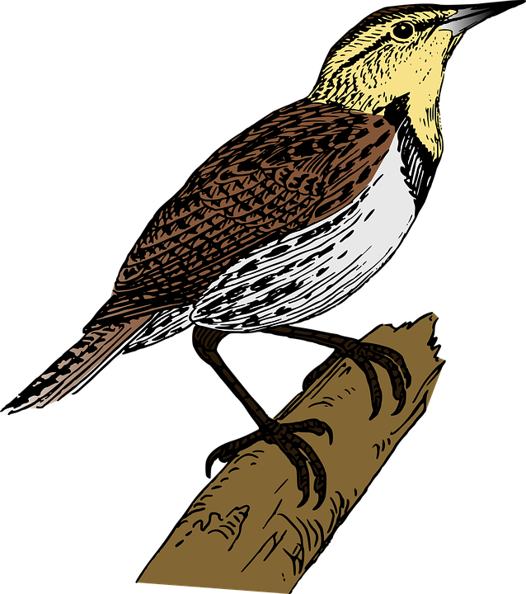
The ending (or coda)
Should the lark:
fly away?
descend back to earth?
or something else?
Notes:
Have a discussion about the ending (or coda). Begin by reminding your children that you are describing the story of the lark flying up into the air, looking down at the world below and then what? You might like to play the very ending of Vaughan Williams' piece (either in full or the BBC 10 Pieces version) to your children to inspire them.
Encourage them to use the story they are telling and create the perfect musical ending for it. Should the lark
fly away?
descend back to earth?
or something else?
Create a new ending for your piece. To make this as easy as possible steer your children towards repeating something they have already made rather than creating something new. Again, you might want to use their poetry from lesson 1 to help you.
Maybe they have already got the perfect ending! If so, practice your piece until it is perfectly executed
Finally, invite another class in to be your audience and perform your piece to them.

Slide 31
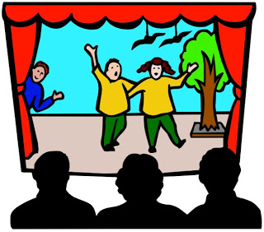
Tell the story!
Notes:
LESSON 6
Warm up. Begin the lesson with a quick focusing warm-up like pass the clap and then talk through the piece you made last lesson. It should look something like this –
Frozen soundscape
Tune – group by group getting louder (warmer) with each group
Coda – big note, rumbles, chords, big bang etc
Get the instruments out and put your piece back together.
Explain that you are going to perform the piece to an audience but first you have to explain a little about the story. Remind them of the story of Firebird and particularly the four main characters –
Prince Ivan
Princess
King Kastchei
Firebird
Split into four groups and ask each group to make a sort ‘signature tune’ for one character. In opera such ‘signature tunes’ would be known as ‘leitmotifs’.
Here are some rules, borrowed from Stravinsky, to help -
Prince Ivan – creeps around slowly and softly. (listen to Firebird Suite: Introduction)
Princess – she is sad. Her music goes down and up using next-door notes only (listen to Firebird Suite: Round of the Princesses)
King Kastchei - big bangs, loud and rhythmic (listen to Firebird Suite: Infernal Dance)
Firebird – fast, flickering, lots of short notes (listen to Firebird Suite: Variation of the Firebird)
Encourage your children to work quickly on this and make just a short, snippet of music for each.
If your class are struggling to remember everything musically, do this activity without instruments. Simply ask each group to ‘become’ their character – stand and pose like him/ her and say one or two sentences to move the story forward
Hear the groups separately and then ask your class to put the characters into an order that helps to tell the story. Add a tiny bit of narration, like this -
‘Prince Ivan crept into a frozen garden’ Prince Ivan music
‘He saw a statue of a beautiful princess, she looked sad’ Princess music
‘King Kastchei came along, he was angry’ King Kastchei music
‘The firebird saved the day’ Firebird music
‘The garden came back to life’ FINALE (everyone)
Practise your piece in order with the narration and finally, invite another class in to be your audience and perform your piece to them.

Slide 32
Taking it further – cross-curricular activities
LISTENING: Birdsong features in many famous pieces. Listen to Beethoven’s 6th Symphony, Movement 2 (ending), The Birds by Respighi or French composer Olivier Messiaen’s Oiseaux Exotiques and draw the birds that you hear.
ARTWORK: Vaughan Williams' lark looks down on the world from up high. What would the world around your school look like to the lark? Draw the school and its surroundings from the sky
LITERACY: Turn your poems into stories or even songs

