Slide 2
Ravi Shankar
Symphony – finale (excerpt)
Primary / KS2 / 2nd Level Classroom Lesson Plan
Written by
Rachel Leach

Slide 3
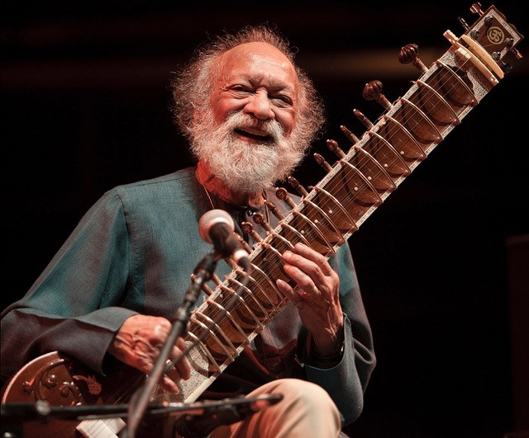
Trailblazer
Passionate sitar performer Ravi Shankar shared his love of Hindustani classical music by exploring it using the instruments of a large western orchestra

Slide 4
Lesson outcomes
After this lesson, pupils will be able to:
listen and reflect on a piece of orchestral music
create their own piece of music using instruments and voice
perform as an ensemble
learn musical language appropriate to the task

Slide 5
Curriculum checklist
Learners will:
play and perform in ensemble contexts, using voices and playing musical instruments
improvise and compose music for a range of purposes using the interrelated dimensions of music
listen with attention to detail and recall sounds with increasing aural memory

Slide 6
Glossary of music terms
Term | Definition
Call and response | a musical conversation. An idea is heard and then repeated by a different section of the orchestra
Coda | the ‘ending’
Drone | one long, continuous sound (pitched or unpitched) that is present throughout a piece, usually at the bottom of the texture
Improvise | make it up on the spot!
Pitched percussion | percussion instruments that can play different pitches – xylophones, glockenspiels, chime bars, etc.
Raga | a special scale used in Indian music, different to the major or minor scales used in western music
Unpitched percussion | percussion instruments that can only make a limited number of sounds – drums, shakers woodblocks, tambourine etc.

Slide 7
Lesson 1
Watching, listening and researching
Notes:
Prepare your class
Explain to your class that you are going to begin a six-week music project focusing on a fantastic piece of music by a composer called Ravi Shankar. He was a musician, performer and composer who made Indian music popular all around the world.
Watch the BBC Ten Pieces Trailblazer film and have a discussion about what you have seen.
Listening task
Watch the full orchestral performance next and ask your children afterwards to list the instruments they have seen on screen. Write these instruments on the board. As well as a full list of orchestral instruments the children will have seen a lot of percussion instruments and the sitar, here’s the full list:
Woodwind: Piccolo, Flute, Oboe, Cor Anglais, Clarinet, Bass Clarinet, Bassoon
Brass: French horn, Trumpet, Trombone, Bass trombone, Tuba
Percussion: Triangle, Bass drum, Cymbal, Whip, Bongos, Woodblock, Xylophone, Marimba
Strings: Harp, Violin, Viola, Cello, Double Bass, Sitar
Explain
Ravi Shankar was the first musician to add the sitar to the western orchestra and it is still very unusual to see it there alongside the violins and cellos, etc.
Divide your class into groups so that each group has access to the internet. Divide up the instrument list above among the groups. For example, if you have four groups, you could give them woodwind, brass, percussion, strings; if you have enough computers to work in pairs, each pair might get just one or two instruments. Your children’s task is to research their instrument/s and find out three facts about it.
You could even work individually and share access to the internet – each child will therefore get one instrument to research.
When this is achieved, ask your children to draw their instrument (they could choose their favourite one if working with a large group) and write their facts on the drawing.
For example – they might draw the violin and then label its bridge, bow and strings.
FINALLY, encourage each group to show their drawings and reveal their facts. Challenge your class to arrange their drawings into the order the musicians sit in. You could turn this into a display of all the instruments of the orchestra (plus sitar).

Slide 8
Background – the composer
Ravi SHANKAR
(1920–2012)
Indian musician and composer
Known as a sitar maestro
Brought Indian classical music to a western audience in the 1960s and was a huge influence on George Harrison from the Beatles, US composer Philip Glass and classical violinist Yehudi Menuhin

Slide 9
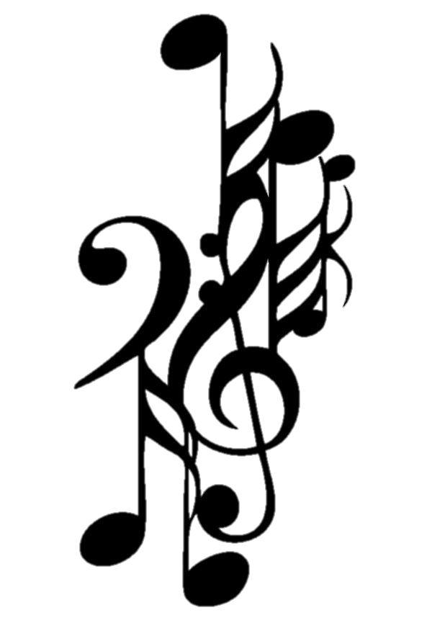
Background – the music
Symphony – finale (excerpt)
This 2010 work is a cross between a symphony and a concerto – it has four movements like a symphony and a prominent concerto-like solo part for sitar
Much of the sitar part is improvised
Uses traditional Indian ragas (modes) rather than major or minor scales and keys
Towards the end, there is a vocal section which uses Indian drum syllables as text

Slide 10
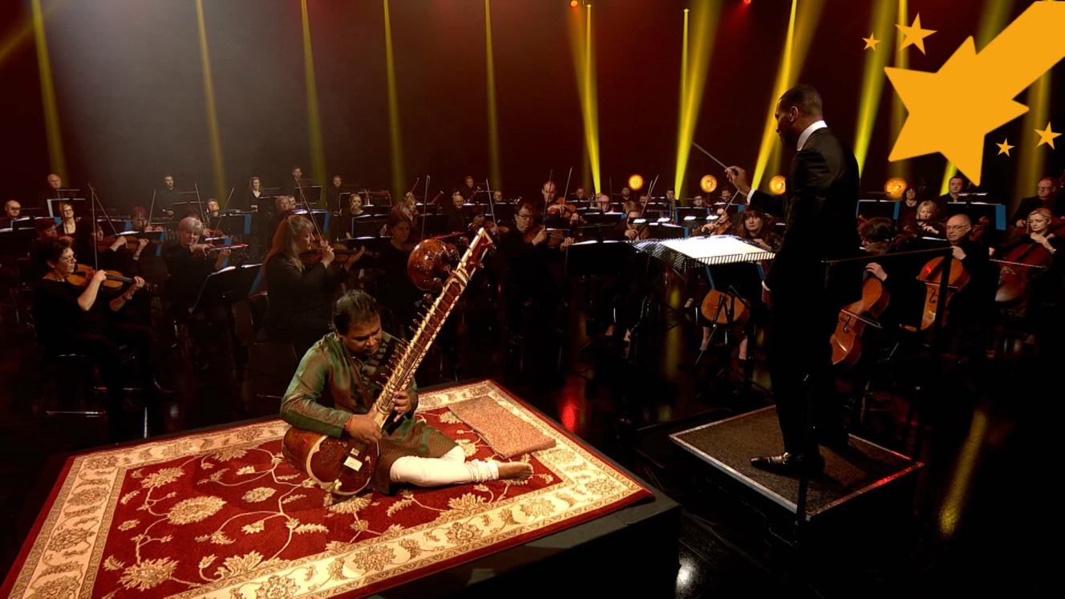
Watch the orchestral performance

Slide 11
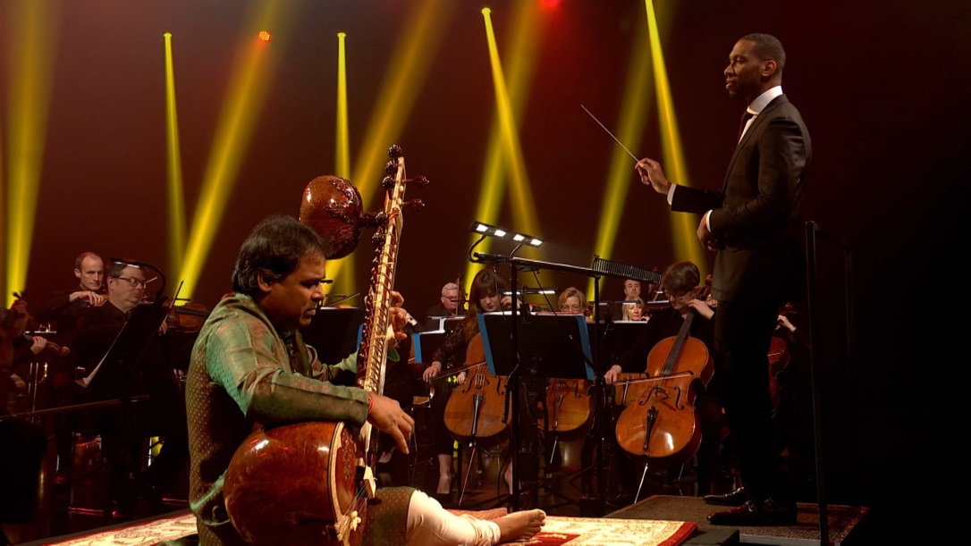
List the instruments you have seen in the performance
Draw one of these instruments (you can use the internet to see what they all look like)

Slide 12
Lesson 2
Ragas, drones and solos
Notes:
Warm-up
Ask your children to sit in a large circle and pass some sounds around like a clap, a ‘ssh’ and any other sounds and gestures they might suggest. Finally, ask your children to join you in making a quiet rumble by patting your knees quickly.
Explain
This sound is similar to a ‘drone’ – i.e. a long note played at the bottom of the music. There is a drone almost all of the way through the type of Indian music Ravi Shankar played and there is often a drone in his symphony.
Practise your drone (knee rumble) again and this time add a vocal sound by asking everyone to hum a low pitch too. Try just the vocal drone alone, if you have a xylophone or piano nearby play a low D and ask your children to hum it. D is the pitch of Shankar’s drone and the most important note in his symphony.
Shankar’s music uses a raga – this is a scale used in Indian music. The notes of the raga give Shankar’s symphony its special and unique sound.
Place a xylophone in the middle of your circle with, if possible, the pitches on it
Most classroom xylophones feature just the ‘white notes’ but many come with additional F# and Bb. If you can find these notes, simply replace the F with F# and the B with Bb. If you haven’t got these notes, just use as many as you can find (i.e. perhaps just D, E, F#, G).
Explain that the sitar soloist often improvises (i.e. makes it up on the spot). The soloist can play whatever they like as long as they stick to the notes of the raga.
Choose a volunteer to come forward and improvise a solo on the xylophone while the rest of the class hums and taps the drone. When the soloist has finished s/he simply chooses the next soloist and switches places with her/him. Challenge the class to keep the drone going while the soloists switch over and keep going in this way until everyone who wants to has had a go.
You may wish to add some instruments to your drone – any instrument that can play a long, low D will work. You could also add a soft rumble from a drum or a shimmer from a shaker. Appoint a conductor to signal changes in volume – this will help to keep the drone players engaged.
FINALLY, end your session by choosing the best three or four soloists, and the best combination of instruments for the drone and making a quick version of your piece so far. Make sure that everyone understands the elements you have used today – drones, raga and improvised solos.

Slide 13
Pat your knees quickly – this sounds like a ‘drone’
Hum a low sound too – a ‘vocal drone’

Slide 14
A RAGA is a scale used in Indian music
Play notes from the Raga on a xylophone

Slide 15
Lesson 3
Two-note patterns
Notes:
Warm-up
Start with your class sitting in a circle and practise your drone again. Remind your children of the music they worked on last lesson. Play a game of ‘copy me’: clap a rhythm, sing a tune or make a gesture and ask your children to copy it back. Keep going until you say ‘stop’. You can then choose a child to be the leader and play the game again.
Place two xylophones in the middle of the circle with just these two pitches on them:
… and choose two volunteers.
Ask your volunteers to repeat the ‘copy me’ game using the xylophones and just these two pitches. So, player A plays something on their xylophone and B copies it as closely as possible. There are no rules other than whatever is played must be easy enough to repeat back exactly. This game isn’t about catching the other player out, it is about communicating an idea clearly so that it can be copied.
Have several goes at this switching the pairs of players. Explain that in music, this is called ‘call and response’ and Shankar uses it a lot in his symphony.
Split the class into an even number of groups. Give each group the same set of instruments ensuring that at least one player has something able to play a D and an A. Beginner musicians may use the instrument they are learning – D and A are often among the first notes they will learn. It will also be useful to have a woodblock in each group keeping a steady pulse.
Challenge each group to make a short ‘call’ using just these two notes and any other unpitched sounds they like. Again, the only rule is that the ‘call’ is simple enough for it to be copied immediately and this time all team members must play the same rhythm at the same time.
Adding words to the ‘call’ may help with memory, for example –
Bring the class back together and hear each group one by one. Check that the ‘call’ is clear and everyone in the group is playing the same thing at the same time. Play the game of call and response using these new ideas like this:
Group 1: Call
Full class: Response (copies)
Group 2: Call
Full class: Response (copies) etc….
Ask all of the woodblock players to play the same pulse steadily, throughout. Use the words to help with any tricky rhythms.
FINALLY – ask your children to suggest an order for this. They might like to think about moving from the quietest call to the loudest, or the shortest to the longest. They can also repeat any patterns that they particularly like. When this order is decided on, write it down on the board carefully and play through it one last time to end the lesson.

Slide 16
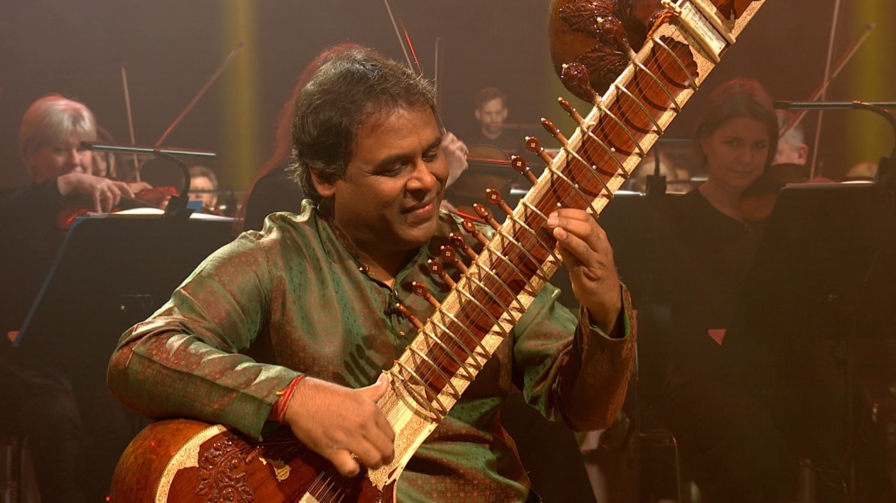
Warm up! Remember your drones from last lesson

Slide 17
Use these two pitches to play a game of ‘call and response’
Make up your own call and response – add words to help, if you like

Slide 18
Lesson 4
Vocalisation, Indian drum syllables
Notes:
Warm-up. Today’s lesson features singing so lead your class in a vocal warm-up, such as the one below:
Raise your left hand and make a nice, long ‘hmmmm!’ sound
Raise your right hand and make a short, horrible ‘urgh!’ sound
Ask your children to follow your hand signals, when you raise the left hand they must make the nice sound, when you raise your right hand they make the horrible sound. Try to catch the children out by raising your hands randomly and without a pattern
Taking it a step further, ask the children to make a high-pitched nice or horrible sound when your hand is held high up and a low-pitched nice or horrible sound when it is held down low
You can also try sliding your hands up and down as the children slide the sounds up and down in pitch
Repeat the ‘copy me’ (or ‘call and response’) game from last lesson but with vocal sounds. You can make random sounds as well as short fragments of melody.
Explain that Shankar uses Indian drum syllables in his symphony. These are short sounds used to teach and remember rhythms in South Indian Carnatic music. Shankar makes an exciting melody out of them and places it near the end of his piece.
Using call and response, teach it to your children. They can also play it on xylophones – it uses the same notes as their improvised solos in lesson 2 – and ask your woodblock players from the last lesson to provide a steady pulse throughout this.
The structure of this melody is very flexible. You may wish to repeat sections several times, perform the lines in a different order or even omit a section.
FINALLY, make a class version of this tune featuring:
Singing (and/or played on instruments)
Woodblock pulse
Drone (on D, or a quiet rumble)
Make sure you record or write down what you have created this lesson, the order of events and who played what.

Slide 19
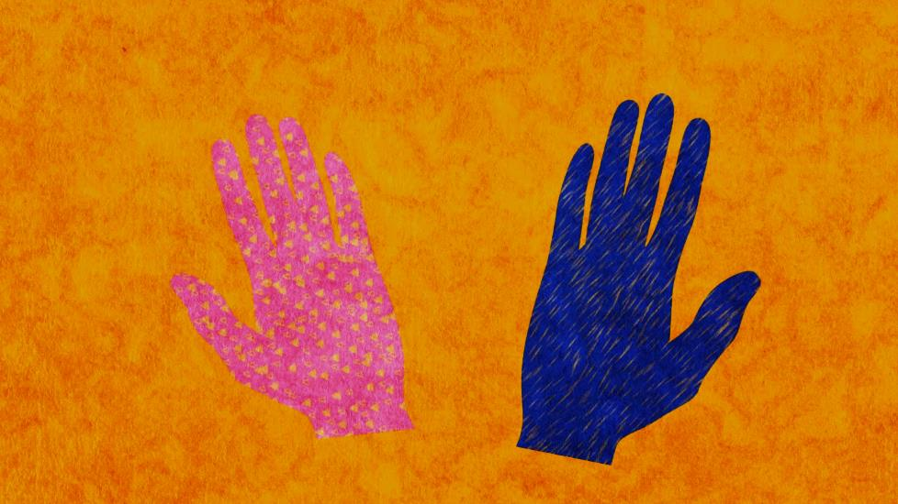
Warm up your voices!
Raising left hand = long ‘hmmmmm’ sound
Raising right hand = short, horrible ‘urgh’ sound

Slide 20
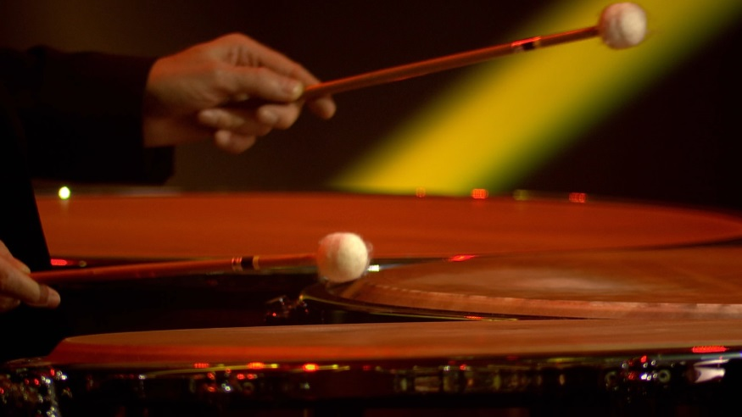
Learn the Indian drum syllables that Shankar uses in his music
Use these to make a class version of this tune, featuring:
Singing
Woodblock pulse
Drone

Slide 21
Lesson 5
Massive coda
Notes:
Warm-up
Begin in a large circle with a quick focusing activity and (spoken) reminder of what happened during the last session. You could repeat your ‘copy me’ rhythms or even sing through the song again.
Explain
Ravi Shankar ends his piece with a short, exciting section called a coda. You might want to listen to this bit again, it’s the last two minutes of the piece, after the singing.
Shankar’s coda is made up of the following ingredients:
Raga running up and down
Pulse and spiky rhythms
Spilt your class into two groups – pitched players and unpitched players. It is important that children remain on the same instrument they have been using since lesson 2.
Pitched group: create a short section that wanders up and down the notes of the raga. It doesn’t have to move all the way up and down, it can ‘get stuck’ in the middle. All the players must be playing the same thing at the same time.
The section must end with everyone playing a D together.
Unpitched group: This section must feature a constant, steady pulse but other rhythms or unexpected sound effects may be added to the pulse. For example, the group might want to create some ‘splashy’ sound effects such as a cymbal crash or a short rumble but these sounds must only appear occasionally and unexpectedly.
The section must end with one big bang – everyone playing together.
Bring the groups back together, hear each one separately and give some gentle feedback. Ask the class to suggest a way to put these two sections together to make one big coda. Should they begin at the same time or staggered? Can you adapt the speed of the raga to fit with the pulse? How do you line up the endings? You might have to try out a few versions before you decide on the best way to do this.
FINALLY, practise your coda until it is neat and everyone knows what they are doing. Write it down or record it.

Slide 22
Massive coda
Listen to the Coda again, which is at the end of the piece.
You can hear:
Raga running up and down
Pulse and spiky rhythms

Slide 23
Three tasks!
Pitched instruments: create a short section that wanders up and down the raga notes
Unpitched instruments: a constant, steady pulse, but other sound effects may be added
Fit these together to make your own Coda!

Slide 24
Lesson 6
Performance time!
Notes:
Prepare your class
Sit the children in a circle and quickly lead your vocal ‘copy me’ game to get a bit of focus in the room.
Talk through all of the elements they have made so far:
Improvised solos with drone (lesson 2)
Call and response two-note patterns (lesson 3)
Sung syllables (lesson 4)
Massive coda (lesson 5)
Get the instruments out and split back into groups. Give the class just five minutes to remember their ideas and then, working as a full team, slowly put all of these elements back together.
Ask your children to suggest an order for these sections so that they run seamlessly together and sound like one piece. Ravi Shankar’s piece uses the order above, but yours doesn’t have to!
Rehearse your full piece fixing any issues that might arise until everyone knows what they are doing and you are ready for a performance.
FINALLY, invite another class to hear your music and tell them all about Ravi Shankar.

Slide 25
Recap
Improvised solos with drone
Call and response
Sung syllables
Massive Coda

Slide 26
Practise and perform!

Slide 27
Taking it further – cross-curricular activities
MUSIC: Listen to traditional South Indian Carnatic music and see how it compares and differs from Ravi Shankar’s piece. Listen to how Ravi Shankar inspired the Beatles and American composer Philip Glass.
RESEARCH: Continue your research by taking a closer look at the other Indian instruments featured in a Carnatic orchestra, or instruments from other places around the world. Maybe someone in your class has family members who can play one of these instruments.
DANCE: Indian music is often danced to. Record your new piece and create a dance to go with it. Or choreograph Ravi Shankar’s piece.
UPLOAD: Show us what you’ve created! Submit your creative responses using our Uploader for a chance to be featured on the Ten Pieces website .

