Slide 2
Steve Reich
Music for 18 Musicians (excerpt)
Secondary / KS3 / 3rd & 4th Level Classroom Lesson Plan
Written by
Rachel Leach

Slide 3
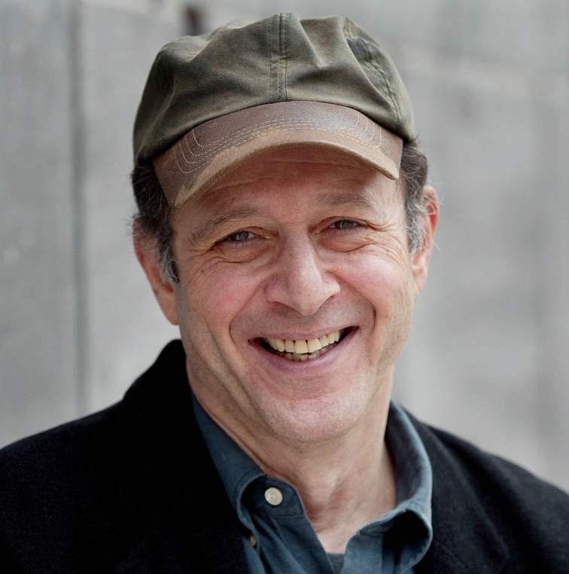
Trailblazer
Experimental composer Steve Reich helped to create a whole new form of music – Minimalism

Slide 4
Lesson outcomes
After this lesson, pupils will be able to:
listen and reflect on a piece of orchestral music
create their own piece of music using instruments and voice
perform as an ensemble
learn musical language appropriate to the task

Slide 5
Curriculum checklist
Learners will:
play and perform in ensemble contexts, using voices and playing musical instruments
improvise and compose music for a range of purposes using the interrelated dimensions of music
listen with attention to detail and recall sounds with increasing aural memory

Slide 6
Glossary of music terms
Term | Definition
Crescendo | gradually getting louder
Diminuendo | gradually getting softer
Dynamics | the term used for louds and softs/volume
Ostinato | a repeating (often rhythmic) pattern
Pitched percussion | percussion instruments that can play different pitches – xylophones, glockenspiels, chime bars, etc.
Unpitched percussion | percussion instruments that can only make a limited number of sounds – drums, shakers, woodblocks, tambourines, etc.

Slide 7
Lesson 1
Watching and listening
Notes:
Prepare your class
Explain to your class that you are going to begin a six-week music project focusing on a fantastic piece of music by an American composer called Steve Reich. Explain that Reich ‘invented’ a type of music called minimalism which is made up of small ideas that repeat a lot.
Watch the BBC Ten Pieces Trailblazers film and have a class discussion about what you have seen.
Listening task
Ask your children to sit comfortably and close their eyes. If you have the space, ask them to spread out and lie on the floor. Darken the room as much as possible by turning off the lights and closing the blinds or curtains.
Play the full performance of Reich’s piece and ask them to think about colour as they listen. Does the music sound like a particular colour? Can they ‘see’ colours in their mind as they listen?
When the music has finished have a discussion about this and write their colour choices on the board. Tell your children that there really is no right or wrong answer, it will be different for everyone and everyone’s opinion is valid.
Give each child a sheet of paper with a large circle printed on it. As you listen again, ask the class to lightly shade in the circle with the colour the music made them think of. Challenge them to shade in the whole circle during the time it takes to listen to the piece again (it lasts about four and a half minutes). Can they work in time with the pulse?
Coloured pencils will work best for this task because the children will be layering up different colours on top of each other.
Next ask your class to place a series of notches around the edge of the circle, as evenly spaced as possible. You could specify how many or just leave it up to them. The task below will work best with fewer notches so any number between five and ten.
This simple task could tie in to work you have been covering in maths. If you have talked about polygons, you could use their knowledge of these to help. i.e. draw eight notches to make an octagon.
Ask your children to join these notches together on the inside of the circle to make a second shape within it. They can use straight lines or curvy lines – it’s up to them. They can also join them in whatever order they like.
Finally challenge them to join the lines together again to make a third shape within the circle (they may need to miss out some notches, draw more or draw in a different way to make this work). This may result in many different shapes appearing within the circle and that’s ok.
When this is done, listen to the full performance of Reich’s piece again. This time, as they hear the music change they must colour in the new shapes within their circle with new colours inspired by the changing sounds of the music.
Continue in this way, listening to the music over and over and colouring in more and more areas adding new colours each time the music shifts.
FINALLY, take a look at everyone’s artwork. You could even create a quick art gallery by pinning them on the wall and having everyone wander around looking as the music plays one last time. Explain that their artwork looks similar to a kaleidoscope and that is one of the images Steve Reich had in his mind when he created his music back in 1974.

Slide 8
Background – the composer
Steve REICH
(b. 1936)
American composer – one of the most famous and well-respected contemporary composers
Began his career as a percussionist and was fascinated with repeating patterns
Is known as the ‘father’ of minimalism

Slide 9
Background – the music
Music for 18 Musicians (excerpt)
Written in 1974
One of Reich’s first pieces for large ensemble
Features an ensemble of clarinet, bass clarinet, violin, cello, voices, marimbas, vibraphones, metallophones, xylophones, pianos and maracas
Minimalism is a type of music that features just a few short ideas and a lot of repetition

Slide 10
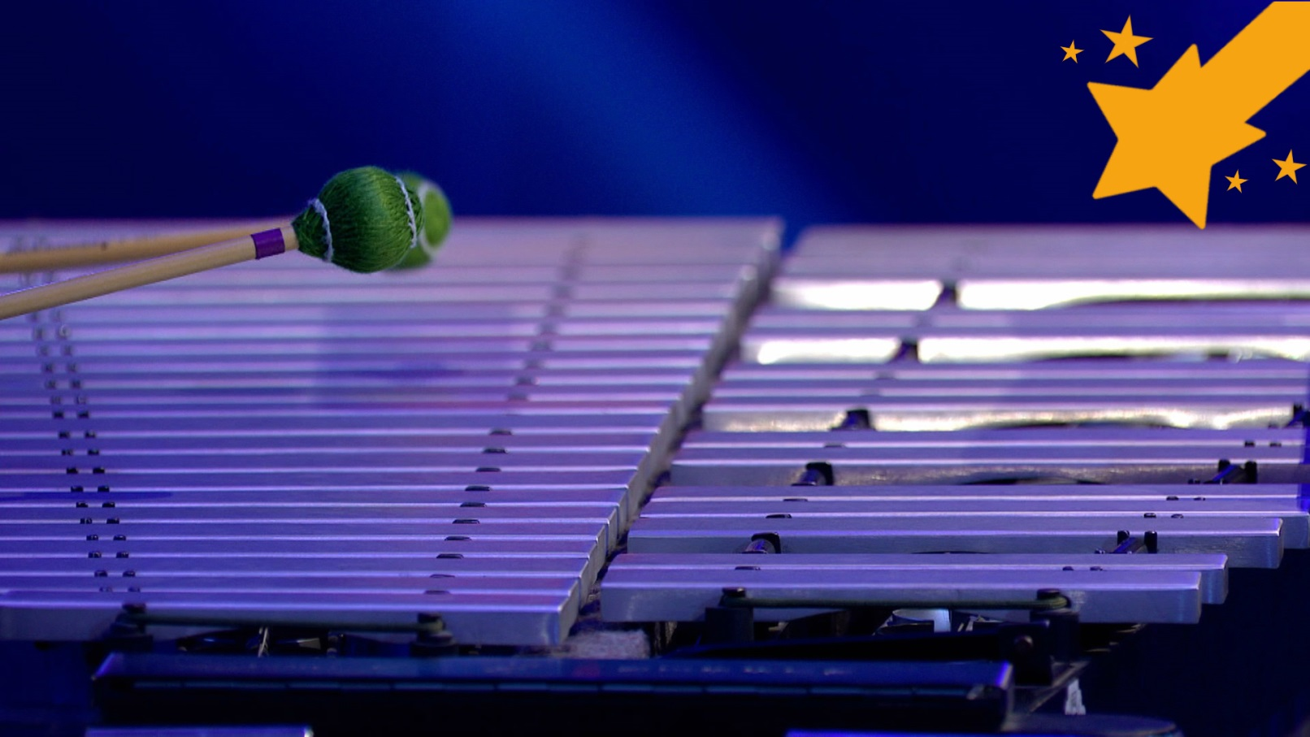
Watch the orchestral performance

Slide 11
Listen out for these instruments
Clarinets
Marimba
Xylophone
Violin
Maracas
Voices
Vibraphone
Piano
Cello

Slide 12
Lesson 2
Alternating quaver pulse
Notes:
Warm-up
Remind your children about Steve Reich and the work they did during the last lesson. Ask them to sit in a large circle and pass a clap around to get some focus.
Next, clap a steady pulse and encourage the class to join in. Stop and tell your children that as you clap the pulse you are counting over and over to six in your head. Show them what you mean by counting out loud and again, ask them to join in:
Ask one member of the class to play a drum on the first of every six as the rest of the class continue clapping the pulse without counting aloud. Like this:
Ask your children to suggest other ways to evenly split up the six (i.e. 1, 3, 5 or 1, 4 – maths helps here too: 3x2 or 2x3) and gradually give out instruments to play on just these numbers. For now, just use unpitched percussion.
Challenge some members of the class to play double speed, fitting a beat in between the main six beats.
Shakers, maracas or cabasas are ideal for this task
FINALLY, layer up these ideas to make a constant, yet perhaps changing, pulse. Try it with a conductor signaling when the different pulses enter and stop. Children who don’t yet have percussion can remain clapping or using body percussion sounds. Remind your class that Steve Reich’s piece has a similar pulse throughout and if you have time play the recording to them again

Slide 13
Use body percussion to perform this rhythm in two halves

Slide 14
Choose four pitches Create an alternating pulse like this one
Adding pitch!

Slide 15
Lesson 3
Expanding and contracting ostinato
Notes:
Warm-up
Start with your class sitting in circle and remind them, without using instruments, of the pulse exercise you worked on during the last lesson. Layer up your pulse in six again just using body percussion.
Explain
Steve Reich’s music uses repeated rhythmic patterns. A repeated pattern is called an ostinato. In Music for 18 Musicians, he uses just one ostinato that gradually lengthens and then shortens over the course of the movement. Follow these simple steps to create your own ostinato
Ask a simple question and ask for an answer expressed as a full sentence. You could choose a question related to this or another topic area you are studying, or you could just ask a random question like: ‘What’s your favourite food?’
Hear several answers and choose a simple one to work with. For example: ‘I like pizza’.
Challenge the class to say this over and over to your pulse.
When this is achieved, add something on to the end and practise saying this in rhythm:
This is your expanding/ contracting ostinato. Write all of the words on the board.
Don’t worry about how many beats the patterns last or the time signature – Steve Reich doesn’t! He likes it when things shift, collide and phase in different ways.
Structure your ideas
Steve Reich doesn’t fix how many times his patterns repeat and he doesn’t ask his musicians to count. In his pieces, often one player is in charge of when the changes happen. So, appoint a ‘conductor’. This person will signal when to shift to the next pattern by holding up his/her arm on the last pattern before the shift and then pointing downwards on the first beat of the new pattern.
You also need to choose a small group of children to keep the pulse going throughout this. Again, these children play unpitched instruments as the rest of the class speak the patterns. You will move onto instruments next lesson. If you keep changing the children performing pulse, everyone gets a go but also you can subtly ‘audition’ the children to find the best group for this really important task.
When this is achieved (you can try with several conductors too), challenge the class to make a version which expands from the simplest pattern (‘I like pizza’) getting longer and longer each time to the most complicated version (‘I like pizza and chocolate spaghetti mushrooms’), and then gradually contracts back to the simplest again. Each pattern should repeat several times before moving onto the next.
FINALLY: end the session with a performance and perhaps record it to help with memory next time.

Slide 16
Think of a simple rhythm and add words
Let’s make an ostinato!

Slide 17
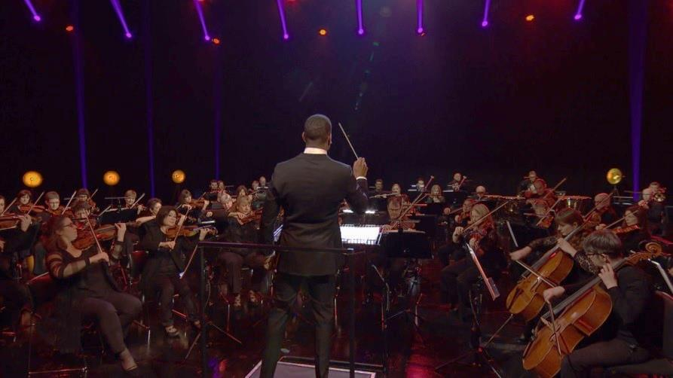
Choose a small group to keep the main pulse going, and a conductor to help coordinate it all!
Let’s make an ostinato!

Slide 18
Use the four pitches you chose in your last lesson

Slide 19
Invent a way to play the ‘I like pizza’ ostinato using the four pitches you have chosen.
Keep it simple!

Slide 20
Lesson 4
Floating notes
Notes:
Warm-up
Begin as usual in the circle and practise your expanding/contracting ostinato piece from last week.
Explain that is it time to move the ostinato onto pitched instruments. Steve Reich uses four-note chords in his piece. To find your own four-note chord simply ask the class to choose four pitches that they can all play so if you only have white note xylophones, choose four pitches from the white notes available. If you have beginner string players you might like to choose the four open strings or for beginner brass/woodwind players, simply go with the notes they are confident with. Write your choice of notes on the board.
Split the class into smaller groups and make sure each group has at least one pitched instrument within it. Challenge each group to invent a way to the play the original, simple ostinato (‘I like pizza’) using just the four pitches you have chosen. Encourage them to keep it as simple as possible, they don’t have to use all four pitches at this stage.
Bring the class back together and hear their efforts. Decide on the best one and teach it to the full class so that everyone with a pitched instrument can play it together neatly. Children without pitched instruments can provide the pulse or speak the rhythm.
Working either as a full class or back in groups figure out how to play all the different versions of the ostinato and practise until everyone with a pitched instrument can play them together. Always keep the beginning of the ostinato the same.
FINALLY, put your structure together with a conductor just like in the last lesson, i.e. moving from the shortest pattern to the longest, and back again as signalled by the conductor and with a group of children providing the pulse.

Slide 21
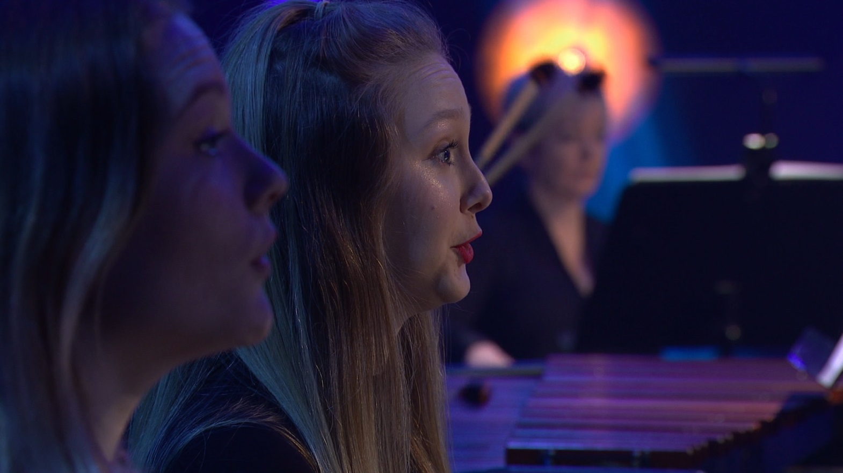
Warm up your voices!

Slide 22
As you’re singing, stretch these notes out to last for six, eight or ten beats Steve Reich lets performers hold the notes for as long as they can – you can try this too!
Sing the four pitches that you chose
in the last lesson

Slide 23
Choose a conductor to start and stop the sound and to control the dynamics

Slide 24
Lesson 5
Sections
Notes:
Warm-up
Begin in a large circle with a quick focusing activity and spoken reminder of what happened during the last session. You could also quickly clap through your pulse and your expanding and contracting ostinato.
Vocal warm-up
This lesson includes some singing so lead a quick vocal warm-up.
Ask your children to sing a song that everyone knows really well (‘Happy Birthday’ for example)
Ask everyone to close their eyes and sing it again
Ask the class to choose their favourite words from the song and when they sing again, stretch out this word every time they come to it. Demonstrate this by singing a quick solo version
During this last sing through, naturally the children will have chosen several different words and so the song will stretch out in many different ways at once causing clashes and unexpected harmonies. Some children will finish before others. This is exactly what you are aiming for!
Explain that you are going to add some singing to your minimalist piece, just like Steve Reich did. Remind the class of the four notes you selected last week and lead the children in singing these notes to a ‘do’ sound. Appoint a small group (perhaps those who don’t wish to sing!) as pulse keepers and challenge the rest of the class to make their notes stretch six beats, then eight, then ten, etc. Encourage them to aim for a lovely, round sound. It doesn’t need to be loud.
Ask the class to choose an order for these pitches and practise singing them in this order to an agreed number of beats (something easy like four or six beats). The easiest way to do this is to simply move up or down in pitch order, but it will be more fun to move around more randomly. Practise this until everyone can sing the order confidently. Something like this:
Explain that in Reich’s piece, the singers (and clarinettists) perform the long, floating notes. They simply play or sing each note for as long as they can and then stop. Steve Reich doesn’t tell them how long, it all depends on how much breath they take and for how long they can do it. Have a go at this. Ask your singers to sing the first note of the pattern until their breath is beginning to run out and then stop. Encourage them to stop before the sound is compromised!
Appoint a conductor
S/he will signal the start of the note and then the singers will sing until their breath runs out. After a short gap, the conductor will signal the next note. The pulse group should play while this is happening.
If you have beginner players, you can easily adapt this task to include them. Woodwind players, like in the real piece, must play until their breath runs out. Brass players can do the same. String players can play until their bow runs out. If you have metallophones or glockenspiels, the length of the notes can be until the sound has faded on its own. Players just hit the note quite hard once and let the sound ring until it dies naturally.
Control the volume
Explain that each long, floating note in Reich’s piece has a ‘swell’ of dynamics, i.e. it gradually gets louder (crescendo) and then gradually fades away (diminuendo). Ask your conductor to indicate this swell by raising and lowering his/her hand during each long note. Practise using the order you agreed above with the notes lasting as long as the breath and the pulse group keeping time. Continue doing this until it is neatly and confidently performed. You can keep switching conductor (secretly ‘auditioning’) and pulse players.
FINALLY, end this session by explaining that you have now explored all of Steve Reich’s musical ideas, during the next lesson you are going to put them together to make a piece.

Slide 25
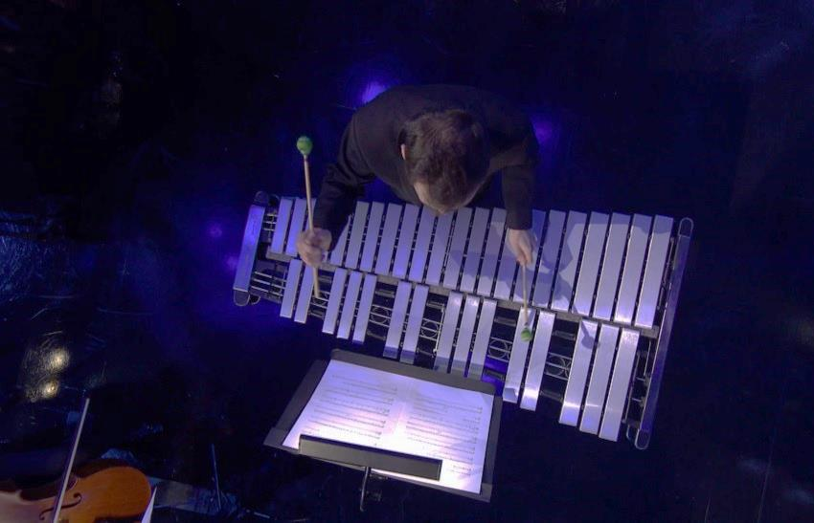
These three ideas move in and out as the quaver pulse remains constant
Recap
alternating quaver pulse
expanding ostinato
long, floating notes

Slide 26
Work as a group using eye contact and gesture to start and stop the different elements

Slide 27
Lesson 6
Performance time!
Notes:
Prepare your class
Sit the children in a circle and recap using just voices and body percussion all the elements you have explored so far. You should have
layered pulses - different ways to split up six beats. Conducted (lesson 2)
expanding and contracting ostinato using four-note chords. Conducted (lessons 3 and 4)
long floating notes with changing dynamics. Conducted (lesson 5)
Split into three teams. Each team will do just one of the elements above. You should have a pretty good idea which children will fit each task especially if you have kept track during the last four ‘experimental’ sessions. Appoint a conductor for each team and allow about ten minutes to rehearse.
Bring the class back together and hear each group one by one. Fix anything that needs a bit of extra work. You may need to help the conductors a little for example.
Ask the pulse group to begin and, when it is established, signal to one of the other groups to join and then the third. After a while, signal to all three teams to stop or fade away.
Ask the class to come up with an overall order of their own. Did they like the version they just performed, or can they come up with a better idea? You might need to appoint another conductor to signal all three groups just like you did or you could write a simple order on the board such as:
Pulse team
Floating notes join
Ostinatos join
Floating notes stop
Ostinatos stop
Pulse fades away
FINALLY, invite another class to hear your music.

Slide 28
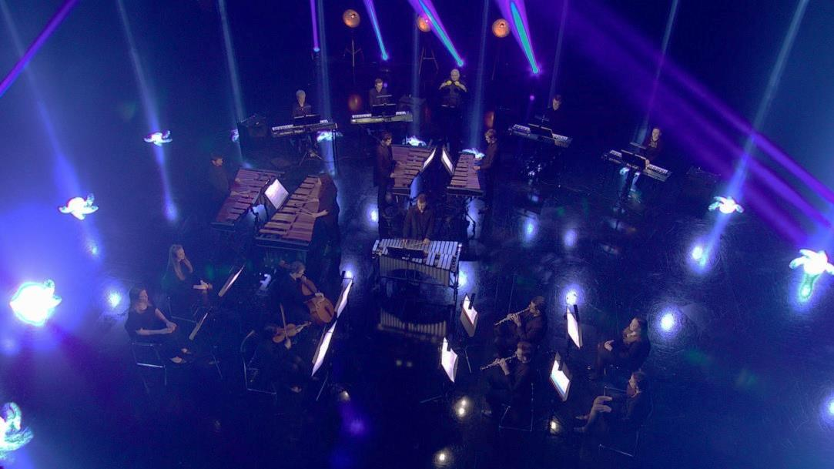
Think about structure and order The finished piece should move seamlessly from one group to the next

Slide 29
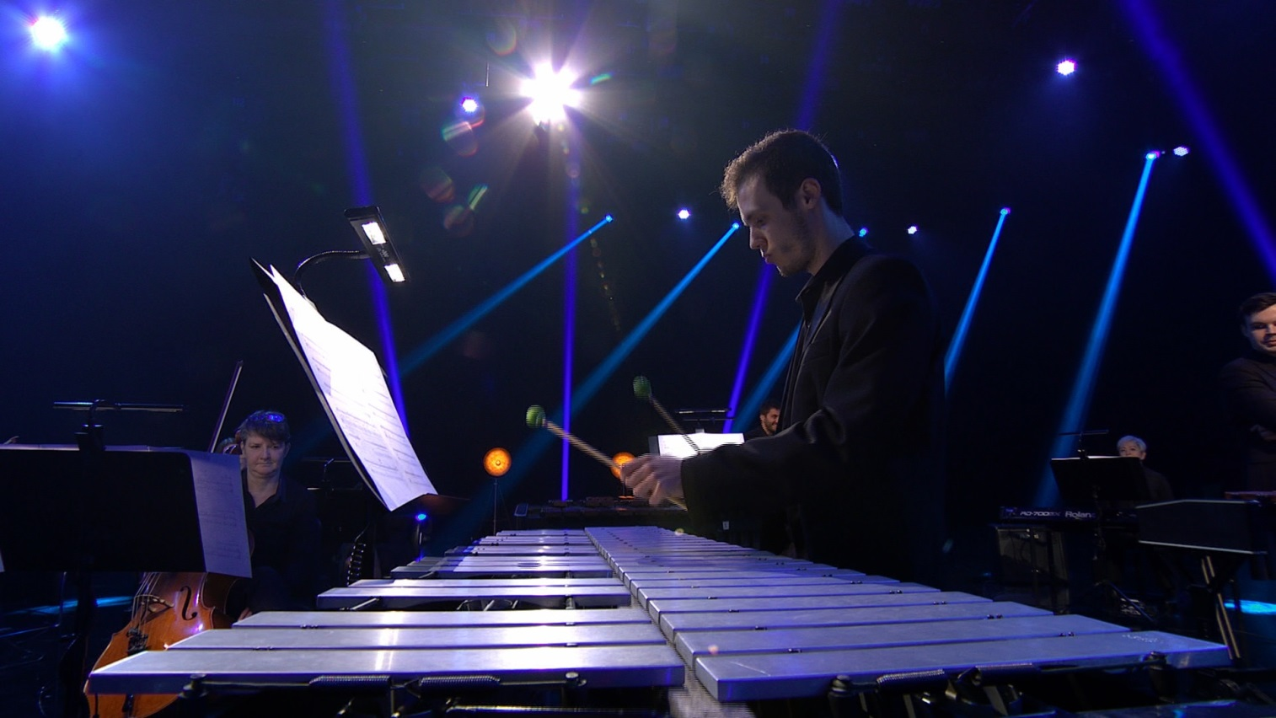
Practise and perform!

Slide 30
Taking it further – cross-curricular activities
MUSIC: Steve Reich’s music was a huge influence on another BBC Ten Pieces composer – John Adams. Adams’ music is minimalist but it also often tells a story. See ‘Short Ride in a Fast Machine’ for more details.
ART: Many artists have been inspired by the ‘colour’ they perceive in music. Research the abstract paintings of Kandinsky or use other BBC Ten Pieces music to inspire your own abstract art work.
TECHNOLOGY: Steve Reich’s early pieces were made using loops of tape. He would record sentences onto different lengths of tape and then loop these tapes around listening to how the recordings repeated and collided in different ways. Use software such as Garage Band, Audacity and BandLab to do the same thing.
UPLOAD: Show us what you’ve created! Submit your creative responses using our Uploader for a chance to be featured on the Ten Pieces website .

