Slide 1

Reena Esmail
Sun Sundar Sargam
Primary Classroom Lesson Plan
Author
Harpal Manku

Slide 2

Lesson outcomes
    Listen to and reflect on the piece Sun Sundar Sargam
    Create their own piece of music using instruments and voice
    Perform as an ensemble
    Learn musical language appropriate to the task

Slide 3
Resources required
Classroom percussion instruments (e.g. glockenspiels), keyboards or iPads with GarageBand
Classroom or school hall
Supporting resources (Resources, Sun Sundar Sargam Words)
African drums e.g. djembes or bongos

Slide 4
Curriculum Checklist
National Curriculum in ENGLAND (KS2)
Play and perform in solo and ensemble contexts, using their voices and playing musical instruments with increasing accuracy, fluency, control and expression
Listen with attention to detail and recall sounds with increasing aural memory
Improvise and compose music for a range of purposes using the interrelated dimensions of music
SCOTLAND Curriculum for Excellence (Second Level)
Performs on instruments, individually or as part of a group, to communicate the mood and character of a piece of music through, for example, the use of appropriate dynamics and expression
Explains, with supporting reasons, what works well and what could be improved in their own and others’ work, using appropriate musical vocabulary
Curriculum for WALES: Expressive Arts (Progression Step 3)
I can explore how creative work can represent, document, share and celebrate personal, social and cultural identities
I can identify and respond creatively to challenges with resilience and flexibility
I can apply knowledge and understanding of context, and make connections between my own creative work and creative work by other people from different places and times
NORTHERN IRELAND Primary Curriculum (KS2)
Listen and respond to their own and others’ music-making, thinking about, talking about and discussing a variety of characteristics within music that they create, perform or listen
Sing and perform with simple instruments from memory, by ear or from notation to develop vocal and instrumental skills.

Slide 5
Glossary of music terms
Term | Definition
Drone | Long sustained sounds without variation used for an atmospheric or ambient effect
Dynamics | How loudly or quietly a piece of music should be played
Tuned instruments | Instruments that have different pitches and can be used to play a melody or tune, e.g. glockenspiel
Pulse | Steady beat that runs through the music
Raga | A specific set of notes played in a specific order, like a scale, often on a sitar.
Raga Yaman | A type of raga which includes all seven notes in an octave. It is a early evening raga played between 7pm-10pm which is romantic in nature and signifies happiness, serenity, calmness and devotion
Rhythm | A pattern of sounds of different lengths
Sitar | A string instrument that comes from Northern India which is played sat down and looks similar to a guitar (although a sitar can have up to 21 strings, whereas a guitar has six strings)

Slide 6
Glossary of music terms cont.
Term | Definition
Tabla | Traditional Indian drum
Tala | A rhythmical pattern or phrase set to a cycle of time
Tanpura | A traditional long-necked plucked string instrument, visually similar to the sitar
Tempo | Speed of the music
Tintal | Most common tala, made up of 16 beats (4 + 4 + 4 + 4)
Tone | Refers to the sound qualities of a particular sound e.g. a loud tone, deep tone, pleasing tone etc.
Untuned instruments | Instruments that do not have different pitched sounds and cannot be used to play a melody, e.g. triangle

Slide 7
Lesson 1
Listen in colour
Copyright Harpal Manku & BBC

Slide 8

Background – the composer
Reena Esmail (b. 1983)
Reena Esmail first realised she wanted to be a composer around the age of 17. Her potential was spotted by her teachers at the Los Angeles County High School for the Arts, who put her into a composition class on Fridays.
Her talents blossomed when she carried on studying composition at The Julliard School in New York, but Reena Esmail has also studied Hindustani music in India.
Her music often celebrates how different musical styles can be mixed; Hindustani and Western classical music is a popular combination for her.
She is passionate about using music to bring communities together in a collaborative space and being a mentor to young composers.
Photo: Hannah Arista

Slide 9
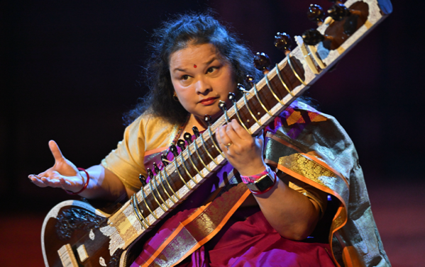
Background – the music
Sun Sundar Sargam
Reena Esmail’s piece is for voices and sitar, a popular stringed instrument in Northern India, Pakistan and Bangladesh. The sitar player sits down to perform and balances the sitar between their left foot and right knee.
Like Reena Esmail, other musicians have mixed the Hindustani sounds of the sitar with different music. Bands such as The Beatles and The Rolling Stones included the sitar in their music.
The piece uses the words sun sundar sargam which translates to ‘listen to the beautiful musical notes’.
Reena Esmail has based her piece on Raag Yaman, a popular raga in Hindustani music. A raga is a group of notes that act as ‘ingredients’ for improvisation.

Slide 10
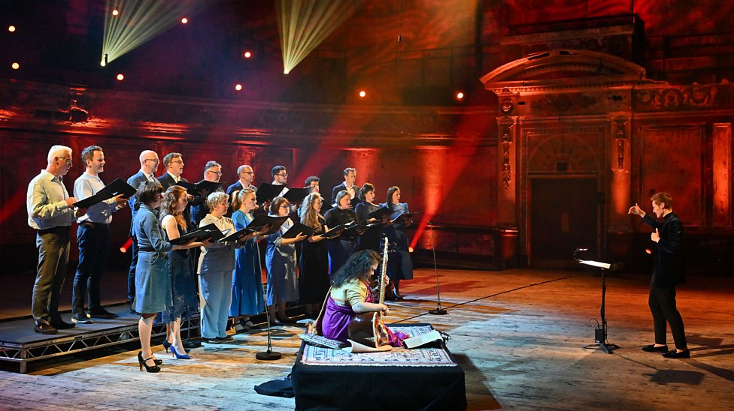
Listen to the orchestral performance
https://teach.files.bbci.co.uk/tenpieces/audio-Reena-Esmail-Sun-Sundar-Sargam-BBC.mp3
Notes:
WARM UP
Students are first going to create non-representational artwork based on the emotions they interpret in Sun Sundar Sargam.
Give each child a set of colours and plain A4 paper. Explain how students will be listening to Sun Sundar Sargam without knowing anything about it. Encourage them to think creatively about what they are hearing and to use musical terminology to support their colour choices, for example ‘the dynamic is loud and the key is minor, so I have used a strong, dark colour like black’.
Play the audio for Sun Sundar Sargam listening to the whole track. Give the students five minutes to start to draw any shapes using the colours.
Questions to consider:
Is there a consensus or is everyone picking different colours?
If the colours chosen are different, how different are they and why do you think that is?
What is the mood of the music?
What emotions do you feel when listening?

Slide 11
Sun Sundar Sargam
Audio guides by Reena Esmail
Sŭn sŭndar sargam sŭn Sapnā pāne kā sapnā bŭn Gāyegĭ dŭnĭyā terī dhŭn Sŭn sŭndar sargam sŭn Chŭp-chŭp the, tō gūnj ŭthe | Listen to the beautiful melody Weave the dream of achieving your dream The world will sing your song Listen to the beautiful melody If you are quiet, then the echoes will arise
Music: Reena Esmail Lyrics: Reena Bhansali
https://teach.files.bbci.co.uk/tenpieces/audio-Reena-Esmail-Sun-Sundar-Sargam-BBC.mp3
Notes:
2. ACTIVITY
Teacher to read the words of Sun Sundar Sargam both in Hindi and English meaning of the words.
Before listening to the audio for the second time, ask children to consider the following:
Key questions
What instruments can you hear? Answer (SITAR)
What is happening with the speed?
Where do you think this music is from?
What makes you think that?
Play the audio for Sun Sundar Sargam again to the whole class.
Ask the children to think about which country the music comes from and why they think that. Ask what instruments the children think they heard and to describe the tempo (speed) and dynamics (volume).
The children will be learning some of the traditional aspects of Indian music, including the instruments, the main components to listen out for and expression.
The children will learn the words of Sun Sundar Sargam. You can find Reena Esmail’s audio guides to her composition, including pronunciations, on the link on the slide.

Slide 12
Sitar – a string instrument played upright like a guitar.
Raga – a specific set of notes played in a specific order, like a scale, often on a sitar. Ragas relate to specific moods or times of the day and we will be learning more about this in the next lesson. Hear the Sitar Raga from 5’53 of Sun Sundar Sargam here.
Raga Yaman – a type of raga which includes all seven notes in an octave. It is an early evening raga played between 7pm-10pm which is romantic in nature and signifies happiness, serenity, calmness and devotion.
Notes:
Sitar – a string instrument played upright like a guitar.
Raga – a specific set of notes played in a specific order, like a scale, often on a sitar. Ragas relate to specific moods or times of the day and we will be learning more about this in the next lesson. Hear the Sitar Raga from 5’53 of Sun Sundar Sargam of the audio file (see slide 11).
Raga Yaman – a type of raga which includes all seven notes in an octave. It is an early evening raga played between 7pm-10pm which is romantic in nature and signifies happiness, serenity, calmness and devotion.

Slide 13
Raga Yaman Notes
Ni | Re | Ga | Ma | Da | Ni | Sa* | Sa* | Ni | Da | Pa | Ma | Ga | Re | Sa
B | D | E | Gb | A | B | C | C | B | A | G | Gb | E | D | C
Going up the scale
Aaroh Ascending
Coming down the scale
Avroh Descending
Notes:
With the class, discuss the Raga Yaman and what feeling or emotion students think it may be conveying.
Assessing student progress and understanding
Students with secure understanding indicated by: their ability to create a graphic drawing using colours and describe how this matches the general structure and mood of the music
Students working at greater depth indicated by: their ability to create a detailed graphic score showing several musical features, and justify their colour choices using musical terminology
Differentiation
Students needing extra support: might need the opportunity to view other groups’ graphic drawings during the activity and will be working in mixed ability groupings
Students working at greater depth: should use musical terminology throughout to describe the music they are listening to

Slide 14
Lesson 2
Raga Yaman
Copyright Harpal Manku & BBC
Notes:
Before the lesson
Teacher listens and plays the scale of Raga Yaman
Prepare the classroom with instruments, keyboards, Glockenspiels or iPads with GarageBand
Have ready Sun Sundar Sargam audio
Print out the relevant supporting resources (Sun Sundar Sargam Words, Resources – see slide 2)

Slide 15
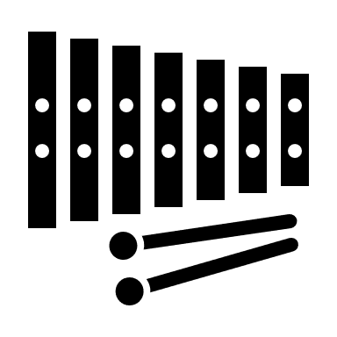
Raga Yaman Notes
Ni | Re | Ga | Ma | Da | Ni | Sa* | Sa* | Ni | Da | Pa | Ma | Ga | Re | Sa
B | D | E | Gb | A | B | C | C | B | A | G | Gb | E | D | C
Aaroh Ascending Going up the scale |  |  |  |  |  |  | Avroh Descending Coming down the scale
Notes:
SET UP
Children are going to be learning the basics of what Raga Yaman is and how they can use it.
Ask if they can remember what a raga is from last lesson (a raga is a series of notes which Indian music uses to create the tune).
They are going to be using keyboards or glockenspiels in pairs, using the following notes for the raga (see slide)
The idea is that the students will only use these notes within their composition.
2. ACTIVITY
First, get them to practise playing the notes of the raga in the right order. Hand out the worksheet Resources (see raga section) / display this slide and get them to try going up and down until they can play it fluently.
Next, allow one of the students to have a go at playing the same given notes in a different order. They can take it in turns improvising, as this is commonly found in traditional Indian music.
Explain to students what a drone is. A drone is a long sustained sound without variation which is used for an atmospheric or ambient effect. It is a note played over and over in the background, which can sound a bit like someone humming a long-held note.

Slide 16
Raga Yaman Notes
Ni | Re | Ga | Ma | Da | Ni | Sa* | Sa* | Ni | Da | Pa | Ma | Ga | Re | Sa
B | D | E | Gb | A | B | C | C | B | A | G | Gb | E | D | C
Drone Notes
Pa | Sa | Pa | Sa
G | C | G | C
Notes:
3. MAIN TASK
Put the children into pairs.
The children choose Pa or Sa (the note G or C – see Resources worksheet) for their drone which should be played on the keyboard or glockenspiels. Once they have decided which note to use, give them a few minutes to practise playing it again and again. They should play slowly, allowing the note to naturally die out before playing it again.
Once they are happy with the way it sounds, one person from each pair should continue to play the drone, while the other plays the raga alongside it. The person playing the raga should start in the given order, but when confident, can start to improvise (whilst still ensuring that they stick to the given notes).
Make sure both students in each pair get the opportunity to play the raga and the drone, even changing to the other drone note if desired.
Explain to the children that in Indian music the instrument used to create the drone effect is call the Tanpura. As sustained effect is obtained when the string is plucked.
In Sun Sundar Sargam, Reena Esmail often uses the voices as the drone. For example, in the opening of the piece, the voices are playing the drone.

Slide 17
Listen to the orchestral performance
https://teach.files.bbci.co.uk/tenpieces/audio-Reena-Esmail-Sun-Sundar-Sargam-BBC.mp3
Notes:
4. PLENARY
Ask the children to listen to Sun Sundar Sargam again, listening out for how the drone effect is created in the music (using the voices).
Students to show their work in progress to another group and get some peer feedback. Ask students to consider the following questions when giving feedback:
Have they used the note Pa or Sa?
How smoothly is it played?
Can they hum or sing Pa or Sa notes?
Does the raga play in time with the drone?
Assessing students progress and understanding
Students with secure understanding indicated by: Using the correct notes of the raga, playing alongside a drone.
Students working at greater depth indicated by: Showing more originality with their experimenting of the raga and playing in time with the drone.
Differentiation
Students needing extra support: Might need to use stickers on the notes that they need for the Raga Yaman.
Students working at greater depth: Should consider how to play in time with the drone.
Should experiment with a louder or quieter drone

Slide 18
Lesson 3
Tala
Copyright Harpal Manku & BBC
Notes:
Before the lesson
Teacher listens and plays the scale of Raga Yaman
Prepare the classroom with instruments including hand-played drums such as bongos or djembes, keyboards, Glockenspiels or iPads with GarageBand
Have ready Sun Sundar Sargam audio
Print out the relevant supporting resources (Sun Sundar Sargam Words, Resources)

Slide 19



Tala
Three Elements
Raga
A specific set of notes played in a specific order, like a scale, often on a sitar.
Drone
Long sustained sounds without variation used for an atmospheric or ambient effect
A rhythmical pattern or phrase set to a cycle of time
Notes:
SET UP
In the last lesson, the children should have mastered their ragas and understood the simplicity of the drone. Today, they are going to learn about the third element of Indian music: the tala, which simply plays a repeated rhythm that measures musical time.
The rhythm they will use has four different sounds. Each word represents a different sound played on the table/drum (Dha, Dhin, Ta and Tin).

Slide 20
Tintal Tala
1 | 2 | 3 | 4 | 5 | 6 | 7 | 8 | 9 | 10 | 11 | 12 | 13 | 14 | 15 | 16
Dha | Dhin | Dhin | Dha | Dha | Dhin | Dhin | Dha | Dha | Tin | Tin | Ta | Ta | Dhin | Dhin | Dha
1 | 2 | 3 | 4
Clap | 2 | 3 | 4
1 | 2 | 3 | 4
Clap
Notes:
2. ACTIVITY
Split the students into pairs.
Hopefully you’ll have access to some hand-played drums such as bongos or djembes (African drums). Give each pair one between two and get them to come up with four different sounds using only that drum. They can make four different sounds by playing with different parts of their hands and on different parts of the head of the drum (the top).
Once they have created four different sounds, they need to give each sound one of the names (Dha, Dhin, Ta or Tin) so that they can play the rhythm.
Once they’ve assigned each sound a name, they can have a go at playing the rhythm on their drums.
Explain that we are going to learn a common type of tala (a rhythmical pattern or phrase set to a cycle of time) called Tintal. It has sixteen beats and the strong and weak beats are marked with actions.
Go through the above the Tala grid and practise this section of the Tintal tala together. The first strong beat has been marked with a clap. Repeat it several times.
First, say the numbers aloud:
Clap / 2 / 3 / 4 / Clap / 2 / 3 / 4 / Clap / 2 / 3 / 4 / Clap / 2 / 3 / 4
Next, say the numbers in thinking voices only:
Clap / -- / -- / -- / Clap / -- / -- / -- / Clap / -- / -- / -- / Clap / -- / -- / --

Slide 21
1 | 2 | 3 | 4 | 5 | 6 | 7 | 8 | 9 | 10 | 11 | 12 | 13 | 14 | 15 | 16
Dha | Dhin | Dhin | Dha | Dha | Dhin | Dhin | Dha | Dha | Tin | Tin | Ta | Ta | Dhin | Dhin | Dha
CLAP | 2 | 3 | 4 | CLAP | 6 | 7 | 8 | WAVE | 10 | 11 | 12 | CLAP | 14 | 15 | 16
https://www.bbc.co.uk/teach/ten-pieces/articles/z2tfdnb
Notes:
3. MAIN TASK
Take a look at the following table of the Tala grid (16 box grid) and practise this together. Split the class into two – half the class should follow the hand gestures with the counting, and the other half can play the drum patterns (for Dha, Dhin, Ta and Tin). You can then swap over.
A wave has now been added to the weak beat 9 (rather than a wave like waving goodbye, this wave is an outward sweeping motion with the handheld palm upwards). Watch the performance film to see this in action, or see the slide for Ten Pieces sitar player Debipriya demonstrating this.
Try to perform the entire tala together, first saying the numbers aloud with the actions, then saying the numbers only in thinking voices. Once you reach 16, go straight back to 1.
Once you have performed the complete Tintal tala a few times, explain that children are going to construct their own piece.
As the first beat of an Indian tala is the most important, children should always put a clap on this. Each pair should now have: a drone, a raga and a tala, and now they are going to put all of these elements together. They should both have a go at each part.
Assessing student progress and understanding
Students with secure understanding indicated by: using the correct notes of the tala tintal, can develop an understanding of strong and weak beats, can count using the thinking voice and maintain a steady pulse
Students working at greater depth indicated by: showing the strong accents on beats 1, 5 and 13 and showing the weak accent on beat 9
Differentiation
Students needing extra support: might need to use stickers on the notes that indicate the strong and weak points in the tintal cycle, support with maintaining a steady pulse
Students working at greater depth: should perform with increasing accuracy and aural memory

Slide 22
Lesson 4
Performance
Copyright Harpal Manku & BBC
Notes:
Before the lesson
Check children have the performance piece to hand
Access to all the instruments you need, including student’s own instruments (if using them)
Device to record the performances for evidence

Slide 23
Drone Notes with Gaps
Pa |  | Sa
G |  | C
Sun Sundar Sargam
1 | 2 | 3 | 4
Sun |  | Sun
1 | 2 | 3 | 4
Sun | Dar | Sar | Gam
Raga Scale (Ascending & Descending)
Pa | Ma | Ga | Re
G | Gb | E | D
Ga | Re | Ni | Re
E | D | B | D
Notes:
SET UP
Ask the children to get back into their groups from Lesson 3 and to rehearse their pieces of music.
Remind the children that they will be performing these pieces in ten minutes time, so they need to use their time wisely to make any changes or improvements to their piece.
Ask the key questions and discuss the success criteria to ensure that everyone knows what they are working towards.

Slide 24



Let’s perform!
Notes:
2. MAIN TASK
The children will now perform as a class. Video or audio record this as an assessment record.
Gradually invite each group to perform their piece of music.
Play the video or audio recording back to the students and ask the following questions, trying to get the children to comment on both the piece of music itself and on the way it was performed:
What was the best part of the music?
What was the best thing about the performance?
What could they improve?
Ask the children to fix any issues that might arise until everyone knows what they are doing and you are ready for the performance.
3. PLENARY
Ask the children to tell you everything they have learned during lessons. Focus on the musical skills they have developed and encourage them to use musical terminology where appropriate in their answers.
Finally, get the class on stage in front of another class/the whole school to hear your music and tell them all about your musical journey with Raga Yaman.
Assessing students progress and understanding
Students with secure understanding indicated by: the ability to work as a group to perform a piece of music
Students working at greater depth indicated by: the ability to take a lead role in a group to perform a piece of music
Differentiation
Students needing extra support: could be grouped together with you supporting them
Students working at greater depth: should help support the class in the music making process

Slide 25
Taking it further – cross curricular activities
GEOGRAPHY/RESEARCH: The sitar is a traditional Indian instrument. Choose 3 different countries from anywhere around the world and research their traditional musical instruments, what they look like and what they sound like.
ARTWORK: Come up with a brand new musical instrument! Draw your instrument on a piece of paper and label the picture thinking about what it looks like, what it sounds like and why it looks this way.

