Slide 1

Judith Weir
Storm – Magic
Primary Classroom Lesson Plan
Written by Fran Hart

Slide 2

Lesson outcomes
Learners will:
Listen and reflect on the music heard
Explore developing knowledge of musical components by composing music to create a specific mood
Develop control of sounds to play/sing with more expression
Use voices creatively
Perform a structured composition in an ensemble

Slide 3
Resources required
Tuned and untuned classroom instruments
Non-instruments, e.g. wood, stones, metal

Slide 4
Curriculum Checklist
National Curriculum in ENGLAND (KS2)
Listen with attention to detail and recall sounds with increasing aural memory
Play and perform in solo and ensemble contexts, using their voices and playing musical instruments with increasing accuracy, fluency, control and expression
Improvise and compose music for a range of purposes using the interrelated dimensions of music
SCOTLAND Curriculum for Excellence (Second Level)
Recognises a range of music styles and identifies some of the main instruments used in, for example, classical music, jazz music, rock and pop music
Performs on instruments, individually or as part of a group, to communicate the mood and character of a piece of music through, for example, the use of appropriate dynamics and expression
Uses voice, instruments and technology to create music, experimenting with timbre, for example, uses tuned/untuned percussion instruments to create simple melodies and rhythms
Curriculum for WALES: Expressive Arts (Progression Step 3)
I can explore and describe how artists and creative work communicate mood, feelings and ideas and the impact they have on an audience
I can apply knowledge and understanding of context, and make connections between my own creative work and creative work by other people and from other places and times
I can identify and respond creatively to challenges with resilience and flexibility
NORTHERN IRELAND Primary Curriculum (KS2)
Sing and perform with simple instruments from memory, by ear or from notation to develop vocal instrumental skills
Work creatively with sound by creating musical stories, pictures, patterns, conversations, accompaniments and by investigating ways of preserving the music they have created

Slide 5
Glossary of music terms
Term | Definition
Andante | Musical direction meaning moderately slow speed
Chords | Two or more notes played at the same time
Concords | Comfortable-sounding chords (can be major or minor)
Compose | Create original music
Discords | Uncomfortable-sounding chords, clashes
Dynamics | How loudly or quietly a piece of music should be played
Expression | The mood, feeling, emotion or atmosphere created by the music
Forte | Played at a loud dynamic
Legato | Smooth sounds
Lyrics | The words in a song
Piano | Played at a quiet dynamic
Untuned instrument | Instruments that do not have different pitched sounds and cannot be used to play a melody, e.g. triangle

Slide 6
Glossary of music terms cont.
Term | Definition
Tuned instrument | Instruments that have different pitches and can be used to play a melody or tune, e.g. glockenspiel
Movement | A structure used to divide up a longer musical composition e.g. a symphony may be made up of three or four movements
Rondo | Section A is the first part, followed by Section B, a new section. A is then repeated before a new Section C is played. This can expand, e.g. ABACADAEA
Staccato | Short, detached sounds
Structure | The order of the different sections that make up a piece of music, e.g. intro, verse, chorus, outro
Tempo | Speed of the music
Ternary | A three-part structure, ABA, where A and B are contrasting sections
Texture | How we combine, mix and layer sounds (how ‘thick’ or ‘thin’ the music is, e.g. how many instruments are playing, how they are being played etc.)
Timbre | The particular sound quality of a musical instrument (e.g. your voice will have a different timbre to a flute)

Slide 7
Lesson 1
Copyright Fran Hart & BBC

Slide 8

Background – the composer
Judith Weir (b. 1954)
Best known for her music for opera and theatre – her music is performed all round the world.
Master of the King’s Music from 2014 to 2024 (an important job created back in 1626 by King Charles I!) – this means Weir works closely for royal events such as weddings, jubilees and coronations.
She grew up in London, from a Scottish family – her music draws inspiration from Scottish folk tales as well as older stories from Medieval times.

Slide 9


Background – the music
‘Magic’ from Storm
Uses text from William Shakespeare’s famous play The Tempest, drawing on the ocean, wind, waves and the air rather than specific characters.
Small ensemble of just 9 players, including female voices and a children’s choir.
The text for ‘Magic’ is written in Shakespeare’s favourite style: iambic pentameter where a line of text is split into ten syllables (stressed and unstressed).
Notes:
STARTER
Introduce the synopsis of Shakespeare’s The Tempest. Prospero uses magic to create a storm. This impacts shipwrecked people on an island, including Prospero’s brother. Judith Weir has composed ‘Storm’ in 5 movements that represent this story in music. The five movements are:
Storm/Shipwreck 2) Charm 3) Magic 4) Spirit 5) Mercy

Slide 10
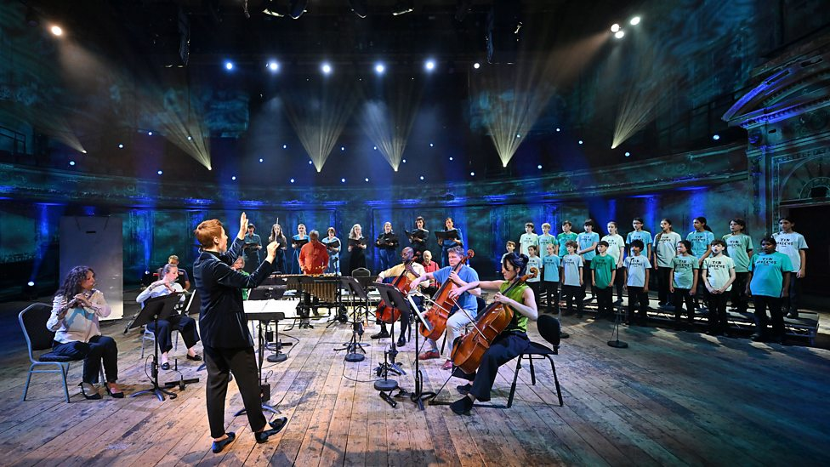
Watch the orchestral performance
https://www.bbc.co.uk/teach/ten-pieces/articles/zpyrmbk
Notes:
Watch or listen to 'Magic'.

Slide 11
William Shakespeare
The Tempest (Act V Scene 1)
Ye elves of hills, lakes, standing lakes and groves,
And ye that on the sands with printless foot
Do chase the ebbing Neptune and do fly him
When he comes back; you demi-puppets that
By moonshine do the green sour ringlets make,
Whereof the ewe not bites; and you whose pastime
Is to make midnight mushrooms, that rejoice
To hear the solemn curfew…. I have bedimmed
The noontide sun…. graves at my command
Have waked their sleeper, opened, let them forth.
Notes:
2. ACTIVITY
Discuss in pairs how the music creates a magical atmosphere. Share as a class.
Identify the use of everyday objects to create some of the sounds, e.g. stones are used at the very beginning, a referee’s whistle, and a sheet of metal. This will be easier if students have watched the film. Ask if anyone could make out any words.
Look at the words – the lyrics, as shown on the slide – taken from Shakespeare’s play, and identify any references to magic.

Slide 12

Create a magical atmosphere …
Use:
Vocal sounds
Untuned instruments
Tuned instruments
Everyday objects e.g. water bottles, pots, tubs …
Notes:
3. MAIN TASK
Prospero is about to cast a spell in The Tempest. Challenge – in groups, create a magical atmosphere using:
Vocal sounds
Untuned instruments
Tuned instruments
Everyday objects e.g. water bottles, pots, tubs etc. (Year 5 & 6 – use concords and discords)

Slide 13
Questions to think about…
How will the composition start?
How will the music change?
How will it end?
What will each player do?
How will we know if we are successful?
Notes:
Key questions groups can use to help their compositions:
How will the composition start?
How will the music change?
How will it end?
What will each player do?
How will we know if we are successful?
Groups explore sounds and how to play them to create a magical atmosphere. Encourage them to be creative with their instruments / voices and to use dynamics, tempo, texture, timbre etc., although this is the focus of Lesson 2. Record the compositions so that students can remember them.

Slide 14



Time to share!
Notes:
4. PLENARY
Groups share their compositions so far. Discuss how successful the group has been in creating a magical atmosphere, with suggestions and comments from other pupils. Has the group used all of the required sounds?

Slide 15
Lesson 2
Copyright Fran Hart & BBC

Slide 16
Watch the orchestral performance
https://www.bbc.co.uk/teach/ten-pieces/articles/zpyrmbk
Notes:
STARTER
Sing a well-known song, e.g. Twinkle Twinkle Little Star, Boom Chikka Boom, Drunken Sailor etc. We will revisit this later in the lesson.
2. Watch or listen to ‘Magic’ by Judith Weir again

Slide 17
‘Magic’ from Storm
What dynamics, tempo, texture, timbre would describe the opening?
How does the piece end?
Is the music always the same dynamic?
Does the tempo change?
Notes:
Discuss how the music changes and develops. Example questions:
Use dynamics, tempo, texture, timbre etc. to describe the opening
e.g. quiet – piano / short sounds – pizzicato pulsing/ quite thin textured / andante – walking pace
How does the piece end?
A descending flute pattern – scale, a metal sheet or thunder sheet and strings playing on the bridge for a rough scratchy effect
Is the music always the same dynamic?
No – it starts quietly, has louder and quieter sections before a loud climax two thirds in where the referee’s whistle is used. It reduces in dynamic, but is very loud just before the very end
Does the tempo change?
No – there are changes of rhythm/duration, particularly in the flutes, but the pulse remains the same
3. LEARNING
Sing the well-known song (chosen at the start of this lesson, e.g. Drunken Sailor or Boom Chikka Boom), but make changes to it e.g. singing it at different tempo (speed), dynamics (how loud or quiet), with different length sounds (duration) and using different ‘voices’, e.g. whispering, in an opera style, with an accent (timbre). Can any layers be added to make a thicker texture?
Discuss the impact of these changes on the mood of the song. This is expression – the mood, feeling, emotions or atmosphere of a piece of music. Highlight how a singer might show expression as they sing (e.g. this can be done through diction and dynamics).

Slide 18
Musical Expression
Revisit your magical atmosphere creations
How can you develop the use of…
  Dynamics?
  Tempo?
  Timbre?
  Texture?
  Duration?
Notes:
4. MAIN TASK
Apply this understanding of expression to the magic music creation in Lesson 1. Revise the task that was set to create a magical atmosphere using:
Untuned instruments
Tuned instruments
Everyday objects (Year 5 & 6 – use concords and discords)
Groups need to develop their use of dynamics, tempo, timbre, texture and duration to make their compositions more expressive and magical.

Slide 19
Time to share!
Notes:
5. PLENARY
Share the magic compositions again. Each group should explain the changes they have made to make their composition more expressive. The other class members should give feedback to the group to say how successful they have been in creating expressive magic music.

Slide 20
Lesson 3
Copyright Fran Hart & BBC

Slide 21
Watch the orchestral performance
https://www.bbc.co.uk/teach/ten-pieces/articles/zpyrmbk
Notes:
STARTER
Listen or watch Magic’ by Judith Weir again, focussing on the lyrics and how they are combined with the instrument sounds.

Slide 22
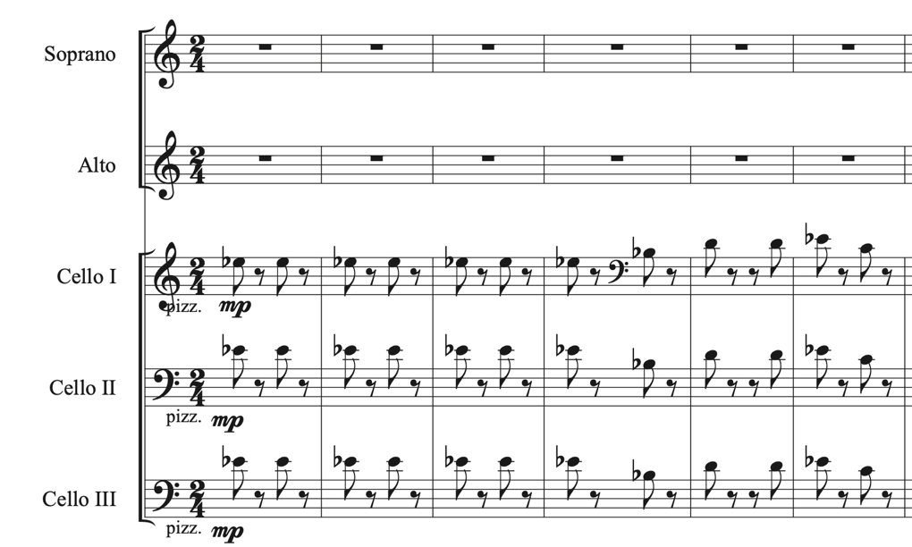
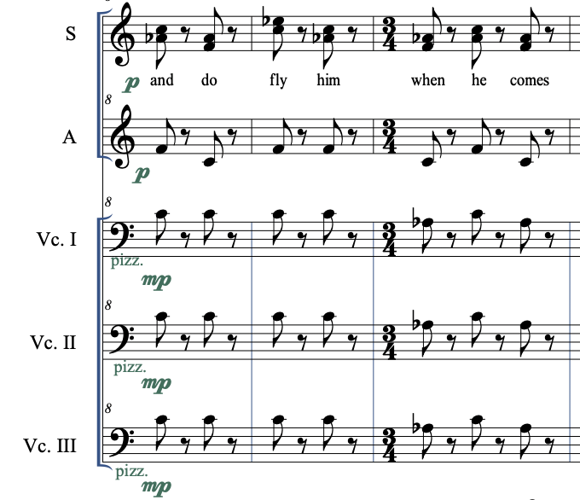
https://teach.files.bbci.co.uk/tenpieces/audio-Judith-Weir-Magic-from-Storm-BBC.mp3
Notes:
Listen again to the opening few bars and identify how the sounds are short (staccato) as the cellos play pizzicato.
This is also heard with the voices in bars 15-17 (0’25) 32-35 (0’55) and 39-43 (1’07).
Here are bars 15-17 (see slide above, second image)
2. ACTIVITY
Listen again and ask the pupils to identity when the music changes mood and is no longer short and staccato. This is in bar 46 (1’19) where the music is marked as legato misterioso. Ask the class – what do you think legato misterioso means? Answer: smooth and mysteriously.

Slide 23
The noontide sun, called forth the mutinous winds,
And ’twixt the green sea and the azured vault
Set roaring war—to th' dread rattling thunder
Have I given fire, and rifted Jove’s stout oak
Notes:
3. LEARNING
Read together:
The noontide sun, called forth the mutinous winds,
And ’twixt the green sea and the azured vault
Set roaring war—to th' dread rattling thunder
Have I given fire, and rifted Jove’s stout oak
This is still part of Prospero’s speech before his spell is cast. These Shakespearean words are in iambic pentameter. This means there are usually 10 syllables in a line where they are in pairs of an unstressed syllable, followed by an stressed one.
Read the words again, stressing the alternating syllables.
Explore the words, copying the staccato opening of Storm and then repeating with legato (smooth) sounds.
Experiment with changing duration, tempo, dynamics, pitch and timbre of the words as they are spoken.
Discuss how changing dynamics, tempo, texture, timbre etc. creates different moods from the words.
4. MAIN TASK
Year 3 & 4 – as a class
Year 5 & 6 – in the same groups as Lesson 1 and 2
Either prepare a performance of Prospero’s words (2 or 4 lines), creating a mysterious atmosphere that matches the words or write 2 lines of a spell in iambic pentameter. These lyrics will then need to be performed in a mysterious way, using some of the techniques explored, e.g. whispered, short, quiet sounds, followed by legato, loud sounds. They can also be sung rather than spoken.

Slide 24
Time to share!
Notes:
5. PLENARY
Share the lyrics rehearsed so far. What techniques have been used to create a mysterious atmosphere? Do they sound like a spell? Are there suggestions on how improvements can be made?

Slide 25
Lesson 4
Copyright Fran Hart & BBC

Slide 26

Musical Structure
Is there…
An intro
Verse
Chorus
Outro
Can you think of some other examples?
Notes:
STARTER
Sing a well-known song and identify how it is structured. For example, an intro, verse, chorus, verse, chorus, outro.
What is structure? It is the way the music is mapped or planned out.

Slide 27
Our Magic Music
Lyrics
Structure
The noontide sun, called forth the mutinous winds,
And ’twixt the green sea and the azured vault
Set roaring war—to th' dread rattling thunder
Have I given fire, and rifted Jove’s stout oak
Year 3 & 4 – rondo
Section A – whole class lyrics
B – group magic music
A
C – another group’s magic music
A
D etc.
Year 5 & 6 – ternary form
A section– magic music
B section – mysterious spell lyrics
A section repeated
Notes:
MAIN TASK
Year 3 & 4 – whole class should rehearse the lyrics, revising how these will be performed to create a mysterious atmosphere for casting a spell. Groups should also rehearse their magic music. The class will need to rehearse the whole composition, ordering their music as a rondo:
Section A – whole class lyrics
B – group magic music
A
C – another group’s magic music
A
D etc.
Questions to ask:
Are all the players clear when they play?
Is a conductor or leader needed to point to groups or something displayed to help?
Are there any improvements needed before the final performance?
Is everyone remembering how to control the sounds to make the music expressive?
Year 5 & 6: Introduce ternary form. This is music in 3 sections where the third section is a repeat of the first, i.e., ABA, where A and B are contrasting/different.
A section– magic music
B section – mysterious spell lyrics
The groups will need to rehearse their separate magic music and spell lyrics before rehearsing them in the ABA structure.
Groups need to ask themselves:
Are the 2 sections different?
Does the music flow from A into B, then back to A?
Are all the musicians clear on what they do in each section?
Is a conductor or leader needed to help the group?
Are any improvements needed before the final performance?
Is everyone remembering how to control the sounds to make the music expressive?

Slide 28
Time to share!
Notes:
3. PLENARY
Perform and record the compositions.
4. EVALUATE
How expressive was the music?
How successfully was a magical atmosphere created?
What could be improved further?
What have we learnt?

Slide 29
Evaluate
How expressive was the music?
How successfully was a magical atmosphere created?
What could be improved further?
What have we learned?

Slide 30
Taking it further – cross curricular activities
MUSIC: Listen to other music that conjures up a magical atmosphere, e.g. Mussorgsky’s Night on a Bare Mountain. Compare the music to Magic.
ENGLISH: Explore further iambic pentameter. Develop this in writing poetry or a play to perform as a class in an assembly (this could be linked to the composition from this unit.
RESEARCH: Find out more about Shakespeare – his plays and his life. How and why has he become such an influence on writing and the stage? Include information about the globe theatre and life in Shakespearian times.

