Slide 1

Sally Beamish
Seavaigers - Haven
Primary Classroom Lesson Plan
Written by
Fran Hart

Slide 2

Lesson outcomes
After this lesson, pupils will be able to:
Listen and reflect on the music they hear
Explore developing knowledge of musical components by composing music to create specific moods
Use voices and instruments creatively
Develop control of sounds to perform with more expression
Develop improvisation through question and answer
Develop understanding of chords – concords and discords
Learn musical vocabulary

Slide 3
Resources required
Tuned and untuned classroom instruments

Slide 4
Curriculum Checklist
National Curriculum in ENGLAND (KS2)
Listen with attention to detail and recall sounds with increasing aural memory
Play and perform in solo and ensemble contexts, using their voices and playing musical instruments with increasing accuracy, fluency, control and expression
Improvise and compose music for a range of purposes using the interrelated dimensions of music
SCOTLAND Curriculum for Excellence (Second Level)
Performs on instruments, individually or as part of a group, to communicate the mood and character of a piece of music through, for example, the use of appropriate dynamics and expression
Uses voice, instruments and technology to create music, experimenting with timbre, for example, uses tuned/untuned percussion instruments to create simple melodies and rhythms
Curriculum for WALES: Expressive Arts (Progression Step 3)
I can explore and describe how artists and creative work communicate mood, feelings and ideas and the impact they have on an audience
I can identify and respond creatively to challenges with resilience and flexibility
I can apply knowledge and understanding of context, and make connections between my own creative work and creative work by other people and from other places and times
NORTHERN IRELAND Primary Curriculum (KS2)
Discuss and make suggestions about their own and others’ music-making
Think and talk about the elements of music and how they are used in music from different styles and cultures
Create stories and pictures through sound, for example, using voices, instruments and other sound sources

Slide 5
Glossary of music terms
Term | Definition
Chords | Two or more notes played at the same time
Compose | Create original music
Concerto | A piece of classical music that features one or more soloists accompanied by an orchestra or ensemble
Concords | Comfortable-sounding chords (can be major or minor)
Discords | Uncomfortable-sounding chords, clashes
Dynamics | How loudly or quietly a piece of music should be played
Expression | The mood, feeling, emotion or atmosphere created by the music
Improvising | Creating music without preparation
Melody | The tune, made up of a mixture of high and low pitch sounds played one after the other (it’s the part of the music that you often find yourself singing along to or remembering)
Movement | A structure used to divide up a longer musical composition e.g. a symphony may be made up of three or four movements
Ostinato | Rhythm or melody that constantly repeats

Slide 6
Glossary of music terms cont.
Term | Definition
Tuned instruments | Instruments that have different pitches and can be used to play a melody or tune e.g. glockenspiel
Rhythm | The pattern that goes over a beat. The rhythm is the pattern of the words in songs
Staccato | Short, detached sounds
Structure | Thee order of the different sections that make up a piece of music e.g. intro, verse, chorus, outro
Tempo | Speed of the music
Texture | How we combine, mix and layer sounds (how ‘thick’ or ‘thin’ the music is, e.g. how many instruments are playing, how they are being played etc.)
Timbre | The particular sound quality of a musical instrument (e.g. your voice will have a different timbre to a flute)
Triad | Three-note named chords, e.g. C major
Untuned instruments | Instruments that do not have different pitched sounds and cannot be used to play a melody e.g. a triangle
Tuned instruments | Instruments that have different pitches and can be used to play a melody or tune e.g. glockenspiel

Slide 7
Lesson 1
Copyright Fran Hart & BBC

Slide 8
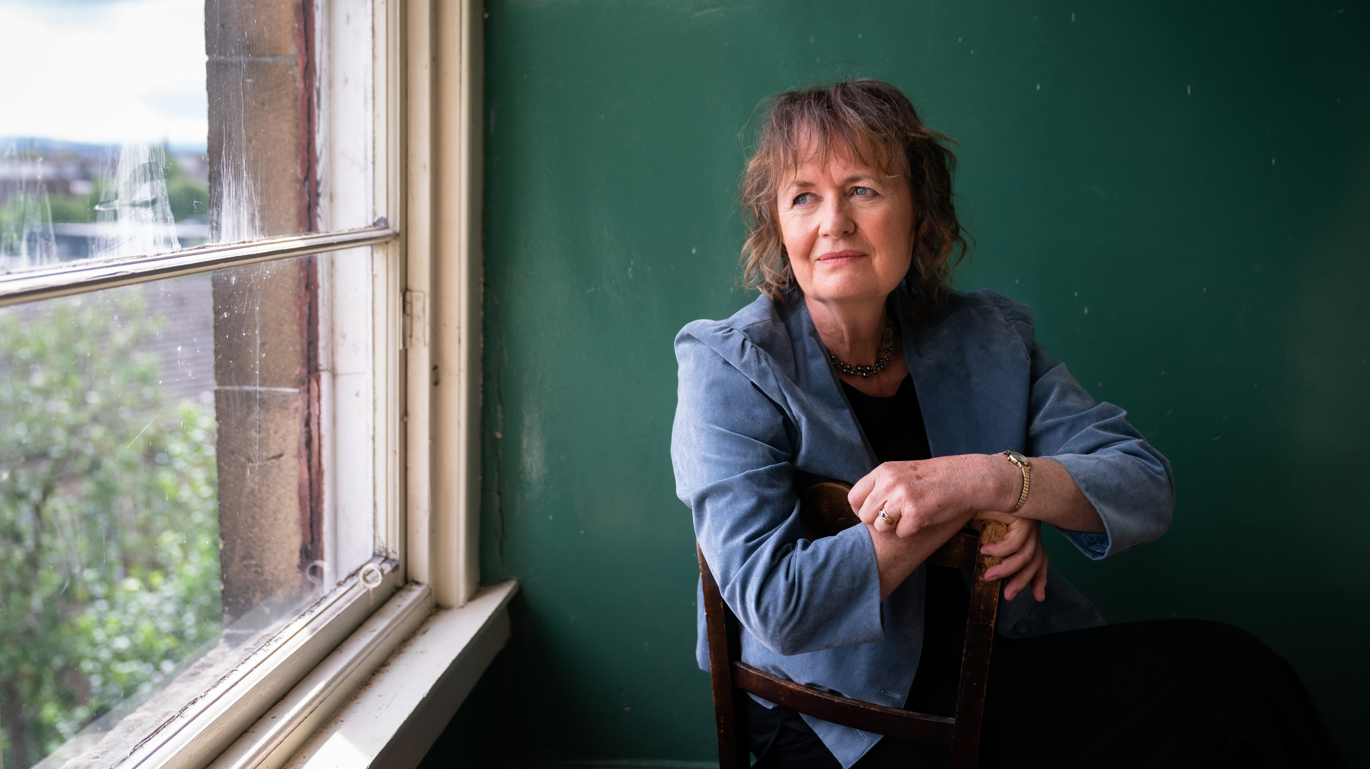
Background – the composer
Sally Beamish (1956 – Present)
British composer and viola player, has played in many ensembles
She has written music for huge variety of instruments and ensembles including opera, theatre, concerti, and traditional folk instruments
She is largely self taught as a composer and studied viola in Manchester
She was mentored by famous classical music figures including Lennox Berkeley, Oliver Knussen and Peter Maxwell Davis

Slide 9

Background – the music
‘Haven’ from Seavaigers
Seavaigers is a is a concerto and means ‘Seafarers’ in Scots, referring particularly to the North Sea, which is off the East coast of Scotland and England.
Travelling by sea is exciting and beautiful but it can be difficult. ‘Haven’ is about the long-awaited return to home after being at sea.
The solo instruments in Seavaigers are the Scottish harp, or ‘clársach' (pronounced KLAR-suhkh (-ar as in bar, -kh as in Scottish ‘loch’ (not lock)) and the Shetland fiddle. These are played by Catriona McKay and Chris Stout who are from Dundee and Shetland. These are places in Scotland whose history is heavily connected to the North Sea.
Seavaigers brings together traditional folk instruments and a classical string orchestra to create a musical fusion of sound.

Slide 10
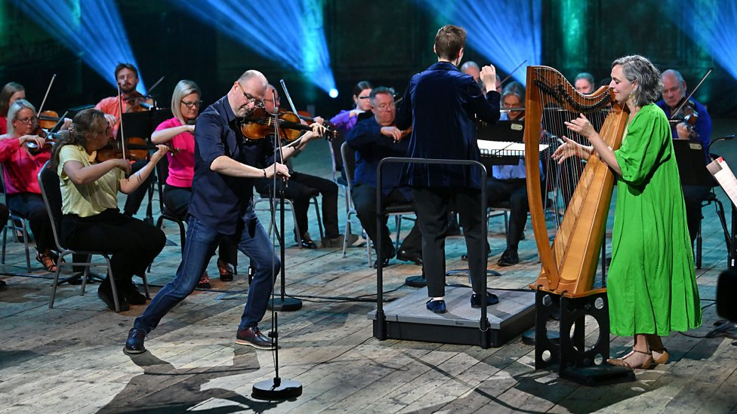
Watch the orchestral performance
https://www.bbc.co.uk/teach/ten-pieces/articles/z4bcxg8
Notes:
STARTER
Watch or listen to ‘Haven’.
What is a haven? It is a safe place. This music is the last movement of Seavaigers, a composition by Sally Beamish that represents the treacherous journey between the North Sea island of Shetland and northerly mainland port of Dundee. The title means ‘Seafarers’ and refers to the seafaring people of the North Sea.
It is in 3 movements – Storm, Lament and Haven.
See next slide for questions for students to consider.

Slide 11
Listen and Reflect
  What is a haven?
  How does the music create the idea of a safe haven?
Notes:
Split the class into pairs, getting pairs to discuss how the music creates the idea of a safe haven. Share as a class.

Slide 12














Let’s create chords!
Notes:
MAIN TASK
Next, the children will explore tuned instruments to create chords. The combination of 2 or more notes creates chords. If using glockenspiels and xylophones, for instance, ask children to play 2 notes at the same time and identify whether the sound is comfortable or not.
What is the rule for creating a discord? Play notes next door to each other.
What is the rule for creating concords? Play notes apart.
Year 5 & 6 – Develop this to understanding triads: 3 note chords, e.g. played on a keyboard, that are named major (happy sounding) or minor (sad sounding). If you have any, instrumentalists could share out the notes, e.g. root (the first note of the scale and the triad) and one other. For example, in C major, the notes of the C major triad are C, E, G. One student can play C (the root) and another student could alternate playing either E (the third) or G (the fifth). To try a minor chord, do the same with A minor where the triad is made up of A (root), C (third) and E (fifth).

Slide 13

Your storm
  Create a sense of danger in an 8-beat long pattern of short notes
  Use concords and discords
  Use this pattern as an ostinato
  What other sounds can be used to create the stormy, dangerous atmosphere?
Notes:
As a class (Year 3 & 4) or in small groups (Year 5 & 6), create a sense of danger in an 8-beat long pattern of short notes, using a combination of concords and discords. Notate this pattern either writing letter names or using staff notation.
Use this pattern as an ostinato in a short composition to depict a storm, adding other sounds, e.g. untuned percussion to voices to create the idea of wind and crashing waves. There should be an awareness of dynamics, tempo, texture, timbre etc. to create the stormy, dangerous atmosphere.
PLENARY
Record the composition(s) so far as this will be needed in later lessons. Discuss how successful the group has been in creating a stormy atmosphere.

Slide 14
Lesson 2
Copyright Fran Hart & BBC

Slide 15
Watch the orchestral performance
  Focus on the solo fiddle and clársach (harp)
https://www.bbc.co.uk/teach/ten-pieces/articles/z4bcxg8
Notes:
STARTER
Watch or listen. to 'Haven’ focusing on the solo fiddle and harp.
Discuss that some of the solo fiddle and harp player’s music is not written in the music, but they are making it up; this means that every performance will be different. This is called improvising. Explain that the soloists are often improvising – the composer wanted them to add their own ideas to the piece.
Then complete the activity on the following slide.

Slide 16
Improvisation
Rain on green grass
Rain on the trees
Rain on the roof tops
But not on me
Notes:
Read the traditional nursery rhyme and do the following activity:
Rain on green grass
Rain on the trees
Rain on the roof tops
But not on me
Step 1: Chant nursery rhyme whilst clapping a pulse, then Count 1, 2, 3, 4, 5, 6, 7, 8 (repeat)
Step 2: Chant nursery rhyme, then clap 8 beats (repeat)
Step 3: Chant nursery rhyme, then Children to ‘think’ 8 beats (repeat)
Step 4: Chant nursery rhyme, then Model improvising a clapped rhythm in the 8-beat gap (repeat)
Continue chanting the rhyme and ask the pupils to improvise rhythms in the 8-beat rest, repeating it several times. As pupils gain confidence, half the group can try improvising, then to a quarter of the class, then gradually to individual pupils improvising between the class reciting the rhyme.

Slide 17
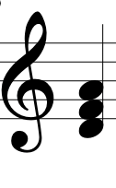
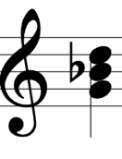
D Minor
G Minor
D F A
G Bb D
Notes:
2. LEARNING
Introduce the D minor chord notes – D F A. Minor chords are ‘sad’ sounding, whereas major chords are ‘happy’ sounding.
Then the G minor chord – G Bb D:
Children familiarise themselves with the notes in the chords on tuned instruments such as xylophones or glockenspiels.
MAIN TASK
The class with be developing their improvising using ‘question and answer’. This is going to represent the call for help in the storm, with the improvising reflecting the unknown of the outcomes of the journey. Minor chords are being used to reflect sadness.
Teacher models creating a ‘question’ melody that is 2 bars long:
Bar 1: Dm - DFA
Bar 2: Gm - GBbD
Note: the ‘question’ does not end on the root of the chord, so that is does not sound finished. This makes it a question.
Children should learn the tune as the example.

Slide 18
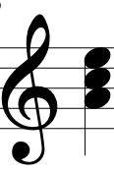
A Minor
A C E
Notes:
Introduce A minor – A C E
Children should familiarise themselves with the notes of A minor so that they can improvise the ‘answer’. Chords for the 2-bar answer:
Bar 1: A Minor - ACE
Bar 2: D Minor - DFA
Teacher plays the ‘question’ and children improvise the ‘answer’ using the notes in the chord pattern above. When improvising the answer, the children should:
End on D, so it sounds like an answer
Think about rhythm – how can you make it interesting?
Remember the 8-beat feel from the starter
Think about musical shape
Consider including passing notes to add interest. These are notes not in the chord.
Focus on 1 or 2 notes to start with and play musically, e.g. AE – AD, then once confident, include other notes
Year 3 & 4 – As a class, use the question printed above or create a class question. Divide the class into two – half playing the ‘question’, half improvising the ‘answer’, then swap.
Gradually divide the class down into smaller groups playing the ‘question’ and ‘answer’.
Rehearse performances of question-and-answer work, agreeing on who will play which part, how many times, at what tempo etc. Can the rest of the class play the chord sequence in the background? Ideally only one person will improvise at a time to avoid clashes.
Year 5 & 6 – in the same groups as Lesson 1, use the class ‘question’ (or create their own) to fit the chord sequence. The group need to consider how to organise their question-and-answer piece:
Who will play the piece?
Who will improvise the answer?
Will everyone have the chance to improvise?
Can the chords be added to support this?
How many times will the question be asked?
What tempo will the piece be played?
PLENARY
Share and record the question-and-answer pieces, reflecting the call for help in the storm. Make sure if a question has been composed, it is either notated or recorded for future lessons.

Slide 19
Lesson 3
Copyright Fran Hart & BBC

Slide 20
Watch the orchestral performance
  When do you hear the music change?
https://www.bbc.co.uk/teach/ten-pieces/articles/z4bcxg8
Notes:
STARTER
Listen or watch ‘Haven’ again, asking the children to indicate when they hear the music change.
Ask the children to consider how the music changes. For example, bar 489 of ‘Haven’ (see 5’10 in audio) slows to Andante (walking pace) and is pp – pianissimo (very quiet). After 10 bars, it returns to the original tempo (see 5’59 in audio) and gradually increases in dynamic (crescendos) to the end.
What do they think this part of the music might represent? Could this be the boat finally arriving at the harbour and the relief of being safe?
Recap – so far ,the class has created storm-like music using concords and discords and then a question and improvised answer to represent calling for help in the storm. This lesson focuses on arriving at the haven.
2. LEARNING
Use vocal sounds to create calm music. Explore different vocal sounds such as ssh, sighs, humming, tapping cheeks (gently), whispering, whistling etc. Explore structuring the sounds, e.g. layering them gradually or starting together, and changing dynamics, tempo, texture, timbre etc. Discuss the impact.

Slide 21
Let’s compose!
Use:
Vocal sounds
Untuned instruments
Tuned instruments
Chords
Dynamics
Texture
Temp
Timbre
Notes:
3. MAIN TASK
Use these ideas to create a piece reflecting arriving at a safe place – a haven.
The piece should use:
Vocal sounds
Untuned instruments
Tuned instruments
Chords
Dynamics, tempo, texture, timbre etc. should be considered at all times, in order to create the emotions and atmospheres of arriving at the safe place. How will the composition start and end?
Year 3 & 4 – compose this as a class
Year 5 & 6 – compose this in the same groups as Lesson 1 and 2
4. PLENARY
Share and record compositions. Are there suggestions on how successful the composition is and what improvements can be made?

Slide 22
Lesson 4
Copyright Fran Hart & BBC

Slide 23
Watch the orchestral performance
  When do you hear the music change?
https://www.bbc.co.uk/teach/ten-pieces/articles/z4bcxg8
Notes:
STARTER
Listen or watch 'Haven’ again.
Recap – so far the class has created:
A storm-like music using concords and discords
A question and improvised answer to represent calling for help in the storm
Music representing arriving at a haven, using vocal sounds, untuned and tuned sounds and chords

Slide 24
Recap and rehearse!
Storm
Calls for help (question and answer improvisation)
Arriving at a haven
Notes:
2. MAIN TASK
Using the compositions from the previous lessons, create a 3-section piece:
Storm
Calls for help
Arriving at haven
Rehearse each section (listening to the recordings where needed and prepare a performance).
Year 3 & 4 – the whole class should revise each section and then rehearse as one complete piece. Map out the structure on a board as a visual reminder, and include notes/notation where needed. Revise how the players should control their sounds to create the different moods of each section.
Year 5 & 6 - groups should revise each section. They should have notes/notation written, with any reminders of what needs to be played when, including changing instruments and changing dynamics, tempo, texture, timbre etc.
Questions to ask:
Are all the players clear when they play?
Does everyone have the instrument they need for the different sections?
Does everyone know which instrument to use in each section?
Is a conductor or leader needed to point to groups or something displayed to help?
How will the piece move between the sections? Will there be silence, or could a linking sound/melody/chord be used?
Are any improvements needed before the final performance?
Is everyone remembering how to control the sounds to make the music expressive?

Slide 25



Let’s perform!
Notes:
3. PLENARY
Perform the compositions and record.

Slide 26
Evaluate
How expressive was the music?
How successfully were the different atmospheres created?
Did the composition feel like one, flowing piece?
What could be improved further?
What have we learnt?

Slide 27
Taking it further – cross curricular activities
MUSIC: Listen to storm music by other composers and compare e.g. Britten’s Storm Interlude from his opera Peter Grimes, Richard Strauss Eine Alpensinfonie – Gewitter und Sturm, Storm by Judith Weir, or Tchaikovsky’s The Tempest. Listen to examples of traditional Scottish music and compare the sounds heard in ‘Haven’. Listen to Storm and Lament from Seavaigers and identify how the movements link.
ENGLISH: Research poems about havens. Use as in inspiration for children to write a poem about a haven. Year 3 & 4 – use as a choral poem, Year 5 & 6 – perform individual poems. These could be included in a performance or assembly, accompanied by the music composed in the lessons.
GEOGRAPHY: Find out more about the Scottish islands, focussing on the Shetland Isles. Investigate the habitats, the weather and the geology forming the islands.

