Slide 1

Laura Shigihara
Plants vs Zombies - Grasswalk
Primary Classroom Lesson Plan
Written by Katie Teage

Slide 2

Lesson outcomes
Learners will:
Engage with a piece of orchestral music through active listening and creative thinking activities
Experiment with technology to create their musical compositions
Create a computer program and import their musical compositions

Slide 3
Resources required
Laptop/Chromebook/iPad
Access to edu.bandlab.com
Access to scratch.mit.edu
3 x resources/worksheets (Listening Map / Instrument Chart / Mood Chart)
Musical bingo grids

Slide 4
Curriculum Checklist
National Curriculum in ENGLAND (KS2)
Appreciate and understand a wide range of high-quality live and recorded music drawn from different traditions and from great composers
Improvise and compose music for a range of purposes using the interrelated dimensions of music
SCOTLAND Curriculum for Excellence (Second Level)
Recognise a range of musical styles and identify some of the main instruments in the genre
Use voice, instruments and technology to create music
Curriculum for WALES: Expressive Arts (Progression Step 3)
I can explore how creative work can represent, document, share and celebrate personal, social and cultural identities
I can apply knowledge and understanding of context, and make connections between my own creative work and creative work by other people and from other places/times
I can reflect upon how artists have achieved effects or communicated moods, emotions and ideas in their work
I can explore and experiment independently and demonstrate technical control with a range of creative materials, processes, resources, tools and technologies showing innovation and resilience
NORTHERN IRELAND Primary Curriculum (KS2)
Listen and respond to their own and others’ music-making, thinking about, talking about and discussing a variety of characteristics within music that they create, perform, or listen to
Work creatively with sound by creating musical stories, pictures, patterns, conversations, accompaniments and by investigating ways of preserving the music they have created

Slide 5
Glossary of music terms
Term | Definition
Bar | Beats are organised together into bars. There will be a strong beat at the start of the bar.
Beat | A beat is the underlying pulse of the music. There are strong beats and weak beats.
Melody | The tune of a piece of music
Sprite | A 2D character or icon which may be moved on-screen e.g. during a video game
Structure | The order of the different sections that make up a piece of music e.g. intro, verse, chorus, outro
Tempo | Speed of the music
Time signature | The number of beats in a bar
4/4 time signature | Music with 4 beats in a bar (strong-weak-weak-weak)

Slide 6

Background – the composer
Laura Shigihara
Laura Shigihara is the mastermind creative behind the music for the popular game Plants vs. Zombies. Her talents are not just musical however; she is also a video game developer and singer-songwriter.
Music was part of her life from when she was a child growing up playing the piano, but she decided to study International Relations, Business and Computer Science, before coming back to music later.
She has created audio on over 35 video game titles, and now runs her own studio where she developed the game Rakuen.
As a composer, Laura’s music has attracted over 500 million combined views on YouTube and can be heard on television shows and in films like Minecraft: The Story of Mojang.

Slide 7

Background – the music
‘Grasswalk’ from Plants vs. Zombies
Grasswalk is one piece that forms part of a soundtrack. The soundtrack is played whilst the gamer is protecting their home from the Zombie Apocalypse by using the power of plants.
Laura Shigihara’s original music was produced using a digital music synthesizer. This instrument is very versatile and can be used to create other music such as dance music, film music and contemporary classical music. Laura also uses composition software to notate her work.
This piece contains short, memorable melodies that are repeated in different instruments. They are distinct so that the gamer remembers them, but not so complicated that they distract the gamer from their game!

Slide 8
Lesson 1
Copyright Katie Teage & BBC

Slide 9
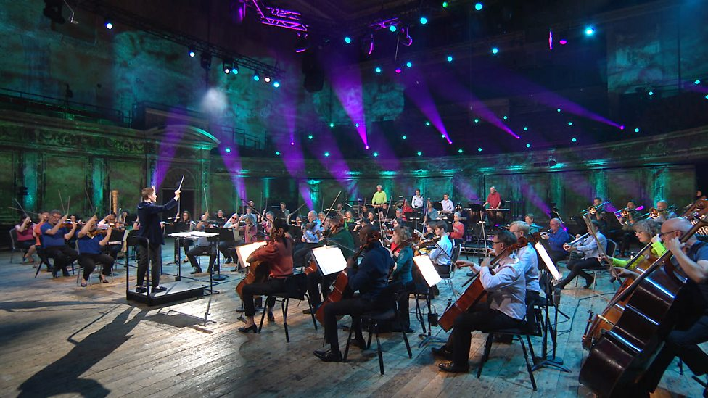
Listen to the music
https://teach.files.bbci.co.uk/tenpieces/audio-Laura-Shigihara-Grasswalk-BBC.mp3
Notes:
STARTER
Start by asking the class to name some of the places you hear music / some reasons why music might be composed, for example: live performance, dancing, film soundtracks, advert jingles, video games…
Listen to Grasswalk from Plants vs. Zombies without watching the accompanying introduction film.
Tell the children that the piece of music is from a video game. Whilst they listen, ask them to draw what they think the characters would look like from the game and what the game might be about. Ask them to explain their reasons.

Slide 10
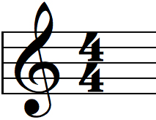
Video game music
What do you think might be happening?
What characters might be in this game?
Draw what you think the characters will look like
Why does the music make you think of that?
Does the music change?
Why do you think the composer chose this time signature? (4/4)
Notes:
You may wish to listen through twice. On the second listen, try counting along: 1,2,3,4 1,2,3,4. Can you tap your big toe in your shoe to this beat? How about tapping your 2nd, 3rd, 4th, 5th finger over and over again. This piece of music has a steady, predictable beat. It doesn’t get faster or slower – it is constant all the time. Try drawing the sides of a square to the pulse or beat. Each new square starts on number one. As you listen you are drawn into this walking pace – not too fast and not too slow.
Prompt questions
What do you think might be happening?
What characters might be in this game?
Draw what you think the characters will look like
Why does the music make you think of that?
Does the music change?
Why do you think the composer chose this time signature (4/4)?
Ask the class to share their thoughts and ideas on characters they’ve come up with and what the game might be about.

Slide 11
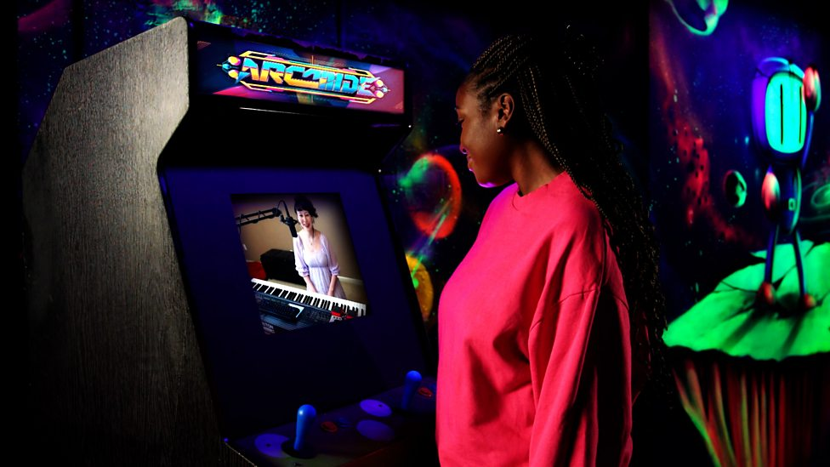
Watch the Introductory Film
https://www.bbc.co.uk/teach/ten-pieces/articles/ztsb7v4
Notes:
2. ACTIVITY
Watch the BBC introduction film for Grasswalk from Plants vs. Zombies, where the children discover what the game is actually about!
Explain that you are going to use some software to make your own music for your own video game.
The game and its music need to include a change, so we will be designing two different parts to the music.
The children will start by creating the first section of music with a beat in Bandlab. For their video game music they need to try and match it to the kind of sprite (Scratch character) and backdrop that they want to have in their game and that they’ve begun thinking about in the first part.

Slide 12



Let’s create loops!
Beat | A beat is the underlying pulse of the music. There are strong beats and weak beats.
Bar | Beats are organised together into bars. There will be a strong beat at the start of the bar.
Tempo | Speed of the music
Time signature | The number of beats in a bar
4/4 time signature | Music with 4 beats in a bar (strong-weak-weak-weak)
https://edu.bandlab.com/
Support/guidance: https://help.edu.bandlab.com/hc/en-us
Notes:
MAIN TASK
Go to Bandlab (see slide for URL).
The aim is for students to use Bandlab to create an 8-bar loop, which they will revisit in later lessons. This lesson is all about exploration of sound, the combinations that they can make and getting the technology working for the children.
Remember to disable the commenting section for your class. Set up two assignments for your class to access. We will be working on the first assignment today, following the steps below.
Step 1 – Class to ‘Open in mix editor’
Step 2 – Select and choose preferred drum machine. Move drum machine to the start of the track, experimenting with changing the sound of your drum loop (click the boxes to generate different colour dots).
Step 3 – To extend your drum machine, hover the mouse at the end of the loop until it turns to a small black arrow pointing to the right. Drag this arrow to number 9 above the block. You should now have 8 blocks of your drum machine. You may also change the speed (tempo) by double click/tap on your drum machine to increase or decrease the BPM (beats per minute).
Step 4 – Click the loop icon (two arrows) so that it turns green, and a red bar will appear over your drum machine. Drag this so it also goes up to number 9 so that your drum loop will now repeat until you turn it off. If you wish, click on ‘loops’, then ‘packs’ and search the term ‘games’ to play around with vintage game sounds.
Step 5 – Drag and drop the loops into the timeline (the open space below the drum machine) to experiment. Students may wish to make their loops longer than 8 bars. You will be revisiting these loops in later lessons so make sure you save them as audio files. Save the children’s creations / download them as audio files (File – Download – Mixdown As) and save them in a place the children can access them.

Slide 13
Lesson 2
Copyright Katie Teage & BBC

Slide 14
Mood charts
Can you create your own key to represent different emotions?
Excited | Sad | Cheeky
Scared | Relaxed | Amazed
Wonder | Magical | Secretive
Mysterious | Want to dance | … and more!
Notes:
STARTER
We are going to work out the way that Laura Shigihara has structured her piece of music and the instruments she has used.
Split the children into pairs. Each pair will need a print out of these 3 handouts (see slide 3 for links):
Listening Map
Instrument Chart
Mood Chart
Hand out colouring pencils. Ask the children to either independently or as a pair complete the Mood Chart, creating their own key to represent different emotions (see top of Mood Chart for instructions, see slide 4 for resource).

Slide 15












Watch the orchestral performance
https://www.bbc.co.uk/teach/ten-pieces/articles/ztsb7v4
Notes:
2. ACTIVITY
Using the Mood Chart just created and the Instrumental Chart which provides a list of instruments in an orchestra, ask the children to fill out their Listening Map whilst either watching or listening to the BBC performance of Laura Shigihara’s Grasswalk.
Teacher to shout out the letters in the section column as the time comes up to each section, and students are to fill out the instruments used and feelings created (using their key from Mood Chart) columns as they are listening. If needed, feel free to pause the track while students write at each intersection. You may need to listen through more than once.
Once you have finished, ask the children to describe the way the mood changes in the piece (for example how it starts and ends, and what happens to the mood of the music in between). Link this to the instruments they noticed in each section and see if any patterns emerge (e.g. a certain section or mood always being associated with a certain instrument).

Slide 16
Our video game music
Can you keep improving your 8-bar loops for the music?
What is your character going to look like? Do they match the mood of the music?
What is your setting or backdrop going to be? Does it match the mood of the music?
https://scratch.mit.edu/projects/editor/?tutorial=getStarted
Support: https://scratch.mit.edu/educators
Notes:
3. MAIN TASK
Revisit Bandlab creations from Lesson 1. Continue refining the existing 8 bar loops, have a go at creating new loops or extend the length of loops to more than 8 bars.
Open Scratch and ask the children to select a backdrop that matches their first composition, then ask them to choose a contrasting backdrop for their second composition. They will compose some music for this contrasting backdrop in the next lesson.
They can also start thinking about their character or ‘sprite’.
If you are not using Scratch to do the video game design aspect, ask the children to use the character designs from the first lesson and draw their own settings.
You will be revisiting the Bandlab loops in later lessons so don’t forget to save them.

Slide 17
Lesson 3
Copyright Katie Teage & BBC

Slide 18
Watch and listen
Tempo
Dynamics
Melody
Instrumentation
Watch: https://www.bbc.co.uk/teach/ten-pieces/articles/ztsb7v4 Listen: https://teach.files.bbci.co.uk/tenpieces/audio-Laura-Shigihara-Grasswalk-BBC.mp3
Notes:
WARM UP
Watch the introduction film to remind students about the plot and inspiration behind the game.
Next, as a class listen through again to just the audio, this time asking students to make a list of what they are hearing in the music which represents the plot of the game. Encourage students to think of adjectives, as well as musical features, then come together to mind map some ideas on the whiteboard.
Musical features could include:
Tempo
Dynamics
Melody
Instrumentation

Slide 19
Create your own video game music!
How can you make the next section of your music contrast with your 8-bar loops?
Can you change the tempo? (the speed of the music)
Can you change the dynamics? (how loud or quiet the music is)
Can you change the texture? (the number of layers to the music)
Can you change the instrumentation?
https://edu.bandlab.com/
Support: https://help.edu.bandlab.com/hc/en-us
Notes:
2. MAIN TASK
Revisit Bandlab creations from previous lessons. Students will now open the second assignment and use this to create a contrasting mood for their game. We will do this through ‘midi’ work.
Explain to students that this could be the energetic or exciting section of their game and encourage them to be creative in their thinking.
Ask the children to think about what kind of music might contrast with their first composition. For example, if it’s a slow beat, could they speed it up (make the tempo faster)? Or if it is simple it might get more complex?
Step 1 – Open in mix editor and select instruments to use. The students will then be able to ‘type’ the notes for the instrument to play.
Step 2 – Students should drag in a loop, e.g. Game Sounds, and make sure it lasts 8 bars so that it is the same length as the first assignment from Lesson 1 & 2 (to do so, drag the loop to the number 9 on the timeline)
Step 3 – To record, make sure to start at the beginning of the music and press the back arrow, so that the white cursor is at the beginning. Select the red record symbol, and you will then hear a 4 click count in before the recording begins.
Step 4 – Students can then type to play the instruments, and can add as many instruments as they like by adding a new track. If you have midi keyboards in your school then these will work as an alternative that doesn’t involve typing on the keyboard to type the notes.
Step 5 – To edit music that has been recorded, click the Midi Editor (bottom left of the screen).
The children will now have two contrasting sections of music (assignment one from Lesson 1 & 2, and assignment two from today’s lesson). Download the children’s creations and save them as audio files (File – Download – Mixdown As) and save them in a place the children can access them.

Slide 20
Lesson 4
Copyright Katie Teage & BBC

Slide 21

Musical bingo!
https://www.bbc.co.uk/teach/ten-pieces/articles/ztsb7v4
Notes:
STARTER
Watch the orchestral video and ask students to name the instruments they see being played during the video.
The game theme can be continued by making the activity into a game itself, by playing musical bingo. Provide each child with a grid from the resource and ask them to cross off when they hear / see them being played. First to get a full line says bingo.

Slide 22
Build your own video game!
Checklist:
Your two different musical compositions
Two different backdrops
A sprite (character)
Code which changes the music when the backdrop changes
Share your creations and give each other feedback!
https://scratch.mit.edu/projects/editor/?tutorial=getStarted
Support: https://scratch.mit.edu/educators
Notes:
MAIN ACTIVITY
In this session, the children will be using Scratch to create a coded video game or scene to attach their own music to. There are many tutorials online and on Scratch itself that will help you get started.
Before the lesson, teachers to get the following website URL open on the devices the students will use.
We are going to attach the audio created on Bandlab in previous lessons to different backdrops on Scratch, so that when the backdrop is changed it will change the music.
See slide for support/guidance with Scratch.
Step 1 – Make sure the iPad is rotated/help landscape (on its side) so that the full Scratch page fits on the screen. Select stage on the bottom right corner of the screen.
Step 2 – Select the backdrop tab.
Step 3 – Choose a backdrop at the bottom left corner (green button). Click the magnifying glass to choose from the different backdrop options. Students to select their own backdrop.
Step 4 – Students will need to create a second backdrop. To do this, simply click the same icon in the bottom left corner as done at the start of Step 3. Students should then choose a second backdrop, again using the magnifying glass. You should now see two backdrops.
Step 5 – Go to the Sounds tab and import the two audio files students made in previous lessons on Bandlab (which should ideally reflect two contrasting moods). Make sure that stage is still selected (bottom right) so that we are attaching the sounds to the backdrop and not the sprite.
Step 6 – Students to choose the sprite they want to use, thinking creatively about the character which will best match their two composition loops.
Step 7 – By now, students should have chosen the two backdrops, a sprite and have uploaded your sounds so that we can attach music to your backdrops. With the stage still selected, move to the code tab.
Step 8 – In the code tab, select the ‘when backdrop switches to [insert your backdrop]’ control button and the play sound button. Select two of each so that each backdrop has a piece of music attached to it.
Step 9 – Once this has been completed, you can create some code for your sprite that involves backdrop changes. To recap, attaching the audio created on Bandlab in previous lessons to different backdrops in Scratch means that when the backdrop is changed it will change the music, bringing together the lessons on how music needs to change for different moods and parts of a game.
3. PLENARY
Students to swap devices and peer review each other’s work, with teachers encouraging students to offer feedback to one another.

Slide 23
Taking it further – cross curricular activities
HISTORY: Laura Shigihara taught herself how to use software to write music for computer games. As a class, can you find out how computer games were invented and why? If you were one of the first to invent computer games, what kind of game would you have designed?
CREATIVE WRITING: Plants Vs. Zombies is based on a zombie apocalypse. As a class, brainstorm scary/spooky ideas (common characters/themes/plots etc.). Give the children pen and paper and 10 minutes to independently try and write the opening to their own scary story, setting the scene as vividly as they can. If time, students can swap stories for peers to read, or read aloud to the class.

