Slide 1

Hildegard of Bingen
O Euchari in leta via
Primary Classroom Lesson Plan
Written by Katie Teage

Slide 2

Lesson outcomes
Learners will:
Learn about plainchant and musical language appropriate to tasks
Learn about and create a graphic score
Play musicianship games to explore indicative musical features
Perform as an ensemble (or as individuals)

Slide 3
Resources required
A3 paper & colouring pens/pencils (+ additional art materials if desired)
HvB Worksheet 1 (Score)
HvB Stained Glass Window Stencil
Classroom instruments
Recording/video device

Slide 4
Curriculum checklist
National Curriculum in ENGLAND (KS2)
Play and perform in solo and ensemble contexts, using their voices and playing musical instruments with increasing accuracy, fluency, control and expression
Use and understand staff and other musical notations
Listen with attention to detail and recall sounds with increasing aural memory
SCOTLAND Curriculum for Excellence (Second Level)
Recognise a range of musical styles and identify some of the main instruments in the genre
Use voice, instruments and technology to create music, experimenting sounds, pitch, melody, rhythm, timbre and dynamics
Perform on instruments, individually or as part of a group, to communicate the mood and character of a piece of music
Curriculum for WALES: Expressive Arts (Progression Step 3)
I can apply knowledge and understanding of context, and make connections between my own creative work and creative work by other people and from other places and times
I can explore how creative work can represent, document, share and celebrate personal, social and cultural identities
I can identify and respond creatively to challenges with resilience and flexibility
NORTHERN IRELAND Primary Curriculum (KS2)
Sing and perform with simple instruments from memory, by ear or from notation to develop vocal and instrumental skills
Work creatively with sound by creating musical stories, pictures, patterns, conversations, accompaniments and by investigating ways of preserving the music they have created
Respond imaginatively to a wider range of music in a variety of styles and media

Slide 5
Glossary of music terms
Term | Definition
A Capella | No accompaniment
Duration | How long a note is played or sung
Dynamics | How loudly or quietly a piece of music should be played
Forte | Played at a loud dynamic
Graphic score | Instead of lines and dots on a musical stave, graphic scores can use all sorts of different images and symbols for a musician to interpret
Melisma | One syllable sung to many notes
Manuscript | A handwritten piece of music
Modes/modal | A type of scale or order of pitches – not the normal major or minor scales that are often used today
Monophonic | A single line of music
Non-metric | No sense of pulse – the singer or instrumentalist can sing or play at any speed
Piano | Played at a quiet dynamic
Tuned | Instruments that have different pitches and can be used to play a melody or tune, e.g. glockenspiel
Staff notation | Staff notation or the stave is five horizonal lines and 4 spaces that represent a different musical pitch
Timbre | The particular sound quality of a musical instrument (e.g. your voice will have a different timbre to a flute)

Slide 6
Lesson 1
Copyright Katie Teage & BBC

Slide 7
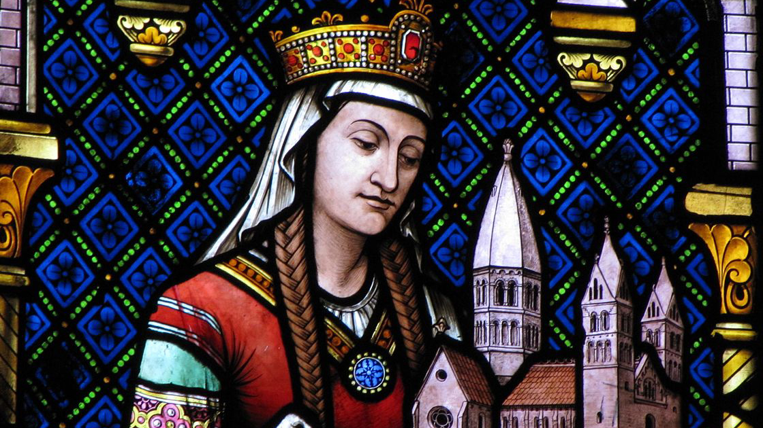
Background – the composer
Hildegard of Bingen (1098-1179)
Born over 900 years ago in Medieval Europe, the 10th child of a noble family. Before she was even a teenager, her parents planned a life service to the church for her.
She was a determined and strong-minded individual. She led a group of nuns as ‘prioress’ and founded new monasteries.
Once she became prioress, she began to write beautiful vocal works linked to her faith and work in the church. Hildegard’s work did not stop there however; she also produced important works about medicine, natural history and created her own language Lingua Ignota.
Fast forward to today, Hildegard of Bingen is celebrated as one of the most important female composers in Western Classical music. She was named as a Doctor of the Church in 2012 by the Pope and she is a patron saint of musicians and writers. Hildegard even has her own feast day on 17th September!

Slide 8

Background – the music
O EUCHARI IN LETA VIA
Hildegard of Bingen’s music is written in Latin, the language of ancient Rome. In Hildegard’s time, Latin was spoken and widely used in Europe as a language of learning and education. Nowadays, we no longer speak Latin, but a lot of English words have roots in this ancient language.
O Euchari in leta via is about ‘Euchari’, or Saint Eucharius. In her music, Hildegard celebrates St. Eucharius’ devoted love and passion for his faith. Hildegard may have also learnt that St. Eucharius was present at important religious events such as the Last Supper and the Pentecost and therefore was an important figure for her faith.
The text is full of praise and admiration for St. Eucharius. Along with Hildegard’s beautiful melodies, it allows a listener to hear how a talented and devoted abbess from Medieval Europe might write music to express how much she admired another individual. Listen to how beautifully the voices sing this most ancient of compliments.

Slide 9
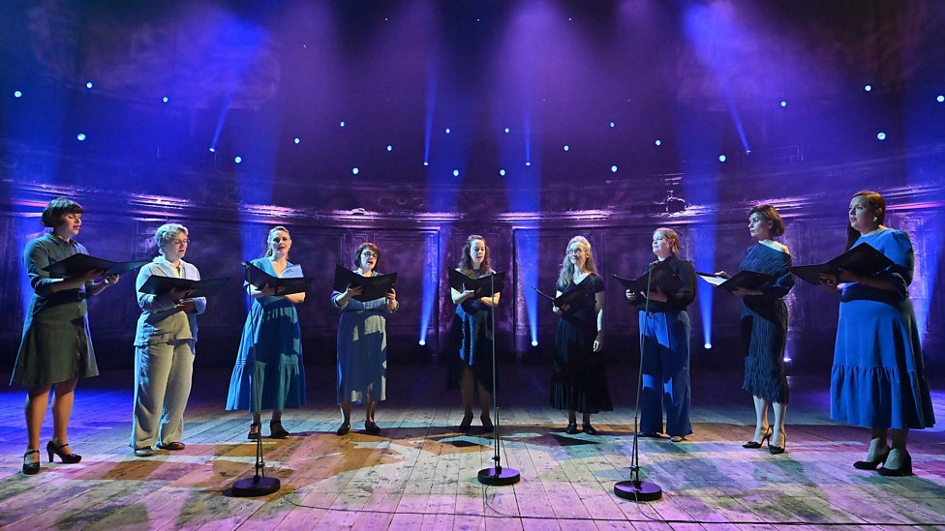
Watch the orchestral performance
https://www.bbc.co.uk/teach/ten-pieces/articles/zsc8p9q
Notes:
STARTER
As a class, ask students to put their hands up and tell the class their favourite piece of music. Encourage students to explain why the music is special to them, and if appropriate, play short excerpts of these pieces to the class (on Spotify or YouTube). Make sure you share yours, too.
Explain to the class that music used to be shared with other people before it was recorded, and also before it was written down. People would listen to the music and copy what they heard.
This often took place in a religious context and still does today. Music plays a significant role in many religions and is used in many differing ways:
In Buddhism, music can help people focus before meditation
In the Sikh religion, music, known as Kirtan, helps people connect with the religion's teachings and God
In Judaism, music is used to recite the Tora
In Islam, the call to prayer is often recited in a melodious tone
Religious music helps people of all religions connect with their faith and remember their religious values. Ask children in your classes to share their experiences with their religions (if comfortable) and the music they listen to.
2. ACTIVITY
Watch and listen to the film for Hildegard of Bingen’s O Euchari in leta via.
As students are listening, ask them to write down how the music makes them feel (this can be in sentences or a list). Discuss some of these responses as a class and collect their ideas on the board. As you discuss, bring in words that describe the colour of temperatures, landscapes, and emotions reflected in the music – this will support the next step in this lesson.

Slide 10
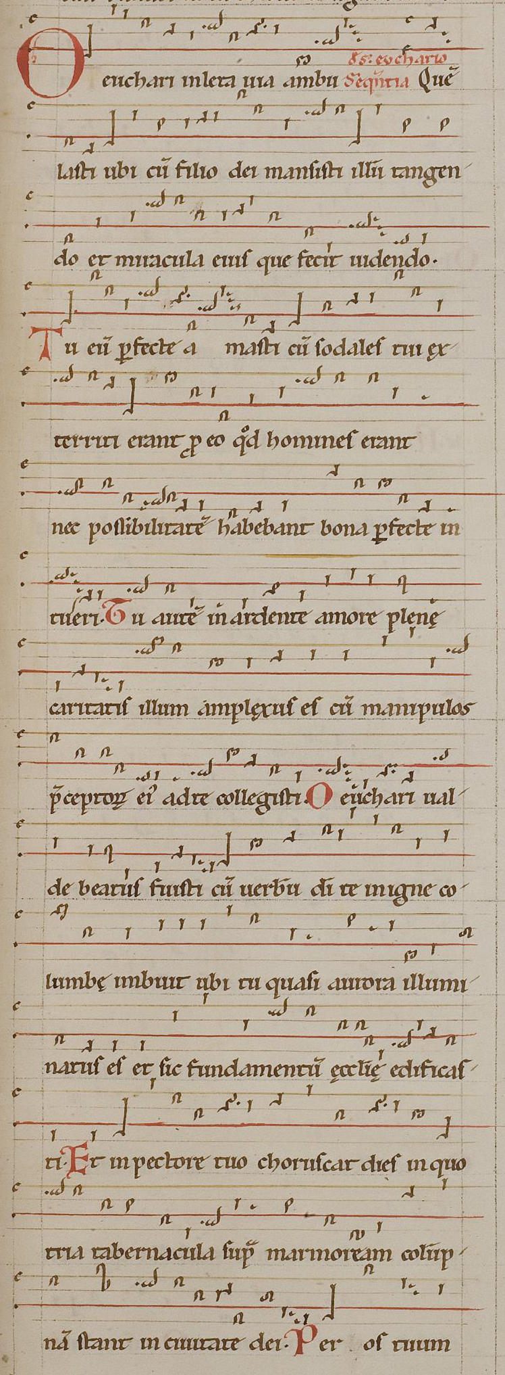
Notes:
3. MAIN TASK
Hand out HvB Worksheet 1 (Score) and coloured pencils.
On the whiteboard, show the children the old manuscript score (HvB Old Manuscript). Explain that both scores represent the same piece of music. Ask children to compare HvB Worksheet 1 (printed out in front of them) to HvB Old Manuscript (pictured here on slide), encouraging them to notice any similarities or differences.

Slide 11
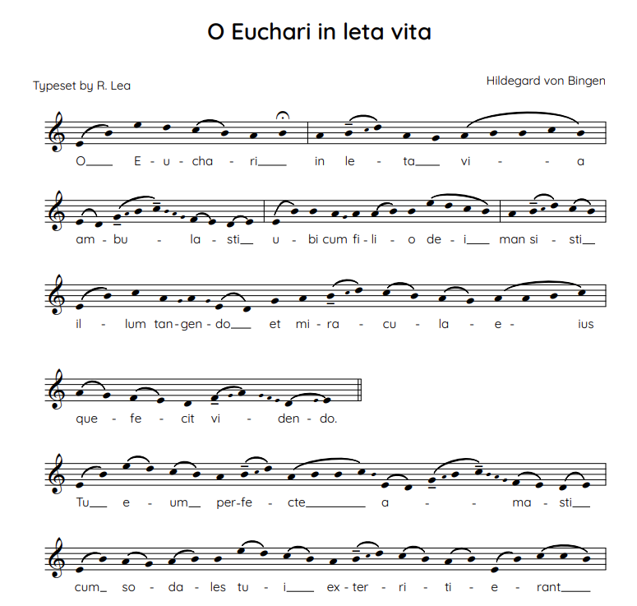
https://teach.files.bbci.co.uk/tenpieces/audio-Hildegard-of-Bingen-O-Euchari-in-leta-via-BBC.mp3
Notes:
Listen to the recording of O Euchari in leta via and ask the children to colour in the HvB Worksheet 1 (Score) as they listen to the colours that the piece suggests – for example, green could suggest calm sounding, purple could suggest mysterious sounding etc. Encourage the children to be creative, there is no right/wrong with how to do this/which colours they use! They may not know how to follow the score’s music, which is okay. Tell them that the music shows how it moves up and down in pitch. The higher the dot on the group of lines, the higher the note, and the lower it is placed, the lower the sound.

Slide 12
Listen and Reflect
https://teach.files.bbci.co.uk/tenpieces/audio-Hildegard-of-Bingen-O-Euchari-in-leta-via-BBC.mp3
Notes:
After they have listened to it twice, ask them to describe how the music sounds. They may say things along the lines of:
There is one voice
I’m not sure what language it is, but it is different to my language
I can’t feel a beat
It sounds sad but also different

Slide 13

Plainchant
Monophonic in texture (a single line)
Sung ‘a capella’ (no accompaniment)
Sung in Latin
Non-metric (no sense of pulse; the singer can sing at any speed)
Composed in modes (not the usual major or minor scales that are often used today)
They also have a special feature called a melisma (one syllable sung to many notes)

Slide 14
Lesson 2
Copyright Katie Teage & BBC

Slide 15








Dynamics
Softer |  |  |  |  |  |  | Louder
piannississimo | piannissimo | piano | mezzo piano | mezzo forte | forte | fortissimo | fortississimo
Notes:
WARM-UP GAME
This warm-up activity helps children explore the range of sounds, colours, and dynamics they can create with their instruments, preparing them for later activities. Dynamics is the word used by musicians to describe how loud or quiet sound is.
They are often described using Italian vocabulary.
Ensure each child has an instrument or a selection of instruments to play. Explain that you will now play a game where different actions represent different dynamics.
Action: Dynamics
Open your hands: Play very loudly (forte)
Close your hands: Play very quietly (piano)
Moving between open and closed hands: Play every dynamic in between (see above table)
Palms completely together: Silence
Practise moving from loud to quiet and vice versa, aiming for the full range of dynamics. Can they play even quieter or louder? Encourage children to come up to lead or conduct using these signals to create short pieces exploring loud and quiet.
Next, repeat the exercise using the same actions above but different opposites instead of loud and quiet, for example:
Lots of notes to few notes
Spiky sounds to smooth sounds
Shiny sounds to rough sounds
Random notes to notes of an E minor chord (E G B)
Any other opposites suggested by the children
With these opposites, challenge the children to be as spiky or smooth as possible (b and c) and tradition from a mass of notes to a specific group of notes (a & d).

Slide 16
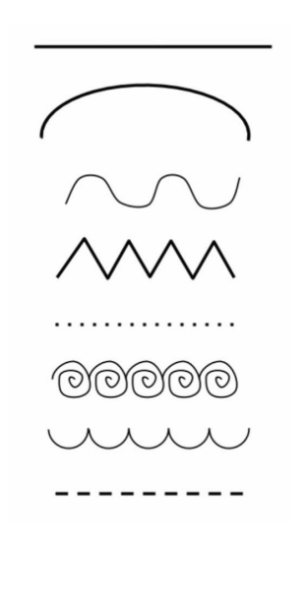
Graphic
Scores
Notes:
2. ACTIVITY
We are going to create compositions using graphic scores. Explain that a graphic score represents music using pictures, symbols and colours instead of traditional musical (staff) notation.
Ask your class whether they think lines can have emotion and if so, what are they?
Ask pupils to experiment by playing these lines on musical instruments or with their voices, thinking about how they can interpret or convert the different lines into musical sounds:
Emphasise that graphic scores help students understand the structure and elements of music, such as pitch, duration, dynamics, and timbre, without needing to read traditional musical (staff) notation. This means that it will not be a picture; there will be a start and an end to this ‘art’ as it will represent the sound moving through time.

Slide 17
Listen and respond
https://teach.files.bbci.co.uk/tenpieces/audio-Hildegard-of-Bingen-O-Euchari-in-leta-via-BBC.mp3
Notes:
3. MAIN TASK
Before students start their own graphic scores, it might be helpful to revisit the work from the last lesson and discuss the colours they came up with during their emotional response and colours when responding to the music.
Listen to the piece again several times and provide large pieces of paper. Encourage students to be as creative as they like here when creating their graphic scores. You may want to stick to A3 with pencils and pen, or you may want to use large pieces of sugar paper with pastels, paint and even collage material. Provide paper, markers, coloured pencils, and other art supplies.
Once they have finished, explain that they will use this graphic to create their own piece of music. They can keep this within the realm of plainchant, i.e:
monophonic in texture (a single line)
sung a cappella (no accompaniment)
sung in Latin
non-metric (no sense of pulse; the singer can sing at any speed)
composed in modes or modal (not the normal major or minor scales often used today) – the notes EFGABCDE can be used in a scale-like pattern here
Or, they can create a piece with multiple lines. Group the children into pairs and ask them to combine their graphic scores to create a bigger piece. The children should start to write down how they think their pieces would sound on a piece of paper next to their pictures.

Slide 18
Lesson 3
Copyright Katie Teage & BBC

Slide 19















Experimenting with sounds
Can you play…
Short, wobbling sounds with gaps in between
Rising or falling scale patterns
Loud, sustained notes
Smooth, wavy figures moving between two notes
Accented zigzags moving between high and low notes
Any others?
Notes:
WARM UP
Hand out classroom instruments. Ask the class to play very short, quiet sounds with pauses in between, like raindrops, each playing at different times. Ask them what this could look like on a page as a symbol; for example, maybe dots on a page. Discuss with the class what other kinds of sounds you could use to create different musical textures, such as:
Short, wobbling sounds with gaps in between
Rising or falling scale patterns
Loud, sustained notes
Smooth, wavy figures moving between two notes
Accented zigzags moving between high and low notes
Collectively decide on symbols that could be drawn for each new sound texture, then practice each one while looking at the symbols. Invite the children to come up and conduct using the open and closed hands from the previous lesson to control the dynamics (volume).

Slide 20



Practice and record!
Notes:
2. ACTIVITY
Separate the class back into their groups with their graphic scores and written descriptions of the pieces. Ask the children to further annotate their scores with the symbols created by the class. This will help them define the sounds further. Ask the children to list the instruments they think they will need to play their pieces.
Hand out instruments to the children so they can practice their pieces. Encourage them to explore all the different sounds one instrument can make. Remind them that they can still use their voices as instruments.
While the children work on their pieces, record or film them and ask them to listen to or watch their pieces. To help them develop their ideas further, ask them to consider and write down what they like/dislike/think works well/needs improvement. Analysing and refining their scores helps students develop critical thinking and problem-solving skills.

Slide 21
Lesson 4
Copyright Katie Teage & BBC

Slide 22
Musical Contrasts!
Notes:
WARM UP
Start the lesson by recapping the musical contrasts we have been working on over the past few sessions. This can be done with the voice or classroom instruments:
Loud and quiet
Fast and slow
Spikey and smooth
Long and short
High and low

Slide 23
PATTERN 1 | Count: 1 2 3 4 5 6 7 (Rest) Count: 1 2 3 4 5 6 7 (Whisper 8) Action: Pat Pat Pat Pat Pat Pat Pat (Rest) Action: Pat Pat Pat Pat Pat Pat Pat (Rest)
PATTERN 2 | Action: Pat Clap Pat Clap Pat Clap Pat (Rest) Action: Pat Clap Pat Clap Pat Clap Pat (Rest)
PATTERN 3 | Action: Pat Clap Click Pat Clap Click Pat (Rest) Action: Pat Clap Click Pat Clap Click Pat (Rest)
PATTERN 4 | Cross hands over whilst patting Action: Pat Cross Pat Clap Click Clap Pat (rest) Action: Pat Cross Pat Clap Click Clap Pat (rest)
Notes:
2. ACTIVITY
Teach the children the hand-clapping game ‘Sevens’. This game can be played sitting on a carpet or at tables.
There are 4 clapping patterns to learn.
Pat legs or the table x 7 – do this twice with a one-pat gap (or one beat rest) in between
PATTERN 1
Count: 1 2 3 4 5 6 7 (Rest)
Count: 1 2 3 4 5 6 7 (Whisper 8)
Action: Pat Pat Pat Pat Pat Pat Pat (Rest)
Action: Pat Pat Pat Pat Pat Pat Pat (Rest)
PATTERN 2
Action: Pat Clap Pat Clap Pat Clap Pat (Rest)
Action: Pat Clap Pat Clap Pat Clap Pat (Rest)
PATTERN 3
Action: Pat Clap Click Pat Clap Click Pat (Rest)
Action: Pat Clap Click Pat Clap Click Pat (Rest)
PATTERN 4
Cross hands over whilst patting
Action: Pat Cross Pat Clap Click Clap Pat (rest)
Action: Pat Cross Pat Clap Click Clap Pat (rest)
You then put the parts together in this order: 1, 2, 3, 4, 3, 2, 1. You can then play the game using our musical contrasts: slow and fast, loud and quiet, etc. Start slowly and build up!

Slide 24

Practice and perform!
Notes:
3. MAIN TASK
Hand out the graphic scores from last lesson, notes that the children have made along with them, and the classroom instruments. Allow the children time to practise their pieces, and then ask them to perform them to the class.
After each performance, encourage the children to explain how they decided on the sounds from their graphic scores.

Slide 25
Stained glass windows
https://teach.files.bbci.co.uk/tenpieces/audio-Hildegard-of-Bingen-O-Euchari-in-leta-via-BBC.mp3
Notes:
4. PLENARY
The plainchant often included lines from the bible or single words such as Alleluia, which were sung at certain times during church service. In Medieval times, there would have been no electricity, and hardly anyone could read. People would attend church and would have had a deep sensory experience. They would have been in an impressive building with low lighting, incense and music that echoed around it. The music would have ‘drawn people’s eyes up’ as it echoed and reverberated around the church, and people would have experienced the music in a very special way.
Around the time of this composition, stained glass windows were being invented. Imagine how amazed the congregation would have been at seeing different coloured lights pour into the building when the sun shone. Hand out HvB Stained Glass Window Stencil to the class along with colouring pens/pencils. Listen to the piece one final time, and as the children listen, ask them to colour in the stained glass window stencil, imagining how vibrant it would have been if the sun was shining through their window.

Slide 26
Taking it further – cross curricular activities
ART: Hildegard of Bingen was not just a musician but a prolific writer about natural medicine. Design a stained-glass window with a portrait of other important women in medical history. You can use black paper to create an outline and tissue paper to fill in the colours of the ‘glass’ so that the colours can be seen when it is stuck to a window
GEOGRAPHY: Hildegard of Bingen was born in Bermersheim vor der Höhe in Germany. Compare this village to where you live. Ask questions such as:
  What physical features are there in this place? (hills, mountains, rivers, coast, forest, vegetation and valleys)
  What businesses or trades are there in this area?
  What is the climate like?
  What is the population?
  How far away are other towns?
  Are there any famous landmarks nearby?

