Slide 1

Margaret Bonds
Montgomery Variations
Primary Classroom Lesson Plan
Written by Andrea Price

Slide 2

Lesson outcomes
Learners will:
Engage with a piece of orchestral music through listening, watching, moving, and discussing
Create their own pieces of music using voices and instruments
Perform as an ensemble
Explore musical language and engage with Western musical notation

Slide 3
Resources Required
A suitable space for movement; either in a classroom or a larger space
Tuned and untuned classroom percussion instruments
There is also an accompanying worksheet for children who would prefer to write or notate their ideas

Slide 4
Curriculum Checklist
National Curriculum in ENGLAND (KS2)
Play and perform in solo and ensemble contexts, using their voices and playing musical instruments with increasing accuracy, fluency, control and expression
Improvise and compose music for a range of purposes using the interrelated dimensions of music
Appreciate and understand high-quality live and recorded music drawn from different traditions
Use and understand staff and other musical notations.
SCOTLAND Curriculum for Excellence (Second Level)
Recognise a range of musical styles and identify some of the main instruments in the genre
Use voice, instruments and technology to create music, experimenting with timbre.
Express and communicate ideas, thoughts and feelings through musical activities.
Perform on instruments, individually or as part of a group, to communicate the mood and character of a piece of music
Explain, with supporting reasons, what works well and what could be improved in their own and others’ work, using appropriate musical vocabulary.
Curriculum for WALES: Expressive Arts (Progression Step 3)
I can explore how creative work can represent, document, share and celebrate personal, social and cultural identities.
I can explore and describe how artists and creative work communicate mood, feelings and ideas and the impact they have on an audience.
I can give and consider constructive feedback about my own creative work and that of others, reflecting on it and making improvements where necessary.
NORTHERN IRELAND Primary Curriculum (KS2)
Sing and perform with simple instruments from memory, by ear or from notation to develop vocal and instrumental skills.
Work creatively with sound by creating musical stories, pictures, patterns, conversations, accompaniments and by investigating ways of preserving the music they have created

Slide 5
Glossary of music terms
Term | Definition
3/4 time signature | Music with 3 beats in a bar (strong-weak-weak)
4/4 time signature | Music with 4 beats in a bar (strong-weak-weak-weak)
Bass line | The lowest part of the texture
Beat | A beat is the underlying pulse of the music. There are strong beats and weak beats.
Bar | Beats are organised together into bars. There will be a strong beat at the start of the bar.
Ensemble | A group of musicians
Melody | The tune of a piece of music
Off-beats | The weak beats in a bar of music.

Slide 6
Glossary of music terms
Term | Definition
Pentatonic scale | A five-note scale. We have used C, D, F, G, A in this project.
Phrase | A group of bars that form a musical sentence, usually 2 or 4 bars.
Texture | The layers of the music (e.g. melody, off-beats, bass line)
Tuned classroom percussion | Instruments with a defined pitch such as glockenspiel, xylophone, chime bars etc.
Untuned classroom percussion | Instruments without a defined pitch such as claves, castanets, shakers, hand drums etc.

Slide 7
Lesson 1
Copyright Andrea Price & BBC

Slide 8
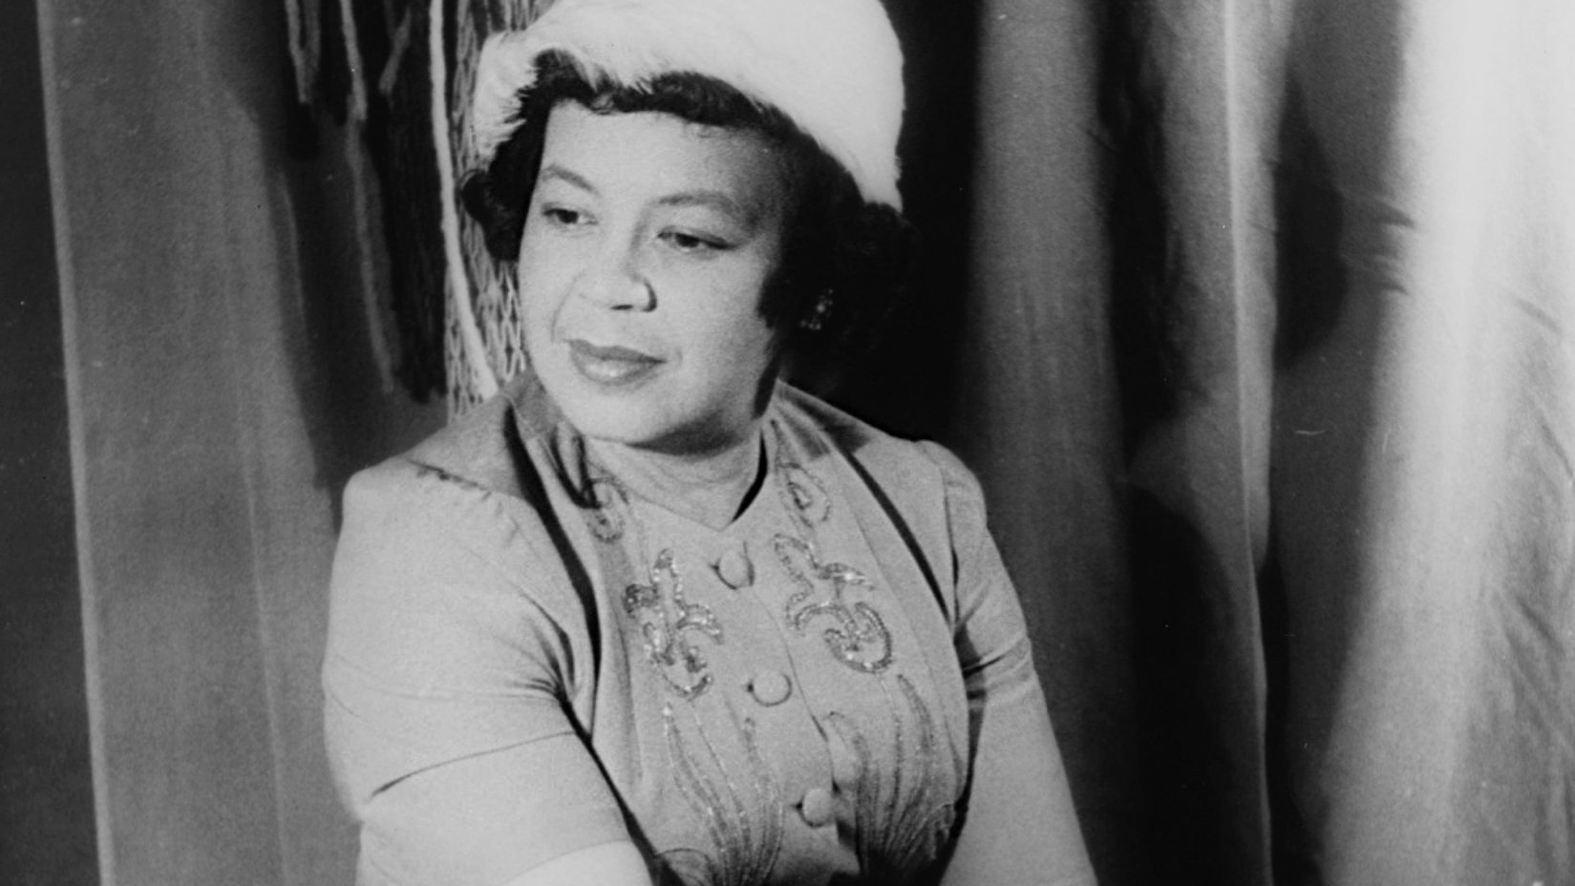
Background – the composer
Margaret Bonds (1913 – 1972)
American composer and pianist
Taught by the American composer Florence Price
The first Black soloist to perform with the Chicago Symphony Orchestra in 1933 at just 20 years old
She is remembered today for her commitment to supporting the careers of Black artists during a time of activism in the US
Due to restrictions placed on women of colour in copyrighting and recording work, most of her music was thought to be lost. Thankfully, in 2013, several boxes of manuscripts were recovered

Slide 9

Background – the music
Montgomery Variations
‘March’ and ‘Dawn’ are two movements from larger piece of music, Montgomery Variations, written in 1964. The piece has seven movements and tells a story of struggle, strength in a community and a fight for equality in society.
Margaret Bonds began writing the piece after a visit to Montgomery, Alabama in 1963. This was where Rosa Parks’ actions sparked the Montgomery Bus Boycott and remains one of the most well-remembered events in the civil rights history.
As part of the boycott, members of the Black community walked to work rather than take the buses. The mass movement on foot is captured in the movement ‘March’.
The movement ‘Dawn’ refers to several of the southern States in America, including Alabama, realising that changes in society are coming.

Slide 10
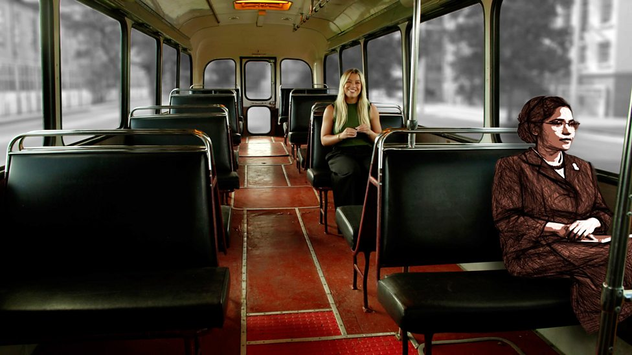
Watch the Introductory Film
https://www.bbc.co.uk/teach/ten-pieces/articles/zs6nkhv
Notes:
1. Prepare your class
Explain to the class that you are going to begin a music project focusing on an important piece of music by Margaret Bonds, one of the first Black composers and performers to gain recognition in the United States. The piece is called Montgomery Variations, and we are going to listen to two variations: ‘March’ and ‘Dawn’. Let’s find out what makes this music so important.
2. Watch the film and have a discussion about it. This could tie in effectively with Black History Month or a range of PSHE / PSE topics about law, rights, and responsibilities.

Slide 11
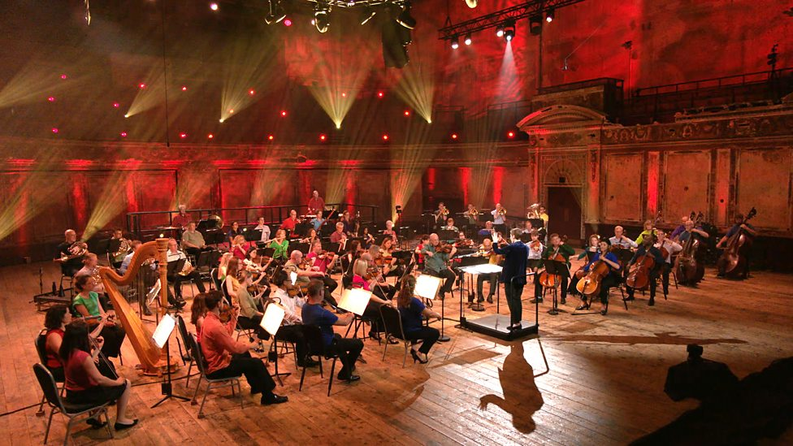
Watch the orchestral performance
https://www.bbc.co.uk/teach/ten-pieces/articles/zs6nkhv
Notes:
3. Watch the full orchestral performance and talk about the instruments you have seen. Try to pick out the woodwind instruments. They are very important in this music, as they often have the melody. Look out for the bassoon and the cor anglais* in the ‘March’, then the flute, oboe, and clarinet in ‘Dawn’. How can we tell these instruments apart?
*the cor anglaise (pronounced kaw-RONG-glay, or kaw-RAANG-glay) is like an oboe, but larger and slightly lower-pitched.

Slide 12

Time to move!
Time Signature:
4/4
1 | 2 | 3 | 4 | 1 | 2 | 3 | 4
knees | clap | clap | clap | chest | clap | clap | clap
Notes:
4. Exploring movement activity – understanding 3/4 and 4/4 time signatures
This activity can be done in a classroom with limited space, or in a larger space such as the school hall. Try out some of the suggested movements along to the music. You can tailor the activity to the needs of your class and to the available space. If you have time, try exploring both ‘March’ and ‘Dawn’, either in the same session or in different sessions. Full instructions for suggested movements can be found below.
Moving with your feet:
March in time to the music. March with heavy feet. Aim to feel the pressure of the ground through your heels. Whilst marching, count “1, 2, 3, 4” on each beat. Try to make the heaviest step on beat 1 of each bar.
If you are marching on the spot, turn to face a different direction every 8 beats (count to 8 and then change direction). If there are four beats in a bar, how many bars do 8 beats fit into?
If you are marching around the room in a larger space, change direction every 8 beats (count to 8 and then change direction). Take care not to crash into anyone else!
Moving with your hands:
Show the strong and weak beats of the music by performing this pattern:
1 knees
2 clap
3 clap
4 clap
1 chest
2 clap
3 clap
4 clap
5. Reflect on the movement activity by listening to a short clip from each variation and discussing whether the music is in 3/4 time or 4/4 time. You could turn this into a quiz!
6. Additional plenary – recapping woodwind instruments
Ask each child to choose one woodwind instrument (if time / resources allow, they could write its name or even draw a picture of it). Listen to the music again. They should hold up their instrument (or raise their hand or stand up) when their chosen instrument can be seen / heard.

Slide 13
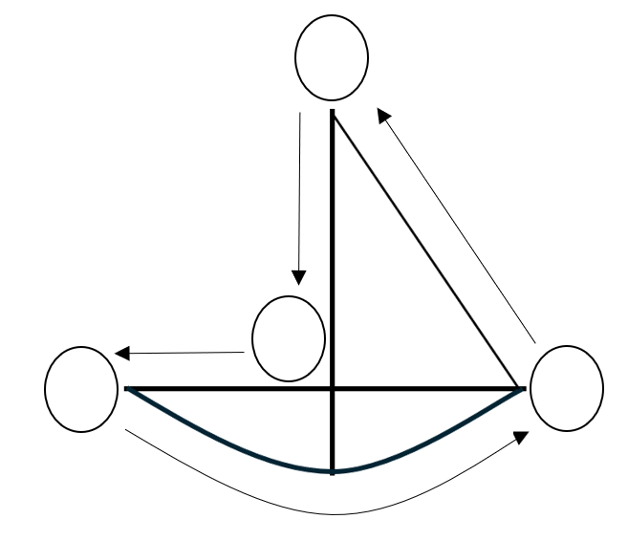
Can you be the conductor?
4
4
Left Hand
Right Hand
1
1
3
2
2
3
Notes:
Take the lead: can you be the conductor?
Draw sailing boats in the air in time to the music. Use one or both hands:

Slide 14
Time to move!
Time Signature:
3/4
1 | 2 | 3 | 1 | 2 | 3
knees | clap | click | knees | clap | click
Notes:
Suggested movements to make during ‘Dawn’ (3/4 time):
Moving with your hands:
Show the strong and weak beats of the music by performing this pattern. Aim to keep the arms in motion (making gentle circles).
1 knees
2 clap
3 click
1 knees
2 clap
3 click

Slide 15
Time to move!
A | B
D | C
left | right | left | right | left | right
A | B | B | C | D | D
Notes:
Suggested movements to make during ‘Dawn’ (3/4 time):
Moving with your feet:
Create a “box step” with your feet. Aim to walk on your toes to show that this music is elegant and hopeful. (see next slide)

Slide 16
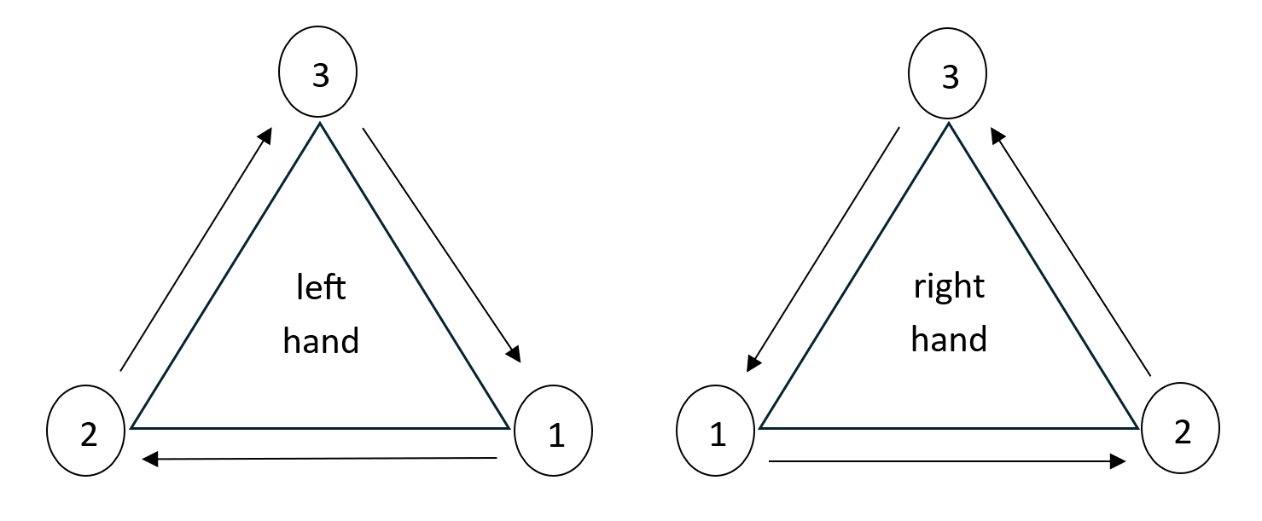
Can you be the conductor?
Notes:
Take the lead: can you be the conductor?
Draw triangles in the air in time to the music. Use one or both hands:

Slide 17
Lesson 2
Copyright Andrea Price & BBC

Slide 18
‘March’
https://www.bbc.co.uk/teach/ten-pieces/articles/zs6nkhv
Notes:
1. Warm-up and recap by listening to the ‘March’ and performing some of the movements from the previous lesson.

Slide 19
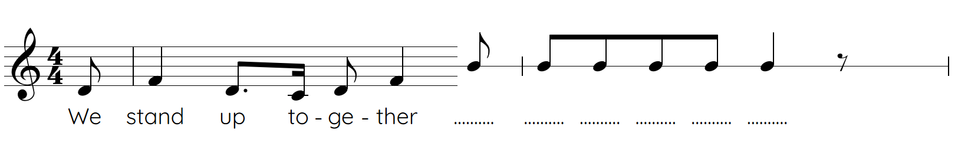
D
F
D
C
D
F
Notes:
2. Explain that you are going to use the start of the melody from the ‘March’ to create your own protest song. Teach the class this short phrase, then try to sing along each time it comes in. This can also be done while marching on the spot!
The phrase can be heard at the very start of the piece when the bassoon comes in at 0’13 and identified throughout.

Slide 20
Notes:
Experiment with this melody by adding your own ending! This can be spoken or sung or performed using tuned classroom percussion.
sing the first half and clap the 2nd half of the pattern, ideally whilst marching or keeping time with your feet. This will help everyone to learn the rhythm.

Slide 21
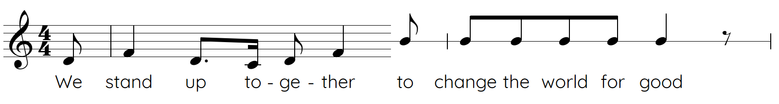
Notes:
b) for a spoken version, choose 6 syllables that fit with the topic of protest and speak / shout them. Here is an example to try speaking / shouting

Slide 22
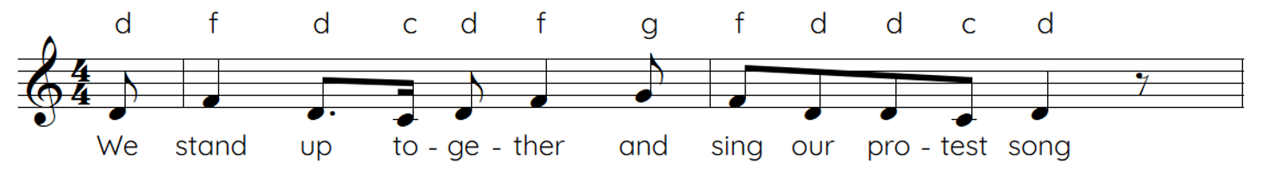
Notes:
c) for a sung or played version, choose pitches from the pentatonic scale: C, D, F, G, A. The note D should be the note used most frequently. Here is an example to try singing and/or playing:

Slide 23
Notes:
4. In pairs, groups*, or as a whole class**, create your own protest song by combining phrases based on the starting points above. Give the groups some time to develop their ideas and practise. Children that are less confident at speaking / literacy may prefer to express themselves using tuned classroom percussion. Children that are less confident in singing may prefer to speak / shout. The most confident children might sing and perform their music at the same time! The performance will be most successful if the music has a strong sense of pulse. Encourage the children to march in time whilst singing / speaking / playing where possible. There is also an accompanying worksheet (see slide 3) for children who would prefer to write or notate their ideas.
*Even numbers of phrases are more musically satisfying, therefore pairs, groups of four, eight etc. are ideal if every child is to take ownership of their own phrase.
**If you are working on this as a whole-class activity, a call-and-response would work well, with the entire class singing “We stand up together”, and individual children taking it in turns to sing / speak / play a response.
5. Bring the class back together and listen to each other’s work. Ask the rest of the class to listen carefully and give some feedback. Did the words fit well with the pulse? Did anyone manage to march along whilst speaking/singing/playing? Did the performance sound strong and proud? What could you say to help the group?

Slide 24















Which instrument is playing your melody?
https://www.bbc.co.uk/teach/ten-pieces/articles/zs6nkhv
Notes:
6. Recap and warm down by listening to the ‘March’ again. Ask the class to listen carefully for ‘their’ melody, and see if they can identify which instrument is playing each time they hear it.

Slide 25
Lesson 3
Copyright Andrea Price & BBC

Slide 26
‘Dawn’
https://www.bbc.co.uk/teach/ten-pieces/articles/zs6nkhv
Notes:
1. Warm-up and recap by listening to ‘Dawn’ and performing some of the movements from lesson 1. Focus on feeling the 3/4 time.
2. Explain that you are going to use the texture of ‘Dawn’ to create your own pieces in groups, using untuned and tuned classroom percussion. The music has three layers of texture; the melody, the bass, and the off-beats. This activity will also work well with other instruments such as keyboards, recorders, ukuleles, or children’s own instruments.

Slide 27
Time Signature:
3/4
1 | 2 | 3 | 1 | 2 | 3
knees | clap | click | knees | clap | click
Notes:
3. Recap the hand movements without the music playing
Explain that beats 2 and 3 are the off-beats (the weaker beats). The bass plays on beat 1 of each bar. Listen again and pick out these features, either without doing the movements or joining in quietly.
Moving with your hands:
Show the strong and weak beats of the music by performing this pattern. Aim to keep the arms in motion (making gentle circles).
1 knees
2 clap
3 click
1 knees
2 clap
3 click

Slide 28

‘Dawn’ - Melody
Can you identify some of the woodwind instruments playing the tune?
Can you remember the type of scale the melody is based on?
Notes:
4. Recap the melody by listening and asking children to identify some of the woodwind instruments playing the tune. Can anyone remember the type of scale the melody is based on? A pentatonic scale, with five different pitches.

Slide 29
Create your own piece!
Performance Grid:
 | 1 | 2 | 3 | 1 | 2 | 3 | 1 | 2 | 3 | 1 | 2 | 3
Layer 1 - melody | Improvise a melody using the five notes of the pentatonic scale: C, D, F, G, A
Layer 2 – off-beats |  | A F | A F |  | A F | A F |  | A F | A F |  | A F | A F
Layer 3 – bass line | D |  |  | C |  |  | A |  |  | C
Notes:
5. In groups, create your own piece using these three layers of texture. More than one person can perform each role. Use the same five notes: C, D, F, G, A.
The off-beats and bass line can be performed using untuned percussion, in addition to or instead of tuned percussion. Ukuleles can perform the off-beat layer by playing a D minor chord.
If stuck with layer 1 (melody), try some of the examples on the next slide.

Slide 30
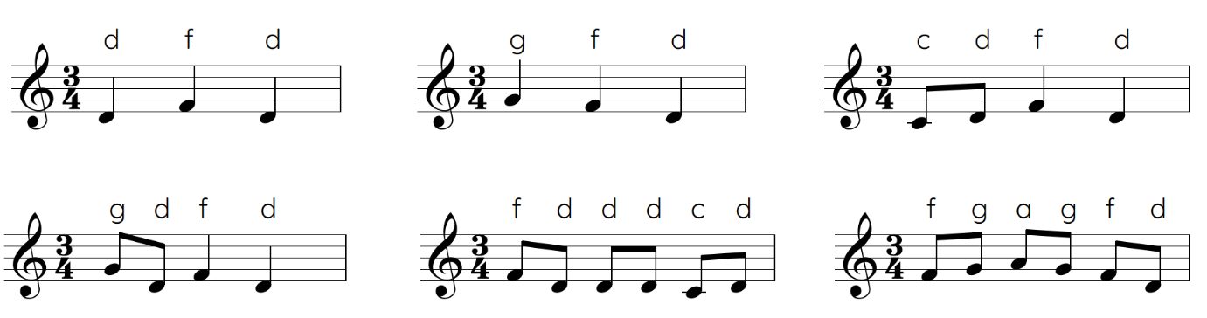
Example Melodies
Notes:
6. Give the groups some time to develop their ideas and practise, then pause to briefly discuss structure and performance. Question prompts:
How many times will your group play the performance grid?
Will everyone play all of the time? Are there more interesting ways that you can think of to use the different layers?
How will you begin and end your performance?

Slide 31



Let’s perform!
Notes:
7. Bring the class back together and listen to each other’s work. Ask the rest of the class to listen carefully and give some feedback. Question prompts:
Can you tell me who performed which layer of texture in the performance?
How did the group begin and end their performance?
Could we feel the 3/4 time? Perhaps we could join in!

Slide 32
Which instrument is playing your role?
https://www.bbc.co.uk/teach/ten-pieces/articles/zs6nkhv
Notes:
8. Recap and warm down by listening to ‘Dawn’ again. Ask the class to listen carefully to ‘their’ part of the texture and see if they can identify which instruments are performing ‘their’ role.

Slide 33
Lesson 4
Copyright Andrea Price & BBC

Slide 34

Musical bingo!
Notes:
Become a musical detective by taking part in musical bingo! The children can create their own 3 x 3 grid, or cut out one of templates provided. Children could play on their own or in pairs. Try the game for the first time before recapping the musical words. Ask these questions in any order to create the bingo game:
How many pitches make up the pentatonic scale? (five)
How many beats were in a bar in the ‘March’? (four)
How many beats were in a bar in ‘Dawn’? (three)
Which woodwind instrument is actually made of metal? (flute)
Which woodwind instrument has the lowest pitch? (bassoon)
What is the word for layers in music? (texture)
What is the musical word for a tune? (melody)
What is the musical word for weak beats? (off-beats)
What is the musical word for the lowest part of the texture? (bass line)

Slide 35
Watch the orchestral performance
https://www.bbc.co.uk/teach/ten-pieces/articles/zs6nkhv
Notes:
2. Watch the orchestral performance and ask the class to think about the boxes they are not sure about. At the end of the performance go through the answers before playing the game again. Answer prompts can be given to students who are struggling so that they can access the game.

Slide 36
Watch the Introductory Film
https://www.bbc.co.uk/teach/ten-pieces/articles/zs6nkhv
Notes:
3. Watch the film again and return to your discussion about the Montgomery Bus Boycott and the idea of protest. Play the orchestral performance of ‘March’ and ask the children to think of and / or write down something about the world that is unfair or unjust. Each child should march up with heavy feet and put their thought in the designated place (e.g. sticky notes stuck to the board, cards posted into a box, verbal response spoken to teacher).

Slide 37
What do you hope for the future?
https://www.bbc.co.uk/teach/ten-pieces/articles/zs6nkhv
Notes:
4. Play the orchestral performance of ‘Dawn’ and ask the children to think of and / or write down something they hope for about the future. Each child should lightly move to the front to place their thought in the designated place (e.g. the other half of the board, cards posted into another box etc.).
4. Final plenary – democracy in action! Ask the class to vote for one final chance to explore something from earlier in the project. This could be the film, the movements to one of the variations, or even watching any recordings you have taken of their own pieces!

Slide 38
Taking it further – cross curricular activities
HISTORY: As a class, watch this BBC Teach KS2 video on Rosa Parks and in smaller groups, get children to consider the video questions (answers on video page): what was the date of Rosa Parks’ actions? Where was Rosa Parks travelling? Where did Rosa Parks sit on the bus? What happened after Rosa Parks refused to give up her seat? What does Rosa Parks say she was ‘tired of’?
HISTORY: As a class, learn about the life of Mary Seacole following the BBC Teach KS2 resources.
ART: After learning about the life & history of Mary Seacole, students can use colouring pencils to colour in the BBC Teach outlines of The British Hotel, and Mary Seacole figures.

