Slide 1

Errollyn Wallen
Mighty River
Primary Classroom Lesson Plan
Written by Fran Hart

Slide 2

Lesson outcomes
Learners will:
Listen and describe the music, with a focus on the spiritual
Sing and play music
Create music using call and response, a pentatonic scale, chords, pitched and unpitched sounds
Perform in an ensemble
Learn musical vocabulary

Slide 3
Resources Required
Tuned classroom instruments e.g. xylophones, glockenspiels
Untuned classroom instruments e.g. tambourines, triangles, drums, cymbals

Slide 4
Curriculum Checklist
National Curriculum in ENGLAND (KS2)
Play and perform in solo and ensemble contexts, using their voices and playing musical instruments with increasing accuracy, fluency, control and expression
Compose music for a range of purposes using the interrelated dimensions of music
Listen with attention to detail and recall sounds with increasing aural memory
SCOTLAND Curriculum for Excellence (Second Level)
Perform songs in unison and in parts, individually or as part of a group, and communicates the mood and character of songs from a range of styles and cultures
Uses voice, instruments and technology to create music, experimenting with timbre
Perform on instruments, individually or as part of a group, to communicate the mood and character of a piece of music
Curriculum for WALES: Expressive Arts (Progression Step 3)
I can explore how creative work can represent, document, share and celebrate personal, social and cultural identities
I can reflect upon how artists have achieved effects or communicated moods, emotions and ideas in their work
I can identify and respond creatively to challenges with resilience and flexibility
NORTHERN IRELAND Primary Curriculum (KS2)
Sing and perform with simple instruments from memory, by ear or from notation to develop vocal and instrumental skills
Work creatively with sound by creating musical stories, pictures, patterns, conversations, accompaniments and by investigating ways of preserving the music they have created

Slide 5
Glossary of music terms
Term | Definition
Call and response | One musician sings or plays a musical phrase, and other musicians reply to or copy the phrase
Chords | Two or more notes played at the same time
Compose | Create original music
Hymn | A religious song
Legato | Smooth sounds
Melody | The tune, made up of a mixture of high and low pitch sounds played one after the other (it’s the part of the music that you often find yourself singing along to or remembering)
Movement | A structure used to divide up a longer musical composition e.g. a symphony may be made up of three or four movements
Notation | Sound represented in symbols e.g. staff notation
Pentatonic scale | A 5-note scale, e.g. CDEGA or DEGAB
Phrase | A part of a melody or rhythm, e.g. a place to breathe, like a comma in writing

Slide 6
Glossary of music terms
Term | Definition
Tuned instruments | Instruments that have different pitches and can be used to play a melody or tune e.g. glockenspiel
Solo | Player or singer performing on their own
Spiritual | A religious song linked to black enslaved people, thought to derive from the combination of European hymns and African music
Structure | The order of the different sections that make up a piece of music, e.g. intro, verse, chorus, outro
Time signature | The number of beats in a bar, or metre
Untuned instruments | Instruments that do not have different pitched sounds and cannot be used to play a melody, e.g. triangle
Vocal | Sounds made by the mouth, e.g. ssh, humming, singing, beat-boxing
Tuned instruments | Instruments that have different pitches and can be used to play a melody or tune e.g. glockenspiel
Solo | Player or singer performing on their own
Spiritual | A religious song linked to black enslaved people, thought to derive from the combination of European hymns and African music

Slide 7
Lesson 1
Copyright Fran Hart & BBC

Slide 8

Background – the composer
Errollyn Wallen (b. 1958)
Born in Belize, Errollyn Wallen studied composition at universities in London and Cambridge.
A CD of her music was taken into space by an astronaut on NASA mission STS-115. It travelled nearly 5 million miles by orbiting the Earth 186 times!
Back on Earth, she is in the ‘Top 20 Most Performed Living Composers’. She was the first black female composer to feature in the BBC Proms and she has written music for the 2012 Paralympic Games 2012, the Queen’s Golden and Diamond jubilees and the global climate change conference COP 26.
She founded the group ‘Orchestra X’ whose motto is “we don’t break down barriers in music... we don’t see any”.
Notes:
Errollyn Wallen has travelled far and wide for her passion for the arts.
Born in Belize, after taking a diploma in piano performance she studied at the Dance Theatre of Harlem, New York she then decided to study composition in the UK at universities in London and Cambridge.
Her music is also well travelled – a CD of her music was taken into space by an astronaut on NASA mission STS-115. It travelled nearly 5 million miles by orbiting the Earth 186 times!
Back on Earth, she is in the ‘Top 20 Most Performed Living Composers’ and her music has appeared at many prestigious events. She was the first black female composer to feature in the BBC Proms and she has also written music for the Paralympic Games 2012, the Queen’s Golden and Diamond jubilees and the global climate change conference COP 26.
She founded the group ‘Orchestra X’ whose motto is “we don’t break down barriers in music... we don’t see any”.

Slide 9
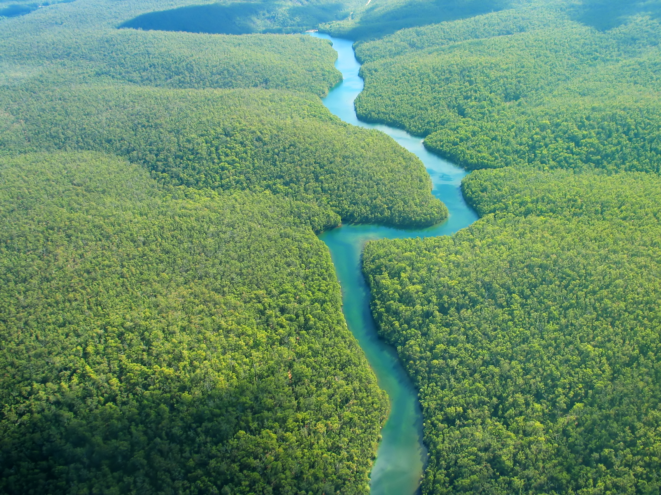
Background – the music
Mighty River
This piece of music explores the themes of slavery and freedom through the idea of a ‘Mighty River’ – a natural, unstoppable force heading for the ocean, just like the innate human desire to be free.
Mighty River is in one single movement and therefore there are no breaks in the music. It flows, like water, from one idea to another.
Errollyn Wallen has included the well-known songs, or spirituals, ‘Deep River’ and ‘Go Down Moses’, as well as the hymn ‘Amazing Grace’, in this piece. These melodies were first introduced to the UK by previously enslaved people over 150 years ago.

Slide 10
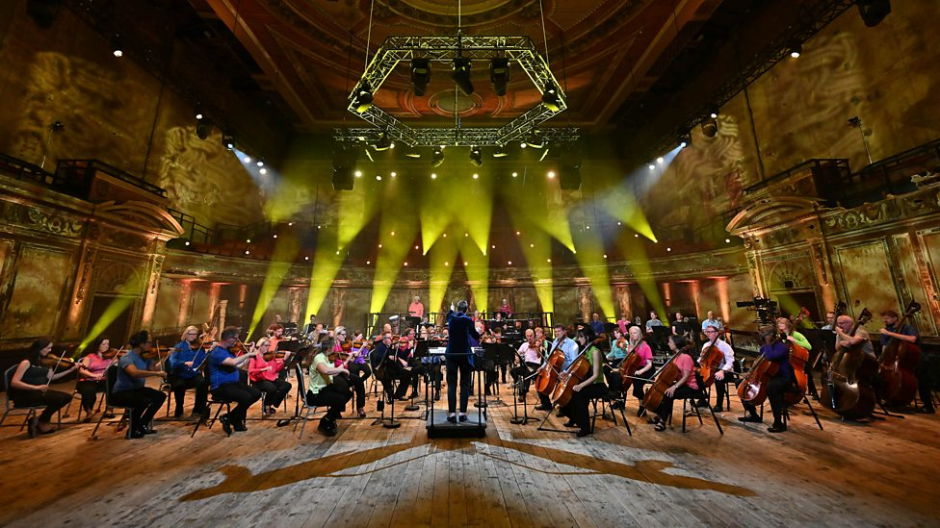
Watch the orchestral performance
https://www.bbc.co.uk/teach/ten-pieces/articles/zhfg239
https://teach.files.bbci.co.uk/tenpieces/audio-Errollyn-Wallen-Mighty-River-abridged-BBC.mp3
Notes:
1. STARTER
Listen to or watch Mighty River by Errollyn Wallen. Read to the class and discuss this quote by Errollyn Wallen about her piece:
“It is an innate human instinct to be free. Just as it is a law of nature that the river should rush headlong to the sea. The perpetual motion of the music, like water, like time, through its sheer momentum, carries with it the cries and echoes of human hearts and voices that are singing out of suffering, repentance, humility and hope.”

Slide 11
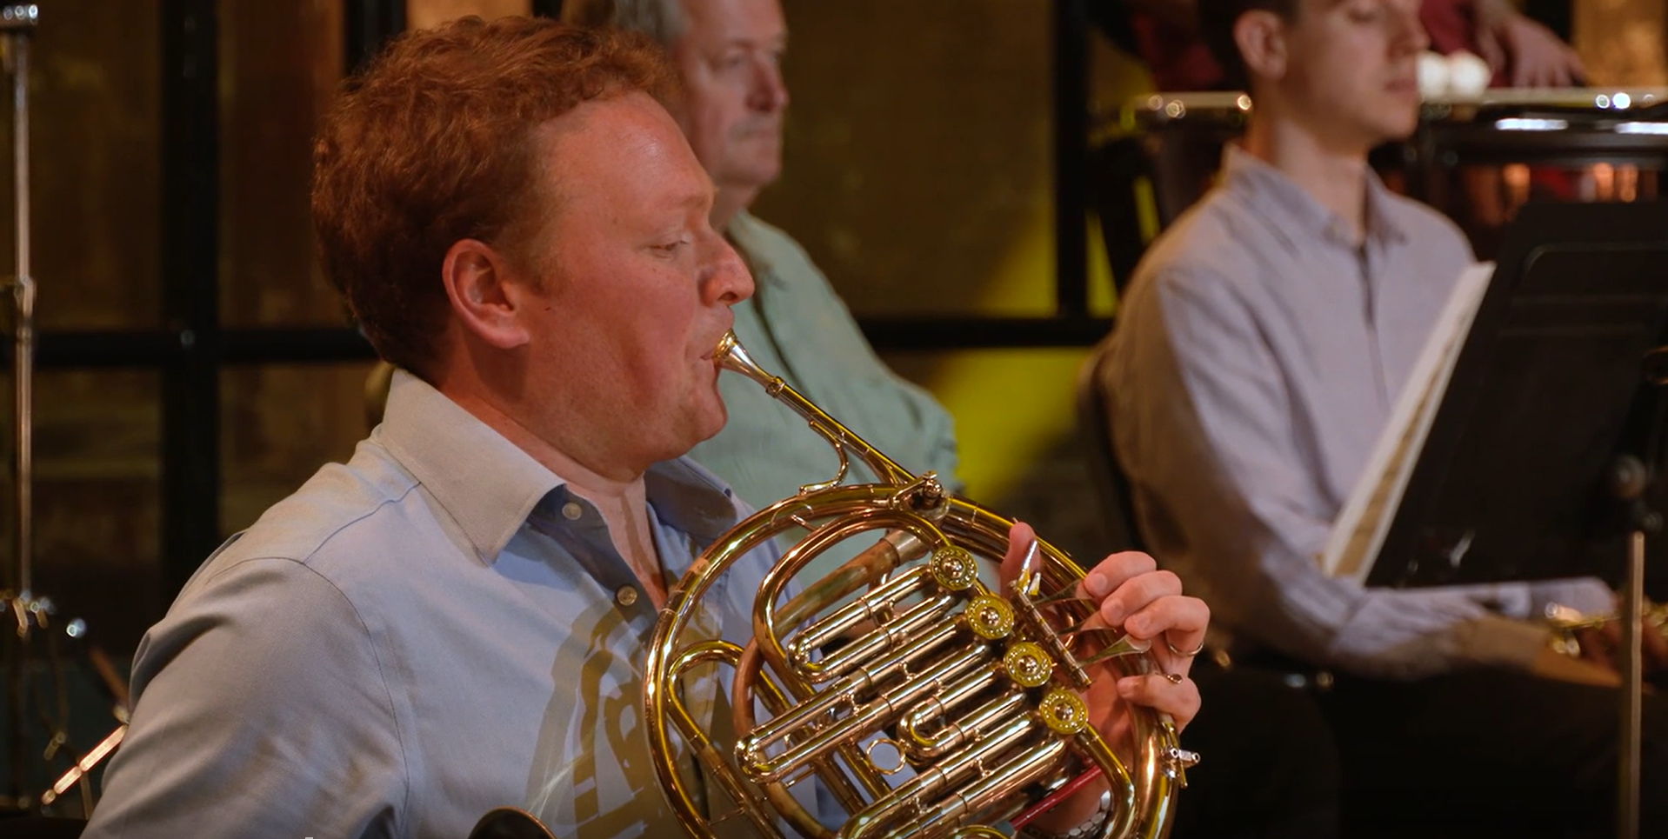
Do you recognise the tune played on the horn at the beginning?
Notes:
2. LEARNING
Discuss the opening of Mighty River, played on the horn, asking the class if anyone recognises the tune that is being played.
This is a well-known hymn tune (a song sung in church) that is also a spiritual, called Amazing Grace.
Listen to the opening of Mighty River again and then listen to alternative performance of Amazing Grace online (be sure to check the version is suitable for children before showing it to the class). Compare the two versions with the class, considering a) similarities b) differences c) student’s personal preference with explanation as to why.
Discuss with the class what a spiritual is and its link to the slave trade.

Slide 12
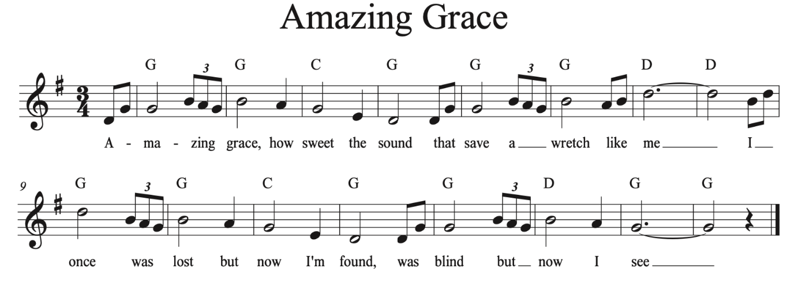
Notes:
As a class, sing Amazing Grace:

Slide 13
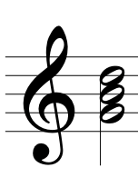
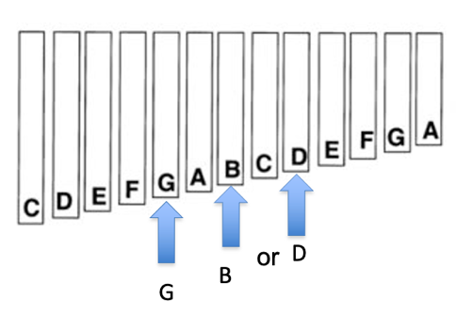
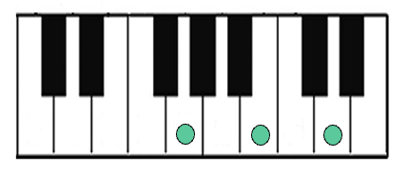
G Major
See this KS2 BBC Bitesize page for more detail.
Notes:
3. MAIN TASK
Year 3 & 4 – develop singing accuracy
Explain to the class what chords are: chords are when two or note mores are played at the same time. Next door notes played at the same time clash and are uncomfortable to our ears; they are called discords. When alternate notes are played at the same time, they are comfortable sounding and called concords. Concords have names, e.g. C major, and commonly consist of three notes (a triad), CEG.

Slide 14
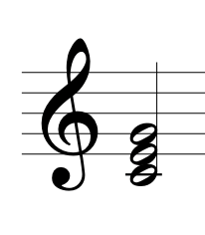
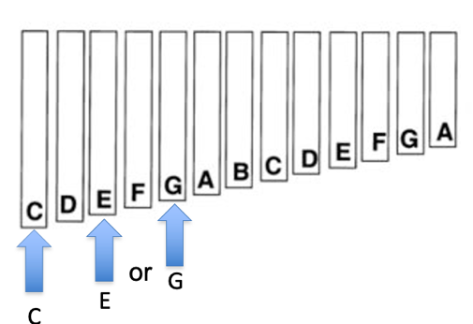
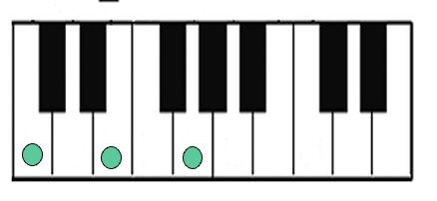
C Major

Slide 15
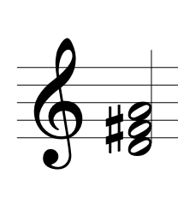
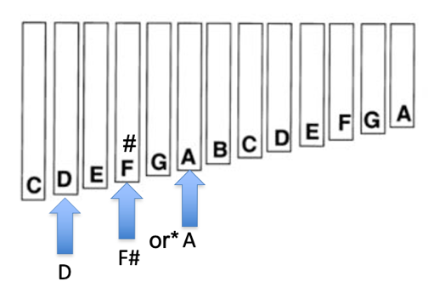
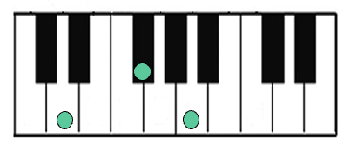
D Major
Notes:
*replace the F bar for an F# if possible. If not, use D and A only

Slide 16

Let’s create chords!
Chord | Chord notes | Xylophone/ glockenspiel
G major | G B D | G B or G D
C major | C E G | C E or C G
D major | D F# A | D F# or D A
Notes:
Learn to play the chords, giving different children different notes to play on classroom instruments such as xylophones or glockenspiels.
Practise playing the chords at the correct time in the song with half the class playing, half the class singing. Challenge a pupil who learns an instrument to play the melody. Challenge pupils to sing a verse on their own (a solo).

Slide 17
Amazing Grace Lyrics
1 Amazing grace (how sweet the sound) that saved a wretch like me! I once was lost, but now am found, was blind, but now I see. | 4 The Lord has promised good to me, his word my hope secures; he will my shield and portion be as long as life endures.
2 'Twas grace that taught my heart to fear, and grace my fears relieved; how precious did that grace appear the hour I first believed! | 5 Yes, when this flesh and heart shall fail, and mortal life shall cease: I shall possess, within the veil, a life of joy and peace.
3 Through many dangers, toils and snares I have already come: 'tis grace has brought me safe thus far, and grace will lead me home. | 6 The earth shall soon dissolve like snow, the sun forbear to shine; but God, who called me here below, will be forever mine.

Slide 18
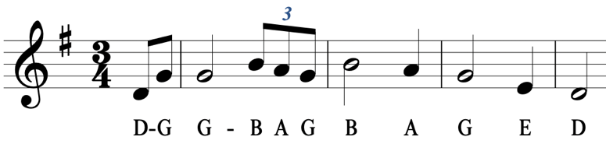
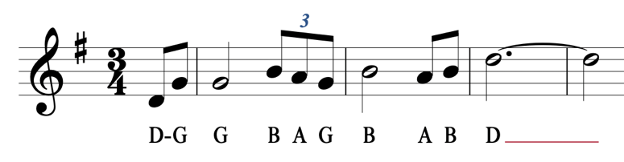
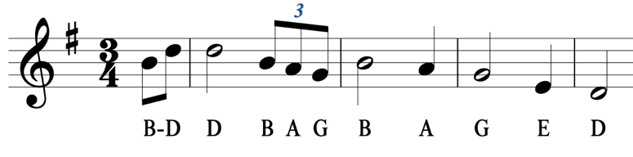
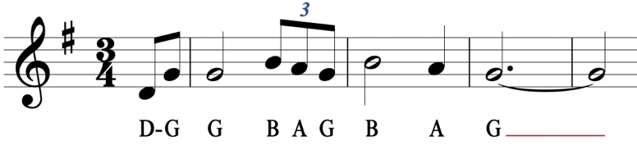
Phrase 1
Phrase 2
Phrase 3
Phrase 4
Notes:
Year 5 & 6 – Learn to play the melody of Amazing Grace from notation
This can be broken down into 4-bar phrases – part, with a group learning one phrase. N.B. phrases 1, 2 and 4 start in the same way.
Challenge pupils who feel more confident to play the whole melody.
You could start by telling the class that it starts in the key D. Ask them to try to work out the next notes by listening and experimenting. Can they work out any of the melody by ear? For support, the class might need paper copies of the melody and some work might be required to help them work out each note of their part.

Slide 19

















Time to share!
Notes:
4. PLENARY
Prepare and perform Amazing Grace agreeing on the number of verses to play, whether there is a solo singer for any verse and how the performance will start and stop.

Slide 20
Lesson 2
Copyright Fran Hart & BBC

Slide 21
Watch the orchestral performance
https://www.bbc.co.uk/teach/ten-pieces/articles/zhfg239
Notes:
STARTER
Watch and listen to Mighty River by Errollyn Wallen. Ask children to identify (for example by raising their hands) every time they hear a reference to Amazing Grace: 1’56 (flute), 2’06 (oboe), 2’28 (strings), 4’05 (trumpets) etc.
Listen to Swing Low, Sweet Chariot (for example, the version by the Plantation Singers) which is another spiritual.
Ask the class if they have heard of or come across call and response before.
Call and response is a musical ‘conversation’ where the first melody is like a question from one musician (the musical leader) and then others reply or respond. It can be vocal or instrumental and is a structure used in many different traditions of music, including in music from Africa.
As a class, identify the use of call and response in Swing Low, Sweet Chariot.

Slide 22
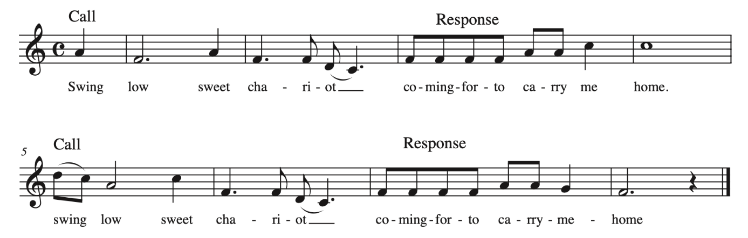
Swing Low Sweet Chariot
Notes:
Sing Swing Low, Sweet Chariot as a class.

Slide 23
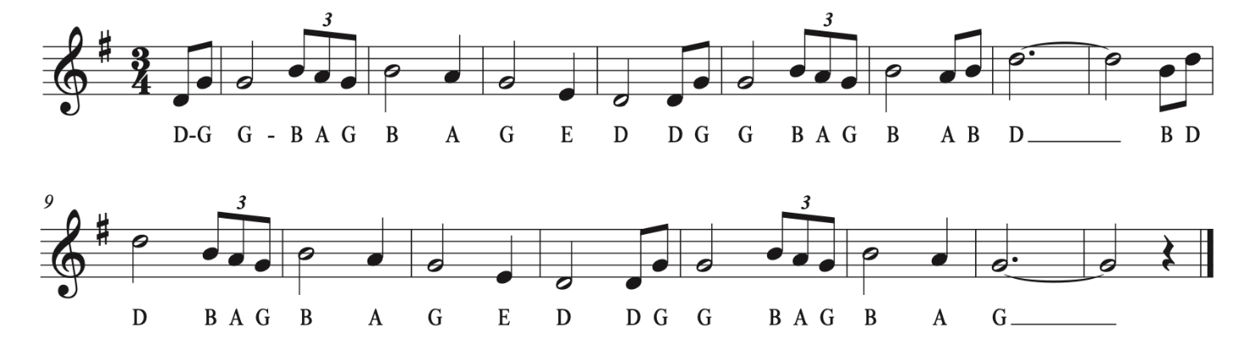
Amazing Grace
Notes:
2. MAIN TASK
Revise Amazing Grace from last lesson, developing accuracy in playing. Year 5 & 6 – add chords is possible (see Lesson 1, Year 3 & 4).
Looking at the notation, identify which pitches (notes) are used in the melody: D E G A B
This is a pentatonic scale – five note scale. There are many examples of these, and they are used in music from different traditions around the world, e.g. Africa, China, Indonesia. Western music tends to use a diatonic scale – seven pitches that cover an octave.
Year 3 & 4 – as a class, explore the pentatonic scale (D E G A B) and create a pentatonic call and response, where one player is the caller and everyone else responds. Only the notes D E G A B can be used.
Year 5 & 6 – in groups, create a pentatonic call and response, where one group member is the caller and the rest of the group respond.
Questions to consider:
Will it be sung and/or played?
Who will be the caller?
How many times will it be played/sung?
3. PLENARY
Use the call and response, rehearse and perform Amazing Grace with a call and response introduction and ending.
Year 5 & 6 – agree on different groups to share their call and response with, with the whole class singing for each performance.

Slide 24
Lesson 3
Copyright Fran Hart & BBC

Slide 25
What patterns do you hear?
https://teach.files.bbci.co.uk/tenpieces/audio-Errollyn-Wallen-Mighty-River-abridged-BBC.mp3
Notes:
STARTER
Listen to Mighty River and identify/consider what and how this music reflects water and the journey made by slaves.
Discuss with the class how the instruments are used (particularly the flowing, overlapping repeated patterns e.g. 1’22 in woodwind
The music is legato, meaning smooth sounding, and there are changes of time signature, meaning metre or the number of beats in a bar, possible reflecting a journey that is not predictable or easy. Does the music sound comfortable? Sometimes the notes clash, creating discords, which could reflect the difficult journey.
Discuss how the melody is played by different instruments during the piece – the horn, violins, flute, clarinet and trumpet, before returning to the horn at the end. Ask the class to discuss and feedback why they think Errollyn Wallen (the composer) may have done this.

Slide 26

Lesson 1 and 2 Recap
Amazing Grace
Swing Low Sweet Chariot
Call and Response
Pentatonic Scales – D E G A B
Notes:
2. MAIN ACTIVITY
As a class, recap the content covered so far in Lesson 1 and 2 (including learning and performing Amazing Grace, creating a call and response, and learning about pentatonic scales).
Revise the pentatonic scale, playing the notes D E G A B.
Consider Mighty River and the inspiration for its creation – the abolition of the Slave Trade Act, the flow of people, journeying the sea, and the suffering of being displaced from your home. If you feel appropriate, link this to current day news stories of those looking to seek asylum in the UK.
Ask the class how it is possible to represent these themes in music.

Slide 27
Create your own an expressive piece of music
You can use:
Pentatonic scale (D E G A B)
Vocal sounds
Pitched instruments
Unpitched instruments
Chords
Notes:
3. TASK
Create an expressive (meaning music that shows emotions and feelings, achieved through careful and controlled use of elements such as tempo, dynamics, pitch, texture etc.) piece of music to reflect this journey, using:
Pentatonic scale (D E G A B)
Vocal sounds
Pitched instruments
Unpitched instruments
Chords
Year 3 & 4 – work as a class with different groups of children allocated to different instruments/vocals. The pitched instruments and voices can work together to develop a pentatonic melody or could work separately to create different melodies. Questions to consider:
Will these work at the same time?
Will the vocalists use lyrics or vocal sounds?
How will the chords be used?
Which chords will be used? Concords, e.g. G Major, C major, D major.
Will there be discords – uncomfortable chords?
Will the rhythms be an ostinato (constantly repeating pattern)?
Which unpitched instruments would be suitable to use?
When would this play?
Year 5 & 6 – groups (same groups as Lesson 2) create a pentatonic melody and develop chords (concords and discords) around this. Questions to consider:
How will vocals be used?
How will unpitched sounds be used?
How will the music be expressive to reflect the emotions of the journey?
How will the groups use their call and response from lesson 2?
How will their music reflect the movement of the sea?

Slide 28
Will these work at the same time?
Will the vocalists use lyrics or vocal sounds?
How will the chords be used?
Which chords will be used? Concords, e.g. G Major, C major, D major.
Will there be discords – uncomfortable chords?
Will the rhythms be an ostinato (constantly repeating pattern)?
Which unpitched instruments would be suitable to use?
When would this play?
Notes:
Year 3 & 4 – Questions to Consider

Slide 29
How will vocals be used?
How will unpitched sounds be used?
How will the music be expressive to reflect the emotions of the journey?
How will the groups use their call and response from lesson 2?
How will their music reflect the movement of the sea?
Notes:
Year 5 & 6 – Questions to Consider

Slide 30
Time to share!
Notes:
4. PLENARY
Perform the journey music (Year 3 & 4 – as a class, Year 5 & 6 – separate group pieces). Consider the following questions:
Does it reflect emotions?
Does it meet all the criteria?
Does the structure work?
How can it be improved?

Slide 31
Lesson 4
Copyright Fran Hart & BBC

Slide 32
Listen and reflect
https://www.bbc.co.uk/teach/ten-pieces/articles/zhfg239
Notes:
STARTER
Listen to the opening of Mighty River by Errollyn Wallen, which was dedicated to her great-great-great-great-great-great grandmother. Discuss the emotions that may have influenced Errollyn Wallen when composing the music. Think about the personal emotions linked to the slave trade and movement of people (discussed in Lesson 3).
Consider with the class how students can make their music more expressive. Expression is the emotion and feeling shown in music, achieved through careful and controlled use of elements such as tempo, dynamics, pitch, texture etc.

Slide 33
Notes:
Sing Amazing Grace. How can we make this more expressive? This could be done by changing the tempo, the dynamics or texture. Sing it unaccompanied – without any instruments in the background - and then add the melody and chords. How does this change the expression?

Slide 34
1 Amazing grace (how sweet the sound) that saved a wretch like me! I once was lost, but now am found, was blind, but now I see. | 4 The Lord has promised good to me, his word my hope secures; he will my shield and portion be as long as life endures.
2 'Twas grace that taught my heart to fear, and grace my fears relieved; how precious did that grace appear the hour I first believed! | 5 Yes, when this flesh and heart shall fail, and mortal life shall cease: I shall possess, within the veil, a life of joy and peace.
3 Through many dangers, toils and snares I have already come: 'tis grace has brought me safe thus far, and grace will lead me home. | 6 The earth shall soon dissolve like snow, the sun forbear to shine; but God, who called me here below, will be forever mine.

Slide 35
Structure a performance
The performance needs to:
start with a call and response
include the expressive pentatonic journey music
include Amazing Grace
Think about:
How will the performance start?
How will it end?
How will the song be performed? Solo? Accompanied? Unaccompanied?
Will a conductor be needed? A conductor is the person who controls the performance, setting the tempo and pointing at players to start and stop. They might also help to show dynamics.
How will the performance be expressive? Can this be improved?
How will everyone know what they are singing or playing and when?
Notes:
2. MAIN TASK
So far, the class have learnt Amazing Grace, created a call and response and composed expressive journey music using the pentatonic scale.
Students should now structure (organise) a performance that:
starts with a call and response
includes the expressive pentatonic journey music
includes Amazing Grace
Decide as a class how to structure the different sections.
Year 5 & 6 – this can be separate group performances with the whole class performing the song, or one long performance in which each group performs their call and response and pentatonic journey music, returning to the whole class song between each group’s work. This would be a rondo structure.
All Year groups: Rehearse the agreed structure, giving pupils the chance to improve their work, using feedback from pervious lessons.
Questions to consider:
How will the performance start?
How will it end?
How will the song be performed? Solo? Accompanied? Unaccompanied?
Will a conductor be needed? A conductor is the person who controls the performance, setting the tempo and pointing at players to start and stop. They might also help to show dynamics.
How will the performance be expressive? Can this be improved?
How will everyone know what they are singing or playing and when?

Slide 36

Time to share!
Notes:
3. PLENARY
Perform and record the final performance(s). This might be a live performance in front of the class or in an assembly or a recorded performance on a recording device, such as an iPad.
4. EVALUATE
Discuss what the class have achieved and how effective it was. Ask the class to reflect on the following questions:
What would you do differently if you did it again?
What have you learnt from doing this?

Slide 37
Taking it further – cross curricular activities
MUSIC: Listen and learn to sing other spirituals, e.g. Down By The Riverside, Good News, Go Down Moses, Steal Away. Perform a range of these in a school assembly or concert (see below).
ENGLISH/RE: Analyse the words of spirituals and compare. Do they have common metre? Do they have common number of lines? What do they mean? Are there references to the bible? What can we learn from them?
DANCE: Learn an African Juba dance which uses patterns of clapping body parts, which were drumming rhythms used to communicate messages. See BBC Ten Pieces – Florence Price Symphony No. 1, Juba Dance
MUSIC: Learn about African instruments and rhythms. Research how these influenced to other musical styles e.g. Blues, Samba etc.
HISTORY/GEOGRAPHY: Learn about the slave trade, including the movement of people around the world and the impact on life today (including the music that has resulted from this, for example, blues). Present the information learnt in the assembly above, helping other children and/or families to have a deeper understanding of slavery.

