Slide 1

Lili Boulanger
D’un matin de printemps
Primary Classroom Lesson Plan
Written by Katie Teage

Slide 2

Lesson outcomes
Learners will:
Listen to and reflect on a piece of 20th Century orchestral music
Write a poem and convert it into their own composition
Perform as an ensemble (or as individuals)
Learn musical language appropriate to the task
Copyright: Words – Katie Teage, Design - BBC

Slide 3
Resources Required
Large space
Writing materials
Boulanger word mat and worksheet
Tuned percussion (e.g. xylophones, glockenspiels, chime bars) or keyboards
Copyright: Words – Katie Teage, Design - BBC

Slide 4
Curriculum Checklist
National Curriculum in ENGLAND (KS2)
Play and perform in solo and ensemble contexts, using their voices and playing musical instruments with increasing accuracy, fluency, control and expression
Use and understand staff and other musical notations.
SCOTLAND Curriculum for Excellence (Second Level)
Recognise a range of music styles and identify some of the main instruments in the genre.
Use voice, instruments and technology to create music, experimenting with timbre.
Perform on instruments, individually or as part of a group, to communicate the mood and character of a piece of music.
Curriculum for WALES: Expressive Arts (Progression Step 3)
I can apply knowledge and understanding of context, and make connections between my own creative work and creative work by other people and from other places and times.
I can explore and describe how artists and creative work to communicate mood, feelings and ideas and the impact they have on an audience.
I can combine my knowledge, experience and understanding to plan and communicate my creative work for a range of different audiences, purposes and outcomes.
NORTHERN IRELAND Primary Curriculum (KS2)
Sing and perform with simple instruments from memory, by ear or from notation to develop vocal and instrumental skills.
Work creatively with sound by creating musical stories, pictures, patterns, conversations, accompaniments and by investigating ways of preserving the music they have created.
Copyright: Words – Katie Teage, Design - BBC

Slide 5
Glossary of music terms
Term | Definition
Beat | A steady pulse that is present throughout a piece of music, like our heartbeat. It can get faster or slower
Chromatic | The chromatic scale is a series of 12 notes, each a semitone, or half note, apart.
Lyrics | The words in a song
Melody | The tune, made up of a mixture of high and low pitch sounds played one after the other (it’s the part of the music that you often find yourself singing along to or remembering)
Modes | A type of scale or order of pitches. There are seven main modes including the one mentioned in this lesson plan: Phrygian mode
Octave | A series of 8 notes of a musical scale. The first and last notes of the scale are 8 notes apart.
Tuned instruments | Instruments that have different pitches and can be used to play a melody or tune e.g. glockenspiel
Rhythm | A pattern of sounds of different lengths
Staff notation | Staff notation or the stave is five horizonal lines and 4 spaces that represent a different musical pitch
Tempo | Speed of the music
Texture | How we combine, mix and layer sounds (how ‘thick’ or ‘thin’ the music is, e.g. how many instruments are playing, how they are being played etc.)
Time signature | The number of beats in a bar, or metre
Copyright: Words – Katie Teage, Design - BBC

Slide 6
Lesson 1
Copyright Katie Teage & BBC

Slide 7
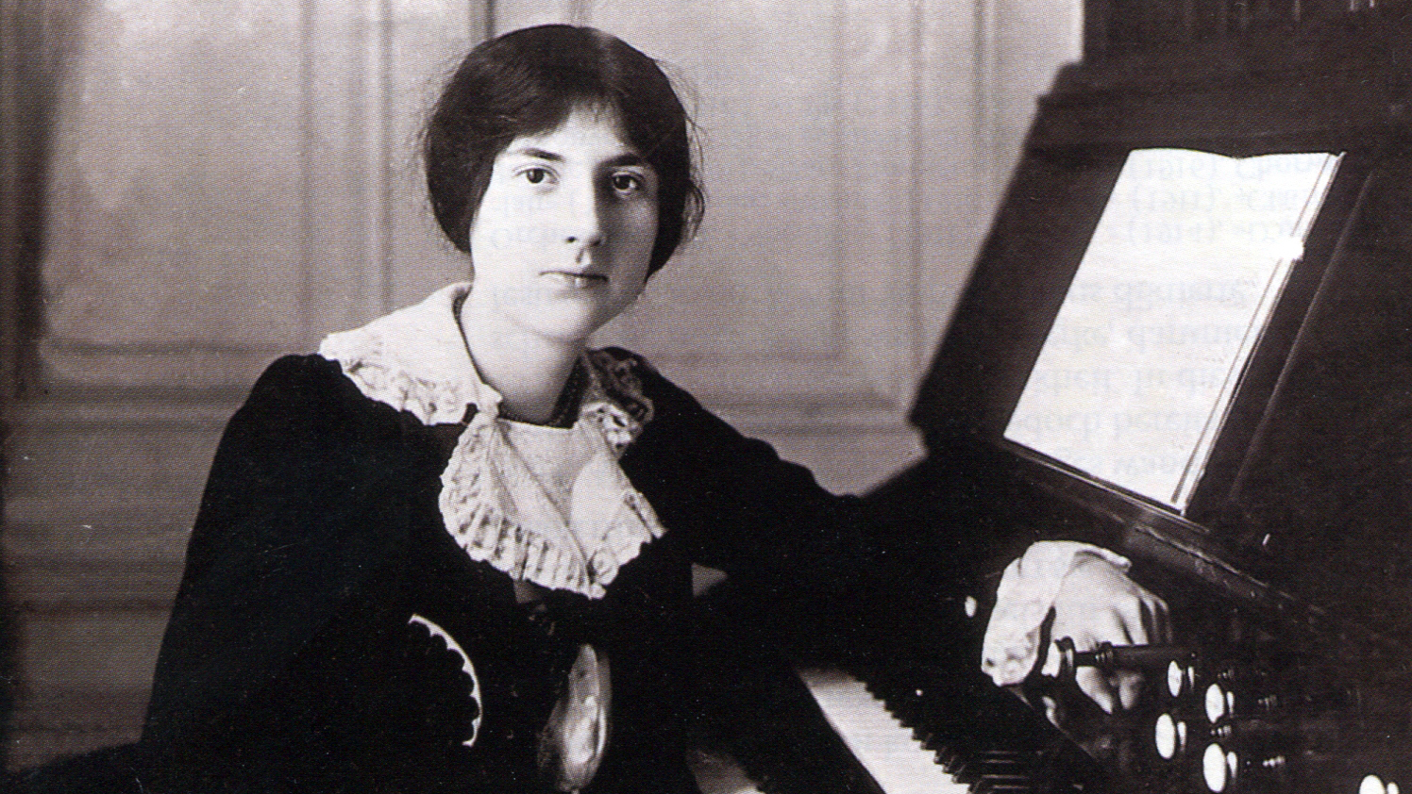
Background – the composer
Lili Boulanger (1893 – 1918)
Boulanger was a French composer who lived in Paris
Her musical talent was spotted at a very young age (before she could speak!)
She learnt to play lots of instruments including piano, violin, harp, cello and she loved to sing
Her sister, Nadia Boulanger, was also a successful composer
Lili died very young, at the age of 24
Copyright: Words – Katie Teage, Design - BBC

Slide 8
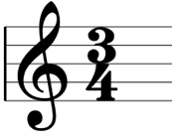
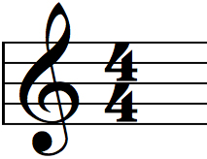
Time Signatures
D’un matin de printemps is largely in ‘three time’, with three beats in a bar
The top number tells us how many beats to count, and the bottom number tells us what type of beats these are.
Copyright: Words – Katie Teage, Design - BBC

Slide 9
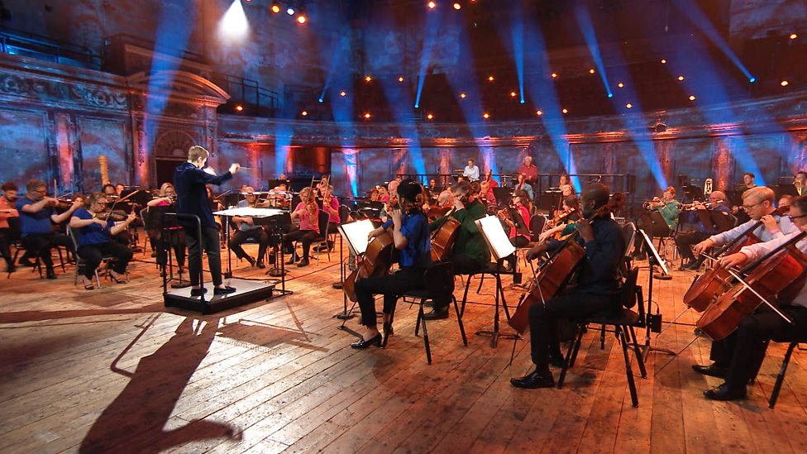
Listen to D’un matin de printemps
https://teach.files.bbci.co.uk/tenpieces/audio-lili-boulanger-d-un-matin-de-printemps.mp3
Copyright: Words – Katie Teage, Design - BBC
Notes:
ACTIVE LISTENING
Play the audio recording and before you do, explain to the class that you are going to listen to a piece of music that describes a certain time of year (don’t say season just yet). Tell them that the piece is about 5 minutes long and that it describes something happening in nature. You are going to be listening to the piece twice. Remember also to listen out for the feeling of 3 beats in a bar.
First listen (hall or classroom)
If space allows: place pieces of paper with words that describe the seasons around the room (use the Boulanger Word Mat - see slide 3 for link to resource - for example words). If space is limited: hand out individual word mats. Ask children to write down or circle words that they think match the music they are listening to. When the music has finished, invite them to share the words they felt matched the music they heard.
Second listen (hall or classroom)
For the second listening, hand out paper and coloured pencils. Ask the children to draw a picture of what they think is happening or what story the music is trying to tell. Some children may find this challenging as it quite an abstract task for some learners. If helpful, you could display the picture of the seasons on the next slide and ask them to copy the one that they think the music is describing. Ask a few children to tell you about what they have drawn.

Slide 10

Listen carefully!
exciting | curious | colourful | majestic | graceful | haunting
delicate | sparkling | relaxing | freezing | sun-kissed | delicious
dazzling | joyful | cosy | crunch | cool | glittering
majestic | fluffy | colourful | colourful | warm | sandy
crisp | blossoming | azure | leafy | playful | happy
gentle | sparkling | pretty | beautiful | cheerful | woolly
awakening | bouncing | warming | migrating | humid | emerald
bright | shiny | sunny | cold | mysterious | bare
Copyright: Words – Katie Teage, Design - BBC
Notes:
ACTIVE LISTENING
Play the audio recording and before you do, explain to the class that you are going to listen to a piece of music that describes a certain time of year (don’t say season just yet). Tell them that the piece is about 5 minutes long and that it describes something happening in nature. You are going to be listening to the piece twice. Remember also to listen out for the feeling of 3 beats in a bar.
First listen (hall or classroom)
If space allows: place pieces of paper with words that describe the seasons around the room (use the Boulander Word Mat - see slide 3 for link to resource - for example words). If space is limited: hand out individual word mats. Ask children to write down or circle words that they think match the music they are listening to. When the music has finished, invite them to share the words they felt matched the music they heard.
Second listen (hall or classroom)
For the second listening, hand out paper and coloured pencils. Ask the children to draw a picture of what they think is happening or what story the music is trying to tell. Some children may find this challenging as it quite an abstract task for some learners. If helpful, you could display the picture of the seasons on the next slide and ask them to copy the one that they think the music is describing. Ask a few children to tell you about what they have drawn.

Slide 11
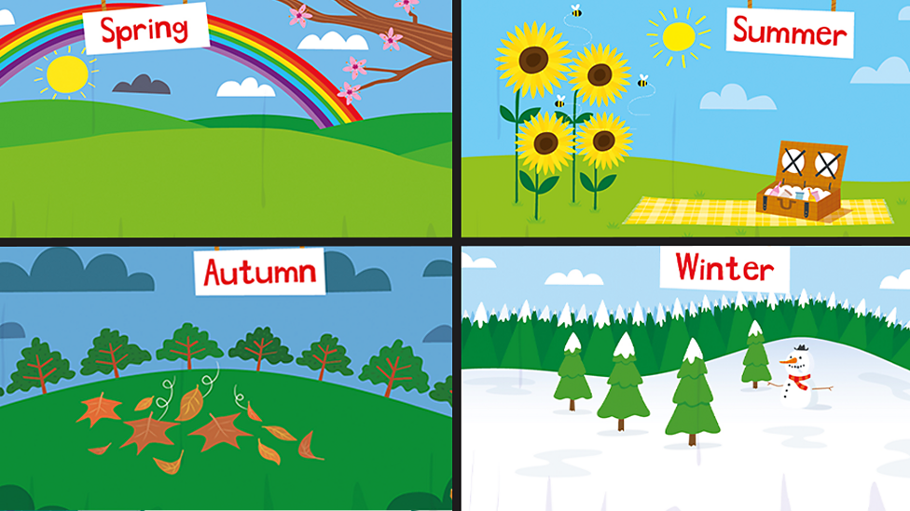
Copyright: Words – Katie Teage, Design - BBC

Slide 12
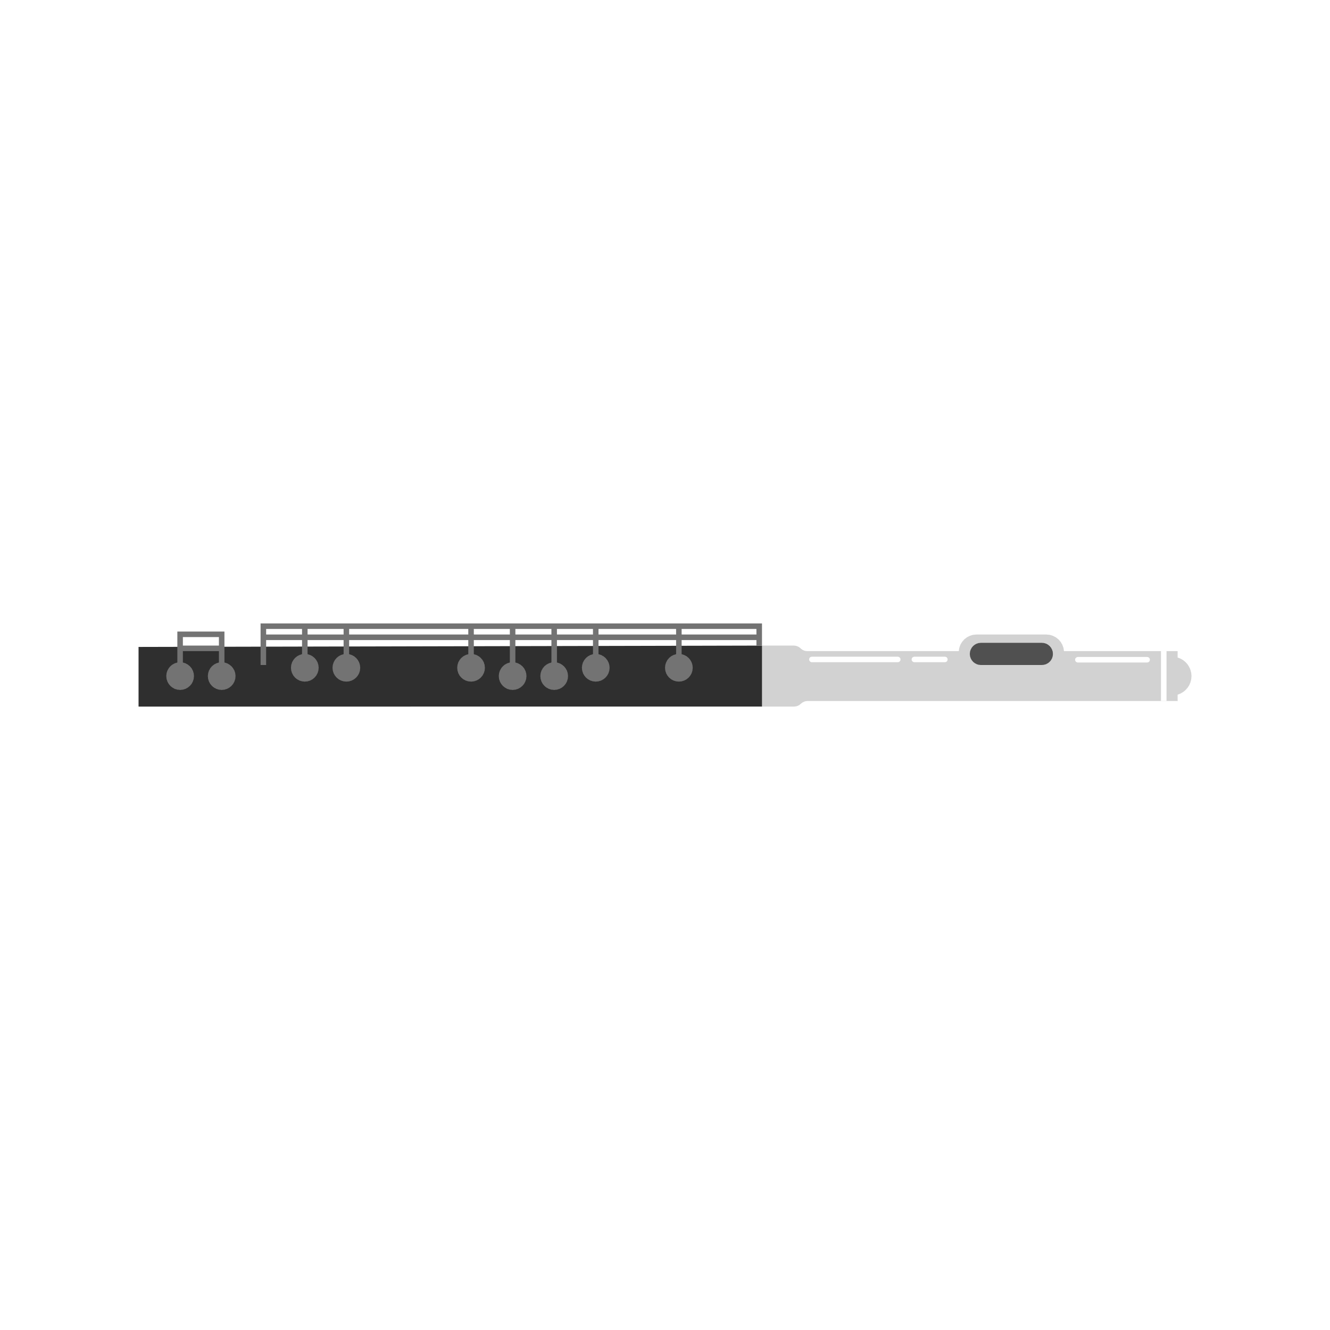
Background – the music
D’un matin de printemps
“D’un matin de printemps” is French for ‘Of a Spring morning’.
Boulanger uses the orchestra to paint a musical picture of a spring morning.
This is an example of Impressionist music, which focusses on the mood and emotion in music. It is also a style of painting made famous by artists such as Monet and Renoir.
Listen out for the melody in the flute at the beginning and how it is played by different instruments through the piece.
Boulanger writes busy musical lines for every instrument, creating an interesting musical texture.
Copyright: Words – Katie Teage, Design - BBC

Slide 13

Introducing Lili Boulanger’s D’un matin de printemps
https://www.bbc.co.uk/teach/ten-pieces/articles/zh7js82
Copyright: Words – Katie Teage, Design - BBC
Notes:
Now watch the introduction video for the piece.

Slide 14
Lesson 2
Copyright Katie Teage & BBC

Slide 15


Let’s create a poem!
Our poems will need:
5 lines
Repetition
Small changes
Large changes at the end
For example:
I like spring
I like spring
I really like spring
I really like spring because
I really like spring because everything blooms, blossoms and comes to life
Copyright: Words – Katie Teage, Design - BBC
Notes:
CREATE A POEM
To help us write our compositions we are going to take inspiration from poetry, as so many composers often do. We are going to write a five-line poem about a season using lots of repetition.
We will then represent this poem in music. Here is a basic example of what we want. Show this to the children:
I like spring
I like spring
I really like spring
I really like spring because
I really like spring because everything blooms, blossoms and comes to life!
Discuss with the children what happens in this poem (shown in green) and how that might be represented in music:
I like spring
I like spring [repeated]
I really like spring [added the word really]
I really like spring because [emphasis on really and addition of because]
I really like spring because everything blooms, blossoms and comes to life! [same phrase repeated and then unexpected number of words added at the end]
Year 3/4: as a class write a poem about a season. If some children are able, they can write their own poems.
Year 5/6: children write their own poems in groups of 2 or 3 about a chosen season.
The music could be kept on in the background quietly whilst they write their poems, if it’s not distracting for the learners.
Checklist for success:
5 lines
Repetition
Small changes
Large changes at the end
Once the poems have been created, ask the groups to recite them together (or recite them as a class if you have created a shared poem). If possible, record them.

Slide 16

Let’s create the melody!
Line 1: | E | F
Line 2: | E | F
Line 3: | E | F | G
Line 4: | E | F | G | A
Line 5: | E | F | G | A | B | C | D | E
Copyright: Words – Katie Teage, Design - BBC
Notes:
2. CONSTRUCT A MELODY
Tell the children they can use the following letters for each line of their poem – these letters are the names of musical notes (pitch). They will be representing each word as a note or notes. Children can either choose 1 note per word, or for more of a challenge, some children may wish to choose 1 note per syllable. We will not be creating a song with these words, simply using them to help write a melody. No need to use instruments at this point – they will be composing on paper for now.

Slide 17


For example …
E | F | E
I | like | spring
E | F | F
I | like | spring
E | F | F | F | G
I | rea- | -lly | like | spring
E | G | F | F | G | A | A
I | rea- | -lly | sike | spring | bea- | -cause
E | G | F | F | G | A | A | F | G | A | B | C | D | B | C | D | E
I | rea- | -lly | like | spring | bea- | -cause | ev- | -ry- | -thing | blooms | blos- | -soms | and | comes | to | life
Copyright: Words – Katie Teage, Design - BBC
Notes:
This is what it could look like after the children have experimented (they will make different choices of order with the same notes)
N.B The children won’t have a feeling of pulse yet, we have not created a rhythm here. We are first exploring developing our tune in our sound world similar to that created by Lili Boulanger in her piece.
We are exploring the sounds of the Phrygian mode (E – E on the piano with no chromatic notes).
Ask children to write the letter names of the notes they are using above their words. Collect in the poems.

Slide 18
Lesson 3
Copyright Katie Teage & BBC

Slide 19
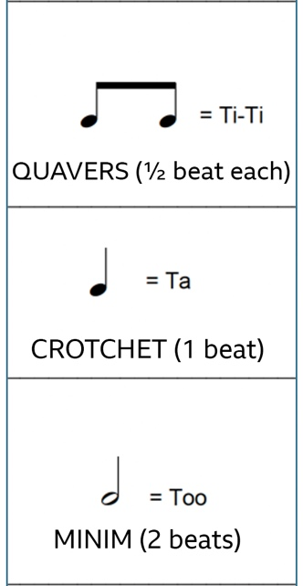
Introducing Rhythm
Copyright: Words – Katie Teage, Design - BBC
Notes:
INTRODUCING RHYTHM NOTATION
The starter exercise for this lesson will help children read and understand rhythms (patterns) in the time signatures that we became familiar with in the musicianship game in Lesson 1 (3/4 and 4/4).
Using a familiar song can be a helpful way to understand some basic rhythms. Show the children the image below. It has the notation for London’s Burning which is ‘in three’ or has three beats in each bar. Below the notes are the lyrics to the song. Above the notes are the names we are going to use to describe each rhythm.
One beat notes are ‘ta’ and half beat notes (that make two sounds within one beat) are ‘ti-ti’ and the two beat notes ‘too’. Some children may know these are crotchets, quavers and minims. Some may call them walk and running or coffee and tea.

Slide 20
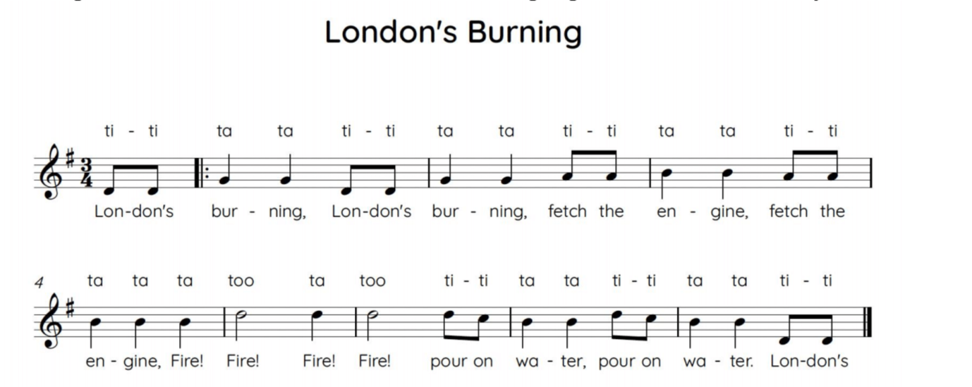
Copyright: Words – Katie Teage, Design - BBC
Notes:
Spend some time getting familiar with the three different rhythms by chanting or singing the rhythms of London’s Burning using ‘ta’, ‘ti-ti’ and ‘too’.

Slide 21
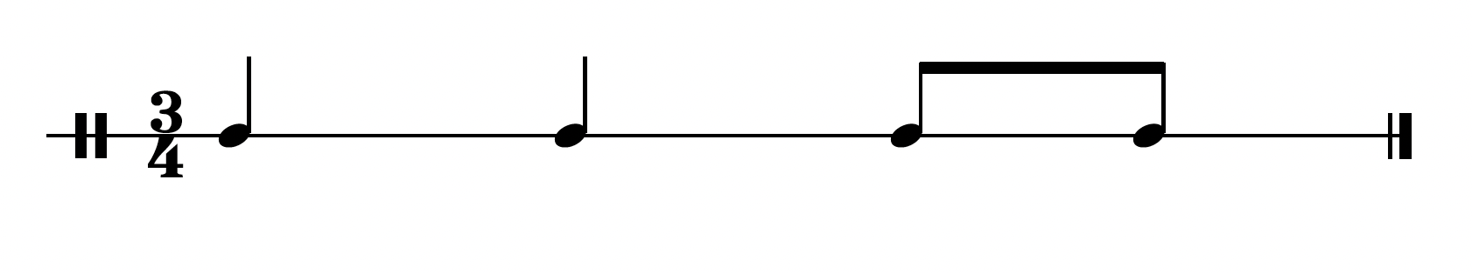
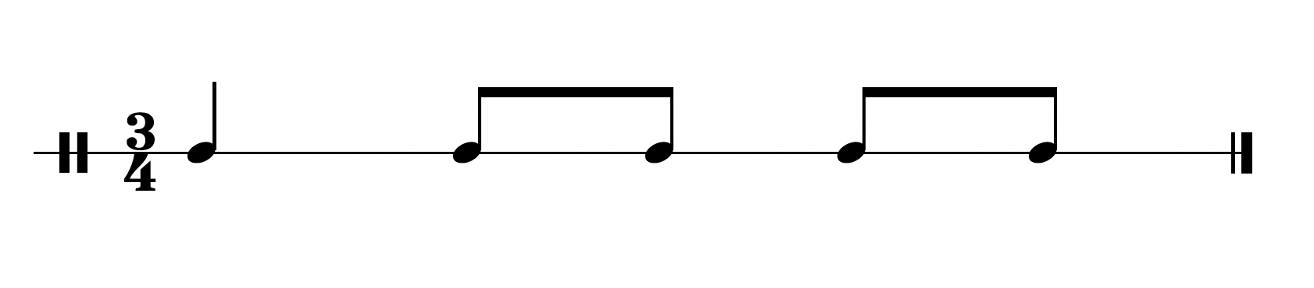
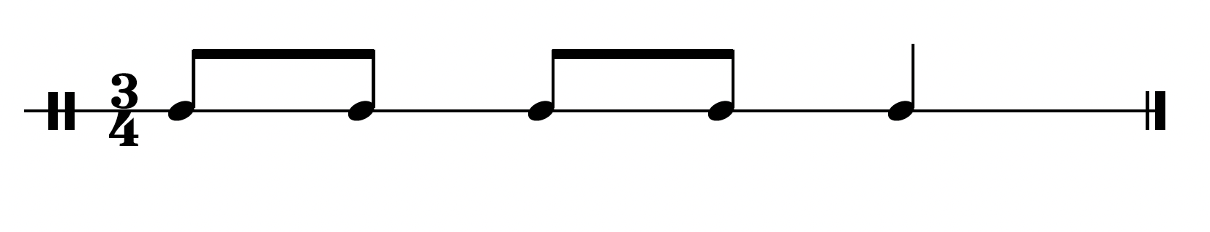
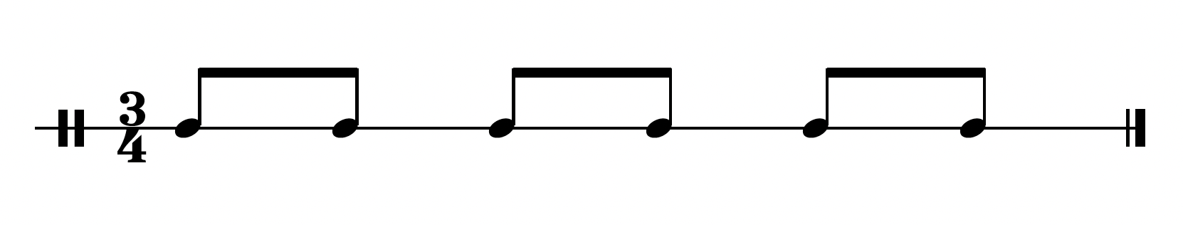
Copyright: Words – Katie Teage, Design - BBC
Notes:
2. CONSOLIDATE RHYTHMIC UNDERSTANDING
Display these images and count the children in as they all chant together using ‘ta’, ‘ti-ti’ and ‘too’. Chanting together will really help the children feel confident.
To add variation, the class could stop using their voices and clap, stamp or tap the rhythms instead.

Slide 22
Create your own rhythm!
Each bar must add up to three beats
Use crotchets (ta), quavers (ti-ti) and minims (too)
You can repeat bars
The final bar should be ‘ta, too’ (1 beat + 2 beats = 3)
Copyright: Words – Katie Teage, Design - BBC
Notes:
CREATE A RHYTHM
Now that children are familiar with crotchets, quavers and minims, we are going to focus on creating a rhythm for our note choices from last lesson. Children are going to create an 8 – 12 bar rhythmic pattern.
Year 3/4 – Some children may need to copy or get ideas from the above examples.
Year 5/6 – Some children may need to follow the instructions for year 3/4, others may be able to write their version by selecting rhythms from this key:
Hand out copies of the worksheet (see slide 3 for link) and ask the children to write their rhythms on the top line of the sheet.
Checklist for success
Each bar must add up to three beats
They can use crotchets (ta), quavers (ti-ti) and minims (too)
They can repeat bars (this is encouraged!)
The final bar should be ‘ta, too’ (1 beat + 2 beats = 3)
Make sure the children can chant their rhythms. Get them to tap the beat on their chest as they chant. This can be hard for some children. Variations to try for a successful outcome:
ask them to slow down
split the group up so that one child claps the beat whilst the other chants their rhythm
get the whole class to say their patterns at the same time whilst you clap steadily at the front
Collect in children’s rhythm sheets.

Slide 23
Lesson 4
Copyright Katie Teage & BBC

Slide 24
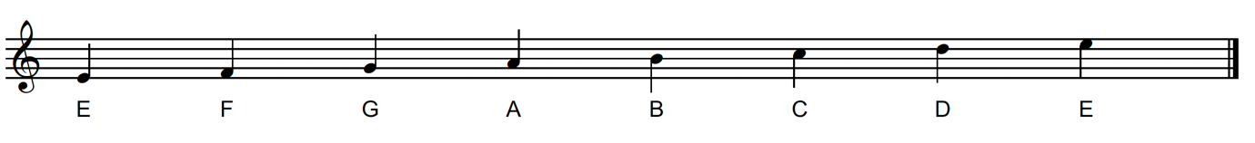
Write your melody on a stave
3 beats in each bar
Variety of rhythms using crotchets, quavers and minims
When using quavers (ti-ti) repeat the same note as much as possible
If you change notes, only move by step up and down
Write the letter names over the pitches if needed
Start and end on E
Copyright: Words – Katie Teage, Design - BBC
Notes:
WRITE MELODY ON STAVE
Hand out poems from a previous session with the note choices they made.
Also hand out children’s rhythm worksheets from last session.
Children can now apply their note choices to their rhythms and transfer their tune to the stave. Display or hand out this image (above) which shows the position of the 8 notes that are available to them for this melody.
Checklist for success
Bars with 3 beats in each bar
Variety in rhythms, i.e. using crotchets, quavers and minims
When using quavers (ti-ti) repeat the same note as much as possible
If you change notes, only move by step up and down
Write the letter names over the pitches if needed (some children may be able to read music already)
Start and end on the note E. To denote the higher pitched E they can put an apostrophe (‘) next to E like this: E’.

Slide 25
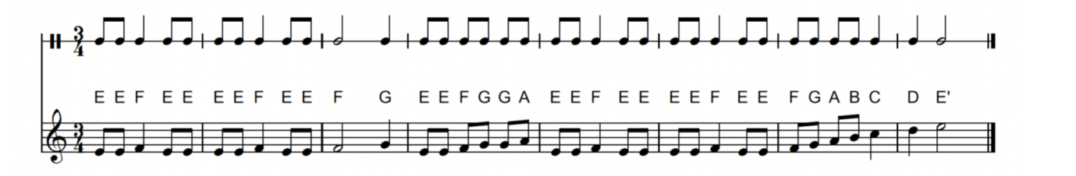
For example …
Copyright: Words – Katie Teage, Design - BBC

Slide 26



Practice and perform!
Copyright: Words – Katie Teage, Design - BBC
Notes:
2. PRACTICE AND PERFORM COMPOSITIONS
When the children have created their 8 -12 bar melody, provide pitched percussion instruments to allow children to explore playing their melodies. Make sure they are playing steadily and are counting 3 beats in each bar.
Finally, rehearsing their compositions, and share the performances within the class or to other groups in the school.

Slide 27
Taking it further – cross curricular activities
ART: Lili Boulanger wrote this piece of music as creative ideas were moving from Impressionism to Surrealism. As a class, research both styles, looking at the differing ways that artists created in these styles and comparing artists such as Renoir and Dali. Then, draw your school building in an Impressionist and then Serialist way to see how different they can look.
SCIENCE: Take a photo from your classroom window every week to better understand how the seasons change in your area. Print the photos, display them in a timeline around your classroom, and annotate them with the scientific changes you can observe (cloud formations, weather patterns, light differences) over the school year.
Copyright: Words – Katie Teage, Design - BBC

