Slide 1
Leonard Bernstein
Mambo
Primary classroom lesson plan
Written by
Rachel Leach
Notes:
For:
Key Stage 2 in England and Wales
Second Level, P5-P7 in Scotland
Key Stage 1/Key Stage 2 in Northern Ireland

Slide 2
Lesson outcomes
After this lesson, pupils will be able to:
• listen and reflect on a piece of orchestral music
• create their own Latin inspired rhythmic ostinatos
• learn rhythms from Bernstein’s ‘Mambo’ and structure them into a piece
• perform as an ensemble
• learn musical language appropriate to the task
Notes:
Resources required
Paper and pens
Classroom percussion instruments and any other instruments your children might be learning
This scheme of work is plotted out over six lessons. Feel free to adapt it to suit your children and the resources you have available.
The six lessons at a glance
Lesson 1:
Activities: Listen and describe a piece of music
Watch the film and discuss
Curriculum link: Listen with attention to detail and recall sounds with increasing aural memory
Appreciate and understand a wide range of high-quality live and recorded music drawn from different traditions and from great composers and musicians
Develop an understanding of the history of music
Lesson 2:
Activities: Create and perform a rhythmic pattern to a pulse
Orchestrate this pattern
Curriculum link: Listen with attention to detail and recall sounds with increasing aural memory
Play and perform in solo and ensemble contexts, using voices and playing musical instruments with increasing accuracy, fluency, control and expression
Lesson 3:
Activities: Learn to play a (mambo) pulse
Choose appropriate instruments and work in groups to perfect the pulse
Curriculum link: Listen with attention to detail and recall sounds with increasing aural memory
Play and perform in solo and ensemble contexts, using voices and playing musical instruments with increasing accuracy, fluency, control and expression
Lesson 4:
Activities: Learn to play mambo rhythms
Choose appropriate instruments and work in groups to perfect these rhythms
Curriculum link: Improvise and compose music for a range of purposes using the interrelated dimensions of music
Play and perform in solo and ensemble contexts, using voices and playing musical instruments with increasing accuracy, fluency, control and expression
Lesson 5:
Activities: Learn and invent a tune
Create short pieces using pulse, ostinato and melody
Curriculum link: Improvise and compose music for a range of purposes using the interrelated dimensions of music
Play and perform in solo and ensemble contexts, using their voices and playing musical instruments with increasing accuracy, fluency, control and expression
Lesson 6:
Activities: Structure all ideas into a piece
Perform the piece to an audience
Use technical terminology where appropriate
Curriculum link: Play and perform in solo and ensemble contexts, using their voices and playing musical instruments with increasing accuracy, fluency, control and expression
Improvise and compose music for a range of purposes using the interrelated dimensions of music

Slide 3
Curriculum checklist
Learners will:
• play and perform in ensemble contexts, using voices and playing musical instruments
• improvise and compose music for a range of purposes using the interrelated dimensions of music
• listen with attention to detail and recall sounds with increasing aural memory
Notes:
Resources required
Paper and pens
Classroom percussion instruments and any other instruments your children might be learning
This scheme of work is plotted out over six lessons. Feel free to adapt it to suit your children and the resources you have available.
The six lessons at a glance
Lesson 1:
Activities: Listen and describe a piece of music
Watch the film and discuss
Curriculum link: Listen with attention to detail and recall sounds with increasing aural memory
Appreciate and understand a wide range of high-quality live and recorded music drawn from different traditions and from great composers and musicians
Develop an understanding of the history of music
Lesson 2:
Activities: Create and perform a rhythmic pattern to a pulse
Orchestrate this pattern
Curriculum link: Listen with attention to detail and recall sounds with increasing aural memory
Play and perform in solo and ensemble contexts, using voices and playing musical instruments with increasing accuracy, fluency, control and expression
Lesson 3:
Activities: Learn to play a (mambo) pulse
Choose appropriate instruments and work in groups to perfect the pulse
Curriculum link: Listen with attention to detail and recall sounds with increasing aural memory
Play and perform in solo and ensemble contexts, using voices and playing musical instruments with increasing accuracy, fluency, control and expression
Lesson 4:
Activities: Learn to play mambo rhythms
Choose appropriate instruments and work in groups to perfect these rhythms
Curriculum link: Improvise and compose music for a range of purposes using the interrelated dimensions of music
Play and perform in solo and ensemble contexts, using voices and playing musical instruments with increasing accuracy, fluency, control and expression
Lesson 5:
Activities: Learn and invent a tune
Create short pieces using pulse, ostinato and melody
Curriculum link: Improvise and compose music for a range of purposes using the interrelated dimensions of music
Play and perform in solo and ensemble contexts, using their voices and playing musical instruments with increasing accuracy, fluency, control and expression
Lesson 6:
Activities: Structure all ideas into a piece
Perform the piece to an audience
Use technical terminology where appropriate
Curriculum link: Play and perform in solo and ensemble contexts, using their voices and playing musical instruments with increasing accuracy, fluency, control and expression
Improvise and compose music for a range of purposes using the interrelated dimensions of music

Slide 4
Glossary of music terms
Term | Definition
Glissando | a ‘slide’ between notes, i.e. when a beater is swiped over the notes of a xylophone. (The most famous glissandos are played by trombones)
Jam | a quick, informal and instant way of putting musical ideas together
Pitched percussion | percussion instruments that can play different pitches – xylophones, glockenspiels, chime bars etc.
Pulse | the steady ‘beat’ under much music made up of notes of the same length (like a ticking clock)
Unpitched percussion | percussion instruments that can only make a limited number of sounds – drums, shakers woodblocks, tambourine etc.

Slide 5
Lesson 1
Watching and listening
Copyright Rachel Leach & BBC
Notes:
Lesson 1:
Activities: Listen and describe a piece of music
Watch the film and discuss
Curriculum link: Listen with attention to detail and recall sounds with increasing aural memory
Appreciate and understand a wide range of high-quality live and recorded music drawn from different traditions and from great composers and musicians
Develop an understanding of the history of music

Slide 6
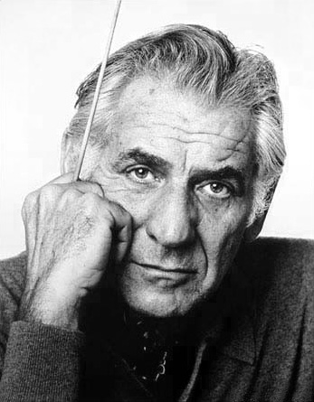
Background – the composer
Leonard BERNSTEIN
(1918 - 1990)
American composer, pianist, conductor, educator
Wrote musicals, operas, songs, symphonies and film scores
Had a popular TV show in which he explained music to children

Slide 7
Background – the music
‘Mambo’ from West Side Story
Written in 1957 for a musical re-telling of Romeo & Juliet
The story is set in New York and about rival gangs – the Jets and the Sharks
Much of the music is inspired by Central American (Latin) rhythms

Slide 8
Watch the orchestral performance
https://www.bbc.co.uk/programmes/p03bvq37
Notes:
Prepare your class
Explain to your class that you are going to begin a 6-week music project focusing on a fantastic piece of music by a composer called Leonard Bernstein. Explain further that the music is from a musical which tells a well-known story.
Listen to Mambo (or watch the orchestra performance film) and afterwards have a discussion about what you have seen. You might like to ask the following questions –
Did you like the film?
What was your favourite part?
What might the music be describing?
Explain that the music is called ‘Mambo’ and is from a musical version of Romeo and Juliet. Check that your class know Shakespeare’s story and explain further that this version takes place in New York in the 1950s with Romeo and Juliet now called Tony and Maria. The Montagues and Capulets are now the Jets and the Sharks, rival gangs. (You could watch the film with Pixie Lott at this point to reinforce these ideas)
Listening task
Give out sheets of paper to everyone and as they listen again, ask them to draw the section of the story it might be describing. Give them three options to choose from. Does it describe:
Tony and Maria falling in love?
The Jets and the Sharks fighting?
Everyone dancing at a party?
There is no ‘correct’ answer for this, it actually describes all three things. In the original show and film, the Mambo happens during a dance. Everyone is dancing but the two gangs are pitted against one another. At the end Tony and Maria meet for the first time.
Play a recording of Mambo in full. Its better if there are no images to look at now, we just want them to listen and draw. Perhaps play the recording two or three times to give them time to finish their pictures.
Discuss their artwork and show some to the class. Tell them that all of their efforts are correct because it is what they imagined whilst they listened. Then explain what happens in the show and film at this point
FINALLY, if you have time left in your lesson and space in your classroom, encourage your class to have a go at dancing to the Mambo too. By now, they should at least be able to shout ‘Mambo’ at the right time!

Slide 9
Did you like the film? What was your favourite part? What might the music be describing?
Response
Notes:
Listen to Mambo (or watch the orchestra performance film) and afterwards have a discussion about what you have seen. You might like to ask the following questions –
Did you like the film?
What was your favourite part?
What might the music be describing?
Explain that the music is called ‘Mambo’ and is from a musical version of Romeo and Juliet. Check that your class know Shakespeare’s story and explain further that this version takes place in New York in the 1950s with Romeo and Juliet now called Tony and Maria. The Montagues and Capulets are now the Jets and the Sharks, rival gangs. (You could watch the film with Pixie Lott at this point to reinforce these ideas)
Listening task
Give out sheets of paper to everyone and as they listen again, ask them to draw the section of the story it might be describing. Give them three options to choose from. Does it describe:
Tony and Maria falling in love?
The Jets and the Sharks fighting?
Everyone dancing at a party?
There is no ‘correct’ answer for this, it actually describes all three things. In the original show and film, the Mambo happens during a dance. Everyone is dancing but the two gangs are pitted against one another. At the end Tony and Maria meet for the first time.
Play a recording of Mambo in full. Its better if there are no images to look at now, we just want them to listen and draw. Perhaps play the recording two or three times to give them time to finish their pictures.
Discuss their artwork and show some to the class. Tell them that all of their efforts are correct because it is what they imagined whilst they listened. Then explain what happens in the show and film at this point
FINALLY, if you have time left in your lesson and space in your classroom, encourage your class to have a go at dancing to the Mambo too. By now, they should at least be able to shout ‘Mambo’ at the right time!

Slide 10
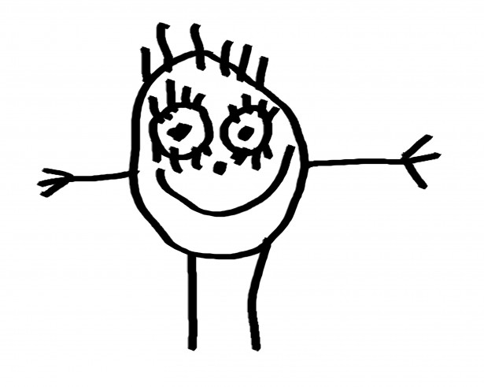
Let’s draw!
Notes:
Explain that the music is called ‘Mambo’ and is from a musical version of Romeo and Juliet. Check that your class know Shakespeare’s story and explain further that this version takes place in New York in the 1950s with Romeo and Juliet now called Tony and Maria. The Montagues and Capulets are now the Jets and the Sharks, rival gangs. (You could watch the film with Pixie Lott at this point to reinforce these ideas)
Listening task
Give out sheets of paper to everyone and as they listen again, ask them to draw the section of the story it might be describing. Give them three options to choose from. Does it describe:
Tony and Maria falling in love?
The Jets and the Sharks fighting?
Everyone dancing at a party?
There is no ‘correct’ answer for this, it actually describes all three things. In the original show and film, the Mambo happens during a dance. Everyone is dancing but the two gangs are pitted against one another. At the end Tony and Maria meet for the first time.
Play a recording of Mambo in full. Its better if there are no images to look at now, we just want them to listen and draw. Perhaps play the recording two or three times to give them time to finish their pictures.
Discuss their artwork and show some to the class. Tell them that all of their efforts are correct because it is what they imagined whilst they listened. Then explain what happens in the show and film at this point
FINALLY, if you have time left in your lesson and space in your classroom, encourage your class to have a go at dancing to the Mambo too. By now, they should at least be able to shout ‘Mambo’ at the right time!

Slide 11
Lesson 2
Latin Rhythms
Copyright Rachel Leach & BBC
Notes:
Lesson 2:
Activities: Create and perform a rhythmic pattern to a pulse
Orchestrate this pattern
Curriculum link: Listen with attention to detail and recall sounds with increasing aural memory
Play and perform in solo and ensemble contexts, using voices and playing musical instruments with increasing accuracy, fluency, control and expression

Slide 12
Choose a special beat number
Notes:
Bernstein’s music is littered with Latin rhythms. The fun lesson below outlines how to make your own Latin dance music
Warm-up. Clear the classroom and ask your children to stand in a circle. To wake them up, pass a quick clap around the circle.
Pulse. Using a drum or a woodblock, play a steady pulse and encourage your class to clap or tap along. When they are good at this you might like to choose a child to play the drum and lead everyone else. Pay particular attention to starting and stopping together.
Now encourage your class to count to eight as they clap. We are heading towards making patterns that will fit one bar of 4/4 and so are counting the 8 quavers
Demonstrate. To make an interesting pattern we have to choose some of the beats to be highlighted or made ‘special’. Ask your class to choose one of the beats (one number from 1 to 8). Challenge your children to tap out the pulse and count in their head. When they reach their ‘special’ number they must say it out loud.
Now ask your class which instrument should play on their chosen ‘special’ beat. Give out that instrument and practise with everyone clapping the 8 and the players just playing on the ‘special’ beat.
When this is achieved, go through the process a couple of times more choosing other numbers to emphasise and add these (with new instruments playing them) into your pattern. Limit your class to a maximum of four ‘special’ beats. Perhaps appoint one child to play the pulse throughout to help keep everyone in time.
Split into small groups and challenge each group to go through the steps above to create their own Latin rhythm. When they are getting good at playing their pattern challenge them further to replace one beat with a flourish, shake, or glissando (slide between notes) or even two quicker notes. Such modifications must still only take up one beat of time! This will make your pattern even more ‘Latin’, but don’t overdo it!
Bring your class back together and hear what they have done. End the session by either layering up all the pieces to create one big Latin dance or by dancing to the patterns (this is easily done by inventing one move for each ‘special’ sound)!

Slide 13
Make your own Latin dance music!
Notes:
Bernstein’s music is littered with Latin rhythms. The fun lesson below outlines how to make your own Latin dance music
Warm-up. Clear the classroom and ask your children to stand in a circle. To wake them up, pass a quick clap around the circle.
Pulse. Using a drum or a woodblock, play a steady pulse and encourage your class to clap or tap along. When they are good at this you might like to choose a child to play the drum and lead everyone else. Pay particular attention to starting and stopping together.
Now encourage your class to count to eight as they clap. We are heading towards making patterns that will fit one bar of 4/4 and so are counting the 8 quavers
Demonstrate. To make an interesting pattern we have to choose some of the beats to be highlighted or made ‘special’. Ask your class to choose one of the beats (one number from 1 to 8). Challenge your children to tap out the pulse and count in their head. When they reach their ‘special’ number they must say it out loud.
Now ask your class which instrument should play on their chosen ‘special’ beat. Give out that instrument and practise with everyone clapping the 8 and the players just playing on the ‘special’ beat.
When this is achieved, go through the process a couple of times more choosing other numbers to emphasise and add these (with new instruments playing them) into your pattern. Limit your class to a maximum of four ‘special’ beats. Perhaps appoint one child to play the pulse throughout to help keep everyone in time.
Split into small groups and challenge each group to go through the steps above to create their own Latin rhythm. When they are getting good at playing their pattern challenge them further to replace one beat with a flourish, shake, or glissando (slide between notes) or even two quicker notes. Such modifications must still only take up one beat of time! This will make your pattern even more ‘Latin’, but don’t overdo it!
Bring your class back together and hear what they have done. End the session by either layering up all the pieces to create one big Latin dance or by dancing to the patterns (this is easily done by inventing one move for each ‘special’ sound)!

Slide 14
Lesson 3
Mambo pulse
Copyright Rachel Leach & BBC
Notes:
Lesson 3:
Activities: Learn to play a (mambo) pulse
Choose appropriate instruments and work in groups to perfect the pulse
Curriculum link: Listen with attention to detail and recall sounds with increasing aural memory
Play and perform in solo and ensemble contexts, using voices and playing musical instruments with increasing accuracy, fluency, control and expression

Slide 15
Let’s start with the pulse…
Notes:
LESSON 3
Warm up. Start with your class stood in a circle again. This time after passing a clap around ask the children to suggest other body percussion or vocal sounds to pass along
Remind them about the work you did with Mambo and tell them that you are going to spend a few lessons creating your own version of Bernstein’s piece. The first and most important element in any mambo is the pulse.
Demonstrate a pulse. Staying in your circle but perhaps sitting down, clap a slow, steady pulse and encourage your class to join in. If children are clapping at a different pace to you or speeding up encourage them to watch you as well as listen and try to stick together
It will help in later lessons if this initial pulse is quite slow. Slow pulses are difficult to perform by a group and will speed up. To prevent this, ask your children to think of a short word between each clap (for example their first name). Filling up the gap between claps can help to steady it
Explain that, unusually, the second beat is louder and stronger than the first
Saying ‘weak’ and ‘strong’ as you clap will help to reinforce this idea
Body percussion: With your class standing encourage them to tap and stamp this slow pulse, tapping on the weak beat and stamping on the strong. (This will feel weird – it’s the opposite way around to what we expect!)
Instruments: Ask the class to choose two sounds, one ‘weak’ and one ‘strong’ to play these beats (a shaker and a drum would be ideal).
Split into groups and ask each team to practice the ‘weak-strong’ pulse either on body percussion or on instruments (you can use any unpitched instruments for this, save xylophones, glocks etc for another session). Challenge them to practice starting and stopping together neatly perhaps by appointing a conductor
FINALLY end the session by hearing all the groups and, if time permits, putting together one big mambo pulse piece.

Slide 16
Let’s start with the pulse…
Notes:
LESSON 3
Warm up. Start with your class stood in a circle again. This time after passing a clap around ask the children to suggest other body percussion or vocal sounds to pass along
Remind them about the work you did with Mambo and tell them that you are going to spend a few lessons creating your own version of Bernstein’s piece. The first and most important element in any mambo is the pulse.
Demonstrate a pulse. Staying in your circle but perhaps sitting down, clap a slow, steady pulse and encourage your class to join in. If children are clapping at a different pace to you or speeding up encourage them to watch you as well as listen and try to stick together
It will help in later lessons if this initial pulse is quite slow. Slow pulses are difficult to perform by a group and will speed up. To prevent this, ask your children to think of a short word between each clap (for example their first name). Filling up the gap between claps can help to steady it
Explain that, unusually, the second beat is louder and stronger than the first
Saying ‘weak’ and ‘strong’ as you clap will help to reinforce this idea
Body percussion: With your class standing encourage them to tap and stamp this slow pulse, tapping on the weak beat and stamping on the strong. (This will feel weird – it’s the opposite way around to what we expect!)
Instruments: Ask the class to choose two sounds, one ‘weak’ and one ‘strong’ to play these beats (a shaker and a drum would be ideal).
Split into groups and ask each team to practice the ‘weak-strong’ pulse either on body percussion or on instruments (you can use any unpitched instruments for this, save xylophones, glocks etc for another session). Challenge them to practice starting and stopping together neatly perhaps by appointing a conductor
FINALLY end the session by hearing all the groups and, if time permits, putting together one big mambo pulse piece.

Slide 17
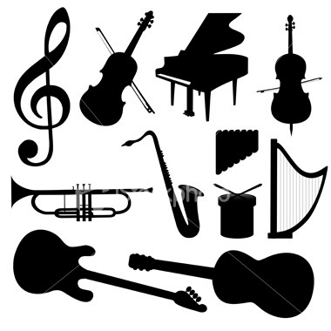
Let’s try with instruments
Notes:
LESSON 3
Warm up. Start with your class stood in a circle again. This time after passing a clap around ask the children to suggest other body percussion or vocal sounds to pass along
Remind them about the work you did with Mambo and tell them that you are going to spend a few lessons creating your own version of Bernstein’s piece. The first and most important element in any mambo is the pulse.
Demonstrate a pulse. Staying in your circle but perhaps sitting down, clap a slow, steady pulse and encourage your class to join in. If children are clapping at a different pace to you or speeding up encourage them to watch you as well as listen and try to stick together
It will help in later lessons if this initial pulse is quite slow. Slow pulses are difficult to perform by a group and will speed up. To prevent this, ask your children to think of a short word between each clap (for example their first name). Filling up the gap between claps can help to steady it
Explain that, unusually, the second beat is louder and stronger than the first
Saying ‘weak’ and ‘strong’ as you clap will help to reinforce this idea
Body percussion: With your class standing encourage them to tap and stamp this slow pulse, tapping on the weak beat and stamping on the strong. (This will feel weird – it’s the opposite way around to what we expect!)
Instruments: Ask the class to choose two sounds, one ‘weak’ and one ‘strong’ to play these beats (a shaker and a drum would be ideal).
Split into groups and ask each team to practice the ‘weak-strong’ pulse either on body percussion or on instruments (you can use any unpitched instruments for this, save xylophones, glocks etc for another session). Challenge them to practice starting and stopping together neatly perhaps by appointing a conductor
FINALLY end the session by hearing all the groups and, if time permits, putting together one big mambo pulse piece.

Slide 18
Lesson 4
Mambo rhythms
Copyright Rachel Leach & BBC
Notes:
Lesson 4:
Activities: Learn to play mambo rhythms
Choose appropriate instruments and work in groups to perfect these rhythms
Curriculum link: Improvise and compose music for a range of purposes using the interrelated dimensions of music
Play and perform in solo and ensemble contexts, using voices and playing musical instruments with increasing accuracy, fluency, control and expression

Slide 19
Remember this?
Notes:
LESSON 4
Warm up. Begin your session with the children in a circle again and a reminder of the ‘weak-strong’ pulse on body percussion.
Explain that you are going to learn three rhythmic patterns from Bernstein’s Mambo. Clap the rhythms below and encourage your class to copy you.
Bernstein’s rhythms are tricky so we’ve simplified them a little and added words. Using words will help everyone to remember and distinguish between the patterns. You could refer to them as ‘dance’, ‘hot’ and ‘love’. Do feel free to simplify them further or just focus on one or two
Split your circle into three teams and give just one rhythm to each team. Ask them to practice saying the words and clapping along until they can perform their pattern confidently and neatly. Hear each group one by one and try putting the three patterns together. At this point you might like to appoint a couple of ‘pulse players’ in each team and give them the task of keeping the ‘weak-strong’ pulse throughout.
Instruments. Ask each group to choose an unpitched instrument. The final piece will work best if everyone within one rhythmic group sticks to the same kind of instrument (i.e. all of group 1 play woodblocks, all of group 2 play drums etc.). If your children are struggling with their patterns, split them in half and try them on two contrasting instruments.
‘Splashy’ sounding instruments such as cymbals, bells and gongs are not good for this task
Practise - Ask each team to practice playing their rhythm on their chosen instrument/s and as they are doing this, make sure that each group has a couple of ‘pulse keepers’ on the ‘weak-strong’ pulse. Also check that each team is playing at roughly the same speed so that putting the rhythms together later on will work.
Bring the class back together and hear what they have done making any tweaks needed (such as adjusting the speed). Finish the session with a quick ‘jam’ session using their patterns - simply set up the pulse and signal for each group to play on top, alone and then together thus layering up the rhythms. Don’t worry if this sounds messy, its just a fun way to end the session
FINALLY – keep a record of what you’ve done, who’s in which group and especially who plays what

Slide 20
Bernstein’s rhythmic patterns
Notes:
LESSON 4
Warm up. Begin your session with the children in a circle again and a reminder of the ‘weak-strong’ pulse on body percussion.
Explain that you are going to learn three rhythmic patterns from Bernstein’s Mambo. Clap the rhythms below and encourage your class to copy you.
Bernstein’s rhythms are tricky so we’ve simplified them a little and added words. Using words will help everyone to remember and distinguish between the patterns. You could refer to them as ‘dance’, ‘hot’ and ‘love’. Do feel free to simplify them further or just focus on one or two
Split your circle into three teams and give just one rhythm to each team. Ask them to practice saying the words and clapping along until they can perform their pattern confidently and neatly. Hear each group one by one and try putting the three patterns together. At this point you might like to appoint a couple of ‘pulse players’ in each team and give them the task of keeping the ‘weak-strong’ pulse throughout.
Instruments. Ask each group to choose an unpitched instrument. The final piece will work best if everyone within one rhythmic group sticks to the same kind of instrument (i.e. all of group 1 play woodblocks, all of group 2 play drums etc.). If your children are struggling with their patterns, split them in half and try them on two contrasting instruments.
‘Splashy’ sounding instruments such as cymbals, bells and gongs are not good for this task
Practise - Ask each team to practice playing their rhythm on their chosen instrument/s and as they are doing this, make sure that each group has a couple of ‘pulse keepers’ on the ‘weak-strong’ pulse. Also check that each team is playing at roughly the same speed so that putting the rhythms together later on will work.
Bring the class back together and hear what they have done making any tweaks needed (such as adjusting the speed). Finish the session with a quick ‘jam’ session using their patterns - simply set up the pulse and signal for each group to play on top, alone and then together thus layering up the rhythms. Don’t worry if this sounds messy, its just a fun way to end the session
FINALLY – keep a record of what you’ve done, who’s in which group and especially who plays what

Slide 21
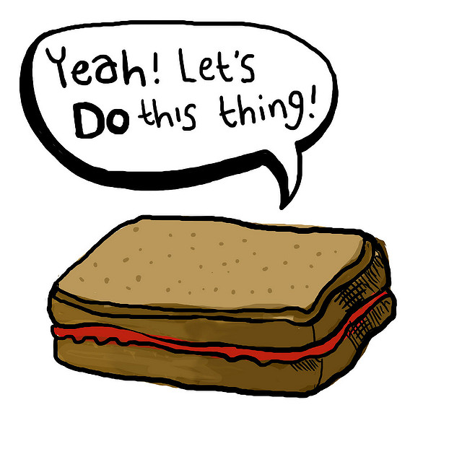
Let’s jam!
Notes:
LESSON 4
Warm up. Begin your session with the children in a circle again and a reminder of the ‘weak-strong’ pulse on body percussion.
Explain that you are going to learn three rhythmic patterns from Bernstein’s Mambo. Clap the rhythms below and encourage your class to copy you.
Bernstein’s rhythms are tricky so we’ve simplified them a little and added words. Using words will help everyone to remember and distinguish between the patterns. You could refer to them as ‘dance’, ‘hot’ and ‘love’. Do feel free to simplify them further or just focus on one or two
Split your circle into three teams and give just one rhythm to each team. Ask them to practice saying the words and clapping along until they can perform their pattern confidently and neatly. Hear each group one by one and try putting the three patterns together. At this point you might like to appoint a couple of ‘pulse players’ in each team and give them the task of keeping the ‘weak-strong’ pulse throughout.
Instruments. Ask each group to choose an unpitched instrument. The final piece will work best if everyone within one rhythmic group sticks to the same kind of instrument (i.e. all of group 1 play woodblocks, all of group 2 play drums etc.). If your children are struggling with their patterns, split them in half and try them on two contrasting instruments.
‘Splashy’ sounding instruments such as cymbals, bells and gongs are not good for this task
Practise - Ask each team to practice playing their rhythm on their chosen instrument/s and as they are doing this, make sure that each group has a couple of ‘pulse keepers’ on the ‘weak-strong’ pulse. Also check that each team is playing at roughly the same speed so that putting the rhythms together later on will work.
Bring the class back together and hear what they have done making any tweaks needed (such as adjusting the speed). Finish the session with a quick ‘jam’ session using their patterns - simply set up the pulse and signal for each group to play on top, alone and then together thus layering up the rhythms. Don’t worry if this sounds messy, its just a fun way to end the session
FINALLY – keep a record of what you’ve done, who’s in which group and especially who plays what

Slide 22
Lesson 5
Mambo tune
Copyright Rachel Leach & BBC
Notes:
Lesson 5:
Activities: Learn and invent a tune
Create short pieces using pulse, ostinato and melody
Curriculum link: Improvise and compose music for a range of purposes using the interrelated dimensions of music
Play and perform in solo and ensemble contexts, using their voices and playing musical instruments with increasing accuracy, fluency, control and expression

Slide 23
Remember to shout!
Notes:
LESSON 5
Mambo tune
Warm-up. Begin in a circle again but this time place children from the same groups next to each other so that you can recap all the rhythms you have learnt so far. Add in the pulse too as you layer up all the rhythms again with everyone clapping.
Remind your children that the orchestra shout out ‘mambo!’ twice during the Bernstein’s piece. Explain that there is a musical signal for this and teach them the rhythm (and words)
You can have fun playing with this. Still in your circle and just using body percussion set up the pulse, bring the rhythms in and out and whenever you say the rhythm above, everyone must stop what they are doing, shout mambo and then freeze before you start the pulse again.
Demonstrate this rhythm on a xylophone. Explain that you only need four pitches to make it work, but they might like to work out a different way to play it
Split back into your three working groups and give out the same instruments as last lesson but also, if possible, give each team at least one xylophone with the above pitches on it
If you have children learning orchestral instruments, now is the time to get them out, also using these four pitches
Challenge each group to make a short piece using –
The ‘weak-strong’ pulse
Their mambo rhythm from last lesson
The mambo ‘tune’
Bring the class back together and hear each group. As last time finish the lesson with a quick ‘jam’ session. Can you find a way to get every group playing the ‘tune’ at the same time?
FINALLY, don’t forget to keep a record of what you have done

Slide 24
Now try performing the rhythm like this:
Notes:
LESSON 5
Mambo tune
Warm-up. Begin in a circle again but this time place children from the same groups next to each other so that you can recap all the rhythms you have learnt so far. Add in the pulse too as you layer up all the rhythms again with everyone clapping.
Remind your children that the orchestra shout out ‘mambo!’ twice during the Bernstein’s piece. Explain that there is a musical signal for this and teach them the rhythm (and words)
You can have fun playing with this. Still in your circle and just using body percussion set up the pulse, bring the rhythms in and out and whenever you say the rhythm above, everyone must stop what they are doing, shout mambo and then freeze before you start the pulse again.
Demonstrate this rhythm on a xylophone. Explain that you only need four pitches to make it work, but they might like to work out a different way to play it
Split back into your three working groups and give out the same instruments as last lesson but also, if possible, give each team at least one xylophone with the above pitches on it
If you have children learning orchestral instruments, now is the time to get them out, also using these four pitches
Challenge each group to make a short piece using –
The ‘weak-strong’ pulse
Their mambo rhythm from last lesson
The mambo ‘tune’
Bring the class back together and hear each group. As last time finish the lesson with a quick ‘jam’ session. Can you find a way to get every group playing the ‘tune’ at the same time?
FINALLY, don’t forget to keep a record of what you have done

Slide 25
We only need 4 notes to make Bernstein’s tune
Notes:
LESSON 5
Mambo tune
Warm-up. Begin in a circle again but this time place children from the same groups next to each other so that you can recap all the rhythms you have learnt so far. Add in the pulse too as you layer up all the rhythms again with everyone clapping.
Remind your children that the orchestra shout out ‘mambo!’ twice during the Bernstein’s piece. Explain that there is a musical signal for this and teach them the rhythm (and words)
You can have fun playing with this. Still in your circle and just using body percussion set up the pulse, bring the rhythms in and out and whenever you say the rhythm above, everyone must stop what they are doing, shout mambo and then freeze before you start the pulse again.
Demonstrate this rhythm on a xylophone. Explain that you only need four pitches to make it work, but they might like to work out a different way to play it
Split back into your three working groups and give out the same instruments as last lesson but also, if possible, give each team at least one xylophone with the above pitches on it
If you have children learning orchestral instruments, now is the time to get them out, also using these four pitches
Challenge each group to make a short piece using –
The ‘weak-strong’ pulse
Their mambo rhythm from last lesson
The mambo ‘tune’
Bring the class back together and hear each group. As last time finish the lesson with a quick ‘jam’ session. Can you find a way to get every group playing the ‘tune’ at the same time?
FINALLY, don’t forget to keep a record of what you have done

Slide 26
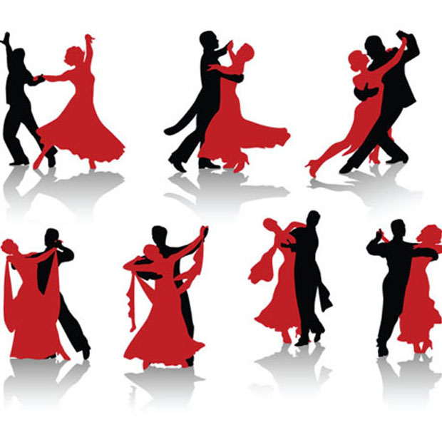
Make a short piece using:
The ‘weak-strong’ pulse
Your mambo rhythm from last lesson
The mambo ‘tune’
Notes:
LESSON 5
Mambo tune
Warm-up. Begin in a circle again but this time place children from the same groups next to each other so that you can recap all the rhythms you have learnt so far. Add in the pulse too as you layer up all the rhythms again with everyone clapping.
Remind your children that the orchestra shout out ‘mambo!’ twice during the Bernstein’s piece. Explain that there is a musical signal for this and teach them the rhythm (and words)
You can have fun playing with this. Still in your circle and just using body percussion set up the pulse, bring the rhythms in and out and whenever you say the rhythm above, everyone must stop what they are doing, shout mambo and then freeze before you start the pulse again.
Demonstrate this rhythm on a xylophone. Explain that you only need four pitches to make it work, but they might like to work out a different way to play it
Split back into your three working groups and give out the same instruments as last lesson but also, if possible, give each team at least one xylophone with the above pitches on it
If you have children learning orchestral instruments, now is the time to get them out, also using these four pitches
Challenge each group to make a short piece using –
The ‘weak-strong’ pulse
Their mambo rhythm from last lesson
The mambo ‘tune’
Bring the class back together and hear each group. As last time finish the lesson with a quick ‘jam’ session. Can you find a way to get every group playing the ‘tune’ at the same time?
FINALLY, don’t forget to keep a record of what you have done

Slide 27
Lesson 6
Putting it all together
Copyright Rachel Leach & BBC
Notes:
Lesson 6:
Activities: Structure all ideas into a piece
Perform the piece to an audience
Use technical terminology where appropriate
Curriculum link: Play and perform in solo and ensemble contexts, using their voices and playing musical instruments with increasing accuracy, fluency, control and expression
Improvise and compose music for a range of purposes using the interrelated dimensions of music

Slide 28
Do you remember?
Pulse
Rhythm
Tune
Notes:
LESSON 6
Putting it all together
Warm up. As usual, begin with a quick focusing warm-up. This is a good chance to recap all of the rhythms you have worked with so far on body percussion
Recap. Put your children back into their three groups and ask them to remember their piece from last time. Each group should have a pulse, a mambo rhythm and the mambo tune.
Get out the instruments and allow for a minute or two of chaos as everyone remembers their ideas. Then, hear each group separately.
Structure. Ask the class to come up with a structure for their pieces so that you end up with one full class mambo rather than three little ones. Prompt them with the following questions -
What order should the groups play in?
Should they overlap and if not, how do you get from one group to the next without a gap?
Should you all play at the same time and if so, how do you line up the mambo tune?
Try out a few suggestions before deciding on the perfect shape and then write it up on the board as a list of events. It might look something like this:
Group 1 – ends with ‘Mambo!’
Group 2 – ends with ‘Mambo!’
Group 3 – ends with ‘Mambo!’
Pulse: 8 beats
All three groups together
Cymbal crash signals all three mambo tunes together
Everyone shouts ‘Mambo!’
FINALLY – record your finished piece or perform it to another class

Slide 29
Structure your pieces
What order should the groups play in?
Should they overlap and if not, how do you get from one group to the next without a gap?
Should you all play at the same time and if so, how do you line up the mambo tune?
Notes:
LESSON 6
Putting it all together
Warm up. As usual, begin with a quick focusing warm-up. This is a good chance to recap all of the rhythms you have worked with so far on body percussion
Recap. Put your children back into their three groups and ask them to remember their piece from last time. Each group should have a pulse, a mambo rhythm and the mambo tune.
Get out the instruments and allow for a minute or two of chaos as everyone remembers their ideas. Then, hear each group separately.
Structure. Ask the class to come up with a structure for their pieces so that you end up with one full class mambo rather than three little ones. Prompt them with the following questions -
What order should the groups play in?
Should they overlap and if not, how do you get from one group to the next without a gap?
Should you all play at the same time and if so, how do you line up the mambo tune?
Try out a few suggestions before deciding on the perfect shape and then write it up on the board as a list of events. It might look something like this:
Group 1 – ends with ‘Mambo!’
Group 2 – ends with ‘Mambo!’
Group 3 – ends with ‘Mambo!’
Pulse: 8 beats
All three groups together
Cymbal crash signals all three mambo tunes together
Everyone shouts ‘Mambo!’
FINALLY – record your finished piece or perform it to another class

Slide 30
Taking it further – cross-curricular activities
LITERACY: Write another version of Romeo and Juliet. Where would you set it? What would the characters be called? Why are they fighting? What happens at the end?
Notes:
TAKING IT FURTHER
Cross-curricular activities
WATCH: Many of the great moments from West Side Story are available online and the DVD of the film is widely available. Watch it with your class. It’s long and might need a bit of editing but it does bring up lots of issues for discussion, many of which are still very relevant today.
SING: West Side Story is full of fantastic songs you could teach to your class.
LISTENING: Several composers have set Shakespeare’s story. Listen to some of the others and compare them with West Side Story. For example, try Tchaikovsky’s Romeo and Juliet Fantasy-Overture, Prokofiev’s ballet or suite (features some very famous music) or Berlioz’s epic ‘symphonie dramatique!’
LITERACY: Write another version of Romeo and Juliet. Where would you set it? What would the characters be called? Why are they fighting? What happens at the end?

