Slide 1
Wolfgang Amadeus Mozart
Horn Concerto No 4, Mvt 3
Primary classroom lesson plan
Written by
Rachel Leach
Notes:
For:
Key Stage 2 in England and Wales
Second Level, P5-P7 in Scotland
Key Stage 1/Key Stage 2 in Northern Ireland

Slide 2
Lesson outcomes
After this lesson, pupils will be able to:
• listen and reflect on a piece of orchestral music
• invent their own musical motifs and structure them into a piece
• perform as an ensemble
• learn musical language appropriate to the task
Notes:
Resources required
Classroom percussion instruments and any other instruments that your children might be learning
Writing materials
This scheme of work is plotted out over six lessons. Feel free to adapt it to suit your children and the resources you have available.
The six lessons at a glance
Lesson 1:
Activities: Listen and describe a piece of music
Watch the orchestral performance and discuss
Analyse the structure of Mozart’s piece
Curriculum link: Listen with attention to detail and recall sounds with increasing aural memory
Appreciate and understand a wide range of high-quality live and recorded music drawn from different traditions and from great composers and musicians
Develop an understanding of the history of music
Lesson 2:
Activities: Use Mozart’s motifs to create a short piece of music
Curriculum link: Listen with attention to detail and recall sounds with increasing aural memory
Improvise and compose music for a range of purposes using the interrelated dimensions of music
Play and perform in solo and ensemble contexts, using voices and playing musical instruments with increasing accuracy, fluency, control and expression
Lesson 3:
Activities: Create contrasting pieces of music
Curriculum link: Listen with attention to detail and recall sounds with increasing aural memory
Appreciate and understand a wide range of high-quality live and recorded music drawn from different traditions and from great composers and musicians
Lesson 4:
Activities: Structure sections of music to create a rondo
Curriculum link: Improvise and compose music for a range of purposes using the interrelated dimensions of music
Play and perform in solo and ensemble contexts, using voices and playing musical instruments with increasing accuracy, fluency, control and expression
Lesson 5:
Activities: Create a cadenza
Use technical terminology
Curriculum link: Listen with attention to detail and recall sounds with increasing aural memory
Improvise and compose music for a range of purposes using the interrelated dimensions of music
Play and perform in solo and ensemble contexts, using their voices and playing musical instruments with increasing accuracy, fluency, control and expression
Lesson 6:
Activities: Create a coda
Perform in front of an audience
Curriculum link: Play and perform in solo and ensemble contexts, using their voices and playing musical instruments with increasing accuracy, fluency, control and expression
Improvise and compose music for a range of purposes using the interrelated dimensions of music

Slide 3
Curriculum checklist
Learners will:
• play and perform in ensemble contexts, using voices and playing musical instruments
• improvise and compose music for a range of purposes using the interrelated dimensions of music
• listen with attention to detail and recall sounds with increasing aural memory
Notes:
Resources required
Classroom percussion instruments and any other instruments that your children might be learning
Writing materials
This scheme of work is plotted out over six lessons. Feel free to adapt it to suit your children and the resources you have available.
The six lessons at a glance
Lesson 1:
Activities: Listen and describe a piece of music
Watch the orchestral performance and discuss
Analyse the structure of Mozart’s piece
Curriculum link: Listen with attention to detail and recall sounds with increasing aural memory
Appreciate and understand a wide range of high-quality live and recorded music drawn from different traditions and from great composers and musicians
Develop an understanding of the history of music
Lesson 2:
Activities: Use Mozart’s motifs to create a short piece of music
Curriculum link: Listen with attention to detail and recall sounds with increasing aural memory
Improvise and compose music for a range of purposes using the interrelated dimensions of music
Play and perform in solo and ensemble contexts, using voices and playing musical instruments with increasing accuracy, fluency, control and expression
Lesson 3:
Activities: Create contrasting pieces of music
Curriculum link: Listen with attention to detail and recall sounds with increasing aural memory
Appreciate and understand a wide range of high-quality live and recorded music drawn from different traditions and from great composers and musicians
Lesson 4:
Activities: Structure sections of music to create a rondo
Curriculum link: Improvise and compose music for a range of purposes using the interrelated dimensions of music
Play and perform in solo and ensemble contexts, using voices and playing musical instruments with increasing accuracy, fluency, control and expression
Lesson 5:
Activities: Create a cadenza
Use technical terminology
Curriculum link: Listen with attention to detail and recall sounds with increasing aural memory
Improvise and compose music for a range of purposes using the interrelated dimensions of music
Play and perform in solo and ensemble contexts, using their voices and playing musical instruments with increasing accuracy, fluency, control and expression
Lesson 6:
Activities: Create a coda
Perform in front of an audience
Curriculum link: Play and perform in solo and ensemble contexts, using their voices and playing musical instruments with increasing accuracy, fluency, control and expression
Improvise and compose music for a range of purposes using the interrelated dimensions of music

Slide 4
Glossary of music terms
Term | Definition
Cadenza | a moment of showing off for one player
Coda | another word for ending
Concerto | a piece with a prominent solo role for one player
Movement | a large section within a symphony or a concerto
Musicologist | an academic who studies how pieces work
Pitched percussion | percussion instruments that can play different pitches – xylophones, glockenspiels, chime bars etc.
Rondo | a musical structure with one section that keeps returning (A-B-A-C-A etc)
Trill | two notes alternating back and forth very fast (like a wobble)
Unpitched percussion | percussion instruments that can only make a limited number of sounds – drums, shakers woodblocks, tambourine etc.

Slide 5
Lesson 1
Watching and listening
Copyright Rachel Leach & BBC
Notes:
Lesson 1:
Prepare your class
Explain to your class that you are going to begin a 6-week music project focusing on a fantastic piece of music by a composer called Mozart watch the introductory film with Katy B
Have a discussion about what you have just watched. There are several technical terms in this piece that your children need to understand straight away to avoid confusion later on. Play this simple game with them to help get the terminology clear –
Stand in a circle and tap your fingers on the top of your head, stop and shout ‘MOZART!’ Ask the children to copy
Ask for a gesture for when you shout ‘Mozart’ and choose the best one.
Tap your shoulders and say ‘ HORN CONCERTO’.
A concerto is a piece with a soloist so ask one child to rush into the centre of the circle and mime playing a French horn. Point at them as you say ‘concerto’. Ask the children in the circle to copy
Tap your tummy and say ‘MOVEMENT 3’
A movement is a section, show this by making a small box shape with your hands and then showing the number 3. Children copy
Tap your knees and say ‘RONDO’
A rondo is a piece with a returning idea. Point to yourself , then someone else, then yourself, then someone else etc. Children copy
Finally, tap your feet and say ‘CADENZA’
A cadenza is a showing off moment for the soloist. Do something spectacular like spinning around, dancing, standing on one leg. Children copy
Now try performing all of this at the same time as your children, like this:
Tap head: “Mozart!” gesture
Tap shoulders: “Horn concerto” point at soloist
Tap tummy “Movement 3” gesture
Tap knees “Rondo” point at self, away, self, away etc
Tap feet “Cadenza” show off!
You can adapt this game to fit with any five facts!
Listening task
Explain that as this piece is a ‘rondo’; there is one tune that keeps returning. Watch the first 10 seconds of the full orchestral performance. Explain that this jaunty theme on horn is the idea that will keep returning, sometimes played by horn alone, sometimes played by the full orchestra.
Watch the full orchestral performance and this time, ask your children to stand up every time they hear that opening theme, when the music is different they must sit down. The tune appears at 0’00 1’07, 1’58, 3’17, 3’36 (fragment)
Play the recording again, they must stand every time they hear the theme, this time if it is played by the horns they must mime playing the horn, if it is played by violins, mime violins.
Play the recording again this time in addition to the above, when they hear the ‘cadenza’ – a showing off moment for the horn - they must move (dance) in the same way as the music sounds so if it is jumpy, they must jump, if it is smooth perhaps they can sway smoothly (it is smooth!)
Finally, give out writing materials, and working in small groups, as you play the orchestral recording one last time, ask your children to write down the structure. They can do this several ways:
a list of events:
horn tune
strings tune
‘something else’ etc
as a diagram of shapes:
horn tune becomes a circle
‘something else’ is a square etc
as a series of letters (this is the musicologist’s way of doing it):
A, B, A, C etc.
Mozart’s structure is as follows –
A – B – A – C – A – D Cadenza – A – Coda*
*coda means ending

Slide 6
Background – the composer
Wolfgang Amadeus Mozart (1756 – 1791)
Austrian composer, pianist, child genius!
Mozart and his sister (Nannerl – also a composer), were famous all over Europe as children
Wrote his first pieces aged just 5!

Slide 7
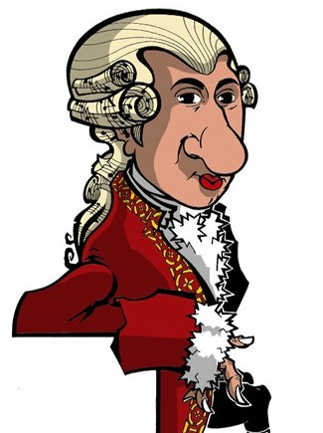
Background – the music
Horn Concerto no 4, movement 3
Written in 1786 for his friend Joseph Leutgeb
This is one of four horn concertos written by Mozart. (The third movements are all surprisingly similar!)
Concertos from this time were often written with three sections (called movements)

Slide 8
Watch the orchestral performance
https://www.bbc.co.uk/programmes/p02b5dmz
Notes:
Lesson 1:
Prepare your class
Explain to your class that you are going to begin a 6-week music project focusing on a fantastic piece of music by a composer called Mozart watch the introductory film with Katy B
Have a discussion about what you have just watched. There are several technical terms in this piece that your children need to understand straight away to avoid confusion later on. Play this simple game with them to help get the terminology clear –
Stand in a circle and tap your fingers on the top of your head, stop and shout ‘MOZART!’ Ask the children to copy
Ask for a gesture for when you shout ‘Mozart’ and choose the best one.
Tap your shoulders and say ‘ HORN CONCERTO’.
A concerto is a piece with a soloist so ask one child to rush into the centre of the circle and mime playing a French horn. Point at them as you say ‘concerto’. Ask the children in the circle to copy
Tap your tummy and say ‘MOVEMENT 3’
A movement is a section, show this by making a small box shape with your hands and then showing the number 3. Children copy
Tap your knees and say ‘RONDO’
A rondo is a piece with a returning idea. Point to yourself , then someone else, then yourself, then someone else etc. Children copy
Finally, tap your feet and say ‘CADENZA’
A cadenza is a showing off moment for the soloist. Do something spectacular like spinning around, dancing, standing on one leg. Children copy
Now try performing all of this at the same time as your children, like this:
Tap head: “Mozart!” gesture
Tap shoulders: “Horn concerto” point at soloist
Tap tummy “Movement 3” gesture
Tap knees “Rondo” point at self, away, self, away etc
Tap feet “Cadenza” show off!
You can adapt this game to fit with any five facts!
Listening task
Explain that as this piece is a ‘rondo’; there is one tune that keeps returning. Watch the first 10 seconds of the full orchestral performance. Explain that this jaunty theme on horn is the idea that will keep returning, sometimes played by horn alone, sometimes played by the full orchestra.
Watch the full orchestral performance and this time, ask your children to stand up every time they hear that opening theme, when the music is different they must sit down. The tune appears at 0’00 1’07, 1’58, 3’17, 3’36 (fragment)
Play the recording again, they must stand every time they hear the theme, this time if it is played by the horns they must mime playing the horn, if it is played by violins, mime violins.
Play the recording again this time in addition to the above, when they hear the ‘cadenza’ – a showing off moment for the horn - they must move (dance) in the same way as the music sounds so if it is jumpy, they must jump, if it is smooth perhaps they can sway smoothly (it is smooth!)
Finally, give out writing materials, and working in small groups, as you play the orchestral recording one last time, ask your children to write down the structure. They can do this several ways:
a list of events:
horn tune
strings tune
‘something else’ etc
as a diagram of shapes:
horn tune becomes a circle
‘something else’ is a square etc
as a series of letters (this is the musicologist’s way of doing it):
A, B, A, C etc.
Mozart’s structure is as follows –
A – B – A – C – A – D Cadenza – A – Coda*
*coda means ending

Slide 9
Terminology
Mozart
Horn concerto
Movement 3
Rondo
Cadenza
Notes:
Lesson 1:
Prepare your class
Explain to your class that you are going to begin a 6-week music project focusing on a fantastic piece of music by a composer called Mozart watch the introductory film with Katy B
Have a discussion about what you have just watched. There are several technical terms in this piece that your children need to understand straight away to avoid confusion later on. Play this simple game with them to help get the terminology clear –
Stand in a circle and tap your fingers on the top of your head, stop and shout ‘MOZART!’ Ask the children to copy
Ask for a gesture for when you shout ‘Mozart’ and choose the best one.
Tap your shoulders and say ‘ HORN CONCERTO’.
A concerto is a piece with a soloist so ask one child to rush into the centre of the circle and mime playing a French horn. Point at them as you say ‘concerto’. Ask the children in the circle to copy
Tap your tummy and say ‘MOVEMENT 3’
A movement is a section, show this by making a small box shape with your hands and then showing the number 3. Children copy
Tap your knees and say ‘RONDO’
A rondo is a piece with a returning idea. Point to yourself , then someone else, then yourself, then someone else etc. Children copy
Finally, tap your feet and say ‘CADENZA’
A cadenza is a showing off moment for the soloist. Do something spectacular like spinning around, dancing, standing on one leg. Children copy
Now try performing all of this at the same time as your children, like this:
Tap head: “Mozart!” gesture
Tap shoulders: “Horn concerto” point at soloist
Tap tummy “Movement 3” gesture
Tap knees “Rondo” point at self, away, self, away etc
Tap feet “Cadenza” show off!
You can adapt this game to fit with any five facts!
Listening task
Explain that as this piece is a ‘rondo’; there is one tune that keeps returning. Watch the first 10 seconds of the full orchestral performance. Explain that this jaunty theme on horn is the idea that will keep returning, sometimes played by horn alone, sometimes played by the full orchestra.
Watch the full orchestral performance and this time, ask your children to stand up every time they hear that opening theme, when the music is different they must sit down. The tune appears at 0’00 1’07, 1’58, 3’17, 3’36 (fragment)
Play the recording again, they must stand every time they hear the theme, this time if it is played by the horns they must mime playing the horn, if it is played by violins, mime violins.
Play the recording again this time in addition to the above, when they hear the ‘cadenza’ – a showing off moment for the horn - they must move (dance) in the same way as the music sounds so if it is jumpy, they must jump, if it is smooth perhaps they can sway smoothly (it is smooth!)
Finally, give out writing materials, and working in small groups, as you play the orchestral recording one last time, ask your children to write down the structure. They can do this several ways:
a list of events:
horn tune
strings tune
‘something else’ etc
as a diagram of shapes:
horn tune becomes a circle
‘something else’ is a square etc
as a series of letters (this is the musicologist’s way of doing it):
A, B, A, C etc.
Mozart’s structure is as follows –
A – B – A – C – A – D Cadenza – A – Coda*
*coda means ending

Slide 10
Let’s dance!
Notes:
Lesson 1:
Prepare your class
Explain to your class that you are going to begin a 6-week music project focusing on a fantastic piece of music by a composer called Mozart watch the introductory film with Katy B
Have a discussion about what you have just watched. There are several technical terms in this piece that your children need to understand straight away to avoid confusion later on. Play this simple game with them to help get the terminology clear –
Stand in a circle and tap your fingers on the top of your head, stop and shout ‘MOZART!’ Ask the children to copy
Ask for a gesture for when you shout ‘Mozart’ and choose the best one.
Tap your shoulders and say ‘ HORN CONCERTO’.
A concerto is a piece with a soloist so ask one child to rush into the centre of the circle and mime playing a French horn. Point at them as you say ‘concerto’. Ask the children in the circle to copy
Tap your tummy and say ‘MOVEMENT 3’
A movement is a section, show this by making a small box shape with your hands and then showing the number 3. Children copy
Tap your knees and say ‘RONDO’
A rondo is a piece with a returning idea. Point to yourself , then someone else, then yourself, then someone else etc. Children copy
Finally, tap your feet and say ‘CADENZA’
A cadenza is a showing off moment for the soloist. Do something spectacular like spinning around, dancing, standing on one leg. Children copy
Now try performing all of this at the same time as your children, like this:
Tap head: “Mozart!” gesture
Tap shoulders: “Horn concerto” point at soloist
Tap tummy “Movement 3” gesture
Tap knees “Rondo” point at self, away, self, away etc
Tap feet “Cadenza” show off!
You can adapt this game to fit with any five facts!
Listening task
Explain that as this piece is a ‘rondo’; there is one tune that keeps returning. Watch the first 10 seconds of the full orchestral performance. Explain that this jaunty theme on horn is the idea that will keep returning, sometimes played by horn alone, sometimes played by the full orchestra.
Watch the full orchestral performance and this time, ask your children to stand up every time they hear that opening theme, when the music is different they must sit down. The tune appears at 0’00 1’07, 1’58, 3’17, 3’36 (fragment)
Play the recording again, they must stand every time they hear the theme, this time if it is played by the horns they must mime playing the horn, if it is played by violins, mime violins.
Play the recording again this time in addition to the above, when they hear the ‘cadenza’ – a showing off moment for the horn - they must move (dance) in the same way as the music sounds so if it is jumpy, they must jump, if it is smooth perhaps they can sway smoothly (it is smooth!)
Finally, give out writing materials, and working in small groups, as you play the orchestral recording one last time, ask your children to write down the structure. They can do this several ways:
a list of events:
horn tune
strings tune
‘something else’ etc
as a diagram of shapes:
horn tune becomes a circle
‘something else’ is a square etc
as a series of letters (this is the musicologist’s way of doing it):
A, B, A, C etc.
Mozart’s structure is as follows –
A – B – A – C – A – D Cadenza – A – Coda*
*coda means ending

Slide 11
Lesson 2
Hunting calls
Copyright Rachel Leach & BBC
Notes:
Lesson 2:
Activities: Use Mozart’s motifs to create a short piece of music
Curriculum link: Listen with attention to detail and recall sounds with increasing aural memory
Improvise and compose music for a range of purposes using the interrelated dimensions of music
Play and perform in solo and ensemble contexts, using voices and playing musical instruments with increasing accuracy, fluency, control and expression

Slide 12
Mozart’s main theme
Notes:
LESSON 2:
Warm-up. Begin with your class sitting in a large circle. Recap the ‘five facts’ warm-up from lesson 1. Explain that you are going to begin making your own version of Mozart’s piece on instruments.
Explain that Mozart’s main theme (the one that keeps returning) has a very distinctive shape. It starts with a jump upwards and then several repeated pitches. It is quite easy to play the beginning on a xylophone. After this iconic opening it moves on in a twisty direction but keeps repeating some notes over and over.
Challenge a few children to come forward and have a go at Mozart’s theme, or their own version - their tune must begin with a leap and then a series of repeated notes. Can they invent a twisty ending for it?
Explain further that Mozart’s theme is similar to a hunting call. Traditionally horns (made from actual animal horns) were used by hunters on horseback. They would play simple phrases (calls) to each other as a way to communicate.
Split the class into small groups (3 groups is an ideal amount but you could have as many as you like). Set the following task - each group must make a short ‘hunting call’ piece using:
A tune with a leap and a series of repeated notes
Anything else they like to make it sound like a hunting call (horses hooves, a pulse etc.)
You can use whatever instruments you have available for this. If using percussion you need every group to have at least one pitched percussion instrument alongside lots of unpitched. If your children are learning orchestral instruments, feel free to adapt the pitches above to suit the level of your learners
Bring the class back together and hear their efforts. Challenge your children to join all their ‘hunting call’ pieces together to make one big ‘A section’
Finish the lesson with a performance of your new piece. Encourage the children to write down carefully what they have done and who played what. Ask them to label the piece ‘A section’

Slide 13
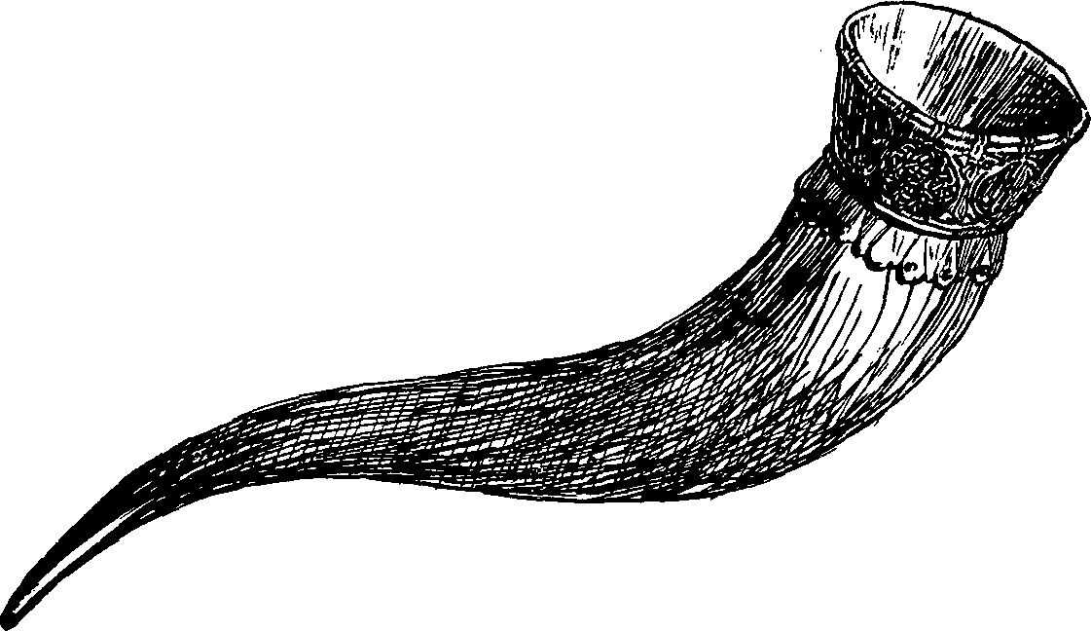
Make a hunting call
Include:
A tune with a leap and a series of repeated notes
Anything else you like to make it sound like a hunting call (horses hooves, a pulse etc.)
Notes:
LESSON 2:
Warm-up. Begin with your class sitting in a large circle. Recap the ‘five facts’ warm-up from lesson 1. Explain that you are going to begin making your own version of Mozart’s piece on instruments.
Explain that Mozart’s main theme (the one that keeps returning) has a very distinctive shape. It starts with a jump upwards and then several repeated pitches. It is quite easy to play the beginning on a xylophone. After this iconic opening it moves on in a twisty direction but keeps repeating some notes over and over.
Challenge a few children to come forward and have a go at Mozart’s theme, or their own version - their tune must begin with a leap and then a series of repeated notes. Can they invent a twisty ending for it?
Explain further that Mozart’s theme is similar to a hunting call. Traditionally horns (made from actual animal horns) were used by hunters on horseback. They would play simple phrases (calls) to each other as a way to communicate.
Split the class into small groups (3 groups is an ideal amount but you could have as many as you like). Set the following task - each group must make a short ‘hunting call’ piece using:
A tune with a leap and a series of repeated notes
Anything else they like to make it sound like a hunting call (horses hooves, a pulse etc.)
You can use whatever instruments you have available for this. If using percussion you need every group to have at least one pitched percussion instrument alongside lots of unpitched. If your children are learning orchestral instruments, feel free to adapt the pitches above to suit the level of your learners
Bring the class back together and hear their efforts. Challenge your children to join all their ‘hunting call’ pieces together to make one big ‘A section’
Finish the lesson with a performance of your new piece. Encourage the children to write down carefully what they have done and who played what. Ask them to label the piece ‘A section’

Slide 14
Lesson 3
Contrasting Episodes
Copyright Rachel Leach & BBC
Notes:
Lesson 3:
Activities: Create contrasting pieces of music
Curriculum link: Listen with attention to detail and recall sounds with increasing aural memory
Appreciate and understand a wide range of high-quality live and recorded music drawn from different traditions and from great composers and musicians

Slide 15
Remember rhythms and tunes
Notes:
LESSON 3:
Warm up. Begin in a circle again and talk through what you made last lesson. This is a good opportunity to clap any rhythms or sing any tunes that were made, making sure everyone is remembering the same thing!
Split back into your small groups and ask each group to put their part of the A section together before as a full class, putting your full A section back together.
Explain that today you are going to make new sections of music called ‘episodes’. These need to contrast with the A section they have already made.
Working in the same small groups, with the same instruments, ask each group to write down three words to describe the piece they made last week.
For example: loud, fast, bouncy
Now ask each team to write three words that are the opposite of their list (or are very different) For example: quiet, slow, flat
Set the following task: Each group must make a piece that is contrasting in every way to the one they made last week. The three words they have just written down should inspire them
When this is achieved, bring the groups back together and hear their efforts. Encourage the rest of the class to give gentle feedback; in particular, have they created music that sounds like their three words?
Finally, finish this lesson with each group writing down what they have done. It might help in future lessons if they name their piece or group at this point

Slide 16
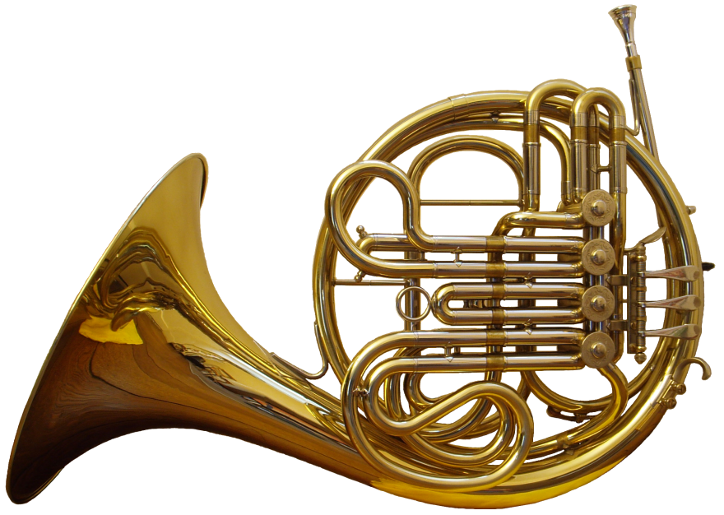
Which words describe your first piece?
Which words are the opposite?
Notes:
LESSON 3:
Warm up. Begin in a circle again and talk through what you made last lesson. This is a good opportunity to clap any rhythms or sing any tunes that were made, making sure everyone is remembering the same thing!
Split back into your small groups and ask each group to put their part of the A section together before as a full class, putting your full A section back together.
Explain that today you are going to make new sections of music called ‘episodes’. These need to contrast with the A section they have already made.
Working in the same small groups, with the same instruments, ask each group to write down three words to describe the piece they made last week.
For example: loud, fast, bouncy
Now ask each team to write three words that are the opposite of their list (or are very different) For example: quiet, slow, flat
Set the following task: Each group must make a piece that is contrasting in every way to the one they made last week. The three words they have just written down should inspire them
When this is achieved, bring the groups back together and hear their efforts. Encourage the rest of the class to give gentle feedback; in particular, have they created music that sounds like their three words?
Finally, finish this lesson with each group writing down what they have done. It might help in future lessons if they name their piece or group at this point

Slide 17
Lesson 4
RONDO!
Copyright Rachel Leach & BBC
Notes:
Lesson 4:
Activities: Structure sections of music to create a rondo
Curriculum link: Improvise and compose music for a range of purposes using the interrelated dimensions of music
Play and perform in solo and ensemble contexts, using voices and playing musical instruments with increasing accuracy, fluency, control and expression

Slide 18
Warm up with a rondo! A – B – A – C – D - A
Notes:
LESSON 4:
Warm up. Begin once again in a circle. Explain that today you are going to make a RONDO and remind your class of what a rondo is by playing this simple game:
Ask one of your class to suggest a gesture or a sound. Ask the rest of the class to copy it (whatever it is). Ask three more children and copy each time. Discuss which is your favourite gesture and label it A. Label the other three B, C, and D (each one includes the solo gesture and then everyone copying). Make the following structure out of your solos and copied ideas (whatever they are):
A – B – A – C – D - A
This is a rondo – the exact shape that Mozart uses in his horn concerto (as they also identified in during the lesson 1 listening task)
Make a list on the board of what you have created so far. It should look something like this:
A section (played by the full class, ‘hunting calls’)
Three ‘episodes’ (made by three smaller groups)
Split back into groups and ask each group to get out their instruments and put their music back together. When the groups are sorted, put the bigger A section back together with everyone.
Challenge your children to structure their sections in rondo form. They have already identified their A section, now they need to decide on the best order for their episodes too. Try out several versions until you all decide on the best one and practise this until it is neat.
Finish the session by writing down carefully what you have done.

Slide 19
Put your sections into Rondo form
Notes:
LESSON 4:
Warm up. Begin once again in a circle. Explain that today you are going to make a RONDO and remind your class of what a rondo is by playing this simple game:
Ask one of your class to suggest a gesture or a sound. Ask the rest of the class to copy it (whatever it is). Ask three more children and copy each time. Discuss which is your favourite gesture and label it A. Label the other three B, C, and D (each one includes the solo gesture and then everyone copying). Make the following structure out of your solos and copied ideas (whatever they are):
A – B – A – C – D - A
This is a rondo – the exact shape that Mozart uses in his horn concerto (as they also identified in during the lesson 1 listening task)
Make a list on the board of what you have created so far. It should look something like this:
A section (played by the full class, ‘hunting calls’)
Three ‘episodes’ (made by three smaller groups)
Split back into groups and ask each group to get out their instruments and put their music back together. When the groups are sorted, put the bigger A section back together with everyone.
Challenge your children to structure their sections in rondo form. They have already identified their A section, now they need to decide on the best order for their episodes too. Try out several versions until you all decide on the best one and practise this until it is neat.
Finish the session by writing down carefully what you have done.

Slide 20
Lesson 5
Cadenza auditions and tweaks
Copyright Rachel Leach & BBC
Notes:
Lesson 5:
Activities: Create a cadenza
Use technical terminology
Curriculum link: Listen with attention to detail and recall sounds with increasing aural memory
Improvise and compose music for a range of purposes using the interrelated dimensions of music
Play and perform in solo and ensemble contexts, using their voices and playing musical instruments with increasing accuracy, fluency, control and expression

Slide 21
Let’s play the Rondo game
Notes:
LESSON 5:
Warm-up. Sitting in a circle, play the rondo game. This time ask your children to add in a ‘cadenza’. Remind them that a cadenza is a showing-off moment for one player. Ask someone to create a sound, rhythm or gesture that is really special. Try out a few until you’ve all agreed on the best one and then add it into your structure. It should go somewhere near the end, but exactly where is up to the class.
Your game might end up looking something like this –
A – B – A – C – D – cadenza - A
Get the instruments and put your piece back together so that it is the same as it was at the end of last lesson. Write the structure on the board.
Ask for volunteers to invent a cadenza on whatever instrument they have. In Mozart’s time the cadenza was invented on the spot and often based on ideas from the bigger piece rather than something new. Try out several ‘soloists’ until everyone has decided on the best one. (You might have to take a vote!)
Looking at the structure of your piece on the board and ask your children to decide where the cadenza should go. Remind them that in Mozart’s concerto it appears near the end, but they might choose a different option. They should think about this musically (i.e. where will it sound the best?) and logistically (is it possible for the player?). When this is decided practice playing your piece up until the cadenza and then stopping.
Traditionally (although not in this version of Mozart’s piece), the end of the cadenza was signalled by a trill – two notes alternating back and forth like a fast wobble. Challenge your cadenza player to finish his/ her cadenza in this way. Or, to share the responsibility around a little, appoint a special ‘trill player’ to perform the trill and thus signal everyone else back in.
Choosing one child to be the ‘soloist’ might cause problems so consider giving several children a go or changing the soloist each time you play through the piece. There is such a thing as double concertos (2 soloists), triple concertos (3) and concerti grossi (a small group of soloists) so you could switch your piece to one of these structures!
Practise your full piece adding in both the cadenza and then the trill signal and the ending
If you have time, explain to your musicians that Mozart sometimes changes the ‘A section’ towards the end of a piece to add a bit of variety to the music. He does this in the horn concerto; towards the end the A section is cut in half and then fragmented further. Using your structure on the board as a guide, can the children tweak their A sections a bit so that they are not exactly the same every time?
Finish this lesson with a performance of your almost finished piece and remember to write down carefully any changes you have made

Slide 22
Can you add a cadenza?
Can you add a trill?
Notes:
LESSON 5:
Warm-up. Sitting in a circle, play the rondo game. This time ask your children to add in a ‘cadenza’. Remind them that a cadenza is a showing-off moment for one player. Ask someone to create a sound, rhythm or gesture that is really special. Try out a few until you’ve all agreed on the best one and then add it into your structure. It should go somewhere near the end, but exactly where is up to the class.
Your game might end up looking something like this –
A – B – A – C – D – cadenza - A
Get the instruments and put your piece back together so that it is the same as it was at the end of last lesson. Write the structure on the board.
Ask for volunteers to invent a cadenza on whatever instrument they have. In Mozart’s time the cadenza was invented on the spot and often based on ideas from the bigger piece rather than something new. Try out several ‘soloists’ until everyone has decided on the best one. (You might have to take a vote!)
Looking at the structure of your piece on the board and ask your children to decide where the cadenza should go. Remind them that in Mozart’s concerto it appears near the end, but they might choose a different option. They should think about this musically (i.e. where will it sound the best?) and logistically (is it possible for the player?). When this is decided practice playing your piece up until the cadenza and then stopping.
Traditionally (although not in this version of Mozart’s piece), the end of the cadenza was signalled by a trill – two notes alternating back and forth like a fast wobble. Challenge your cadenza player to finish his/ her cadenza in this way. Or, to share the responsibility around a little, appoint a special ‘trill player’ to perform the trill and thus signal everyone else back in.
Choosing one child to be the ‘soloist’ might cause problems so consider giving several children a go or changing the soloist each time you play through the piece. There is such a thing as double concertos (2 soloists), triple concertos (3) and concerti grossi (a small group of soloists) so you could switch your piece to one of these structures!
Practise your full piece adding in both the cadenza and then the trill signal and the ending
If you have time, explain to your musicians that Mozart sometimes changes the ‘A section’ towards the end of a piece to add a bit of variety to the music. He does this in the horn concerto; towards the end the A section is cut in half and then fragmented further. Using your structure on the board as a guide, can the children tweak their A sections a bit so that they are not exactly the same every time?
Finish this lesson with a performance of your almost finished piece and remember to write down carefully any changes you have made

Slide 23
Lesson 6
Structure and performance time!
Copyright Rachel Leach & BBC
Notes:
Lesson 6:
Activities: Create a coda
Perform in front of an audience
Curriculum link: Play and perform in solo and ensemble contexts, using their voices and playing musical instruments with increasing accuracy, fluency, control and expression
Improvise and compose music for a range of purposes using the interrelated dimensions of music

Slide 24
Can you add a coda?
Notes:
LESSON 6:
Warm up. Begin the lesson with a quick focusing warm-up like pass the clap and then talk through the piece you made during the last lesson. Write the structure on the board for reference.
Get the instruments out and put your piece back together. Work slowly and carefully and make sure that everyone understands what they are doing in each section.
Listen to the end of Mozart’s piece (from 3’16 onwards: the final A section and then the ending). The ‘posh’ word for ending is ‘coda’. Can you children work out how what’s happening in Mozart’s ‘coda’? They might say something like this:
A section fragments: ‘gets stuck’: starts again: big flourish to finish
Challenge your class to create a coda of their own, using similar ideas or something different.
At this stage discourage your children from creating anything ‘new’, it might be better to simply repeat something that they like, or that works well, over and over.
Practise your full piece with its new ending and then arrange your new ‘orchestra’ in a large semi-circle so that it everyone can be seen and end this lesson with a performance of your finished piece to an invited audience

Slide 25
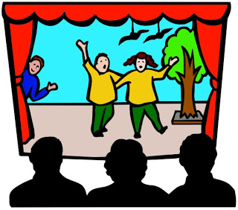
Let’s perform!
Notes:
LESSON 6:
Warm up. Begin the lesson with a quick focusing warm-up like pass the clap and then talk through the piece you made during the last lesson. Write the structure on the board for reference.
Get the instruments out and put your piece back together. Work slowly and carefully and make sure that everyone understands what they are doing in each section.
Listen to the end of Mozart’s piece (from 3’16 onwards: the final A section and then the ending). The ‘posh’ word for ending is ‘coda’. Can you children work out how what’s happening in Mozart’s ‘coda’? They might say something like this:
A section fragments: ‘gets stuck’: starts again: big flourish to finish
Challenge your class to create a coda of their own, using similar ideas or something different.
At this stage discourage your children from creating anything ‘new’, it might be better to simply repeat something that they like, or that works well, over and over.
Practise your full piece with its new ending and then arrange your new ‘orchestra’ in a large semi-circle so that it everyone can be seen and end this lesson with a performance of your finished piece to an invited audience

Slide 26
Taking it further – cross-curricular activities
LISTENING: Mozart wrote four horn concertos in total, each is made up of 3 movements. Listen and then have a go at recreating one of the other movements or analysing the rondo finales
LITERACY: Mozart was a great letter writer (everyone was in the 1770s!). He was often writing letters about what he was working on, the parties he went to with his wife Constanze and his lack of money. Write a letter pretending to be Mozart
ARTWORK: Mozart was hugely famous throughout his life and he was friends with lots of other famous people. Design a poster advertising one of his concerts or personal appearances.

