Slide 1
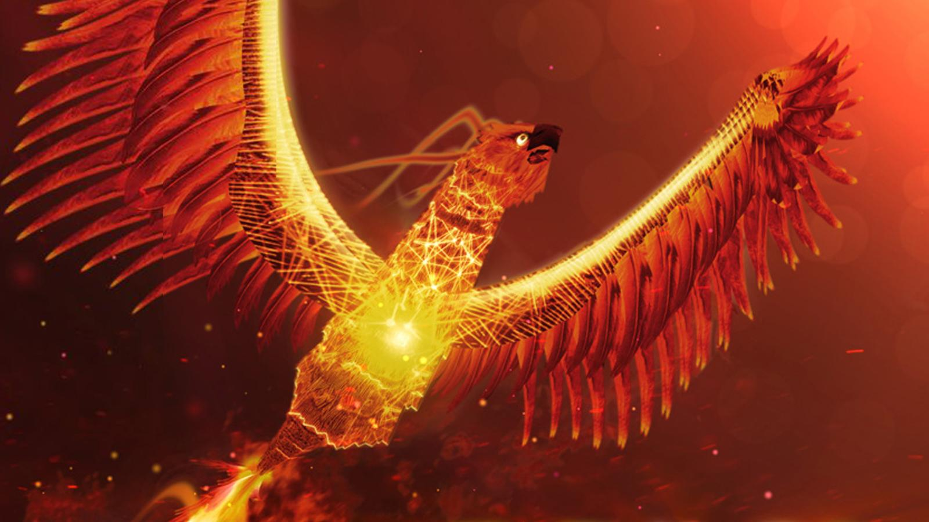


Firebird Magic Sensory Story

Slide 2
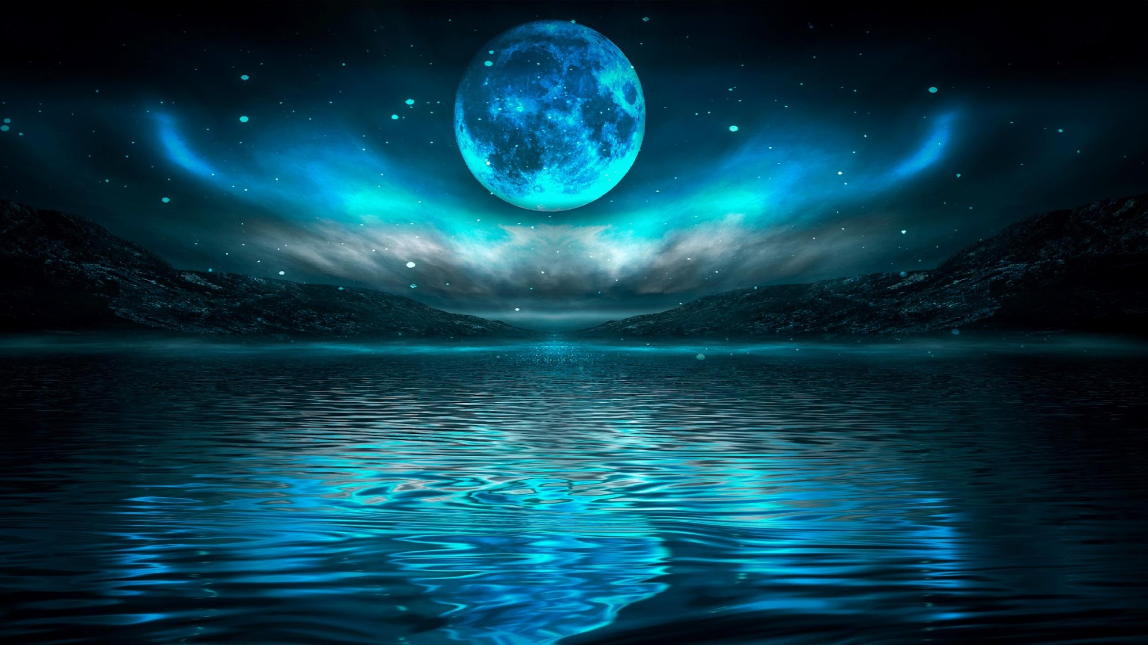


As the day slips away
and the moon begins to rise…

Slide 3
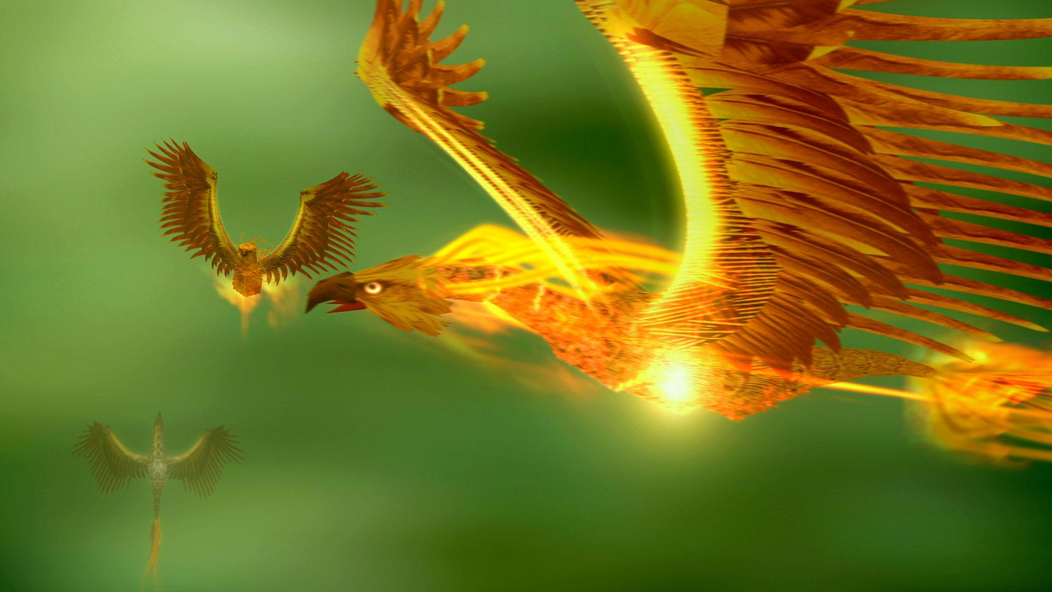
The flame-red Firebird
takes flight over the sea

Slide 4
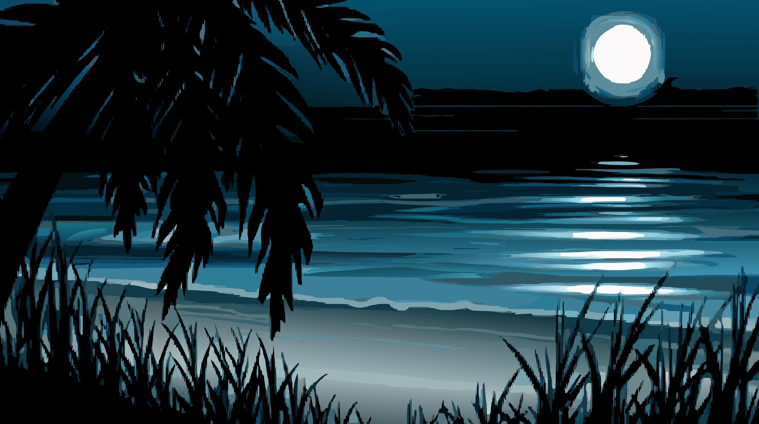
She lands on an enchanted island beach
with lapping waves.
She explores the sounds around her,
using water, rocks and wood to make sounds

Slide 5
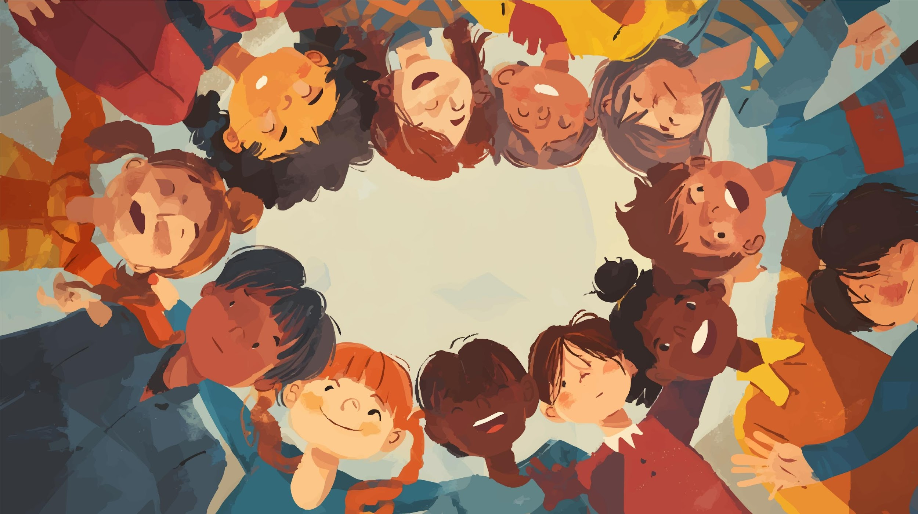
From along the beach, a musical response!
Children appear from along the beach,
joining the music

Slide 6
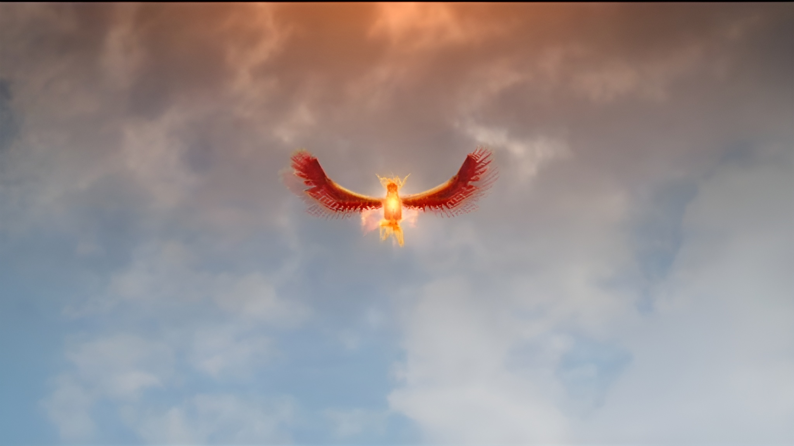
The moon shines through the Firebird’s feathers.
The children begin to sing.

Slide 7
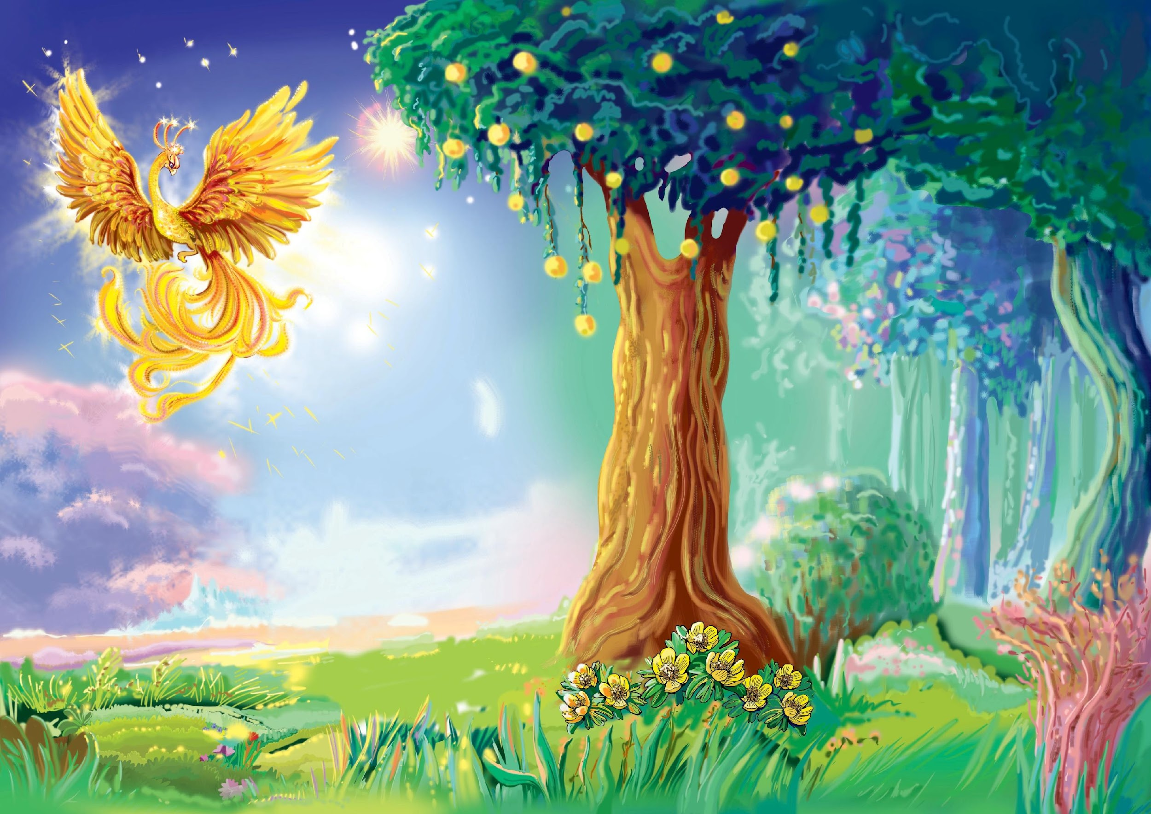
The firebird embraces her new friends
and sheds a happy goodbye tear

Slide 8
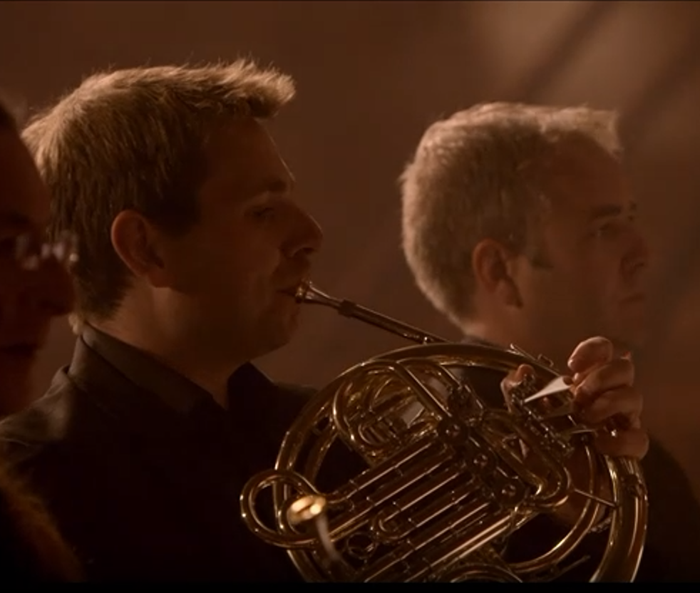
The firebird
stretches her wing and takes flight. Energised by music and connection,
ready once again
to enchant the world.
Watch the full orchestral performance here

Slide 9
The end, for now!

