Slide 1
Orff
Carmina Burana – ‘O fortuna’
Secondary classroom lesson plan
Written by
Rachel Leach
Notes:
For:
Key Stage 3 in England, Wales and Northern Ireland
Third and Fourth Level, S1-S3 in Scotland

Slide 2
Lesson outcomes
After this lesson, pupils will be able to:
listen and reflect on a piece of orchestral music
create their own pieces of music using instruments and voice
perform as an ensemble
learn musical language/ notation appropriate to the task
Notes:
Resources required
A large, open space
Classroom percussion instruments and any other instruments your students might be learning
Recording equipment (not essential)
This scheme of work is plotted out over six lessons. Feel free to adapt it to suit your students and the resources you have available.
The six lessons at a glance
Lesson 1:
Activities: Watch the film and discuss
Listen and create new lyrics in response to the music
Create words inspired by the music
Curriculum link: Identify and use the interrelated dimensions of music expressively and with increasing sophistication, including use of tonalities, different types of scales and other musical devices
Listen with increasing discrimination to a wide range of music from great composers and musicians
Develop a deeper understanding of the music that they perform and to which they listen and its history
Lesson 2:
Activities: Learn and perform complex minor chords
Invent bassline and structure
Curriculum link: Play and perform in a range of solo and ensemble contexts using their voice, playing instruments musically, fluently and with accuracy and expression
Improvise and compose; and extend and develop musical ideas by drawing on a range of musical structures, styles, genres and traditions
Identify and use the interrelated dimensions of music expressively and with increasing sophistication, including use of tonalities, different types of scales and other musical devices
Lesson 3:
Activities: Invent, orchestrate and perform pulse
Learn about and perform a crescendo
Curriculum link: Play and perform in a range of solo and ensemble contexts using their voice, playing instruments musically, fluently and with accuracy and expression
Improvise and compose; and extend and develop musical ideas by drawing on a range of musical structures, styles, genres and traditions
Lesson 4:
Activities: Invent and perform ostinatos
Curriculum link: Play and perform in a range of solo and ensemble contexts using their voice, playing instruments musically, fluently and with accuracy and expression
Improvise and compose; and extend and develop musical ideas by drawing on a range of musical structures, styles, genres and traditions
Lesson 5:
Activities: Invent lyrics and melody
Begin to structure ideas into a piece
Curriculum link: Play and perform in a range of solo and ensemble contexts using their voice, playing instruments musically, fluently and with accuracy and expression
Improvise and compose; and extend and develop musical ideas by drawing on a range of musical structures, styles, genres and traditions
Lesson 6:
Activities: Structure all ideas into a piece
Perform on pitched and unpitched instruments and voice to an audience
Use technical terminology where appropriate
Curriculum link: Play and perform in a range of solo and ensemble contexts using their voice, playing instruments musically, fluently and with accuracy and expression
Improvise and compose; and extend and develop musical ideas by drawing on a range of musical structures, styles, genres and traditions

Slide 3
Curriculum checklist
Learners will:
play and perform in solo and ensemble contexts, using their voices and playing musical instruments musically, fluently and with accuracy and expression
improvise and compose; and extend and develop musical ideas
use staff and other relevant notations appropriately and accurately
identify and use the interrelated dimensions of music including use of tonalities, different types of scales
Notes:
Resources required
A large, open space
Classroom percussion instruments and any other instruments your students might be learning
Recording equipment (not essential)
This scheme of work is plotted out over six lessons. Feel free to adapt it to suit your students and the resources you have available.
The six lessons at a glance
Lesson 1:
Activities: Watch the film and discuss
Listen and create new lyrics in response to the music
Create words inspired by the music
Curriculum link: Identify and use the interrelated dimensions of music expressively and with increasing sophistication, including use of tonalities, different types of scales and other musical devices
Listen with increasing discrimination to a wide range of music from great composers and musicians
Develop a deeper understanding of the music that they perform and to which they listen and its history
Lesson 2:
Activities: Learn and perform complex minor chords
Invent bassline and structure
Curriculum link: Play and perform in a range of solo and ensemble contexts using their voice, playing instruments musically, fluently and with accuracy and expression
Improvise and compose; and extend and develop musical ideas by drawing on a range of musical structures, styles, genres and traditions
Identify and use the interrelated dimensions of music expressively and with increasing sophistication, including use of tonalities, different types of scales and other musical devices
Lesson 3:
Activities: Invent, orchestrate and perform pulse
Learn about and perform a crescendo
Curriculum link: Play and perform in a range of solo and ensemble contexts using their voice, playing instruments musically, fluently and with accuracy and expression
Improvise and compose; and extend and develop musical ideas by drawing on a range of musical structures, styles, genres and traditions
Lesson 4:
Activities: Invent and perform ostinatos
Curriculum link: Play and perform in a range of solo and ensemble contexts using their voice, playing instruments musically, fluently and with accuracy and expression
Improvise and compose; and extend and develop musical ideas by drawing on a range of musical structures, styles, genres and traditions
Lesson 5:
Activities: Invent lyrics and melody
Begin to structure ideas into a piece
Curriculum link: Play and perform in a range of solo and ensemble contexts using their voice, playing instruments musically, fluently and with accuracy and expression
Improvise and compose; and extend and develop musical ideas by drawing on a range of musical structures, styles, genres and traditions
Lesson 6:
Activities: Structure all ideas into a piece
Perform on pitched and unpitched instruments and voice to an audience
Use technical terminology where appropriate
Curriculum link: Play and perform in a range of solo and ensemble contexts using their voice, playing instruments musically, fluently and with accuracy and expression
Improvise and compose; and extend and develop musical ideas by drawing on a range of musical structures, styles, genres and traditions

Slide 4
Glossary of music terms
Term | Definition
Crescendo | gradually getting louder (opposite: decrescendo or diminuendo)
Melody | another word for ‘tune’: a sequence of notes that makes a satisfying shape
Ostinato | a repeating (often rhythmic) pattern
Pulse | the steady ‘beat’ under much music made up of notes of the same length (like a ticking clock)
Tempo | another word for speed

Slide 5
Orff – Lesson 1
Watching and listening
Copyright Rachel Leach & BBC
Notes:
Lesson 1: Watching and listening
Activities: Watch the film and discuss
Listen and create new lyrics in response to the music
Create words inspired by the music
Curriculum link: Identify and use the interrelated dimensions of music expressively and with increasing sophistication, including use of tonalities, different types of scales and other musical devices
Listen with increasing discrimination to a wide range of music from great composers and musicians
Develop a deeper understanding of the music that they perform and to which they listen and its history

Slide 6
Background – the composer
Carl ORFF (1895 - 1982)
German composer
Invented a new approach to music education which is still followed in many parts of Europe

Slide 7
Background – the music
‘Largo’ from Symphony No. 9, ‘From the New World’
• Written in 1893 whilst in America
• Dvořák had secured the opportunity of a lifetime to head a music school in New York City but he was terribly homesick
• This extract is an extremely famous solo for cor anglais (the bigger, deeper sounding oboe)
Carmina Burana – ‘O fortuna’
Written in 1937
‘Carmina Burana’ is a huge piece for orchestra, three choirs and about nine soloists based on 24 medieval poems and sung in a mixture of German and Latin text.
The full piece takes over an hour to perform. ‘O fortuna’ is its very famous opening section
PRONUNCIATION:
KAR-min-uh boor-AA-nuh
Notes:
LESSON 1: Watching and listening
Prepare your class
Explain to your class that you are going to begin a 6-week music project focusing on an important piece of music by a composer called Carl Orff
Explain further that Orff was a German composer whose life spanned the 20th century. His most famous piece is ‘O fortuna’. Warn your students that it might already be strangely familiar to them!
Pronunciation: KAR-min-uh boor-AA-nuh
-oor as in poor (not pour)
-aa as in father
-note stress

Slide 8
Get to know Orff’s ‘O fortuna’ from Carmina Burana
http://www.bbc.co.uk/programmes/articles/3Cj3llLqxGNB2jpd241vHwK
Notes:
Watch the film & discuss
Watch the Orff Ten Pieces film and afterwards invite your class to discuss its themes
You might like to have a further discussion about the concept of ‘fate’ and the idea that life is mapped out before us and there is little we can do to change it. This might be something your students haven’t thought about before. Quickly split them into small discussion groups and ask them: ‘do you believe in fate?’ Pick up also on the idea of a ‘Goddess of Fate and Fortune’ called “Fortuna” who has the power to decide everyone’s fate and her ‘wheel of fortune’ constantly spinning out good and bad luck

Slide 9
Listen/Watch the piece
Watch/listen to the opening (first 25 seconds) of the full orchestral performance of ‘O fortuna’ from Carmina Burana
Listen to ‘O fortuna’
As you listen, you’ll hear three big musical statements that are a call to the goddess of fate. The words are:
O fortuna O fortuna
Velut luna Like the moon
Statu variabilis You are changeable
Notes:
LESSON 1
Watching and listening
Listening task.
Listen to the opening 25 seconds of ‘O fortuna’ again. You can either watch the video clip of the full performance of the piece or listen to the audio by downloading the mp3.
Orff makes three big musical statements. The first is, of course, ‘O fortuna’. Ask your students, working individually, to create new words for these three musical statements. Explain that this should be a cry to the Goddess of Fortune and Luck. You might like to challenge them further to make these lines rhyme.
Choose some of these lines and have fun trying to sing them along with the beginning of the recording – loudly!

Slide 10
Good and bad luck suggestions
Watch/listen to all of the full orchestral performance of
‘O fortuna’ from Carmina Burana
As you listen, split a piece of paper in two columns with the sections ‘Good luck’ and ‘Bad luck’ and fill them with suggestions e.g. ‘a sunny day for an activity’ or ‘pouring with rain and forgetting your umbrella’
Listen to ‘O fortuna’
GOOD LUCK | BAD LUCK
Notes:
Give out A4 paper and ask your students to create two columns on their page and head them ‘good luck’ and ‘bad luck’
As you listen to ‘O fortuna’ again (in full), challenge your class to fill up the columns with suggestions for good and bad luck. You might like to ask for these suggestions to be fun/ serious/ surrealist/ poetic etc. because later in the project these ideas will form lyrics
FINALLY – end your suggestion with another discussion. Ask your students to share their ideas and perhaps create a class list. Save these ideas for future use.

Slide 11
Orff – Lesson 2
Introduction
Copyright Rachel Leach & BBC
Notes:
Lesson 2: Introduction
Activities: Learn and perform complex minor chords
Invent bassline and structure
Curriculum link: Play and perform in a range of solo and ensemble contexts using their voice, playing instruments musically, fluently and with accuracy and expression
Improvise and compose; and extend and develop musical ideas by drawing on a range of musical structures, styles, genres and traditions
Identify and use the interrelated dimensions of music expressively and with increasing sophistication, including use of tonalities, different types of scales and other musical devices

Slide 12
Orff’s introduction
Orff’s introduction is simply a move between two chords – D minor and A minor (or major - Orff leaves this ambiguous)
Let’s play the chords – play any note listed here:
Notes:
LESSON 2: Introduction
Being with a quick reminder of the last lesson before explaining that you are going to begin work on recreating Orff’s piece on instruments. Don’t play the recording at this point, this lesson is all about recreating, not copying, the introduction
Orff’s introduction is simply a move between two chords – D minor and A minor (or major - Orff leaves this ambiguous)
Everyone needs an instrument for this. Work as a full class in a big circle if possible. Ask your students to find a D minor chord and an A minor chord. To do this, simply ask them to choose one note from each of the chords.

Slide 13
Orff’s introduction
Now let’s blur the chords the chords – by swapping in a couple of extra clashing notes.
Notes:
LESSON 2: Introduction
When this is achieved ask them to ‘blur’ the chords by swapping in a couple of extra (clashing) notes. For example, Orff adds an E to his D minor chord, and takes out the 3rd of A minor replacing it with the 4th (so C becomes D)
Again, the best way to do this is to ask students to choose the notes for themselves without too much discussion, hear what you’ve got and tweak it if you need to
Take a moment to focus on the bassline. Orff’s D minor chord is underpinned by a dramatic falling bassline. Can you add this to your class piece? His A chord is underpinned by an octave leap – experiment with this too
Split the class into small composing teams and ask them to make three big musical gestures that are as follows:
Gesture 1 & 2: D minor chord, with added notes and falling bassline
Gesture 3: An ambiguous A chord (no 3rd but added notes) and an octave leap in bass
Bring the groups back together, hear what they have created and give some feedback. Can they work out a way to make one big introduction by joining their group pieces together? Do they want to include some of the words from last lesson sung over the top?
FINALLY – end this session with the groups writing down what they have done. They might want to jot this down as a list of events, or make a diagram or a graphic score

Slide 14
Orff’s introduction
Listen to the bassline – can you hear the dramatic falling bassline under the D minor chord?
Try and add this to your chords
Notes:
LESSON 2
Introduction
Take a moment to focus on the bassline. Orff’s D minor chord is underpinned by a dramatic falling bassline. Can you add this to your class piece? His A chord is underpinned by an octave leap – experiment with this too
Split the class into small composing teams and ask them to make three big musical gestures that are as follows:
Gesture 1 & 2: D minor chord, with added notes and falling bassline
Gesture 3: An ambiguous A chord (no 3rd but added notes) and an octave leap in bass
Bring the groups back together, hear what they have created and give some feedback. Can they work out a way to make one big introduction by joining their group pieces together? Do they want to include some of the words from last lesson sung over the top?
FINALLY – end this session with the groups writing down what they have done. They might want to jot this down as a list of events, or make a diagram or a graphic score

Slide 15
Split into groups and create 3 gestures
Gesture 1 & 2: D minor chord, with added notes and falling bassline
Gesture 3: An ambiguous A chord (no 3rd but added notes) and an octave leap in bass
Can you put them all together?
Notes:
LESSON 2
Introduction
Split the class into small composing teams and ask them to make three big musical gestures that are as follows:
Gesture 1 & 2: D minor chord, with added notes and falling bassline
Gesture 3: An ambiguous A chord (no 3rd but added notes) and an octave leap in bass
Bring the groups back together, hear what they have created and give some feedback. Can they work out a way to make one big introduction by joining their group pieces together? Do they want to include some of the words from last lesson sung over the top?
FINALLY – end this session with the groups writing down what they have done. They might want to jot this down as a list of events, or make a diagram or a graphic score

Slide 16
Orff – Lesson 3
Pulse
Copyright Rachel Leach & BBC
Notes:
Lesson 3: Pulse
Activities: Invent, orchestrate and perform pulse
Learn about and perform a crescendo
Curriculum link: Play and perform in a range of solo and ensemble contexts using their voice, playing instruments musically, fluently and with accuracy and expression
Improvise and compose; and extend and develop musical ideas by drawing on a range of musical structures, styles, genres and traditions

Slide 17
Orff has a steady ‘um-pa’ rhythm throughout the piece
Practise keeping a steady pulse with two alternating sounds
You can try it on instruments with the following pitches:
Notes:
LESSON 3: Pulse
Remind your students of their work last lesson. Give your composing teams a few minutes to remember what they did because you are not going to revisit the introduction this week, you are going to move on to the main body of the piece.
Orff has a steady, slow ‘um-pa’ rhythm going throughout his piece which sounds like an army marching endlessly forward. Clap a steady pulse and encourage your students to join in.
If you notice one or more students can’t do this and keep rushing ahead or are going at a completely different speed, simply ignore them. We all find our sense of rhythm at a different stage - maybe they just haven’t found theirs yet!
Explain that you need two slightly contrasting sounds for your pulse. Can they suggest two different sounds on their bodies. They might suggest a knee-hit and a clap
Practise your pulse by alternating between these two sounds.
Instruments - ask the students to find two slightly contrasting sounds for this ‘um-pa’ pulse using their instruments. Pitched instruments should use just two pitches - D and A.
Gradually add in more ideas and instruments until everyone has something. If you don’t have enough instruments to go around keep one group on body percussion or give them leadership roles such as starting and stopping others.
Split into groups and challenge each team to create a pulse piece with a crescendo, they must gradually get louder but the tempo (speed) must remain constant, just like in Orff’s version.

Slide 18
Add more layers
Add more layers to your pulse – these can be using pitched and unpitched instruments
Think about creating a crescendo
Keep a slow tempo
Notes:
LESSON 3: Pulse
Gradually add in more ideas and instruments until everyone has something. If you don’t have enough instruments to go around keep one group on body percussion or give them leadership roles such as starting and stopping others.
Split into groups and challenge each team to create a pulse piece with a crescendo, they must gradually get louder but the tempo (speed) must remain constant, just like in Orff’s version.

Slide 19
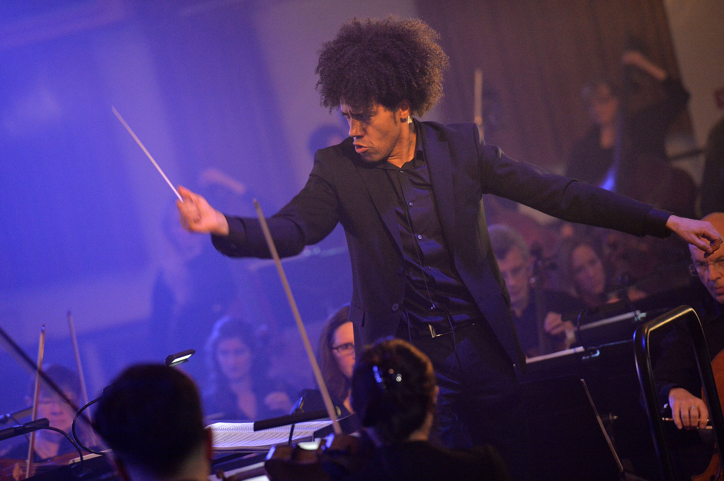
Structure
As a whole class, group your pieces together to make one big crescendo
You’ll also need to work out how to start off and when others need to come in – maybe you want to add in your introduction from the last session
Appoint a conductor to lead this
Notes:
Bring the groups back together and hear each piece. Who has the most effective crescendo?
Structure. Ask the students to structure their group pieces together to make one big piece with a crescendo. They must also work out how to start and stop, how to begin and come in. Maybe they need to appoint a conductor…
FINALLY – have a go at putting this big crescendo after the introduction made last week and again, ask your students to keep a record of what they have done, who played what and the order. (They could add this on to the graphic they created last week)

Slide 20
Orff – Lesson 4
Ostinato (repeating patterns)
Copyright Rachel Leach & BBC
Notes:
Lesson 4: Ostinato (repeating patterns)
Activities: Invent and perform ostinatos
Curriculum link: Play and perform in a range of solo and ensemble contexts using their voice, playing instruments musically, fluently and with accuracy and expression
Improvise and compose; and extend and develop musical ideas by drawing on a range of musical structures, styles, genres and traditions

Slide 21
Making ostinatos – repeating rhythmic patterns
What’s the luckiest thing that has ever happened to you?
Repeat the phrase over a steady pulse
Notes:
LESSON 4: Ostinato (repeating patterns)
Warm-up – quickly recap your pulse piece from last week. If it was wonky at the end of the last session or kept speeding up now is a good time to straighten it out
Explain that you are going to make some repeating rhythmic patterns to go on top of your pulse. The ‘posh’ word for repeating rhythmic pattern is ostinato.
One of the best ways to create ostinatos with students is to use words. Here is a simple method which you can use as a warm-up for your session –
Ask your class a simple question such as ‘what’s the luckiest thing that ever happened to you?’
Choose one student, or a small group, to play the pulse
Ask your class to speak their ‘good luck sentence’ on top of the pulse trying to make the words fit and repeating them round and around.
Ask your students to perform their ostinatos on body percussion rather than speaking them (i.e. one sound for each syllable)

Slide 22
In groups, make a short SLOW piece that includes:
The steady pulse from last session (pitched on D & A, or unpitched, or both)
ONE ostinato that is played by everyone else
The pitches for the ostinato are:
These are the same pitches Orff uses all the way through
Notes:
LESSON 4: Ostinato (repeating patterns)
Split your class into small composing teams and, using the same instruments as last lesson, set the following task –
Make a short SLOW piece that includes:
The steady pulse from last session (pitched on D & A, or unpitched, or both)
ONE ostinato that is played by everyone else
The pitches for the ostinato are: D, A, C, D
These are the same pitches Orff uses in his piece - all the way through! If they are problematic for your students, ask them to choose their own pitches but limit them to just 3 or 4
Bring your class back together and hear each piece. Give feedback: did they stick to the rules? Are they keeping a slow, steady tempo (speed)? Can you hear the ostinato and the pulse?
Challenge your students to put all their pieces together to make one big piece. To do this they must work out a way to add the ostinatos to their pulse piece from last week so students are going to have to decide which role they perform. They must also and keep the crescendo
FINALLY – end your session with a performance of your piece so far and as usual leave a moment for notation

Slide 23
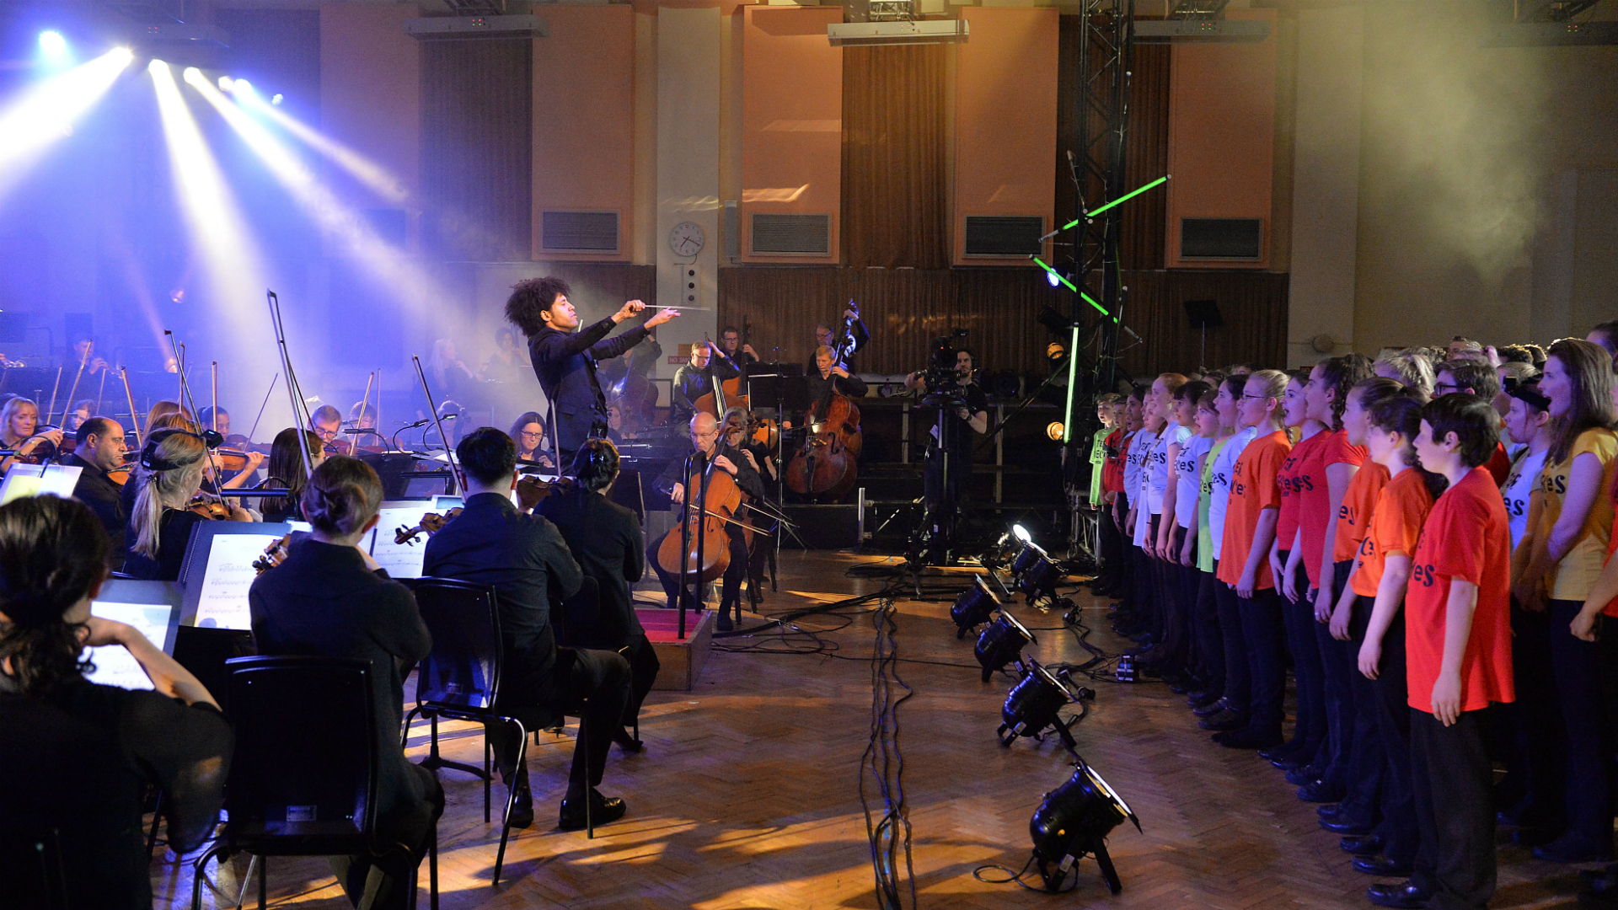
Challenge: as a class, can you make one whole piece?
To do this add your ostinatos to the pulse piece – keep the crescendo too!
Notes:
LESSON 4
Ostinato (repeating patterns)
Bring your class back together and hear each piece. Give feedback: did they stick to the rules? Are they keeping a slow, steady tempo (speed)? Can you hear the ostinato and the pulse?
Challenge your students to put all their pieces together to make one big piece. To do this they must work out a way to add the ostinatos to their pulse piece from last week so students are going to have to decide which role they perform. They must also and keep the crescendo
FINALLY – end your session with a performance of your piece so far and as usual leave a moment for notation

Slide 24
Orff – Lesson 5
Words and melody
Copyright Rachel Leach & BBC
Notes:
Lesson 5: Words and melody
Activities: Invent lyrics and melody
Begin to structure ideas into a piece
Curriculum link: Play and perform in a range of solo and ensemble contexts using their voice, playing instruments musically, fluently and with accuracy and expression
Improvise and compose; and extend and develop musical ideas by drawing on a range of musical structures, styles, genres and traditions

Slide 25
Make a melody using your sentences
GOOD LUCK | BAD LUCK
Remember your good luck/back luck sheets?
Use these as inspiration for lyrics
Notes:
LESSON 5
Words and melody
Prepare the class. Encourage your students to get back into their composing teams and get their instruments out. Give out the ‘good luck/ bad luck’ sheets from the listening task in lesson 1. These are going to be the inspiration for lyrics.
Ask each group to select ideas from their lists and create up to 8 lyric lines. Here are some tips for creating lyrics:
Short lines and words work best (avoid unnecessary words and words with multiple syllables)
Lyrics don’t have to rhyme but if you start a rhyming scheme, you should continue it throughout
Go for an even number of ‘good’ and ‘bad’ luck lines (i.e. four of each)
Pulse – challenge each group to speak their lines to the D & A pulse.
When this is done, hear some of the lyrics and give feedback. Make sure that the groups aren’t all using the same or similar ideas. Also check that the stresses of the lines and words line up correctly with the pulse.
I.e. you don’t say ‘Slip ON a BA-nana skin’, you say ‘SLIP on a ba-NA-na skin’
Pitch – using the pitches D, E, F, G (borrowed from Orff), ask them to work out a melody for their lyric and practice singing it
You can use these pitches or others that suit your students’ ability better. It might make singing easier to add D as well.
Bring the groups back together and hear each piece. As you do so, write up the words (and notes) on the board.
As a full class decide on an order for the groups and the lyrics – remember that you are heading towards one full class piece. As you debate, encourage your students to think about the meaning of the words and the effectiveness of the overall melody. This melody should fit with the crescendo pulse so it’s worth thinking about the crescendo too. Also, decide who is going to sing this melody and practice singing it straight through with the D & A pulse
FINALLY – finish this lesson with a final performance of your ‘song’: lyrics, D&A pulse, ostinatos and crescendo! As usual, write down what you have achieved keeping a careful note of the pitches used for the melody. (It might be easiest and safest to just record this final run-through)

Slide 26
Make eight lyric lines from your ideas
TIPS:
Short lines and words work best (avoid unnecessary words and words with multiple syllables)
Lyrics don’t have to rhyme but if you start a rhyming scheme, you should continue it throughout
Go for an even number of ‘good’ and ‘bad’ luck lines (i.e. four of each)
Notes:
LESSON 5: Words and melody
Ask each group to select ideas from their lists and create up to 8 lyric lines. Here are some tips for creating lyrics:
Short lines and words work best (avoid unnecessary words and words with multiple syllables)
Lyrics don’t have to rhyme but if you start a rhyming scheme, you should continue it throughout
Go for an even number of ‘good’ and ‘bad’ luck lines (i.e. four of each)
Pulse – challenge each group to speak their lines to the D & A pulse.
When this is done, hear some of the lyrics and give feedback. Make sure that the groups aren’t all using the same or similar ideas. Also check that the stresses of the lines and words line up correctly with the pulse.
I.e. you don’t say ‘Slip ON a BA-nana skin’, you say ‘SLIP on a ba-NA-na skin’
Pitch – using the pitches D, E, F, G (borrowed from Orff), ask them to work out a melody for their lyric and practice singing it
You can use these pitches or others that suit your students’ ability better. It might make singing easier to add D as well.
Bring the groups back together and hear each piece. As you do so, write up the words (and notes) on the board.
As a full class decide on an order for the groups and the lyrics – remember that you are heading towards one full class piece. As you debate, encourage your students to think about the meaning of the words and the effectiveness of the overall melody. This melody should fit with the crescendo pulse so it’s worth thinking about the crescendo too. Also, decide who is going to sing this melody and practice singing it straight through with the D & A pulse
FINALLY – finish this lesson with a final performance of your ‘song’: lyrics, D&A pulse, ostinatos and crescendo! As usual, write down what you have achieved keeping a careful note of the pitches used for the melody. (It might be easiest and safest to just record this final run-through)

Slide 27
Adding pulse and pitch
Speak your lyrics over the D & A pulse
Keep an eye out for where you stress syllables
Using Orff’s only pitches – E, F, G - on instruments or using your voice – make a melody using just three or four pitches
Practise singing them
Notes:
LESSON 5
Words and melody
Pulse – challenge each group to speak their lines to the D & A pulse.
When this is done, hear some of the lyrics and give feedback. Make sure that the groups aren’t all using the same or similar ideas. Also check that the stresses of the lines and words line up correctly with the pulse.
I.e. you don’t say ‘Slip ON a BA-nana skin’, you say ‘SLIP on a ba-NA-na skin’
Pitch – using the pitches D, E, F, G (borrowed from Orff), ask them to work out a melody for their lyric and practice singing it
You can use these pitches or others that suit your students’ ability better. It might make singing easier to add D as well.
Bring the groups back together and hear each piece. As you do so, write up the words (and notes) on the board.
As a full class decide on an order for the groups and the lyrics – remember that you are heading towards one full class piece. As you debate, encourage your students to think about the meaning of the words and the effectiveness of the overall melody. This melody should fit with the crescendo pulse so it’s worth thinking about the crescendo too. Also, decide who is going to sing this melody and practice singing it straight through with the D & A pulse
FINALLY – finish this lesson with a final performance of your ‘song’: lyrics, D&A pulse, ostinatos and crescendo! As usual, write down what you have achieved keeping a careful note of the pitches used for the melody. (It might be easiest and safest to just record this final run-through)

Slide 28
List all the lyrics used
Good luck | Bad luck
Notes:
Bring the groups back together and hear each piece. As you do so, write up the words (and notes) on the board.

Slide 29
Decide your final lyrics for your whole class piece and put them in order
Practise singing your piece with the ‘um-pa’ pulse
1)
2)
3)
4)
5)
6)
7)
8)
Notes:
As a full class decide on an order for the groups and the lyrics – remember that you are heading towards one full class piece. As you debate, encourage your students to think about the meaning of the words and the effectiveness of the overall melody. This melody should fit with the crescendo pulse so it’s worth thinking about the crescendo too. Also, decide who is going to sing this melody and practice singing it straight through with the D & A pulse
FINALLY – finish this lesson with a final performance of your ‘song’: lyrics, D&A pulse, ostinatos and crescendo! As usual, write down what you have achieved keeping a careful note of the pitches used for the melody. (It might be easiest and safest to just record this final run-through)

Slide 30
Orff – Lesson 6
Put it all together
Copyright Rachel Leach & BBC
Notes:
Lesson 6:
Activities: Structure all ideas into a piece
Perform on pitched and unpitched instruments and voice to an audience
Use technical terminology where appropriate
Curriculum link: Play and perform in a range of solo and ensemble contexts using their voice, playing instruments musically, fluently and with accuracy and expression
Improvise and compose; and extend and develop musical ideas by drawing on a range of musical structures, styles, genres and traditions

Slide 31
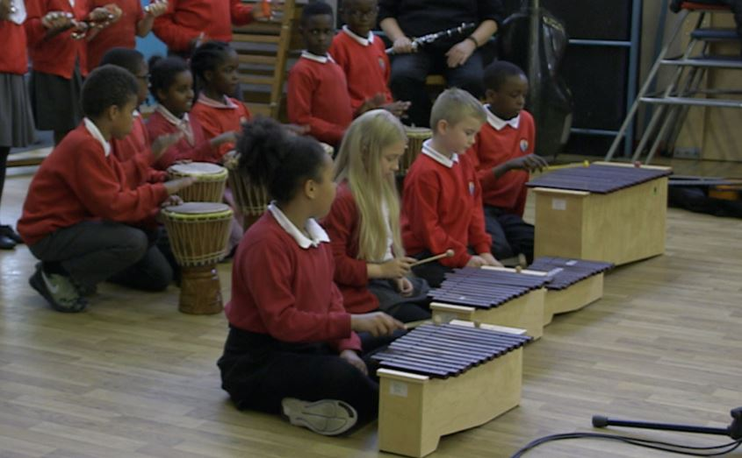
Recap all the elements you have created
Get in your groups and recap the following:
The 3 gesture introduction
The steady D & A pulse and ostinatos with crescendo
The sung melody and words
Practise these elements in your groups
Notes:
LESSON 6
Put it all together
Recap. If space permits, sit the students in a circle and remind them of all the elements you have worked with so far:
The 3-gesture introduction
The steady D & A pulse and ostinatos with crescendo
The sung melody and words
You may have already successfully run through from introduction to crescendo
Get out the instruments and encourage your students to practise each element in their composing groups. Work through this quite quickly

Slide 32
Bring everyone together to create a final piece
Use the same structure as Orff:
Decide on your ending. Orff ends by speeding up and crashing on a big D Major chord.
How would you want to end your piece?
INTRO | Big Crescendo
3 ‘gestures’ Dm – Dm – A (major/ minor?) | Steady pulse on D & A Ostinatos (D, B, C) Melody, with words (D, E, F, G)
Notes:
LESSON 6
Put it all together
Bring everyone back together and practise together. You are aiming for a piece with the same structure as Orff –
INTRO
3 ‘gestures’
Dm – Dm – A (major/ minor?)
Big Crescendo
Steady pulse on D & A
Ostinatos (D, B, C)
Melody, with words (D, E, F, G)
Ending – how are you going to end your piece? Orff suddenly speeds everything up and crashes towards a massive D MAJOR chord but you don’t have to do this. Your students might have a different (better?!) solution
FINALLY – practice your finished piece and record it or perform it to another class.

Slide 33
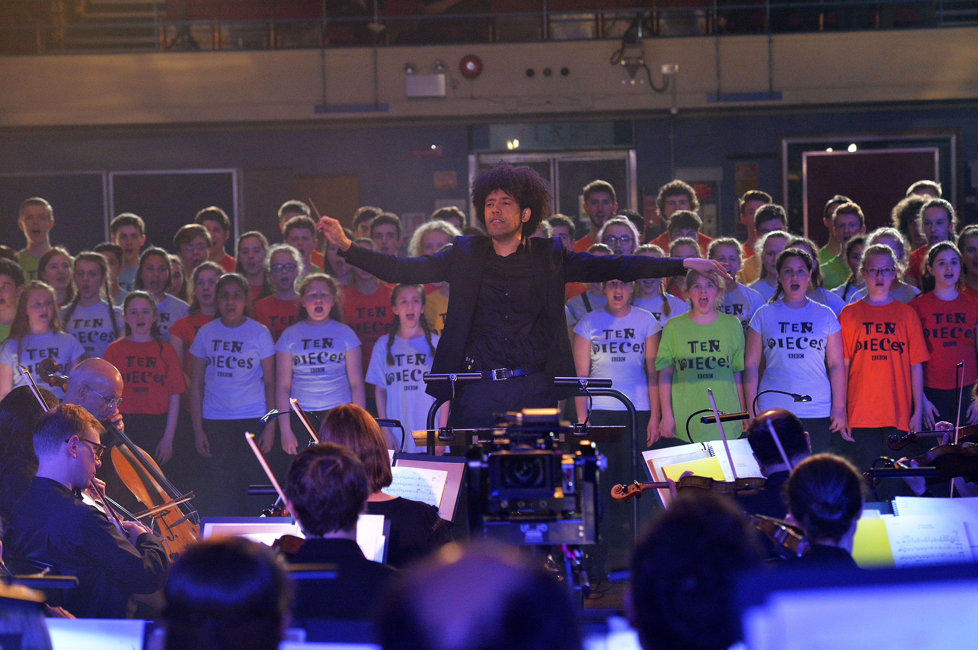
Come together for a final performance!
Perform your piece
You may want to record it or invite another class in to watch!
Notes:
LESSON 6
Put it all together
FINALLY – practice your finished piece and record it or perform it to another class.

Slide 34
Taking it further – cross-curricular activities
MUSIC: make a massive graphic score of the whole piece
LITERACY: create stories or poetry based on the character of Fortuna and the effect her Wheel of Fortune has on people’s lives.
HISTORY: research this Roman Goddess’ life and the lives of other Roman or Greek Gods and Goddesses
MORE MUSIC: listen to more of Carmina Burana (‘O fortuna’ is just the tiny beginning of a much bigger, epic piece) and create another section.

