Slide 1
Elgar
‘Enigma’ Variations – Theme (Enigma), variations 11 (GRS), 6 (Ysobel)
& 7 (Troyte)
Primary classroom lesson plan
Written by
Rachel Leach
Notes:
For:
Key Stage 3 in England, Wales and Northern Ireland
Third and Fourth Level, S1-S3 in Scotland

Slide 2
Lesson outcomes
After this lesson, pupils will be able to:
Listen and reflect on a piece of orchestral music
Learn to play a tune
Create pieces inspired by Elgar
Perform as an ensemble
Notes:
Resources required
Paper and pens
Classroom percussion instruments and any other instruments your students might be learning
This scheme of work is plotted out over six lessons. Feel free to adapt it to suit your children and the resources you have available.
The six lessons at a glance
Lesson 1
Activities: Listen to a piece of music and describe it
Watch the film and discuss
Curriculum link: Listen with increasing discrimination to a wide range of music from great composers and musicians
Develop a deeper understanding of the music that they perform and to which they listen and its history
Lesson 2
Activities: Listen a theme and orchestrate it (or develop it)
Curriculum link: Listen with increasing discrimination to a wide range of music from great composers and musicians
Play and perform in a range of solo and ensemble contexts using their voice, playing instruments musically, fluently and with accuracy and expression
Lesson 3
Activities: Listen and analyse Elgar’s music
Create musical motifs and structure them into a piece
Curriculum link: Listen with increasing discrimination to a wide range of music from great composers and musicians
Play and perform in a range of solo and ensemble contexts using their voice, playing instruments musically, fluently and with accuracy and expression
Improvise and compose; and extend and develop musical ideas by drawing on a range of musical structures, styles, genres and traditions
Lesson 4
Activities: Create musical motifs and structure them into a piece
Curriculum link: Play and perform in a range of solo and ensemble contexts using their voice, playing instruments musically, fluently and with accuracy and expression
Improvise and compose; and extend and develop musical ideas by drawing on a range of musical structures, styles, genres and traditions
Lesson 5
Activities: Create musical motifs and structure them into a piece
Develop a theme
Curriculum link: Play and perform in a range of solo and ensemble contexts using their voice, playing instruments musically, fluently and with accuracy and expression
Improvise and compose; and extend and develop musical ideas by drawing on a range of musical structures, styles, genres and traditions
Lesson 6
Activities: Structure pieces into a concert
Perform in front of an audience
Curriculum link: Play and perform in solo and ensemble contexts, using their voices and playing musical instruments with increasing accuracy, fluency, control and expression
Improvise and compose music for a range of purposes using the interrelated dimensions of music

Slide 3
Curriculum checklist
Learners will:
play and perform in ensemble contexts, using voices and playing musical instruments
improvise and compose music for a range of purposes using the interrelated dimensions of music

Slide 4
Glossary of music terms
Term | Definition
Drone | one long, continuous sound (pitched or unpitched) that is present throughout a piece, usually at the bottom of the texture
Motif | a very short musical ‘idea’
Pitched percussion | percussion instruments that can play different pitches (or ‘notes’) – xylophones, glockenspiels, chime bars etc.
Theme | another word for ‘tune’ or ‘melody’. A linear line of notes, like a musical sentence
Unpitched percussion | Percussion instruments that make sounds that don’t have a specific pitch (or ‘note’) – drums, shakers, woodblocks, tambourine.

Slide 5
Elgar – Lesson 1
Watching and listening
Copyright Rachel Leach & BBC
Notes:
Lesson 1
Activities: Listen to a piece of music and describe it
Watch the film and discuss
Curriculum link: Listen with increasing discrimination to a wide range of music from great composers and musicians
Develop a deeper understanding of the music that they perform and to which they listen and its history

Slide 6
Background – the composer
Edward ELGAR (1857 - 1934)
English composer
Took many years to find fame but then, with ‘Enigma’ Variations, he found himself suddenly very famous
Notes:
LESSON 1
Watching and listening
Prepare your class. Explain to your class that you are going to begin a 6-week music project focusing on an important piece of music by a composer called Elgar
Explain further that Elgar was from England and his most famous piece described his friends in music. He wrote (or borrowed) a simple tune and made lots of different versions of it - one for each of his friends. These versions are called 'Variations' and because Elgar left everyone guessing who was ‘pictured within’ and where the tune came from, the piece is called 'Enigma Variations' (an enigma is a puzzle.)

Slide 7
Background – the music
‘Enigma’ Variations
Written in 1899
Uses one theme to describe 14 of his friends
‘Variation' means the same as 'version’
The 'enigma' remains a mystery - no one can work out the origin of Elgar's theme
Notes:
LESSON 1
Watching and listening

Slide 8
Listen to the audio of Variation 7 (Troyte)
Listen to each of the three Variations
Listen to Variation 7
Listen to Variation 6
Listen to Variation 11
For each one, as you listen try to imagine the person Elgar was describing when he wrote this piece:
How old do you think they are?
What do they look like?
What are they doing?
Jot down notes or draw pictures for each
Notes:
Listening task. Listen to Variation 7 (Troyte) without images. Ask your class to imagine the person being described and jot down their thoughts. You might like to give them the following categories to think about:
Man or woman, boy or girl? Or animal?
Age?
What do they look like?
What are they doing?
Repeat this activity as you listen to Variation 11 (G. R. S.), and 6 (Ysobel)
Discuss their ideas and perhaps create a 'picture' of each person on the board.
Discuss their ideas and perhaps create a 'picture' of each person on the board. Then reveal the real answers:

Slide 9
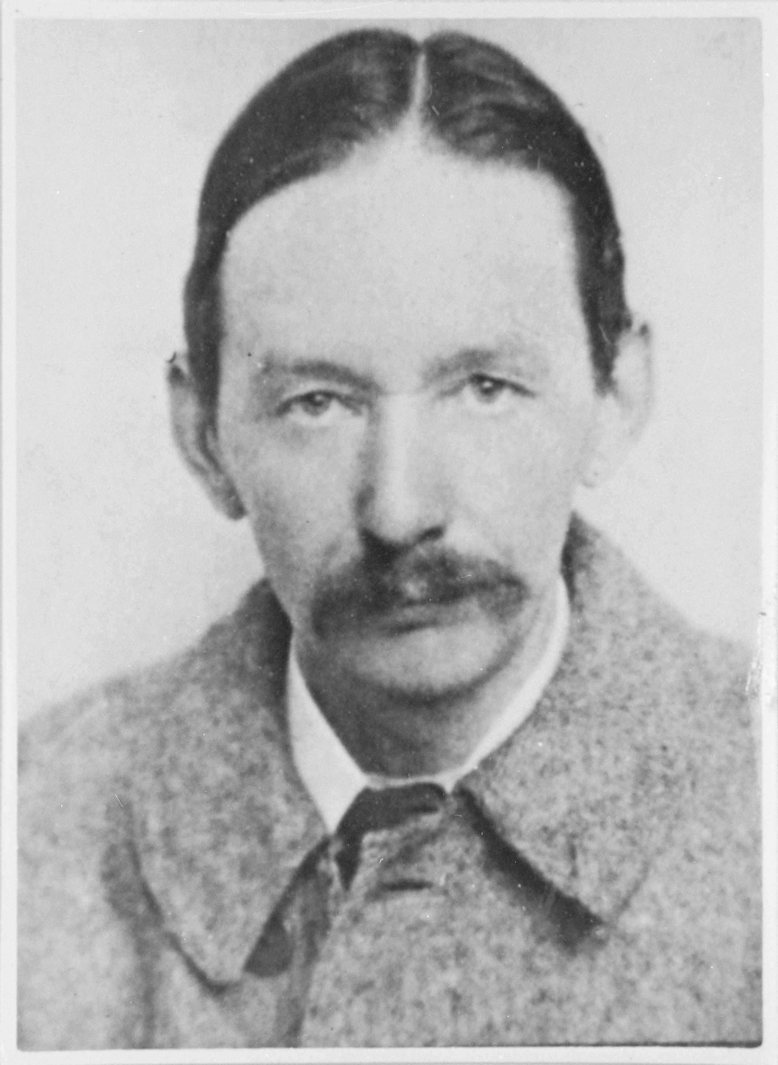
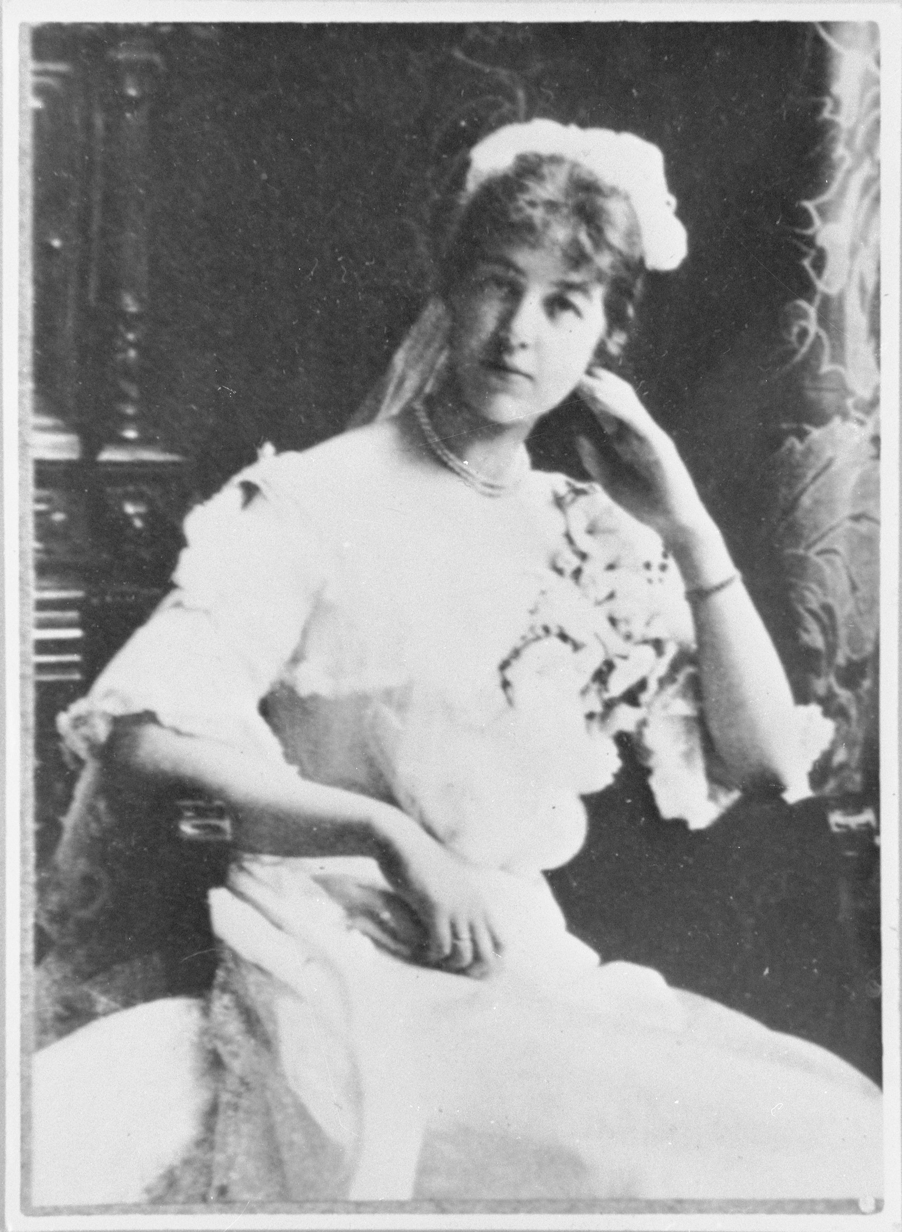
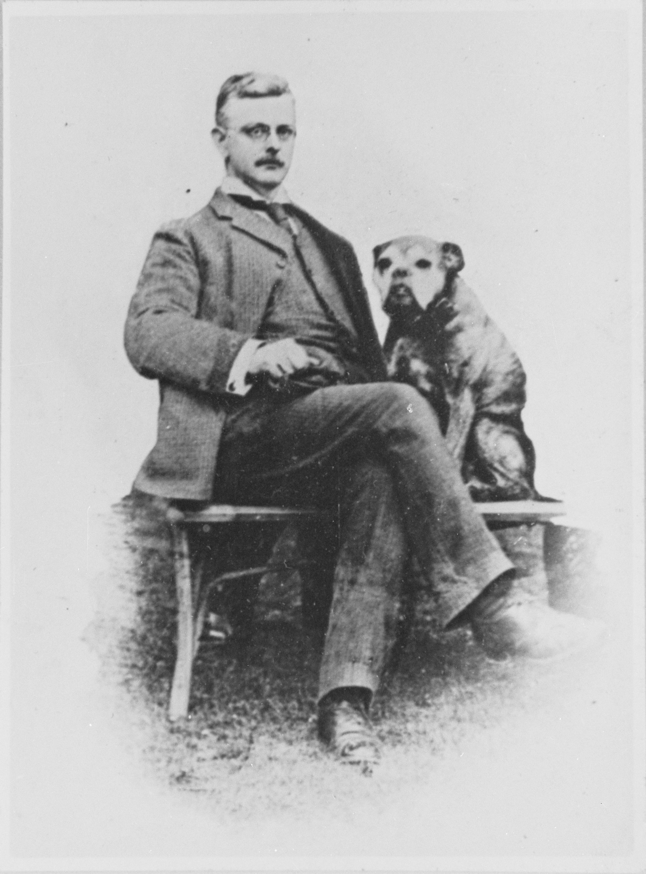
These are the variations:
Variation 7 (Tryote): Arthur Troyte Griffith Male, aged about 40 – one of Elgar’s closest friends This variation depicts him sheltering during a thunderstorm
Variation 6 (Ysobel): Isabel Fitton Female, aged about 30 – she was a beautiful violist This variation depicts her practising her viola
Variation 11 (G. R. S.): A bulldog called Dan Dog! This variation depicts him doing ‘doggy’ things such as running, biting a bone and panting G. R. S are the initials for Dr. George Robert Sinclair who owned Dan the dog

Slide 10
Get to know Elgar’s ‘Enigma’ Variations
http://www.bbc.co.uk/programmes/articles/xFHT9GvfKjBbtw28pgDgyG
Notes:
FINALLY - watch the Elgar Ten Pieces film and afterwards have a class discussion about what you have just seen. Perhaps listen to the Variations one more time or explore some of the others (particularly the theme in full and 9 Nimrod - the most famous)

Slide 11
Elgar – Lesson 2
Elgar’s theme
Copyright Rachel Leach & BBC
Notes:
Lesson 2
Activities: Listen a theme and orchestrate it (or develop it)
Curriculum link: Listen with increasing discrimination to a wide range of music from great composers and musicians
Play and perform in a range of solo and ensemble contexts using their voice, playing instruments musically, fluently and with accuracy and expression

Slide 12
Let’s learn to play Elgar’s theme
Try clapping the following rhythm:
You could even put it to words:
Can you notice anything specific about the rhythm?
Notes:
LESSON 2
Elgar’s theme
Prepare your class by listening to Elgar’s theme once again. Remind them of the background to Elgar’s piece and explain that you are going to spend a few lessons creating your own set of variations. To do this, you must first learn to play Elgar's theme
Teach the following rhythm above
Take some time to explain this shape a little - your students might spot that it is symmetrical. It may help to use words to learn it.
Perform this three times back to back

Slide 13
Let’s learn to play Elgar’s Theme
This is Elgar’s melody:
Notes:
Next, teach the full tune. There are several ways of doing this; if your students can read notation, simply give out the following score and ask them to play it. If they are beginners you might like to break it down into sections and perhaps share it around so that no one has to play the whole thing. For complete beginners teach just the first two bars and then challenge the class to create the second two phrases, ending on a C (or, like Elgar an unexpected C#). The advantage with creating your own theme is that the students will feel more ownership over the music.

Slide 14
Orchestrate the Theme
This is Elgar’s bassline – it moves in steps:
Notes:
Orchestrate the theme. Create a full class version. You might like to include -
pitched instruments on the full theme or part of it
unpitched instruments on the rhythm or keeping a pulse
a simple bassline*, moving in step and using just white notes
a long, low A drone
*here is Elgar’s real bassline –

Slide 15
Can you create your own theme?
Try and create your own theme as a class
See if you can even add any orchestration
You can use Elgar’s rhythm
Try performing it together at the end of the lesson
Notes:
FINALLY - finish off with a performance of your class theme and remember to write down what you've done and who plays what

Slide 16
Elgar – Lesson 3
Elgar’s dog
Copyright Rachel Leach & BBC
Notes:
Lesson 3
Activities: Listen and analyse Elgar’s music
Create musical motifs and structure them into a piece
Curriculum link: Listen with increasing discrimination to a wide range of music from great composers and musicians
Play and perform in a range of solo and ensemble contexts using their voice, playing instruments musically, fluently and with accuracy and expression
Improvise and compose; and extend and develop musical ideas by drawing on a range of musical structures, styles, genres and traditions

Slide 17
Variation 11 (G.R.S.)
Listen to the music and fill out this table making note of things you hear:
Notes:
LESSON 3
Elgar's Dog
Warm-up. Begin your session in a circle with a quick warm up activity and a recap of what you have done so far. Remind the class about the music they heard describing Dan the bulldog.
Listening task: Listen again to Variation 11 (G. R. S.). Ask your students to make a list of the musical events they hear, as follows -
Event Number: E.g. 1, 2
Instruments used: Strings, Bassoon
Describe the music: Downward flurry, Quick even notes
Describe the dog! Running, Still running!
Listen a few times and encourage your students to write down as many ideas as they can. Challenge them to see if they can spot Elgar’s original theme within the music.

Slide 18
Choose three important motifs in the piece
In pairs decide on your top three things:
1)
2)
3)
Notes:
Then, working in pairs or small groups, ask them to compile their thoughts and decide on with the three most important motifs in the piece. This might mean combining or discarding ideas.

Slide 19
Make a piece of ‘dog music’
Elgar’s dog variation is made up of
three basic ideas:
Running
Biting
Breathing
Notes:
Discuss their ideas and see if there is any common ground between the groups. Explain that you think Elgar’s musical dog is made up of these three basic musical ideas –
RUNNING – a quick downward flurry of notes (strings) followed by steady ‘footsteps’ (bassoon). The ‘footsteps’ are made up from the notes of the theme
BITING – one loud chord played by the full orchestra followed by a short fanfare which is four notes from the theme
BREATHING – Elgar uses this rhythm for his panting and it is played softly by the cellos and double basses. This is also derived from the theme

Slide 20
Running
Elgar creates a quick downward flurry of notes (strings) followed by steady ‘footsteps’ (bassoon).
The ‘footsteps’ are made up from the notes of the theme
Notes:
Discuss their ideas and see if there is any common ground between the groups. Explain that you think Elgar’s musical dog is made up of these three basic musical ideas –
RUNNING – a quick downward flurry of notes (strings) followed by steady ‘footsteps’ (bassoon). The ‘footsteps’ are made up from the notes of the theme
BITING – one loud chord played by the full orchestra followed by a short fanfare which is four notes from the theme
BREATHING – Elgar uses this rhythm for his panting and it is played softly by the cellos and double basses. This is also derived from the theme

Slide 21
Biting
Elgar uses one loud chord played by the full orchestra followed by a short fanfare which is four notes from the theme:
Notes:
Discuss their ideas and see if there is any common ground between the groups. Explain that you think Elgar’s musical dog is made up of these three basic musical ideas –
RUNNING – a quick downward flurry of notes (strings) followed by steady ‘footsteps’ (bassoon). The ‘footsteps’ are made up from the notes of the theme
BITING – one loud chord played by the full orchestra followed by a short fanfare which is four notes from the theme
BREATHING – Elgar uses this rhythm for his panting and it is played softly by the cellos and double basses. This is also derived from the theme

Slide 22
Breathing
Elgar uses this rhythm for his panting and it is played softly by the cellos and double basses. This is also derived from the theme
Notes:
Discuss their ideas and see if there is any common ground between the groups. Explain that you think Elgar’s musical dog is made up of these three basic musical ideas –
RUNNING – a quick downward flurry of notes (strings) followed by steady ‘footsteps’ (bassoon). The ‘footsteps’ are made up from the notes of the theme
BITING – one loud chord played by the full orchestra followed by a short fanfare which is four notes from the theme
BREATHING – Elgar uses this rhythm for his panting and it is played softly by the cellos and double basses. This is also derived from the theme

Slide 23
In teams, try and make one of these elements
You don’t have to copy Elgar’s try and make your own ‘dog piece’
Running
Biting
Breathing
Notes:
Split into three teams. Each team must make one of these elements - perhaps ask the students at this point to figure out which instruments are needed for each group/ element. Challenge them to use Elgar’s ideas and the main theme but to make their own motif rather than just copy the real one.
FINALLY - Bring the class back together and structure these ideas into one big ‘dog’ piece.

Slide 24
Elgar – Lesson 4
Composing your own ‘Enigma’ Variations 1
Copyright Rachel Leach & BBC
Notes:
Lesson 4
Activities: Create musical motifs and structure them into a piece
Curriculum link: Play and perform in a range of solo and ensemble contexts using their voice, playing instruments musically, fluently and with accuracy and expression
Improvise and compose; and extend and develop musical ideas by drawing on a range of musical structures, styles, genres and traditions

Slide 25
Today we will describe someone or something in music!
First we need to pick your subject
List any celebrities/animals/things you’d like to use:
Notes:
LESSON 4
Composing your own ‘Enigma’ Variations 1
Warm up. Begin this session by recapping your musical dog piece – you could create a quick body percussion version of it again
Explain that today, like Elgar, you are going to describe someone in music. Have a class discussion about who this might be and decide on three or four candidates.
You need to choose people known to everyone and with distinct characteristics or actions. You also want to avoid offending anyone so it might be safest to choose celebrities or sports people that the class are unlikely to ever meet i.e. the Queen, David Beckham, Elgar! You could choose people you are studying in other curriculum areas i.e. Queen Victoria, the Egyptians, Martin Luther King. You don't even have to use people as inspiration - you could describe animals, insects, places, trees....

Slide 26
Pick a person/thing from your list
Think of three actions/characteristics for them and list them here:
1)
2)
3)
Can you create a sound (musical motif) for each thing?
Notes:
Choose one person from your list. Ask the class to describe this person or their job using three statements
i.e. The Queen
- shakes hands
- waves
- looks happy
Ask your children to create one sound (musical motif) for each of these things.
i.e. The Queen - shakes hands (three short hits on a drum)
- waves (a shaking tambourine)
- looks happy (a scale going upwards)
Challenge the class to structure these motifs together to make a short piece

Slide 27
Now make your own piece in groups
Choose a ‘subject’
Three descriptive words
Make three motifs
Put them together to make one piece
Perform it to the rest of the class
Notes:
Split your class into small groups and ask them to make their own piece using this method -
Choose a ‘subject’
Three descriptive words
Three motifs
One piece
When this is achieved, bring the class back together, hear their pieces one by one and give a bit of gentle feedback
FINALLY – finish the session by giving the children a little time to write down what they have done. This will greatly speed things up next lesson

Slide 28
Elgar – Lesson 5
Composing your own
‘Enigma’ Variation 2
Copyright Rachel Leach & BBC
Notes:
Lesson 5
Activities: Create musical motifs and structure them into a piece
Develop a theme
Curriculum link: Play and perform in a range of solo and ensemble contexts using their voice, playing instruments musically, fluently and with accuracy and expression
Improvise and compose; and extend and develop musical ideas by drawing on a range of musical structures, styles, genres and traditions

Slide 29
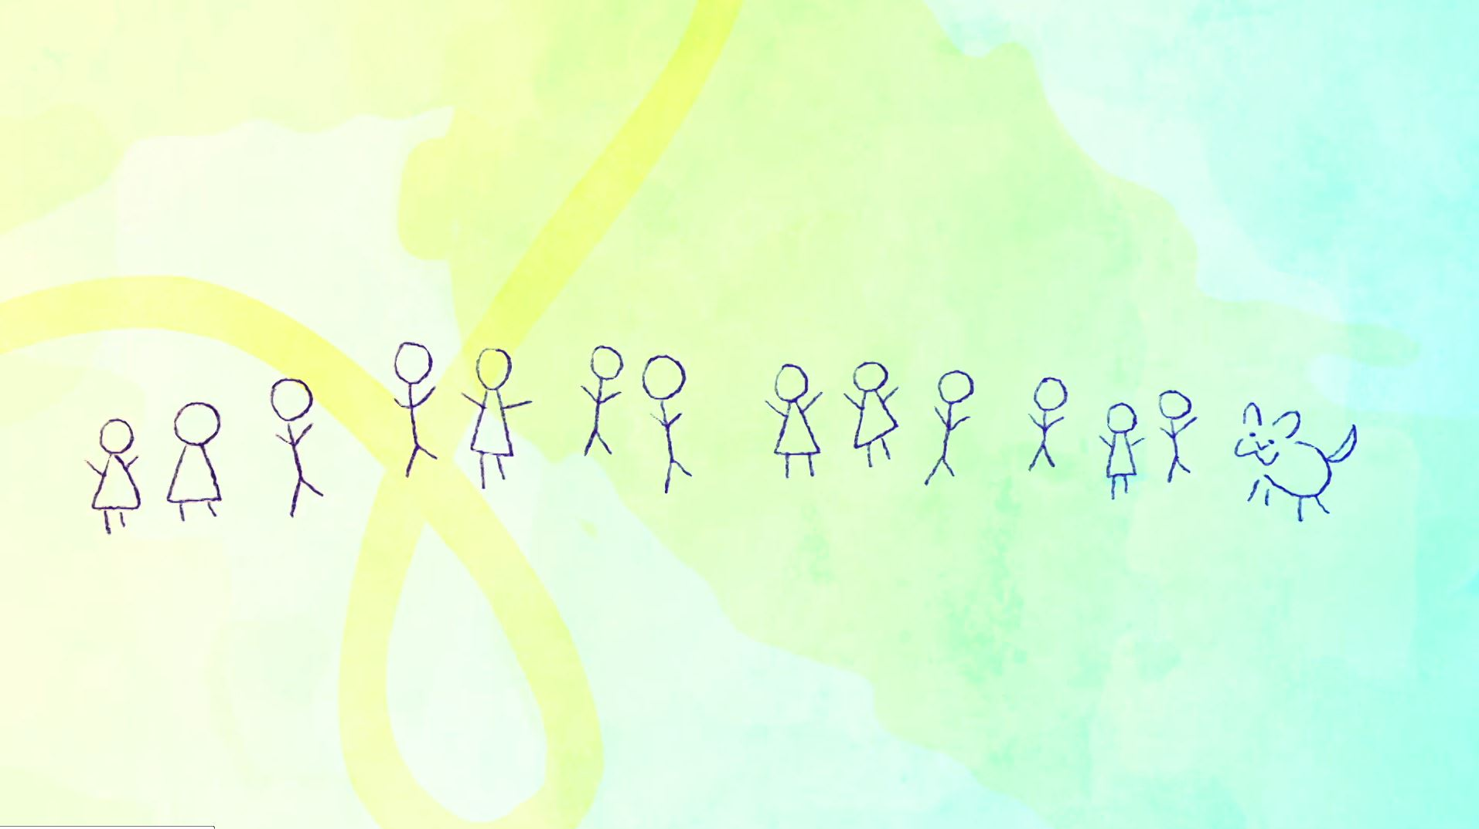
Your theme and variation
Recap your theme from Lesson 2
In your groups, play your piece based on someone’s character from last lesson – this will be part of your variation
Notes:
LESSON 5
Composing your own ‘Enigma’ Variation 2
Warm-up. Once again begin the session with an empty classroom and with the children sitting in a circle on the floor. After a short warm-up and chat about last lesson, split the children back into groups and get the instruments out. Give them a few minutes to put their piece from last lesson back together
As a full class recap the theme you made in lesson 2

Slide 30
Your theme and variation
Elgar’s variations would feature his theme somewhere within them
Try and put some (or all) of your theme into your variation
Try and work out what your theme represents
Come together and perform it with the rest of the class
Feedback – does it sound like the person they’re describing? Can you hear the theme?
Notes:
Remind the class that Elgar's portraits all feature his theme within them. Ask your class to put some (or all) of the class theme into their group variation. Challenge them further to adapt and disguise the theme so that it is hidden. They should work out what the theme represents and adapt it accordingly.
I.e. The first four notes of the theme become a fanfare to welcome the Queen
Bring the class back together and hear their pieces. Have a class discussion about each one - do they sound like the person or animal they are describing? Can you hear the theme or is it well disguised?
FINALLY – try performing all the variations back to back without a pause and make sure the performers have kept a good record of what they have done this lesson

Slide 31
Elgar – Lesson 6
Put it all together
Copyright Rachel Leach & BBC
Notes:
Lesson 6
Activities: Structure pieces into a concert
Perform in front of an audience
Curriculum link: Play and perform in solo and ensemble contexts, using their voices and playing musical instruments with increasing accuracy, fluency, control and expression
Improvise and compose music for a range of purposes using the interrelated dimensions of music

Slide 32
Can you remember the three sections of music you have created?
1)
2)
3)
Notes:
LESSON 6
Putting it all together
Warm-up. As usual, begin with a quick focusing warm-up. It might be fun to ‘mime’ the music silently
Recap - ask the children to remind you of the three sections of music that they have created. Hopefully they will say the following:
The full class theme
Elgar's dog
Their group variations

Slide 33
Decide on an order for the variations and put them all together to perform a completed piece
1) The full class theme
2)
3)
4)
Can you play it in one go and not leave too much of a pause
in between?
The group variations
Dog music
The group variations 2 etc.
Notes:
Get out the instruments and allow for a minute or two of chaos as everyone remembers their ideas. Give them time in groups to put their variation back together. Then put the ‘theme’ and ‘dog’ back together as a full class.
Structure – have a quick chat about order and make a list on the board. Practise in this order aiming to go from movement to movement without too much of a pause just as Elgar does
FINALLY – record your finished piece or perform it to another class

Slide 34
Taking it further : Cross-curricular activities
VISIT: an art gallery and describe some of the portraits you see using the same method as above
LISTEN: Scottish composer James MacMillan wrote a piece with a similar idea called ‘…as others see us…’. Take a listen. All of his subjects are in the National Portrait Gallery and their pictures can be seen online
LITERACY: Write words to fit Elgar’s tune or your own and make a singing variation

