Slide 1
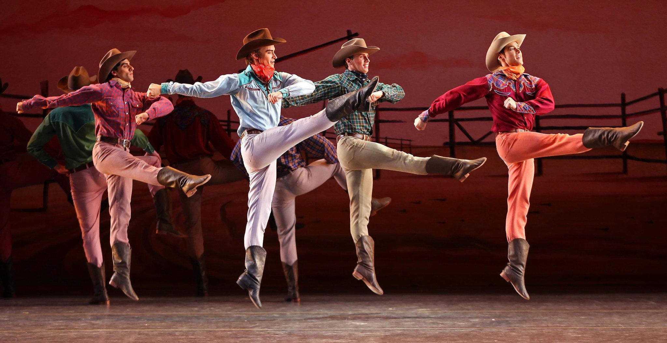
Hoe-Down
Aaron Copland

Slide 2
Hoe-Down - Main Themes
1
2

Slide 3
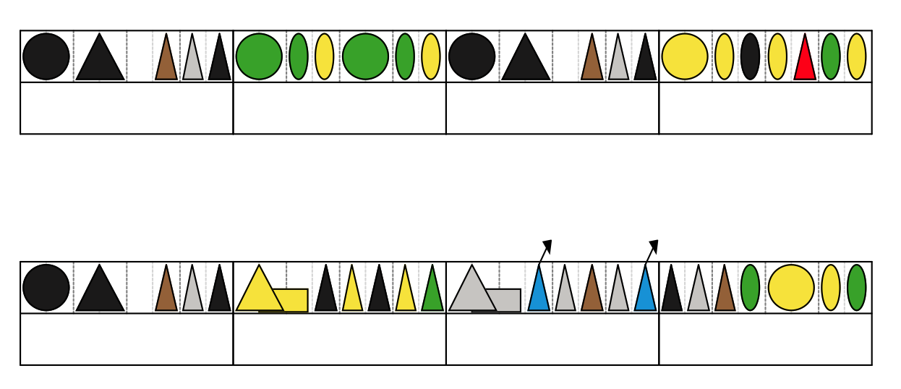
3

Slide 4
Games
Games devised by Birmingham Conservatoire

Slide 5
Aims
Introduce melodic material
Use pulse as a key element
Improve literacy and numeracy skills
Use phrases to learn the melodies of the piece
Explore some of the rhythmic content of the piece through body percussion
Layer melodic content and rhythmic content to produce a piece
Share a new short piece composed collaboratively based on key concepts of the composition

Slide 6
Game 1
Warm Up
Everyone standing in a circle – pass the sound around
First steps:
“Yeehaa” – Pass round clockwise – (arm in fist facing the direction it is going)
“Haybarn” – Skips a person (hands above head in roof shape)
Next steps:
“Hoe-down” – blocks the direction of travel and sends it back the opposite way (arm in fist facing the opposite way of travel)

Slide 7
Game 2
Warm Up
Name everyone “A” or “B”
Ask “B” people to move into the middle and form a smaller circle.
You should now have 2 circles
First Steps - Pulse
In a circle, walk together but in opposite directions, clapping on the beat in 2/4 time (not 4/4)
Next Steps
Ask someone to shout out a number between 1-10
Now walk for 4 bars, still clapping on the beat and rest for the amount of bars that person chose… does everyone come back in at the same time?

Slide 8
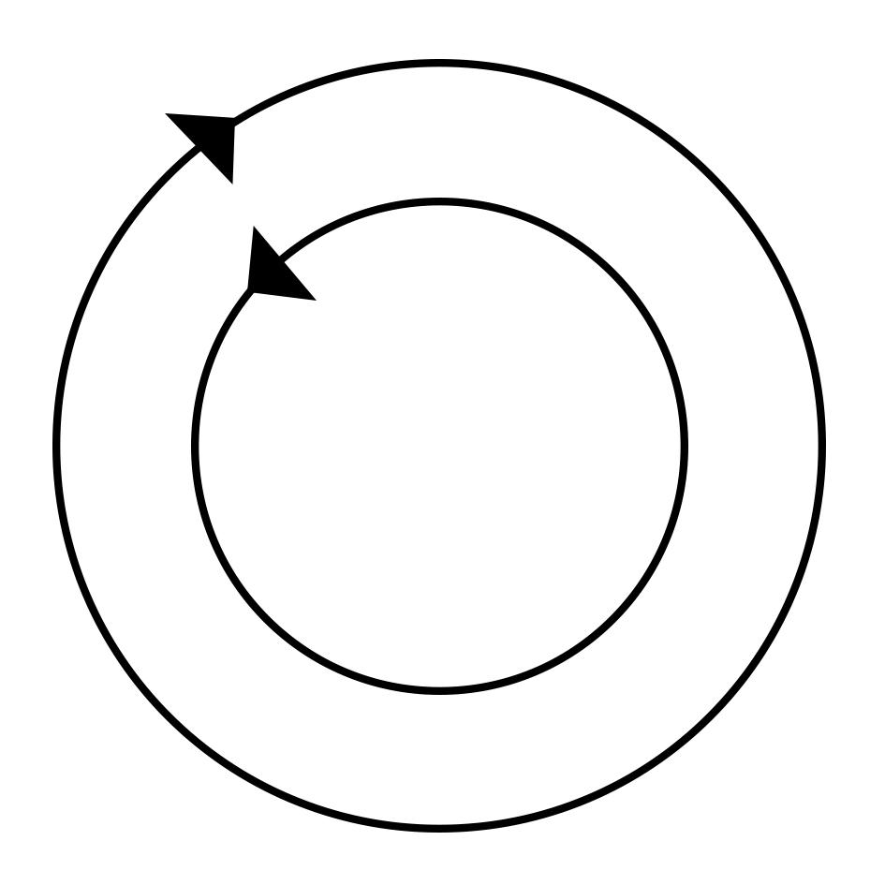
Game 3
Game – On and off the beat
Everyone still in two circles and walking in opposite directions
Sets of claves per person – broom handles work really well chopped up. If no claves then pick a different body percussion sound
One group claps ON the beat while the other group uses claves OFF the beat
Once this is going well then you can STOP for 4 bars before switching the direction and swapping everyone round

Slide 9
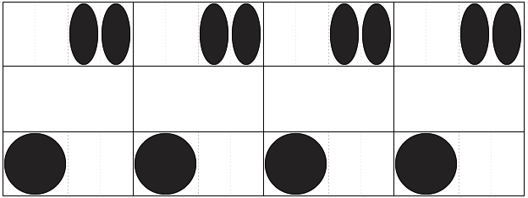
Game 4
Game – On and off the beat
As Game 3 but clapping/tapping twice off the beat instead of once.
Use claves for the top part

Slide 10
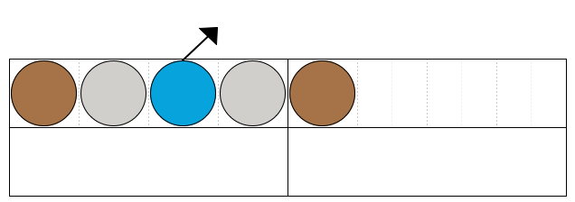
Game 5
Singing Game
Whole group to start with
In D Major using D, E, F#, G, A – sing the numbers.
1
1-2-1
1-2-3-2-1
1-2-3-4-3-2-1
1-2-3-4-5-4-3-2-1
Then in pairs using the following rhythm ask pupils to create their own tunes singing the numbers
You can extend this activity to use all the notes of D Major

Slide 11
Other things to introduce
Similar games can be introduced for traditional folk music from different countries, particularly ceilidh music.
Go into the history of the music and the composer
Find the common rhythms with other pieces

Slide 12
Worksheet
Download the Figurenotes Hoe-Down resources for help with learning the melody
Take a look at the other resources available via the BBC Ten Pieces website or the Figurenotes Resource Base
www.figurenotes.org

