Slide 1
Copland
Rodeo – Hoedown
Secondary classroom lesson plan
Written by
Rachel Leach
Notes:
For:
Key Stage 3 in England, Wales and Northern Ireland
Third and Fourth Level, S1-S3 in Scotland

Slide 2
Lesson outcomes
After this lesson, pupils will be able to:
listen and reflect on a piece of orchestral music
create their own piece of music using instruments and voice
perform as an ensemble
learn musical language appropriate to the task
Notes:
Resources required
A large, open space
Classroom percussion instruments and any other instruments your children might be learning
This scheme of work is plotted out over six lessons. Feel free to adapt it to suit your children and the resources you have available.
The six lessons at a glance
Lesson 1:
Activities: Watch the film and discuss
Copy back gestures and rhythms
Follow signals
Curriculum link: Play and perform in a range of solo and ensemble contexts using their voice, playing instruments musically, fluently and with accuracy and expression
Identify and use the interrelated dimensions of music expressively and with increasing sophistication, including use of tonalities, different types of scales and other musical devices
Listen with increasing discrimination to a wide range of music from great composers and musicians
Develop a deeper understanding of the music that they perform and to which they listen and its history
Lesson 2:
Activities: Copy, invent and play back melodies
Curriculum link: Play and perform in a range of solo and ensemble contexts using their voice, playing instruments musically, fluently and with accuracy and expression
Improvise and compose; and extend and develop musical ideas by drawing on a range of musical structures, styles, genres and traditions
Identify and use the interrelated dimensions of music expressively and with increasing sophistication, including use of tonalities, different types of scales and other musical devices
Lesson 3:
Activities: Learn an ostinato
Choose instruments to play it
Curriculum link: Play and perform in a range of solo and ensemble contexts using their voice, playing instruments musically, fluently and with accuracy and expression
Improvise and compose; and extend and develop musical ideas by drawing on a range of musical structures, styles, genres and traditions
Lesson 4:
Activities: Learn an ostinato
Choose instruments to play it
Curriculum link: Play and perform in a range of solo and ensemble contexts using their voice, playing instruments musically, fluently and with accuracy and expression
Improvise and compose; and extend and develop musical ideas by drawing on a range of musical structures, styles, genres and traditions
Lesson 5:
Activities: Invent musical ideas to portray a story
Begin to structure all ideas into a piece
Curriculum link: Play and perform in a range of solo and ensemble contexts using their voice, playing instruments musically, fluently and with accuracy and expression
Improvise and compose; and extend and develop musical ideas by drawing on a range of musical structures, styles, genres and traditions
Lesson 6:
Activities: Structure all ideas into a piece
Perform on pitched and unpitched instruments and voice to an audience
Use technical terminology where appropriate
Curriculum link: Play and perform in a range of solo and ensemble contexts using their voice, playing instruments musically, fluently and with accuracy and expression
Improvise and compose; and extend and develop musical ideas by drawing on a range of musical structures, styles, genres and traditions

Slide 3
Curriculum checklist
Learners will:
play and perform in solo and ensemble contexts, using their voices and playing musical instruments musically, fluently and with accuracy and expression
improvise and compose; and extend and develop musical ideas
use staff and other relevant notations appropriately and accurately
identify and use the interrelated dimensions of music

Slide 4
Glossary of music terms
Term | Definition
Call and response | a musical conversation. An idea is heard and then repeated by a different section of the orchestra or at a different volume
Melody | another word for ‘tune’. A linear line of notes, like a musical sentence
Orchestrate | music ideas are arranged on different instruments rather than played altogether on one
Ostinato | a repeating (often rhythmic) pattern
Program music | music which tells or describes a story, place, external stimulus
Syncopation | the ‘weaker’ or less obvious notes are emphasised. The result is unexpected, often ‘jazzy’ rhythms
Ternary form | ABA – a very popular musical shape which features the opening music returning at the end after a contrasting middle section

Slide 5
Copland – Lesson 1
Watching and listening
Copyright Rachel Leach & BBC
Notes:
Lesson 1: Watching and Listening
Activities: Watch the film and discuss
Copy back gestures and rhythms
Follow signals
Curriculum link: Play and perform in a range of solo and ensemble contexts using their voice, playing instruments musically, fluently and with accuracy and expression
Identify and use the interrelated dimensions of music expressively and with increasing sophistication, including use of tonalities, different types of scales and other musical devices
Listen with increasing discrimination to a wide range of music from great composers and musicians
Develop a deeper understanding of the music that they perform and to which they listen and its history

Slide 6
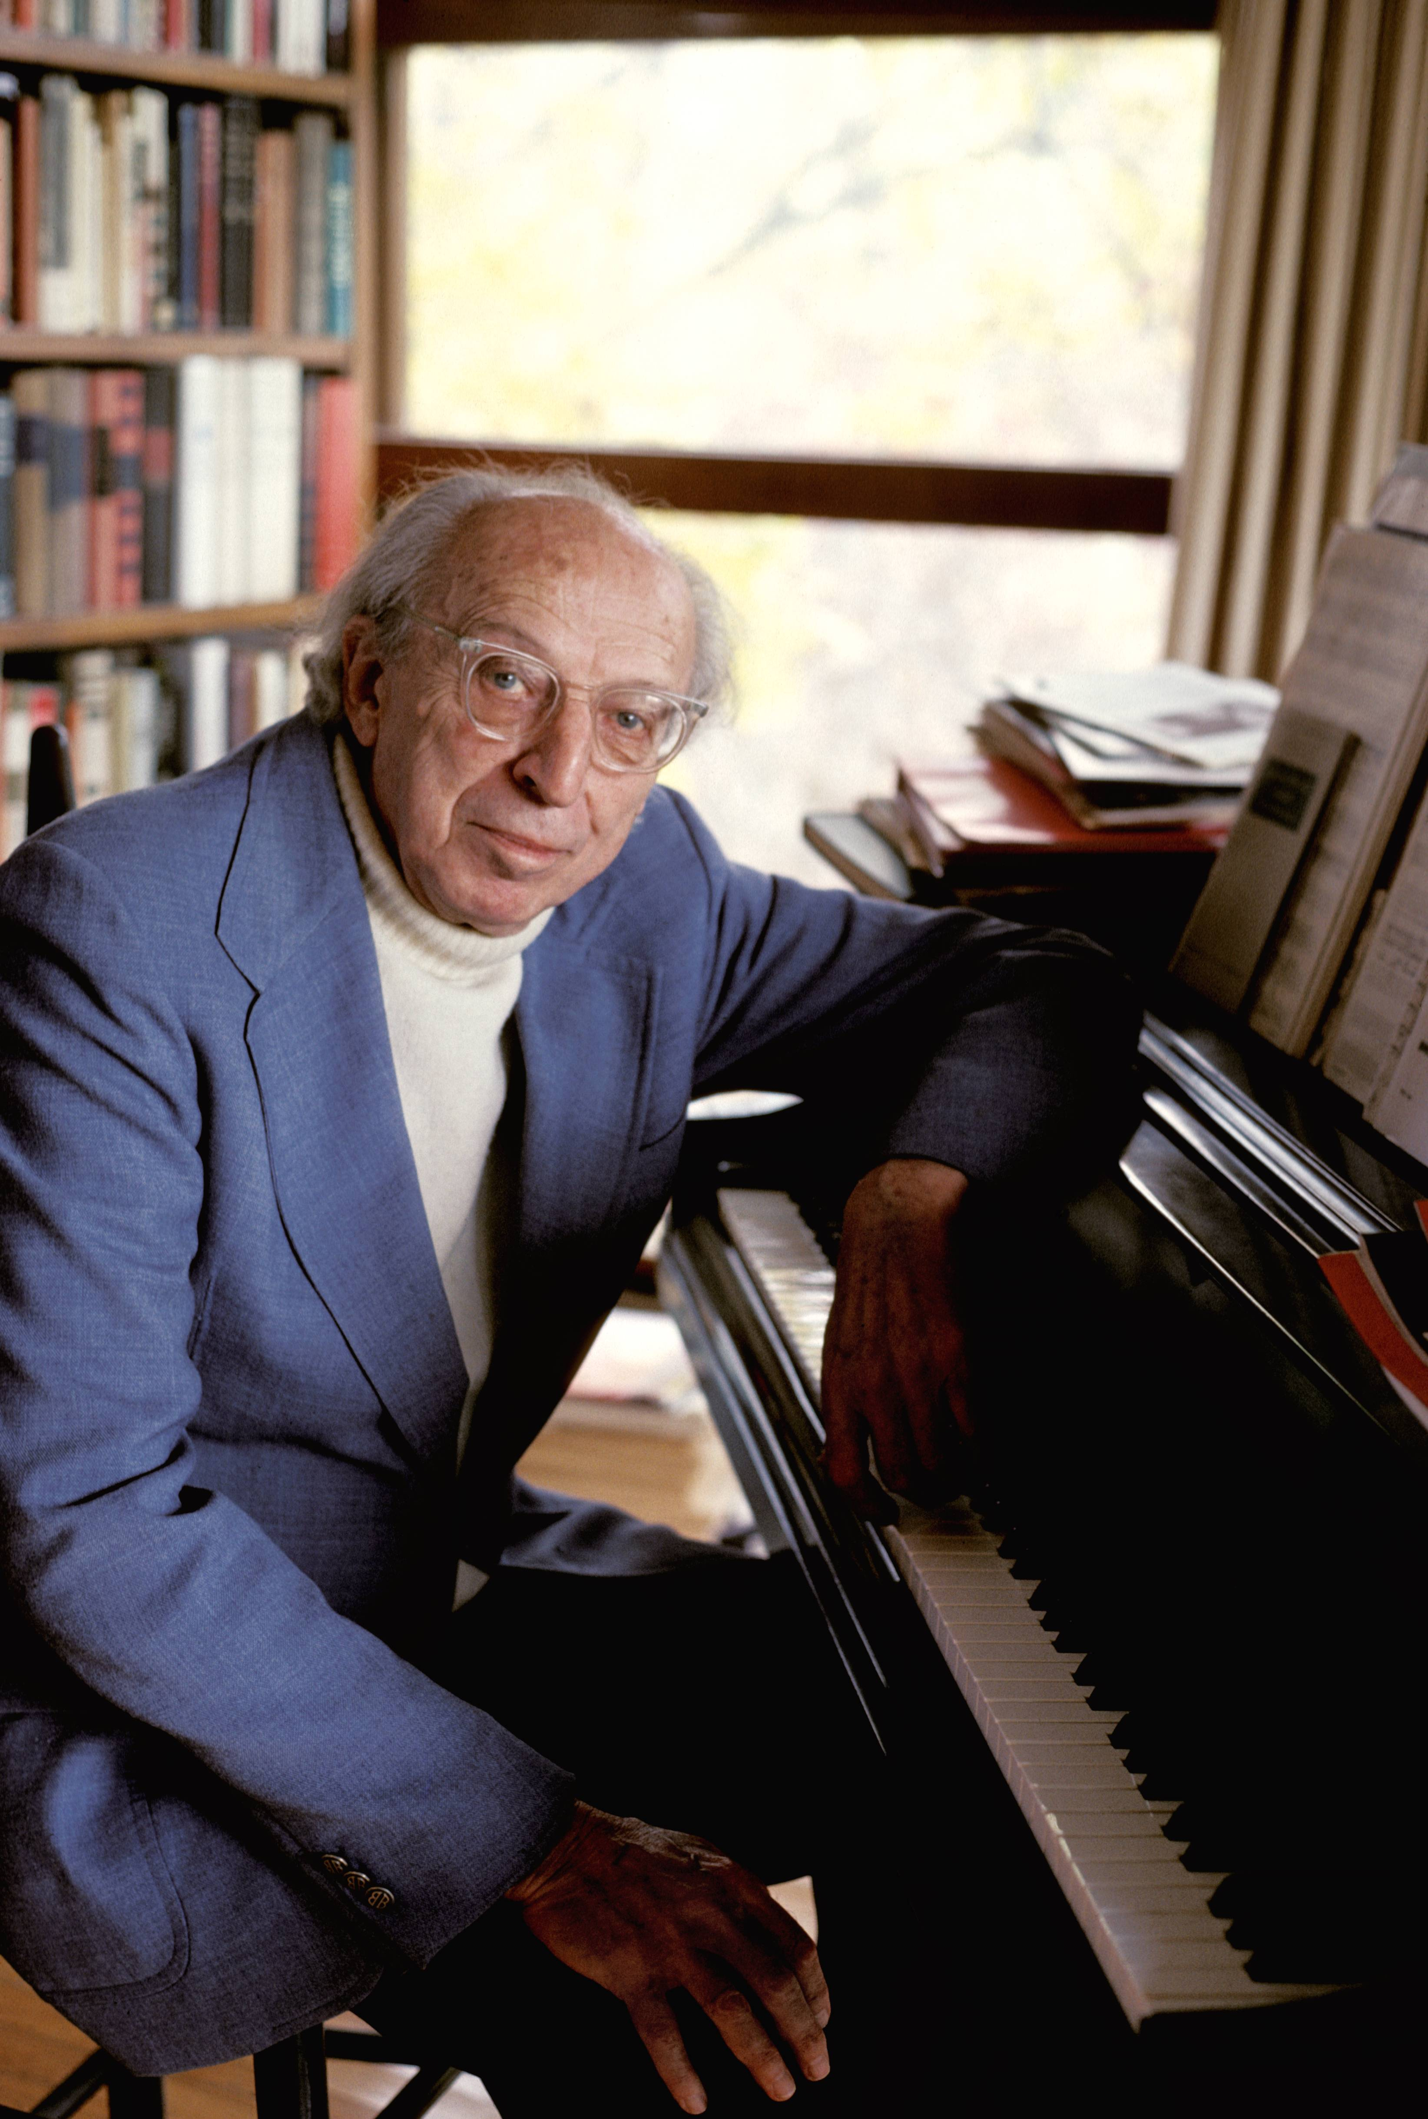
Background – the composer
Aaron COPLAND
(1900–1990)
American composer
Famous for writing music that ‘sounds like America’
PRONUNCIATION:
AIR-uhn KOHP-luhnd
Notes:
Pronunciation: AIR-uhn KOHP-luhnd
-air as in hair
-oh as in no

Slide 7
Background – the music
Rodeo - Hoedown
Written in 1942
‘Rodeo’ is a ballet featuring a story about a cowgirl trying to fit in amongst the men
‘Hoedown’ is the most famous section of music from the ballet and features American folk tunes
A hoedown is traditionally a dance in 2 time and often played by fiddle (violin)
PRONUNCIATION:
roh-DAY-oh
Notes:
Pronunciation:
Rodeo roh-DAY-oh
-oh as in no
-ay as in day
-this reflects the composer’s pronunciation

Slide 8
Get to know Copland’s Rodeo, Hoedown
http://www.bbc.co.uk/programmes/articles/17785e2a-48b0-4d5a-986d-00a093597a61
Notes:
Prepare your class
Explain to your class that you are going to begin a 6-week music project focusing on a fantastic piece of music by an American composer called Aaron Copland.
Explain further that Copland was famous for writing music that sounded like America, and this piece is all about cowboys and cowgirls partying. You may like to encourage your students to research Copland and his music as further research between lessons
Watch the film
Watch the Copland Ten Pieces film (http://www.bbc.co.uk/programmes/articles/17785e2a-48b0-4d5a-986d-00a093597a61) and afterwards have a class discussion about what you have just seen. You might also like to listen to the piece in full. You can either watch the video clip of the full performance of the piece or listen to the audio by downloading the mp3.

Slide 9
Warm-up! Pass the clap and copy me!
Pass the clap
Try standing in a circle and passing a clap around as quickly and smoothly as you can
Copy me
Listen to the pattern I clap and
then copy me
Notes:
Warm-up - clear the classroom and ask your students to stand in a circle. To wake them up, pass a quick clap around the circle.
Explain that many of musical ideas in ‘Hoedown’ are copied back immediately. So, you are going to play a game of ‘copy me’.
Explain that the game starts when you say: ‘copy me’ and finishes when you say: ‘stop’
Say ‘copy me’ and clap a pattern or make a gesture. The students must copy what you do.
When you have done enough, simply say ‘stop’
Play the game again with one (or more) of the students as leader

Slide 10
Copy me on instruments
Choose unpitched percussion and play copy me on your instruments
Take it in turns to have a go at leading
Practise your favourite rhythm and share with the class
Appoint a leader who will signal the start of the pattern
Does anyone know the technical term for ‘copy me’ which Copland uses throughout his Hoedown?
Notes:
Play the game for a third time, this time using instruments. Simply ask your students to choose an unpitched percussion instrument – anything will work. If you don’t have enough for everyone, some students can use body percussion, but do keep switching the instruments around so that everyone gets a turn at some point. (You can also do this activity just with the voice)
Split into small working groups and ask them to play the game again. Everyone should have a go at leading.
After a short time, ask each group to decide on their favourite rhythm or sound from their experimenting and practise it so that they can play it together for the class.
Each team needs to appoint a leader at this point who will signal the start of the pattern. Discourage them from counting in, simply ask them to make sure everyone is watching and begin confidently. If everyone is focused they should come in perfectly after a few tries.
FINALLY – end your session with another class version of the game with each group taking a turn to lead the others using their favourite rhythm or sound.
The technical term for ‘copy me’ is call and response and Copland uses this technique throughout his Hoedown

Slide 11
Copland – Lesson 2
Call and response melodies
Copyright Rachel Leach & BBC
Notes:
Lesson 2: Call and response melodies
Activities: Copy, invent and play back melodies
Curriculum link: Play and perform in a range of solo and ensemble contexts using their voice, playing instruments musically, fluently and with accuracy and expression
Improvise and compose; and extend and develop musical ideas by drawing on a range of musical structures, styles, genres and traditions
Identify and use the interrelated dimensions of music expressively and with increasing sophistication, including use of tonalities, different types of scales and other musical devices

Slide 12
Aaron Copland only used a handful of notes in his tunes - that’s one of the reasons his music is so effective.
You will only be using four or five notes in your pieces too
Notes:
Remind your students of the last session and explain that you are going to work on the ‘copy me’ game again but this time making melodies or tunes. You are going to work on pitched instruments such as xylophones and glocks plus any orchestral instruments that your students might be learning.
Remind your class about Aaron Copland. One of his tricks was to only use a handful of notes in his tunes - that’s one of the reasons his music is so effective. Your students will only be using four or five notes in their pieces too – D, E, F#, A, B:
Split your class into about four groups with a range of instruments in each. If you don’t have enough pitched instruments to go around, use unpitched too, or body percussion/ voice.
Ask each group to play the ‘copy me’ game again using these pitches. Give them at least 5-10 minutes* to do this so that everyone can get a go at leading.
*Working with specific pitches can be difficult so give your students a lot of time for this task and keep checking in on how it’s going. There is no need to play fast, it’s really about getting used to the instruments. If they are encountering problems, encourage them to work with just one pitch and only add the next one when their confidence grows.
FINALLY – bring the class back together and end the session by hearing some of their pieces. You might even like to try one person leading the entire class

Slide 13
Copland – Lesson 3
‘Horse riding’ ostinato
Copyright Rachel Leach & BBC
Notes:
Lesson 3: ‘Horse riding’ ostinato
Activities: Learn an ostinato
Choose instruments to play it
Curriculum link: Play and perform in a range of solo and ensemble contexts using their voice, playing instruments musically, fluently and with accuracy and expression
Improvise and compose; and extend and develop musical ideas by drawing on a range of musical structures, styles, genres and traditions

Slide 14
Do you remember the copy me game?
Notes:
Begin with a reminder of the last lesson and a quick game of ‘copy me’ either on body percussion, voice or instruments and with one of the students leading

Slide 15
Hoedown ostinato
What instruments should play this?
Notes:
Clap the ostinato (repeated rhythmic pattern) and ask your students to copy.
This is a tricky rhythm. It is syncopated i.e. the less important (and unexpected) bits of the bar are made important. If you’re students are learning staff notation, write the rhythm on the board and encourage them to read it.
If not, here’s a method for learning and teaching it –
1. Count to 8 out loud trying to keep a steady pace
2. Shout out the numbers in BOLD and whisper the other numbers
3. Count silently, clapping on the BOLD numbers
4. Replace the numbers with the words, one word on each clap
Ask your students to suggest which instruments should play this. It is going to be the foundation of your piece so it’s very important but it doesn’t need to be too loud and take over.
If they suggest pitched instruments, use the following pitches, D and A (above middle C)

Slide 16
Create a piece of music
In groups create a new short piece which features this ostinato and a call and response melody to perform to the class
Ostinato
Call and response (using
these notes)
Notes:
Split your class back into their small teams and set them the following task –
Make a short piece that features:
This ostinato (unpitched or on D & A)
A call and response melody (using D, E, F#, A, B)
FINALLY - Bring the class back together, hear each team and give feedback.

Slide 17
Copland – Lesson 4
‘Giddy-up’ rhythmic link
Copyright Rachel Leach & BBC
Notes:
Lesson 4: ‘Giddy-up’ rhythmic link
Activities: Learn an ostinato
Choose instruments to play it
Curriculum link: Play and perform in a range of solo and ensemble contexts using their voice, playing instruments musically, fluently and with accuracy and expression
Improvise and compose; and extend and develop musical ideas by drawing on a range of musical structures, styles, genres and traditions

Slide 18
Copland’s rhythmic link
Copland uses this rhythm as a linking device in his piece. No one plays the whole rhythm – it is split across the orchestra.
How could we orchestrate this link?
Notes:
Explain that you are going to learn a new rhythmic pattern today borrowed from Copland.
Copland uses this as a linking device in his piece but no one plays the whole rhythm, it is split across the orchestra.
Ask your class to return to their composing teams from last lesson and get their instruments out. Their task is to ‘orchestrate’ this rhythmic line (i.e. work out who plays what, when). Here are some tips to help:
Split the line up so no one player has to remember the whole thing
Some instruments are better at some things than others. (i.e. a woodblock will sound great on ‘giddy up’, a cymbal will sound awful)
If using pitch – D major is a good place to start
A steady pulse throughout will really help to keep everyone together
Use the words for memory and accuracy of rhythm
When this is achieved ask the groups to decide how many times they want to play it and practise this.
FINALLY – if there is time, encourage your groups to revisit their piece from last session and begin to think about how to order the two sections
You might want to continue this project working towards one, full class piece and use this rhythm as a link between groups. If so, create a class version of it at this stage and decide how many times it is played back to back

Slide 19
Copland – Lesson 5
The story
Copyright Rachel Leach & BBC
Notes:
Lesson 5: The story
Activities: Invent musical ideas to portray a story
Begin to structure all ideas into a piece
Curriculum link: Play and perform in a range of solo and ensemble contexts using their voice, playing instruments musically, fluently and with accuracy and expression
Improvise and compose; and extend and develop musical ideas by drawing on a range of musical structures, styles, genres and traditions

Slide 20
Copland’s Hoedown is from a ballet and is actually describing a small section of the story of that ballet. Music that tells a story is called program music.
During the middle of his piece, Copland slows down the music as the head cowboy approaches the main female character. The music comes to rest on a beautiful Eb major chord which is perhaps the moment when these two characters kiss.
Notes:
Remind your students that Copland’s Hoedown is from a ballet and is actually describing a small section of the story of that ballet. Music that tells a story is called program music
During the middle of his piece, Copland slows down the music as the head cowboy approaches the main female character. The music comes to rest on a beautiful, Eb major chord which is perhaps the moment when these two characters kiss.
Play this section – it comes at around 2’44 in the mp3. Ask your students to try and work out which of the elements that they have been working with is used during this moment. (It is a manipulation of the ‘Giddy up’ rhythm from lesson 4)
Today’s task is to create a short section within their piece to describe this moment and therefore transform their ideas into program music.
Split your class back into their composing groups and ask them to manipulate their ideas to create the moment when the two main characters kiss, or they might choose to create a new bit of story for their piece
FINALLY – encourage your groups to recap all of their ideas so far. This will make your final session a bit less stressful! If working towards one class piece, recap as a class and put together their story ideas into one section that everyone plays.

Slide 21
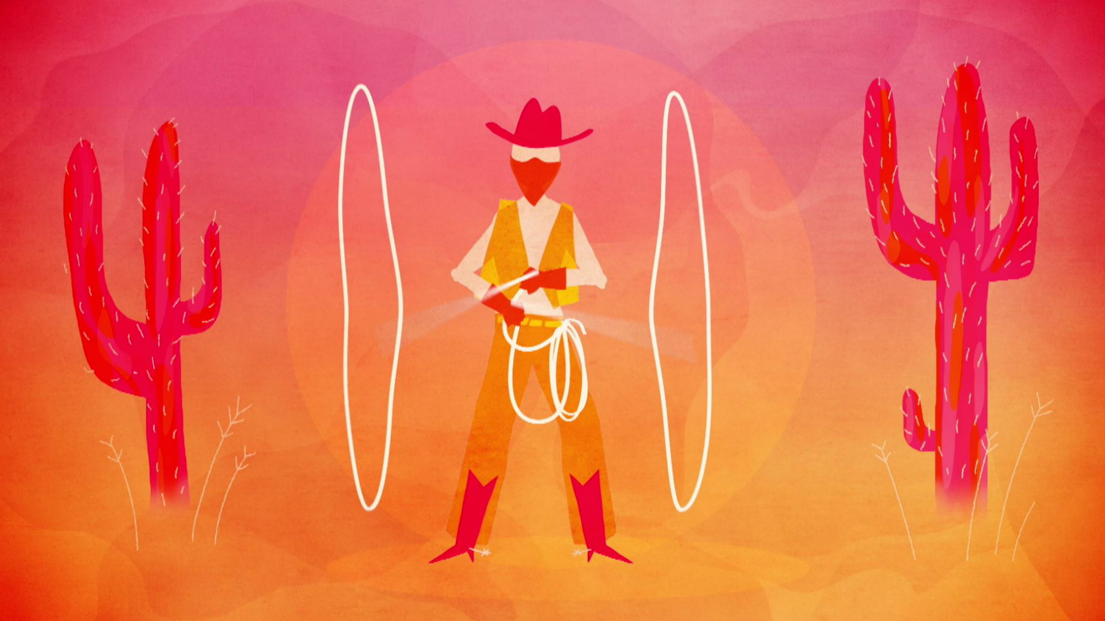
Creating program music
Create a short section within your piece to describe a moment in the story and transform your ideas into program music.
You can create the moment when the two main characters kiss, or create a new part of the story for your piece
Notes:
Today’s task is to create a short section within their piece to describe this moment and therefore transform their ideas into program music.
Split your class back into their composing groups and ask them to manipulate their ideas to create the moment when the two main characters kiss, or they might choose to create a new bit of story for their piece

Slide 22
Reminder of all our ideas
Call and response
The story
‘Horse-riding’ ostinato
‘Giddy up’ rhythmic link
Notes:
FINALLY – encourage your groups to recap all of their ideas so far. This will make your final session a bit less stressful! If working towards one class piece, recap as a class and put together their story ideas into one section that everyone plays.

Slide 23
Copland – Lesson 6
Put it all together
Copyright Rachel Leach & BBC
Notes:
Lesson 6: Put it all together
Activities: Learn to count bars in 3
Perform on pitched and unpitched instruments Structure ideas into a piece
Perform the piece to an audience
Use technical terminology where appropriate
Curriculum link: Play and perform in solo and ensemble contexts, using their voices and playing musical instruments with increasing accuracy, fluency, control and expression
Improvise and compose music for a range of purposes using the interrelated dimensions of music

Slide 24
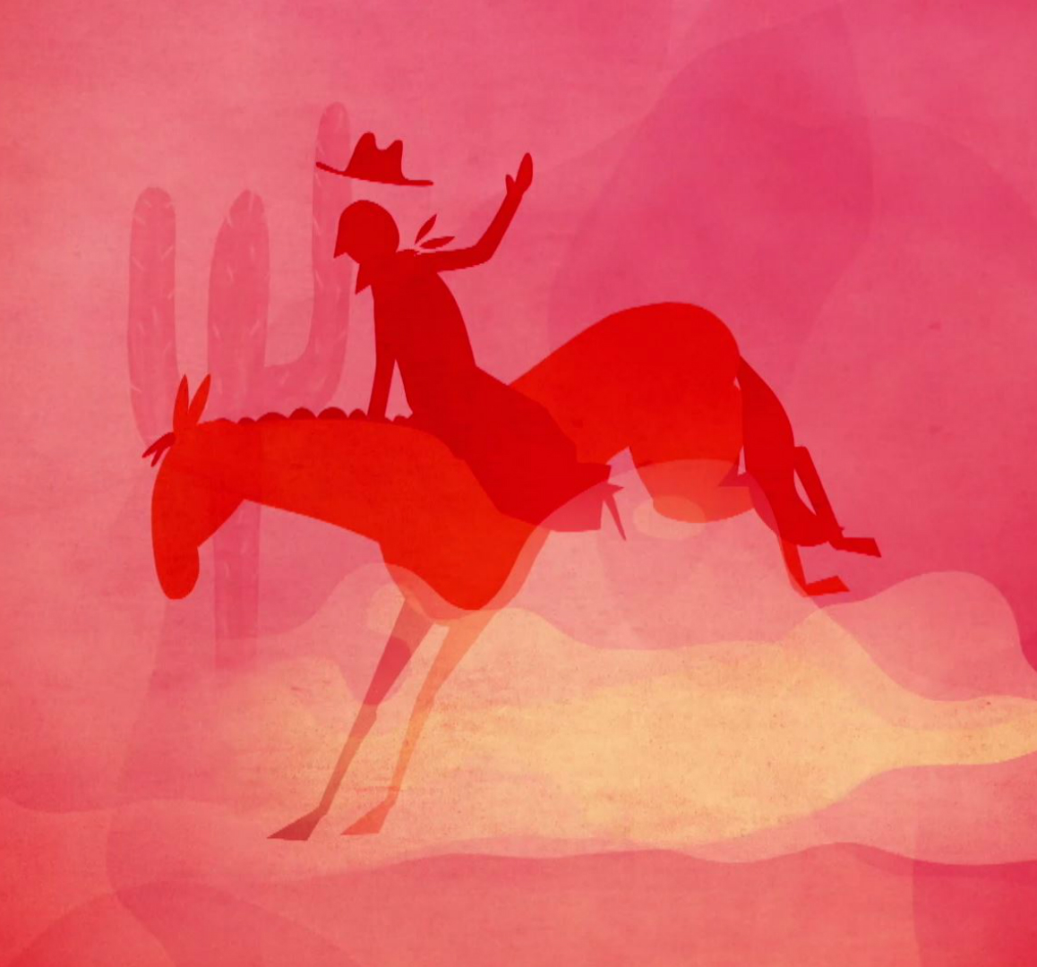
Elements of our piece
Call and response
The story
‘Horse-riding’ ostinato
‘Giddy up’ rhythmic link
Notes:
Remind your students of all the elements of their piece so far:
The call and response technique
The ‘horse riding’ ostinato – practise clapping this and remind them of the notes (D & A)
The ‘giddy up’ link – again, practise clapping this
The ‘story’

Slide 25
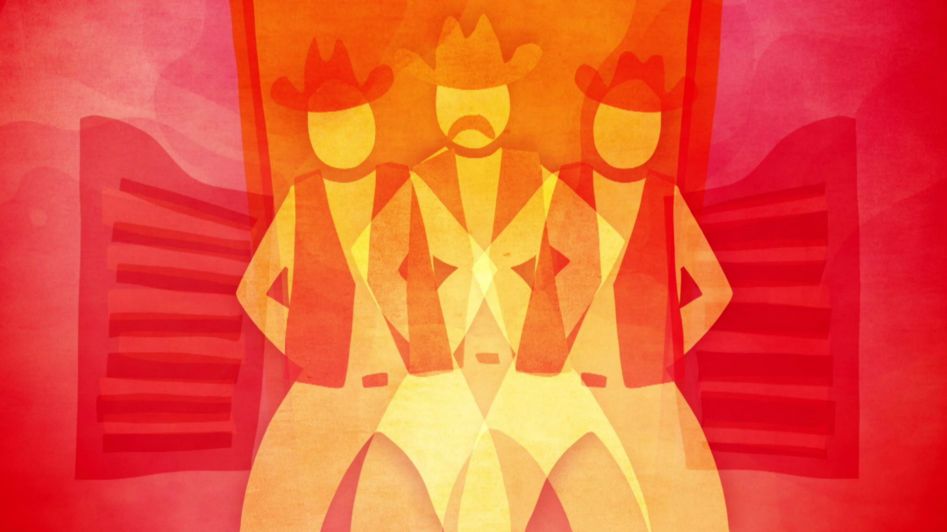
Ternary form
The technical term for a musical shape where the beginning comes back at the end is Ternary form (ABA).
Copland uses Ternary Form (ABA) for his piece. The B section features the ‘giddy up’ rhythm and the kiss. The surrounding A sections feature everything else.
Notes:
Structure
There are two ways forward here:
a. Continue to work separately in the composing groups – each group makes a piece using all the ideas above
b. Work as a full class – perhaps everyone plays the ‘giddy up’ rhythm as a link between group pieces
Either way - Copland uses Ternary Form (ABA) for his piece. The B section features the ‘giddy up’ rhythm and the kiss. The surrounding A sections feature everything else.
Aim to have your piece/s finished about 10 minutes before the end of the session

Slide 26
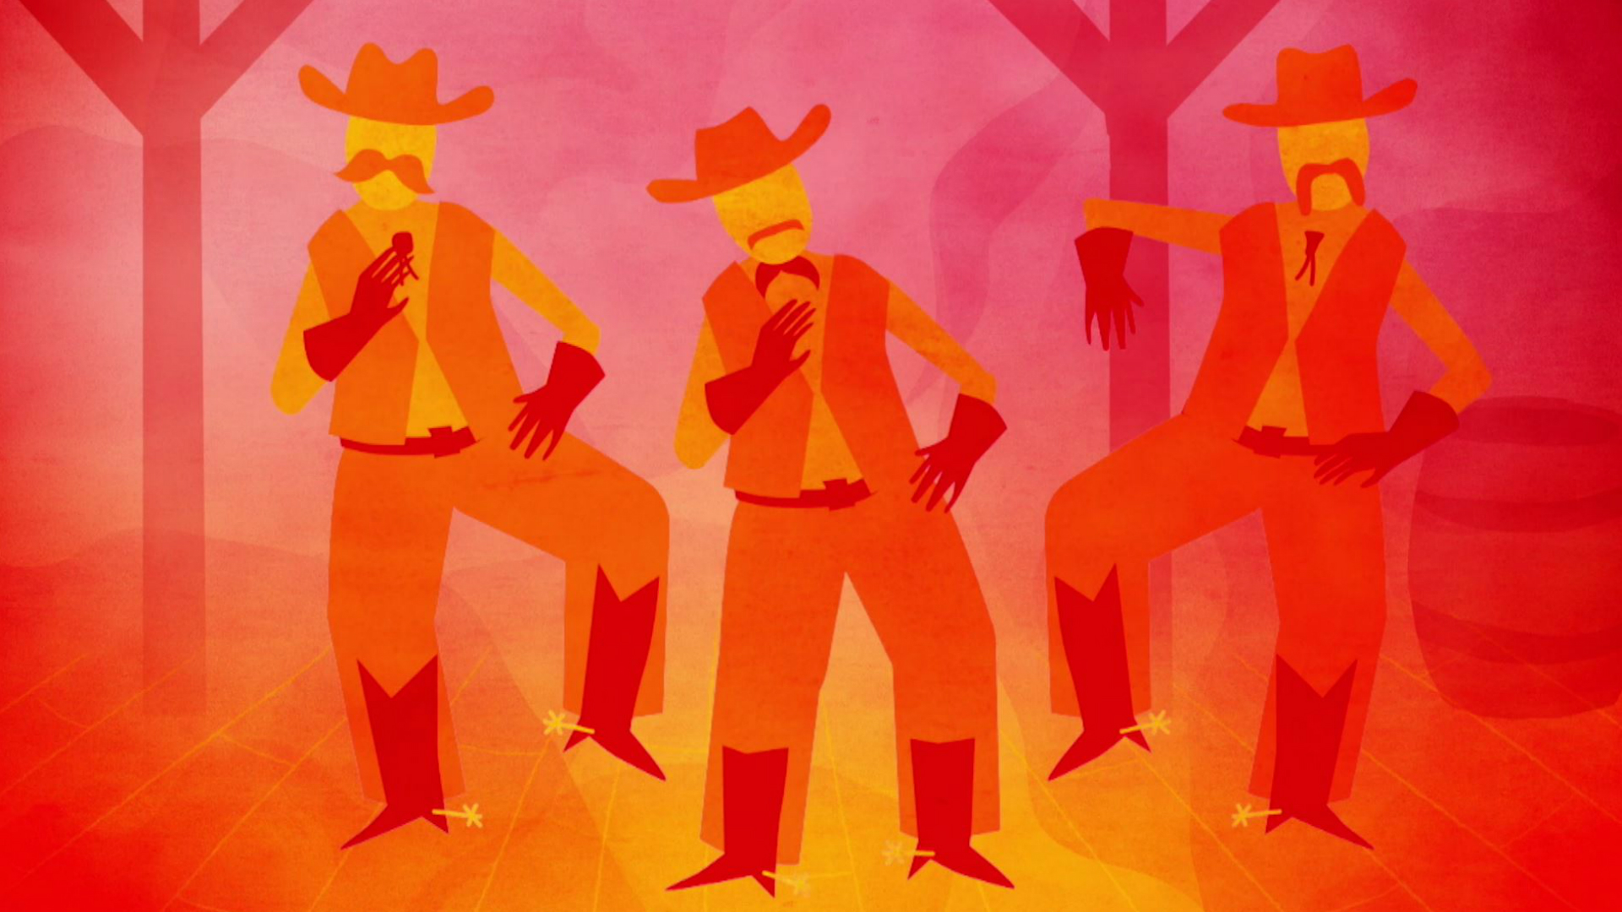
Perform your finished piece
Practise your piece
Perform to the class
How effective was the music at describing the story?
Notes:
FINALLY – end the session and the project with an informal concert of your finished piece/s and discuss how effective the music was at describing the stimulus (a cowboy party) and the story (two characters meet and kiss)

Slide 27
Taking it further – cross-curricular activities
ART/D&T /TEXTILES: Design costumes and stage set for a production of the ballet
DANCE: choreograph a dance to fit with your piece
HISTORY: Several of Copland’s other pieces feature stories from early America. Listen to these pieces (Billy the Kid, Appalachian Spring) and research the true stories behind them

