Slide 1
Mason Bates
Anthology of Fantastic Zoology – Sprite; A Bao A Qu
Primary classroom lesson plan
Written by
Rachel Leach
Notes:
For:
Key Stage 2 in England and Wales
Second Level, P5-P7 in Scotland
Key Stage 1/Key Stage 2 in Northern Ireland

Slide 2
Lesson outcomes
After this lesson, pupils will be able to:
create art-work, poetry and music inspired by a piece of orchestral music
listen and reflect on a work for orchestra
perform as an ensemble
Notes:
Resources required
Art materials such as big paper and pens
Musical instruments of any (every!) kind
This scheme of work is plotted out over six lessons. Feel free to adapt it to suit your children and the resources you have available.
The six lessons at a glance
Lesson 1:
Activities: Listen to a piece of music and create art-work to describe it
Watch the film and discuss
Curriculum link: Listen with attention to detail and recall sounds with increasing aural memory
Appreciate and understand a wide range of high-quality live and recorded music drawn from different traditions and from great composers and musicians
Lesson 2:
Activities: Manipulate words to create new words
Invent and draw animals
Curriculum link: N/A – this is not a music session but could work for art/literacy
Lesson 3:
Activities: Invent a poem based on a stimulus
Curriculum link: N/A – this is not a music session but could work for literacy
Lesson 4:
Activities: Create musical motifs for an imaginary animal
Select appropriate instruments
Structure ideas into a piece
Curriculum link: Play and perform in solo and ensemble contexts, using their voices and playing musical instruments with increasing accuracy, fluency, control and expression
Improvise and compose music for a range of purposes using the interrelated dimensions of music
Lesson 5:
Activities: Create a musical palindrome
Curriculum link: Listen with attention to detail and recall sounds with increasing aural memory
Play and perform in solo and ensemble contexts, using their voices and playing musical instruments with increasing accuracy, fluency, control and expression
Improvise and compose music for a range of purposes using the interrelated dimensions of music
Lesson 6:
Activities: Structure pieces into a concert
Perform in front of an audience
Curriculum link: Play and perform in solo and ensemble contexts, using their voices and playing musical instruments with increasing accuracy, fluency, control and expression
Improvise and compose music for a range of purposes using the interrelated dimensions of music

Slide 3
Curriculum checklist
Learners will:
play and perform in ensemble contexts, using their voices and playing musical instruments
improvise and compose music for a range of purposes using the interrelated dimensions of music

Slide 4
Glossary of music terms
Term | Definition
Motif | a very short musical ‘idea’ – often just a small group of notes or a rhythm
Palindrome | something that is the same forwards as it is backwards
Pitched percussion | percussion instruments that can play different pitches (or ‘notes’) – xylophones, glockenspiels, chime bars etc.
Retrograde | a ‘posh’ word for backwards, often used in music
Unpitched percussion | Percussion instruments that make sounds that don’t have a specific pitch (or ‘note’) – drums, shakers, woodblocks, tambourine etc.

Slide 5
Mason Bates – Lesson 1
Watching and listening
Copyright Rachel Leach & BBC
Notes:
Lesson 1:
Activities: Listen to a piece of music and create art-work to describe it
Watch the film and discuss
Curriculum link: Listen with attention to detail and recall sounds with increasing aural memory
Appreciate and understand a wide range of high-quality live and recorded music drawn from different traditions and from great composers and musicians

Slide 6
Background – the composer
Mason BATES
(born 1977)
American composer
Is becoming famous for mixing different styles of music together, for example – DJ-ing and orchestral music, jazz mixed with techno
Notes:
LESSON 1:Watching and listening
Prepare your class
Explain to your class that you are going to begin a 6-week music project focusing on fantastic music by a living American composer called Mason Bates but at this stage, don’t tell them anything else!

Slide 7
Listen to the piece
Listen to the full orchestral performance of ‘A Bao A Qu’ from Anthology of Fantastic Zoology
As you listen, close your eyes and write down what you imagine
Listen to ‘A Bao A Qu’
Notes:
Listen
Listen to a recording of ‘A Bao A Qu’ without images and ask your children to close their eyes as they listen. Afterwards, ask them ‘what was that music describing?’
After taking a few of their suggestions, tell them that it described an imaginary animal.

Slide 8
Background – the music
‘A Bao A Qu’ and ‘Sprite’ from ‘Anthology of Fantastic Zoology’
Written in 2015
Inspired by Jorge Luis Borges’s ‘Book of Imaginary Beings’ (1957)
‘A Bao A Qu’ is an imaginary breed of snake that slithers up and down the staircase of a famous tower in India
A ‘sprite’ is a fairy-like creature or elf that flies and flickers across water. This one jumps across the orchestra too!
PRONUNCIATION: aa BOW aa KOO
Notes:
Pronunciation:
A Bao a Qu (referring to Mason Bates’ piece) aa BOW aa KOO
-aa as in father
-ow as in now
-k as in king
-suggestion, this reflects the original Spanish pronunciation
Listen
Listen to a recording of ‘A Bao A Qu’ without images and ask your children to close their eyes as they listen. Afterwards, ask them ‘what was that music describing?’
After taking a few of their suggestions, tell them that it described an imaginary animal.
Give out paper, pencils and coloured pens. As you listen again, ask your children to draw the animal they think is being portrayed by the music. Remind them that it is an imaginary animal so they are free to invent something new however, the ‘A Bao A Qu’ is based on a real animal…. Can they guess which one?

Slide 9
Listen and draw
Listen again to the full orchestral performance of ‘A Bao A Qu’
As you listen, draw pictures of the animal
What will you call the animal? Give it a name.
Listen to ‘A Bao A Qu’
Notes:
Listen once again and this time challenge your children to finish their picture and give their animal a name. They should write this name on their picture along with what the animal is doing -
i.e. ‘the cat-snake eats a strawberry’
Have a look at the artwork and encourage a few volunteers to come forward and share their pictures and ideas with the class
If you have time, you might like to repeat this activity with the ‘Sprite’ recording. The ‘Sprite’ is like a small fairy flying across the orchestra

Slide 10
Get to know Mason Bates’s ‘A Bao A Qu’
http://www.bbc.co.uk/programmes/articles/5t3vS7Bk966KKlJrGns66RP
Notes:
FINALLY – end your lesson by watching the Mason Bates Ten Pieces film (http://www.bbc.co.uk/programmes/articles/5t3vS7Bk966KKlJrGns66RP) which reveals what the animal is and its actions. Afterwards have a quick class discussion about what you have just seen. Ask the following questions –
Did you like the film?
Did anyone guess that the animal is a kind of snake slithering up and down a tower?

Slide 11
Mason Bates – Lesson 2
Imaginary animals
Copyright Rachel Leach & BBC
Notes:
Lesson 2:
Activities: Manipulate words to create new words
Invent and draw animals
Curriculum link: N/A – this is not a music session but could work for art/literacy

Slide 12
Today is all about inventing imaginary animals
The book
of
Imaginary Beings
Notes:
LESSON 2
Imaginary animals
For this task you will need some art materials – big paper, coloured pens or crayons, or perhaps paint!
Prepare your class. Give out paper and art materials to everyone and make sure you have lots of space to work in.
Remind them about Bates’ piece and the A Bao A Qu – a snake-like creature who climbs up and down a tower. You can either watch the video clip of the full performance of the piece or listen to the audio by downloading the mp3.This animal was invented by an Argentine writer called Jorge Luis Borges. He invented 120 animals and wrote all about them in his ‘Book of Imaginary Beings’.
Today is all about inventing imaginary animals.

Slide 13
Create an imaginary animal name
Think of a real animal: _______________
Think of another animal:
_________________
Divide these animal names up into syllables:
___ ___ ___ ___ ___ ___ ___
Notes:
Demonstrate the following method to your class –
Ask them to think of a real animal. Take the first suggestion and write it on the board
E.g.: ‘Tarantula’
Ask them for a second, contrasting animal, write this on the board too
E.g.: ‘Elephant’
Divide these words up so that you can see the syllables –
TU-RAN-TU-LA EL-E-PHANT
Ask your children to choose syllables from both words and put them together to make a new word
E.g.: ‘TU-LA-PHANT’
You have created a new animal - a cross between a tarantula and an elephant. Ask a volunteer to come forward and draw this amazing creature on the board and have a quick chat about what the tulaphant does and eats, where does she live etc.?

Slide 14
Create an imaginary animal name
Choose a mix of random syllables from each word:
___ ___ ___ ___ ___ ___ ___
2) Put them in a random order to create a new word:
___ ___ ___ ___
Notes:
Demonstrate the following method to your class –
Ask them to think of a real animal. Take the first suggestion and write it on the board
E.g.: ‘Tarantula’
Ask them for a second, contrasting animal, write this on the board too
E.g.: ‘Elephant’
Divide these words up so that you can see the syllables –
TU-RAN-TU-LA EL-E-PHANT
Ask your children to choose syllables from both words and put them together to make a new word
E.g.: ‘TU-LA-PHANT’
You have created a new animal - a cross between a tarantula and an elephant. Ask a volunteer to come forward and draw this amazing creature on the board and have a quick chat about what the tulaphant does and eats, where does she live etc.?

Slide 15
Draw your imaginary animal
You have now created a new animal:
_______________
Draw it here:
Notes:
Demonstrate the following method to your class –
Ask them to think of a real animal. Take the first suggestion and write it on the board
E.g.: ‘Tarantula’
Ask them for a second, contrasting animal, write this on the board too
E.g.: ‘Elephant’
Divide these words up so that you can see the syllables –
TU-RAN-TU-LA EL-E-PHANT
Ask your children to choose syllables from both words and put them together to make a new word
E.g.: ‘TU-LA-PHANT’
You have created a new animal - a cross between a tarantula and an elephant. Ask a volunteer to come forward and draw this amazing creature on the board and have a quick chat about what the tulaphant does and eats, where does she live etc.?

Slide 16
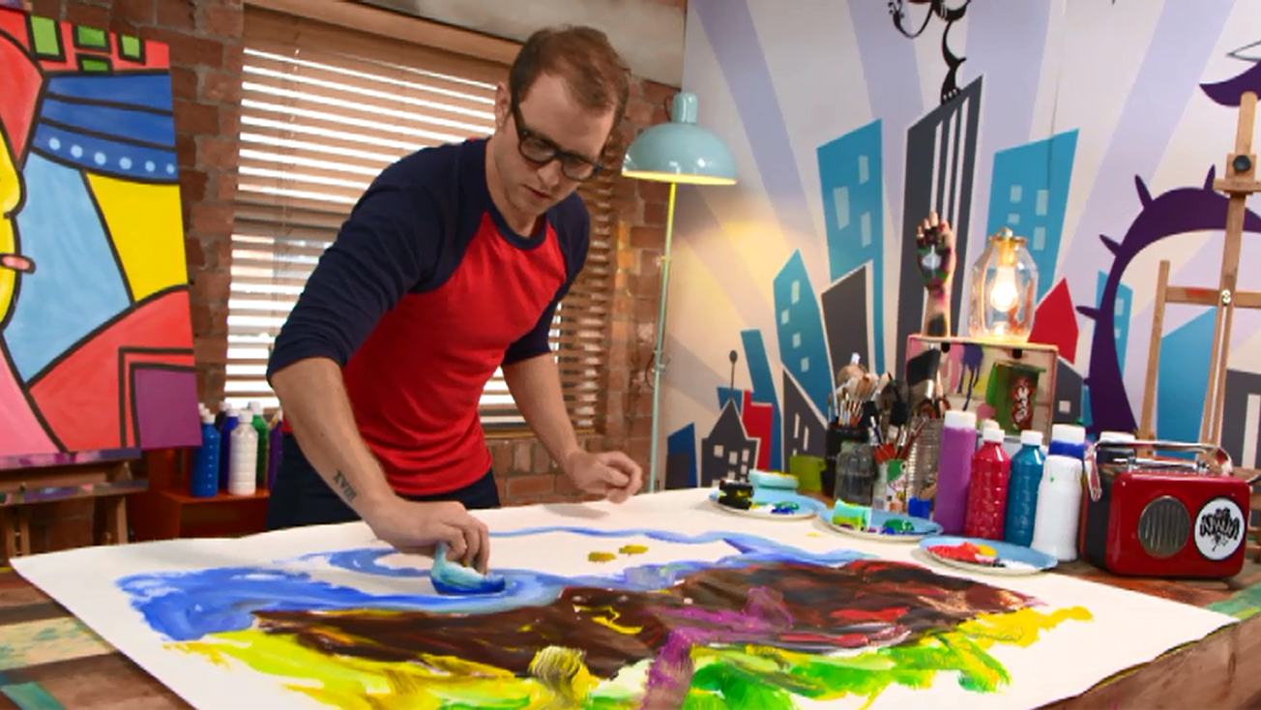
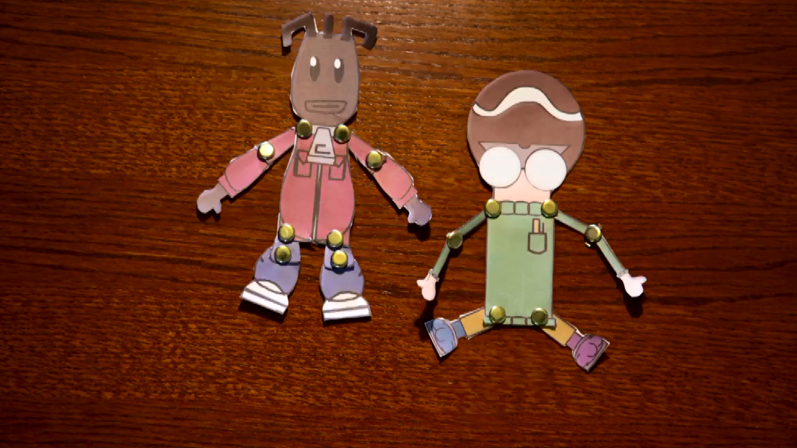
Create more imaginary animals
Draw and stick them up around the room.
You can watch our Art and Digital Art masterclasses for more ideas.
Notes:
Challenge your children to make their own imaginary animals using the same method and then to draw them. This can be done individually or in groups of 3 (you will need to split into groups of 3 later in the project)
A fun way to do this with children new to syllables is to write the words very large on a sheet of A4 with the letters spaced out. Then, cut the paper where the syllables change so that you have each syllable on a different piece. The child can then physically arrange the syllables and try out lots of different options
You might even want to watch some of the other Ten Pieces masterclasses for Digital Art – http://www.bbc.co.uk/programmes/p027wsnz - and our Art Masterclass with the Art Ninja - http://www.bbc.co.uk/programmes/p0282x1z
FINALLY – finish the session with an exploration of the new animals your children have invented. Perhaps place their artwork in the middle of the room and have everyone walk around and look at it as if in a gallery.

Slide 17
Mason Bates – Lesson 3
Animal poems
Copyright Rachel Leach & BBC
Notes:
Lesson 3:
Activities: Invent a poem based on a stimulus
Curriculum link: N/A – this is not a music session but could work for literacy

Slide 18
Let’s find out more about your animals
Think about the animals you created and write down the following about them:
Three colours
Three things the animals does
Three sounds the animal makes
Three emotions the animal feels
Three things in the animal’s world (i.e. his home, food, view)
Three other characteristics
Notes:
LESSON 3
Animal poems
Prepare your class – children should again work either individually or in groups of three for this activity.
Remind your class about the work they did on imaginary animals last lesson and give out their artwork and more paper and pens
Explain that you would like to find out all about their imaginary animals. Ask them to write down the following –
Three colours
Three things the animals does*
Three sounds the animal makes*
Three emotions the animal feels
Three things in the animal’s world* (i.e. his home, food, view)
Three other characteristics
*These could be inspired by the ‘real’ animals used to make up the imaginary one -
I.e. a tarantula creeps, an elephant ‘trumpets’
You don’t have to do all of these and you could adapt them to fit with other areas you are studying. I.e. for a more literacy based task, ask for 3 nouns, 3 adjectives etc. You could also ask for words that rhyme

Slide 19
Make an animal poem
Can you use your descriptions to create a poem about your animal?
Here’s a suggested structure to help you put it together:
The (animal) (verb) like a (noun)
S/he is (colour)/has (emotion)
(Adverb), the (animal) (sounds)
The (animal) is (adjective)
Notes:
Challenge your children to fashion these words into a three-line poem about their animal. To do this they must discard some of their words.
You might like to give them a template for this such as:
The (animal) (verb) like a(noun)
S/he is (colour)/has (emotion) (Adverb), the (animal) (sounds)
The (animal) is (adjective)
You could ask for a particular poetry structure such as haiku, or technique such as alliteration, acrostic. You can make this task fit with whatever you are studying in literacy
If time permits, ask your children to add their poem to their artwork in a clever way – i.e. can they make the words swirl around their picture or hide them within?

Slide 20
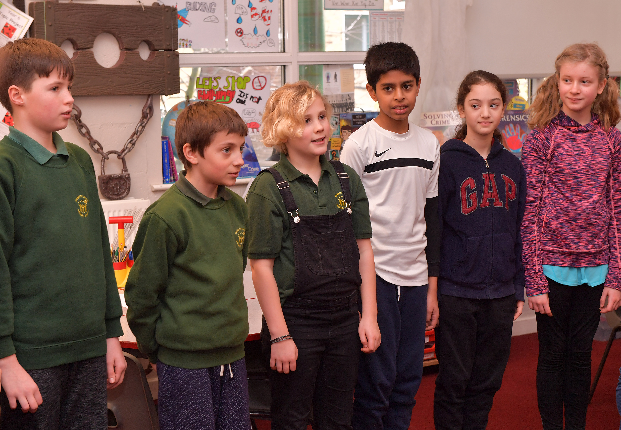
Poetry recital
Recite your poem to the rest of the class
Notes:
FINALLY – have a poetry recital. Ask volunteers to come forward and share their poetry with the class for feedback and discussion

Slide 21
Mason Bates – Lesson 4
The three ideas – musical animal
Copyright Rachel Leach & BBC
Notes:
Lesson 4:
Activities: Create musical motifs for an imaginary animal
Select appropriate instruments
Structure ideas into a piece
Curriculum link: Play and perform in solo and ensemble contexts, using their voices and playing musical instruments with increasing accuracy, fluency, control and expression
Improvise and compose music for a range of purposes using the interrelated dimensions of music

Slide 22
Warm up! Pass a clap around the circle in a similar way to the ‘Sprite’
Notes:
LESSON 4
The three ideas - musical animal
For this lesson, you will need instruments – anything will do, pitched, unpitched, orchestra or even homemade! And your children should be split into groups of 3. If they haven’t been in groups so far, ask them to pool the animals they have created and choose their favourite to work with from now onwards
Warm-up. Clear your classroom and sit the children in a circle on the floor. Begin with a fun focusing warm up.
If you have listened to Bates’ other piece ‘Sprite’, you can quickly recreate it by passing a clap around the circle, then a short burst of claps and then other ideas suggested by your children - just as Bates passes musical ideas across the orchestra.

Slide 23
Let’s turn your imaginary animals into music
Using your own invented animal:
Choose three things that the animal does:
E.g. He blasts a trumpety sound
He creeps
He shakes his head
Invent a short musical sound (motif) for each of these things:
A blast from a real trumpet
Very soft footsteps on a drum
A loud shake on a tambourine
Notes:
Explain that you are going to turn the imaginary animals into music.
Demonstrate the following method to the class using your own invented animal – e.g. the tulaphant from earlier.
Choose three things that the tulaphant does -
He blasts a trumpety sound
He creeps
He shakes his head
Invent a short musical sound (motif) for each of these things (choose three children to help you, one on each instrument/ sound) -
A blast from a real trumpet
Very soft footsteps on a drum
A loud shake on a tambourine
Put these short sounds together to make a short piece that describes your animal, thinking carefully about the order
Mason Bates’ piece features just three ideas too – a waltz rhythm (is the A Bao A Qu dancing?), upward sounds (The A Bao A Qu is climbing), a shaking sound (The A Bao A Qu sheds its skin)

Slide 24
Turn your three ideas into a piece
Mason Bates’s piece features just three ideas too:
a waltz rhythm (is the ‘A Bao A Qu’ dancing?)
upward sounds (the ‘A Bao A Qu’ is climbing)
a shaking sound (the ‘A Bao A Qu’ sheds its skin)
In groups of three, pick one of your imaginary animals
Split the animal’s motifs between the three of you
Notes:
Mason Bates’ piece features just three ideas too – a waltz rhythm (is the A Bao A Qu dancing?), upward sounds (The A Bao A Qu is climbing), a shaking sound (The A Bao A Qu sheds its skin)
Split your class into groups of 3. Ask them to create a short piece of music using this method and focusing on just one animal. Each child in the group plays one instrument and one motif
FINALLY – hear your groups one by one. To save time and energy, simply give the groups an order which circles around the room and ask them to play in turn without leaving a gap for applause. Groups should simply nod to each other when they are done. This will get through them quicker, give you a rest from having to think up feedback and keep the focus of the children as they wait their turn.

Slide 25
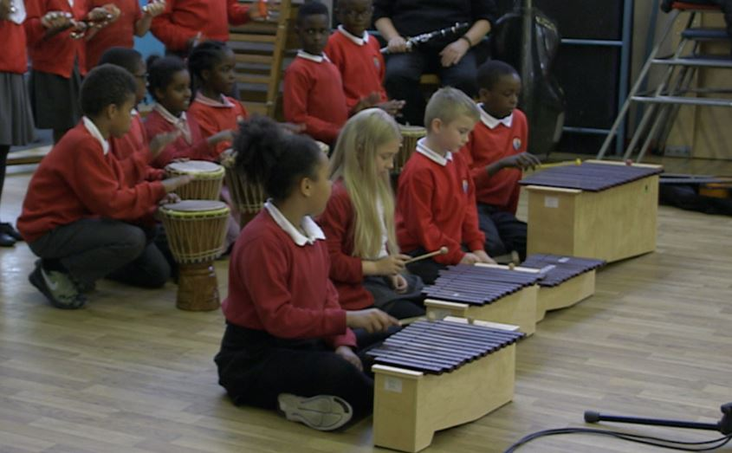
Perform your piece
Play your piece of three motifs to the rest
of the class:
Notes:
Mason Bates’ piece features just three ideas too – a waltz rhythm (is the A Bao A Qu dancing?), upward sounds (The A Bao A Qu is climbing), a shaking sound (The A Bao A Qu sheds its skin)
Split your class into groups of 3. Ask them to create a short piece of music using this method and focusing on just one animal. Each child in the group plays one instrument and one motif
FINALLY – hear your groups one by one. To save time and energy, simply give the groups an order which circles around the room and ask them to play in turn without leaving a gap for applause. Groups should simply nod to each other when they are done. This will get through them quicker, give you a rest from having to think up feedback and keep the focus of the children as they wait their turn.

Slide 26
Mason Bates – Lesson 5
Musical palindromes
Copyright Rachel Leach & BBC
Notes:
Lesson 5:
Activities: Create a musical palindrome
Curriculum link: Listen with attention to detail and recall sounds with increasing aural memory
Play and perform in solo and ensemble contexts, using their voices and playing musical instruments with increasing accuracy, fluency, control and expression
Improvise and compose music for a range of purposes using the interrelated dimensions of music

Slide 27
Listen/watch the Bates introduction film again
Can you hear the palindrome (same forwards as backwards)?
Can you turn your musical piece into a palindrome? (It might help to write down the structure)
The musical term for going backwards is retrograde
F O R W A R D S
S D R A W R O F
Notes:
LESSON 5
Musical palindromes
Warm-up – begin in a large circle with a quick focusing activity and reminder of what happened during the last session.
Split back into groups and get the instruments out. Allow the children to have a few minutes remembering their piece so far. Give them a short amount of time to do this to avoid too much confusion
Listen to the recording of Bates’ piece again, or watch the film. Remind your children that his piece is a palindrome and what one is (i.e. the same forwards as backwards). Ask your composing groups to transform their musical animals into a palindrome too. To do this they must make sure the order of events is clear (maybe they could write this down), where the middle point is, and then figure out how to perform the ideas in reverse order
The musical term for ‘going backwards’ is retrograde
There are several ways of going backwards in music. You can faithfully play everything backwards - rhythms, melodies and rests all therefore in a different order (as in Bates’ piece). Or, much easier, you can just run the order of events backwards but leave the content of each event the same (so rhythms and melodies remain the same, it is just the order that they appear that is different)

Slide 28
Stuck in the middle?
What do you want the middle of your palindrome to sound like?
What sound will represent your animal turning backwards?
Try bringing it all together and perform your piece
M
I
D
D
L
E
F O R W A R D S
S D R A W R O F
Notes:
When this is achieved (don’t worry if it takes the rest of the session to do this – it is a tricky task!), ask each group to invent a short motif, perhaps played by the full group, for the middle of their palindrome that describes what the animal is doing before s/he turns backwards. (In Mason’s piece there is a long slithering sound as the A Bao A Qu sheds his skin). Your children may choose to select an idea from their poems or drawings that they haven’t yet explored.
FINALLY – again, finish the session with a performance from all the groups and allow the rest of the class to give feedback, especially on the palindrome shapes. Also, begin to discuss the order of these pieces paying particular attention to the first one (who has a good beginning?) and the end (who has the best ending?)

Slide 29
Mason Bates – Lesson 6
Create a musical zoo!
Copyright Rachel Leach & BBC
Notes:
Lesson 6:
Activities: Structure pieces into a concert
Perform in front of an audience
Curriculum link: Play and perform in solo and ensemble contexts, using their voices and playing musical instruments with increasing accuracy, fluency, control and expression
Improvise and compose music for a range of purposes using the interrelated dimensions of music

Slide 30
Create a musical zoo from your pieces, art-work and poems!
Get back in your teams and practise your pieces
Find a way to incorporate your poems into it
Think about the art-work – how can you incorporate that into your performance?
Notes:
LESSON 6
Create a musical zoo!
This session is all about making a performance out of your pieces, art-work and poems. You may like to work in a large space for this such as the hall and do remember invite an audience!
Prepare your class. Tell them that you are going to create a musical zoo from their pieces. It will feature their poetry, artwork and music
Split back into groups and give each team a short amount of time to remember and practice their piece from last lesson. They should also find a way of incorporating their poem – should this be read by one person or shared amongst the team? Should it come before, after or during the music?
Hear all the pieces one by one and discuss the order. Appoint team members to take charge of signaling the end of their piece to the following team (i.e. by pointing or nodding). Also spend some time organizing the children into a shape that is audience friendly. This is often a large semi-circle, but you might want to dot the groups around the space and have the audience wander amongst them like in a real zoo
Think about the art-work. Where should this go? Should it be held up before each musical piece as the name is announced, placed on the floor in front of your orchestra or pinned onto the wall behind them?

Slide 31
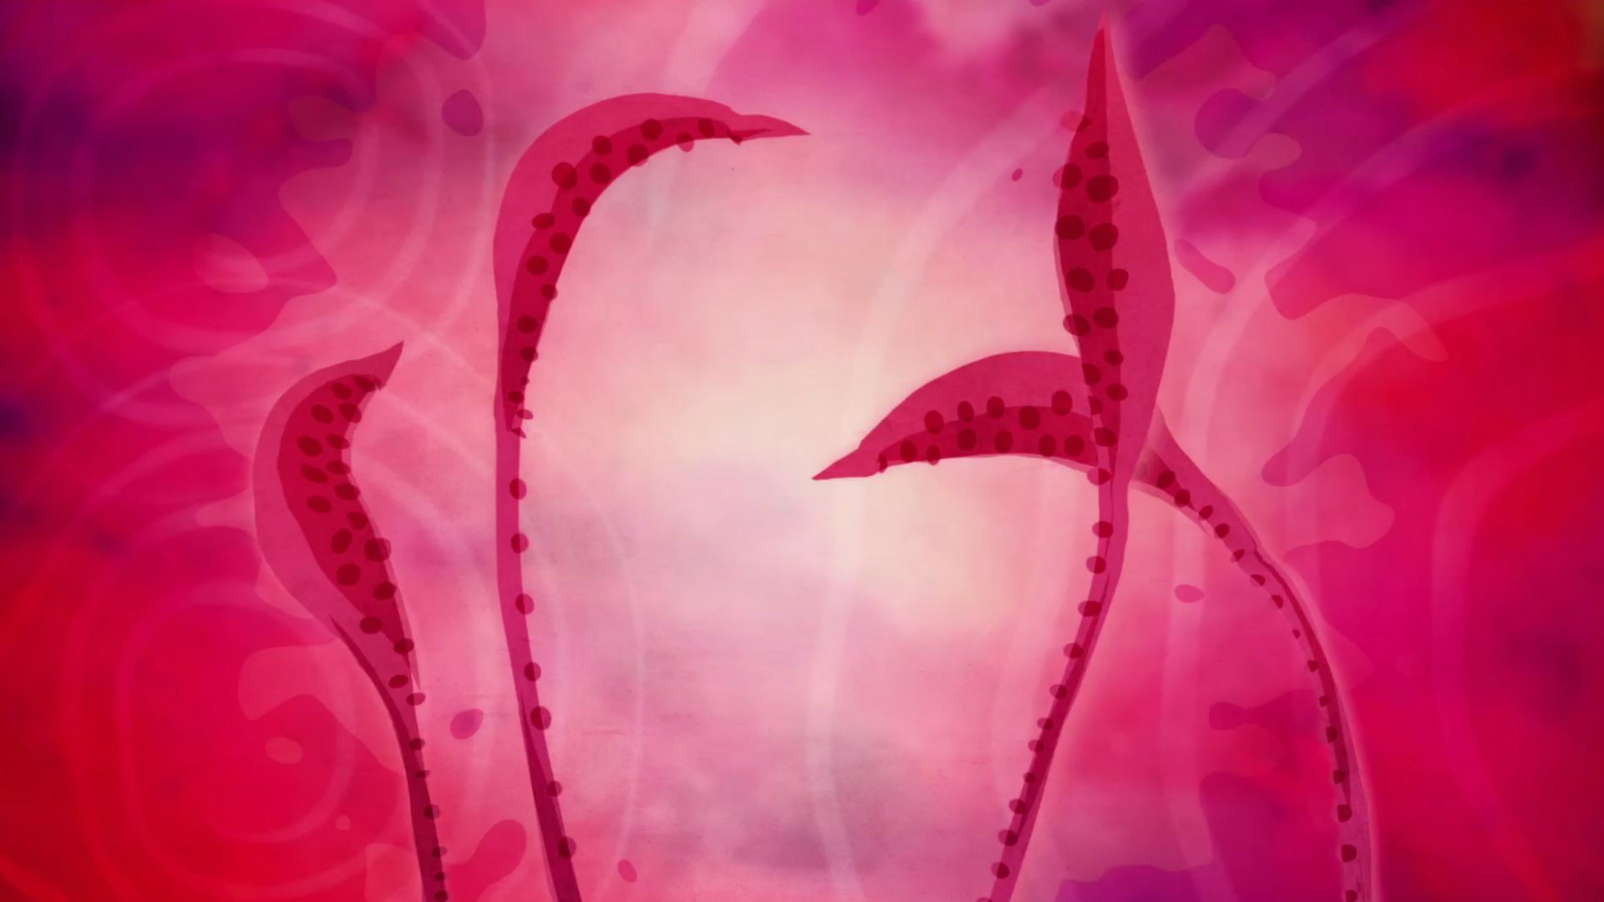
Bring all the elements of your musical zoo together
Arrange yourselves in a shape to best showcase your musical zoo
Perform/display your musical zoo to an audience
Notes:
FINALLY – end this project with a performance of your musical zoo of imaginary creatures to an invited audience

Slide 32
Taking it further : Cross-curricular activities
ART: Draw re-imaginings of your imaginary animals and/or design a programme/leaflet for your final performance
MUSIC: Listen to the other sections of Bates’s piece – there are 11 movements/animals in total. Or listen to some other musical animals – Malcolm Arnold and Camille Saint-Saëns both wrote ‘Carnival of the Animals’ pieces describing (mostly) real animals
RESEARCH: Jorge Luis Borges‘s book features 250 creatures for you to draw, write poems about and make into music
SCHOOL JOURNEY: Visit some real animals and be even more inspired!

