Slide 1
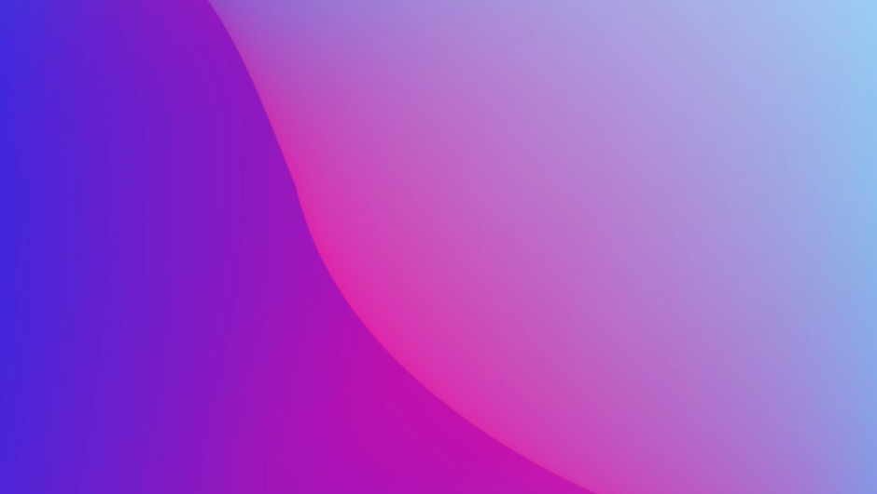
Council Tax
Work in percentages and think about the value of things in comparison to others.
Consider everyone in the community as well as global and social issues.

