Slide 1
https://www.bbc.co.uk/bitesize/articles/zrsdmbk
Notes:
TEACHER NOTES
Have your students complete the quiz (linked) before the lesson so they arrive with some knowledge already.

Slide 2
Notes:
TEACHER NOTES
This can be an entry task as your students arrive into the lesson. Get them to match up the statistic to the statement.

Slide 4
Notes:
TEACHER NOTES
This is the lesson's Big Question. Perhaps complete a quick question and response on this before moving on.

Slide 5
Notes:
TEACHER NOTES
Give your students an opportunity to take in or note down the following definitions.

Slide 9
Notes:
TEACHER NOTES
Get your students to discuss whether they think this post is mis- or disinformation.

Slide 11
Notes:
TEACHER NOTES
Get your students to discuss whether they think this post is mis- or disinformation.

Slide 13
Notes:
TEACHER NOTES
Get your students to discuss whether they think this post is mis- or disinformation.

Slide 15
Notes:
TEACHER NOTES
Get your students to discuss whether they think this post is mis- or disinformation.

Slide 19
Notes:
TEACHER NOTES
Give your students an opportunity to discuss what they think.

Slide 20
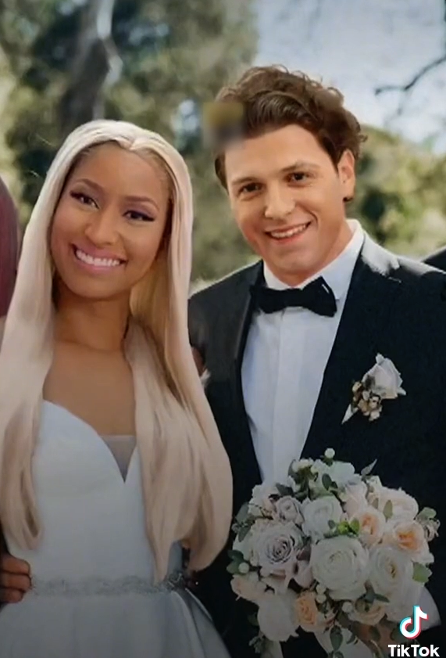

Slide 21
Notes:
TEACHER NOTES
Give your students an opportunity to take in or note down the following information.

Slide 23
Notes:
TEACHER NOTES
There will be a chance to discuss this on the next slide so you don't need to here.

Slide 24
Notes:
TEACHER NOTES
This is quite a structured discussion task. Have your students get into groups of 4 if possible and take on each of the roles. Encourage them to use the verbal sentence starters to bring structure to their debate.

Slide 25
Notes:
TEACHER NOTES
This can be a quiet or silent writing task. Students can use the sentence starters provided but they also have the freedom to write their own response should they wish.

Slide 26
Notes:
TEACHER NOTES
Have students write their answers down or take verbal feedback.

Slide 27
https://www.bbc.co.uk/bitesize/articles/zbwkbqt
Notes:
TEACHER NOTES
Encourage your students to find out more via the link or challenge themselves further by completing the Takeaway Task.

