Slide 1
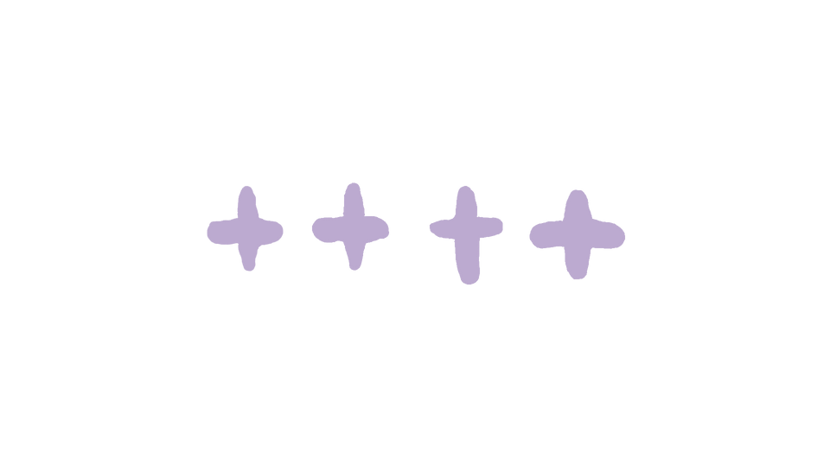
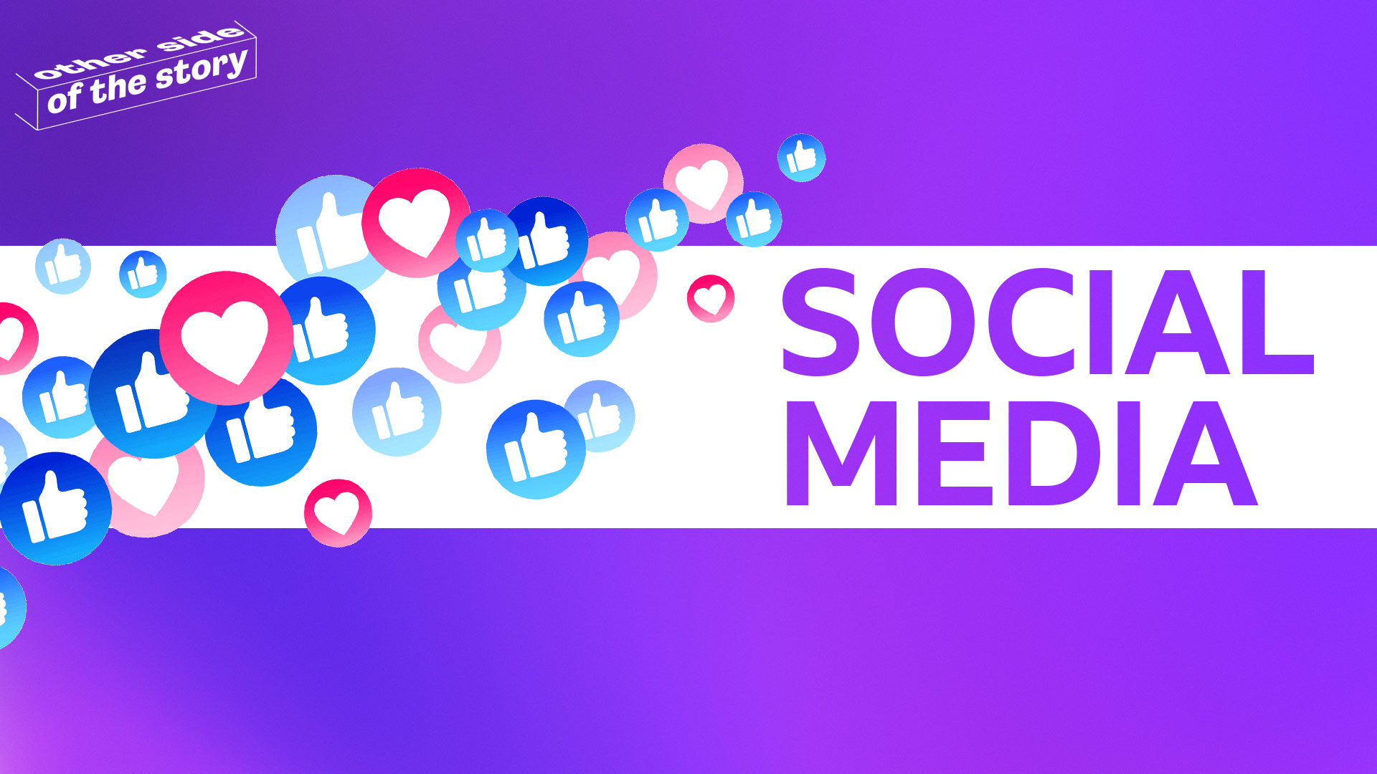



HOW CAN SOCIAL MEDIA IMPACT YOUR VIEWS?

Slide 2


Today’s Big Question:​
How can social media impact your views?​
Word Watch!
Influence​
When something or someone changes the way you think, feel, or act. For example, friends can influence your choices.​
Notes:
TEACHER NOTES
The lesson begins with a ‘Big Question’. Display this as students enter the classroom. The purpose of this task is to engage students immediately and encourage early independent thinking whilst giving time for administrative tasks.
Students could jot down their initial thoughts or ideas, or you may choose to collate ideas on the board or a sheet of flipchart paper. Students will revisit the 'Big Question' at the end of the lesson to reflect on whether their opinions have changed.
If students are struggling to engage with the question, offer the following prompts:
Can you think of a time when something you saw on social media changed your opinion or behaviour? What was it?
Do you think social media affects how you feel about yourself or others?
Have you ever felt pressured to act or look a certain way because of what you see on social media? How did that make you feel?

Slide 3
Activity One: Word Watch ​
Videos, picture or audio clips
made with artificial intelligence
to look real.​
A
What does misinformation mean?
False information that the person sharing doesn’t realise is false or misleading.
B
False information deliberately spread to influence public opinion or hide the
other side of the story​.
C
Notes:
Go through the vocabulary that is going to be used. Ask students to vote for the correct answer by raising their hands.

Slide 4
Activity One: Word Watch ​
Videos, picture or audio clips
made with artificial intelligence
to look real.​
A
What does misinformation mean?
False information that the person sharing doesn’t realise is false or misleading.
B
False information deliberately spread to influence public opinion or hide the
other side of the story​.
C
Notes:
Go through the vocabulary that is going to be used. Ask students to vote for the correct answer by raising their hands.

Slide 5
Activity One: Word Watch ​
Videos, picture or audio clips
made with artificial intelligence
to look real.​
A
What does disinformation mean?
False information that the person sharing doesn’t realise is false or misleading.
B
False information deliberately spread to influence public opinion or hide the
other side of the story​.
C
Notes:
Go through the vocabulary that is going to be used. Ask students to vote for the correct answer by raising their hands.

Slide 6
Activity One: Word Watch ​
Videos, picture or audio clips
made with artificial intelligence
to look real.​
A
What does disinformation mean?
False information that the person sharing doesn’t realise is false or misleading.
B
False information deliberately spread to influence public opinion or hide the
other side of the story​.
C
Notes:
Go through the vocabulary that is going to be used. Ask students to vote for the correct answer by raising their hands.

Slide 7
Activity One: Word Watch ​
Videos, picture or audio clips
made with artificial intelligence
to look real.​
A
What does
deepfake mean?
False information that the person sharing doesn’t realise is false or misleading.
B
False information deliberately spread to influence public opinion or hide the
other side of the story​.
C
Notes:
Go through the vocabulary that is going to be used. Ask students to vote for the correct answer by raising their hands.

Slide 8
Activity One: Word Watch ​
Videos, picture or audio clips
made with artificial intelligence
to look real.​
A
What does
deepfake mean?
False information that the person sharing doesn’t realise is false or misleading.
B
False information deliberately spread to influence public opinion or hide the
other side of the story​.
C
Notes:
Go through the vocabulary that is going to be used. Ask students to vote for the correct answer by raising their hands.

Slide 9

Activity Two: Viral News​
Can you think of a viral fake news story that you’ve seen on social media?​
​​
Why do you think it became so famous?​
Notes:
TEACHER NOTES
The purpose of this activity is to engage students in critical thinking about viral fake news stories and understand the factors that contribute to their spread.
Present the two questions to the class:
Can you think of a viral fake news story?
Why do you think it became so famous?
Give students a few minutes to think individually about the questions. Encourage them to jot down their thoughts and any examples they can recall then have students pair up with a partner to discuss their answers.
Instruct them to share their examples of viral fake news stories and discuss the reasons behind why they became viral. What made people share these stories? Is there a common thread?
Encourage them to consider factors such as sensationalism, emotional appeal, and the role of social media in spreading the story.
Bring the class back together and ask pairs to share their discussions with the group. Highlight key points and common themes that emerge from the discussion.
It may be useful to have a few examples of viral fake news stories that are appropriate for your group to help students who may struggle to think of one.

Slide 10
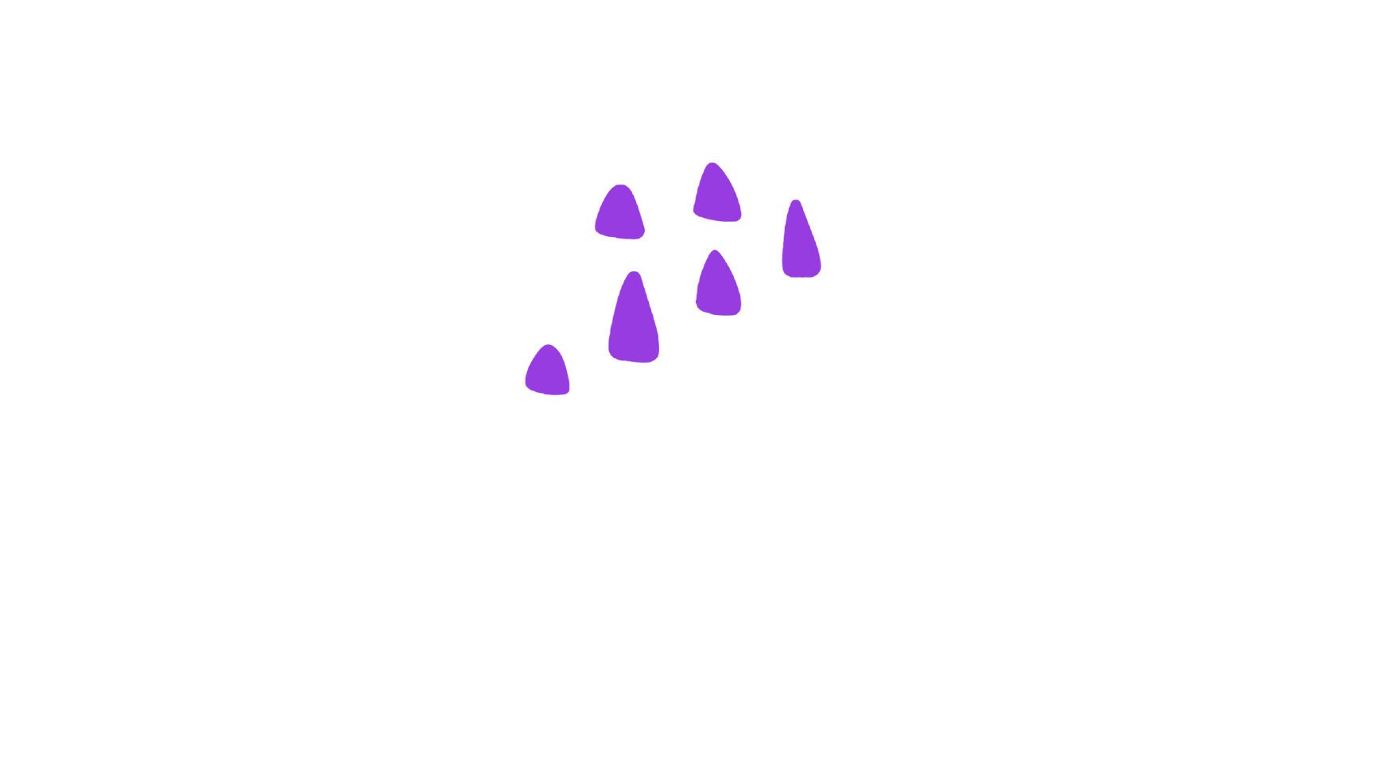
Can social media change the way you think?​
News stories on social media can be very powerful, and these posts or videos can play on your emotions to trick you into liking or sharing.​
​It all depends on the type of content that you watch and​ how you interact with it. ​​
Notes:
TEACHER NOTES
Ask students to pause and reflect on what kind of content they are likely to interact with on social media. Is it cute animal videos, people pulling pranks, makeup tutorials, fitness advice, gaming advice or something else? This is priming students to understand algorithms.

Slide 11
Activity Three: Algorithms​
Do you know what an algorithm is?​
Notes:
TEACHER NOTE
Pose the question and gauge the level of understanding of your group.

Slide 12
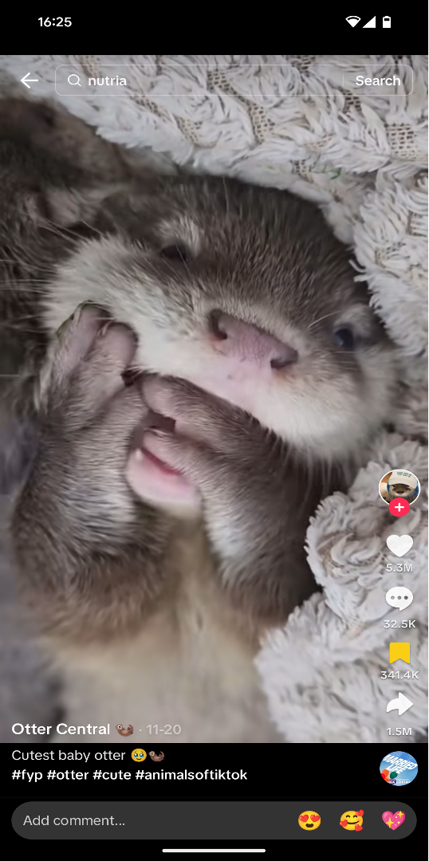
Algorithms
Imagine you like, save and share five cute otter videos on TikTok.​
​
When you open TikTok next what are you likely to see?​
​
Why do you think that might be?​
Notes:
Source: @otter.central on X (formerly known as Twitter)

Slide 13
Algorithms
​
Social media platforms like TikTok will use an algorithm to remember which content you watch and how you react with it.​
​
This might result in TikTok showing you similar content that reflects your biases, and not conflicting content that may offer the other side of the story.​
​
Word Watch!
Echo Chamber​
An echo chamber is a situation where people only hear or see opinions that are the same as their own. ​

Slide 14
Could this be a problem?
Notes:
TEACHER NOTE
Pose the question. Collect some answers about why this may be problematic. If students are struggling, go straight to the next slide.

Slide 15
What if it wasn’t an otter video?​
Now imagine you have watched, liked, saved, and shared 5 videos on TikTok that all show one-sided opinions about a topic like climate change.
These videos only present information that says climate change isn't real and ignore all the scientific evidence that shows it is happening.​
Notes:
TEACHER NOTES
Ask students to predict what kind of videos TikTok will show them next time they open the app. (They will likely see more videos that deny climate change.)
Split the class into groups of four. One person will be feeding back to the group so will need to make notes. Give the groups the following questions to consider:
Why could this be a problem?
How might seeing only one side of the story affect your understanding of the topic?
What are the dangers of only getting information from sources that agree with each other? Challenge point: you may want to introduce the concept of echo chambers.
This scenario helps students understand that algorithms can create an echo chamber, where they only see content that reinforces their existing beliefs. This can lead to a biased view of the world and make it harder to see other perspectives.

Slide 16

Here are some ways you can contribute to the discussion:
Give a new opinion e.g.​
Agree with someone e.g. ​
“I think that…​”
  “I would argue the
  same thing because…”​
“My opinion is…​”
  “I agree with ___
  because…”​
“I believe that…​”
“In my view…”
  “That is an interesting
  point because…”
Challenge a point e.g.
Build on a point e.g. ​
  “I don’t think ____ is
  right because…”​
  “I would like to build
  on ___’s point because…​”
  ”I would like to challenge
  this because…”​
  “Building on
  what ___ said…​”
  “My own view is
  different because…”​
  “In addition to ___’s
  point…​

Slide 17
Activity Four: The Big Debate​
Should social media be banned?​

Slide 18


Should a platform like TikTok​
be banned for teenagers in the UK?​
Educational content ​
Inappropriate content ​
Creativity
Connection​
Cyberbullying
Addiction
Mental health​
Freedom of expression​
Notes:
TEACHER NOTES
Split the class into groups of four. One person will be feeding back to the group so will need to make notes. Ask each group to consider if a platform like TikTok should be banned for teenagers in the UK.
Students may need support with this question. They may wish to consider mental health, inappropriate content, data privacy, cyberbullying, addiction, creativity, connection, educational content, freedom of expression.
A supporting framework to help students to engage in discussion is available on the next slide if needed. You may wish to print this and give a copy to each group.

Slide 19
Here are some ways you can contribute to the discussion:
Give a new opinion e.g.​
Agree with someone e.g. ​
“I think that…​”
  “I would argue the
  same thing because…”​
“My opinion is…​”
  “I agree with ___
  because…”​
“I believe that…​”
“In my view…”
  “That is an interesting
  point because…”
Challenge a point e.g.
Build on a point e.g. ​
  “I don’t think ____ is
  right because…”​
  “I would like to build
  on ___’s point because…​”
  ”I would like to challenge
  this because…”​
  “Building on
  what ___ said…​”
  “My own view is
  different because…”​
  “In addition to ___’s
  point…​

Slide 20
Possible reasons for banning social media for teenagers​
​
  There are mental health concerns. Excessive use of social media has been linked to increased anxiety, depression, and other mental health issues among teenagers​
  There is a risk of exposure to inappropriate content. Teenagers can easily access harmful or inappropriate content, including dangerous trends and challenges​
  Social media platforms often collect a significant amount of personal data, raising concerns about privacy and data security​
  Some social media platforms have been associated with high rates of cyberbullying, which can negatively impact teenagers' well-being​
  The design of social media apps can encourage addictive behaviour, leading to excessive screen time and distraction from activities like studying​
​
​
Notes:
This can also be used a a printed-out worksheet to stimulate the discussion.

Slide 21
Possible reasons against banning social media for teenagers​
​
Social media platforms can allow teenagers to express their creativity through videos, music, and other forms of content
They can help teenagers stay connected with friends and peers, especially during times when in-person interaction is limited​
There is a wealth of educational content available on some social media platforms that can be beneficial for learning new skills and information​
Banning a social media platform could be seen as an infringement on teenagers' freedom of expression and access to information​
Many older teenagers use social media to build personal brands and even earn money, so a ban could negatively affect their economic opportunities​
​
​
Notes:
This can also be used a a printed-out worksheet to stimulate the discussion.

Slide 22
Today’s Big Question:​
How can social media impact your views?​
I believe social media can/can’t change my views because…​
​
In my opinion, the best way to present news is…​
​
In conclusion, as a young person consuming news online I will…​
Key Vocabulary: Algorithm, Trustworthy, Genuine, Authentic, Balanced, Informative​
Notes:
TEACHER NOTES
Come back to the ‘Big Question’. Have students changed their minds since the beginning of the lesson?

Slide 23
So, could social media change the way you think?​
Which group are you?​
​
Hands up for the group that matches your opinion.​
DEFINITELY
POSSIBLY
NEVER
Notes:
TEACHER NOTES
This activity can be completed physically with students moving to different spaces in the classroom or it can be done by raising hands.

Slide 24
Reflecting on Social Media​
In this lesson, you've explored social media. You've learned about the algorithms and thought about whether social media platforms are suitable for teenagers. To help you reflect on today’s lesson try a SIT exercise:
1
1
1
  surprising fact or idea​
  interesting fact or idea​
  troubling fact or idea​
Notes:
TEACHER NOTES
It is important that students take time to reflect on what they have learnt. Encourage them to jot notes, journal or talk to a partner about their experiences and takeaways from this lesson.

Slide 25
Lesson 2 Complete​

