Slide 1
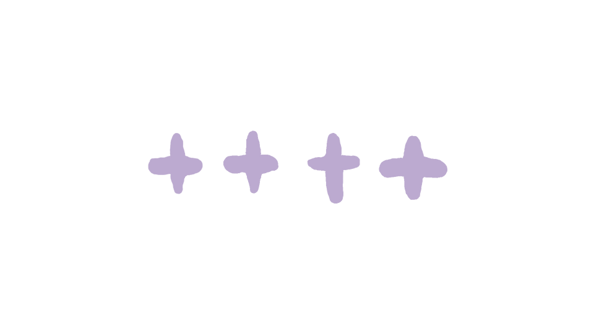



WHAT IS FAKE NEWS?

Slide 2
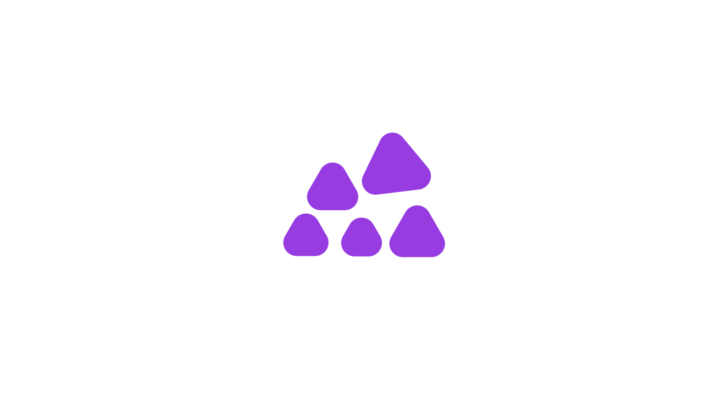
GLOSSARY
In this lesson you will come across words such as:
Fake news False stories that appear to be news, spread on the internet or other media, by someone who may or may not know it’s fake.
Peers People who are the same age or have the same interests as you.​ For example, your classmates.​
Misinformation False information that the person sharing doesn’t realise is false or misleading.
Disinformation False information deliberately spread to
influence public opinion or hide the
other side of the story​.
Regulation Making sure a business follows official rules or laws.

Slide 3

Today’s Big Question:​
How do you know that​
what you’re seeing is true?​
Notes:
TEACHER NOTES
The lesson begins with a ‘Big Question’. Display this as students enter the classroom. The purpose of this task is to engage students immediately and encourage early independent thinking whilst giving time for administrative tasks.
Students could jot down their initial thoughts or ideas, or you may choose to collate ideas on the board or a sheet of flipchart paper. Students will revisit the 'Big Question' at the end of the lesson to reflect on whether their opinions have changed.
If students are struggling to engage with the question, offer the following prompts:
Have you ever seen something that looked real but turned out to be fake? How did you find out?
What makes you trust some things you see but not others?
What clues do you look for to decide if something is true or not?

Slide 4
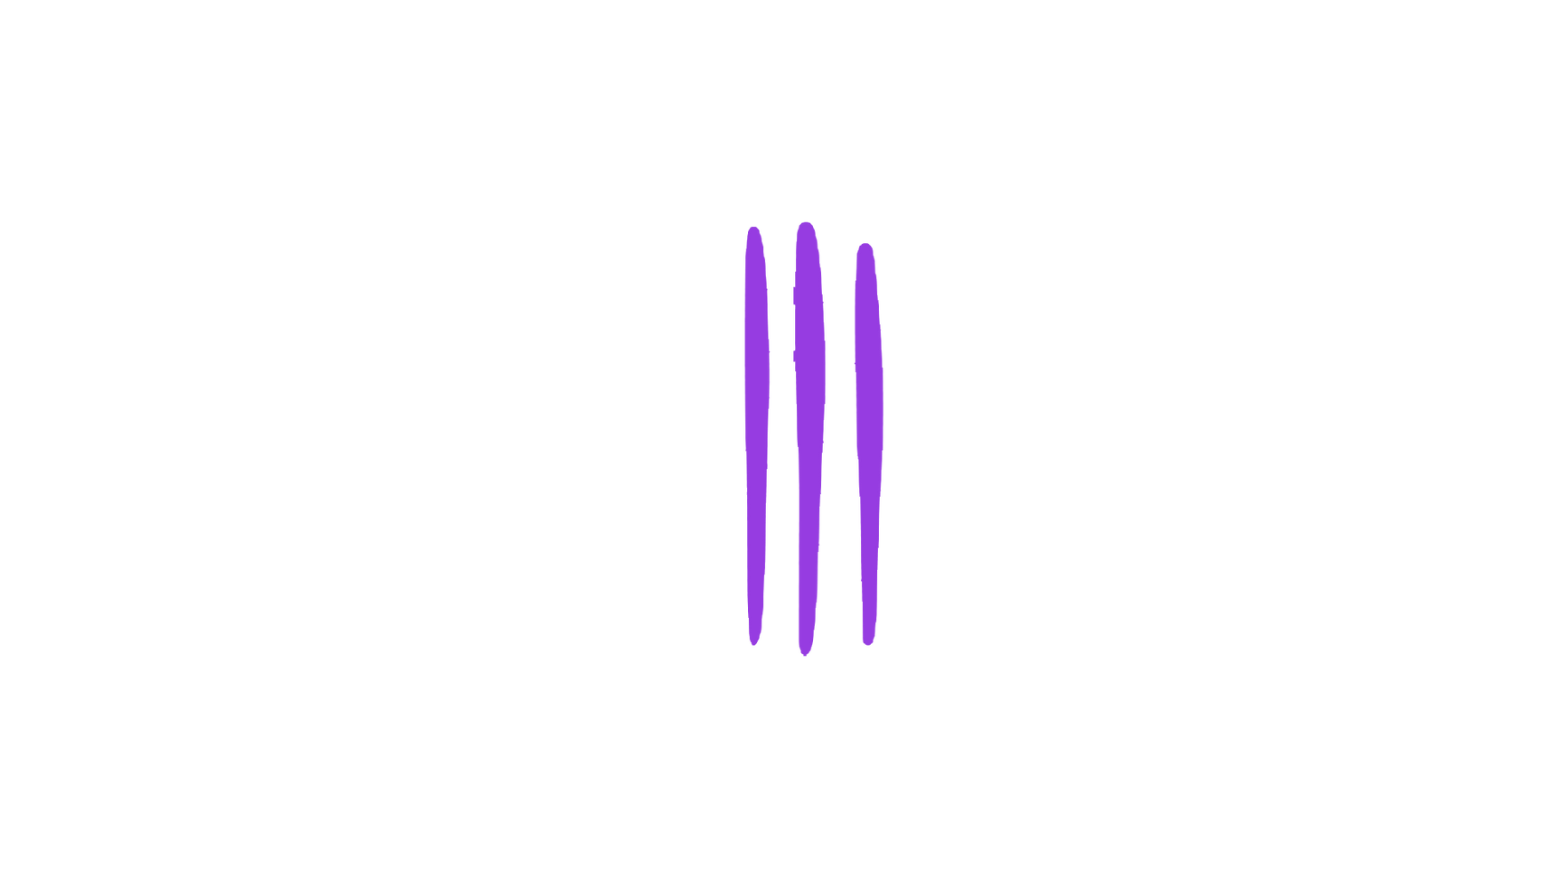
Activity One: The Statistics ​
Fake news has been around for thousands of years in one way or another, but social media has made it easier than ever for fake news to spread, with content often shared with little or no thought about its source or reliability.
In a survey from BBC Bitesize and BBC Radio 5 Live over half of 13–18-year-olds said they were concerned about fake news.
​
​
​
Word Watch!
Peers​
People who are the same age or have the same interests as you.​ For example, your classmates.​
Notes:
Source:https://www.bbc.co.uk/bitesize/articles/zkfy239#ztwjb7h
TEACHER NOTES
Encourage students to think about their own experiences with fake news and what they know about their peers. Highlight the Word Watch box if you think your students will need support with the word peers.
Go through the statistics and discuss any surprising or interesting findings.

Slide 5

The most common reasons for that concern were….
37%
43%
29%
​
thought conspiracy theories are replacing what is established scientific fact
struggled to identify what is AI content
had difficulty identifying what is a scam
Notes:
Source: https://www.bbc.co.uk/bitesize/articles/zkfy239#ztwjb7h

Slide 6
So, who do you and your peers trust to give you your news?
​
Newspapers?
TV and Radio
e.g. BBC?
Parents?
Influencers?
Notes:
TEACHER NOTES
OPTIONAL – GROUP DISCUSSION
Depending on the timing of your lesson, you may choose to expand this activity into a discussion. Split the class into groups. One person will be feeding back to the group so will need to make notes. Ask them to consider the following questions:
Do you think social media platforms are trustworthy?
Do you think young people trust influencers more than politicians?
Does the BBC seem more trustworthy than other news sources? Why?
Where do your parents get their news from?
A supporting framework to help students to engage in discussion is available on the next slide. You may wish to print this and give a copy to each group.
Have one person from each group present their group's thoughts to the class.

Slide 7

Here are some ways you can contribute to the discussion:
Give a new opinion e.g.​
Agree with someone e.g. ​
“I think that…​”
“I would argue the
same thing because…”​
“My opinion is…​”
“I agree with ___
because…”​
“I believe that…​”
“In my view…”
“That is an interesting
point because…”
Challenge a point e.g.
Build on a point e.g. ​
“I don’t think ____ is
right because…”​
“I would like to build
on ___’s point because…​”
”I would like to challenge
this because…”​
“Building on
what ___ said…​”
“My own view is
different because…”​
“In addition to ___’s
point…​

Slide 8
Activity Two: Talking about trust​
Which news channels and social media sites do you trust the most and why?​

Slide 9
Why do you trust them? Are they credible?
Do they have regulations they have to follow?
How can you check the information found on them?
Why is it important to seek out multiple sources and consider different perspectives?
Word Watch!
Regulation
Making sure a business follows official rules or laws
Notes:
TEACHER NOTES
When it comes to trusted news channels and social media sites, several sources are often cited for their reliability and credibility. It is likely that students will give you answers such as the BBC, Sky News, ITV News, C4 News, The Daily Mail, The Sun, The Guardian, or The Times. They may also mention sites such as TikTok or Instagram. It is important to explore this.
Unlike regulated news sources, social media outlets allow anyone to publish news. This isn’t necessarily a bad thing. It helps democratise information, allowing more people to have a platform and a voice, but it also allows the spread of misinformation. On platforms like TikTok, identify and discuss pages that are known for reliable information. What makes these pages trustworthy? You may wish to introduce the term ‘regulation’.
For students who need a further challenge, you may wish to pose the following questions:
Ask students to explain why they trust certain sources.
Do certain news sources have rules they have to follow? Why is regulation important? The Independent Press Standards Organisation (IPSO) is the largest independent regulator for the newspaper and magazine industry in the UK and Ofcom regulates TV and radio.
How can they check the information found on them? Check other websites, reverse image search the pictures.
Why is it important to seek out multiple sources and consider different perspectives?

Slide 10
Activity Three: Misinformation vs Disinformation
Fake news can be either:
Misinformation
Disinformation​
or
False information that the person sharing doesn’t realise is false or misleading.
False information
deliberately spread to
influence public opinion or hide the
other side of the story​.
This rhyme might help
you to remember:​
Misinformation is a mistake;
Disinformation is purposefully fake.​
Notes:
TEACHER NOTES
Introduce the vocabulary. Students must understand these terms well. Read through the definitions with students and check for understanding.
You could use the following scenarios:
Misinformation - A student shares a news article in a year 11 group chat that says all exams have been cancelled. The article looks official, but it turns out the student misread the date, and the article was actually from 2020 when exams were cancelled due to the Covid-19 pandemic.
Disinformation - A person creates a fake social media post claiming that a celebrity has endorsed a product that helps people build muscle just by drinking it. They use edited photos and fake quotes to make the post look real, intending to trick people into buying the product.

Slide 11
The following posts are untrue.​
But can you tell if they are…
Misinformation​
or​
Disinformation?​

Slide 12
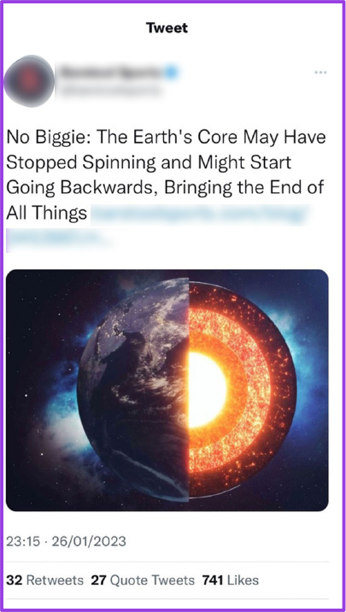
Misinformation is a mistake;
Disinformation is purposefully fake.​
Misinformation​
or​
Disinformation?​
Notes:
Source: @barstoolsports, on X (formerly known as Twitter)
Picture credit: Rost-9D

Slide 13
Misinformation
​This has been misinterpreted
from a scientific study that said,
‘the rotation of the Earth’s solid core may have recently paused and​ could be reversing’.​
Notes:
Source: @barstoolsports, on X (formerly known as Twitter)
Picture credit: Rost-9D
TEACHER NOTE
OPTIONAL
You could extend the discussion by asking the students about the source.
The post was shared by a page that usually posts sport news. Does this sound like the best place to get this scientific information from? Why or why not? Where could we check this information?

Slide 14
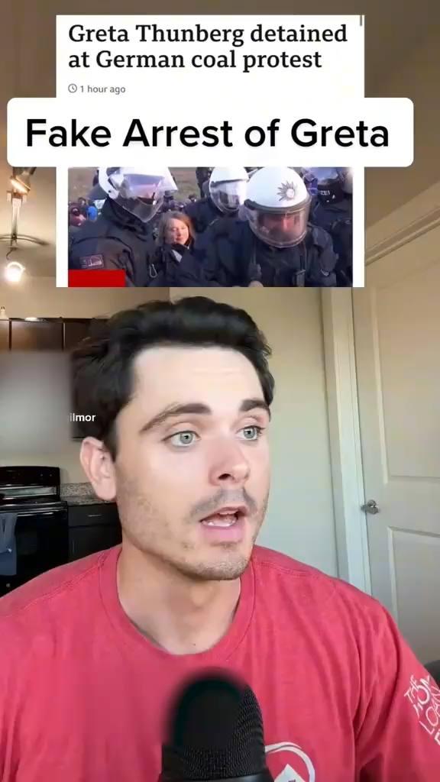
Misinformation is a mistake;
Disinformation is purposefully fake.​
Misinformation​
or​
Disinformation?​
Good to know!
As a child, Greta Thunberg started a global movement to fight climate change by protesting and inspiring others worldwide to join her.​
Notes:
Source: @spencergilmor on TikTok
TEACHER NOTE
OPTIONAL
Check if students know who Greta Thunberg is. If they are unsure, offer this short explanation:
As a child, Greta Thunberg started a global movement to fight climate change by protesting and inspiring kids worldwide to join her.
WATCH THE VIDEO

Slide 15
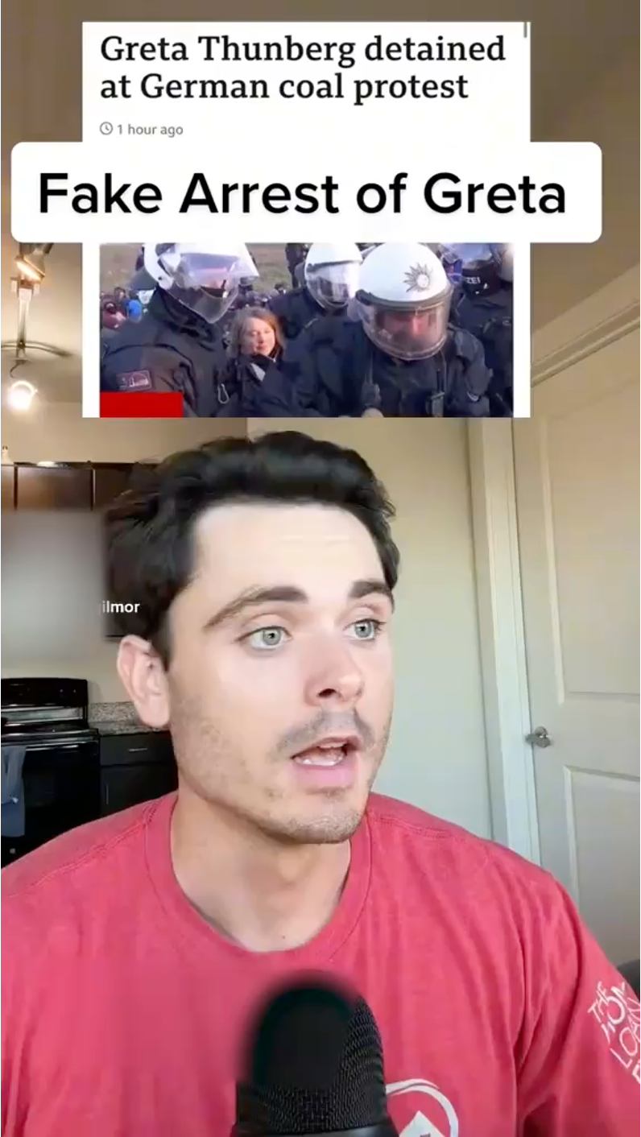
Disinformation​
​
The person has claimed that the arrest was fake, and that Greta Thunberg was using it as a photo opportunity. He’s trying to suggest that she’s only protesting for publicity.​
Notes:
OPTIONAL
Ask students if they think this person would be safe to trust. What steps could they take to check if this is disinformation? Encourage answers around checking multiple sources, looking at mainstream media versions.

Slide 16
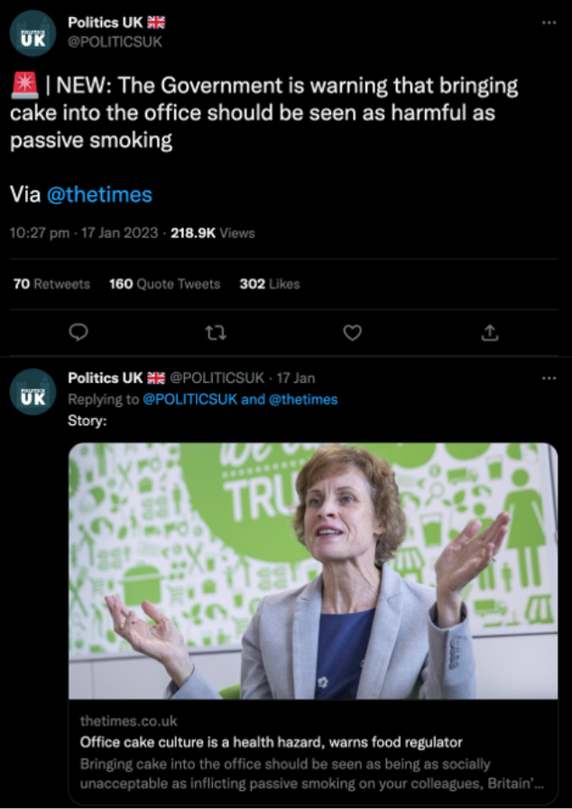
Misinformation is a mistake;
Disinformation is purposefully fake.​
Misinformation​
or​
Disinformation?​
Notes:
Source: @POLITICSUK on X (formerly known as Twitter)

Slide 17
Misinformation​
​
​This post made a mistake and is missing part of the story. The original quote from the health official says that “Cake culture should be seen as a health hazard like passive smoking”. Not that it’s as harmful as passive smoking.​
Notes:
TEACHER NOTE
OPTIONAL
You may want to extend this discussion further. You could place students into groups and use the following prompts to get them to explore the importance of quotation:
Why is it important to use the exact words when quoting someone?
How can shortening a quote change its meaning?
What could happen if someone misquotes a health official or an expert?
Can you think of a time when you heard or read a quote that was taken out of context? How did it affect your understanding?

Slide 18
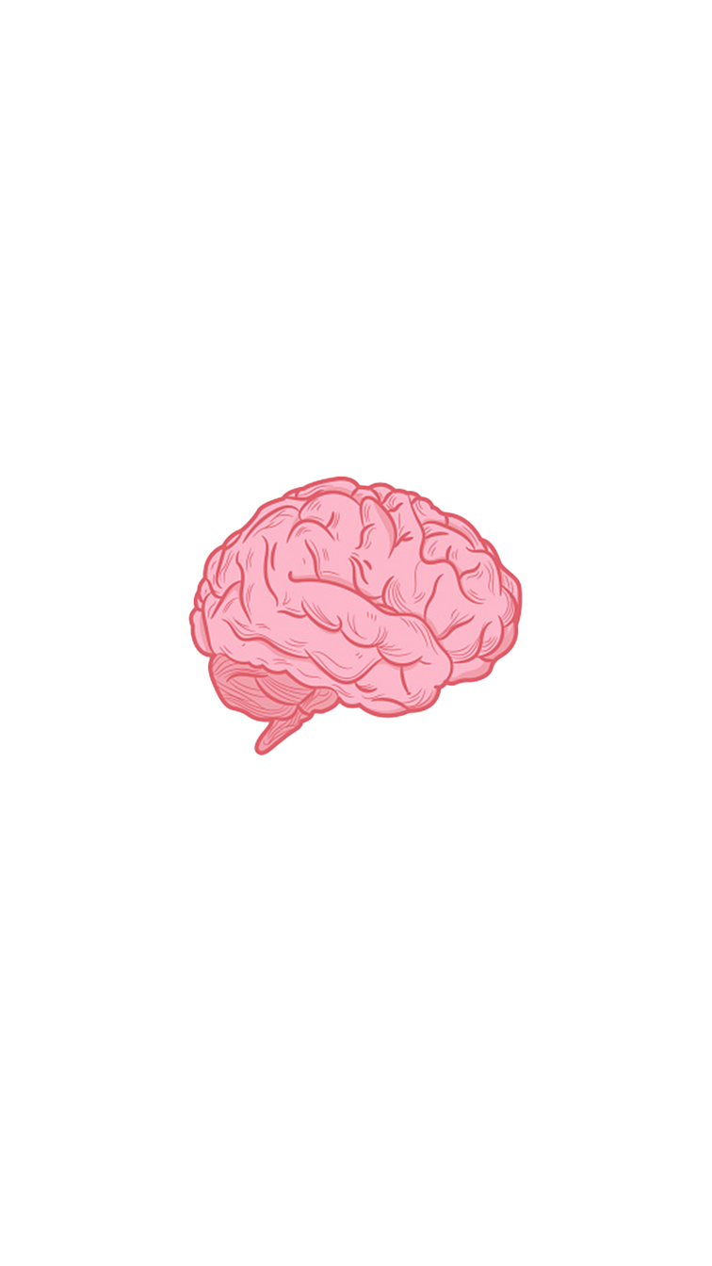


Can we stop fake news from​ going viral?
​
One tip…​
Think before you share​!

Slide 19
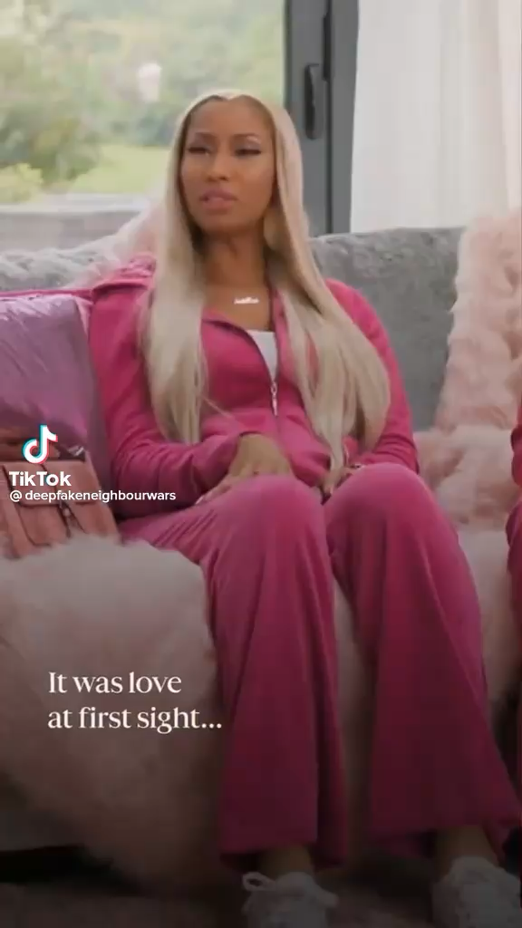
Do you believe this?​
Why/why not?​
Activity Four:
Deepfakes
Credit: Deep Fake Neighbour Wars, ITV and Tiger Aspect Productions
Notes:
Credit: ITV and Tiger Aspect Productions
TEACHER NOTES
This task is designed to get classes discussing how convincing deepfake and AI technology is becoming. Watch the clip, identify deepfake features to look out for (which are listed on the next slide) , before watching it back and picking out inconsistencies.

Slide 20
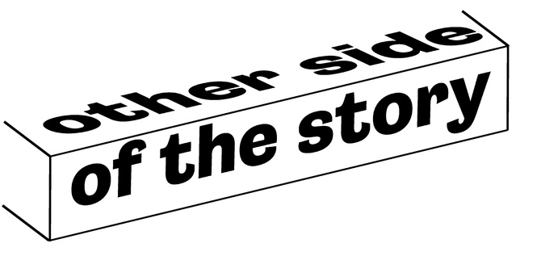

Deepfakes
Deepfakes are videos, pictures or audio clips made with artificial intelligence to look real.​
​
They can be used for fun but sometimes they're used to impersonate people like politicians, celebrities or world leaders, to deliberately mislead people.​
Look out for…
Lip movements slightly
out of sync with speech ​
Blurring or flickering
when face changes ​
Common sense - is it something they’d say? ​

Slide 21
Lip movements slightly
out of sync with speech ​
Watch the video again.​
​
Can you spot any of the signs?​
Blurring or flickering
when face changes ​
Common sense -
is it something they’d say? ​
Credit: Deep Fake Neighbour Wars, ITV and Tiger Aspect Productions

Slide 22
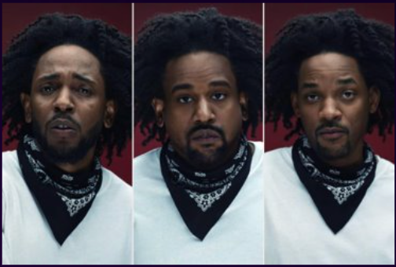
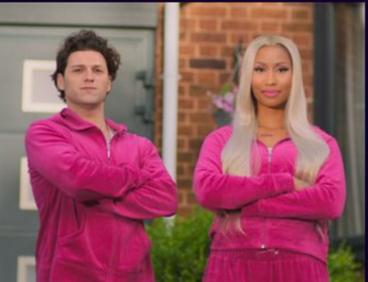
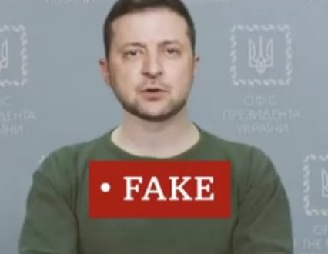
Deepfakes are used to...
Be creative
Be funny
Increasingly, for news
Credit: Kendrick Lamar, Dave Free, PGLang Project 3 and Deep Voodoo
Credit: ITV and Tiger Aspect Productions
Notes:
Credit: Kendrick Lamar, Dave Free, PGLang Project 3 and Deep Voodoo
Credit: ITV and Tiger Aspect Productions
Teachers notes
Be creative – In Kendrick Lamar’s “The Heart Part 5” music video the rapper morphs into the faces of several public figures using deepfake technology.
Be funny – In ITV’s “Deepfake Neighbour Wars” deepfakes of well-known celebrities in ridiculously mundane situations and relationships are used to make people laugh.
Increasingly, for news – In 2022, a deepfake video of Ukraine’s President Zelensky appeared on the hacked website of Ukrainian TV network Ukrayina 24. In it, he was telling Ukrainian troops to put down their weapons and surrender to Russia. More information: https://www.bbc.co.uk/news/technology-60780142

Slide 23
Thinking about a deepfake video, is it ethical?​
Do you think it's fair to use someone's face or voice in a deepfake without asking them first? Why?​
What are some possible consequences of creating and sharing?​
How can deepfakes affect the trust we have in what we see online?
​
Come up with 3 rules you think should be
in place for deepfakes.​
​
Word Watch!
Ethical​
Doing the right thing and
being fair and honest.​
Notes:
OPTIONAL – GROUP DISCUSSION
Depending on the timing of your lesson, you may choose to expand this activity into a discussion. Split the class into groups of four. One person will be feeding back to the group so will need to make notes. Ask each group to consider the questions:
Do you think it's fair to use someone's face or voice in a deepfake without asking them first? Why or why not?
What are some possible consequences of creating and sharing deepfakes of real people?
How can deepfakes affect the trust we have in what we see online?
Finally, have the groups create 3 rules or guidelines that they think should be in place for creating and sharing deepfakes.
A supporting framework to help students to engage in discussion is available on the next slide if needed. You may wish to print this and give a copy to each group.

Slide 24
Here are some ways you can contribute to the discussion:
Give a new opinion e.g.​
Agree with someone e.g. ​
“I think that…​”
“I would argue the
same thing because…”​
“My opinion is…​”
“I agree with ___
because…”​
“I believe that…​”
“In my view…”
“That is an interesting
point because…”
Challenge a point e.g.
Build on a point e.g. ​
“I don’t think ____ is
right because…”​
“I would like to build
on ___’s point because…​”
”I would like to challenge
this because…”​
“Building on
what ___ said…​”
“My own view is
different because…”​
“In addition to ___’s
point…​

Slide 25
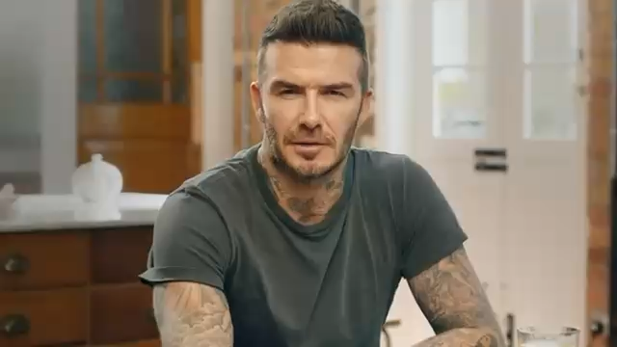
Is there a possibility a deepfake could be used for good?
Credit: Malaria No More
Can you think of any other ways deepfakes could be positive?​
Notes:
Credit: Malaria No More
TEACHER NOTES
Watch the video.
Pose the question, ‘Is there a possibility a deepfake could be used for good?’ Ask students to consider it but not share their answers yet. Show the video of David Beckham speaking different languages as part of a malaria campaign. Ask the students if this is an example of a deepfake being used for good.
Ask students to think of other examples of how deepfakes could have a positive impact.

Slide 26
Today’s Big Question:​
How do you know that​
what you’re seeing is true?​
I know if what I am seeing is true/untrue because I can/will…​
In my opinion, the best way to check if something is true is to…​
Notes:
TEACHER NOTES
Come back to the ‘Big Question’. Have students added any strategies to their toolkit?

Slide 27
Reflecting on fake news​
In this lesson, you've explored fake news. You've learned about the difference between misinformation and disinformation, and you've also looked at deepfakes and thought about whether they are ethical.​ Try a 3-2-1 exercise to finish:
3
2
1
Give three opinions you have about this​
State two opinions someone else had​
Ask one question you
still have​
Notes:
TEACHER NOTES
It is important that students take time to reflect on what they have learnt. Encourage them to jot notes, journal or talk to a partner about their experiences and takeaways from this lesson. You may also want to have a go at the quiz on the next slide or set this as homework.

Slide 28
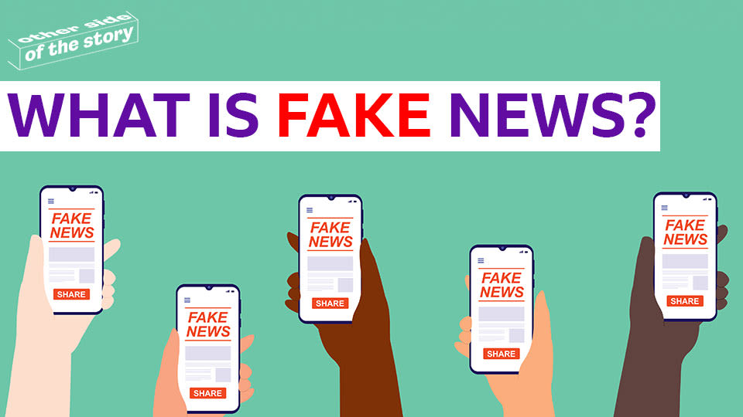
Lesson 1 Complete
TAKEAWAY TASK
Click on the picture above to try our monthly fake news quizzes to test what you’ve learnt

