Slide 2
Our aim today
To find out what we mean by real news or fake news.
If news isn’t true, does that make it fake?
Where does it come from and why people share it?
Spotting the difference between real and false.
Notes:
Define real news. The difference between fact and fiction/fake
Why does it matter is it isn’t ‘quite true’
Fake news could be a story that is completely false or could be suggested as misleading, a false claim, spin, satire or even a mistake.
Where does the material come from and why do people share it.

Slide 3
What is ‘fake’ news?
BBC’s definition: False information distributed deliberately, usually for political or commercial purposes
Made up stories and information
Meant to be widely shared - perhaps to shock or scare
Its purpose is to persuade people to think a certain way or vote a certain way
Or to make money from advertising - clickbait
Notes:
BBC defines fake news as “false information distributed deliberately, usually for political or commercial purposes.” It’s very specific and doesn’t include mistakes, jokes, spin etc.
“Fake news” is a term you’ll hear used by people and organisations for all sorts of inaccuracies in a story. For some “fake news” has become a catch-all term to dismiss a story, claim or news report, or even a reporter asking a question.
For info:
BBC Trending: The (almost) complete History of ‘fake news’ http://www.bbc.co.uk/news/blogs-trending-42724320
This is Justin Webb interviewing Tony Maddox of CNN, on the Today programme [08/02/2018 @ 7.50am or 1 hour 50 mins into programme. https://www.bbc.co.uk/programmes/b09qb0k9

Slide 4
VIDEO
Insert still image from film here
Real or Not?
Notes:
Film explaining why fake news matters
Watch the video from website for information about why fake news matters

Slide 5
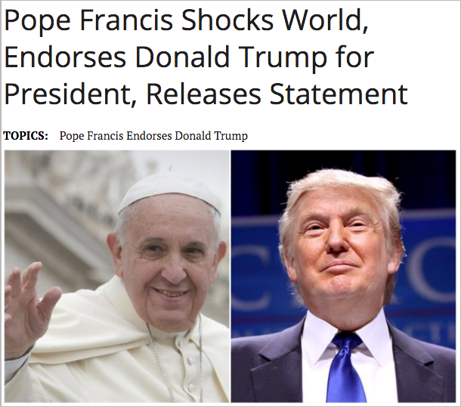
Notes:
The following slides are examples of different kinds of “fake” and “false” stories.. This first one fits the BBC definition of fake news
Demonstrates how fake news could affect votes
Pope is Head of Catholic church – could influence how Catholics vote in election
Written by WTOE-5 a fake news website, now defunct. No one ever knew who owned or authored the site. Buzzfeed reported that teenagers in Macedonia were responsible for the story. BBC Trending also believes this to be the case. The teenagers made money from stories like these. This is Clickbait.
(additional info)
In both the US and the UK, allegations have been made that Russia is behind lots of fake news stories, in an attempt to influence elections – most notably the US Presidential election and Brexit referendum. Kremlin representatives have denied these allegations.
Additional activity for older students – Research background to these claims.

Slide 6
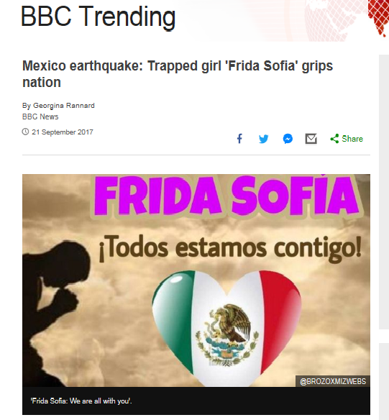
#FridaSofia
Notes:
An example of a rumour/mistake that went viral (but spread in good faith) – called fake news by some but doesn’t fit BBC definition
Background - In September 2017, there was a major earthquake in Mexico. A school collapsed with children and adults trapped inside and a major rescue operation was launched.
A Mexican TV news channel got a story, from rescuers, that a young girl, Frida Sofia had been located inside the building, alive, and rescuers were desperately trying to reach her. Other news organisations picked up on the story, as did social media. A hashtag was started and people all over world were tweeting their support and messages of hope.
In fact the story was not true, and about 36 hours after it was first reported, Mexican officials stated that there was no little girl called Sofia trapped inside.
BBC Trending reported on the story being untrue as did others, this is the Independent.
It’s maybe more an example of a rumour that was picked up by mainstream media and spread on social media in good faith.
For a good account of what happened look at: BBC Trending http://www.bbc.co.uk/news/blogs-trending-41346787 and NY Times: https://www.nytimes.com/2017/09/27/world/americas/mexico-earthquake-trapped-girl.html

Slide 7
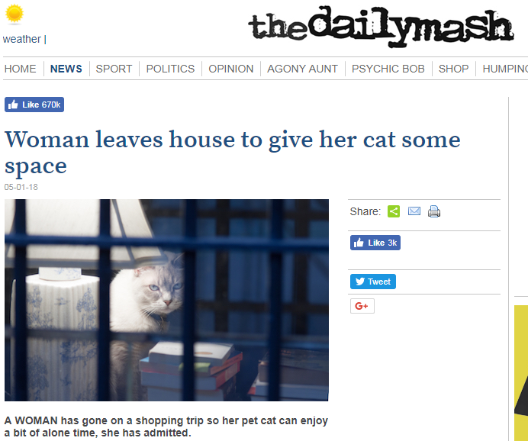
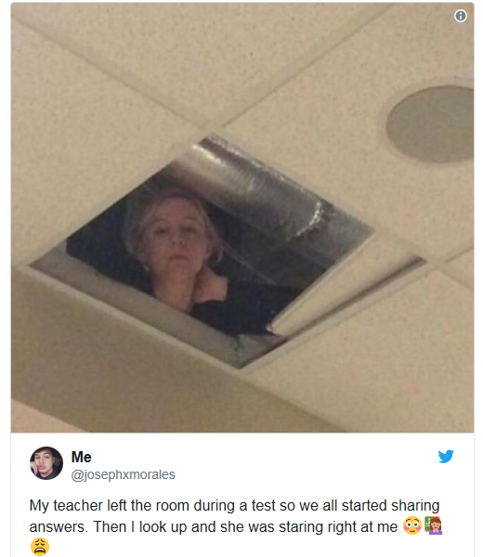
Notes:
Example of fun/hoax/joke and satire (again, doesn’t fit BBC definition)
Story 1 - joke
Josephxmorales is really Joseph Longoria. He found the photo and made the story up to see what happened. It got one million likes and/or re-tweets.
Story 2 - Satire
Info:
There are other websites like the Daily Mash. For example NewsBiscuit or The Onion. These sites, like most satire sites, declare themselves to be satire sites, deliberately trying to be funny and are not claiming the story is true. They would say they are not “fake news”, because they are open and honest about what they are.

Slide 8
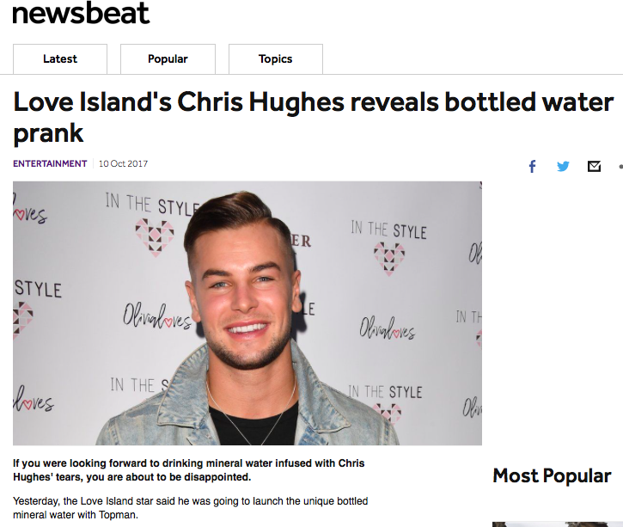
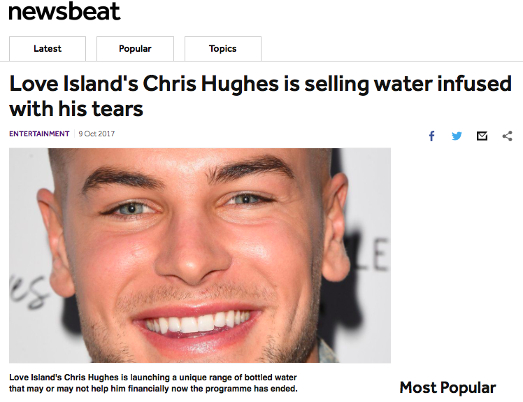
Notes:
This example is a Publicity stunt/deliberate joke
Background:
Chris Hughes became famous on ‘Love Island’ in 2017. In October 2017 he launched bottled water, infused with is tears, in partnership with Topman. He tweeted and lots of outlets ran it, including the BBC. Why infused with his tears? Because he was known for his crying on ’Love Island’.
The next day, he revealed that the story was a publicity stunt for World Mental Health Day “#DONTBOTTLEITUP” campaign.
In this case it wasn’t for commercial purposes but it was promotional - another kind of deliberate joke, or publicity stunt.

Slide 9
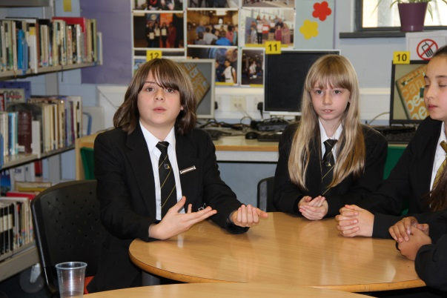
Why does fake news matter?
Exercise 1: Proving a story is real
Exercise 2: Same but different
Notes:
Exercise one – low tech version to help students
Exercise two – suits students who have access to computers

Slide 10
Is this story REAL?
Notes:
Students are about to take part in a role playing exercise. They will hear accounts of the same event but from different viewpoints. They will need to decide who is telling the truth and who isn’t – and then write their story up based on what they have found out.
The first questions they need to ask uses the acronym REAL

Slide 11
REAL
checks
R
E
A
L
eal - ask “is this real?”
vidence - What’s the source? author, publication, web address, date & time, including pictures.
dd it all up - Ask around, use own knowledge, other’s knowledge, the story detail and a little research.
ook around - any other sources carrying the story?
Notes:
Over the next few slides, students have the chance to decide if the story is real.
They can use their help sheet to assist and use the REAL acronym.

Slide 12
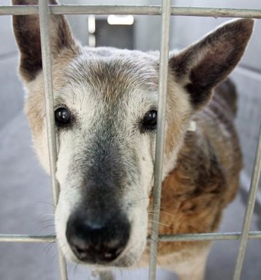
Exercise: What’s true?
THE LYING TIMES
DOG BITES MAN!!
A man has been attacked by a dog whilst walking through Tall Tale Park. Mr Jonathan Jones (48) says he was bitten by the pit bull terrier yesterday morning. “I was minding my own business when an enormous, vicious creature leapt out of the bushes and attacked me. I don’t think I’ll ever use my left hand again. “
Mr Jones, grandfather of 7, is now recovering at home.
A hospital spokesman said the doctor who had treated Mr Jones was horrified at the extent of the injury. He added that he thought this breed of dog had been banned.
The dog is called Putch. His owner told us that he has never been any trouble in the past and is usually as gentle as a kitten.
Reporters: Paul K.Pize & Ivor Fibb
Image: GETTY IMAGES
Notes:
Read the details of the report to the students
Download the scenarios and role play

Slide 13
Remember your journalism checks
Who?
What?
Where?
Why?
When?
How?
Notes:
Journalist students can be reminded to ask open questions as they quiz the characters to gather more details about what happened

Slide 14
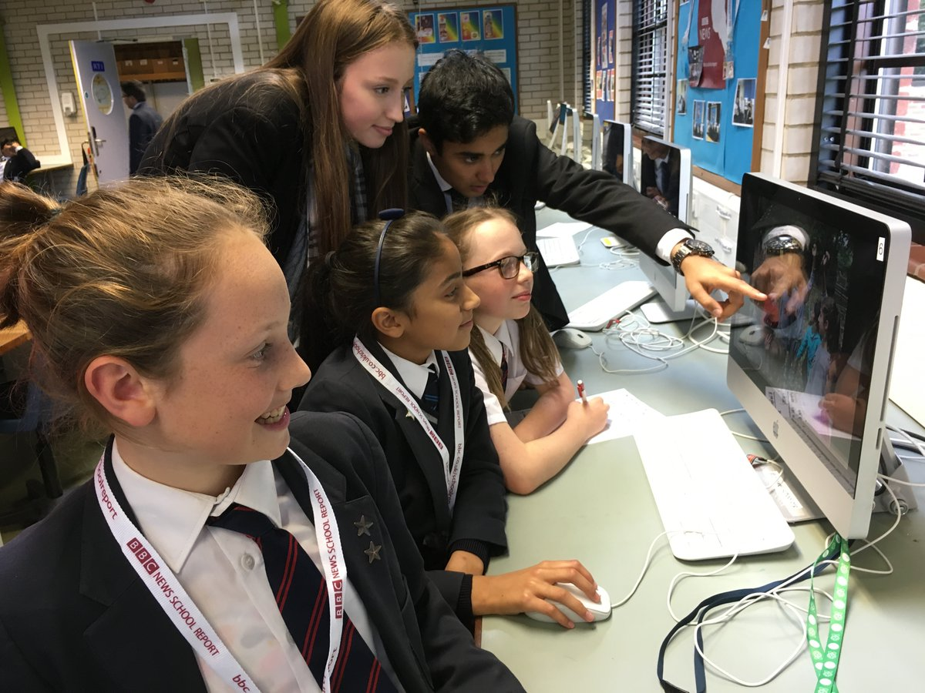
Clear, concise, correct!
Re-write the story in your own words using the facts that you have gathered. Make sure your story is all true!
Notes:
Journalist students can be reminded to ask open questions as they quiz the characters to gather more details about what happened

Slide 15
Film
Insert still of film here
How to Check if something is real
Notes:
Watch the film ‘How to Check if Something is Real’

Slide 16
R
E
A
L
EAL ?
VIDENCE?
DD UP?
OOK AROUND
Notes:
Reminder of how to check if something is real or fake – and reminder to students to use their Help Sheets, if they need to, when checking out stories.

