Slide 2
The Environment
Hi Go Jet Cadets! Have you ever heard of any of these words? What do you think they mean?
environment
weather
climate

Slide 3
The Environment
‘Environment’ means the world around us. It can refer to just the place we live or the whole world.
environment

Slide 4
The Environment
‘Weather’ is all about whether it is hot, cold, rainy, sunny or snowy.
weather

Slide 5
The Environment
‘Climate’ is the weather in an area over a long time.
climate

Slide 6
The Environment
Have you ever heard of any of these words? What do you think they mean?
pollution
deforestation
climate crisis

Slide 7
The Environment
‘Pollution’ means something which is harmful to the environment. It includes plastic in the ocean and gases released by factories.
pollution

Slide 8
The Environment
‘Deforestation’ is when large forests are cut down.
deforestation

Slide 9
The Environment
‘Climate crisis’ describes serious problems happening to the environment. All of these things are caused by humans.
climate crisis

Slide 10
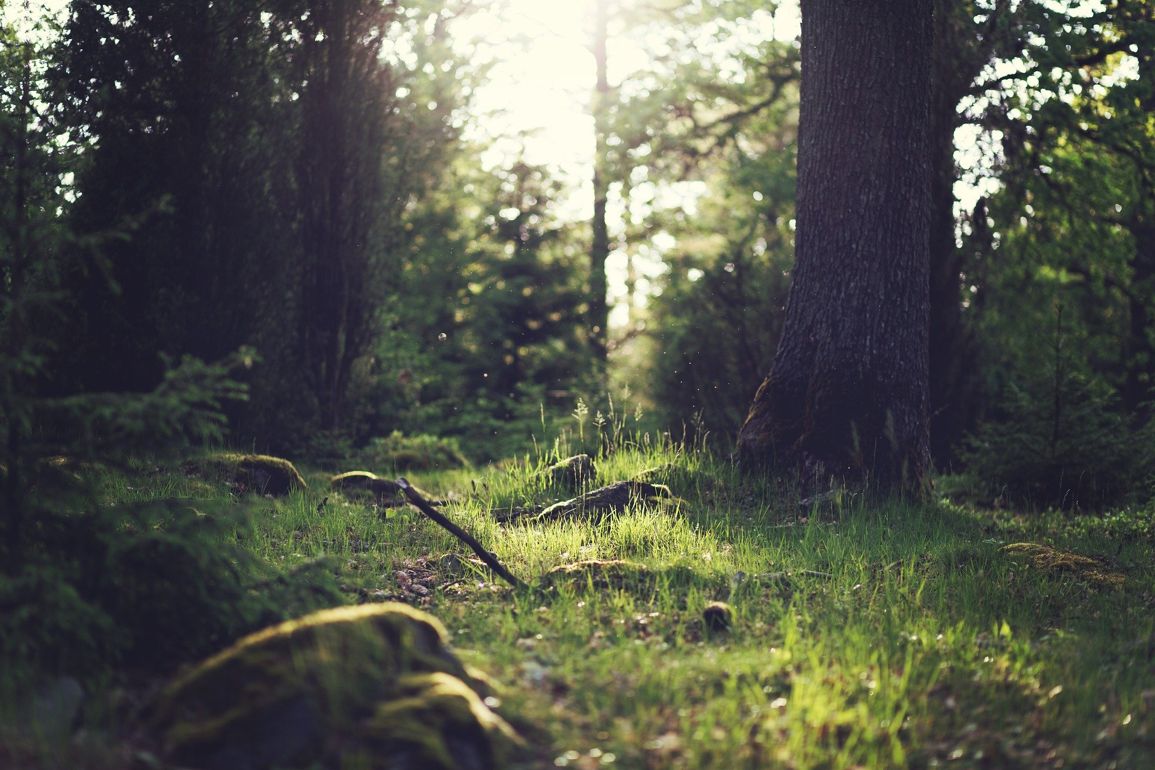
The Environment
Although some of these things can sound a bit frightening, there are lots of things we can do to protect our environment.
How can we help look after our planet? Share your ideas with a partner.

Slide 11
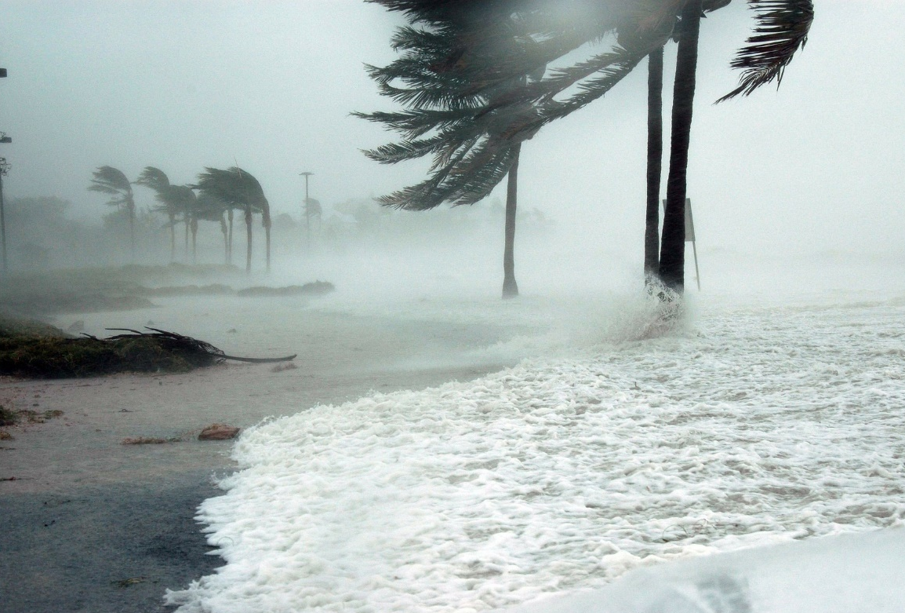
Hurricanes
Ubercorn's ready with his funky facts to tell us more about hurricanes and how they are formed.

Slide 12
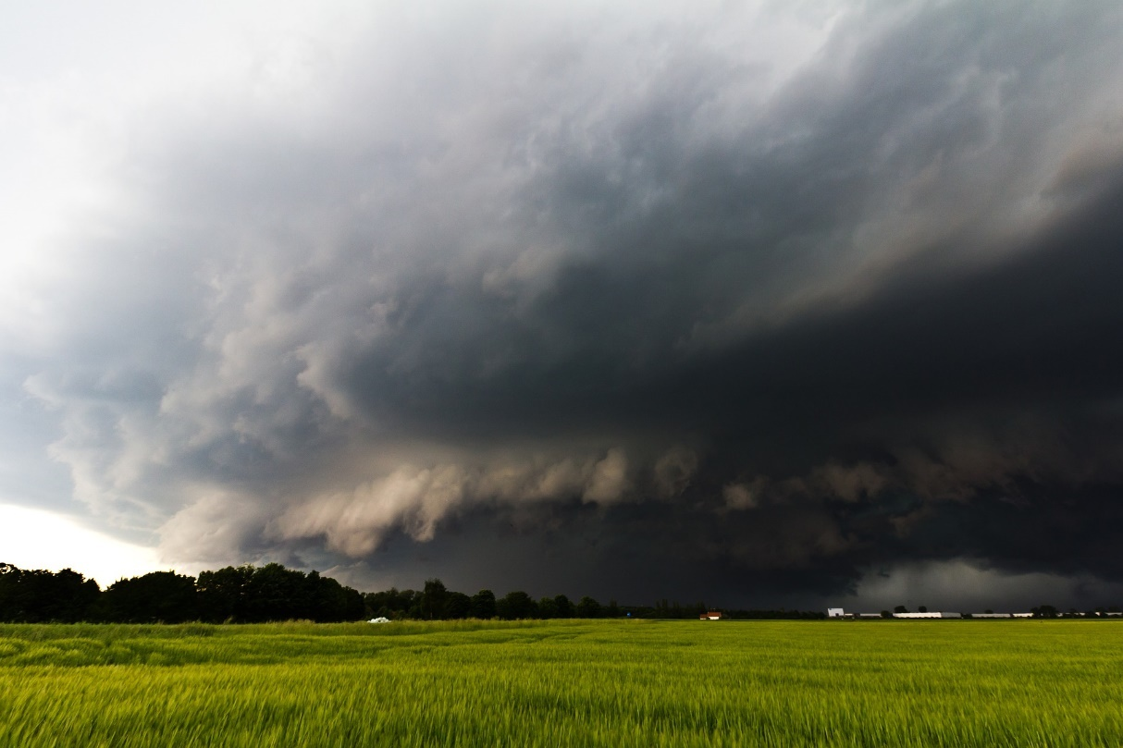
Hailstorms
Have you ever seen a hailstorm? Ubercorn is here with his funky facts to tell us lots more about them.

Slide 13
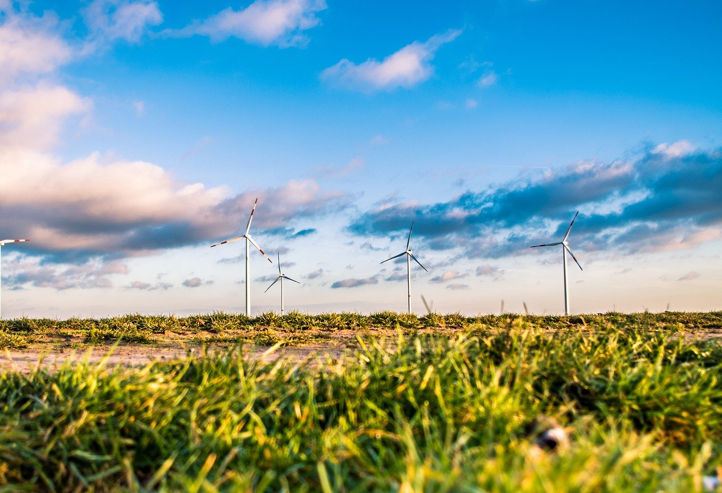
Wind Power
Ubercorn is ready to tell us all about the power of wind.

Slide 14
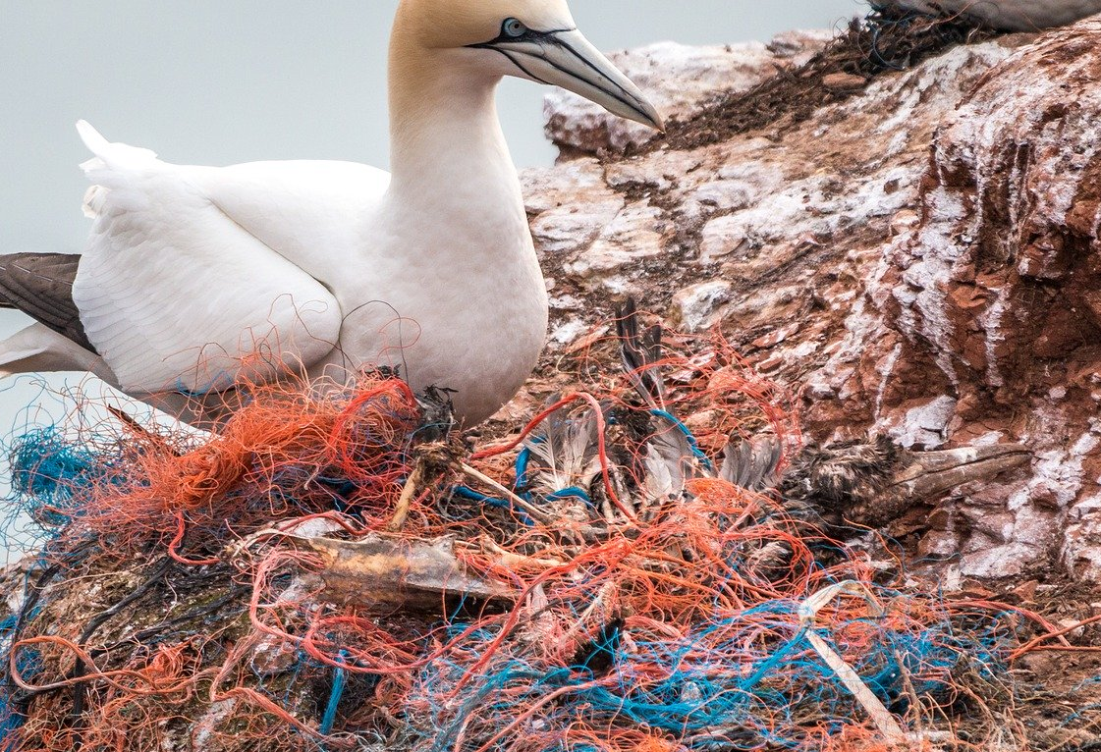
Great Pacific Garbage Patch
Sometimes people don’t look after our planet properly. Here is Ubercorn to tell us more.

Slide 15
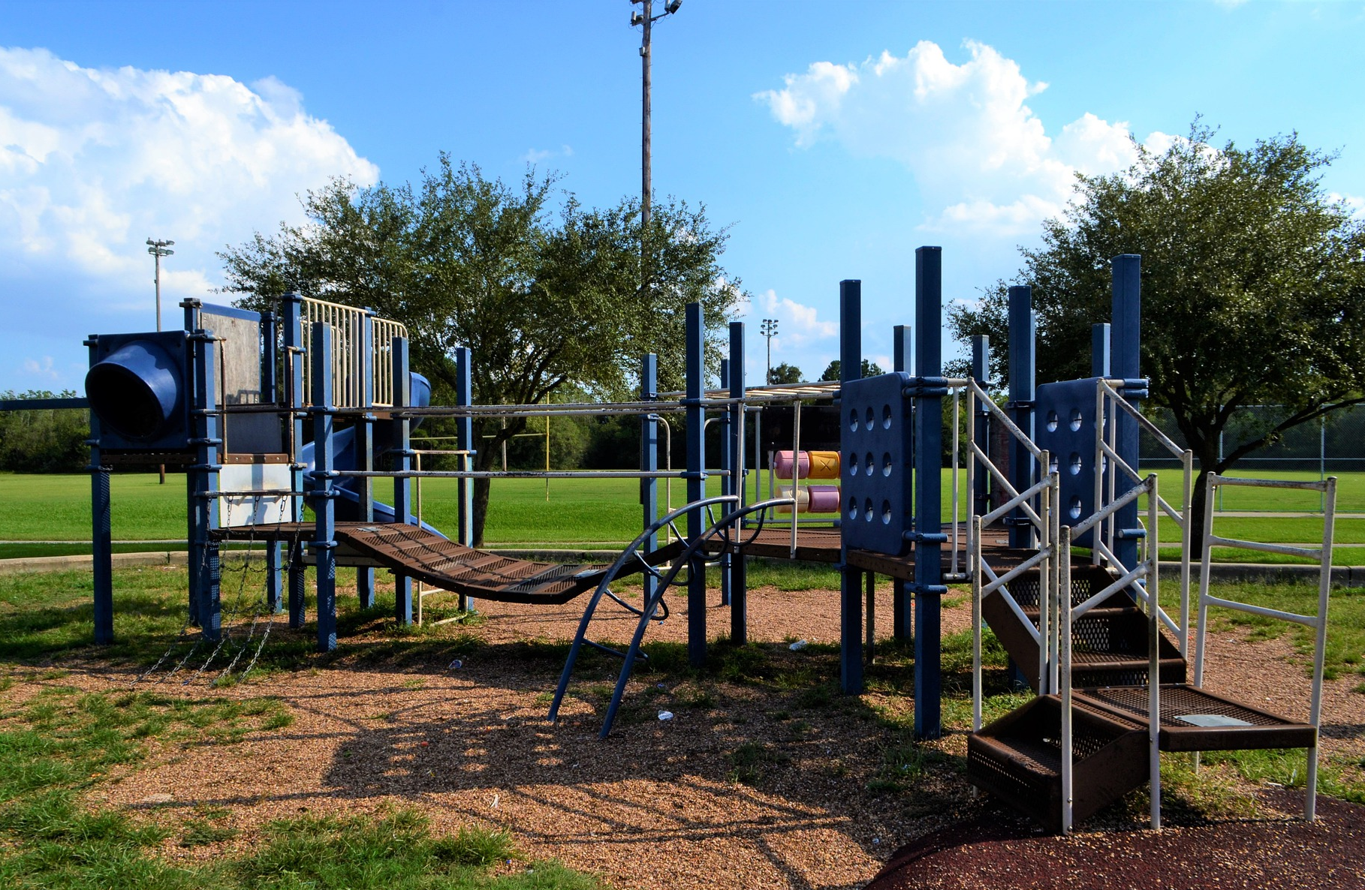
Discover
Look around your school. What things are you already doing to look after the environment? Are there other things you could do to look after our planet?

Slide 16
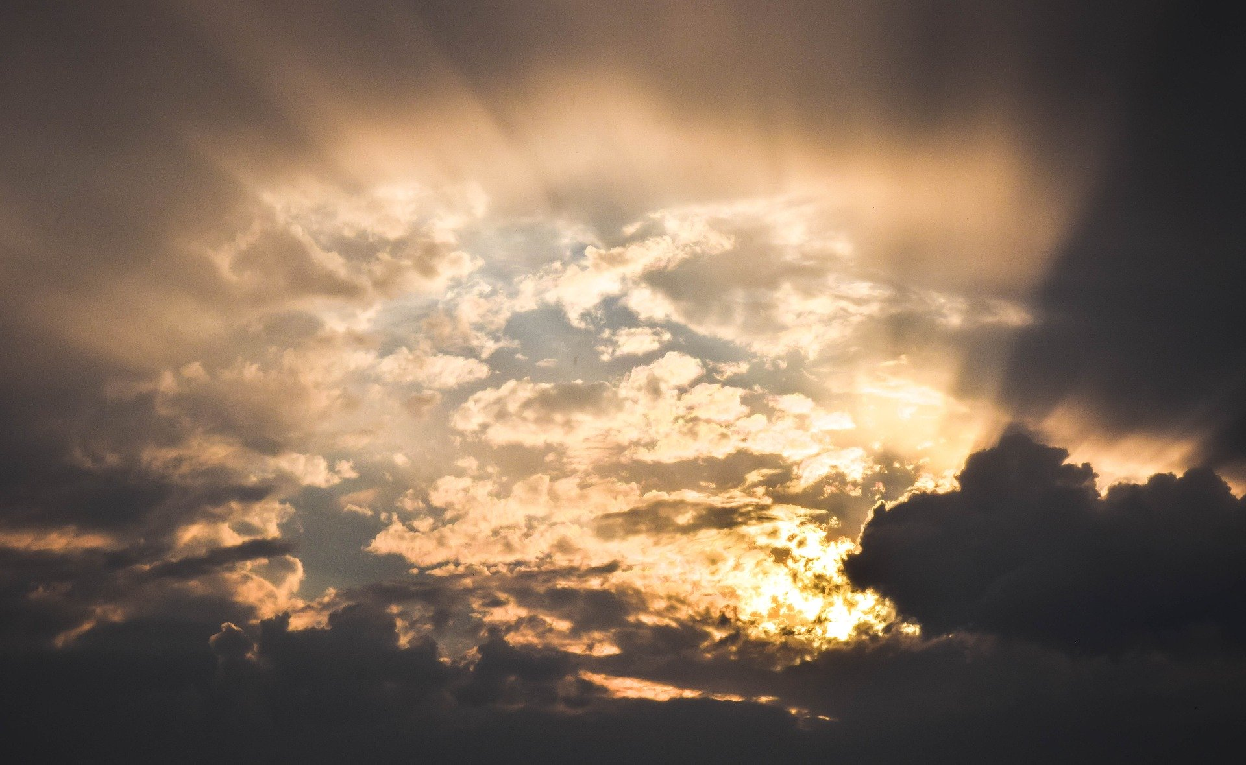
Discover
Why not investigate the weather?
You could keep a weather diary for a week.
You could compare the weather where you live with somewhere else in the world.

Slide 17
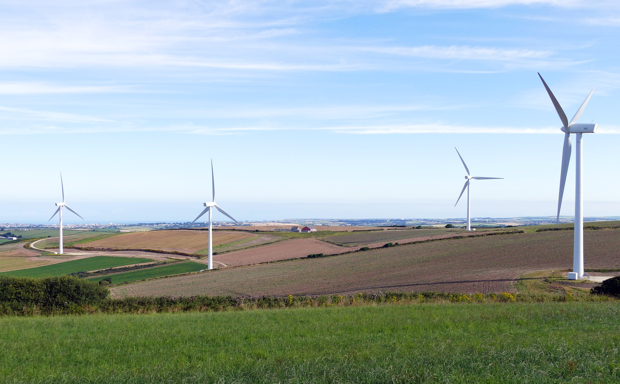
Discover
Find out about wind farms. You could also discover other environmentally friendly ways of making electricity.

