Slide 2
Florence Price
Symphony No. 1 in E minor (3rd mvt)
Primary / KS2 / 2nd Level Classroom Lesson Plan
Written by
Rachel Leach

Slide 3
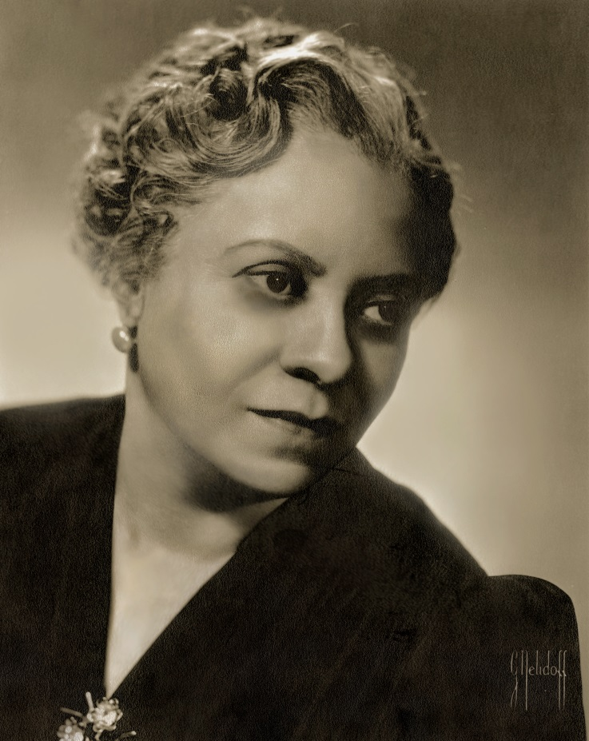
Trailblazer
African-American composer Florence Price overcame much prejudice to become the first black female composer to have her work performed by a major orchestra.

Slide 4
Lesson outcomes
After this lesson, pupils will be able to:
listen and reflect on a piece of orchestral music
create their own piece of music using instruments and voice
perform as an ensemble
learn musical language appropriate to the task

Slide 5
Curriculum checklist
Learners will:
play and perform in ensemble contexts, using voices and playing musical instruments
improvise and compose music for a range of purposes using the interrelated dimensions of music
listen with attention to detail and recall sounds with increasing aural memory

Slide 6
Glossary of music terms
Term | Definition
Coda | a fancy, show-off ending
Ostinato | a repeating (often rhythmic) pattern
Pitched percussion | percussion instruments that can play different pitches – xylophones, glockenspiels, chime bars, etc.
Pulse | the steady ‘beat’ under much music made up of notes of the same length (like a ticking clock)
Rondo | (or Rondeau) a music shape with a recurring theme. The theme is alternated with contrasting ‘episodes’
Unpitched percussion | percussion instruments that can only make a limited number of sounds – drums, shakers, woodblocks, tambourines, etc.

Slide 7
Lesson 1
Watching and listening
Notes:
Prepare your class
Explain to your class that you are going to begin a six-week music project focusing on a fantastic piece of music by an African-American composer called Florence Price. Tell your children that Price was a true trailblazer – she was the first African-American woman to have a piece performed by a major American symphony orchestra.
Watch the Trailblazers film and have a discussion about it. This could tie in nicely with Black History Month or be the starting point for an exploration of slavery in America .
Watch the full orchestral performance and again have a discussion afterwards. Talk about the instruments you have seen and in particular the percussion instruments. Price’s piece features some African drums that aren’t often seen within the symphony orchestra and a sliding whistle known as a ‘swanee’ – did your children spot them? Perhaps you have similar instruments in school .
Listening/movement task
Move into a large space such as the school hall, or if working in the classroom then clear all of the furniture to the sides so that your children can stand in a circle. Explain that Price’s music is inspired by the ‘juba dance’. The dancers would stand in a circle with everyone facing the same way. Ask your children to organise themselves so that everyone faces the back of the person next to them and therefore if they were to walk forwards they would all move in the same direction.
Encourage your children to walk forwards creating a steady beat with their feet and staying in the circle shape (i.e. everyone is simply following the person in front of them). Move in a clockwise direction.
When this is achieved, ask the class to quickly turn and then try walking in the other direction (anti-clockwise). Practise moving 15 steps in one direction, turn quickly on the 16th beat and then move 15 steps in the other direction before turning back again on the 16th beat. It may help to tap a drum during this to keep time and, while practising encourage the class to count out loud. Alternate your walking like this a few times until everyone has got the hang of it.
Next, ask the class to slap their thighs in between each step. To be really authentic they should try slapping the thigh of the leg that has just stepped forward and use an upward motion. So, step the left leg forward, slap the back of that leg by moving the left arm upwards. Try this using the same counting method as above. (i.e. walk for 15 steps, turn on 16, repeat).
FINALLY, try performing these moves along to Price’s music. They should fit perfectly but as the track is quite long, you may want to stop the walking from time to time and have 16 beats of freestyle dancing – perhaps a soloist can dance in the middle of the circle. To make these changes simply call out ‘freestyle’ and ‘juba juba’ when you want them to walk again. You could even choose a child to do this job for you.

Slide 8
Background – the composer
Florence PRICE
(1887–1953)
African-American composer
First black woman to have a composition played by a major American orchestra
Wrote four symphonies (and many songs and chamber music)

Slide 9
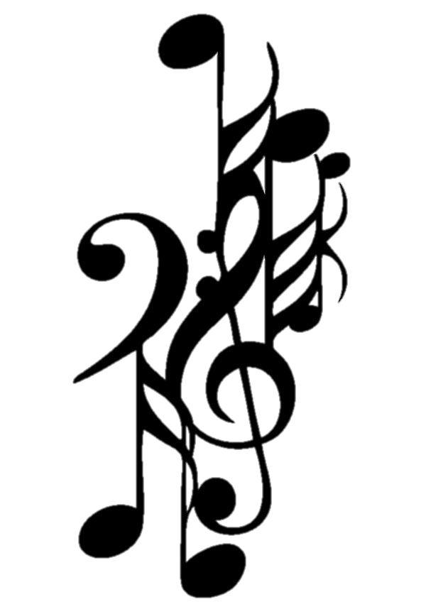
Background – the music
Symphony No. 1 in E minor (3rd mvt)
Her first large-scale orchestral work
Written in 1931-32 and premiered by the Chicago Symphony Orchestra in 1933
Third movement is called ‘Juba Dance’
Also known as the ‘hambone’, or ‘pattin’ juba’, this dance was performed by slaves and featured music provided by their own body percussion
The juba dance is the forerunner to tap dancing

Slide 10
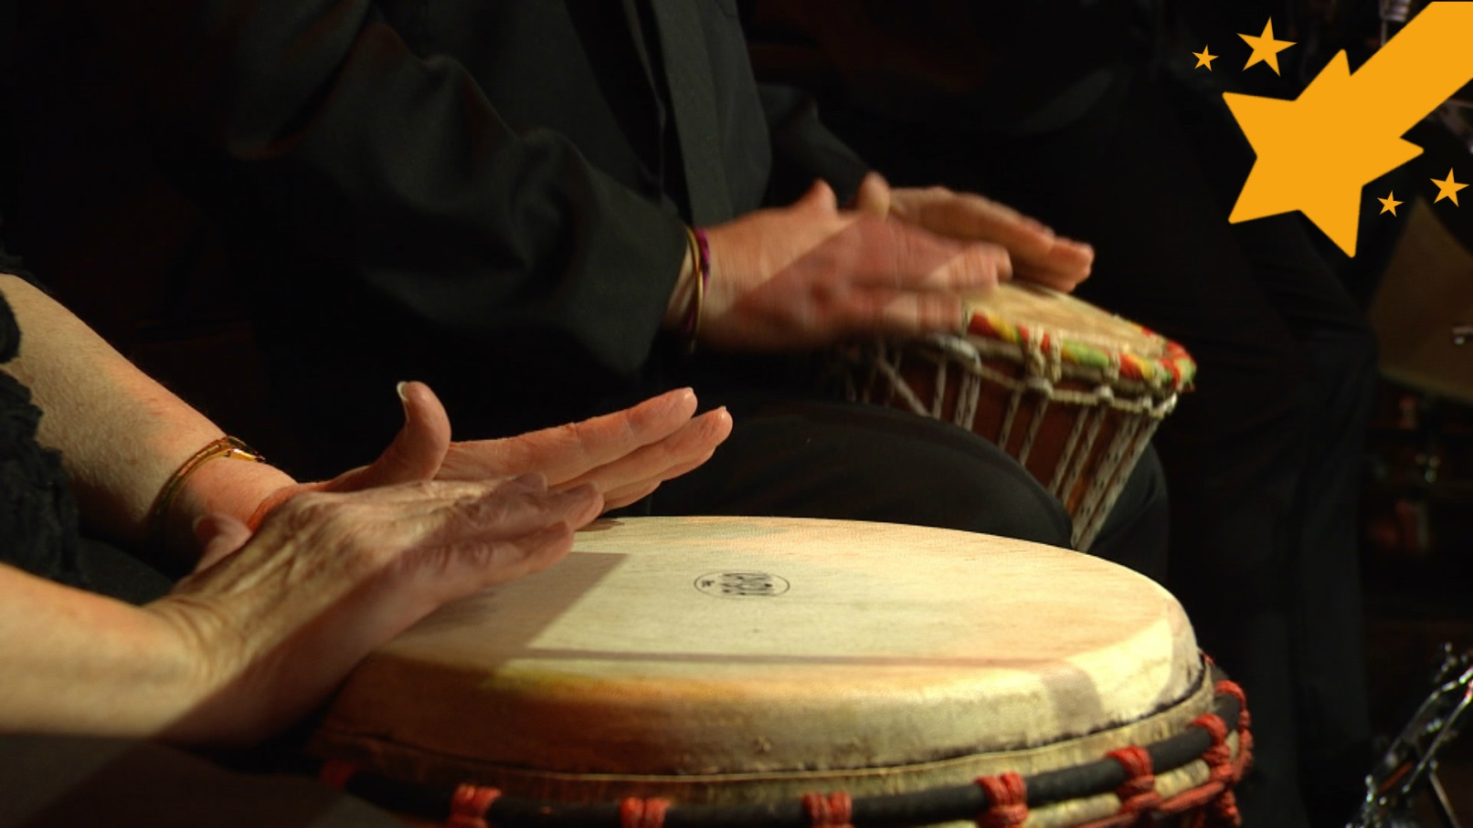
Watch the orchestral performance

Slide 11
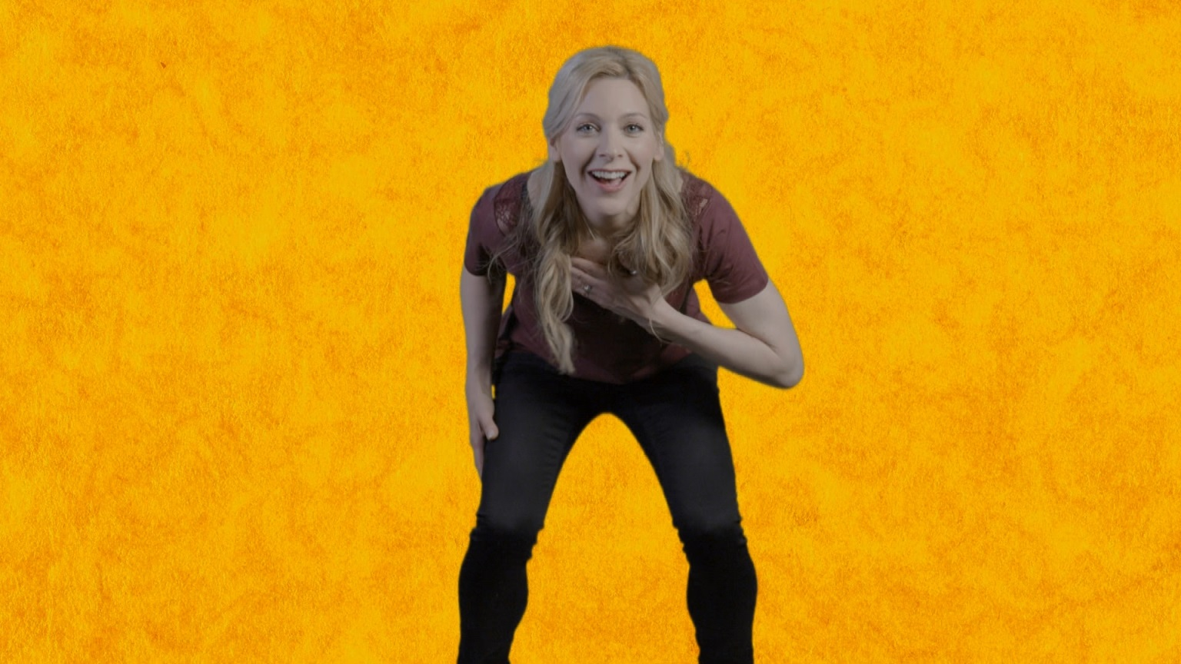
Learn the juba dance!

Slide 12
Lesson 2
‘Pattin’ juba’
Notes:
Warm-up
Perform your dance to Price’s music.
Explain
During a traditional juba dance, often all of the music would be created by the dancers performing rhythms on their bodies. They did this because they didn’t have any instruments. Today we call this ‘body percussion’ but back when this dance became popular, around 1845, it was known as ‘pattin’ juba’.
Florence Price’s symphony features many of these body percussion rhythms within the orchestral parts. Split your circle into four groups and teach each group one of the following patterns. A repeating pattern is also called an ‘ostinato’.
Challenge each team to come up with a way of performing their rhythm using more of their bodies than just clapping. Give each group a little time to practise and challenge them to repeat their pattern eight times and then stop.
If these rhythms are proving tricky, please simplify them or encourage the children to invent their own.
Bring the class back together and hear each ostinato. Ask the rest of the class to listen carefully and give some feedback – did they manage to do just eight repetitions? Were the rhythms neat?
Practise the walking circle again and then ask the children to try and perform this structure:
Walking circle – 15 steps, turn, 15 steps, turn
Group 1 – eight times
Walking circle – 15 steps, turn, 15 steps, turn
Group 2 – eight times
Walking circle – 15 steps, turn, 15 steps, turn
Group 3 – eight times
Walking circle – 15 steps, turn, 15 steps, turn
Group 4 – eight times
They can decide the order of the groups.
Explain
This is very similar to the musical shape that Price uses. It is called ‘rondo’ and features an idea that keeps returning (i.e. the walking circle).
Coda
Price adds a fancy ending onto her piece called a coda. Ask your children to think of a way to end their dance. Encourage them to use ideas they have already worked on rather than try something new – all the groups together perhaps, or a freestyle moment?
FINALLY, add this on to the end of your structure and try performing the dance along with Price’s music. You’ll probably notice that Price actually changes the ‘neatness’ of her piece by slowing down slightly in the middle. You can either ignore this or wait and pick up again afterwards.
Obviously there is no recorded evidence of juba dancing but it probably wasn’t a quiet, sedate affair! The performers and audience probably joined in with whoops and cries of ‘juba juba’ – encourage your performers to do the same.
If you feel uneasy about recreating a slave dance, here’s a useful fact: It is now thought that the body rhythms contained coded messages and the dance was actually a way of the slaves communicating without their plantation owners understanding, so it was actually a form of rebellion and empowerment. Also, without juba dancing we probably wouldn’t have modern tap dancing or even street dance.

Slide 13
‘pattin’ juba’ = body percussion

Slide 14
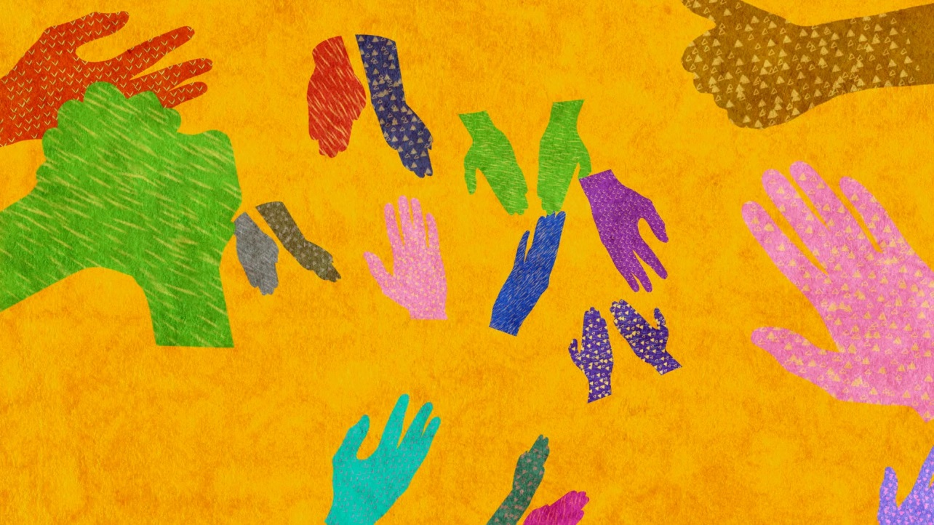
Use body percussion to try out these rhythms. By playing them over and over you are making an ‘ostinato’

Slide 15
Lesson 3
‘Walking’ juba
Notes:
Warm-up
Start with your class sitting in a circle and perform the body percussion rhythms you worked on during the last lesson.
Explain
The walking/thigh slapping rhythm you have all been using (the walking circle) is actually the pulse that keeps the music together. It is known as an ‘um-pah’ pulse because of the strong ‘um’ sound (made by the feet) and the weaker ‘pah’ sound (made by the thigh slap).
Ask the class to choose two unpitched instruments to play this rhythm – one ‘strong’ and one ‘weak’. Try out several suggestions until you have the perfect combination and choose two children to play it, again 16 times. A fun way to count the 16 is by saying ‘1-pah, 2-pah’, etc.
Pitched percussion
Price uses these notes for her ‘um-pah’ at the beginning of the piece.
Choose someone to have a go at this. You can even share it between two players.
Try putting a class version of this um-pah together using pitched and unpitched instruments. Perform 16 ‘um-pahs’ only and then stop.
FINALLY, remind your children of the walking circle. It should fit with this ‘um-pah’ pulse. Remind the class that they travelled in alternating directions. To emulate this on instruments, split the class into two halves and alternate back and forth between the groups, 16 um-pahs one way and then 16 ‘um-pahs’ back. Call this your ‘walking juba’ section.

Slide 16
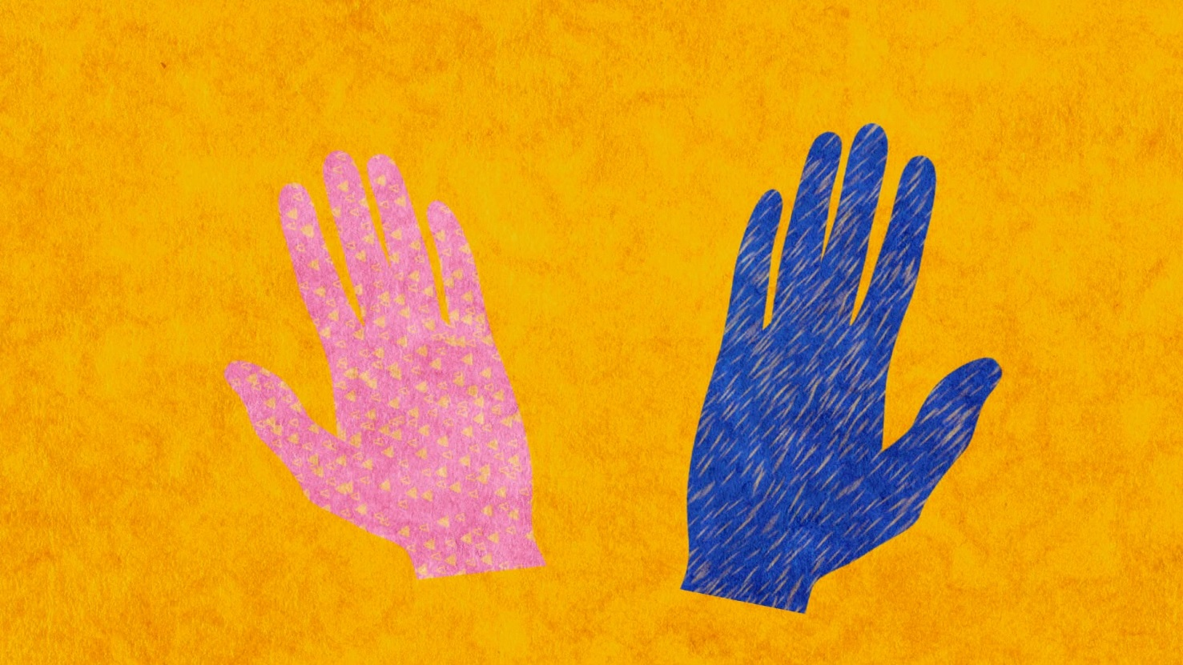
Warm up with some body percussion!

Slide 17
The ‘walking circle’ is the pulse of the piece. It is an ‘um-pah’ pulse
Play this with two different players or two different groups

Slide 18
Lesson 4
‘Team’ juba
Notes:
Warm-up
Recap the ‘um-pah’ pulse from the last lesson and, quickly splitting back into groups, the body percussion rhythms from lesson 2.
Get the instruments out and put the ‘walking juba’ section back together ensuring that everyone has the same instruments as last time.
Remind your children of the shape of Price’s piece. It was a rondo – a shape with one idea that keeps returning. Explain that your ‘walking juba’ is the section that will keep returning, now you need to make the ‘episodes’ that go in between.
Split back into the groups you were in during lesson 2 and again make sure that everyone sticks to the same instrument they have been playing so far and doesn’t swap! The task is to move the body percussion rhythms onto instruments. If using pitches each group must stick to the white pitches only. As before, they must make just eight repetitions of the rhythm and then stop together neatly.
When this is achieved, bring the class back together and hear each team one by one. Encourage the rest of the class to give feedback and check that everyone’s piece is the perfect length (eight repetitions), starting and stopping together neatly.
FINALLY, end this lesson by encouraging each team to carefully write down what they have done and who played what.

Slide 19
Do you remember the ‘walking juba’ and the ‘um-pah pulse’? Put these together using the same instruments as last time

Slide 20
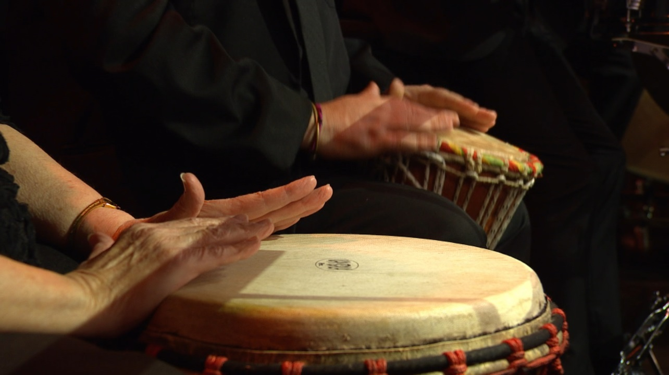
Listen to all of the performances and give some feedback to other groups – it’s good to hear what others think!

Slide 21
Lesson 5
Rondo and coda
Notes:
Warm-up
Begin in a large circle with a quick focusing activity and recap, without instruments, the ‘um-pah’ pulse and all of the rhythms you have worked with so far.
Remind your class of the RONDO shape again and to help them understand it, play this quick game:
Ask one of your class to suggest a gesture or a sound. Ask the rest of the class to copy it (whatever it is)
Ask three more children and copy each time
Discuss which is your favourite gesture and label it A. Label the other three B, C, and D (each one includes the solo gesture and then everyone copying)
Make the following structure out of your solos and copied ideas (whatever they are):
A – B – A – C – A - D - A
This is the shape that Price uses in her symphony and the shape of the ‘pattin’ juba’ you made in lesson 2.
Make a list on the board of what you have created so far. It should look something like this:
Walking juba – everyone performing in two halves (16 beats then 16 beats). ‘Um-pah’ notes are A, C/E
Four team juba pieces (eight patterns each). White notes
Split back into groups and ask each group to get out their instruments and put their music back together. When the groups are sorted, put the bigger ‘walking juba’ section back together with everyone.
Challenge your children to structure their sections into rondo form. The ‘walking juba’ section will keep returning but the class must decide on the order of the ‘episodes’ in between (the ‘team jubas’). Try out several versions until you have the best one.
Practise your order until it is neat and you can move from section to section without a break.
Coda
Remind your children of the end of Price’s piece – the CODA. The children made a coda to their ‘pattin’ juba’ in lesson 2. Perhaps they layered everything up? Perhaps it was freestyle? Challenge them to create a coda (fancy ending) using their instruments and again, aim for this to be a quick and easy task – no time for new ideas or swapping instruments!
FINALLY, end the session by performing your whole piece and write down carefully what you have done.

Slide 22
The Rondo shape!
Make the following structure out of your solos and copied ideas (whatever they are):
A – B – A – C – A – D – A

Slide 23
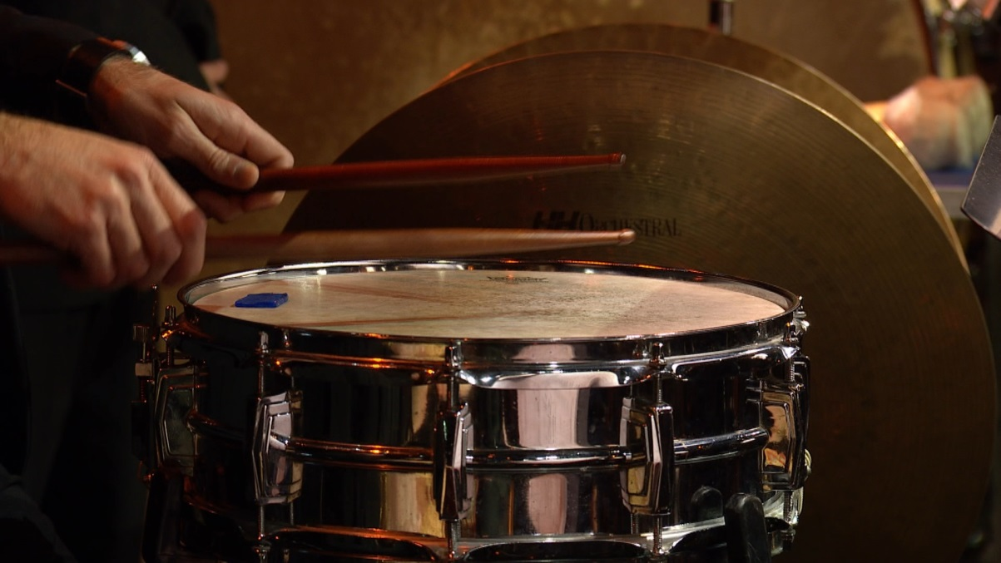
Listen again to the end of Price’s piece, called the Coda. Create your own coda (or fancy ending) using instruments

Slide 24
Lesson 6
Performance time!
Notes:
Warm up
Sit the children in a circle and recap using just voices and body percussion all the elements you have created so far. Talk through your structure too.
Get the instruments out and split back into groups. Give the class just five minutes to remember their ideas and put their group sections back together.
Try performing the whole Rondo and Coda structure just like you did at the end of the last lesson. Take some time here to rehearse and make your piece as neat and as musical as possible.
Taking a break from the instruments, and using the recording of Price’s piece, put the dance back together from lesson 1.
Invite a class in to hear your music and watch your dance. Tell them all about Florence Price and her music.
FINALLY teach the audience (or encourage your children to teach the audience), the walking circle part of your dance and perform your music again with some of the audience dancing along. If you have enough space the audience can dance in a big circle around the ‘band’. In the group sections they may freestyle or clap along.

Slide 25
Recap
Juba dance
Walking juba
Rondo and Coda

Slide 26
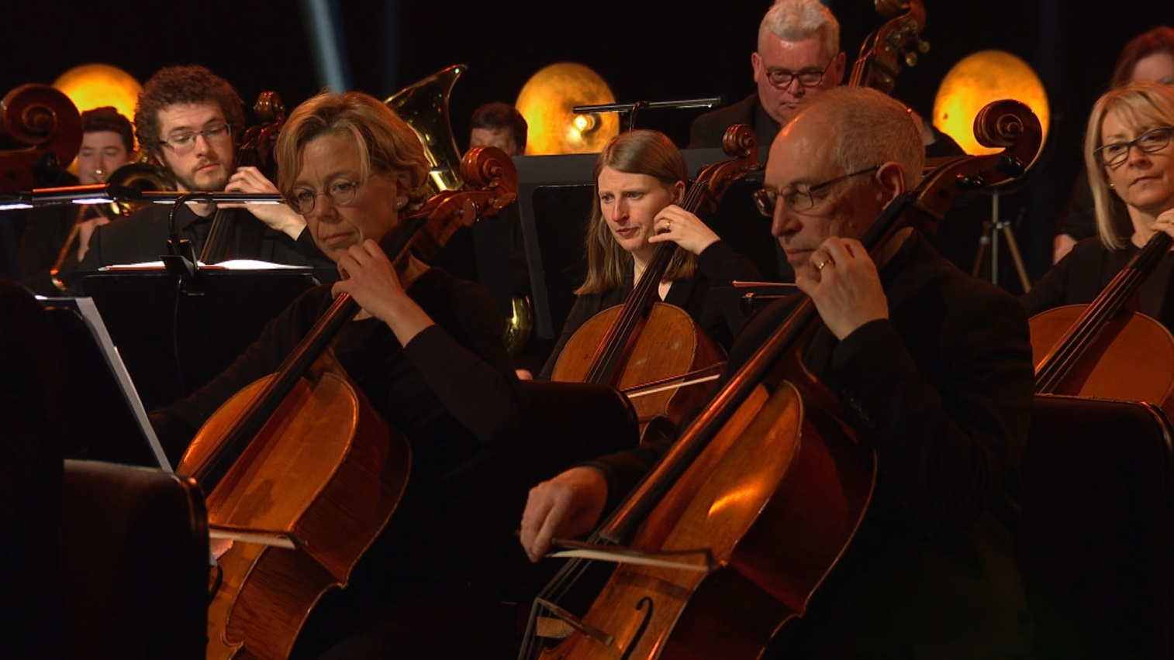
Practise and perform!

Slide 27
Taking it further – cross-curricular activities
MUSIC: Florence Price wrote four symphonies. In each one, the third movement is a ‘juba dance’. Her tastes and skills increased the more she wrote so these juba dances are very different to each other. Compare and contrast them, which is the best and which one are you going to dance to next?
RESEARCH: The juba dance developed into tap dancing largely because of a very famous African-American dancer called ‘Master Juba’. Tap dancing then grew into street dancing. Research Master Juba’s story and the history of these dance styles or have a go at tap dancing!
LITERACY: Florence was from a wealthy African-American family but she grew up in very difficult times when the American South was segregated and there were strict laws for how black people should behave. This affected her everyday life; she would have been banned from ‘whites only’ places and unable to travel around freely. Imagine how that must have felt and write a letter in her voice.
UPLOAD: Show us what you’ve created! Submit your creative responses using our Uploader for a chance to be featured on the Ten Pieces website.

