Slide 2
Johannes Brahms
Hungarian Dance No. 5 in G minor
Primary / KS2 / 2nd Level Classroom Lesson Plan
Written by
Rachel Leach

Slide 3
Trailblazer
Johannes Brahms was fascinated with the sound of the Hungarian Gypsy travelling bands. He took these sounds and super-sized them for the orchestra!

Slide 4
Lesson outcomes
After this lesson, pupils will be able to:
listen and reflect on a piece of orchestral music
create their own piece of music using instruments and voice
perform as an ensemble
learn musical language appropriate to the task

Slide 5
Curriculum checklist
Learners will:
play and perform in ensemble contexts, using voices and playing musical instruments
improvise and compose music for a range of purposes using the interrelated dimensions of music
listen with attention to detail and recall sounds with increasing aural memory

Slide 6
Glossary of music terms
Term | Definition
Bar | A very short, countable section of music
Melody | another word for ‘tune’, like a musical sentence
Off-beat | the ‘weak’ beats between the strong, ‘on-beats’ of the pulse
Orchestrate | choose which instruments perform which parts of the music
Ostinato | a repeating (often rhythmic) pattern
Pitched percussion | percussion instruments that can play different pitches – xylophones, glockenspiels, chime bars, etc.
Unpitched percussion | percussion instruments that can only make a limited number of sounds – drums, shakers woodblocks, tambourine etc.

Slide 7
Lesson 1
Watching and listening and dancing!
Notes:
Prepare your class
Explain to your class that you are going to begin a six-week music project focusing on a fantastic piece of music by a very important German composer called Johannes Brahms. Brahms became fascinated by the sound of Hungarian folk music and ‘gypsy-style’ violin playing, and so he put both of these ideas into this music.
Watch the BBC Ten Pieces Trailblazers film and the full orchestra performance , and have a discussion about both. Ask the children:
Did you like the music?
Did it make you want to dance?
If you could combine two musical styles which two would you choose?
Listening/movement task
Move into a large space such as the school hall or, if working the classroom, clear all of the furniture to the sides. Brahms’ dance is based on a traditional dance called a csárdás. This is a dance performed in pairs, so ask your children to find a partner to dance with.
Listen to the opening tune again and count out loud to eight.
Encourage your children to count with you. You should be able to count to eight, four times before the music changes.
Ask your pairs to come up with a gesture or movement to perform on each count. They can do the same movement eight times or several different movements, but the challenge is to fit to the eight counts (bars) and be able to repeat the set four times over.
Watch sets of pairs perform their moves at the same time, perhaps counting rather than using the music, and then ask all the pairs to perform together with the music.
Listen on – the music changes and becomes more bouncy. You can still count four sets of eight but the 2nd and 4th sets slow down in the middle. Count this out loud with the children and challenge them to make a new set of (up to) eight movements for this part. These new movements should contrast with the previous ones so perhaps encourage each pair to add in a jump or a hop to match the new shape of the music.
Again, watch some of the pairs separately before watching them perform altogether with the music. The extra challenge here is to avoid bumping into one another!
Listen on – at about one minute into the dance the music changes again and is made up of very short, fast notes and then some longer, stretched out sounds. Can your pairs come up with movements to match this bit too? There is one more new rule here – this bit must include some holding hands and turning or spinning around just like in a real csárdás.
Put this bit together with the music.
FINALLY, your children have now made movements to match the three different types of music in Brahms’ piece. His structure is as follows:
A: (8 counts, 8 counts, 8 counts, 8 counts) – just gestures
B: (8 counts, 8 counts slowing down, 8 counts, 8 counts slowing down) – jumps/ hops added
C: (fast notes, stretched out notes) – holding hands, turning/ spinning
A: (8 counts, 8 counts)
B: (8 counts, 8 counts slowing down, 8 counts, 8 counts slowing down)
Three loud chords to end
Your children should now have a good understanding of Brahms’ piece and have created a Hungarian dance of their own!

Slide 8
Background – the composer
Johannes BRAHMS
(1833–1897)
German composer
One of the ‘three B’s’ of German music – Beethoven, Bach, Brahms
Wrote four symphonies and much for smaller chamber groups
Known as a perfectionist, a traditionalist and an innovator

Slide 9
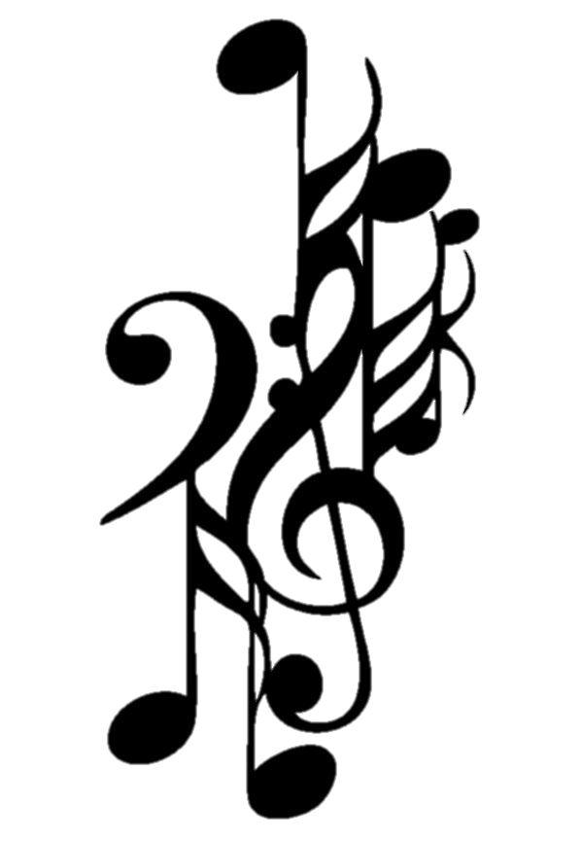
Background – the music
Hungarian Dance No. 5 in G minor
The most famous dance from a set of 21 originally written for piano (four hands) in 1869
Brahms became fascinated by Hungarian folk music after meeting and working with violinist Ede Reményi who introduced him to ‘gypsy-style’ playing
Brahms thought he was using a traditional Hungarian folk tune but he actually, unknowingly, stole this tune from a composer called Béla Kéler
The Hungarian Dances are his most popular and lucrative pieces

Slide 10
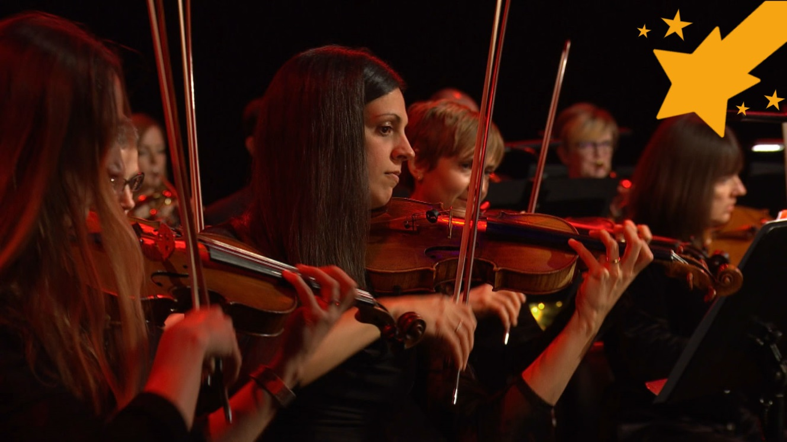
Watch the orchestral performance

Slide 11
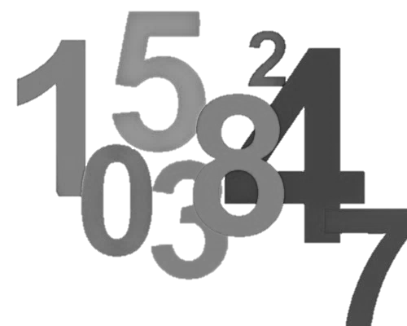
Listen to the melody and count to eight as you listen

Slide 12
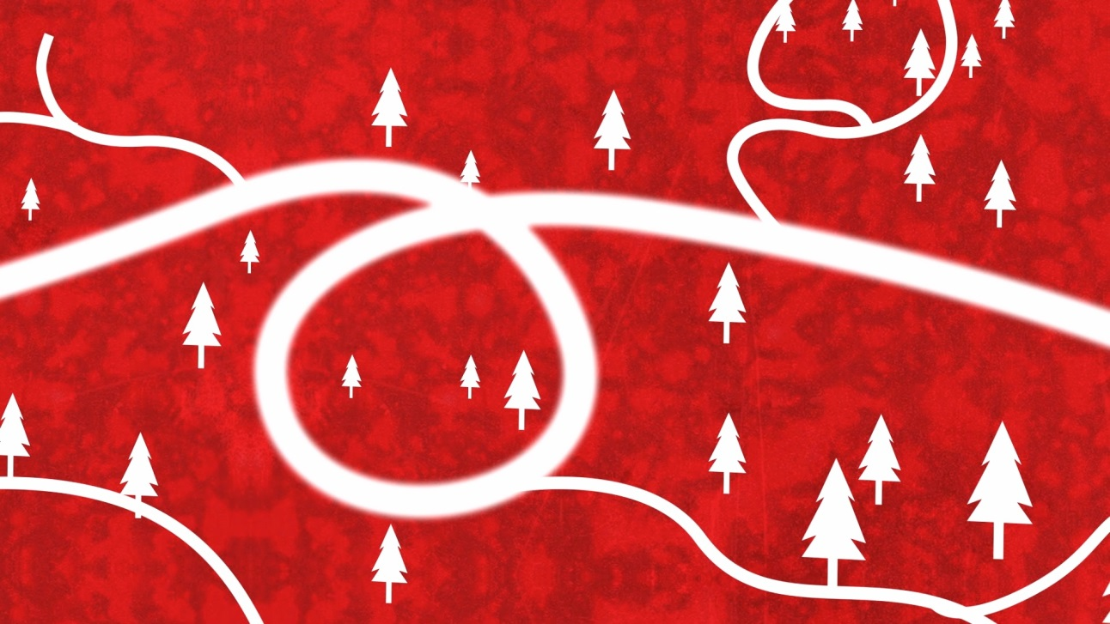
Think of some movements to fit with the beat

Slide 13
Lesson 2
Um-pah pulse
Notes:
Warm-up by performing your dance again to Brahms’ music or just counting along. It’s important that the children remember the counts of eight.
Explain
This is called counting bars. Bars are very small measures of music. Each of Brahms’ bars contains two beats and that gives the dance its ‘um-pah’ sound.
Select two drums with different sounds – i.e. a big drum such as Djembe with a low sound and a smaller hand drum with a higher sound. Play a steady pulse with these drums alternating back and forth between the two sounds just like the bassline of Brahms’ piece. As you do so, encourage the children to keep counting.
They should count on each ‘high’ drum and not on the ‘low’ one. (eight counts = 16 drum hits). You can play this along with Brahms’ music too.
Choose a volunteer to take over from you. The drumming is called an ‘um-pah’ and children can join in with the drummer by patting opposite knees. They should continue counting out loud too.
Next, get out a xylophone and add the pattern.
Choose a child to add this on top of the um-pah patterns.
Split the class into three teams with the following jobs:
Um-pah drumming group
Xylophones on G and D as above
Beginner musicians also on G and D (you can replace the D with F# or A for extra harmony if you like)
If you have more advanced players, or players on bass instruments you might like to add this ‘um-pah bassline’ in too:
FINALLY, bring the groups back together and make a class version of this. Try performing it along with the orchestral recording – only play during the main theme (A) sections (refer to the structure listed at the end of lesson 1 for more info).

Slide 14
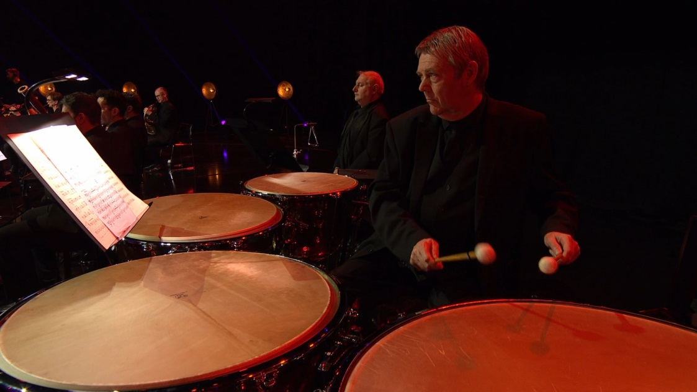
Drum pattern

Slide 15
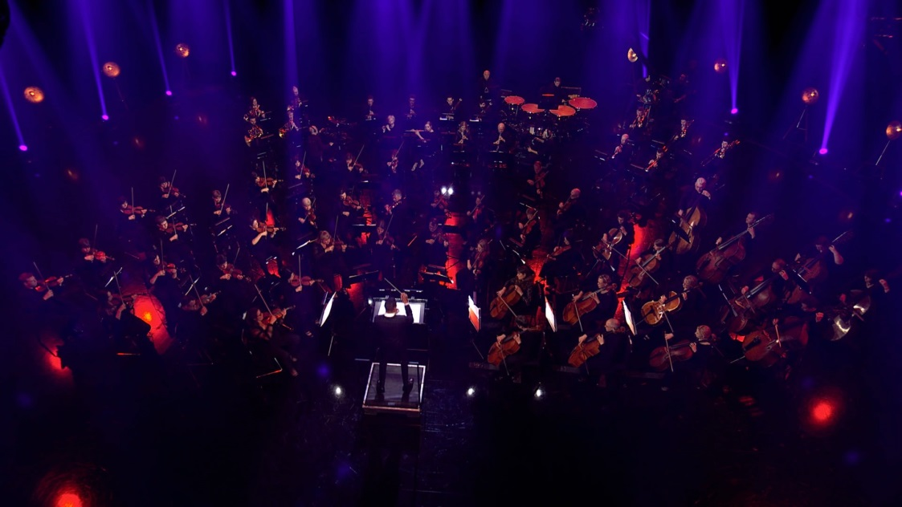
Xylophone pattern

Slide 16
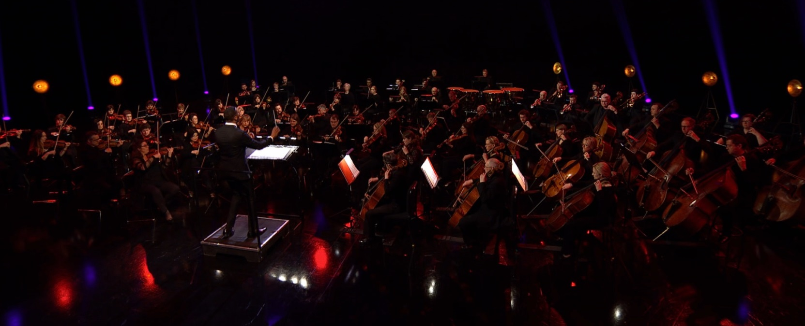
Play these patterns in small groups and as a class!

Slide 17
Lesson 3
Off-beats (double ‘um-pah’)
Notes:
Warm-up
Start with your class sitting in a circle and play a quick focussing game such as ‘pass the clap’. Start a slow um-pah pulse by tapping your knees.
Encourage your children to join in.
Sing the xylophone Gs and Ds on top. Again, encourage your children to join in and bring them to a stop after a full set of eight.
Remind your children that the pattern you are tapping on your knees is called ‘um-pah’. Challenge them to perform it again, still alternating between left and right knee but this time using only one hand. When this is going well use your free hand to add an ‘offbeat’ – i.e. tap your chest in between each knee tap.
Encourage your children to join this too and again, bring them to a neat stop when everyone has got the hang of it.
Explain that the chest taps are called ‘off-beats’. These are notes placed in between the stronger ‘on-beats’ of the pulse. The off-beats make their own ‘um-pah’ with the on-beats thus making a double um-pah with the slower um-pah bassline! Brahms uses them throughout his piece and they are the ingredient that makes the music good to dance to.
Ask your children to choose an unpitched instrument to play the off-beats. This should be something capable of making a short, soft and ‘crisp’ sound (a cabasa, triangle, woodblock for example). Allow the children to try out several options and eliminate anything that doesn’t work (cymbals, gongs etc.).
Split your class into four groups. Mix up your instrumentalists, drummers and xylophonists from last time so that each group can perform all of the elements you have discussed so far. Ask each group to make eight counts.
As the groups work on this, float between them checking that they are all performing at roughly the same speed and check also that everyone has an instrument and something to do.
Bring the groups back together and hear them one by one giving a bit of feedback after each. Ask the ‘audience’ to check that they are sticking to eight counts – no more and no less.
FINALLY, ask your children to put the groups into an order and try playing in that order moving from group to group without stopping or losing the pulse. So, each team is either playing their eight counts, or counting and waiting. Write down what you have done and who played what.

Slide 18
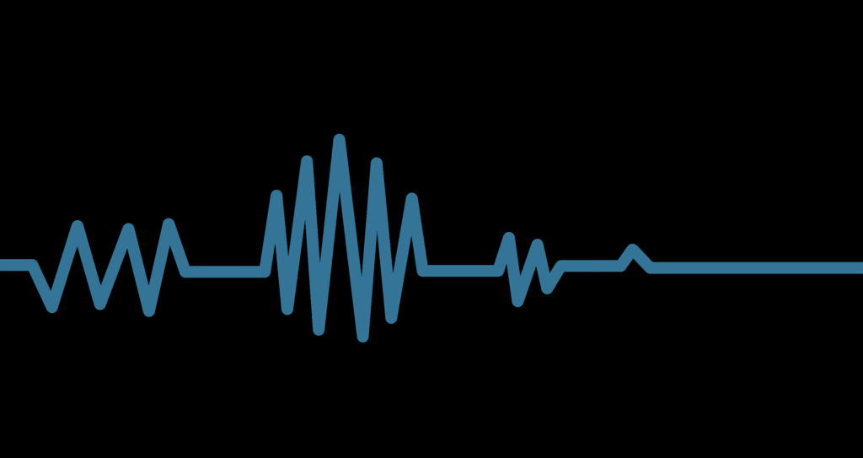
Warm up with an um-pah pulse!

Slide 19
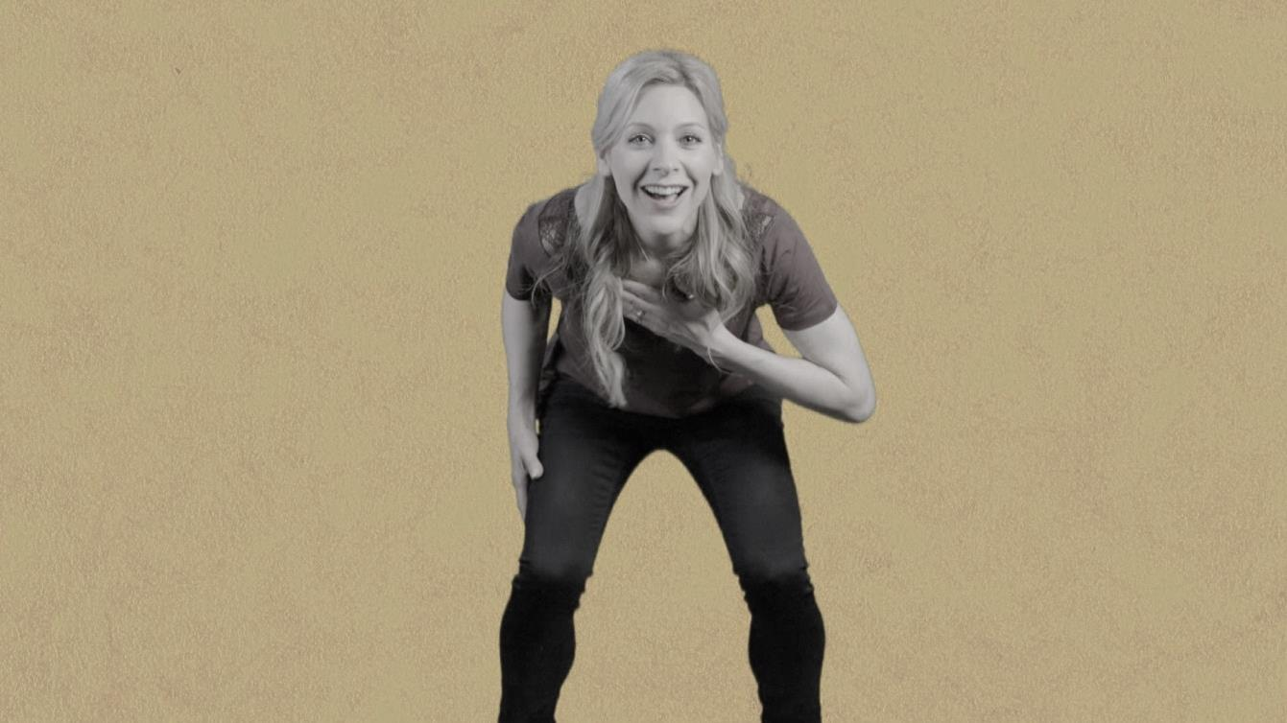
Add a ‘chest tap’ to your pattern – this is called the ‘off-beat’

Slide 20
Lesson 4
Steal a tune!
Notes:
Warm-up
Recap the um-pah pulse from last lesson sitting in a circle and performing the body percussion version.
Get the instruments out and split quickly back into groups to put the eight counts back together.
Remind your children that Brahms used a melody in his dance that he thought was a traditional folk melody but it actually turned out that he had stolen it from another composer. During this lesson you will create a melody (or tune) to go on top of your um-pah.
If you don’t have these ‘black’ notes (sharps and flats), just use white ones. It will simply disguise Brahms’ tune further!
Steal from someone else – perhaps there is a simple tune that your children already know and that can be adapted to fit the um-pah pulse.
Steal from Mozart! – he wrote the melody we now know as ‘Twinkle, twinkle little star’. This is very easy to play on most instruments.
Create a new tune – use just G, A, B, C, E, keep it short and repetitive and perhaps use a rhythm that contrasts with the um-pah pulse.
Whichever method you use, your tune must fit with just eight counts of um-pah.
Decide which method you are going to use and teach/create the melody with the full class. Then, split back into your four groups. Ask the children with pitched instruments to practise the melody while those with unpitched instruments continue to work on the um-pah.
Bring the class back together and hear their pieces. Ask them to come up with the structure for their music. They have four groups performing eight counts of um-pah each and now they also have a melody. Can they fit all this together to make one big piece?
FINALLY, - when your structure is decided on, perhaps you have tried out several options before deciding, write it on the board and practise it until everyone knows what they are doing and the music is neat. Explain that this is just one part of your dance piece and it is called ‘The A Section’.

Slide 21
Do you remember hearing the melody and counting to eight?

Slide 22
Think of a simple tune that will fit your pulse

Slide 23
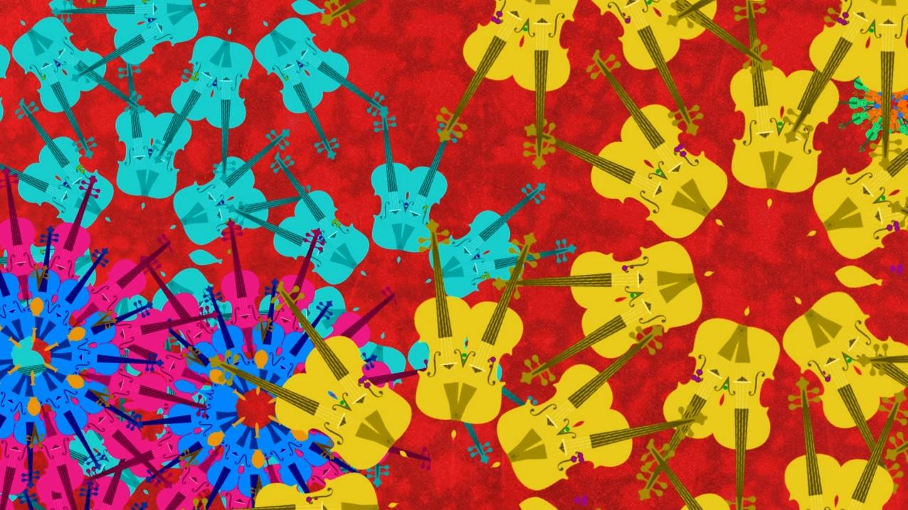
Pitched instruments = melody
Unpitched instruments = um-pah pulse

Slide 24
Lesson 5
Long sounds, short sounds
Notes:
Warm-up
Begin in a large circle with a quick focusing activity and recap, without instruments, the um-pah pulse and all the rhythms you have worked with so far. It might be fun at this point to recap the dance you made in lesson 1 too.
Remind your class about the middle of Brahms’ piece when the um-pah stops and instead the music is made up of some longer, stretched out sounds and then some very short, fast notes. Teach the body percussion version of the same bit.
Ask your children to get back into their four groups and, using the same instruments as last lesson, orchestrate this body percussion piece – i.e. decide which instruments should play which parts. They should pay particular attention to which instruments can make long sounds and which can make short sounds.
Hear each group separately and then challenge the full class to join their ideas together to make one big piece. Again, you might have to try out several until you find the best version.
FINALLY, end this lesson by playing through your new section. Write down what you have done on the board and name it ‘Section B’. If you have time, quickly play through ‘Section A’ to end the lesson.

Slide 25
Body percussion

Slide 26
Which instruments make these sounds?
Long sounds
Short sounds

Slide 27
Lesson 6
Performance time!
Notes:
Get the instruments out and split back into groups. Give the class just five minutes to remember their ideas and put their group sections back together – both the A section (eight counts of um-pah, off-beats and tune) and the B section (the long and short sounds from last lesson).
Bring the class back together and put Section A and B back together using the structures you came up with in lessons 4 and 5.
Ask the class to put these sections into an order so that they become one big piece. Practise this order until it is neat and everyone knows what they are doing all the way through. Brahms’ order is A – B – A but yours doesn’t have to be.
If you refer back to the structure listed in lesson 1, you have actually made Section A and C – we didn’t focus on Brahms’ original section B.
If you have time, remind the class about the end of the piece – it is just three big chords played by the whole orchestra. Can your children come up with a similar ending for their piece?
FINALLY, practise your piece in full and then invite a class in to hear your music. You might also like to show them the dance you made during lesson 1 or encourage members of your audience to dance to your new piece.

Slide 28
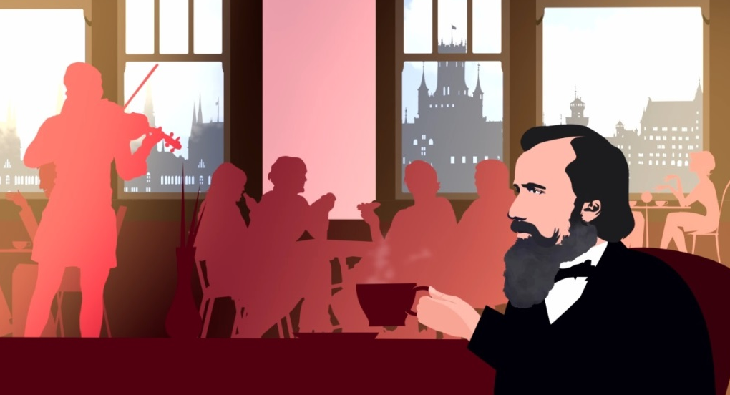
Recap
Um-pah
Off-beats and melody
Long and short sounds

Slide 29
Practise and perform!

Slide 30
Taking it further – cross-curricular activities
MUSIC: BBC Ten Pieces features other dance pieces you might like to explore: Florence Price’s ‘Symphony No. 3’ is based on the ‘juba dance’, Tchaikovsky’s ‘Nutcracker Suite; is made up of dances from his ballet including a lively Russian dance (Trepak) and Anna Meredith’s ‘Connect It!’ features physical gestures and body percussion instead of instruments.
RESEARCH: Brahms was actually one of the finest symphony composers of all time – a symphony is a large piece for orchestra. Find out about his symphonies or research how he felt about his simple ‘Hungarian Dances’ becoming the pieces for which he was most known, rather than his ‘serious’ works.
UPLOAD: show us what you’ve created! Submit your creative responses using our uploader for a chance to be featured in the Ten Pieces creative showcase.

